Slide 1











NUSTAR Technical Progress 11th FAIR-NUSTAR Resources Review Board FAIR/GSI, Darmstadt, Germany
Jürgen Gerl
NUSTAR Technical Coordinator
FAIR
Finland
France
Germany
India
Poland
Romania
Russia
Slovenia
Sweden
UK
Czech Republic

Slide 2
NUSTAR from Phase-0 to FAIR 2030
2018 | 2019 | 2020 | 2021 | 2022 | 2023 | 2024 | 2025 | 2026 | 2027 | 2028 | 2029 | 2030
Super-FRS
Early Start
Day one
FAIR 2030
construction and installation
commissioning
full operation
NUSTAR caves
civil construction & infrastructure
NUSTAR experiments
construction/operation „outside“ FAIR
installation
commissioning
operation at FAIR
2
Phase 0
Phase 1

Slide 3
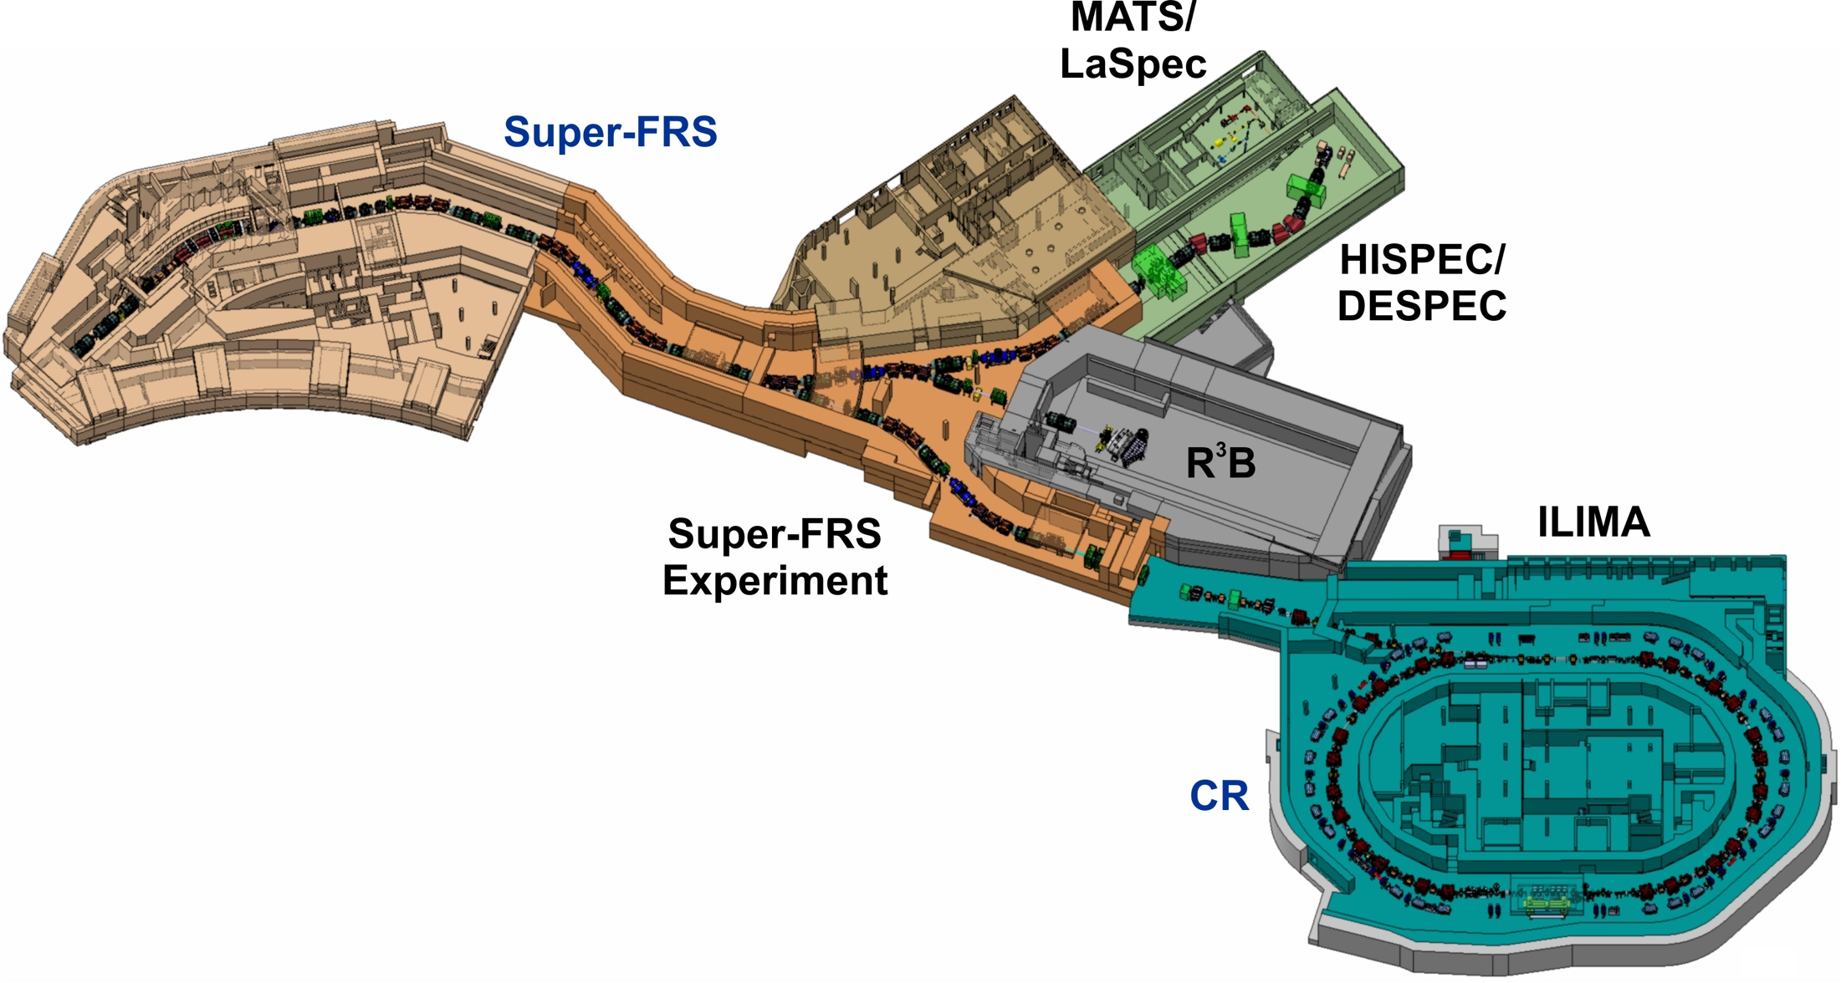
Physics start-up at the FAIR facility
3
2
1
Ready for Experiments
Early Science: S-FRS Exp., DESPEC, R3B 2025/2026
Phase 1: and HISPEC (AGATA), 2026/2027
and MATS/LASPEC, 2027
and ILIMA 2027
1 with SIS18 beams, 2 preferably SIS100 operation, 3 SIS100 operation needed
4
CR
11th FAIR-NUSTAR RRB meeting - February 21-22, 2022

Slide 4
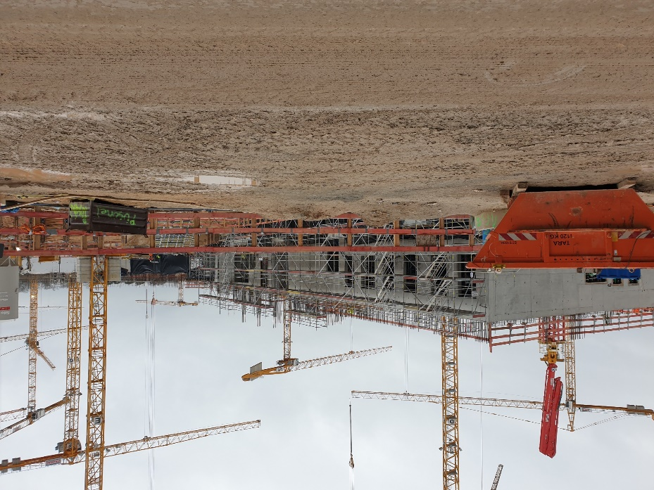
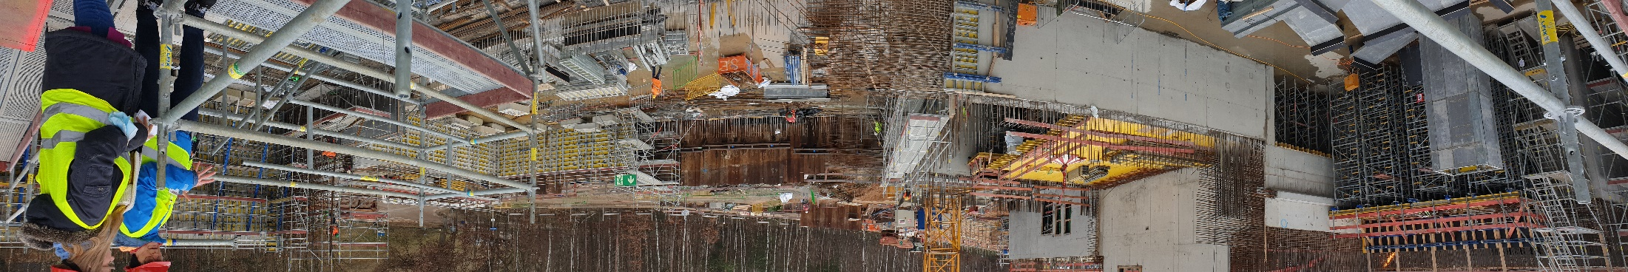
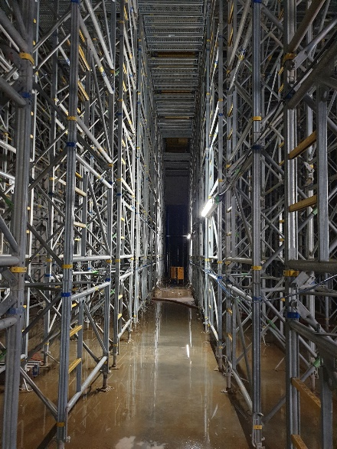
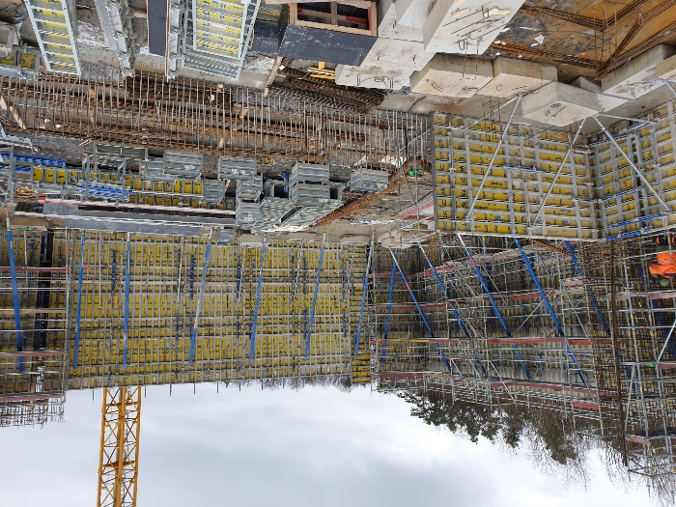
Recent Progress of NUSTAR Buildings
NUSTAR/Super-FRS Control
The construction site on Feb. 8, 2022
LEB Cave
Concrete Shell will be ready in March in time…
HEB Cave
11th FAIR-NUSTAR RRB meeting - February 21-22, 2022

Slide 5
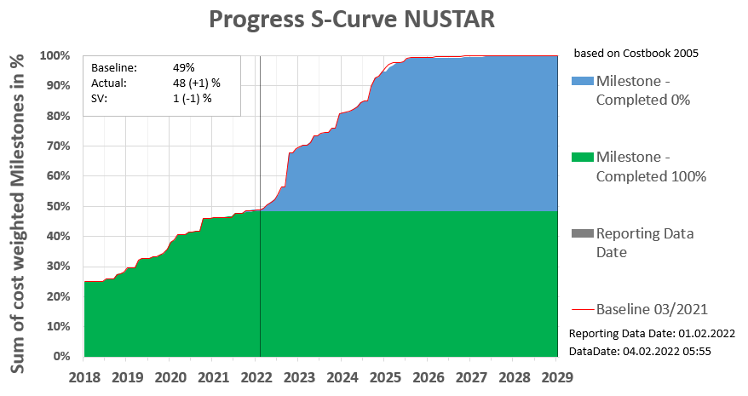
Planning Status of NUSTAR
NUSTAR is progressing according to plans, with only minor impact from Covid19 so far
11th FAIR-NUSTAR RRB meeting - February 21-22, 2022

Slide 6
Pending TDRs
TDR # | title (or working title) | experiment | Date expected | NUSTAR phase
29 | R³B infrastructure | R³B | approved | Day one
26 | Si tracker | R³B | May 22 | Day one
40 | Liquid hydrogen target | Super-FRS EC | Nov 22 | Phase 1
41 | (ice target and tensor force) | Super-FRS EC | Nov 22 | Phase 1
1 | LEB infrastructure | LEB infrastructure | submitted | Day one
 |  |  |  | Phase 2
30 | R³B spectrometer | R³B | Nov 22 | Phase 2
18 | gSPEC | HISPEC/DESPEC | Nov 22 | Phase 2
37 | Slowed down beam setup | HISPEC/DESPEC | Nov 22 | Phase 2
7 | Active target (India) | HISPEC/DESPEC | Nov 22 | Phase 2
8 | HYDE | HISPEC/DESPEC | Nov 22 | Phase 2
42 | (future WASA) | Super-FRS EC | Jul 24 | Phase 2
27 TDRS have already been approved by ECE
11th FAIR-NUSTAR RRB meeting - February 21-22, 2022

Slide 7
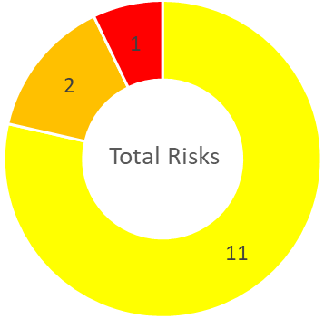
Risk Register
(top items only)
Will be updated in February for Risk Report
Risk ID | scenarios | Status | Work package | Risk title | Probability | Performance | Risk Score | Status Update / Comment
173 |  | Mitigation ongoing |  | No budget available to order NUSTAR infrastructure. | 25% | severe | 14
358 |  | Mitigation ongoing | Silicon tracker | Detection threshold of Si Tracker modules far too high. | 50% | major | 13
402 |  | Mitigation ongoing | CALIFA forward endcap | Energy resolution of CEPA scintillator detectors is insufficient due to position dependence. | 70% | moderate | 9
reduced to 13 because of progress with the MoU
reduced to 9 because of progress with mitigation
New risk: DESPEC/AIDA wide version not fully reaching specs.
Risk score 7, mitigation planned

Slide 8
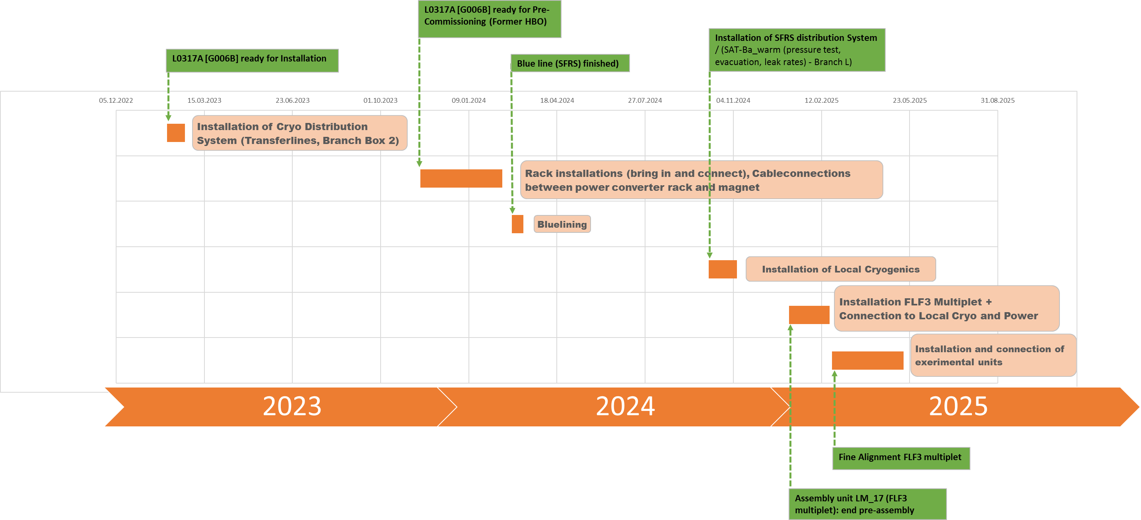
Installation Time Line LEB
Early physics
FSB, Super-FRS installation
NUSTAR installation
NUSTAR depends on other FAIR Sub-projects, and has time buffers
11th FAIR-NUSTAR RRB meeting - February 21-22, 2022

Slide 9
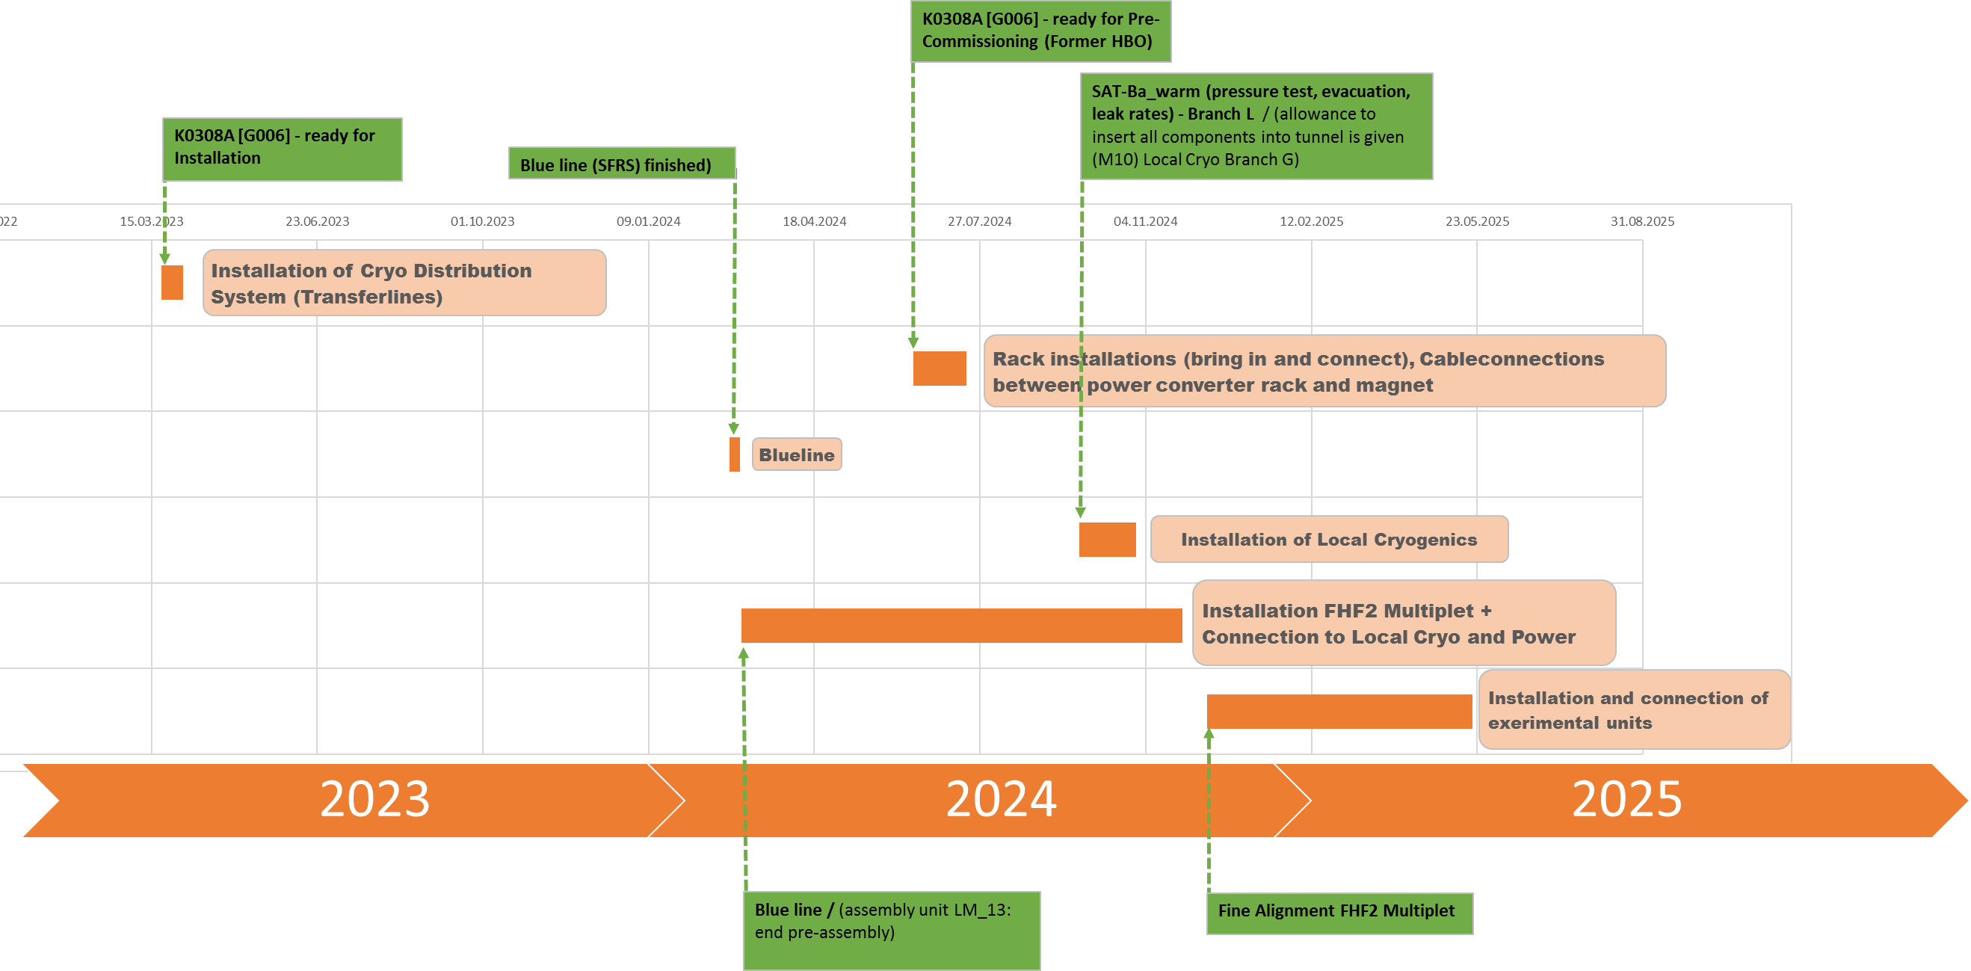
Installation Time Line HEB
Early physics
FSB, Super-FRS installation
NUSTAR installation
NUSTAR depends on other FAIR Sub-projects, and has time buffers
11th FAIR-NUSTAR RRB meeting - February 21-22, 2022

Slide 10
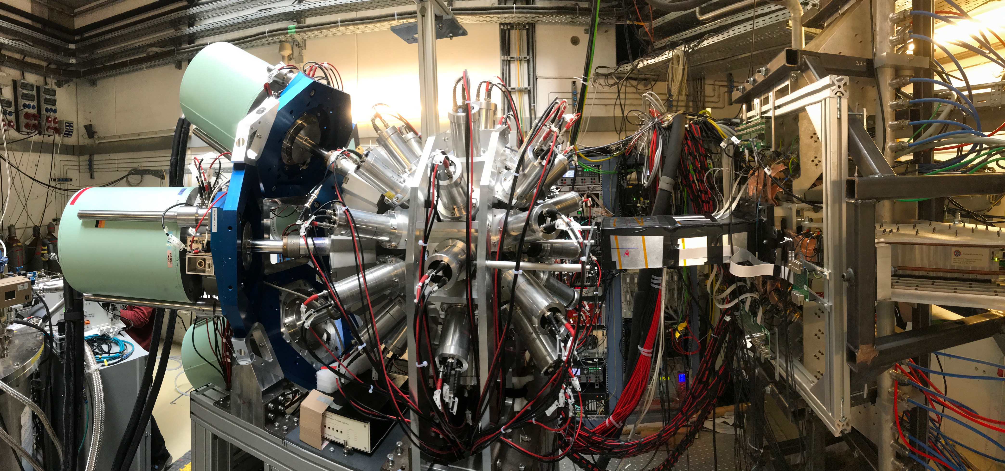
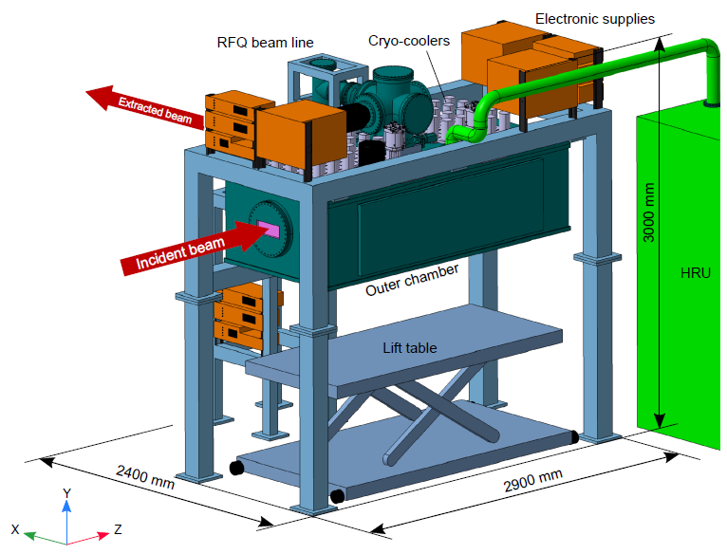
Early Science Set-ups
DESPEC
Plan to move DEGAS(+FATIMA) set-up from FRS/S4 to Super-FRS starting in Q1 2025 after the phase-0 runs of 2024.
R3B
Plan to move full set-up from Cave-C to HEB starting in Q4 2024 with GLAD. Phase-0 experiments not requiring GLAD may still run in 2024.
Super-FRS EC
Plan to get the CSC ready for the first experiments. All other componets for early science are already ready and in operation.
All sub-collaborations have basic set-ups ready for 2025.
Additional detector modules and the CSC are planned to be available.
Certain infrastructure items are not yet funded/available.

Slide 11
Critical to success
Acquiring funding for NUSTAR infrastructure through Common Funds
Fulfilling all formal safety requirements to be able to operate the planned set-ups
Getting sufficient beam time at GSI for i) testing FAIR/NUSTAR equipment, ii) gaining further operating experience and iii) training scientists and technicians
11th FAIR-NUSTAR RRB meeting - February 21-22, 2022

