Slide 1
INFN-LNF - SPAS
STRAW MODULES INTEGRATION-
- PROPOSAL FOR A SOLUTION OF A “STRAW MODULE” INTEGRATION -
INFN-LNF-SPAS- December 2011- D. Orecchini – P. Gianotti

Slide 2
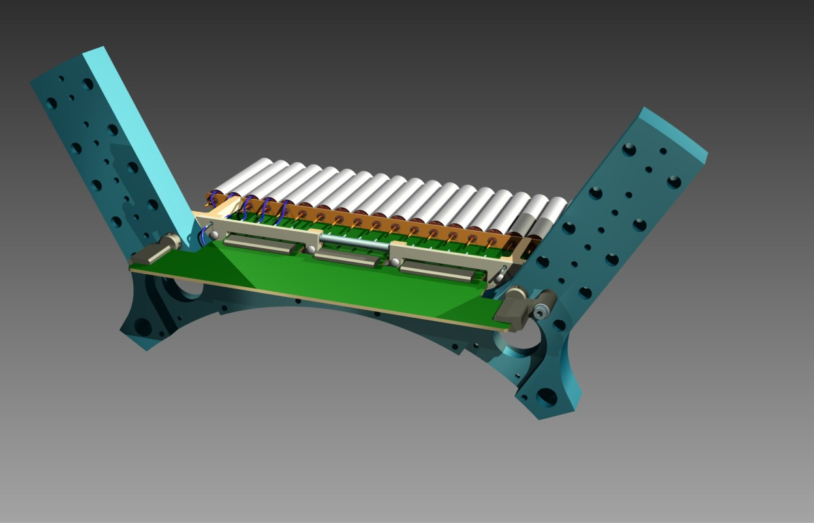
INFN-LNF - SPAS
STRAW MODULES INTEGRATION-
“STRAW DOUBLE-LAYER” INTEGRATION SOLUTION -
FRONT PICTORIAL VIEW-
- HIGH VOLTAGE
DISTRIBUTION CARD.
- “STRAW MODULE” SUPPORT EQUIPMENT.
- “STRAW MODULE”.
- BACKWARD”SUPPORT END-PLATE ”.
- “ELECTRONIC CARD”
INFN-LNF-SPAS- December 2011- D. Orecchini – P. Gianotti

Slide 3
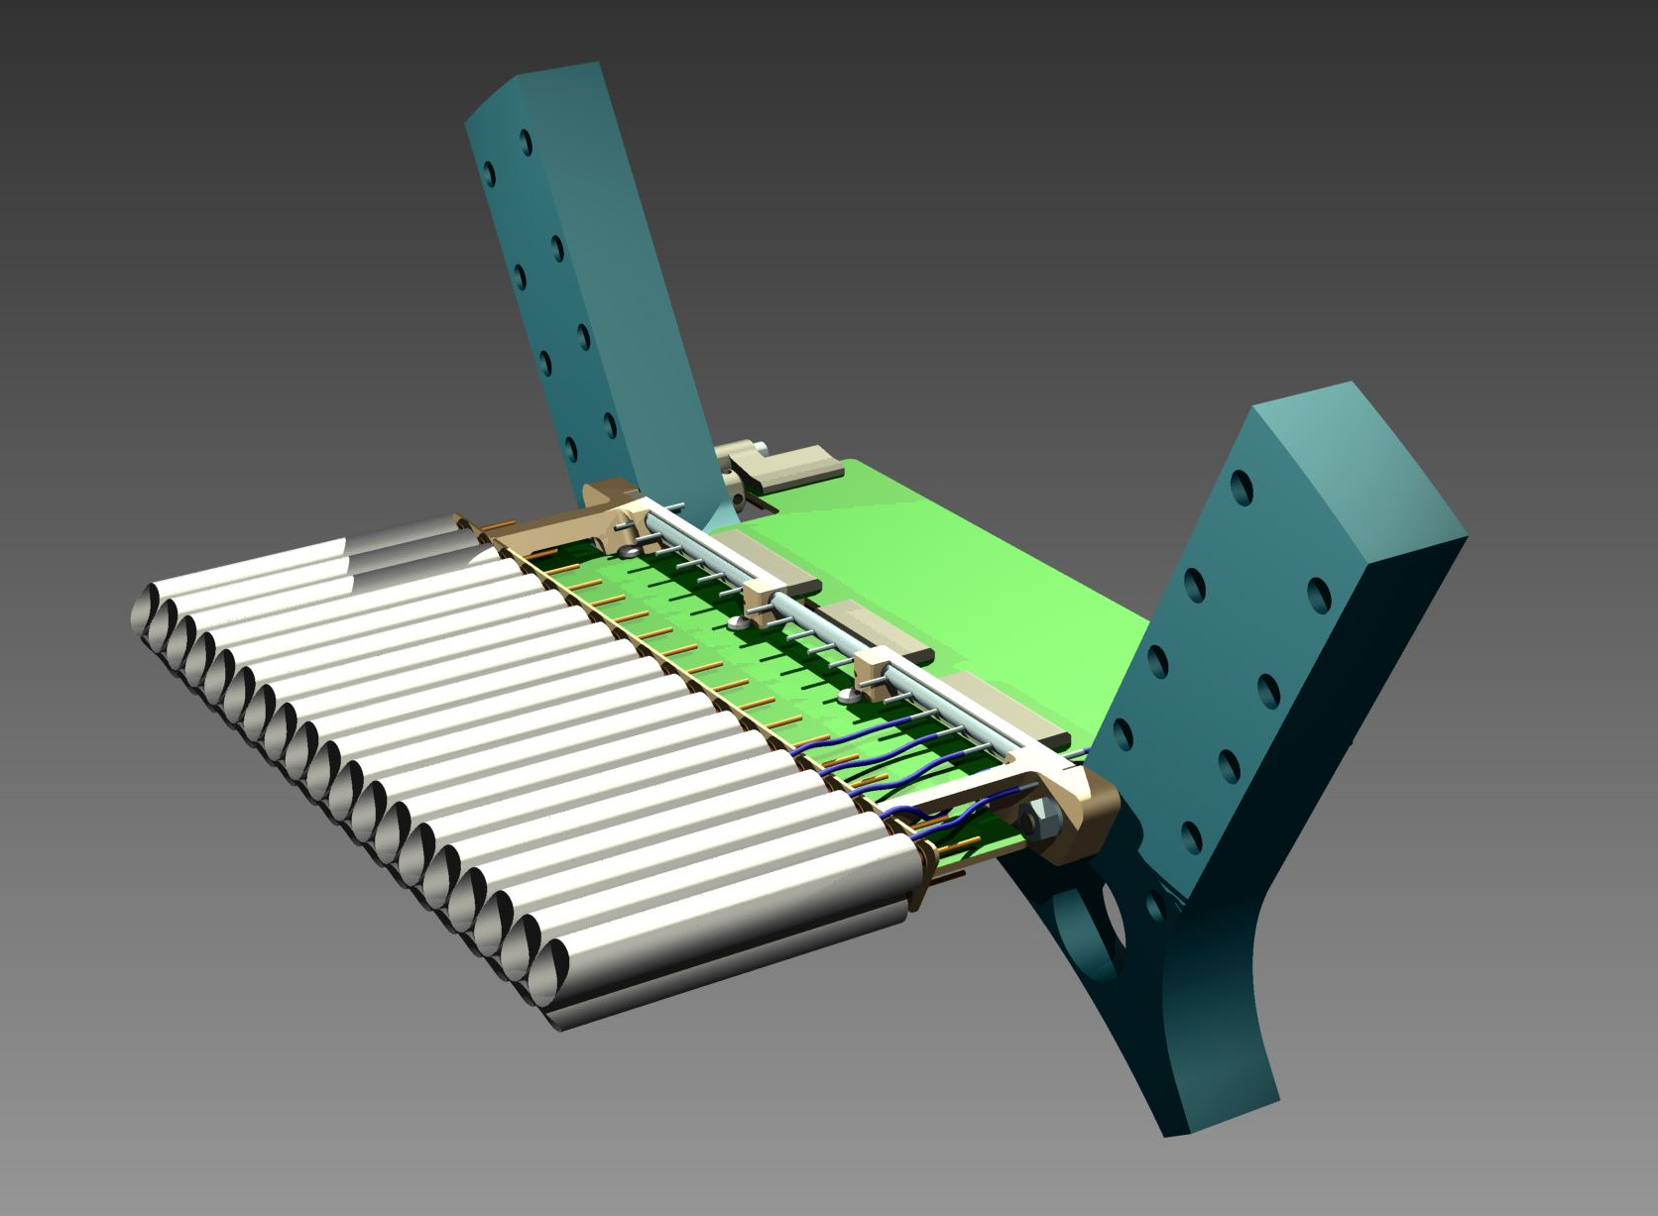
INFN-LNF - SPAS
STRAW MODULES INTEGRATION-
“STRAW DOUBLE-LAYER” INTEGRATION SOLUTION -
REAR PICTORIAL VIEW -
- “STRAW MODULE” SUPPORT EQUIPMENT.
- HIGH VOLTAGE
DISTRIBUTION CARD.
- “ELECTRONIC CARD”
- “STRAW MODULE”.
- BACKWARD”SUPPORT END-PLATE ”.
INFN-LNF-SPAS- December 2011- D. Orecchini – P. Gianotti

Slide 4
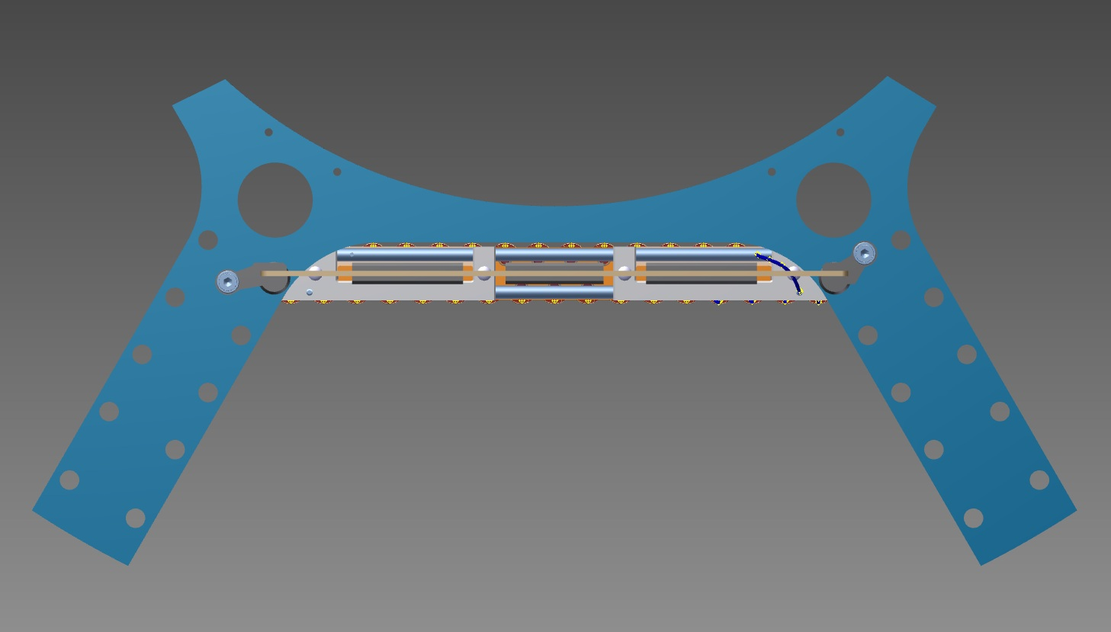
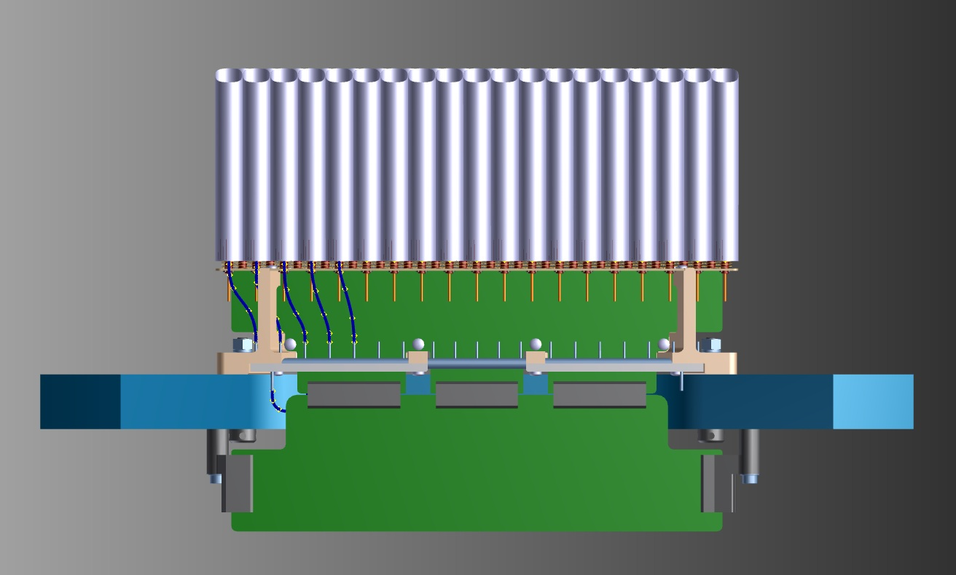
INFN-LNF - SPAS
STRAW MODULES INTEGRATION-
“STRAW DOUBLE-LAYER” INTEGRATION SOLUTION -
FRONT VIEW -
THE SHOWN DIMENSION S
ARE THOSE CHOSEN FOR
THE PROTOTYPE.
OBIOUSLY THEY COULD BE
CHANGED IF THE
ELECTRONICS REQUIRE MORE
OR DIFFERENT SPACE.
- HIGH VOLTAGE
DISTRIBUTION CARD.
40
20
40
TOP VIEW -
- “ELECTRONIC CARD”
180
INFN-LNF-SPAS- December 2011- D. Orecchini – P. Gianotti

Slide 5
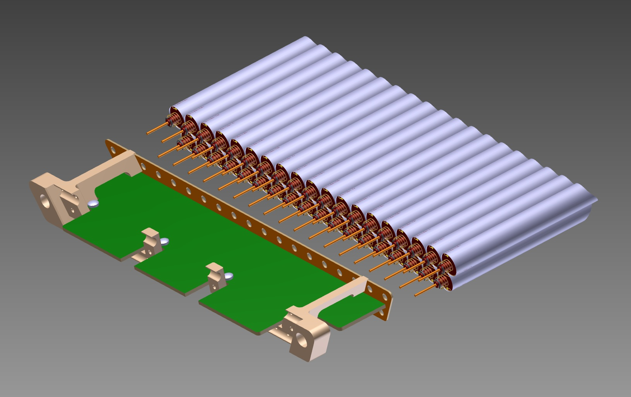
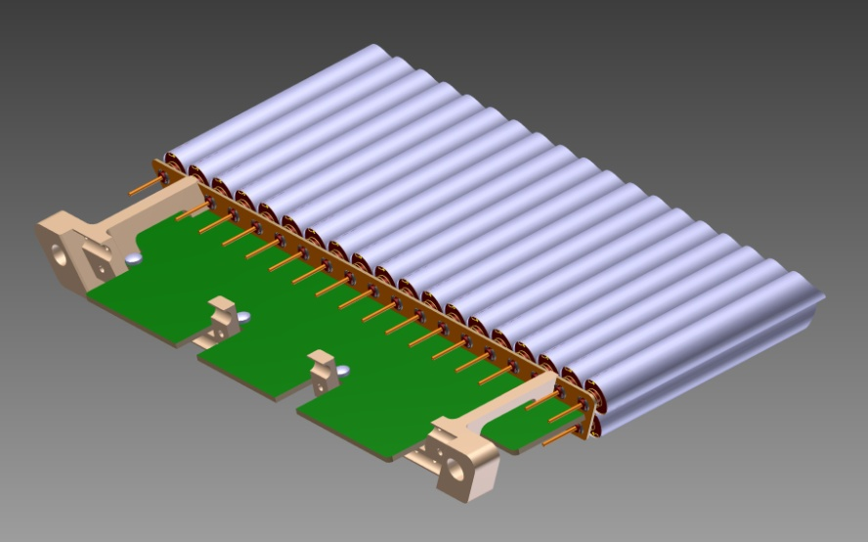
INFN-LNF - SPAS
STRAW MODULES INTEGRATION-
STEP_1, ASSEMBLING OF: STRAW MODULE – 1° PART OF “SUPPORT EQUIPMENT”.
PRE–ASSEMBLED -
- “STRAW MODULE”.
- HIGH VOLTAGE
DISTRIBUTION CARD.
- STRAW FRAME.
ASSEMBLED -
- CONNECTION PARTS OF THE “SUPPORT EQUIPMENT”.
INFN-LNF-SPAS- December 2011- D. Orecchini – P. Gianotti

Slide 6
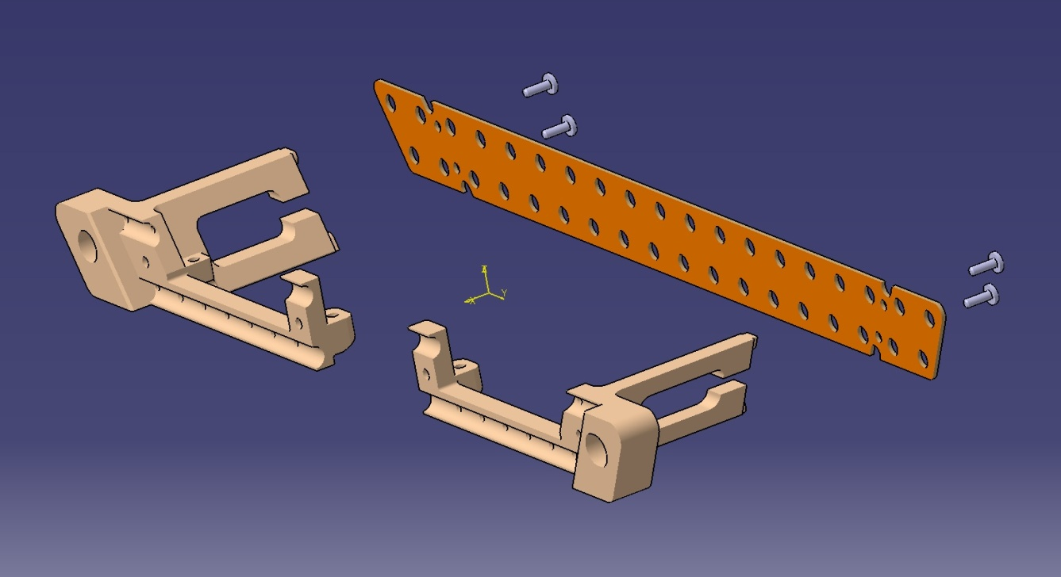
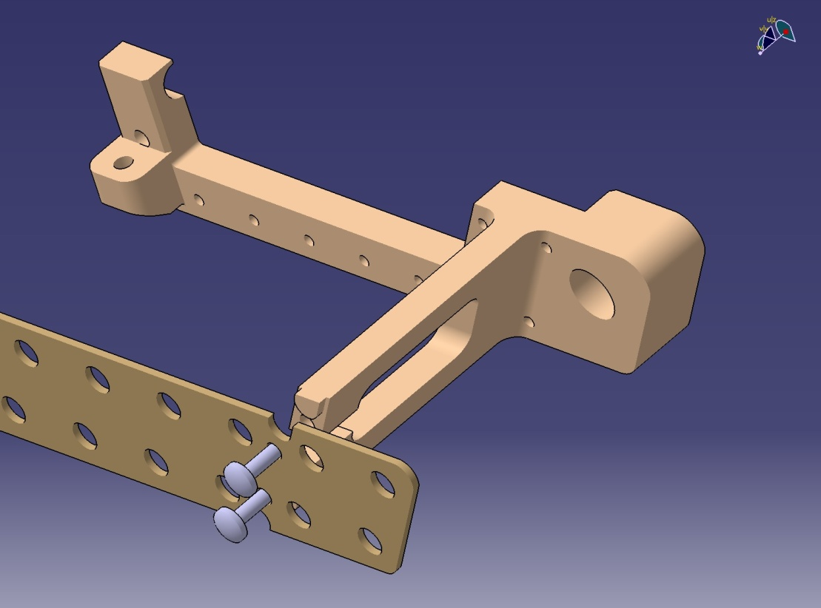
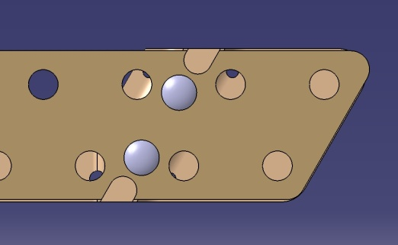
INFN-LNF - SPAS
STRAW MODULES INTEGRATION-
1° PART “SUPPORT EQUIPMENT” : HOW IS IT DONE ?
- PLASTIC MINI-SCREW 2mm DIAMETER.
- STRAW FRAME.
ASSEMBLING DETAIL.
- “LEFT” AND “RIGHT” CONNECTION PARTS.
OBTAINED BY INJECTION MOLDING.
MATERIAL: ABS OR SIMILAR.
NOTE: ELEMENTS OF COUPLING ARE:
-1) EMBOSSED ELEMENTS MADE ON THE
“SUPPORT PARTS”;
-2) MILLING POCKETS MADE ON THE
“STRAW- FRAME”.
COUPLING BETWEEN THEM ENSURE THE
CORRECT GEOMETRIC INTERFACE.

Slide 7
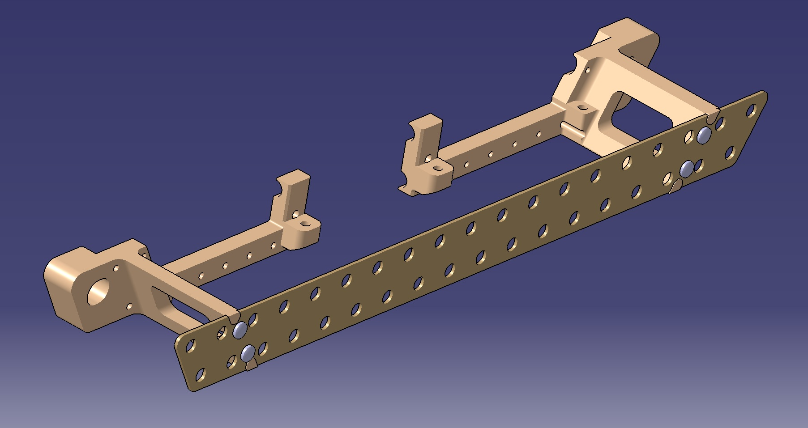
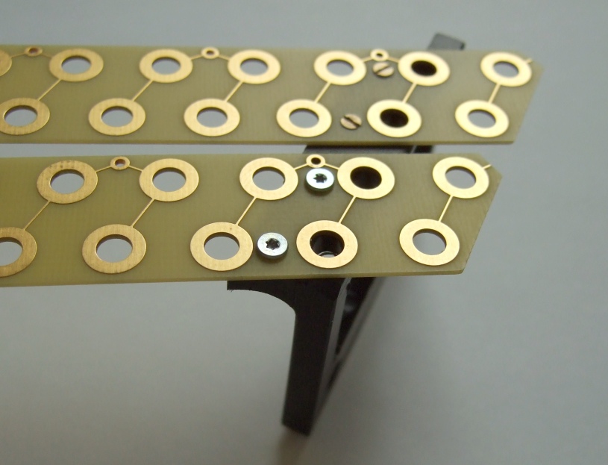
INFN-LNF - SPAS
STRAW MODULES INTEGRATION-
STEP_1: ASSEMBLING STRAW MODULE – 1° PART OF “SUPPORT EQUIPMENT”
- CONECTION PARTS OF THE “SUPPORT EQUIPMENT”.
- STRAW FRAME.
- PLASTIC MINI-SCREW 2mm DIAMETER.
THE SHOWN SOLUTION IS BASED ON A “JULICH IDEA”
(SEE THE PHOTO) DEVELOPED TO FIND AN OVERALL INTEGRATION.
INFN-LNF-SPAS- December 2011- D. Orecchini – P. Gianotti

Slide 8
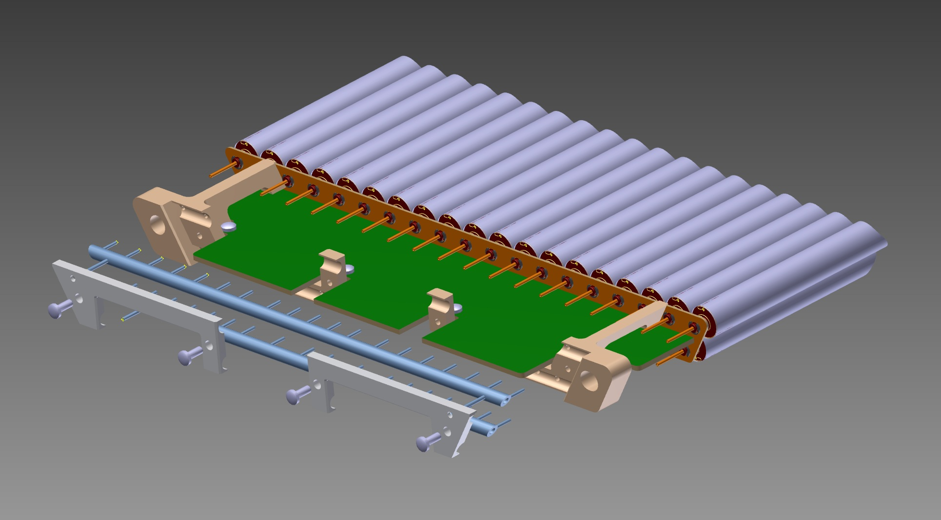
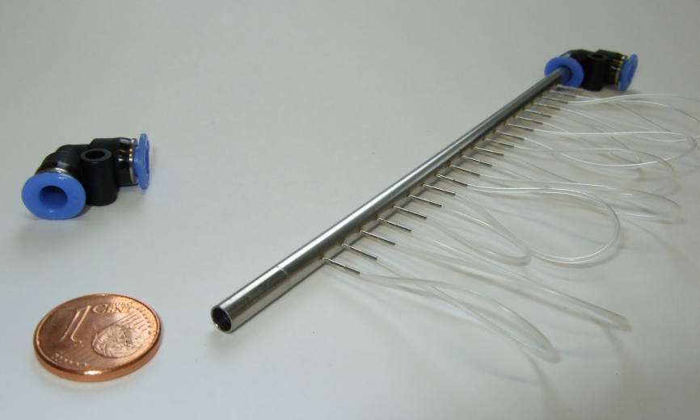
INFN-LNF - SPAS
STRAW MODULES INTEGRATION-
STEP_2: ASSEMBLING “GAS MANIFOLD “ - 2° PART OF “SUPPORT EQUIPMENT” -
-FIXING PART OF “GAS PIPES”.
- “UP” AND “DOWN” GAS PIPES
- FIXING PART OF “GAS PIPES”.
MATERIAL: STEEL, 4mm DIAMETER.
- AGAIN, THE SHOWN SOLUTION IS BASED ON A “JULICH IDEA” (SEE THE PHOTO) DEVELOPED TO FIND AN OVERALL INTEGRATION.
INFN-LNF-SPAS- December 2011- D. Orecchini – P. Gianotti

Slide 9
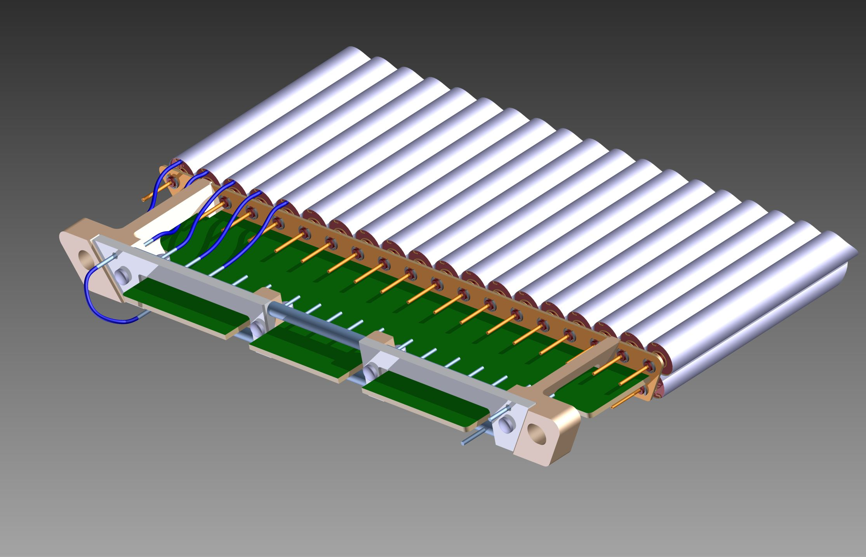
INFN-LNF - SPAS
STRAW MODULES INTEGRATION-
STEP_3°: “CONNECTION OF GAS SYSTEM
“UP” AND “DOWN” GAS PIPE , ARE
CONNECTED WITH THE SINGLE STRAW TUBE.
THE “UP-PIPE” IS CONNECTED WITH THE ”DOWN-PIPE”.
THE ASSEMBLED “STRAW MODULE” IS READY TO BE
MOUNTED IN THE “SUPPORT STRCTURE”.
INFN-LNF-SPAS- December 2011- D. Orecchini – P. Gianotti

Slide 10
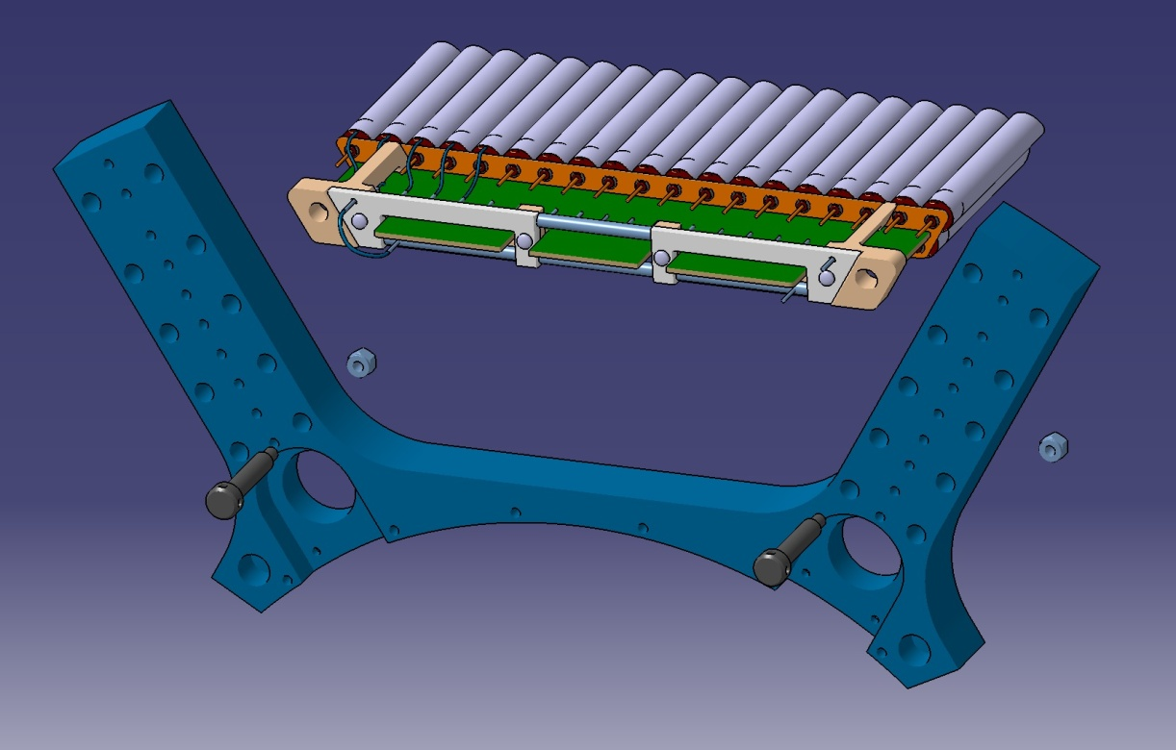
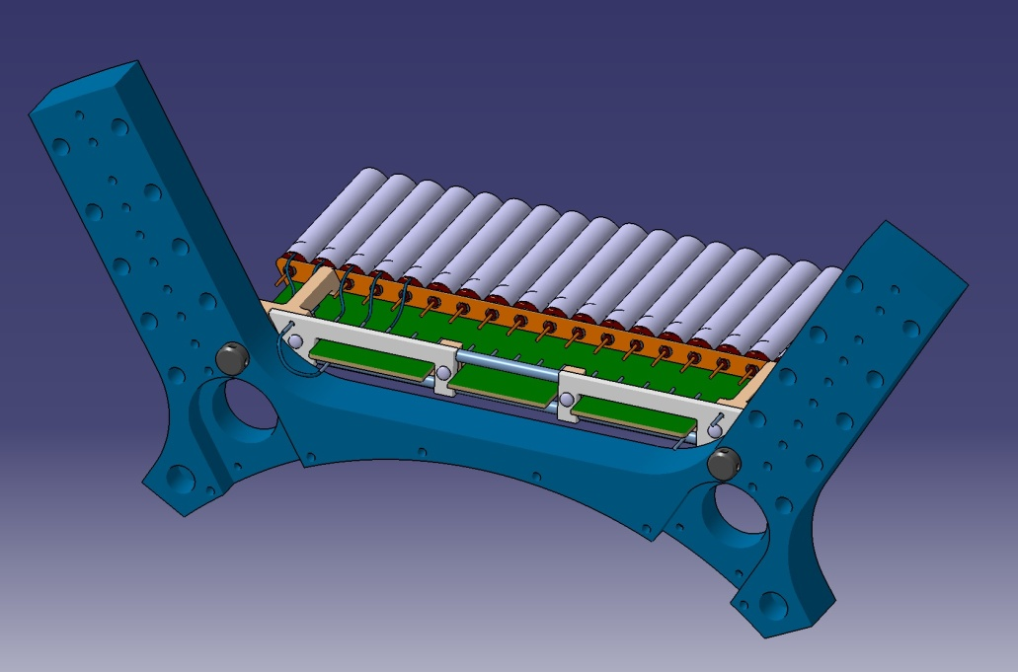
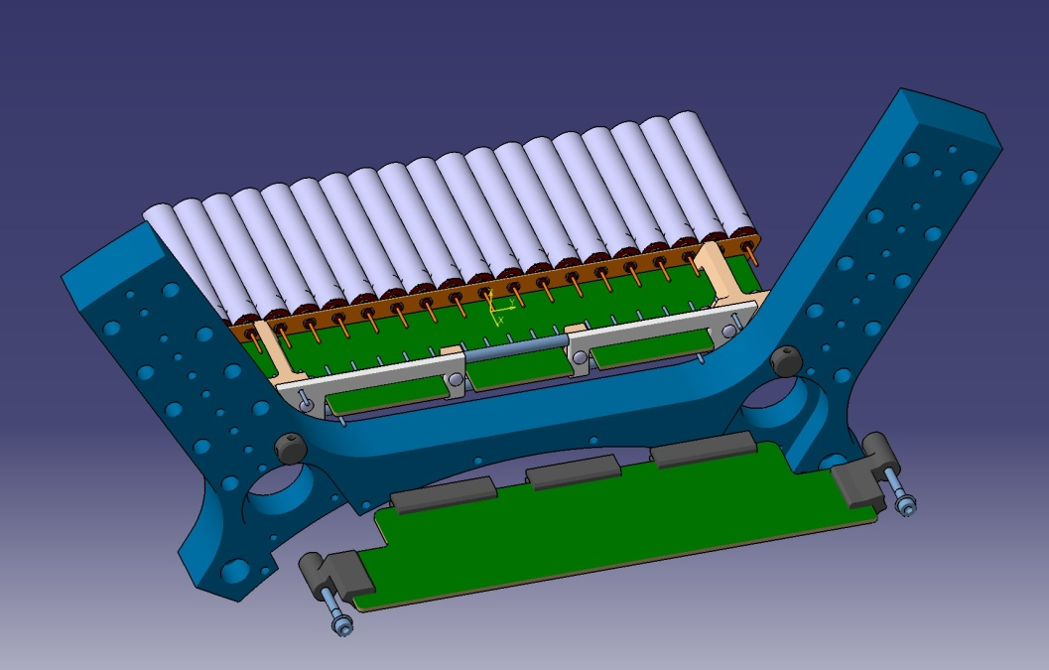
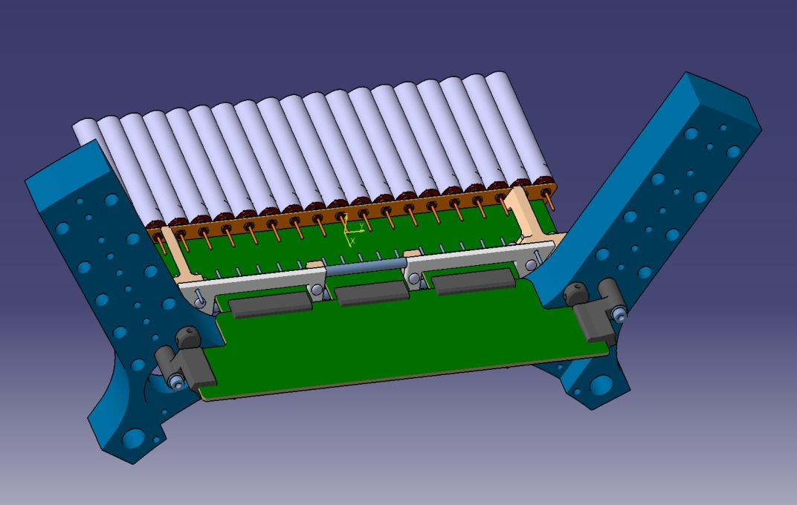
INFN-LNF - SPAS
STRAW MODULES INTEGRATION-
FINAL STEP: INTEGRATION “STRAW MODULE” – SUPPORT STRUCTURE -
“STRAW MODULE” INSERTION IN THE “SUPPORT STRUCTURE”.
“STRAW MODULE” FIXED ON THE “SUPPORT STRUCTURE”.
“ELECTRONIC CARD” POSITIONED ON THE “SUPPORT
STRUCTURE”.
“ELECTRONIC CARD” FIXED ON THE “SUPPORT STRUCTURE”.
INFN-LNF-SPAS- December 2011- D. Orecchini – P. Gianotti

Slide 11
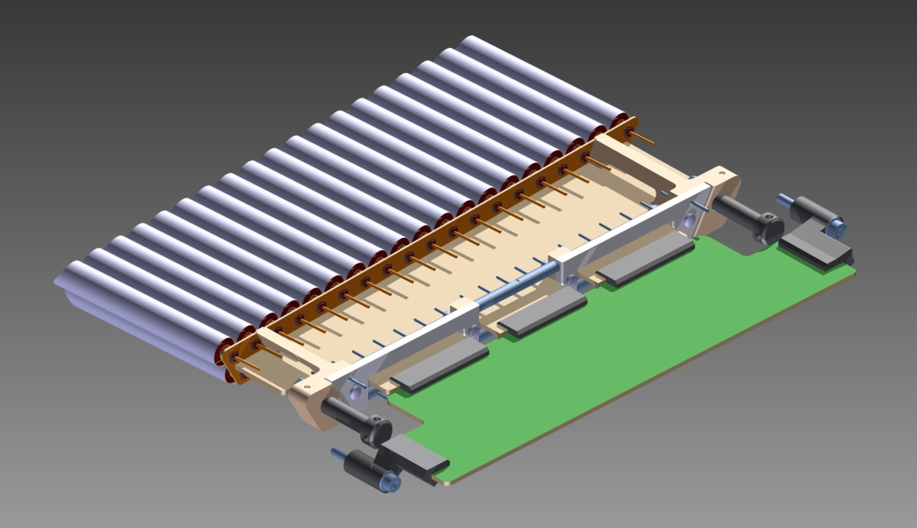
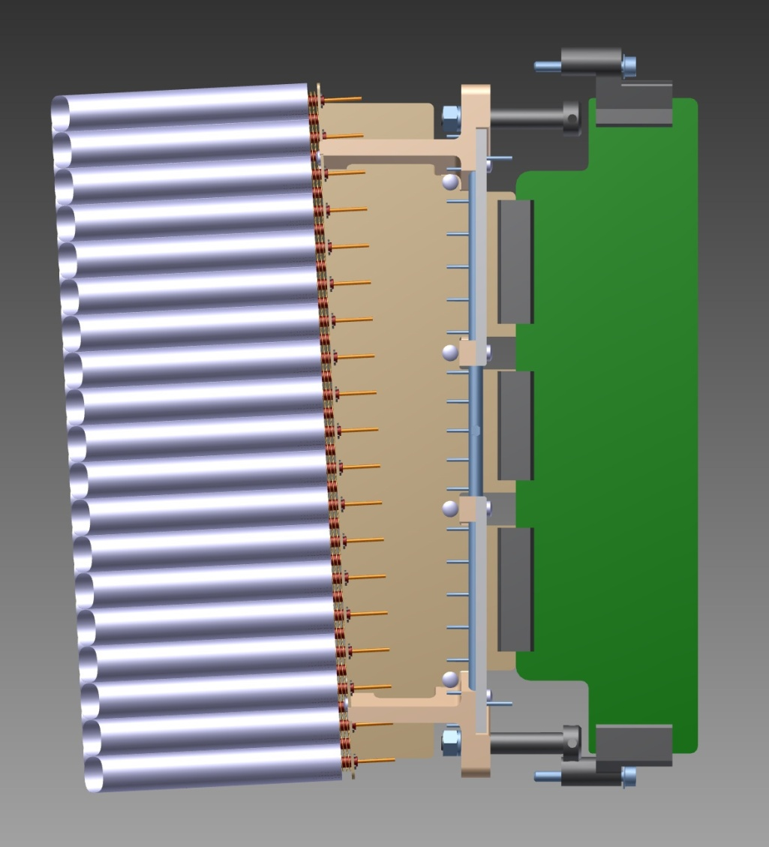
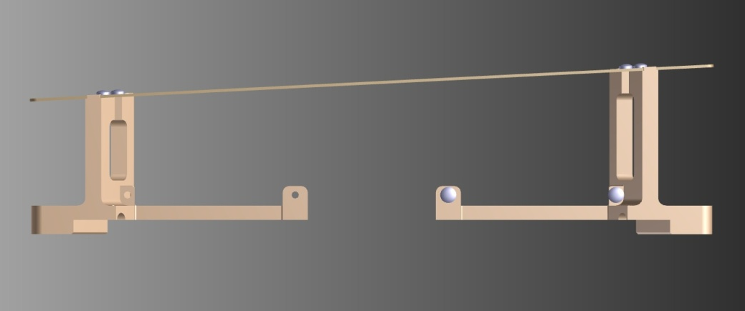
INFN-LNF - SPAS
STRAW MODULES INTEGRATION-
TYPICAL “SKEWED STRAW DOUBLE-LAYER” INTEGRATION SOLUTION -
PICTORIAL VIEW-
- SKEWED ANGLE: 2.89°
-THE TWO CONNECTION PARTS OF THE
“SUPPORT EQUIPMENT” MUST BE REALIZED
WITH DIFFERENT LENGTHS, AND WITH THE
INTERFACE SIDE WITH THE “STRAWS FRAME”
WITH A “SKEWED ANGLE”.
L1
L2
INFN-LNF-SPAS- December 2011- D. Orecchini – P. Gianotti

Slide 12
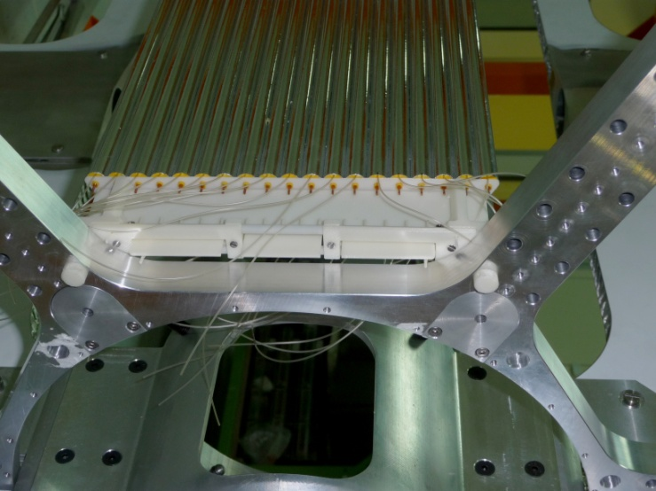
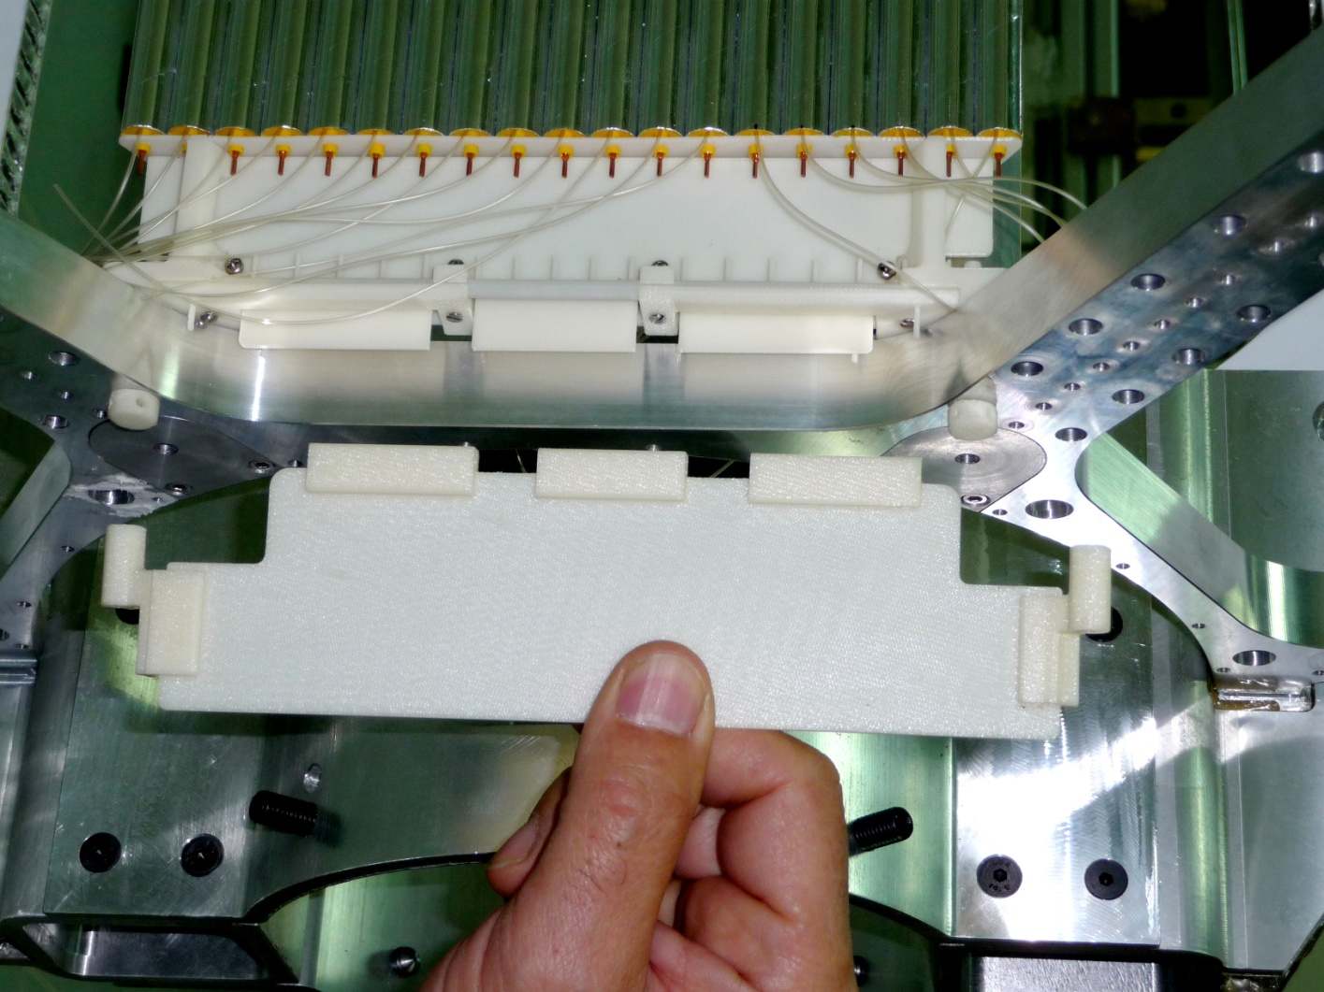
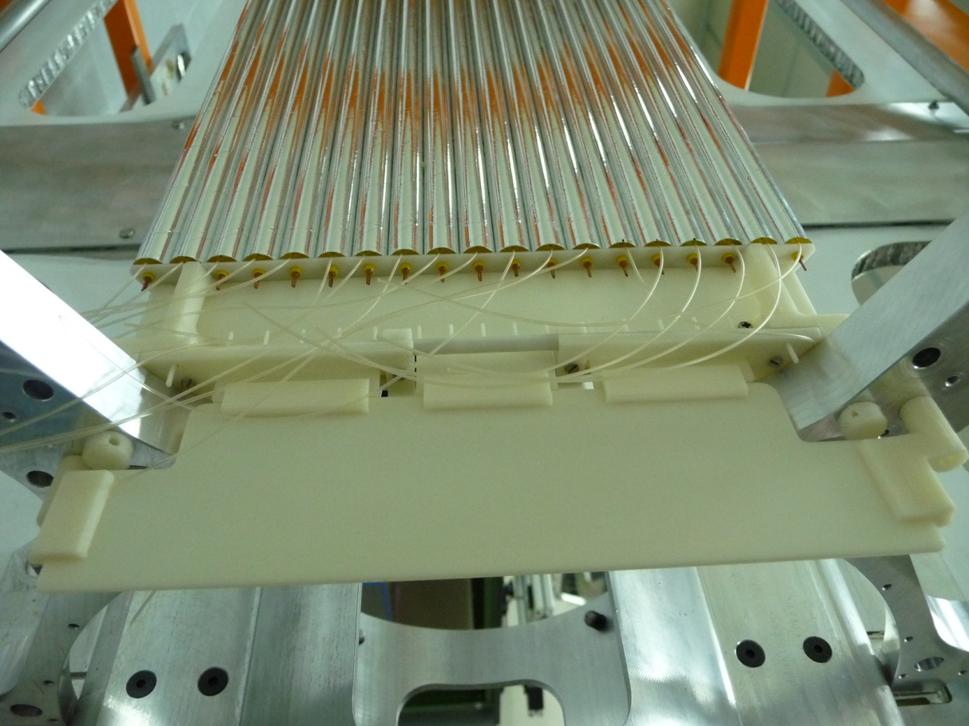
INFN-LNF - SPAS
STRAW MODULES INTEGRATION-
STEREOLITHOGRAPHY PROTOTYPE ASSEMBLED
ON THE “SUPPORT STRUCTURE PROTOTYTPE”.
INFN-LNF-SPAS- December 2011- D. Orecchini – P. Gianotti

Slide 13
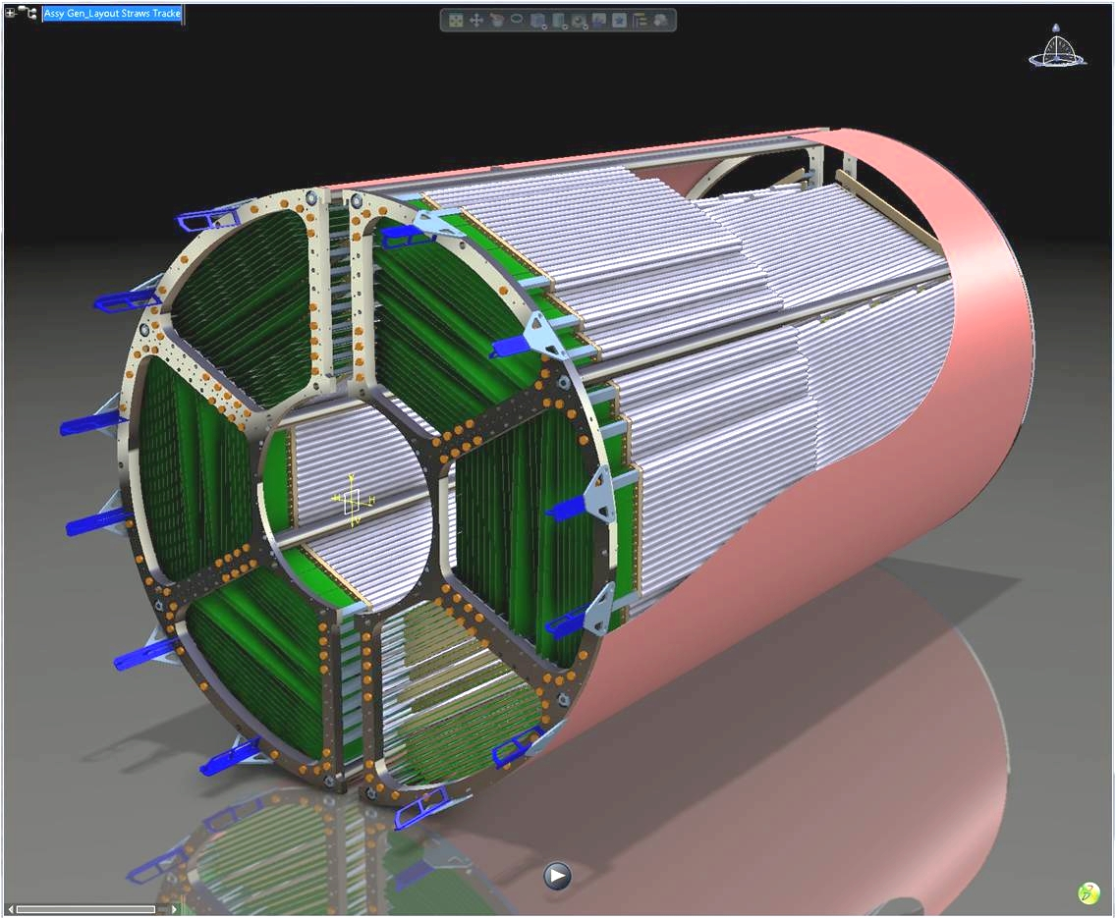
INFN-LNF - SPAS
STRAW MODULES INTEGRATION-
CONCLUSIONS -
-THE SHOWED “ASSEMBLING PROCEDURE” CAN BE ADOPTED ALSO ON THE FORWARD SIDE OF THE “SUPPORT
STRUCTURE”.
THE ONLY DIFFERENCE IS THAT, THE “UP” AND “DOWN” GAS MANIFOLD WILL BE CONNECTEND WITH
THE MAIN “IN” AND “OUT” GAS PIPES.
THE SHOWED “ASSEMBLING PROCEDURE” , WITH SOME MODIFICATIONS, CAN BE ADOPTED ALSO WITH
A “QUAD STRAW MODULE” SOLUTION.
-THIS SOLUTION REDUCES AT MINIMUM THE NUMBER OF DIFFERENT OBJECTS THAT WILL BE REALIZED
WITH INJECTION MOLDING.
WE WILL HAVE 2 SERIES OF SUPPORTS : A “RIGHT SERIES”, AND A “LEFT SERIES”.
- FOR THE SUPPORTS OF THE SKEWED MODULES THIS KIND OF OPTIMIZATION, PROBABLY, WILL NOT BE
POSSIBLE.
IN CASE OF ADOPTION OF THE PROPOSED SOLUTIONS, ITS NECESSARY TO DEVELOP A DISCUSSION ABOUT
DETAILS (DIMENSIONS, GAS-PIPES, CONNECTORS, ETC….) WITH “STRAWS - PEOPLE” AND WITH THE
“ELECTRONICS DEVELOPERS” .
INFN-LNF-SPAS- December 2011- D. Orecchini – P. Gianotti

Slide 14
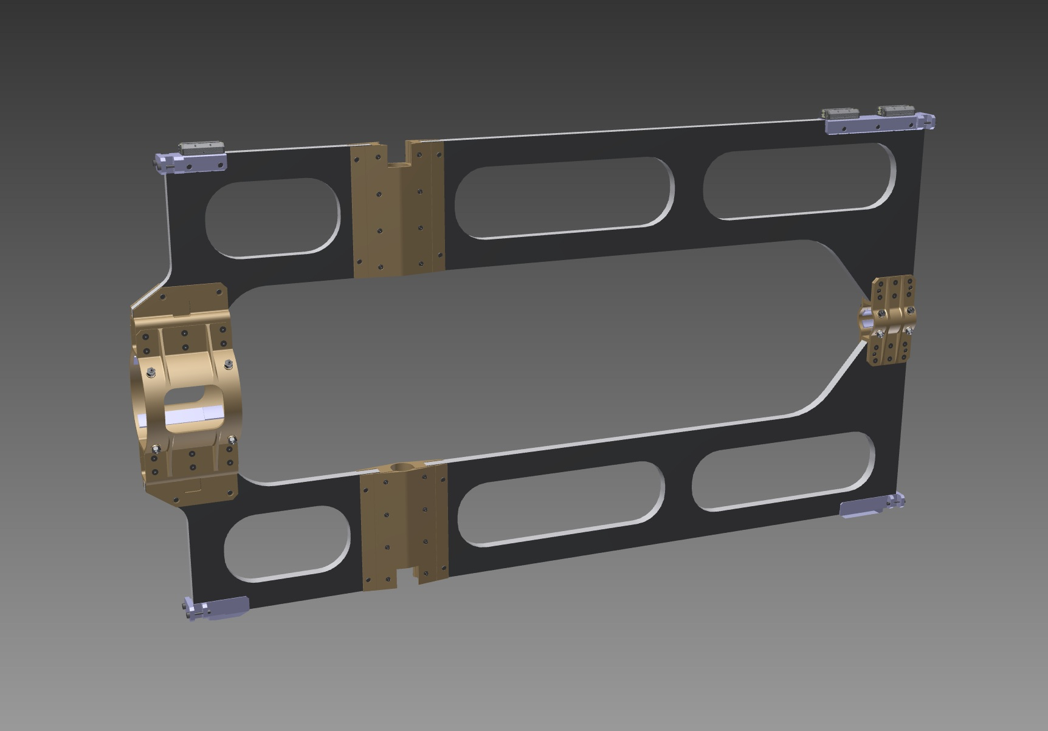
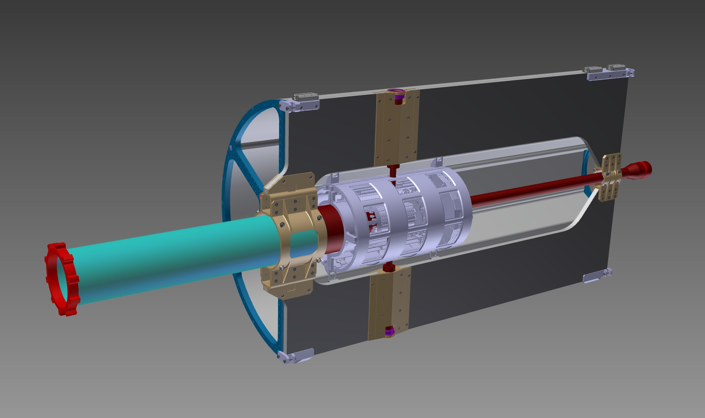
- CENTRAL SUPPORT FRAME STRUCTURAL ANALYSIS -
- JUST TO REMEMBER ………..-
AFTER THE LAST FEM ANALYSIS (presented in this meeting, in the mechanical session) THE “CSF” HAS BEEN CHANGED:
- THE DIMENSIONS AND THE EXTERNAL GEOMETRY ARE STILL
THE SAME;
- ALL THE INTERNAL “LIGTHNING WINDOWS” HAVE BEEN
CLOSED.
CENTRAL SUPPORT FRAME OLD GEOMETRY
CENTRAL SUPPORT FRAME NEW GEOMETRY
GSI-DECEMBER 2011: B. GIRAUDO / D. 0RECCHINI

