Slide 1
CENTRAL SUPPORT FRAME STRUCTURAL ANALYSIS
FIRST APPROACH AND PRELIMINARY RESULTS
G. Giraudo & D. Orecchini
XXXIX PANDA COLLABORATION MEETING GSI-DECEMBER 2011 B. GIRAUDO / D. ORECCHINI

Slide 2
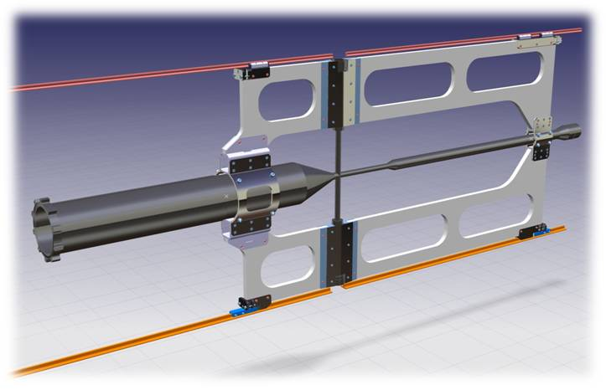
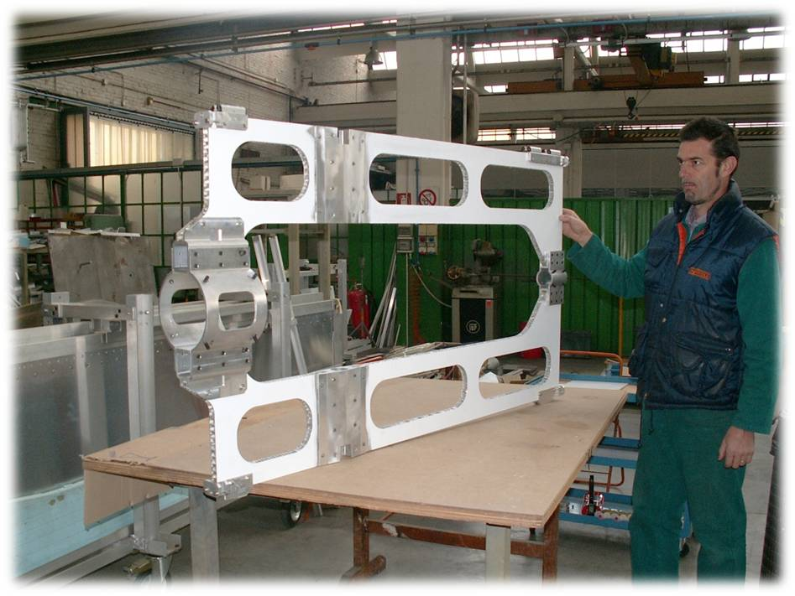
- CENTRAL SUPPORT FRAME STRUCTURAL ANALYSIS -
Preliminary basic idea:
Common support for inner devices; (MVD, STT, cross pipe)
Lightweight, stiff and stable structure.
References for external survey.
- Central Support Frame (CSF) basic idea.
Geometrical prototype
Frame →aluminium honeycomb.
Ancillary parts →aluminium.
GSI-DECEMBER 2011: B. GIRAUDO / D. 0RECCHINI

Slide 3
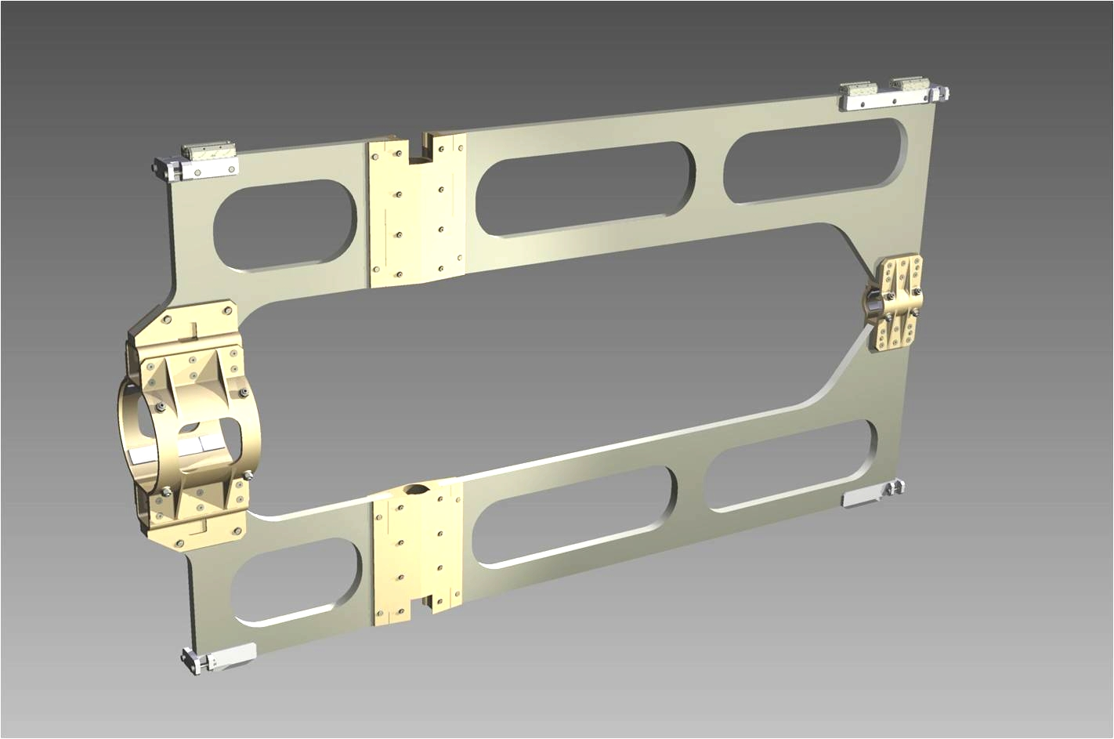
- CENTRAL SUPPORT FRAME STRUCTURAL ANALYSIS -
- Central Support Frame (CSF) - foreseen materials
TITANIUM
TITANIUM
SUPPORT FRAME: - CORE, ROHACELL IG51
- SKINS, M55J/LTM110-5
TITANIUM
GSI-DECEMBER 2011: B. GIRAUDO / D. 0RECCHINI

Slide 4
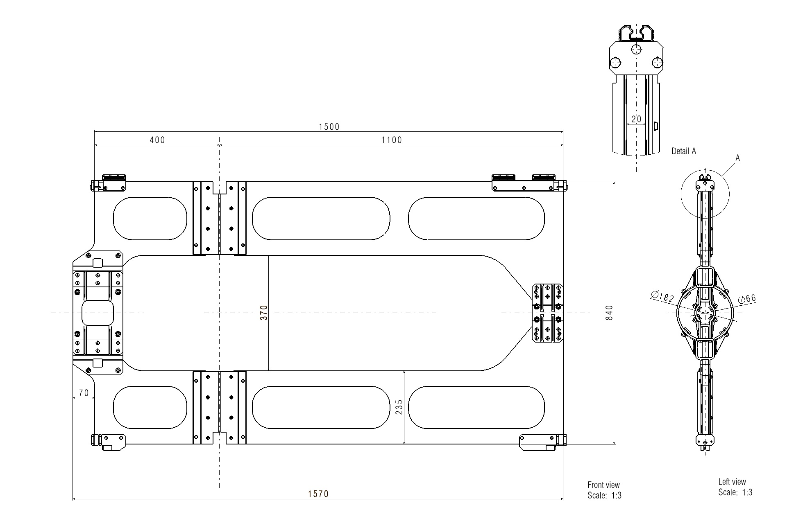
- CENTRAL SUPPORT FRAME STRUCTURAL ANALYSIS -
Central Support Frame (CSF): main dimensions
GSI-DECEMBER 2011: B. GIRAUDO / D. 0RECCHINI

Slide 5
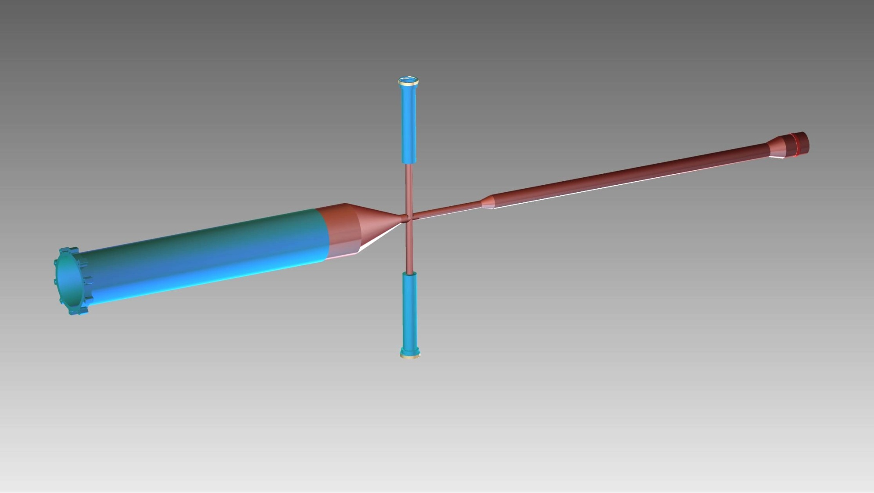
- CENTRAL SUPPORT FRAME STRUCTURAL ANALYSIS -
CROSS-PIPE: foreseen materials,
(From document: Vacuum-Target-CJT_V2010kw48) Ref. EDMS Doc 1107870-872 v.1 .
TITANIUM (0.5mm Thickness)
STAINLESS STEEL (0.5mm Thickness)
(OR TITANIUM ??)
STAINLESS STEEL FLANGE
TITANIUM (0.5mm Thickness)
TITANIUM (0.2mm Thickness)
STAINLESS STEEL (2mm Thickness.)
GSI-DECEMBER 2011: B. GIRAUDO / D. 0RECCHINI

Slide 6
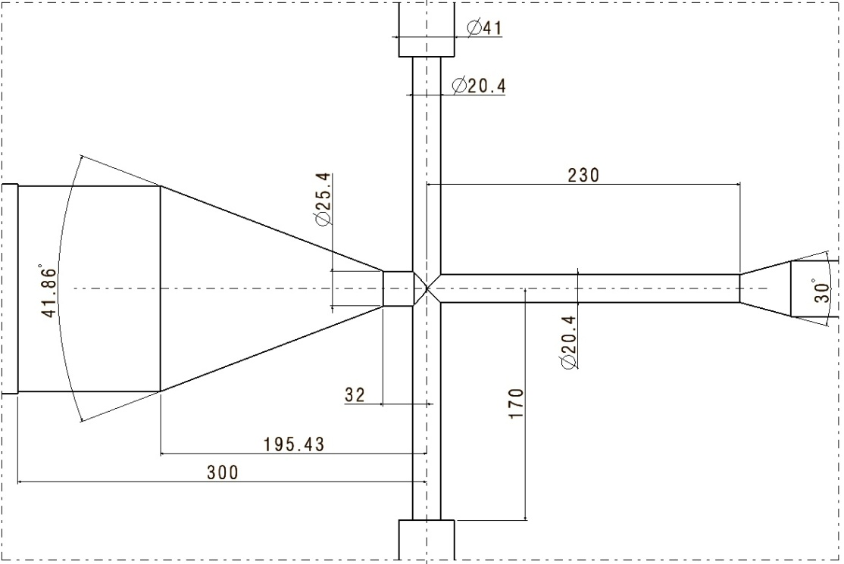
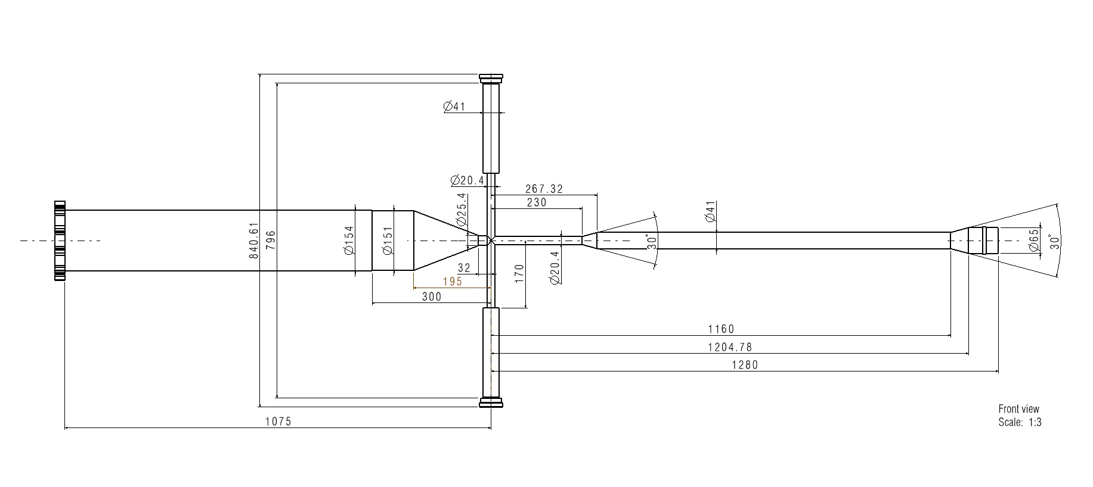
- CENTRAL SUPPORT FRAME STRUCTURAL ANALYSIS -
Cross-Pipe: I.P. area
Cross-Pipe: MAIN DIMENSIONS
From document, Vacuum-Target-CJT_V2010kw48)
GSI-DECEMBER 2011: B. GIRAUDO / D. 0RECCHINI

Slide 7
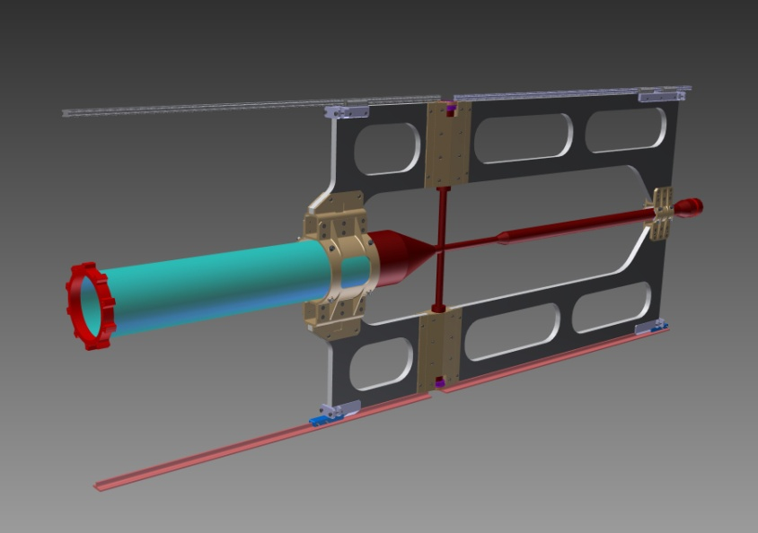
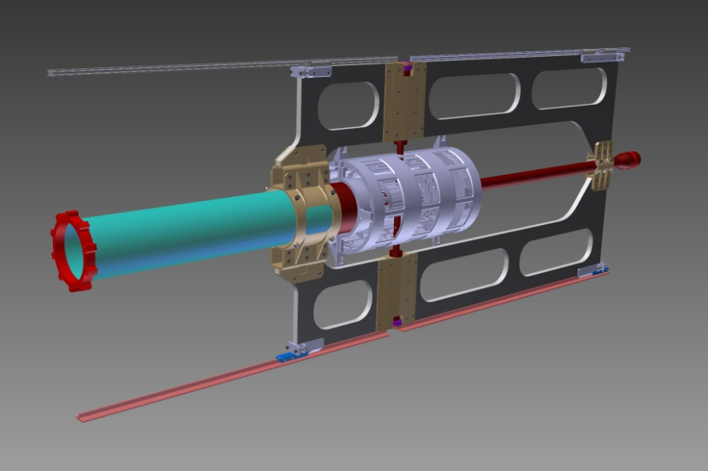
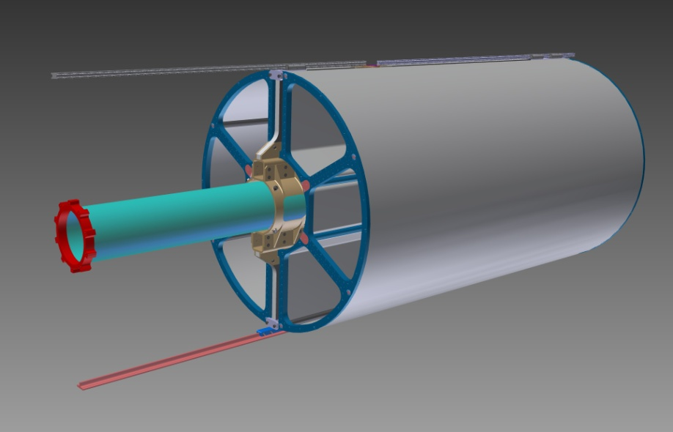
- CENTRAL SUPPORT FRAME STRUCTURAL ANALYSIS -
- CENTRAL SUPPORT FRAME: Loads input
“CF” & “CROSS PIPE” GRAVITY LOAD
90N
183N
MVD’s GRAVITY LOAD
260N
330N
810N
STT’s GRAVITY LOAD
GSI-DECEMBER 2011: B. GIRAUDO / D. 0RECCHINI

Slide 8
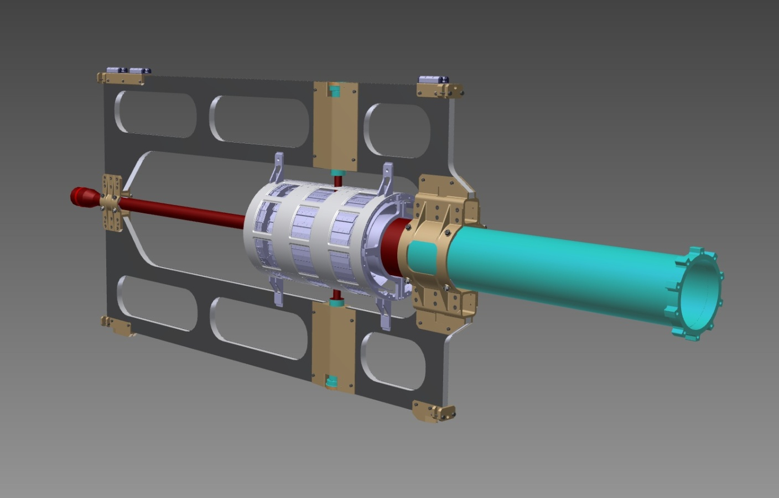
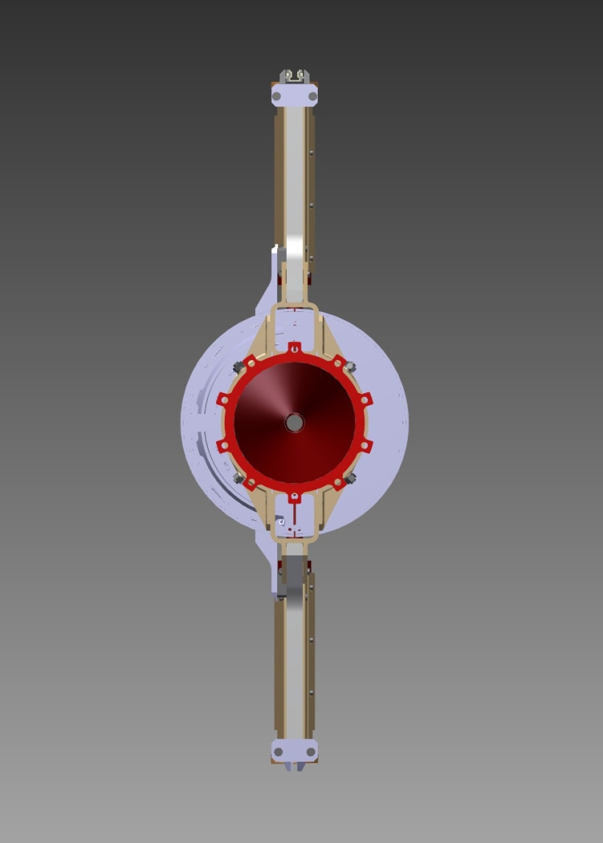
- CENTRAL SUPPORT FRAME STRUCTURAL ANALYSIS -
- CENTRAL SUPPORT FRAME: Loads conditions
VERTEX SUPPORT SYSTEM
Vertex support system and related moment
260N
BACKWARD PIPE LONG ARM
260N
Backward Pipe and related moment
GSI-DECEMBER 2011: B. GIRAUDO / D. 0RECCHINI

Slide 9
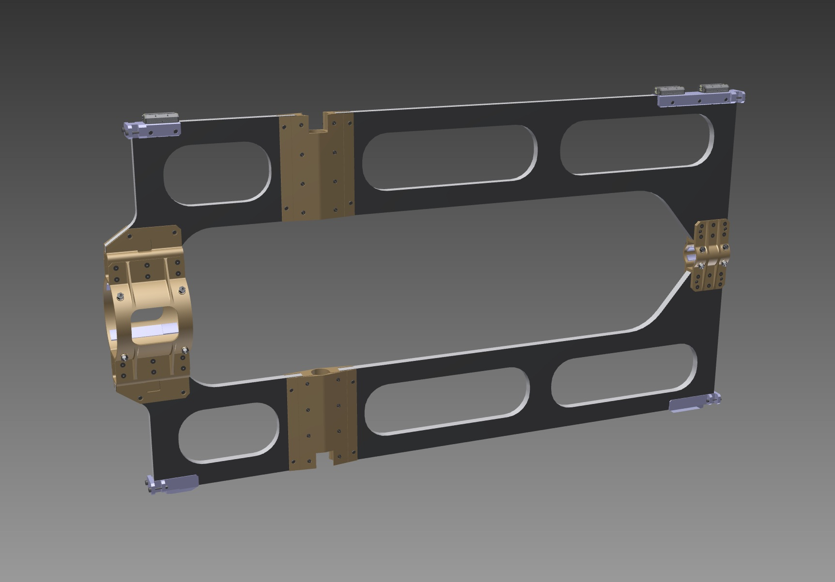
- CENTRAL SUPPORT FRAME STRUCTURAL ANALYSIS -
CENTRAL SUPPORT FRAME: Constraint conditions
CONSTRAINT CONDITIONS
TARGET : ACCEPTABLE MAX DISPLACEMENT: 0.05mm -
GSI-DECEMBER 2011: B. GIRAUDO / D. 0RECCHINI

Slide 10
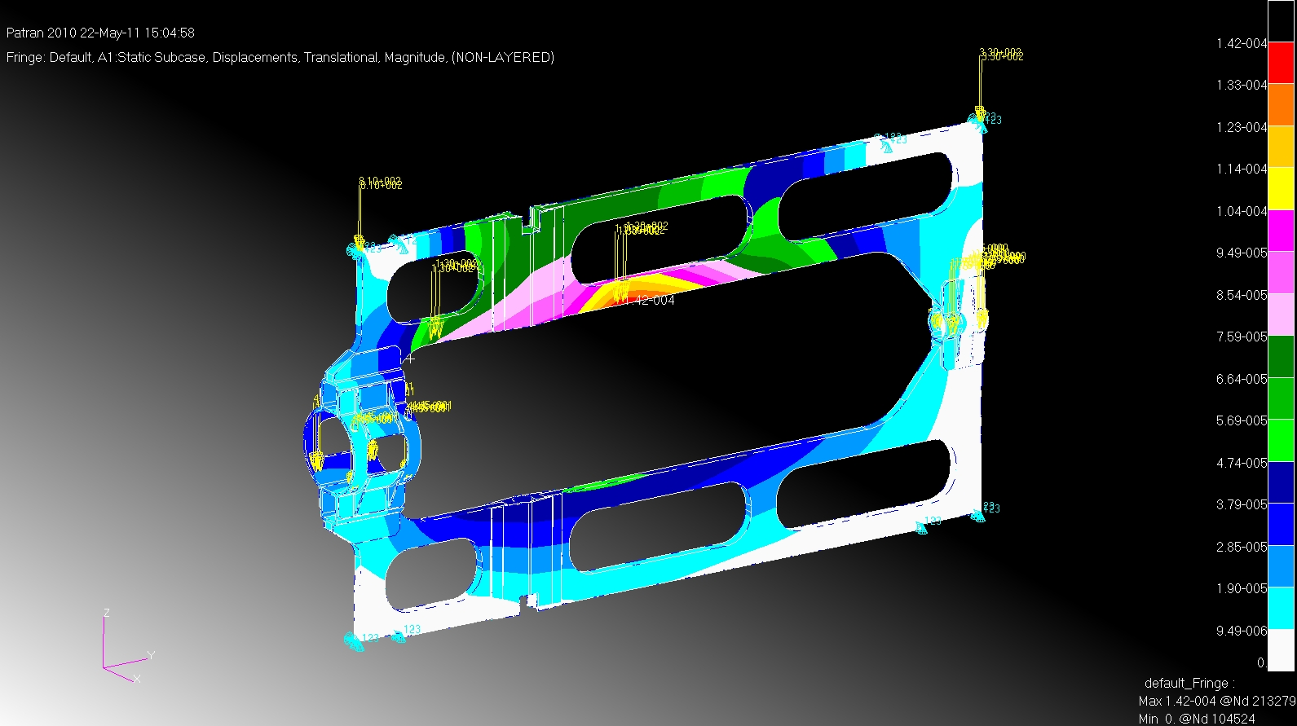
- CENTRAL SUPPORT FRAME STRUCTURAL ANALYSIS -
1° FEM STEP: Geometry as the prototype
TARGET : ACCEPTABLE MAX DISPLACEMENT: 0.05mm -
4xM55J + Rohacell + 4xM55J
The Cross-pipe has been considered as load.
Translational values – Magnitude: Max 0.14mm
GSI-DECEMBER 2011: B. GIRAUDO / D. 0RECCHINI

Slide 11
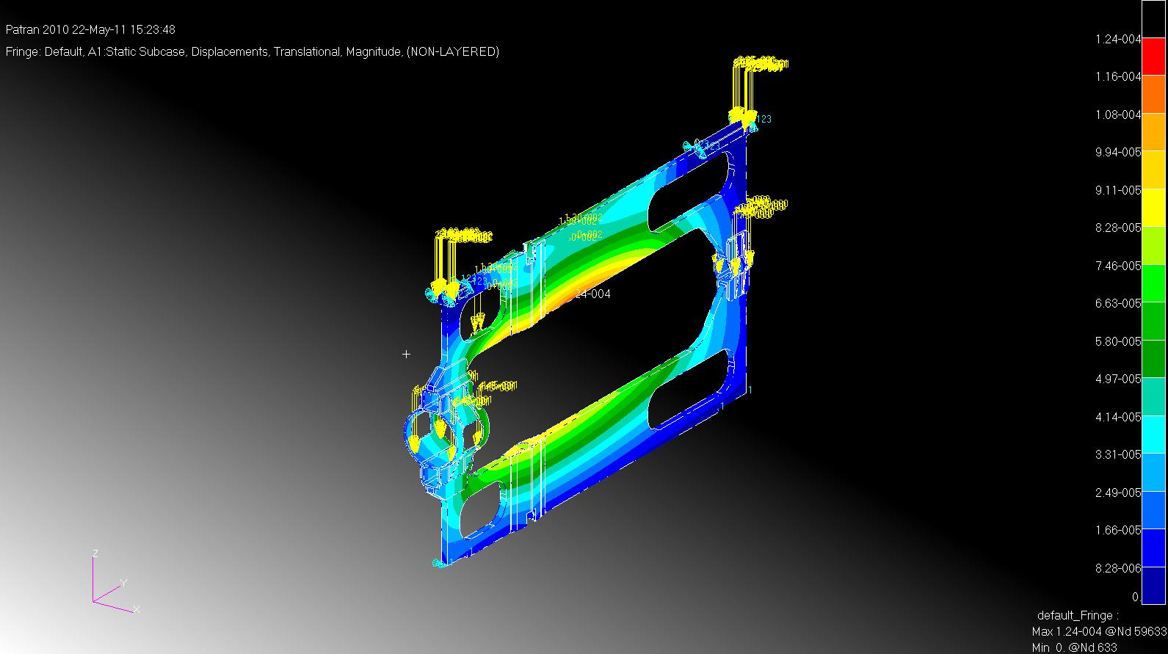
- CENTRAL SUPPORT FRAME STRUCTURAL ANALYSIS -
2° FEM STEP: The central window has been closed
- TARGET : ACCEPTABLE MAX DISPLACEMENT: 0.05mm -
4xM55J + Rohacell + 4xM55J
The Cross-pipe has been considered as load.
Translational values – Magnitude: Max 0.12mm
GSI-DECEMBER 2011: B. GIRAUDO / D. 0RECCHINI

Slide 12
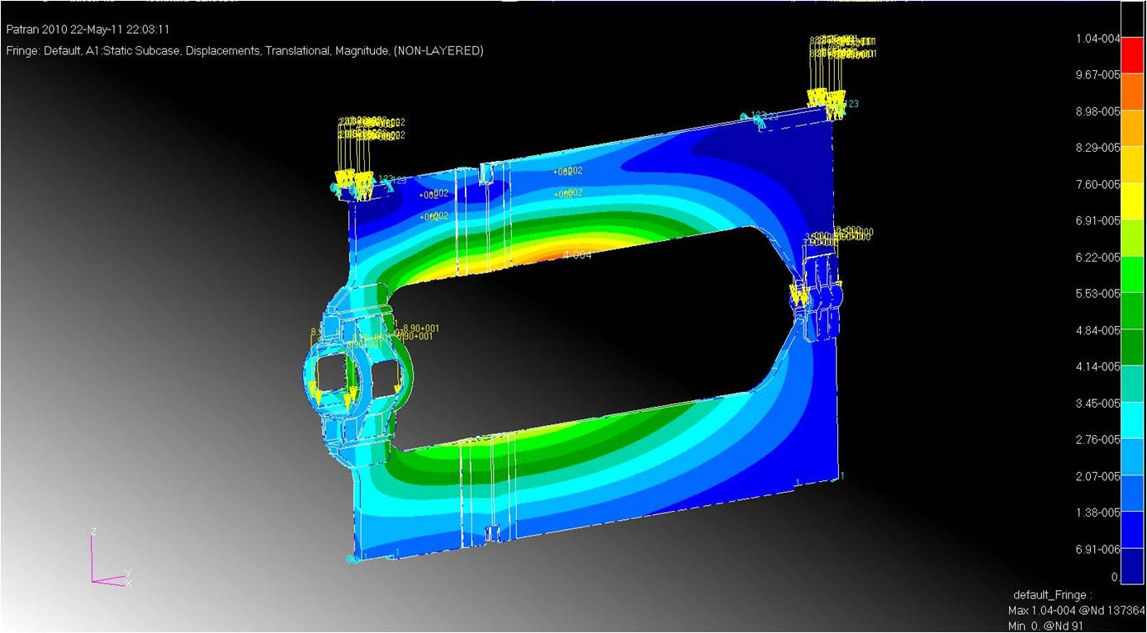
- CENTRAL SUPPORT FRAME STRUCTURAL ANALYSIS -
3° STEP: All the windows has been closed
TARGET : ACCEPTABLE MAX DISPLACEMENT: 0.05mm -
4xM55J + Rohacell + 4xM55J
The Cross-pipe has been considered as load.
Translational values – Magnitude: Max 0.1mm
GSI-DECEMBER 2011: B. GIRAUDO / D. 0RECCHINI

Slide 13
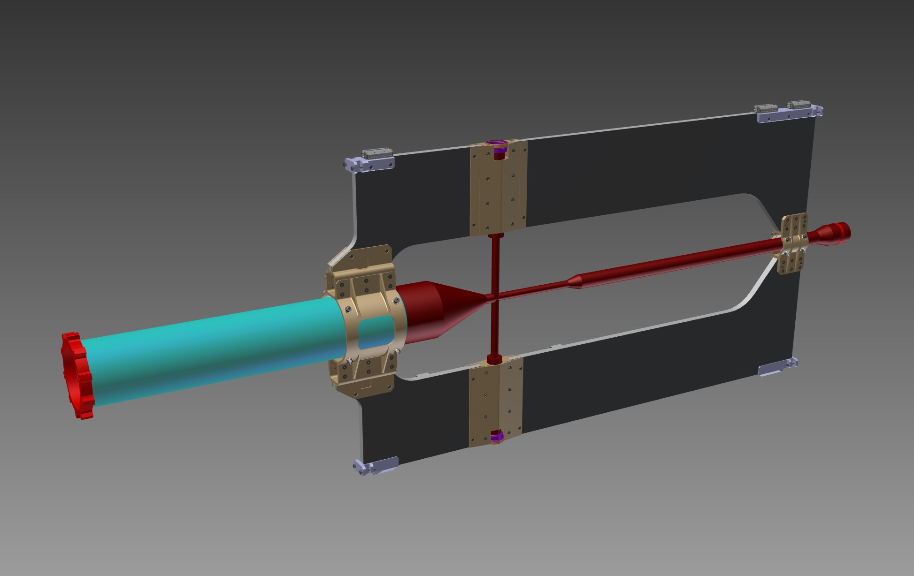
- CENTRAL SUPPORT FRAME STRUCTURAL ANALYSIS -
4° FEM STEP:
- A)- All the windows has been closed.
- B)- Frame skins has been changed: plies added.
- C)- The Cross-pipe has been integrated as part of the FEM model
trying to evaluate its behaviour under strains.
GSI-DECEMBER 2011: B. GIRAUDO / D. 0RECCHINI

Slide 14
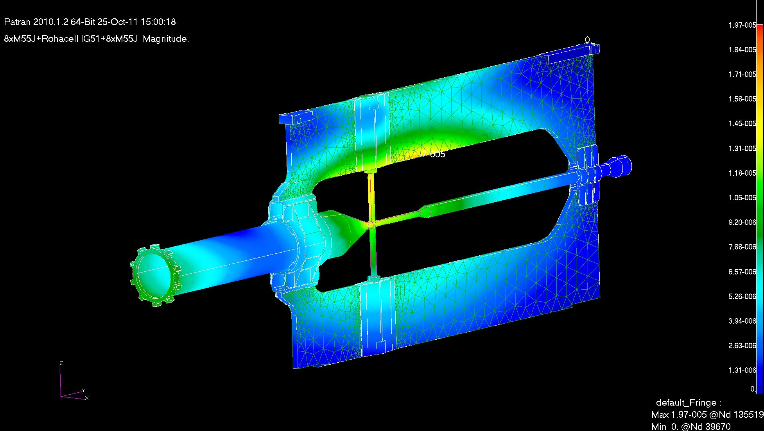
- CENTRAL SUPPORT FRAME STRUCTURAL ANALYSIS -
4° FEM STEP: Results
TARGET : ACCEPTABLE MAX DISPLACEMENT: 0.05mm -
8xM55J + Rohacell + 8xM55J
The Cross-pipe has been considered as part of the FEM model.
Translational values – Magnitude:
Max 0.0197mm
GSI-DECEMBER 2011: B. GIRAUDO / D. 0RECCHINI

Slide 15
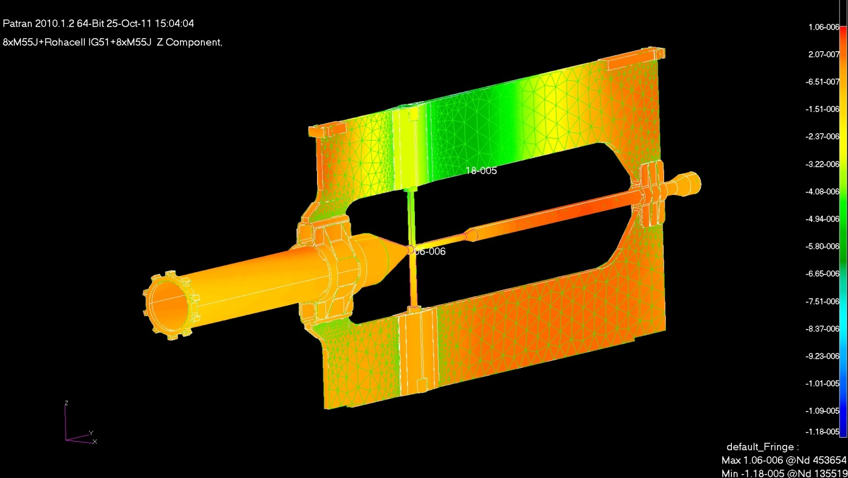
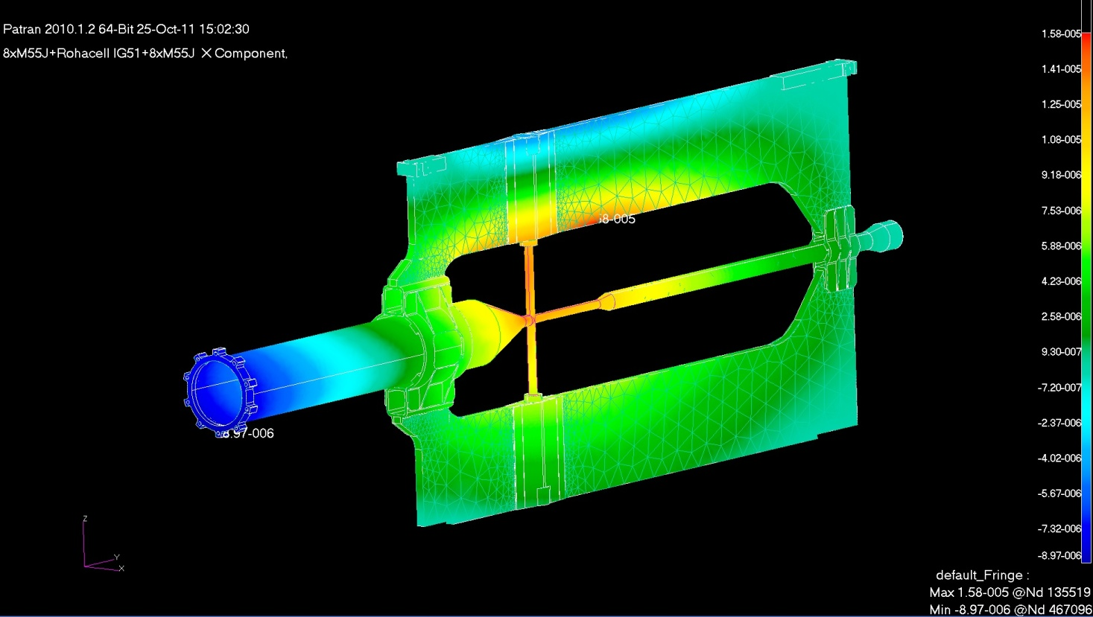
4° FEM STEP: Results
- CENTRAL SUPPORT FRAME STRUCTURAL ANALYSIS -
Translational values
Z component:
Max 0.018mm
Translational values
X component:
Max 0.0158mm
GSI-DECEMBER 2011: B. GIRAUDO / D. 0RECCHINI

Slide 16
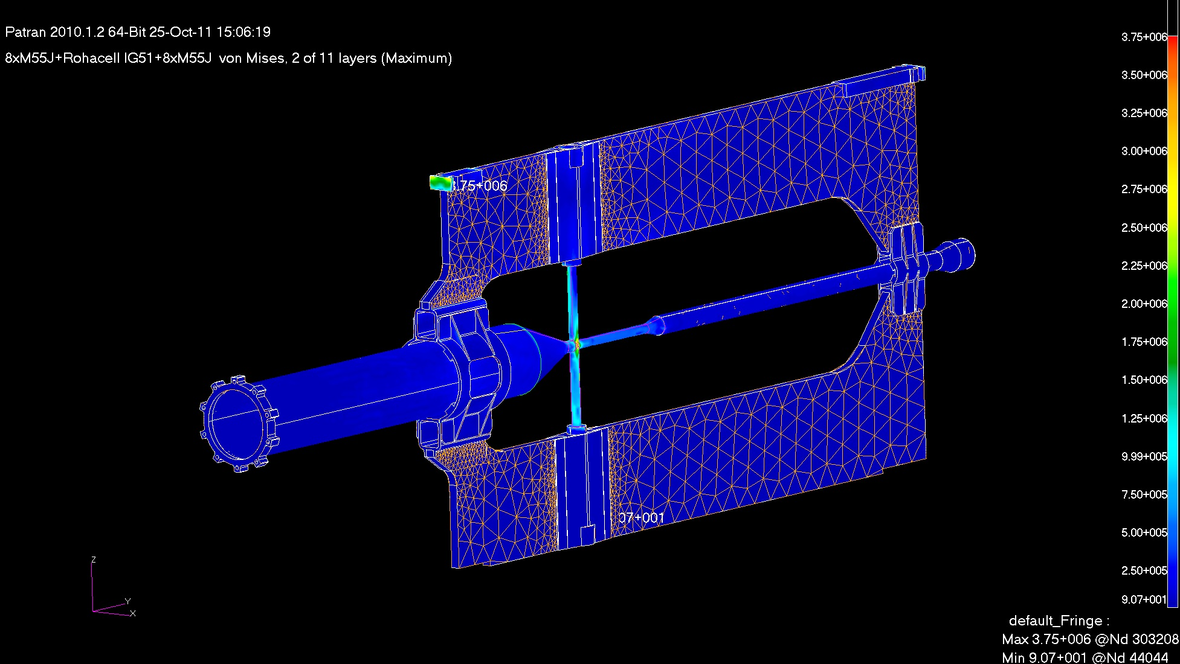
- CENTRAL SUPPORT FRAME STRUCTURAL ANALYSIS -
4° FEM STEP: Results
Von Mises: Max 3.75MPa
GSI-DECEMBER 2011: B. GIRAUDO / D. 0RECCHINI

Slide 17
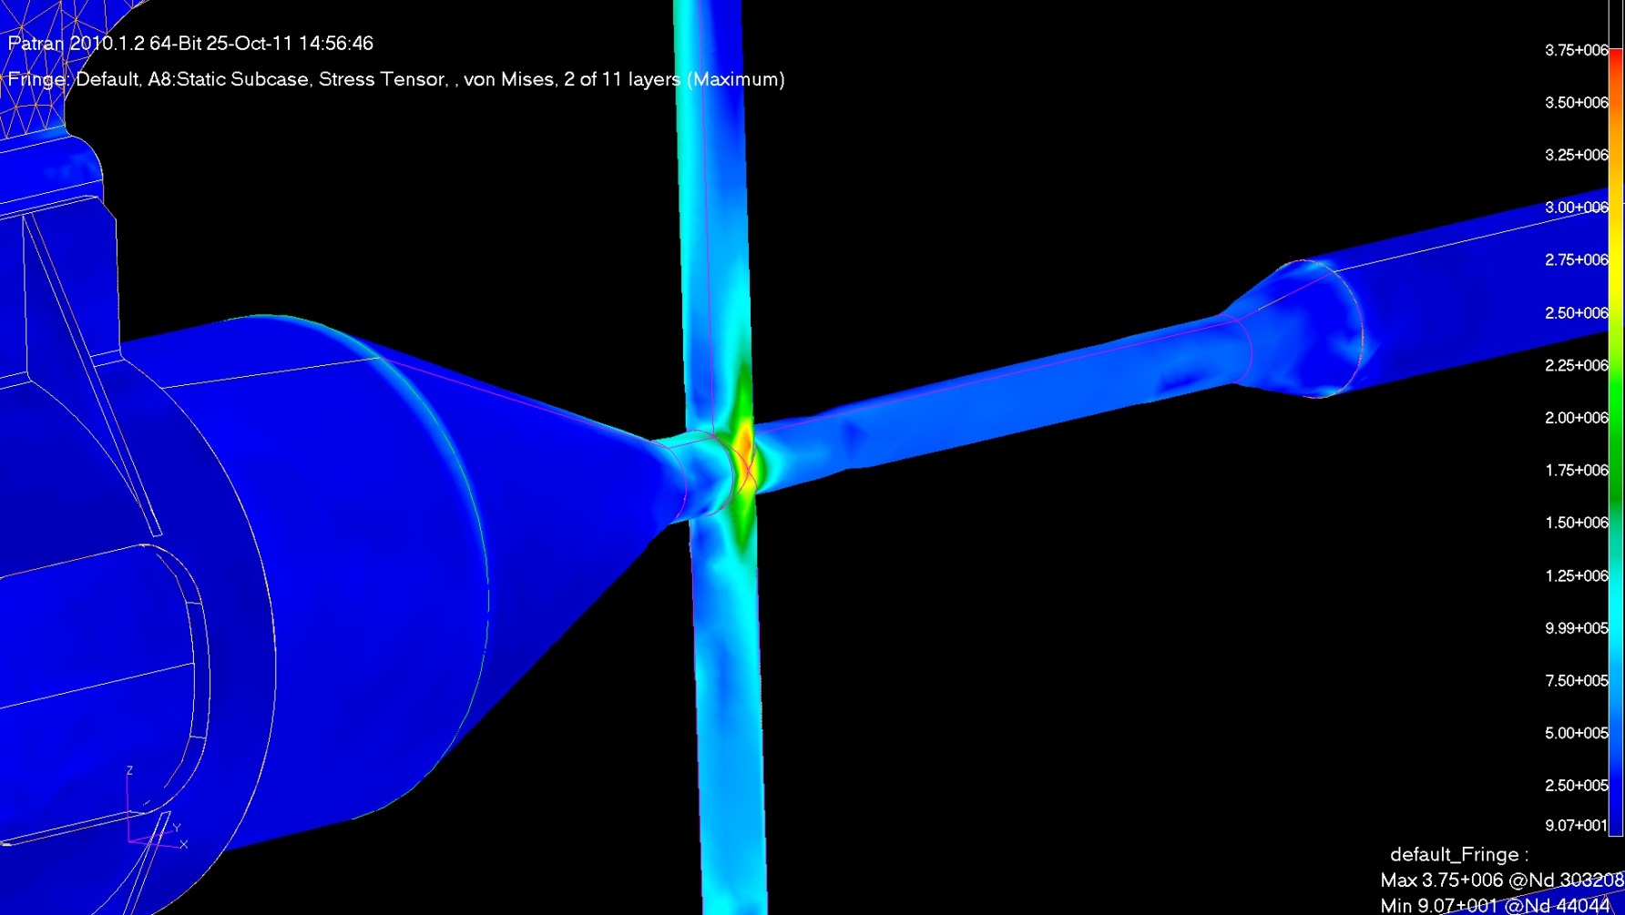
- CENTRAL SUPPORT FRAME STRUCTURAL ANALYSIS -
4° FEM STEP: Results
TITANIUM (Grade 5) MECHANICAL PROPERTIES:
- Density: 4400 Kg/m³
- Tensile Strength - Yield: 828 MPa
- Tensile Strength – Ultimate: 895 MPa
- Young Modulus: 106 GPa
Von Mises: Max 3.75MPa
GSI-DECEMBER 2011: B. GIRAUDO / D. 0RECCHINI

Slide 18
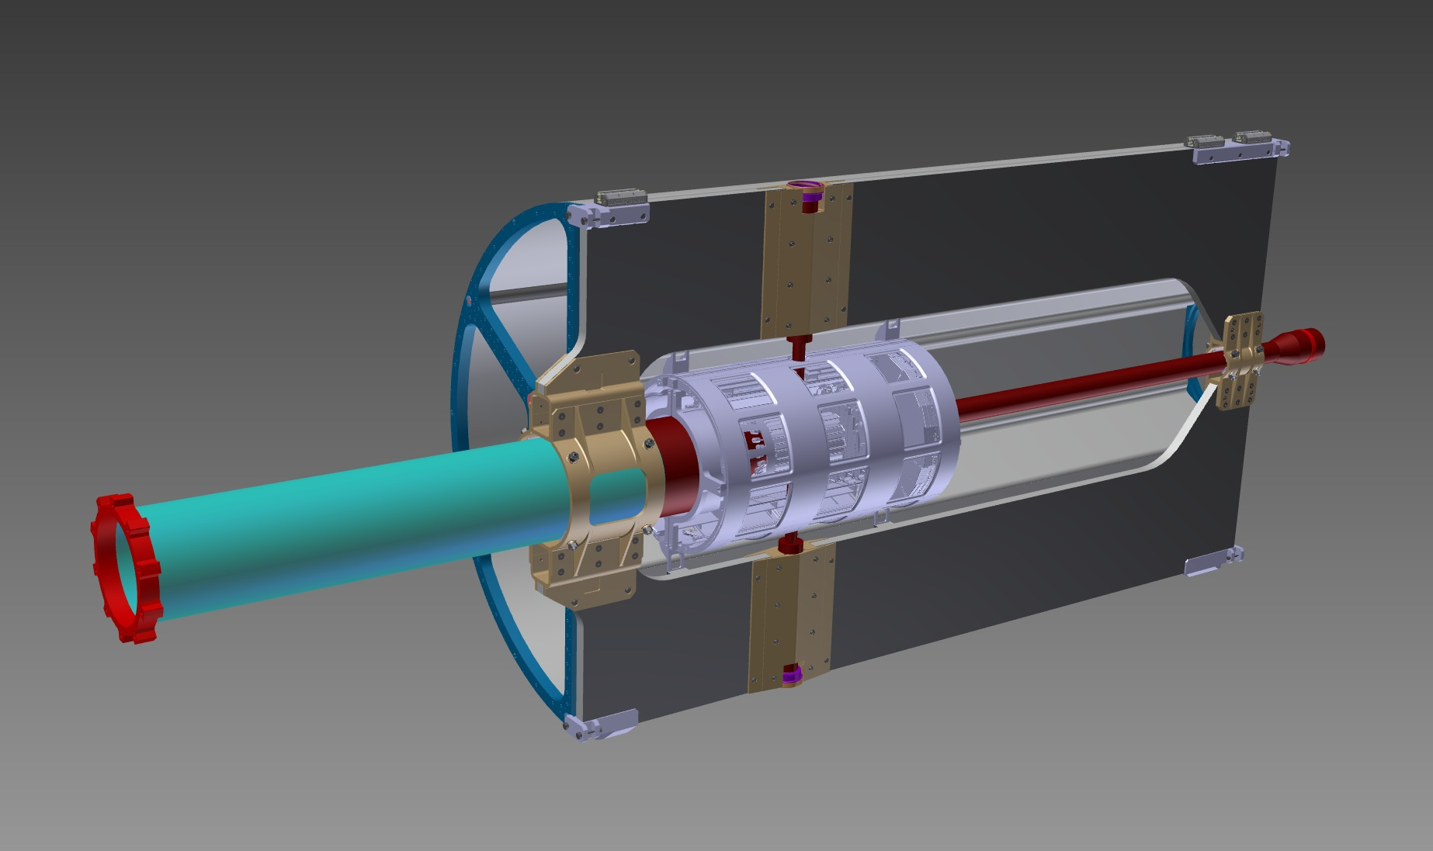
- CENTRAL SUPPORT FRAME STRUCTURAL ANALYSIS -
5° FEM STEP:
The torque due the insertion of the “Pellets pipes” has been considered in the FEM model.
CENTRAL SUPPORT FRAME: Loads conditions.
1Nm
INSERTION TORQUE
1Nm
GSI-DECEMBER 2011: B. GIRAUDO / D. 0RECCHINI

Slide 19
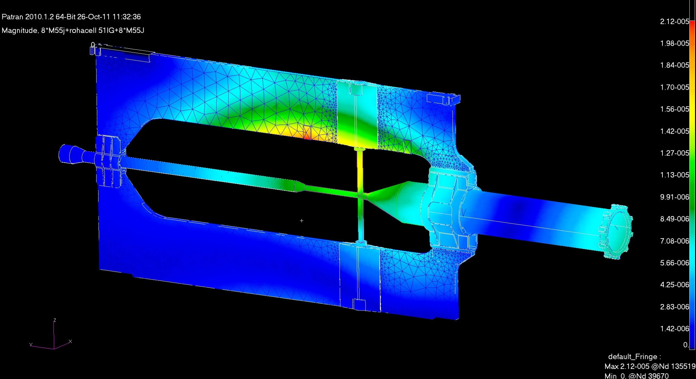
- CENTRAL SUPPORT FRAME STRUCTURAL ANALYSIS -
- 5° FEM STEP: Results (Gravity loads + torque)
TARGET : ACCEPTABLE MAX DISPLACEMENT: 0.05mm -
8xM55J + Rohacell + 8xM55J
The Cross-pipe has been considered as part of the FEM model.
Translational values – Magnitude:
Max 0.0212mm
GSI-DECEMBER 2011: B. GIRAUDO / D. 0RECCHINI

Slide 20
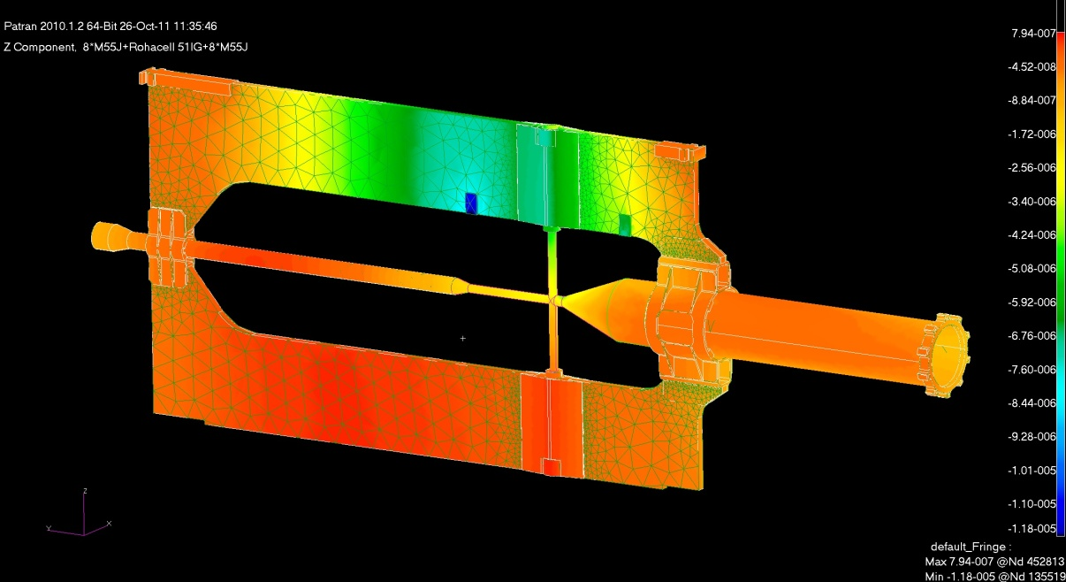
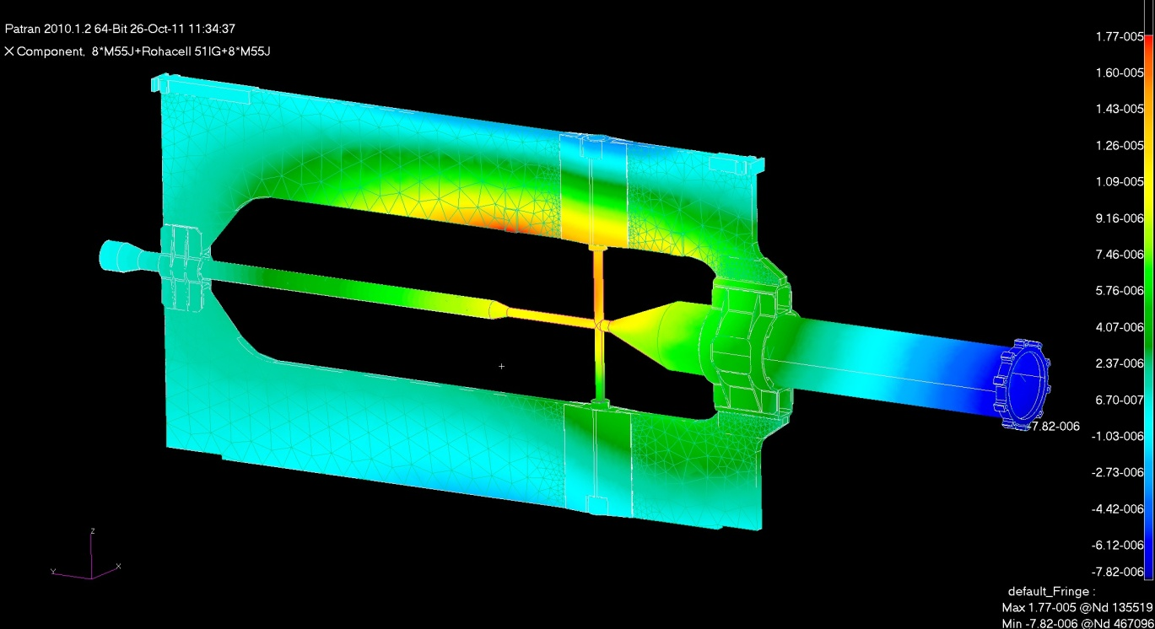
- CENTRAL SUPPORT FRAME STRUCTURAL ANALYSIS -
- 5° FEM STEP: Results (Gravity loads + torque)
Translational values – Z component:
Max 0.00794mm
Translational values – X component:
Max 0.0177mm
GSI-DECEMBER 2011: B. GIRAUDO / D. 0RECCHINI

Slide 21
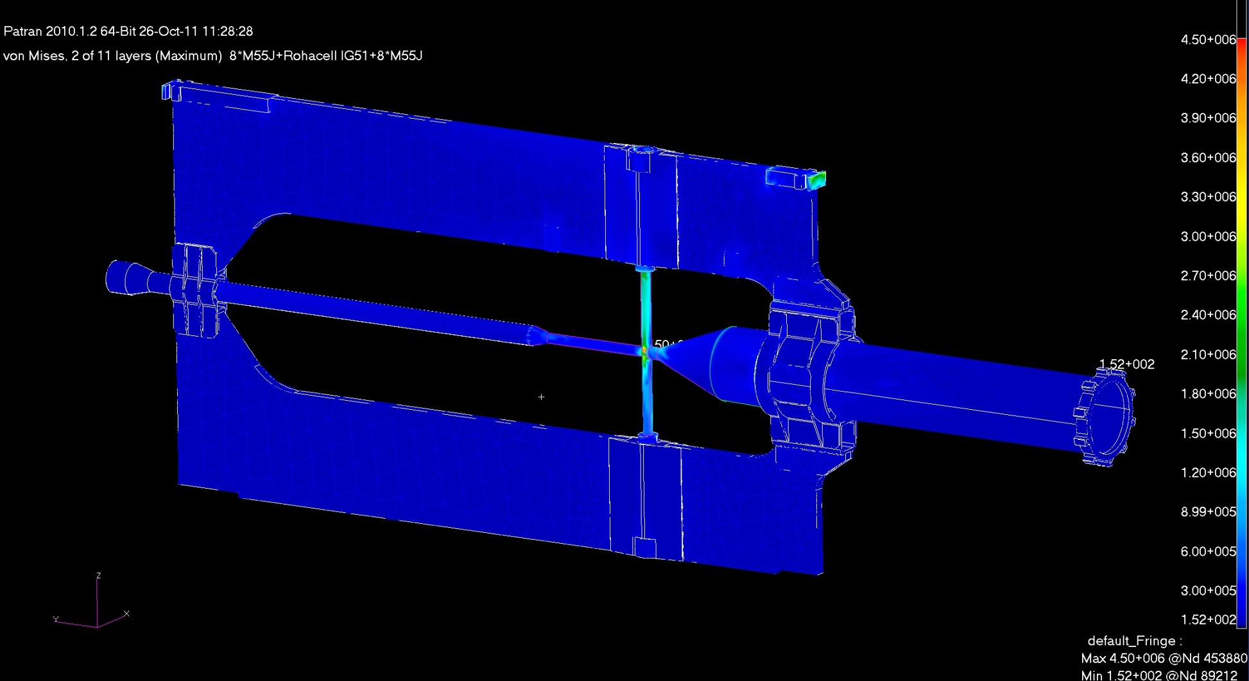
- CENTRAL SUPPORT FRAME STRUCTURAL ANALYSIS -
- 5° FEM STEP: Results (Gravity loads + torque)
Von Mises: Max 4.50MPa
GSI-DECEMBER 2011: B. GIRAUDO / D. 0RECCHINI

Slide 22
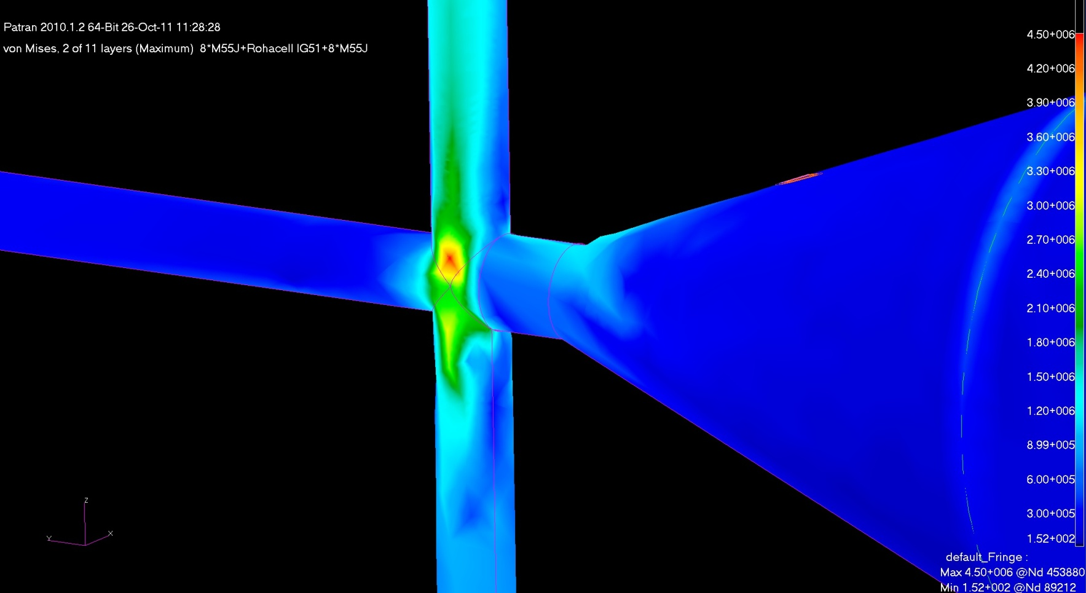
- CENTRAL SUPPORT FRAME STRUCTURAL ANALYSIS -
- 5° FEM STEP: Results (Gravity loads + torque)
TITANIUM (Grade 5) MECHANICAL PROPERTIES:
- Density: 4400 Kg/m³
- Tensile Strength - Yield: 828 MPa
- Tensile Strength – Ultimate: 895 MPa
- Young Modulus: 106 GPa
Von Mises, without torque: Max 3.75MPa
Von Mises, with torque: Max 4.50MPa
GSI-DECEMBER 2011: B. GIRAUDO / D. 0RECCHINI

Slide 23
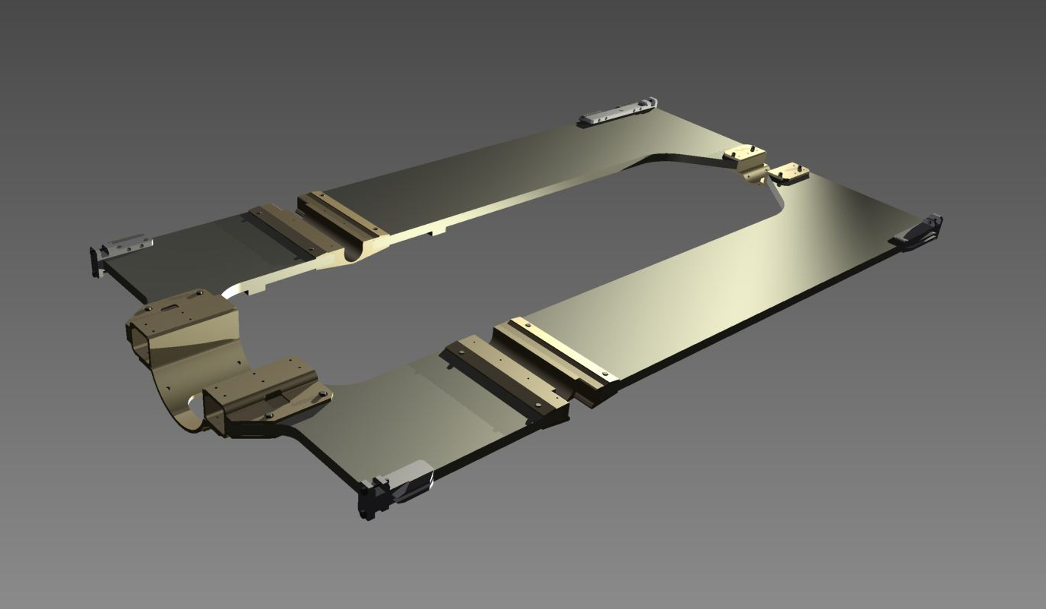
- CENTRAL SUPPORT FRAME STRUCTURAL ANALYSIS -
6° FEM STEP:
“CSF” POSSIBLE PROBLEMS DURING HANDLING.
CENTRAL SUPPORT FRAME OPENED SCENARIOS: Constraint conditions.
“CSF” GRAVITY LOAD
GSI-DECEMBER 2011: B. GIRAUDO / D. 0RECCHINI

Slide 24
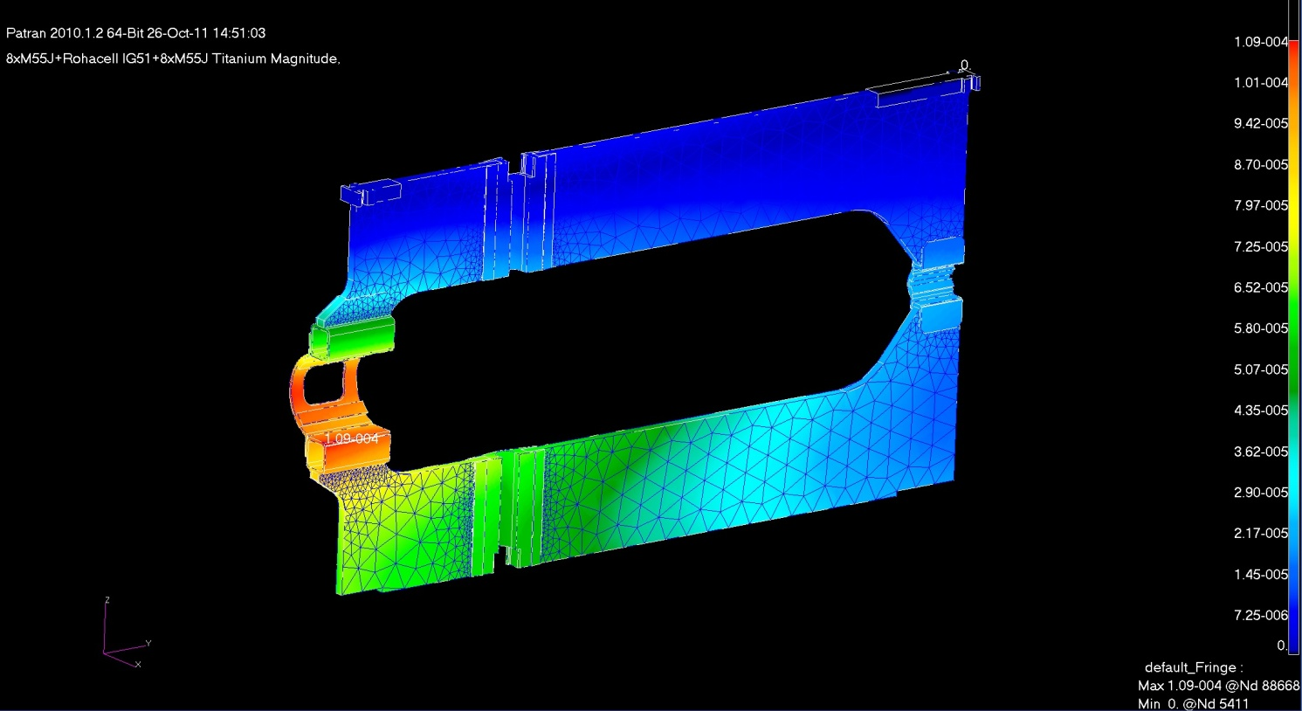
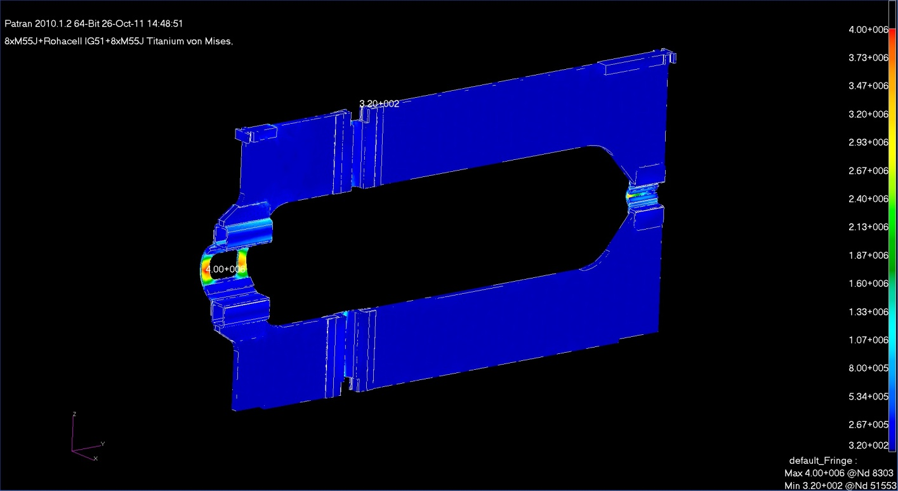
- CENTRAL SUPPORT FRAME STRUCTURAL ANALYSIS -
6° FEM STEP: Results (Handling)
8xM55J + Rohacell + 8xM55J
Translational values – Magnitude:
Max 0,109mm
Von Mises: Max 4.00MPa
GSI-DECEMBER 2011: B. GIRAUDO / D. 0RECCHINI

Slide 25
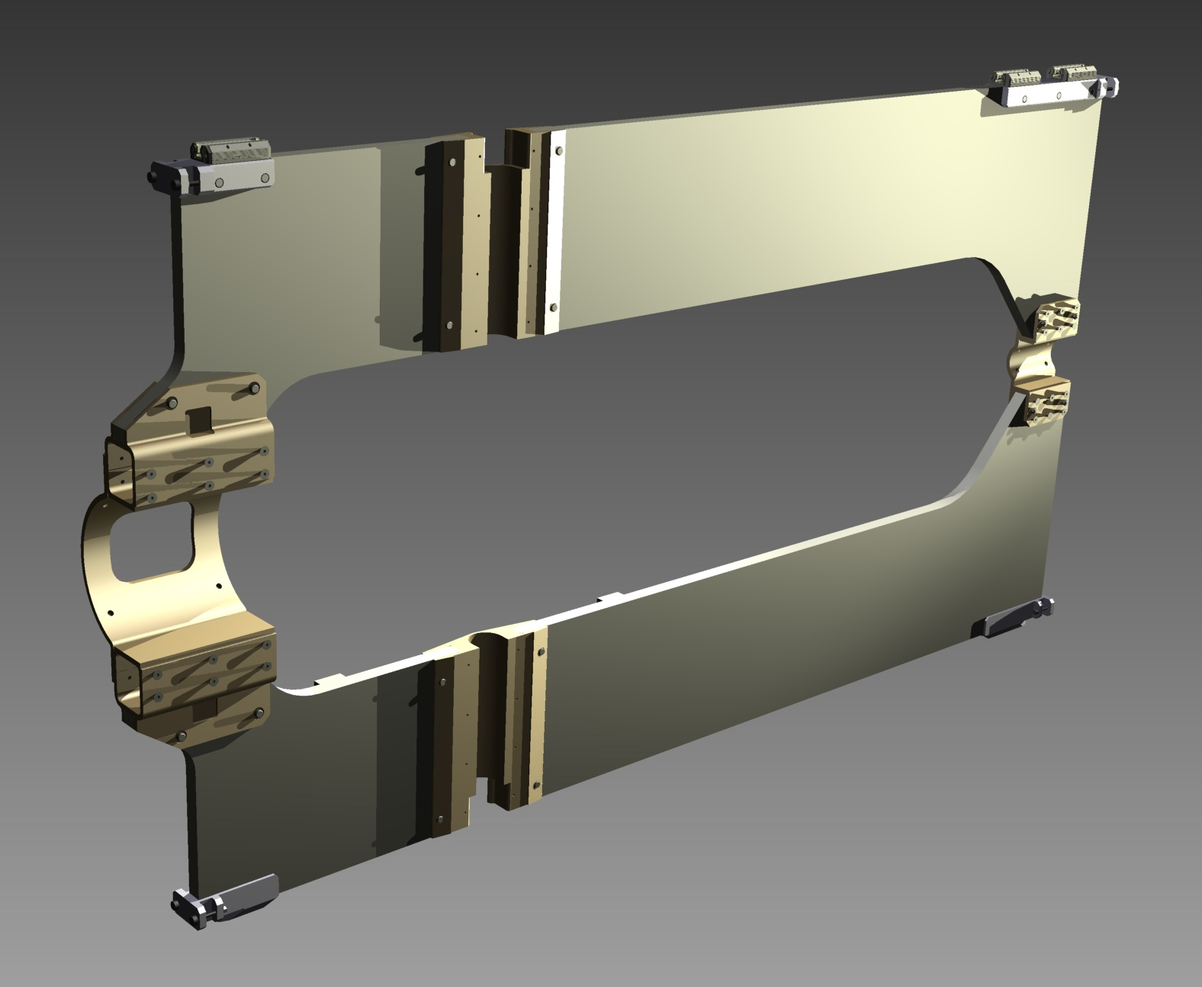
- CENTRAL SUPPORT FRAME STRUCTURAL ANALYSIS -
7° FEM STEP:
“CSF” POSSIBLE PROBLEMS DURING HANDLING.
CENTRAL SUPPORT FRAME OPENED SCENARIOS: Constraint conditions.
“CSF” GRAVITY LOAD
GSI-DECEMBER 2011: B. GIRAUDO / D. 0RECCHINI

Slide 26
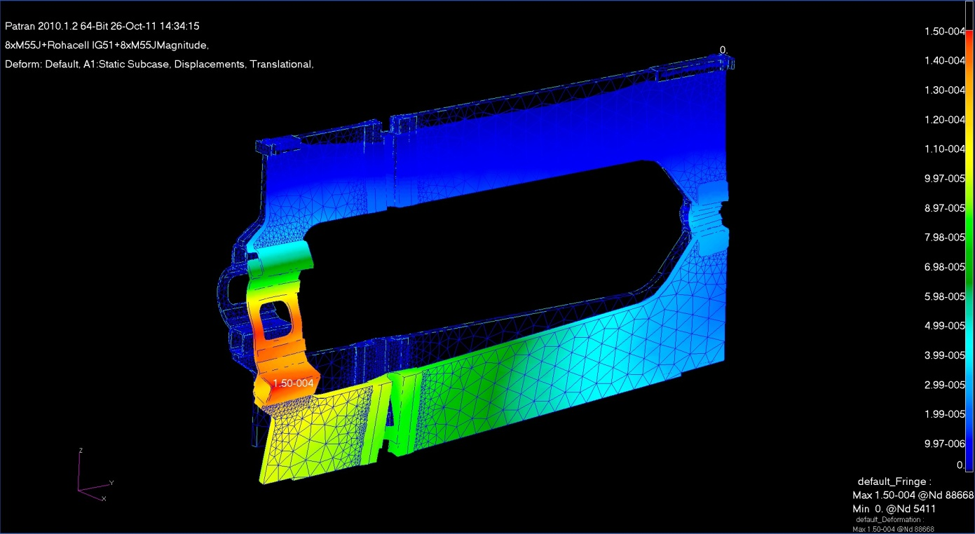
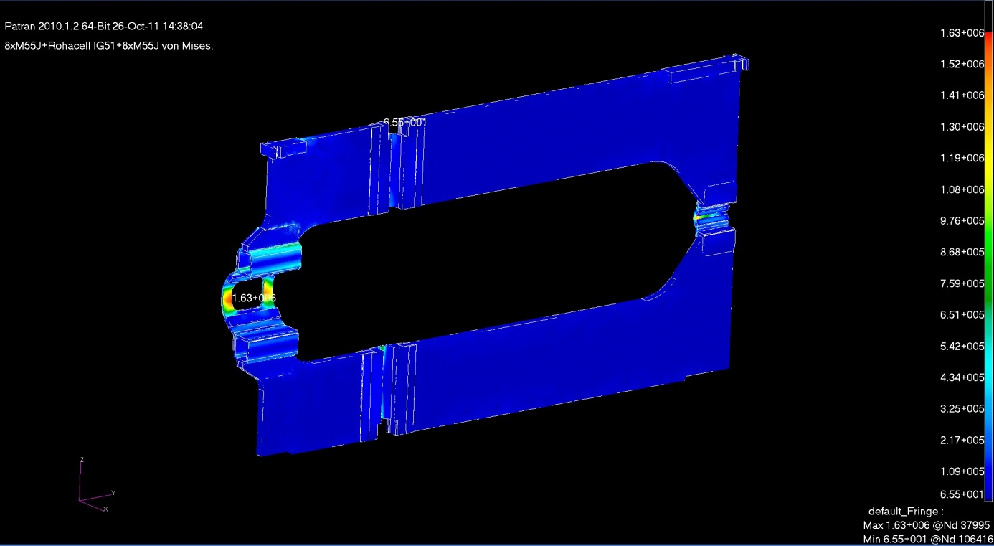
- 7° FEM ATTEMPT: Results
- CENTRAL SUPPORT FRAME STRUCTURAL ANALYSIS -
8xM55J + Rohacell + 8xM55J
Translational values – Magnitude:
Max 0,150mm
Von Mises: Max 1.63MPa
GSI-DECEMBER 2011: B. GIRAUDO / D. 0RECCHINI

Slide 27
- CENTRAL SUPPORT FRAME STRUCTURAL ANALYSIS -
CENTRAL SUPPORT FRAME AFTER FEM ANALYSIS
The external geometry has not changed.
All the “windows of lightening” has been closed.
The connection area for the “MVD” and the “STT” are defined.
The “Cross-Pipe” connections must be defined and fixed.
GSI-DECEMBER 2011: B. GIRAUDO / D. 0RECCHINI

Slide 28
- CENTRAL SUPPORT FRAME STRUCTURAL ANALYSIS -
CONCLUSIONS
-THE DESIGN REACHES THE GIVEN TARGETS. (FEM analysis)
THE DEVELOPMENT OF THE “CROSS-PIPE” IS A BASIC KEY FOR THE
FINAL DEFINITION OF THE INTERFACES BETWEEN THE CSF AND THE CROSS-PIPE.
SERVICES CONTRIBUTIONS NOT COMPLETELY DEFINED.
NEXT STEPS:
1) DEFINITION OF THE INTERFACE BETWEEN THE “CSF” AND THE CROSS-PIPE
2) CONTACTS WITH SPECIALIZED COMPANIES:
- definition of technological details.
- design optimization.
GSI-DECEMBER 2011: B. GIRAUDO / D. 0RECCHINI

