Slide 1
ClusterS @ H elmholtz I nstitut M ainz
Dalibor Djukanovic
Helmholtz-Institut Mainz
12.12.2011
PANDA Collaboration Meeting
GSI, Darmstadt

Slide 2
HIMster - Intro

Slide 3
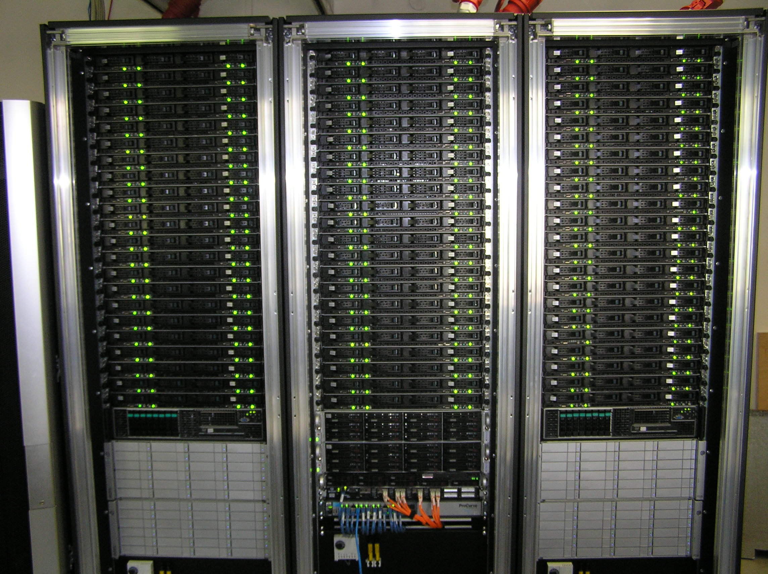
HIMster
Cluster for experiment simulation = HIMster (HIM Cluster)
Procurement started in late 2010
Installation early 2011 by Megware
Delivery and initial setup = 2 days
3 Water cooled Racks of Hardware

Slide 4
Hardware
134 Compute Nodes, each node:
2 AMD 6134 CPUs @ 2.3 GHz, 8 cores per CPU => 2144 cores
2 Gbyte RAM / core, 14 Nodes with 4 Gbyte / core => 4.7 Tbyte
Infiniband Host Channel Adapter QDR 40 Gbit/s
No HDD (Diskless Setup)
1 Frontend (1 Database) Server
Same CPUs
4 Gbyte Ram / core
Infiniband HCA, 10 Gbit-Nic
Redundant Power Supplies / Systemfans
Storage:
15 k RPM SAS Drives (Frontend only approx. 1 TByte):
/home – systemwide NFS-mounted, quota 10 Gbyte
/cluster – systemwide NFS-mounted software dir
Central Parallel File System
/data = 124 Tbyte disk space (7.2 k RPM)
Read/Write Performance 700 Mbyte/s (single client)
Read/Write Performance 1000 - 1500 Mbyte/s (aggregated multiclient)

Slide 5
HIMster Node
RAM
CPU
IB HCA
CPU
RAM
PSU

Slide 6
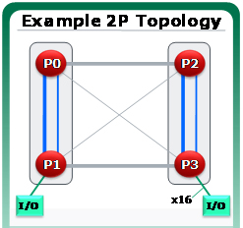
HIMster Node - CPU
1 CPU (Package) = 2 Dies ( „Magny Cours“ )
4 cores @ 2.3 GHz per Die
512 kb L2-cache, 5 MB shared L3-cache (per Die)
Magny Cours = 4 NUMA (Non uniform memory access) zones
„Scatter Jobs“ across Numa Nodes (avoid foreign memory)
=> Nodeallocation policy, Process Pinning
Mbyte/s | 0 | 1 | 2 | 3
0 | 12483 | 7312 | 6928 | 6590
1 | 7605 | 12267 | 6629 | 7043
2 | 7016 | 6620 | 12260 | 7322
3 | 6708 | 7047 | 7286 | 12312

Slide 7
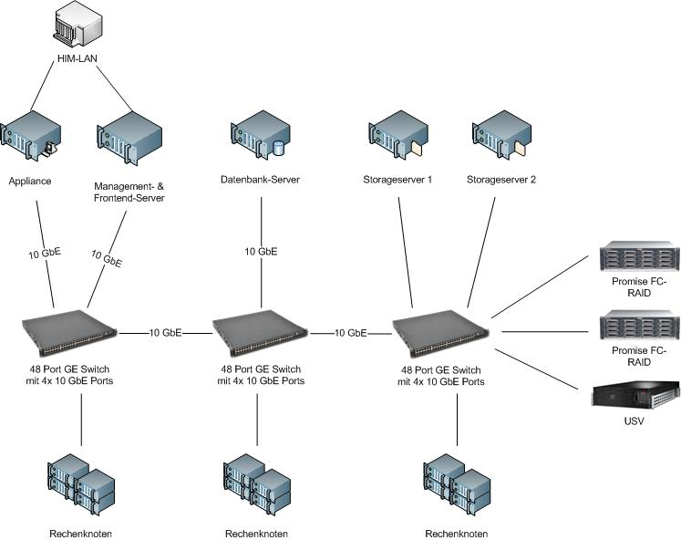
HIMster - Network
Infiniband Network:
Fat Tree
Blocking Factor 2:1
40 Gbit/s = 4 x QDR
36-port managed switches
(modular)
Gbit Network:
Administration
Interactive Usage
Switches 10 Gbit uplink

Slide 8
HIMster - Network
High Bandwidth - 2.9 Gbyte/s (unidirectional)
Low Latency - approx. 1.4 microseconds
[dalibor@frontend osu_benchmarks]$ mpirun -np 2 -hostfile ./hostfile ./osu_bw
# OSU MPI Bandwidth Test v3.1.2
# Size Bandwidth (MB/s)
1 2.20
2 4.39
4 8.92
8 17.81
16 34.97
32 65.83
64 127.64
128 246.90
256 469.72
512 787.50
1024 1309.41
2048 1875.94
4096 2365.92
8192 2578.63
16384 2417.19
32768 2644.08
65536 2767.79
131072 2833.08
262144 2866.21
524288 2883.92
1048576 2893.15
2097152 2905.48
4194304 2904.55
[dalibor@frontend osu_benchmarks]$ mpirun -np 2 -hostfile ./hosts ./osu_latency
# OSU MPI Latency Test v3.1.2
# Size Latency (us)
0 1.38
1 1.40
2 1.40
4 1.40
8 1.48
16 1.49
32 1.56
64 1.61
128 2.47
256 2.66
512 3.05
1024 3.75
2048 5.17
4096 6.43
8192 9.42
16384 13.17
32768 18.41
65536 29.76
131072 52.19
262144 97.74
524288 188.18
1048576 369.60
2097152 730.50
4194304 1463.14

Slide 9
Storage - Topology
What we wanted:
Roughly 1 Gbyte/sec throughput
Easy setup / maintenance
Stable System
FraunhoferFS / Vendor promised:
Throughput in excess of 1.5 Gbyte/s ✔
Easy RPM based Installation ✔
High Availability / High Redundancy ? / ✔
Benefits of a parallel FS, while
hiding comlpexity.

Slide 10
Storage - Basic Setup
2 Servers each running 1 instance of:
Object Storage Server (4 RAID6 sets, XFS)
Meta Data Server (RAID10, ext4)
Server:
Dual Socket Intel E5630 @ 2.53GHz (Quadcore)
12 Gbyte RAM (-> Upgrade to 24 Gbyte)
Intel SSD 40 GByte
Infiniband QDR (40 Gbit/s), Dual Port Fibre Channel (8 Gbit/s per port)
Clients connect via Kernel module (no costly context switches)
Native Infiniband Support (RDMA)

Slide 11
Storage - Performance (Single Client)
Single Client Write Performance
Single Client Read Performance
[dalibor@node130 ~]$ dd if=/dev/zero of=/data/work/kphth/dalibor/test.file bs=1M count=100000
100000+0 records in
100000+0 records out
104857600000 bytes (105 GB) copied, 153.017 s, 685 MB/s
[dalibor@node130 ~]$ dd if=/data/work/kphth/dalibor/test.file of=/dev/null bs=1M
100000+0 records in
100000+0 records out
104857600000 bytes (105 GB) copied, 98.823 s, 1.1 GB/s

Slide 12
Storage - Performance (Multi Client Write)
./IOR -a POSIX -b (100 GByte) / (# of nodes) -o /data/tests/testScaleing –i 3 -w -r –t 1m -d 10 -F

Slide 13
Storage - Performance (Multi Client Read)
./IOR -a POSIX -b (100 GByte) / (# of nodes) -o /data/tests/testScaleing –i 3 -w -r –t 1m -d 10 -F

Slide 14
I/O - Profile - Generic Benchmarks
Application I/O Profile:
Tracing I/O using Linux Standard
strace-tool (e.g. ioapps)
200 Events using Dmitry‘s Macro
Access on file quite irregular
Not easy to find „generic“
Benchmark
I/O Profiling done with:
http://code.google.com/p/ioapps/
https://twiki.cern.ch/twiki/bin/view/Main/CmsIOInstrumenting
strace -q -a1 -s0 -f -tttT -oOUT_FILE -e trace=file,desc,process,socket APPLICATION ARGUMENTS

Slide 15
I/O - Simple Scaling Estimate (Write)
Simple I/O run:
Prog writes 100 kbyte then sleeps for a second
Run multiple Threads

Slide 16
Meta Data
Distributed Meta Data helps
Sometimes we see problems with ROOT Macros?
./mdtest -n 10 -i 200 -u -t -d /data/work/kphth/dalibor/meta_test/
Process 16615 detached
% time seconds usecs/call calls errors syscall
------ ----------- ----------- --------- --------- ----------------
96.23 13.599951 42 325252 26396 stat
1.37 0.192971 192971 1 wait4
.
.
.
------ ----------- ----------- --------- --------- ----------------
100.00 14.133237 927007 27782 total
FhGFS update promises to improve stat performance ... Lets see.

Slide 17
Policies / Environment
User Management (separate clusterwide NIS)
Default Resources:
10 Gbyte quota on /home
1 Tbyte scratch on /data (FhGFS)
Faishare 20 percent (+ Queue based restrictions)
So far account with the Inst. f. Kernphysik mandatory
Compute nodes may only be used via batch system
No access from outside (yet)
PANDAGrid Access (work in progress)
Approx. 1000 cores with adjusted priority
5 Tbyte scratch

Slide 18
Batch System
Combination of Torque/Maui
Queue assignment depends on walltime of job (routing queues)
Queue limits depend on max walltime
Rules revisited regularly to match Cluster usage pattern
Route
Default Queue
Long
Walltime: 24 hours
Max/User: 1700 Jobs
Big
Walltime: 2 hours
Max/User: 1000 Jobs
Medium
Walltime: 12 hours
Max/User: 250 Jobs
Midrange
Walltime: 4 hours
Max/User: 500 Jobs
Express
Debug Queue
Max: 16 Cores
Mon-Fri: 08:00 – 22:00

Slide 19
Summary - Outlook
Cluster is in stable production state ☺
Users seem to be happy so far ☺
No (too) big issues left ☺
Database server max out @ 20.000 queries / sec ☹
Metadata might be bottleneck under heavy load? ☹
Job output to stdout quite large (several Mbyte / job => several Gbytes)
Integrate Cluster with Grid (on the way)
Questions?

