Slide 1
MAPS

Slide 2
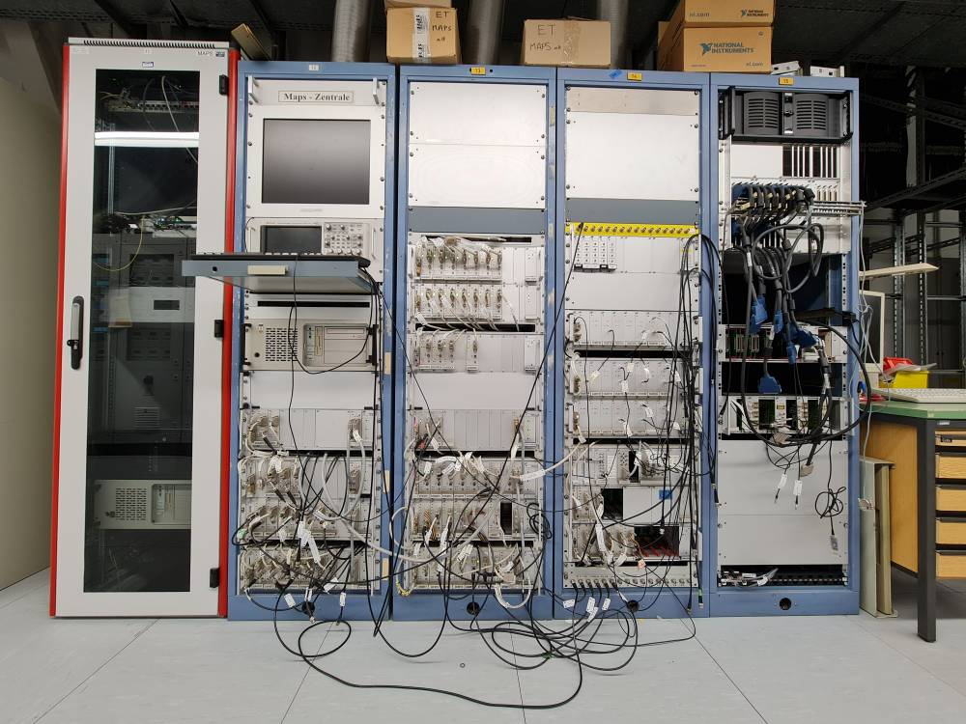
MAPS - The Macro Pulse Selector @ UNILAC 2022
What is MAPS:
Data Acquisition and display of UNILAC transformer data including gate pulses.
Provides separate signals for SVÜ
Part of the BTM system

Slide 3
MAPS - The Macro Pulse Selector @ UNILAC 2022
Project idea:
Total renovation of the aged MAPS system, independed of FCC
Replacement of all old DAQ hard- and software (x86 CPU on MS-DOS, Borland C)
All signals will be digitized in parallel
For commissioning: system signals will be splitted for parallel usage of old and new MAPS (only signals, not pre-amp power and I/O settings)
The SVÜ will not be touched. We need to make sure, that the pre-amp is always powered. SVÜ signals will be converted into TTL pulses and offered to ACO.
A first prototype with readout of a few UNILAC transformers will be presented in the next beam time January 2022 -> NOT POSSIBLE
Project objective at risk:
Complex adaptor box not ready(e.g. missing components, order stop, delivery time)
Lack of man power (parallel workload for beam operation and Hitrap, retirement)
LSA not yet ready at UNILAC

Slide 4
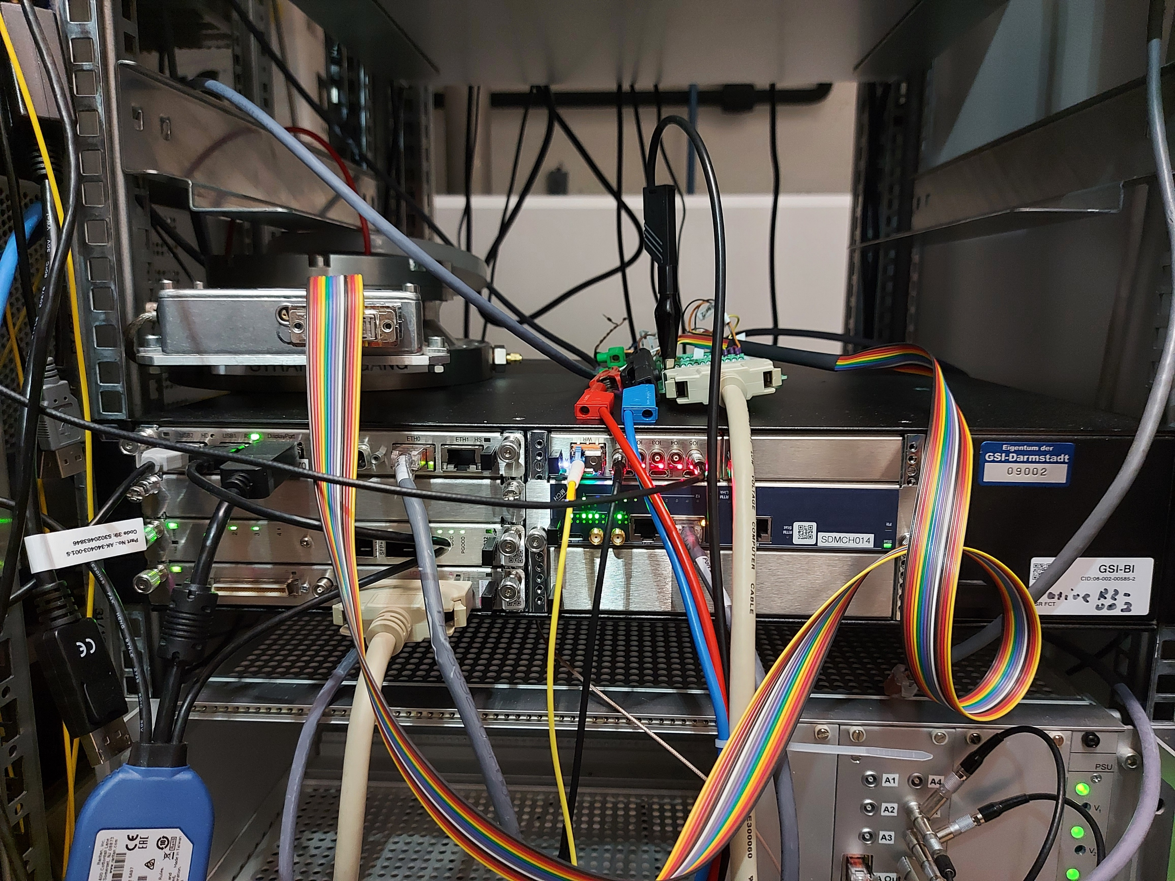
MAPS - The Macro Pulse Selector @ UNILAC 2022
Software Status:
DAQ chain from transformer/pre-amp in lab via driver up to GUI as draft expert version tested and functional
Optimization of performance -> fulfills given requirements (10MHz, 5,5ms)
Triggered readout ( tested with simulated WR timing)
User interface requirements from operation received
Hardware Status:
MAPS hardware at LSB 4 ( X 5):
2U MTCA system with AM G64 CPU
TAMC532 32 Channel ADC with RTM
2 x SIS8864 I/O Modules
Fair Timing Receiver Node (FTRN)

Slide 5
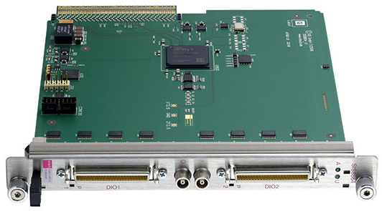
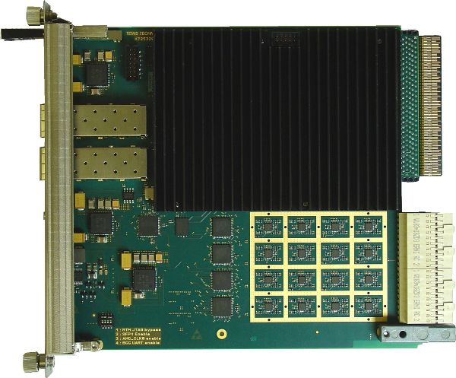
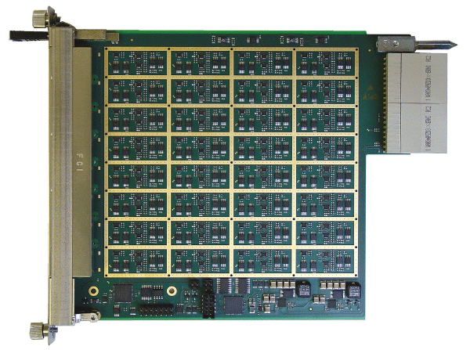
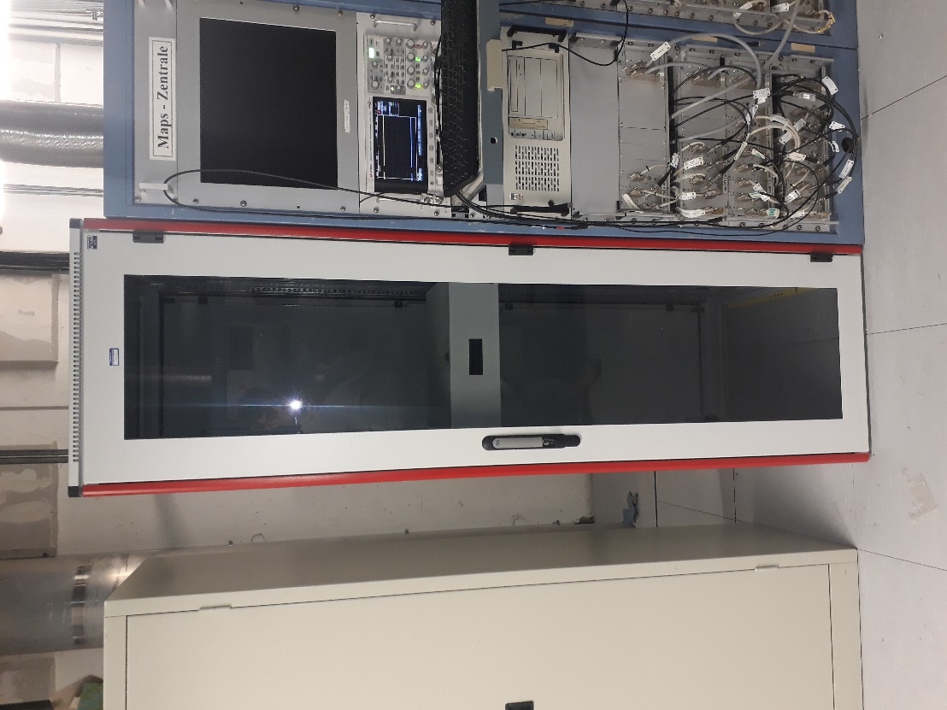
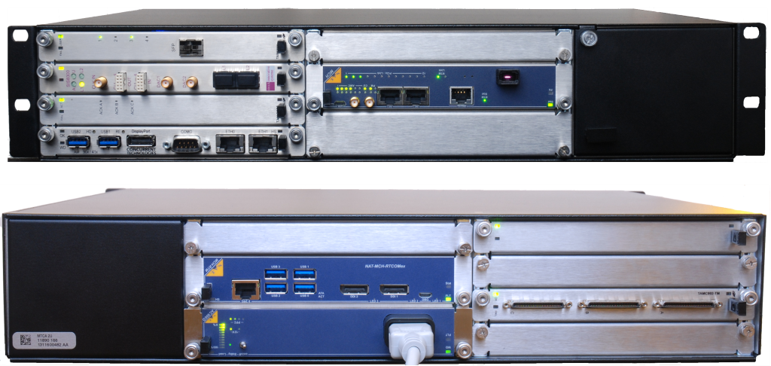
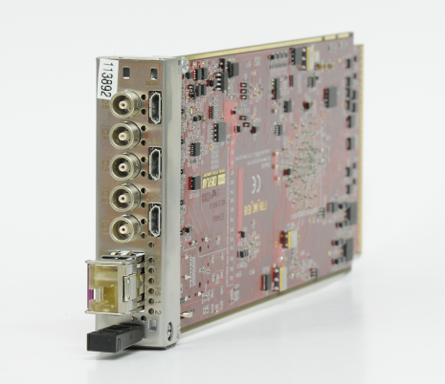
MAPS - The Macro Pulse Selector @ UNILAC 2022
LSB4
5 x TAMC-532 32 Channel ADC with input RTM
10 x SIS8864 MTCA 64 Channel I/O Register
FAIR Timing Receiver Node (AMC)
5 x MTCA.4 6-slot systems incl. CPU (Xeon), MCH und PS
LAN and WR installed

Slide 6
MAPS - The Macro Pulse Selector @ UNILAC 2022
Next steps:
Preparation of adaptor box
First tests with beam (e.g. automatic range setting)
Integration of LSA (e.g. charge state) and BTM system
White Rabbit timing tests
Realisation step-by-step, very many aspects and dependencies to old CS
Set-up of U/f converter for SVÜ
Open issues:
No solution for MAPS Oscilloscope yet, if 1GHz sampling is required
Plan A (easy): limited to 4 fixed signals, no switching and remote control of oscilloscope (LSB)
Plan B (expensive): switch matrix 64/4 to 1GHz DAQ or oscilloscope
Status now: 10MHz is sufficient, higher resolution signals can be observed with phase probes and ion source oscilloscopes

Slide 7
MAPS - The Macro Pulse Selector @ UNILAC 2022
Efforts (estimated):
Task Duration Man power Costs
Preparation of adaptor box: 3 - 6 months 0.25 FTE 10k€
Installation (step-by-step): 4 weeks 0.1 FTE 1k€ (cables, adaptors etc)
Programming basic FESA and GUI: 3 months 0.25 FTE
Implementation additional features: 6 months 0.25 FTE
SVÜ (preparation U/f converter boxes): 6 months 0.1 FTE unclear
With adaptor box it is quite realistic to have MAPS 2022 operational in late 2022 early 2023.

Slide 8
UNIMON

Slide 9
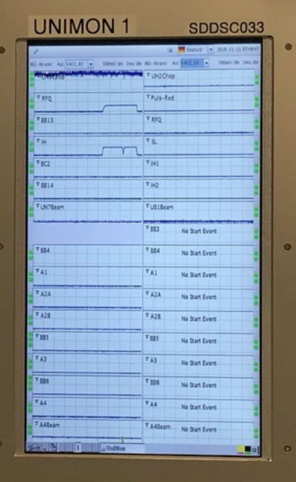
UNIMON – UNILAC rf-Signal Monitor @ UNILAC 2022
What is UNIMON:
Live display of UNILAC rf signals:
Chopper
Buncher
RFQ, IH, Alv and ER a.o.
Provides fast view on active and inactive rf signals
Presentation on fixed displays

Slide 10
UNIMON – UNILAC rf-Signal Monitor @ UNILAC 2022
Upgrade plan:
Replacement of old DAQ ADC hardware (FEBEX from EE) with microTCA system
Upgrade to latest FESA release
Change of orientation of displays
Switch to White Rabbit timing
Keep old system until new one is ready
Parallel task:
Move of complete system from main control room console to LSB after next beam time
Requires:
main responsible organiser (Linac RF or BEA?)
determination of a new rack location
complete careful move of cables
organizing of rack space, LAN and WR timing

Slide 11
UNIMON – UNILAC rf-Signal Monitor @ UNILAC 2022
Software Status:
DAQ readout of 80 channels available (1kHz – 5MHz)
Triggered readout ( tested with simulated WR timing), via backplane connection (FTRN/ADC)
Test-GUI and FESA class working
Hardware Status:
UNIMON hardware is installed within the Unilac console:
2U MTCA system with AM G64 CPU
4 x IOXOS 3117 - 20Ch FMC ADC
2 x AFC V3.1 FMC Carrier
Next: Fair Timing Receiver Node (FTRN)
Prototype of adaptor box

Slide 12
UNIMON – UNILAC rf-Signal Monitor @ UNILAC 2022
Open Issues:
White Rabbit FOL connection (done yesterday ☺)
Unclear state of WR timing domains
Movement planning, so far no contact to LRF
Adaptor box design and production

Slide 13
UNIMON – UNILAC rf-Signal Monitor @ UNILAC 2022
Efforts (estimated):
Task Duration Man power Costs
Preparation of adaptor box: 3 - 6 months 0.25 FTE 10k€
Installation HKR: 1 week 0.02 FTE 1k€ (cables, adaptors etc)
Movement to LSB: 3 months 0.25 FTE 5k€ (rack, cables, adaptors etc)
Programming ADC gateware 2 months 0.25 FTE
Programming FESA and GUI: 3 months 0.25 FTE
UNIMON 2022 ready in mid 2022, but dependent on move to LSB.

