Slide 1
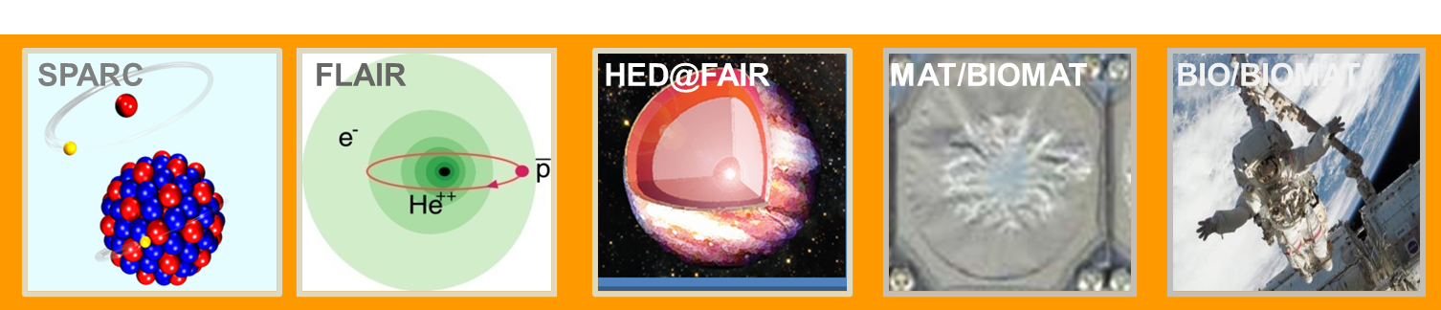
APPA: status & response to the "First-Science and Staging Review of the FAIR Project"
Thomas Stöhlker
Helmholtz Institute Jena, GSI and Friedrich-Schiller University, Jena

Slide 2
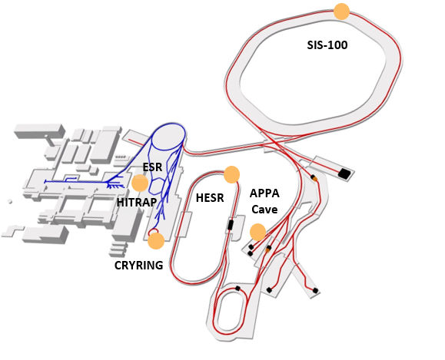


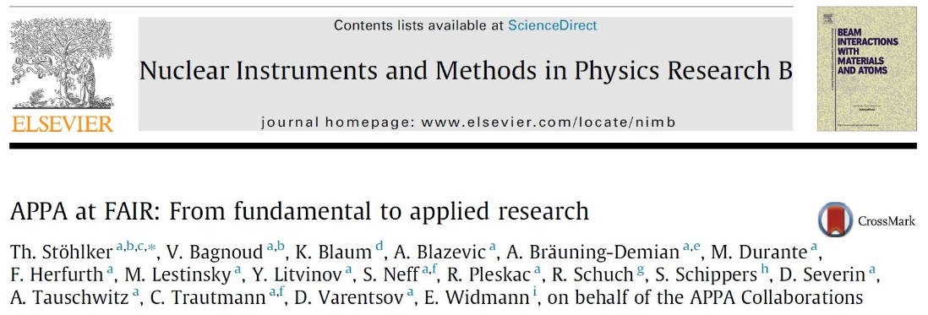
APPA: Matter under Extreme Conditions
FACILITY CAPABILITY
SCIENTIFIC CAPABILITY
Highest Charge States
Relativistic Energies
High Intensities
High Charge at Low Velocity
Low-Energy Anti-Protons
Extreme Static Fields
Extreme Dynamical Fields and Ultrashort Pulses
Very High Energy Densities and Pressures
Large Energy Deposition
Antimatter Research
⇔
Plasma Physics
200 members from 11 countries
Atomic and Fundamental Physics
439 members from 26 countries
APPA
White Paper
NIMB 365 (2015) 680
2

Slide 3
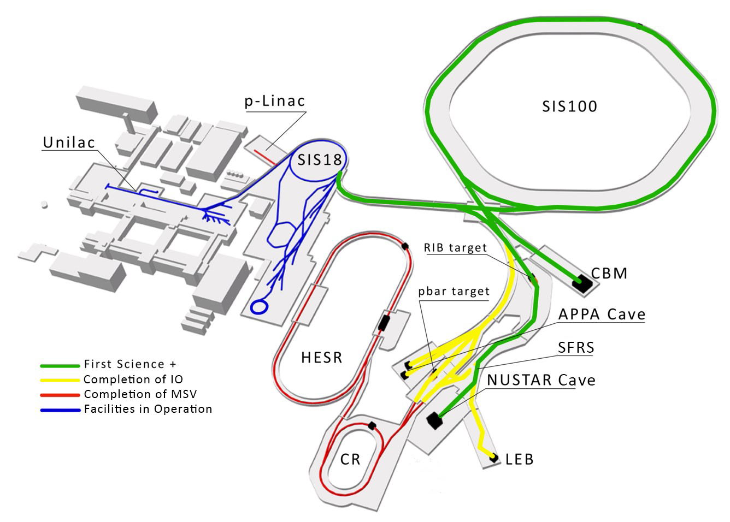
Delayed Realization of APPA Cave & HESR
For the APPA collaborations the substantial delay in the realization of the dedicated FAIR facilities (APPA cave and HESR) would be acceptable if:
          this strategy will be paired with the continuation of the current GSI program during this time
          it will increase the chance of SIS100 timely realisation.
The delay of the APPA cave realization could be a problem for the HED (Plasma) collaboration due to the up coming of the HIAF facility. Some experiments could move there.
Notes:
Since the MSV remains our ultimate goal, we have to make sure that activities are paused in such a way to be resumable.
Additional components will progressively be authorized construction when funds will be made available.
It is likely that this will will happen in the order APPA Cave, then LEB, then rest of IO, then CR, HESR and pLinac.

Slide 4
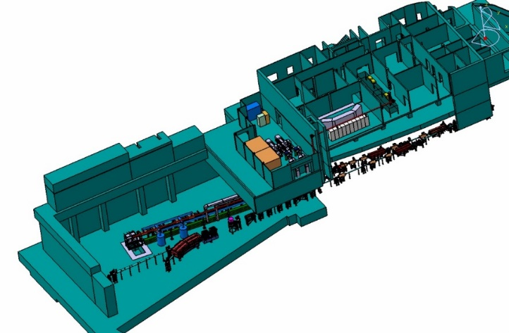
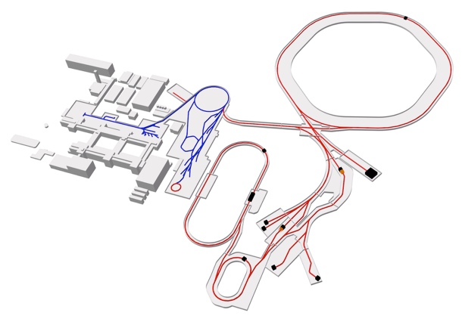
Research at APPA Cave
APPA cave
Ring Accelerators
Linear Accelerator
UNILAC
SIS100
SIS18
/
100 m
APPA
cave
HED@FAIR - Ionization Potential Depression in heavy-ion heated plasmas (min. U beam with 10¹⁰ ions/pulse, 100 ns pulse, rep rate 1/min)
Existing facilities
FAIR beamlines
Experiment stations
APPA stations
Storage
Rings
Main advantage - APPA Cave accepts higher energies and rates than existing caves e.g. SIS18 beams U⁷³⁺: 2E9 ions/second
SPARC – Heavy ions with energies > 1 GeV/u are required for precision spectroscopy.

Slide 5
APPA Facilities in Operation
(HED@FAIR and SPARC)
APPA fully involved in FAIR Phase 0
  ESR, CRYRING (Swedish inkind), HITRAP are part of FAIR MSV
  PRIOR (proton microscope) and Heavy-Ion Heating setup (HIHEX) commissioned at HHT
Worldwide unique experimental capabilities
  Plasma physics with combined laser and ion beams
  Atomic Physics in rings and traps
11 MeV/u
UNILAC
SIS 18
400 MeV/u
1 GeV/u
FRS
HHT
ESR
Z6
PHELIX
Cave A
Atomic physics
4 MeV/u
Plasma physics
HITRAP
CRYRING
100 keV/u - 10 MeV/u
10 MeV/u
block diagram o relevant facilities
Notes:
need updated drawing (HHT beamline is wrong) -> who made the original?

Slide 6
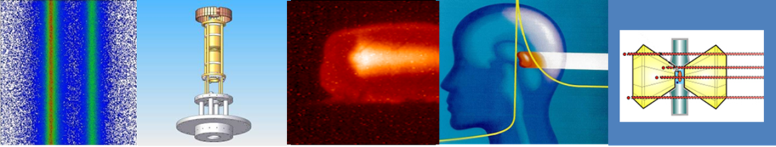



Stored Particles Atomic Physics Research Collaboration
Atomic, Quantum, and Fundamental Physics
6

Slide 7

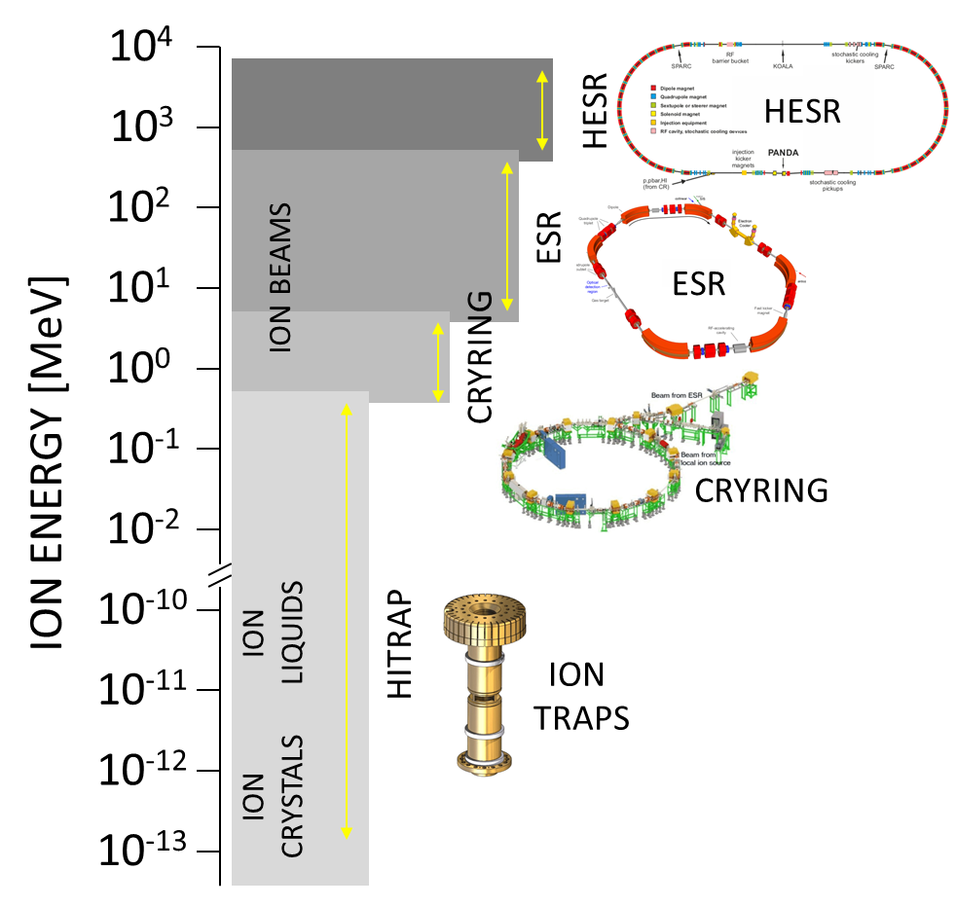
Precision Physics, Trapping & Storage
Quantum, Fundamental and Atomic Physics
Unique research
potential !
From rest to relativistic energies (up to 4.9 GeV/u)
QED at the Schwinger-Limit
Correlated multi-body dynamics
Astrophysical phenomena involving exotic ions/nuclei
Borderline between atomic and nuclear physics
Fundamentals
✓
Cooling: key for precision
✓
✓
From single ions to highest intensities
7

Slide 8
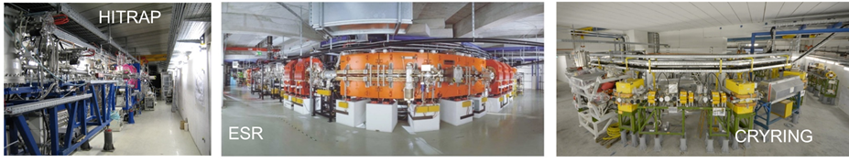
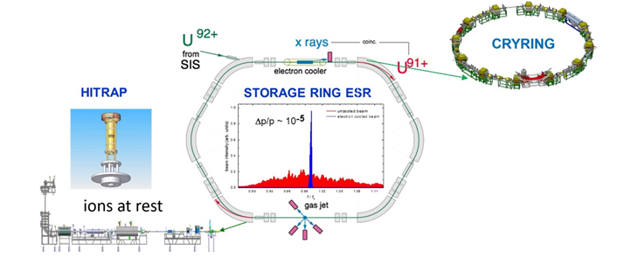
SPARC at Present GSI & FAIR Facilities
Precision Domain of FAIR: Atomic, Quantum, and Fundamental Physics
HITRAP, CRYRING, ESR are part of the MSV
For the years to come, the current MSV facilities of SPARC/APPA are highly competitive and worldwide unique.
For the exploitation of these research opportunities, the continuation of the FAIR phase-0 research program without interruption is of utmost importance.
Notes:
need to improve slide -> who has the original?

Slide 9
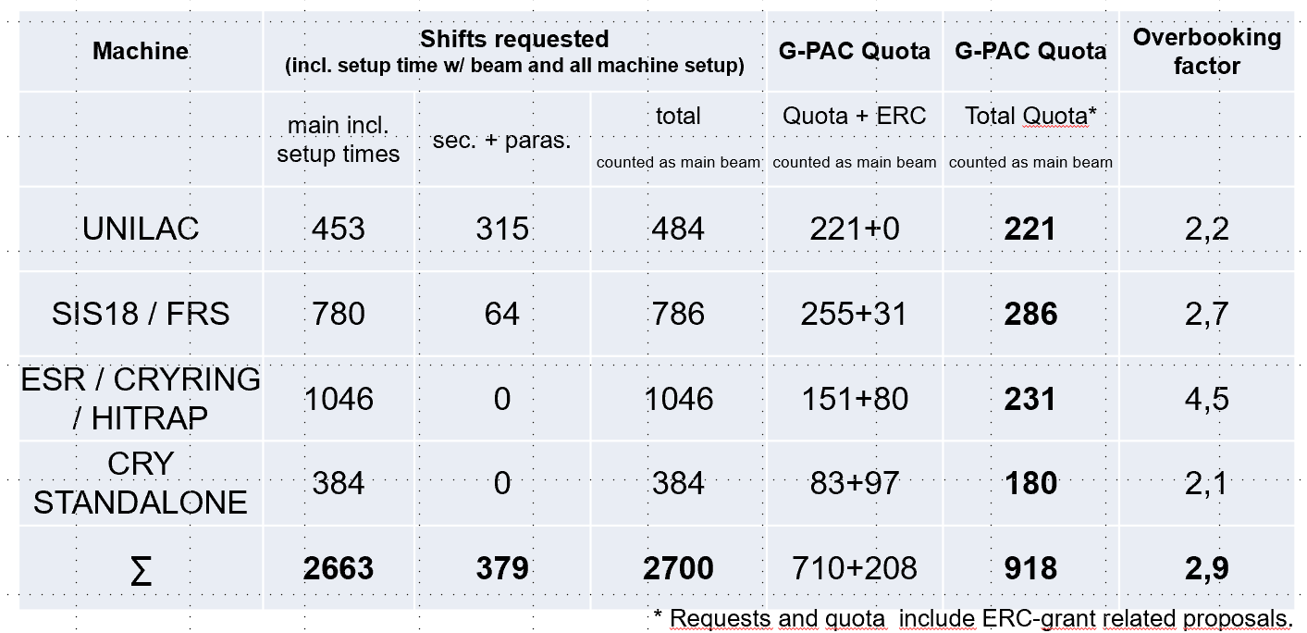
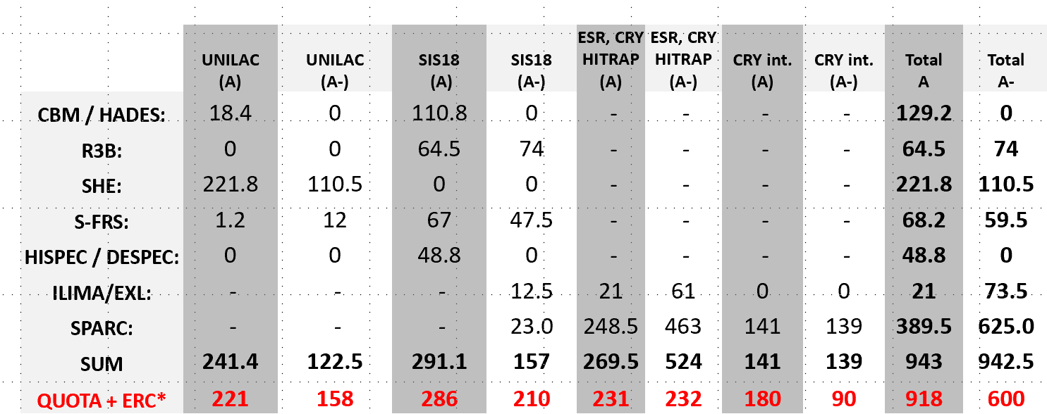
SPARC at Present GSI & FAIR Facilities
Huge demand of beam time for the storage rings!
Notes:
need to improve slide -> who has the original?

Slide 10
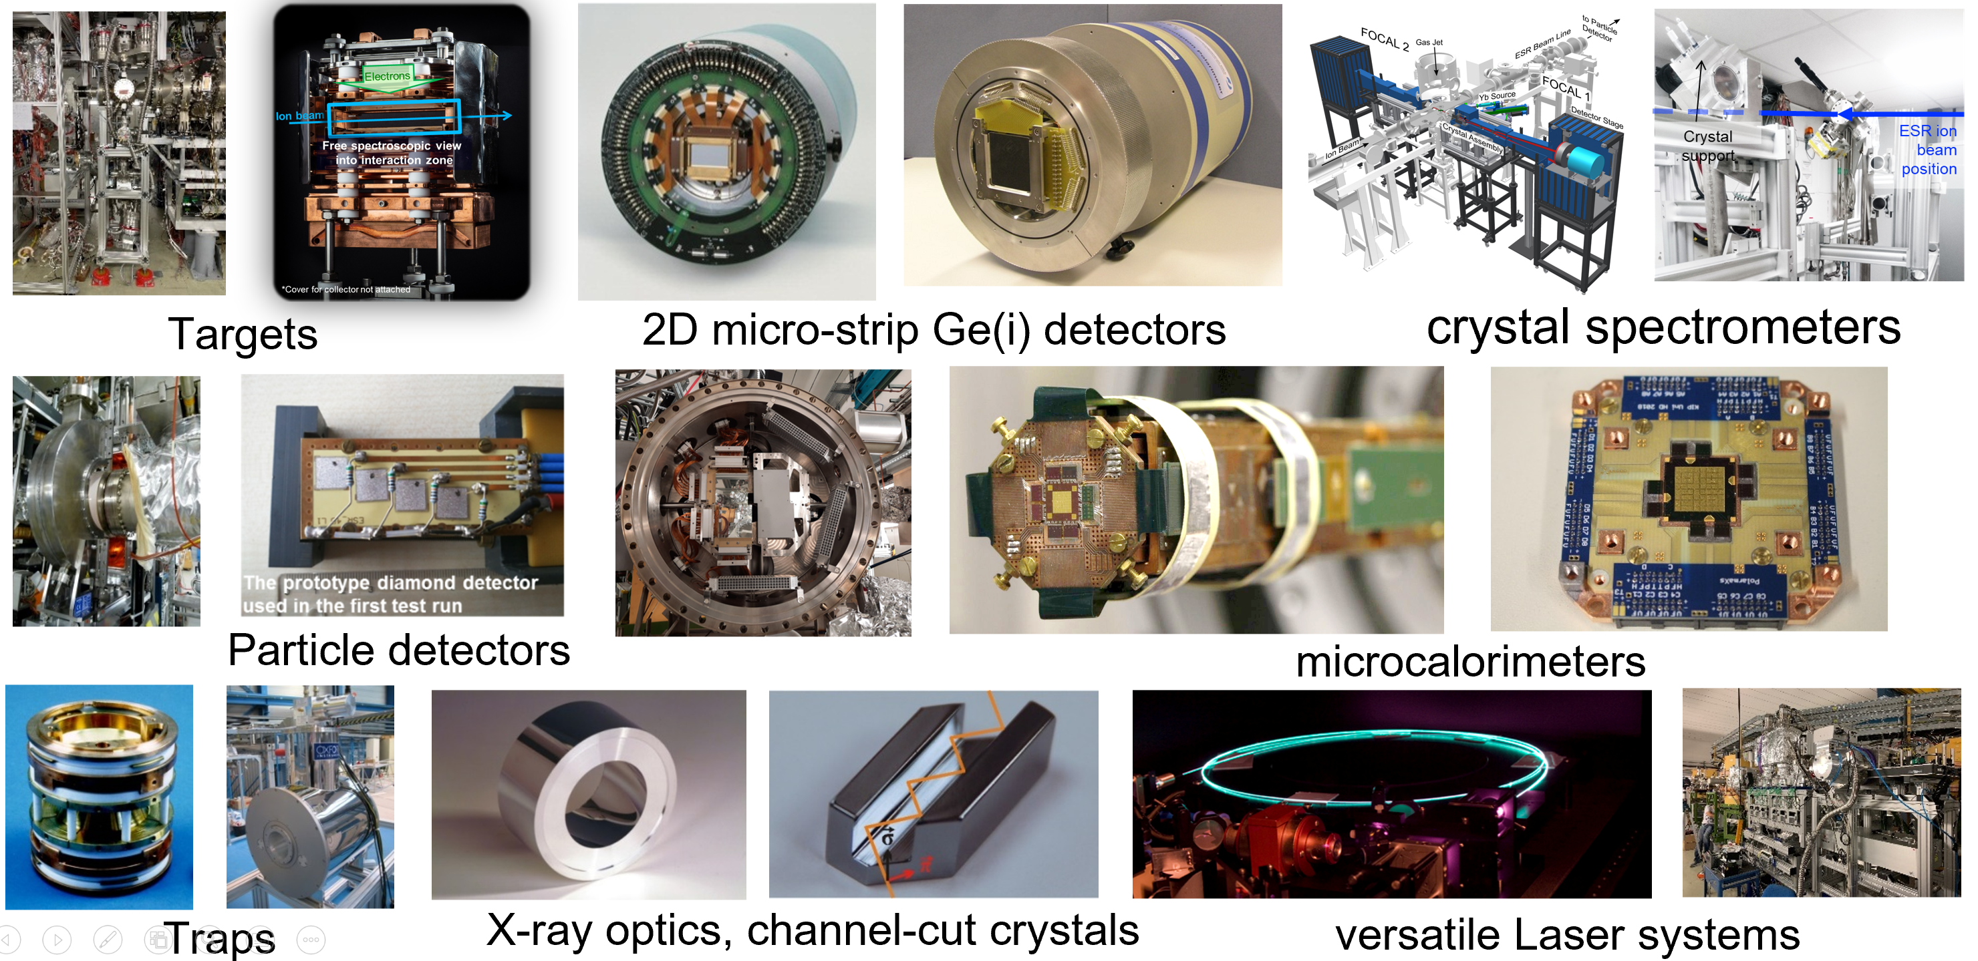
Novel Research Opportunities based on
Sophisticated and Versatile Instrumentation
SPARC/APPA: Besides its facilities, instrumentation is of utmost importance. Already the large portfolio of novel FAIR instrumentation guarantees for a rich science research program at the existing facilities HITRAP, CRYRING@ESR, and ESR.
Notes:
do we need to repeat the details on the PAC?

Slide 11
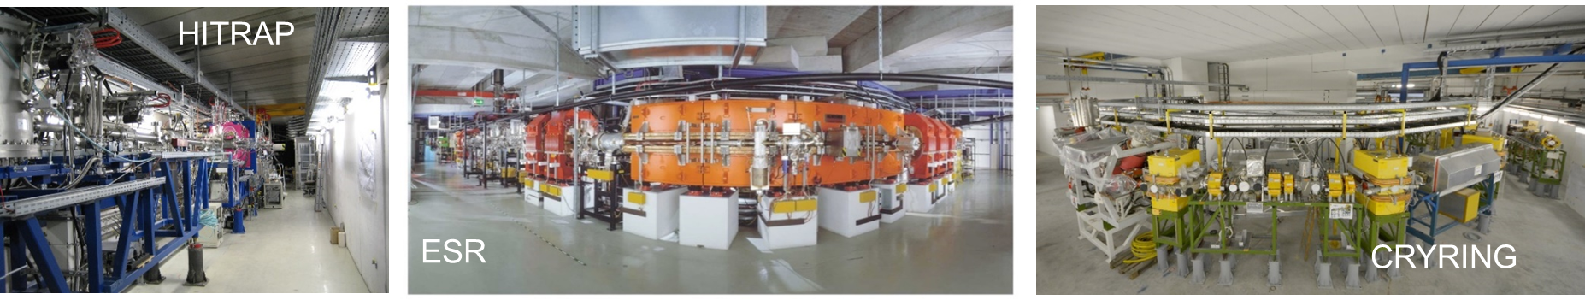
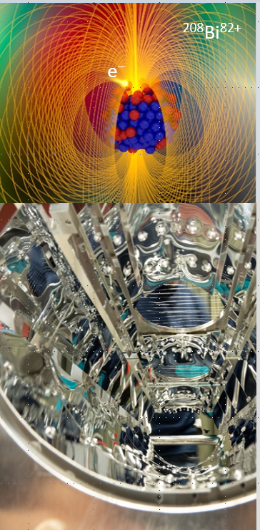
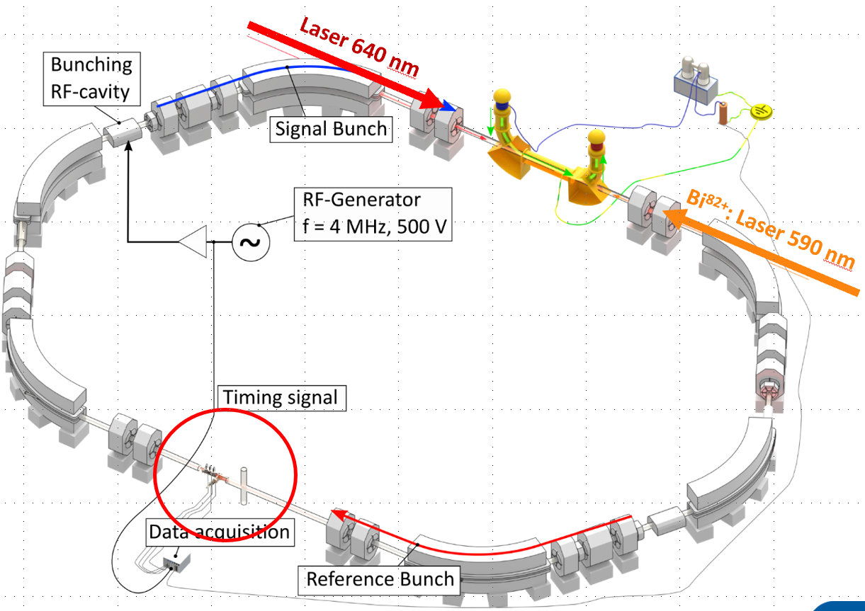
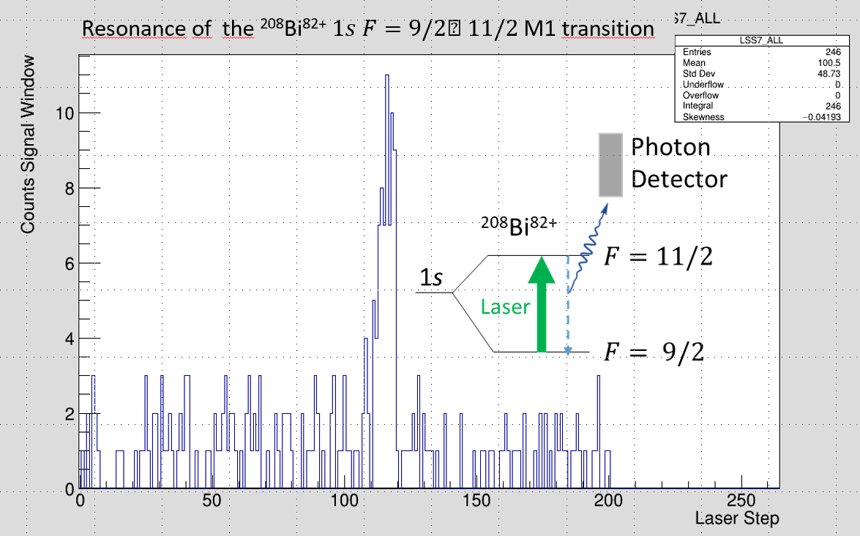

Science at existing facilities
SPARC Experiments at ESR
Hyperfine structure of ²⁰⁸Bi⁸²⁺ and ²⁰⁹Bi⁸²⁺
²⁰⁸Bi⁸²⁺
“Hyperfine puzzle”
Jean-Philippe Karr
Nature Physics (2017)
Topics
Precision studies of atomic structure at high Z with stable and exotic beams
Atomic and nuclear astrophysical reactions with primary and secondary beams
Influence of atomic configurations on nuclear decay modes
Nuclear clocks
Premiere, May 2022:
Laser Excitation of an Accelerator-Produced Isotope in ESR
²⁰⁸Bi⁸²⁺
W. Nörthershäuser, R. Sanchez et al.

Slide 12
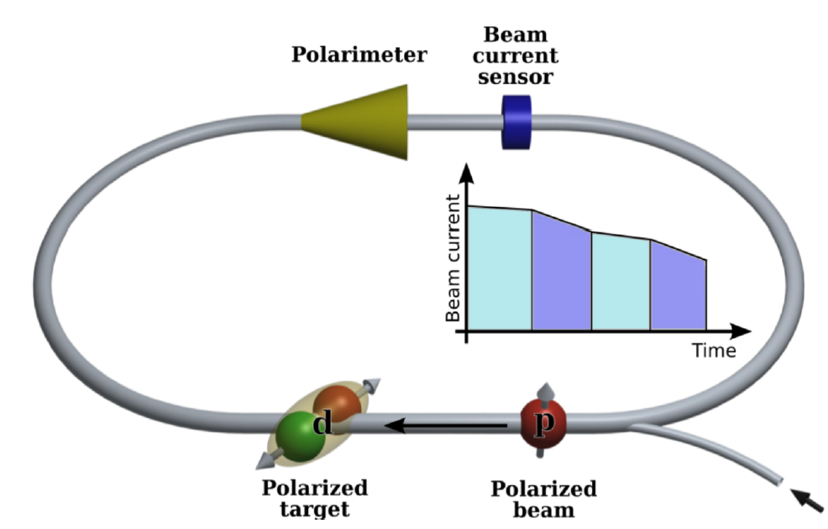
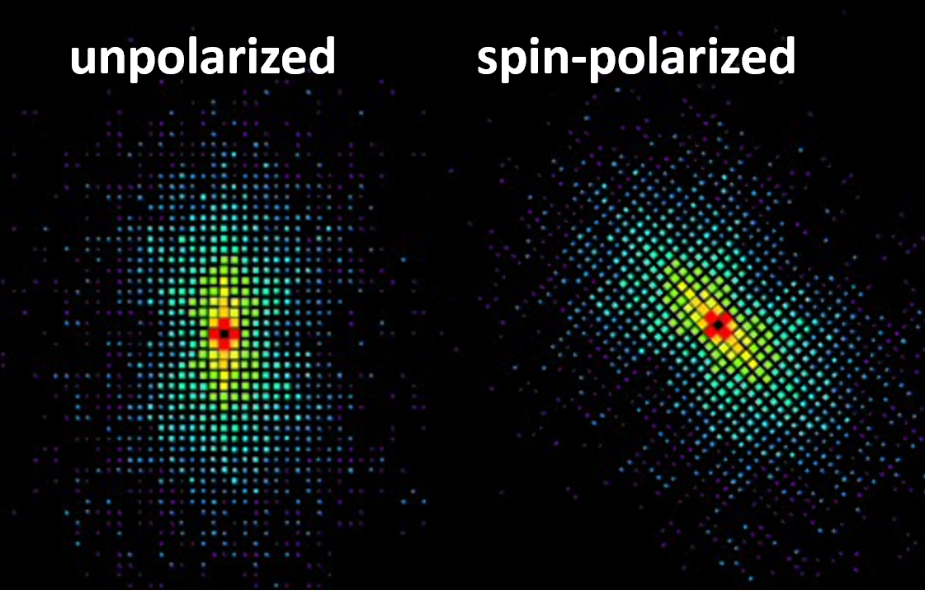
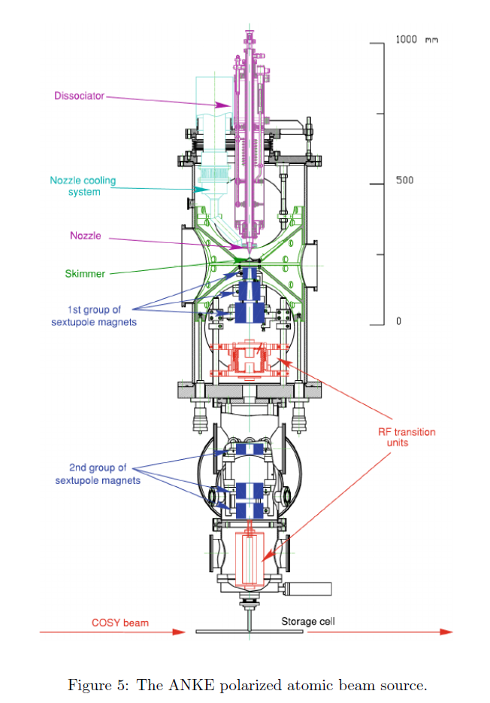
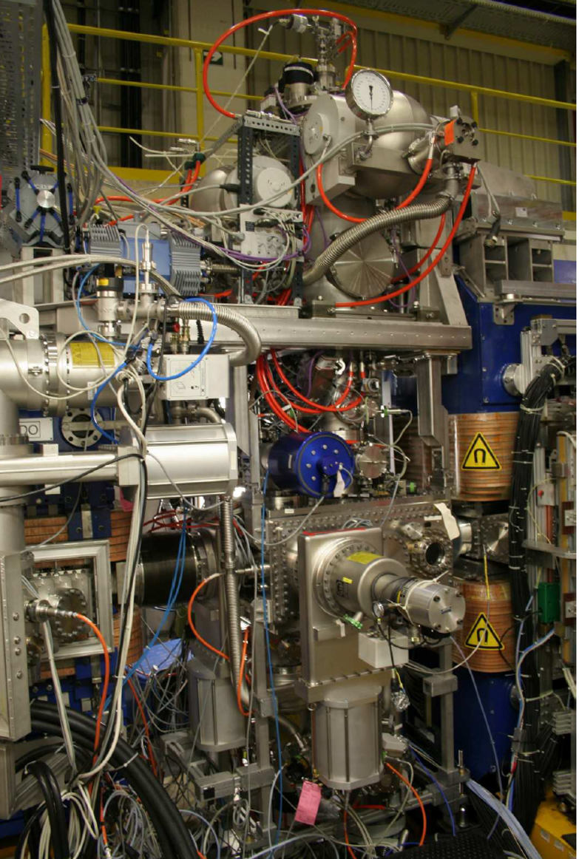
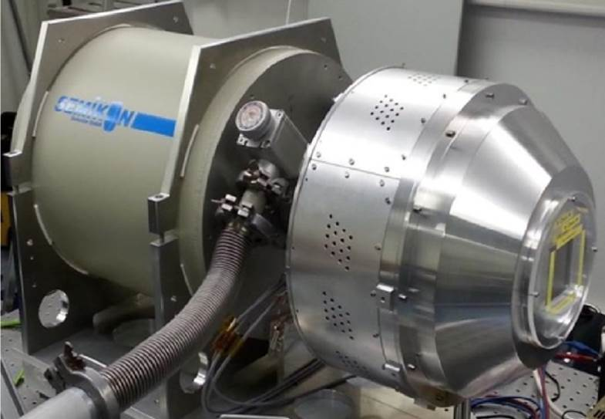
Towards polarized beams and targets at the GSI/FAIR storage rings
Exploiting synergies with IKP FZJ/GSI
Targets
Diagnostics
Topics
GPAC 2022:
LOI0073
✓
Step 1: Diagnostics
electron spin dependent x-ray radiation
neutrino recoil for bound-state beta decay
Step 2: Spin preservation
absolute capture cross-section / photon emission (Pauli blocking)
Step 3: Spin-transfer to nuclei
ions with magnetic moment ⇔ spin transfer to the nucleus)
Goal: Experiments with spin-controlled stored particles, e.g.
Search for physics beyond the SM
Atomic PNC experiments at high-Z
EDM / Axion search
  https://arxiv.org/abs/2208.07293
Compton imaging of x-rays
Polarized target,
atomic beam source (ABS) at COSY:
thickness of 1 × 10¹² atoms/cm²

Slide 13
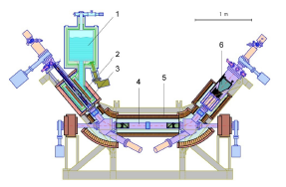
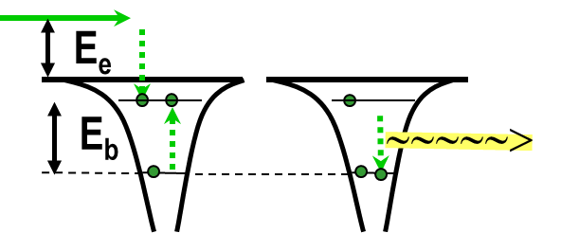
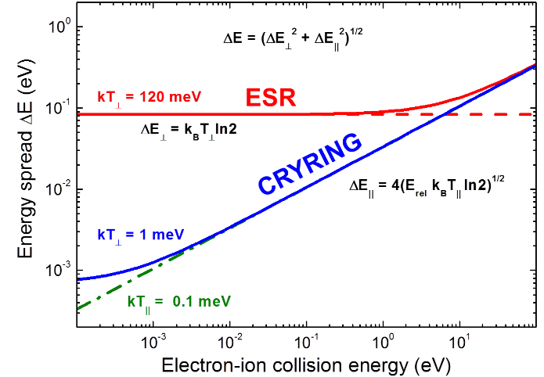
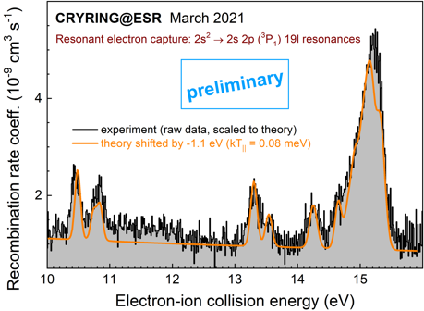
Science at existing facilities
SPARC Experiments at CRYRING@ESR
Ultra cold electron target
Di-electronic recombination
Topics
Precision spectroscopy for tests of strong-field QED
x-ray, laser, di-electronic
Ion-atom and ion-ion collisions in unexplored regime
recoil ion momentum spectroscopy
Astrophysics at low-energies atomic and nuclear astrophysical reactions / decay modes
Be-like lead (Pb⁷⁸⁺)
S. Schippers et al.

Slide 14



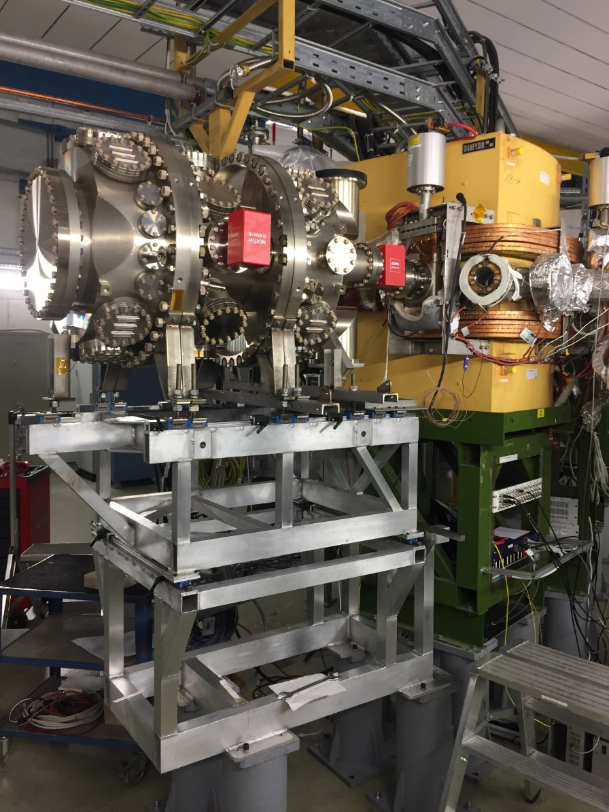
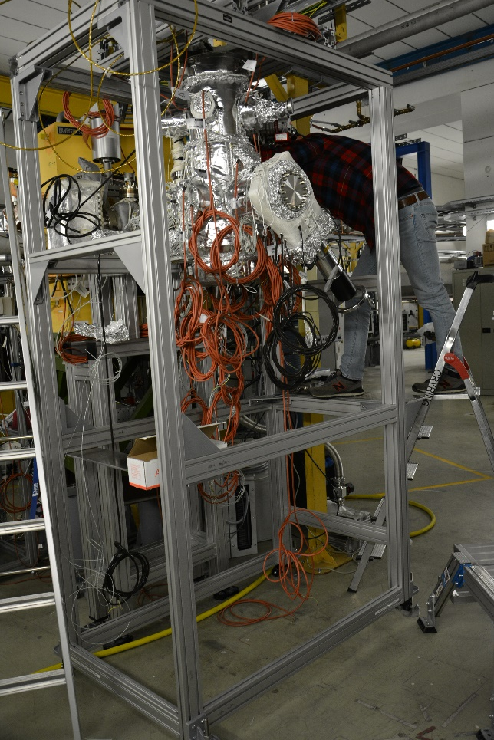
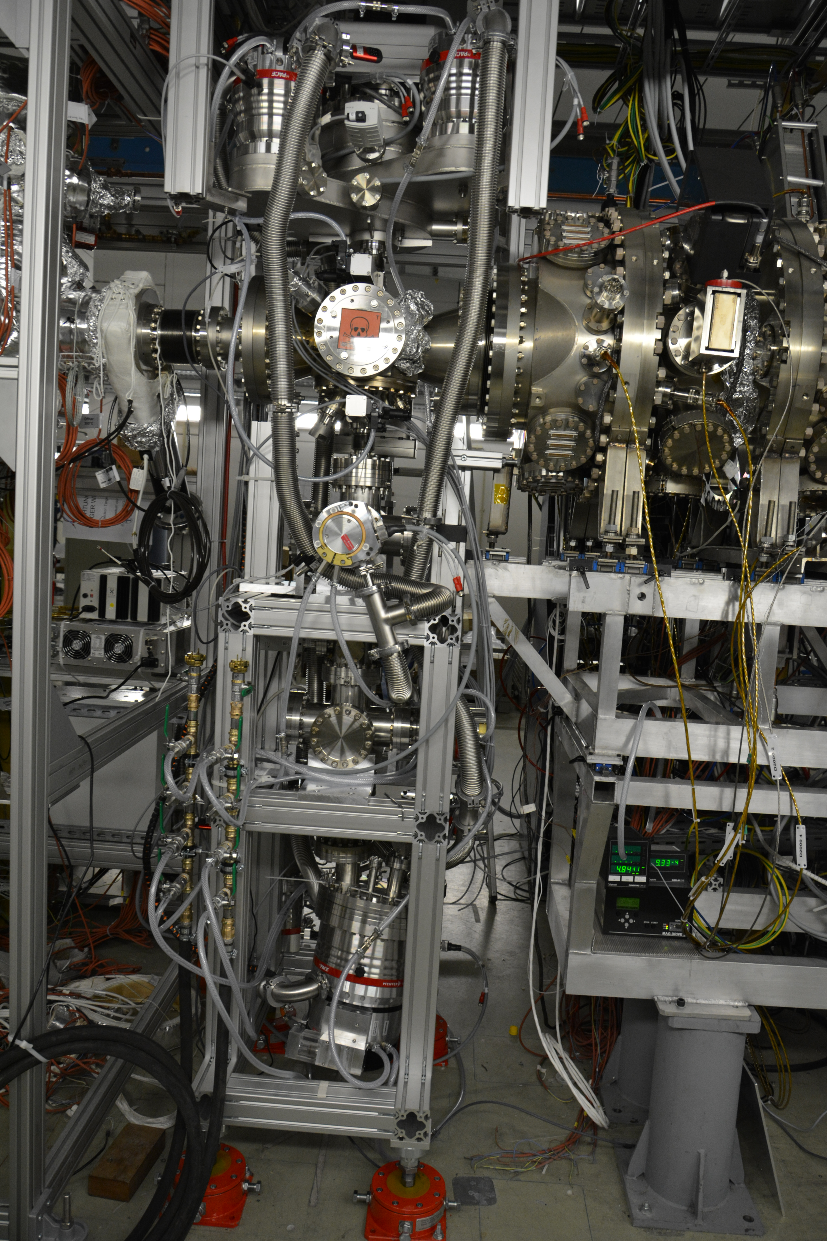

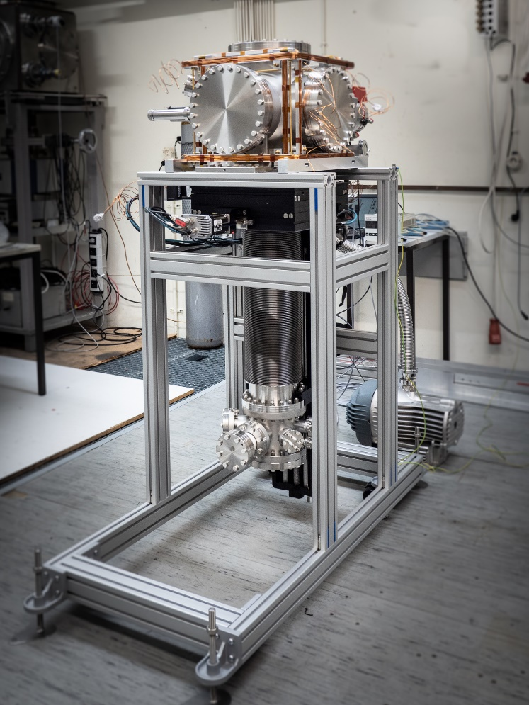


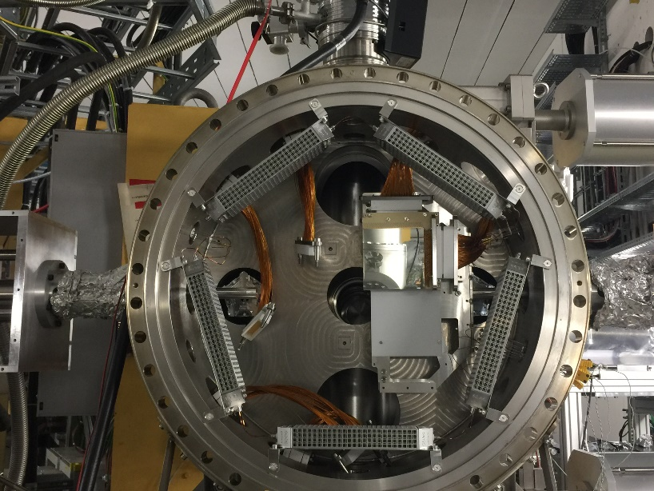
Examples: Experiment Installations and Testing at CRYRING
Status December 2022
CARME spectrometer
E- transversal target
Gas-Jet target
Top interaction Chamber:
e-gun
Installation in ring of the forward part
Vacuum test of the chamber with. backing concluded: p= 2x 10⁻¹¹ mbar
Coupling to the target interaction chamber.
First text experiment with beam in 2022.
Commissioning of the new internal target took place in early 2022.
Two successful experiments on H-like gold beam on N₂ and He.
Target areal densities of up to 6x10¹¹ cm⁻² at target width of Δx = 1 mm achieved.
The upper part is installed in the ring and ready backing and vacuum test.
optimisation of the electron-gun part is in work.
Operation expected for 2023.

Slide 15
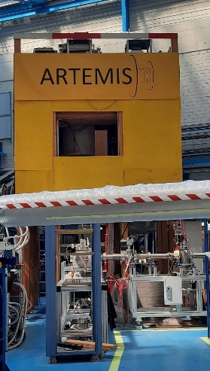
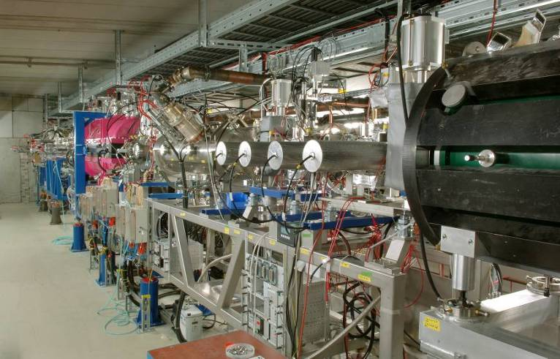
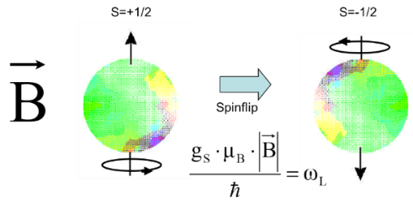
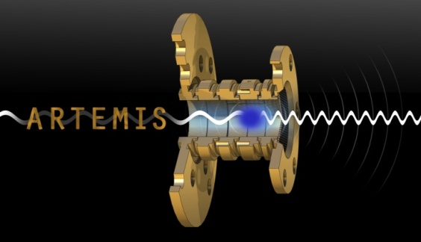
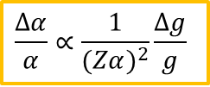
Science at existing facilities (commissioning started 2022)
SPARC Experiments at HITRAP: HCI at Rest
HITRAP
Bound-electron g-factor
(magnetic moment at ARTEMIS),
precision Penning trap
Topics
Precision measurements of bound-electron and nuclear magnetic moments
High-precision test of strong-field QED
Physics beyond SM (quantum logic spectroscopy)
Fundamental constants
Very slow, controlled HCI (astrophysics)
Ion-surface interaction
$$\frac{Δα}{α}∝\frac{1}{(Zα)^{2}}\frac{Δg}{g}$$
g-Factor measurements
in a series of elements up to U⁹¹⁺
  medium-Z → fine-structure constant α
  high-Z → test of strong-field QED
forΔg/g ~ 10⁻¹¹
feasible
S. Sturm et al., 2014,
Nature (London) 506, 467

Slide 16
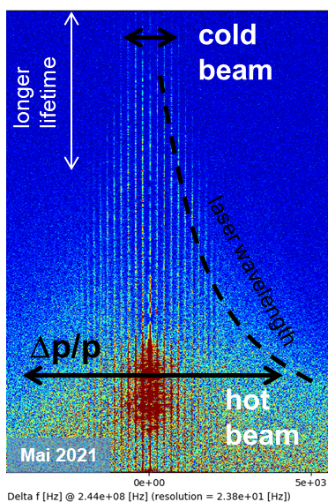
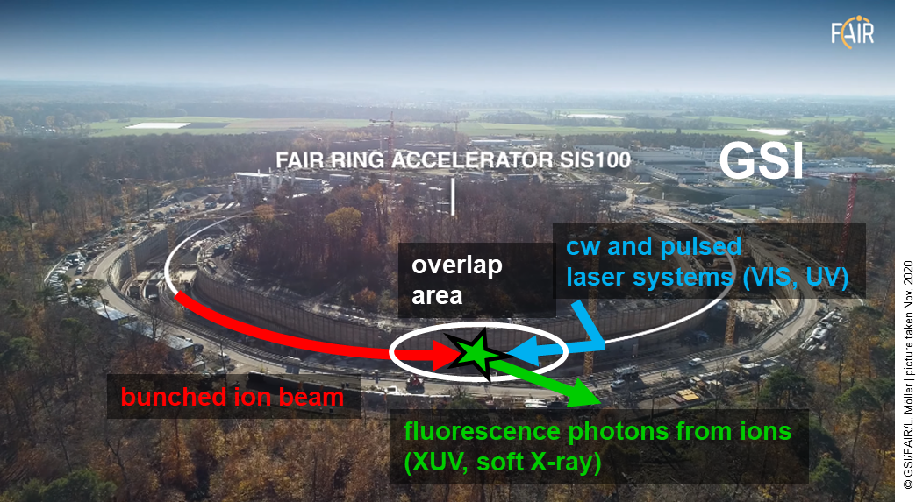
Added science with additional facilities
SPARC Experiments at SIS100
Laser Cooling of Bunched Relativistic Ion Beams at SIS100 with γ ~ 13
Laser-cooled relativistic heavy-ion beams (Z = 10 - 60)
Only cooling method at SIS100 energies (Δp/p down to 10⁻⁷ in a few sec.)
Extraction of very cold and very short ultra-relativistic ion bunches
World-wide unique!

Slide 17
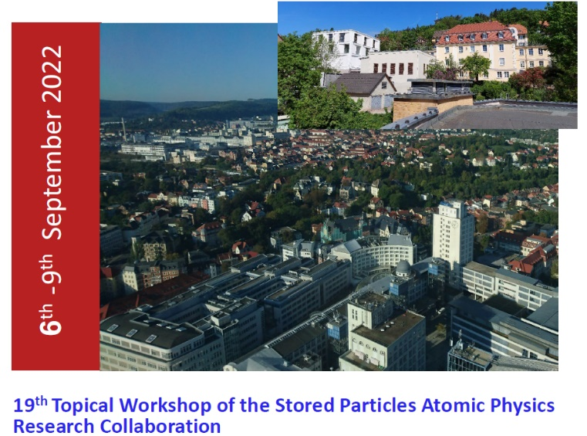
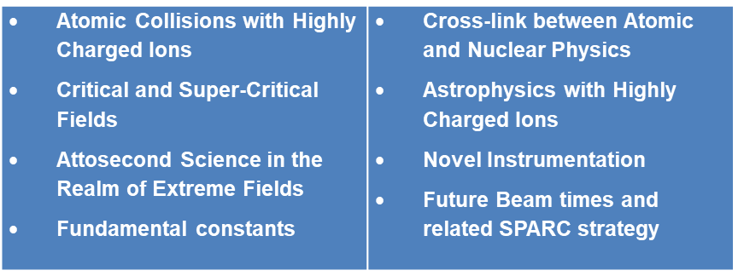
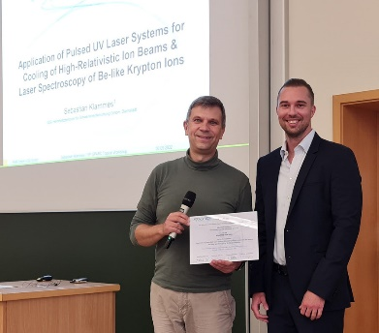
19th SPARC Topical Workshop 6th – 9^{h}, Sept. 2022
Hybride, University of Jena & HI-Jena
Participants: more than 120 participants from 13 countries
SPARC PhD Award 2022 for Sebastian Klammes
The SPARC collaboration sincerely congratulates Sebastian Klammes (HI-Jena) on receiving the SPARC PhD award 2022. Application of pulsed UV laser systems for cooling of high-relativistic ion beams and laser spectroscopy of Be-like krypton ions.
Sebastian Klammes, GSI-Darmstadt and TU-Darmstadt

Slide 18
High Energy Density Collaboration
Plasma Physics
18

Slide 19

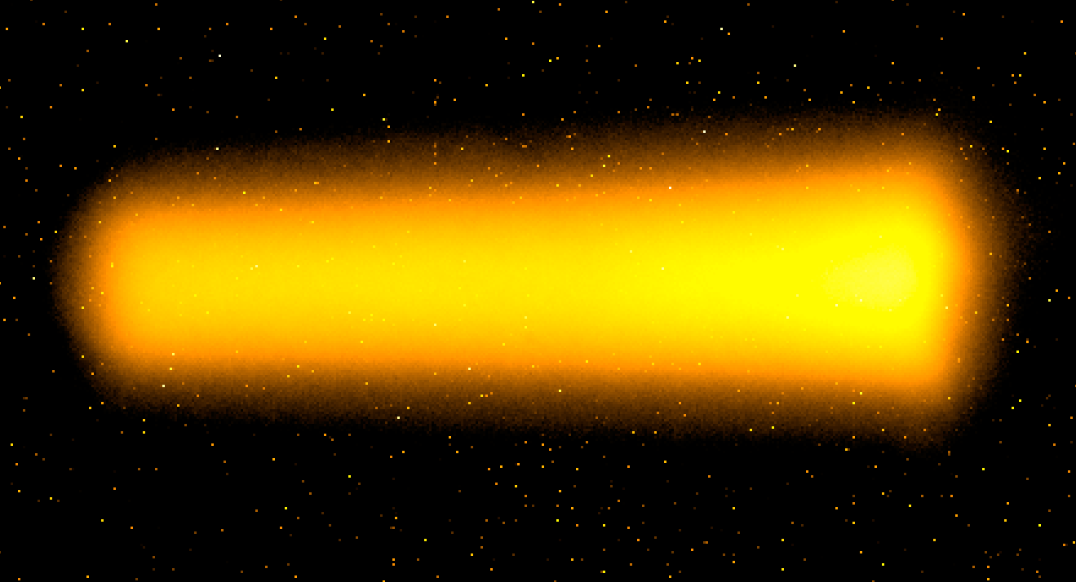
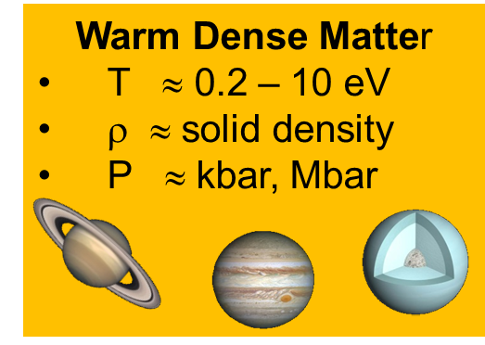
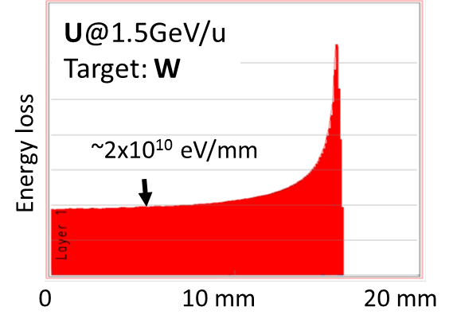
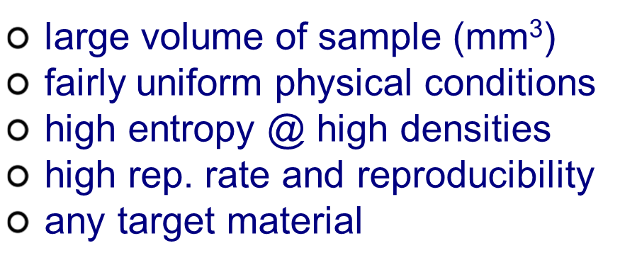
Plasma Physics at FAIR: HED@FAIR
HED
@
Interaction of ions and photons with plasmas
Equation of state, phase transitions, transport phenomena
Matter under high pressure
Coupling of intense light with matter
3 mm
U@350 MeV/u; Target: W
FAIR will produce the largest volume of uniform WDM worldwide.
Compared to GSI, FAIR will provide a specific intensity and energy deposition increase by a factor of 100.
FAIR will host the worlds highest resolution proton microscope.

Slide 20
Delayed Realization of APPA Cave
HED
@
For the HED collaboration the delay in the realization of the APPA cave is acceptable if:
          this strategy will be paired with the continuation of the current GSI program during this time.
          HED beamline: Replacement of sc magnets from EU vendors as soon as budget is available.
          HHT serves as a platform for initial HED experiments until the APPA cave becomes available.
          R&D for diagnostics and laser technology for HED
          experiments is continuing.
Notes:
Since the MSV remains our ultimate goal, we have to make sure that activities are paused in such a way to be resumable.
Additional components will progressively be authorized construction when funds will be made available.
It is likely that this will will happen in the order APPA Cave, then LEB, then rest of IO, then CR, HESR and pLinac.

Slide 21
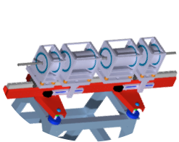
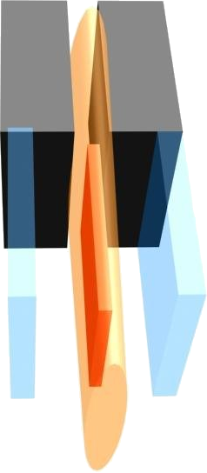
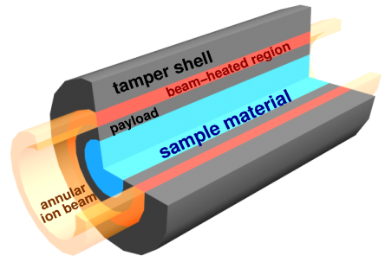
Main experimental platforms
Proton Microscope for FAIR
- PRIOR -
worldwide unique high-energy proton microscopy setup with SIS-100 proton beam
dynamic HEDP experiments, density measurements from thick dense objects
unparalleled density distribution measurements
Isochoric Heating and Expansion
- HIHEX -
uniform quasi-isochoric heating of a large-volume dense target and isentropic expansion
numerous high-entropy HED states:
EOS and transport properties of non-ideal plasmas / WDM for various materials
Compression Experiments
- LAPLAS -
ring-shaped beam implodes a heavy tamper shell,
low-entropy compression of hydrogen
Mbar pressures @ moderate temperatures: hydrogen metallization, interior of Jupiter, Saturn or Earth

Slide 22
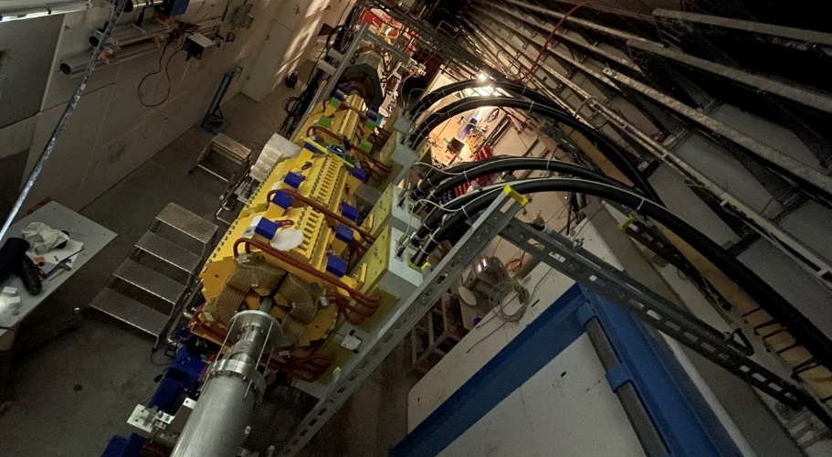
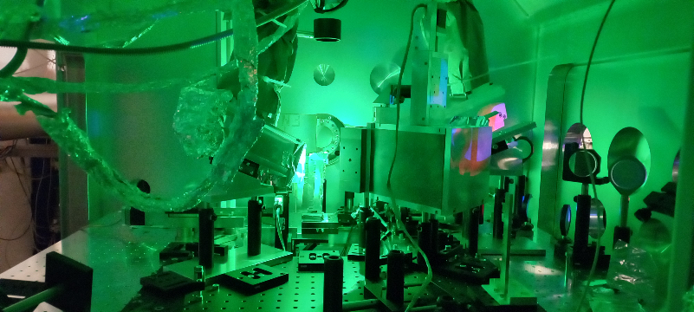
HED FAIR Experiments at GSI
HED
@
PRIOR at HHT
HIHEX at HHT
PHELIX
ions
PRIOR and HIHEX (HED@FAIR detectors for APPA cave) successfully used in physics runs in 2022.
HIHEX‘s setup would require to upgrade the current HHT cave for SIS18 beams to keep HED competitive (in case early science for HED at APPA cave would not be possible).
Notes:
modulate message based in FAIR council result

Slide 23


Proton microscope PRIOR:
Commissioned with recent phase 0 experiments
HED
@
Experimental setup at HHT
Static imaging (watch)
Design parameters
Spatial resolution 10 µm
Temporal resolution 10 ns
Density resolution 1%
Secondary drivers
Laser shocks
Gas gun
Electric wire explosions
High-explosives
Experiment: “Understanding liquid-liquid phase transformations by temperature-dependent viscosity measurements at high pressures using high energy proton microscopy”
High pressure heated Titanium-vessel
Steel ball „falling“ in liquid Sulfur
B. Winkler,
GU Frankfurt

Slide 24



PHELIX world-class laser: standalone or coupled experiments
HED
@
Using ultrafast optical parametric amplifier (uOPA) temporal contrast of 10⁶ to 10¹¹ can be applied
Improvement of beam transport, implementation of a deformable mirror and focussing by a glass parabola; max. proton energy increased from 80 MeV to 93 MeV

Slide 25








Laser Ion Generation, Handling and Transport (Light):
R&D, injecting laser-accelerated ions into SIS-18
HED
@
Energy selection, transport and transverse focusing
Mission
Use of protons (ions) accelerated by means of the PHELIX laser and provide transport, focusing and bunch rotation of the laser generated particle bunches by conventional ion optics and RF technology in a "test stand" located at the Z6 experimental area of GSI
RF-Cavity
Carbon ion bunch parameters (January 2021)
Longitudinal manipulation (reduction of energy spread → 3% / temporal compression → sub-ns)
SIS
nhelix
Z6
PHELIX
HHT
2. target chamber
TK
Proton bunch parameters
(June 2022)
focusing solenoid
UNILAC
Z6

Slide 26


New capabilities for coupled laser beam - ion beam experiments at GSI (2021)
HED
@
ESR hall
200J/ns laser pulses, focused to 10¹²-10¹⁵ W/cm²
HHT
high energy, high temperature experimental cave
Intense He-α line-radiation sources (<10keV) from mid-Z plasmas, few keV quasi-continuous radiation from high-Z plasmas
⇒ Laser-driven x-rays enable diagnostic capabilities
PHELIX
laser facility
few Mbar shocks into solids
Shock-induced ablation/spallation
Laser-accelerated flyer plates
∼ 65 m
⇒ Driver for proton microscopy experiments with PRIOR
Achievements
Beamline completed
First light in HHT cave (May 2021)
Simultaneous ion + laser pulses in new target chamber
Up to 200J at 2ω (2ns pulse duration)
Focal spot-∅ 20 μm (~90% in 60µm)
Setup at HHT experimental area

Slide 27




First Phase 0 experiment using coupled laser and ion beams at HHT
HED
@
May 2022: First beamtime combining intense heavy-ion beams with high-energy laser pulses
APPA day-1 target chamber used in first experiment at HHT-cave
High-energy laser beamline at full specs! (200J at 527nm)
Variety of ion beam, optical + x-ray diagnostics fielded
Demonstrated laser-driven x-ray probing of HI-heated targets
Experiments on graphitization of diamond
Strong participation by several university groups from within HED@FAIR
Setup in target chamber
X-spec
X-Ray Diffraction
→ graphitization, melting
XRTS
BIF
X-Ray Thomson Scattering → ionic vibrations (T_{i})
focus diag
Ti-He_{α} (4.75keV)
PHELIX
pyro
(img.)
Source
XRD
pyro
(point)
heated region
Scattering
energy
ions
X-ray probing reveals microscopic
properties of HED samples

Slide 28









HED news: THRILL project granted (2022)
HED
@
      EU Funding for R&D High-Power Laser for HED@FAIR
Topic: R&D for high-energy high-repetition-rate lasers (KJ class, 1 Hz rep. rate)
Deliverables:
  design studies and concept for high-energy lasers at EU-XFEL and FAIR
  amplifier prototypes
  training of next generation’s scientists (80 FTE reserved for new hires over 4 years)
Volume 10,4 M€, coordinator: GSI (3,3 M€ for GSI + FAIR)
Notes:
does it belong here?
how about news of spokesperson election?

Slide 29


40th High Energy Density Workshop (January 2020)
& Paper on Science Program of HED@FAIR
Phys. Plasmas 27, 043103 (2020)
Topics
Properties of high energy density matter created (EOS, phase transitions in dense plasmas, transport, and relaxation)
Beam-plasma interactions (lasers, ion beams, pulsed power)
Particle acceleration and generation of intense beams
Relativistic laser-plasma interactions
Accelerator issues of intense beams
New and upcoming HED facilities
Diagnostic methods for high energy density matter
Experiments at FAIR

Slide 30
Status of TDR´s and Funding
30

Slide 31

APPA: Status of TDR`s and Funding
Status: February 2022
31

Slide 32


Applications to BMBF for 2021 - 2024
EruM-FSP T05
“Physics of the Smallest Particles”
13 Universities, 32 Projects
SPARC, HED@FAIR
U Greifswald
HED
&
U Rostock
@
U Lüneburg
HU Berlin
U Münster
TU Braunschweig
U Duisburg-Essen
U Göttingen
TU Dresden
U Düsseldorf
U Kassel
U Gießen
HI Jena
U Jena
HZDR
HS Rhein-Main
U Frankfurt
U Mainz
HI Mainz
FAIR / GSI
THM
TU Darmstadt
MPIK
U Erlangen-Nürnberg
TU Kaisers-
lautern
U Heidelberg
U Stuttgart
TU München
U München
32

Slide 33


bmbf ERUM-FORSCHUNGSSCHWERPUNK appa-fsp appa: Atomic, plasma, and applied sciences
https://fair-center.eu/user/experiments/appa/appa-rd.html
2019-2021
2021-2024
SPARC, HED@FAIR (2019-2021)
16 applications funded by the program
“Physics of the Smallest Particles”
coordinated by S. Schippers (Giessen)
6.3 M€
SPARC, HED@FAIR (2021-2024)
20 applications funded by the program
“Physics of the Smallest Particles”
coordinated by S. Schippers (Giessen)
7.6 M€
MAT Users (2010-2022)
2 funded applications
“Condensed Matter”
coordinated by M. Schleberger (Duisburg-Essen)
1,4 M€
MAT Users (2022-2025)
“Condensed Matter”
1.4 M€
33

Slide 34
Summary and Outlook
Towards the Realization of the FAIR MSV
HED
@
For the next decade and beyond, FAIR and its storage and trapping facilities offer novel, worldwide unique research opportunities with large discovery potential for APPA.
  SPARC experiments are well prepared, and a large portfolio of novel FAIR instrumentation is already available for experiments.
  HED@FAIR experiment platforms are already available at GSI/HHT for experiments, awaiting deployment in the APPA cave.
For the exploitation of these research opportunities provided by APPA, the continuation of the FAIR phase-0 research program without interruption and sufficient beam time is of utmost importance (training and promotion of young scientists, maintaining the collaboration)
APPA continues its efforts for a timely realization of APPA cave and HESR with their unique discovery potential.

Slide 35

Thank you
air view of the FAIR southern buildings (NUSTAR & APPA Caves)

