Slide 1
Feasibility study of femtoscopic measurements in CBM
Daniel Wielanek for the CBM Collaboration
Warsaw University of Technology, Faculty of Physics
Joint Institute for Nuclear Research, High Energy Physics Laboratory

Slide 2
Outline
The femtoscopy
Physics at CBM
Perspectives on pion femtoscopy
Perspectives on baryon femtoscopy
Summary

Slide 3
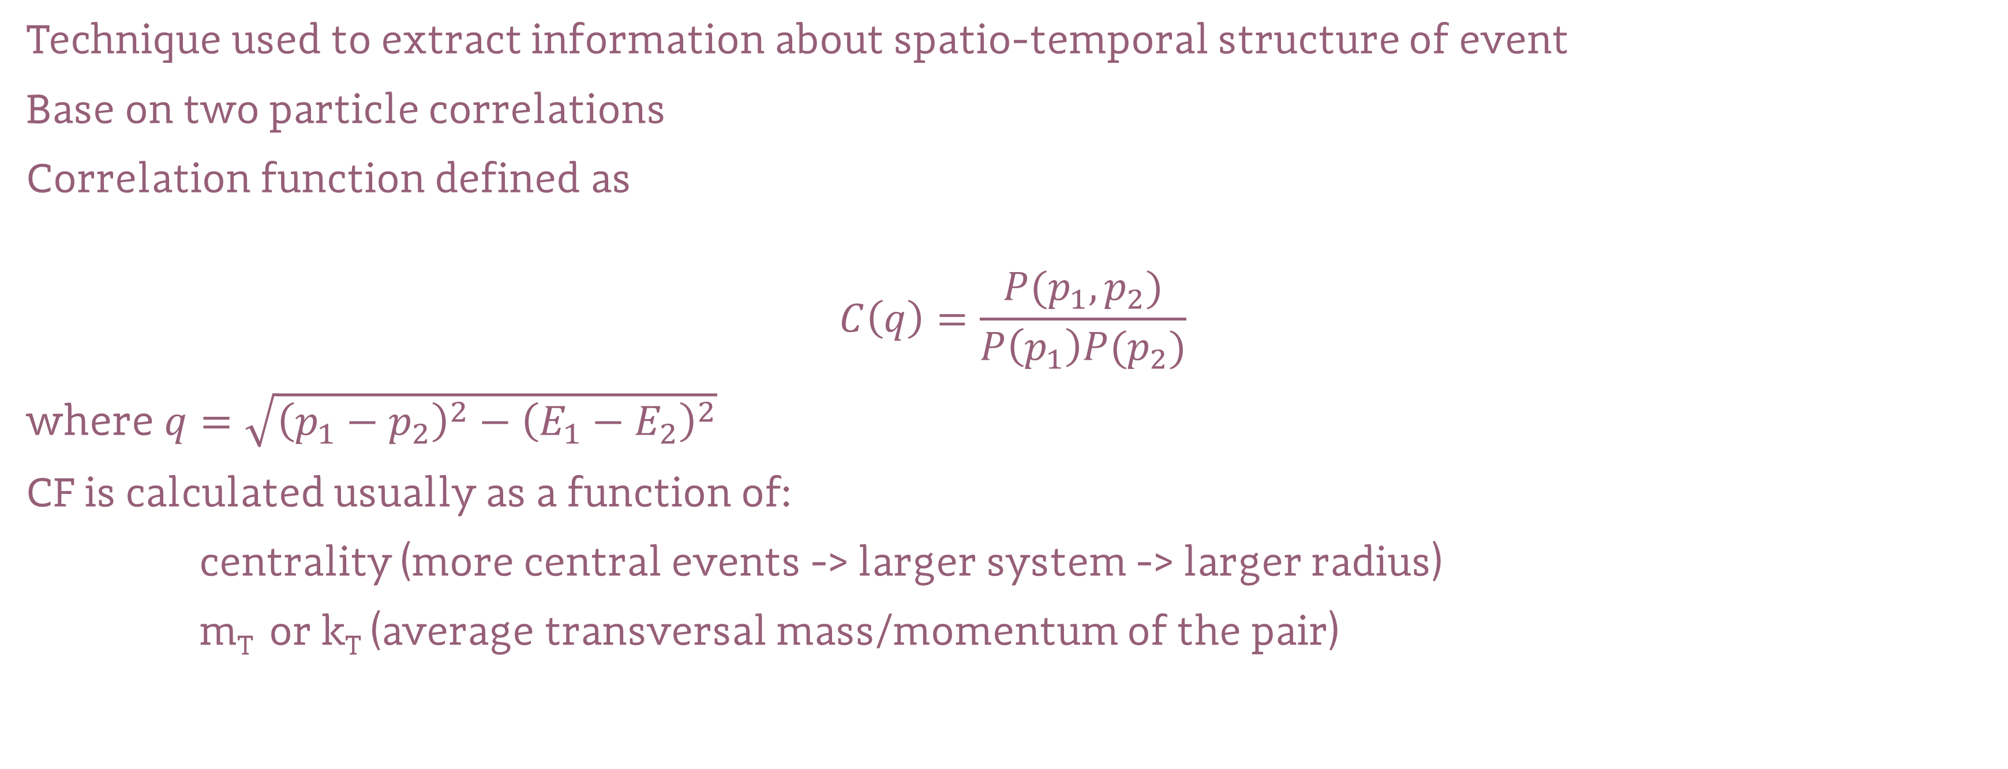
Femtoscopy
Technique used to extract information about spatio-temporal structure of event
Base on two particle correlations
Correlation function defined as
$$C\left(q\right)=\frac{P(p_{1},p_{2})}{P\left(p_{1}\right)P(p_{2})}$$
where $q=\sqrt{{\left(p_{1}−p_{2}\right)}^{2}−{\left(E_{1}−E_{2}\right)}^{2}}$
CF is calculated usually as a function of:
centrality (more central events -> larger system -> larger radius)
m_{T} or k_{T} (average transversal mass/momentum of the pair)

Slide 4
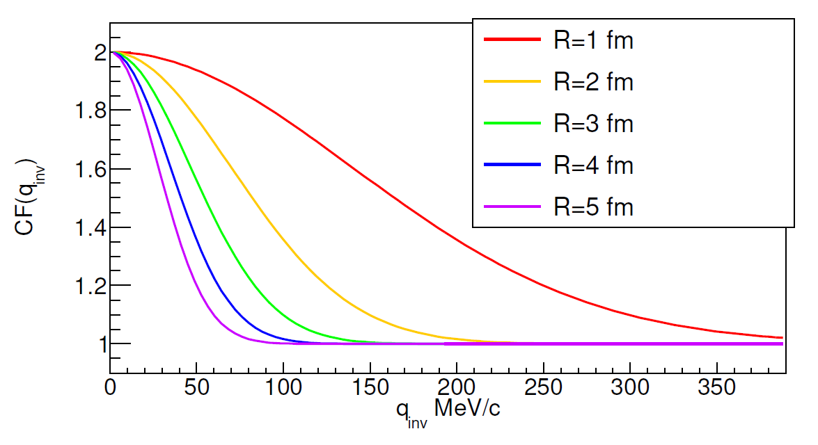

Theoretical shape of the CF
Let’s consider noninteracting bosons with spin zero, single particle probability of emission
$$ρ\left(x\right)≈e^{−\left(\frac{x^{2}}{2R^{2}}\right)}$$
Probability of pair emission is:
$$ρ\left(Δx=x_{1}−x_{2}\right)≈e^{−\left(\frac{Δx^{2}}{{4R}^{2}}\right)}$$
Influence of quantum statistic term:
$${\left|Ψ\left(Δx,Δp=q\right)\right|}^{2}=1+cos⁡(Δxq)$$
Correlation function
$$C\left(q\right)=∫ρ\left(x_{1},p_{1}\right)ρ(x_{2},p_{2})|Ψ(x_{1},p_{1},x_{2},p_{2}{)\left.​\right|}^{2}dx_{1}d{x_{2}=1+λe^{−q^{2}R^{2}}}_{}$$
~1/R

Slide 5

Femtoscopy
Known interactions ($|Ψ(x_{1},p_{1},x_{2},p_{2}{)\left.​\right|}^{2}$)e.g. proton-proton:
$$C\left(q\right)=∫ρ\left(x_{1},p_{1}\right)ρ(x_{2},p_{2})|Ψ(x_{1},p_{1},x_{2},p_{2}{)\left.​\right|}^{2}dx_{1}dx_{2}→ρ\left(x_{1},p_{1}\right)ρ(x_{2},p_{2})$$
Unknown interactions, known/assumed size of the source ($ρ\left(x_{1},p_{1}\right)ρ(x_{2},p_{2})|$) e.g. lambda-lambda:
$$C\left(q\right)=∫ρ\left(x_{1},p_{1}\right)ρ(x_{2},p_{2})|Ψ(x_{1},p_{1},x_{2},p_{2}{)\left.​\right|}^{2}dx_{1}dx_{2}→|Ψ(x_{1},p_{1},x_{2},p_{2}{)\left.​\right|}^{2}$$

Slide 6
Femtoscopy
Femtoscopic measurements are sensitive to dynamics of the source:
Lack of collectivity
Collectivity
Small k_{T}/m_{T}
Large k_{T}/m_{T}

Slide 7
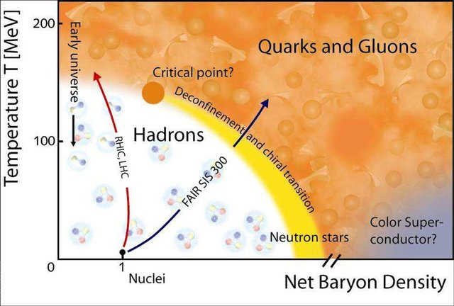
Physics in CBM
More info:
See P. Senger talk at 14:00
Introductory lectures on lattice QCD at nonzero baryon number, December 2015
Journal of Physics Conference Series 706(2)

Slide 8
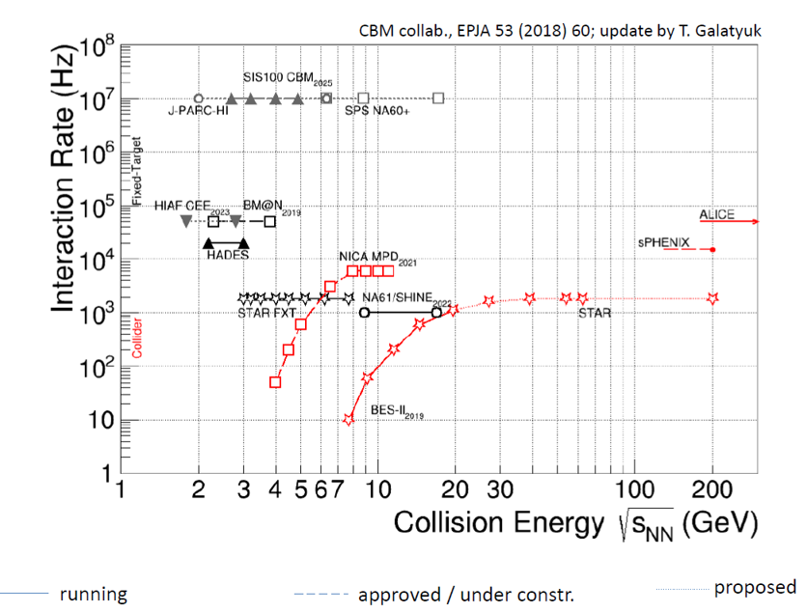
Physics in CBM

Slide 9
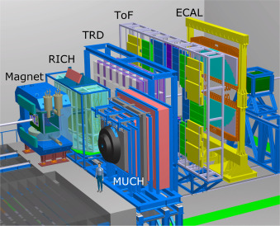
Physics in CBM
Nuclear Instruments and Methods in Physics Research Section A: Accelerators, Spectrometers, Detectors and Associated Equipment, 2017

Slide 10
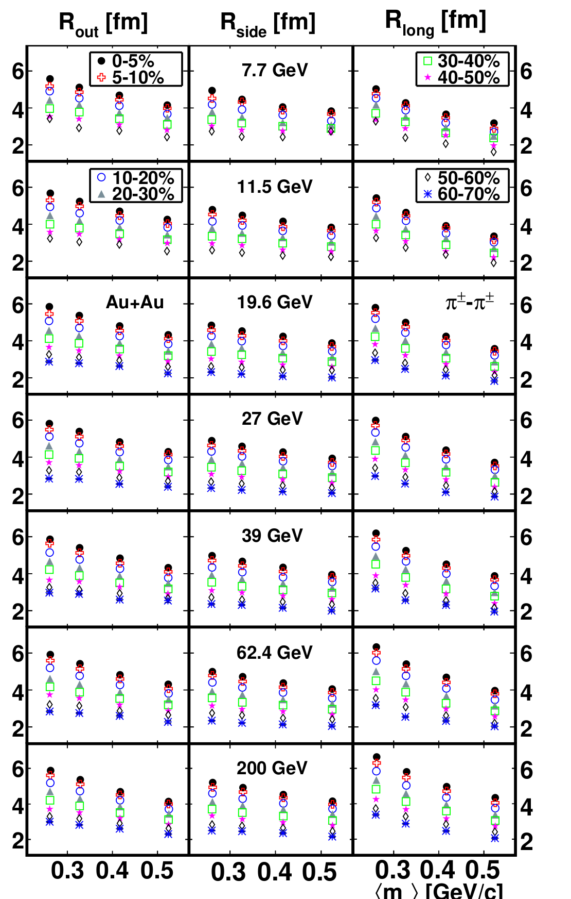
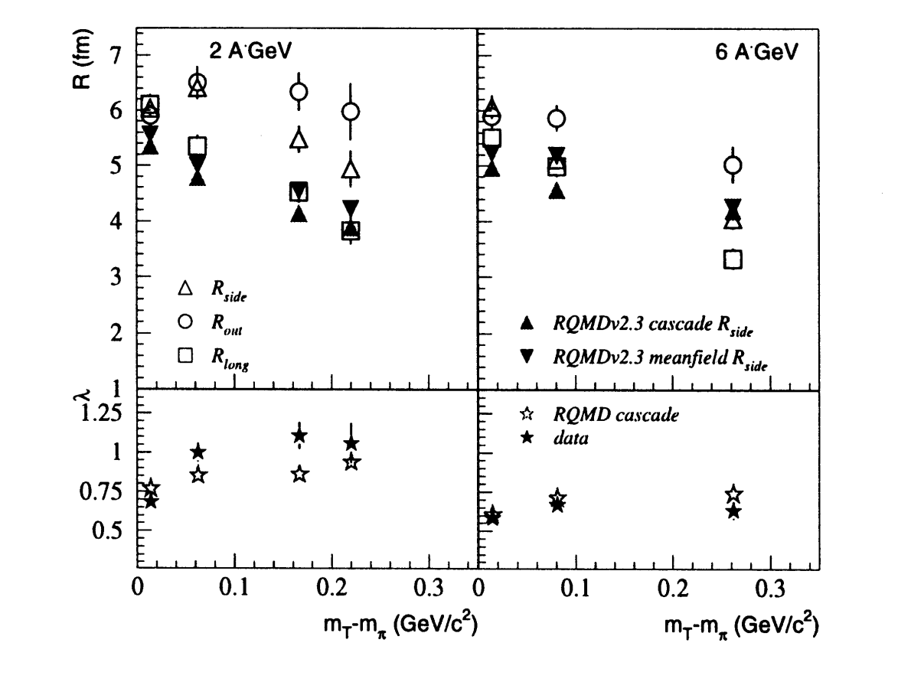
Physics in CBM
Advances in nuclear dynamics 5 , W. Bauer G. d. Westfall
THE BOMBARDING ENERGY
DEPENDENCE OF 1r INTEFEROMETRY
AT THE AGS, M. Lisa et al..
Beam energy dependent two-pion interferometry and the freeze-out eccentricity of pions in heavy
ion collisions at STAR, Physical Review C 92, 2014, L. Adamczyk et al..

Slide 11
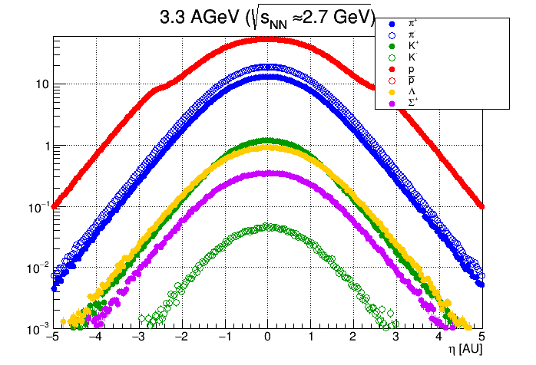
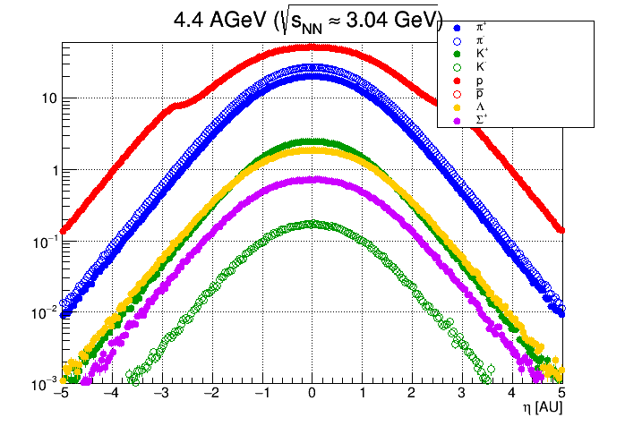
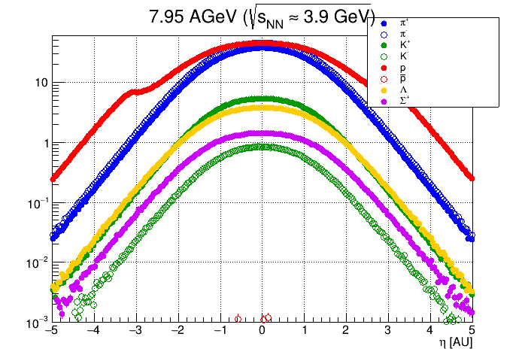
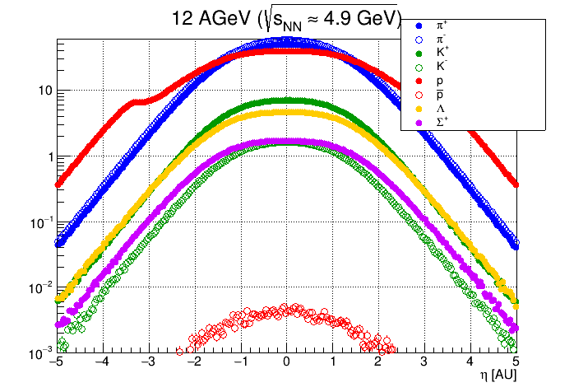
Physics in CBM – model predictions

Slide 12
Femtoscopy in CBM
Problems with CF in experiment:
Identification of particles (type, primary/secondary)
Momentum resolution
Two-track effects
Residual correlations

Slide 13
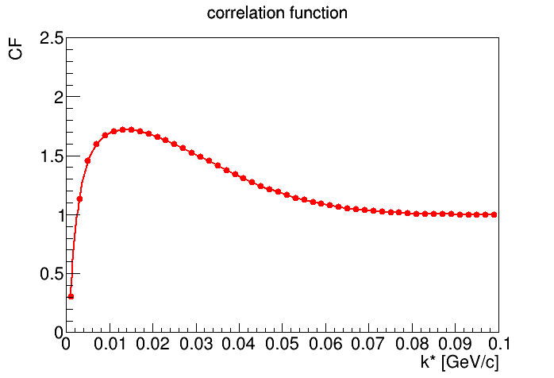
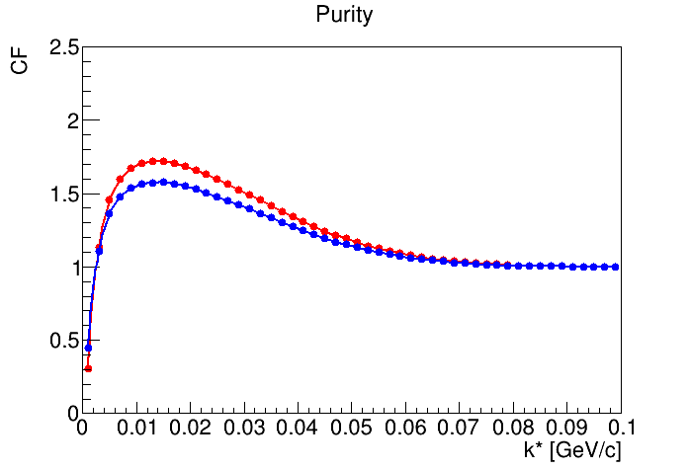
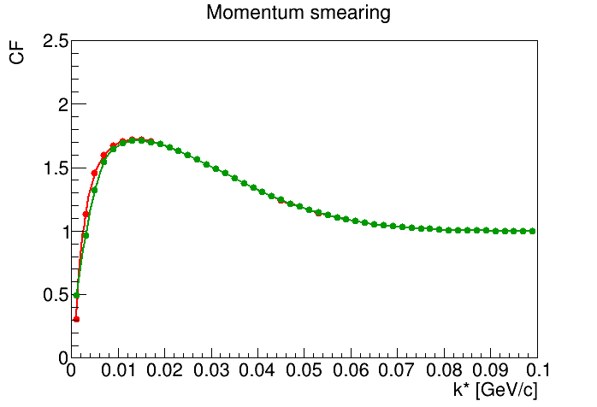
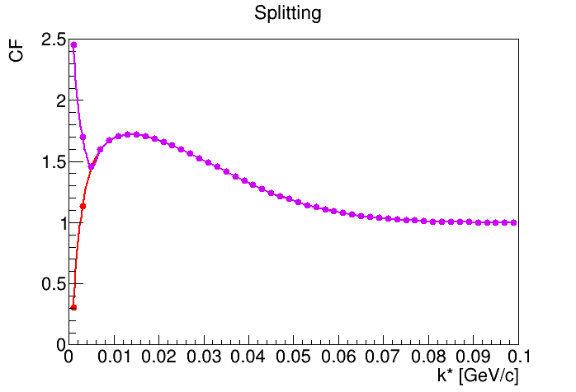
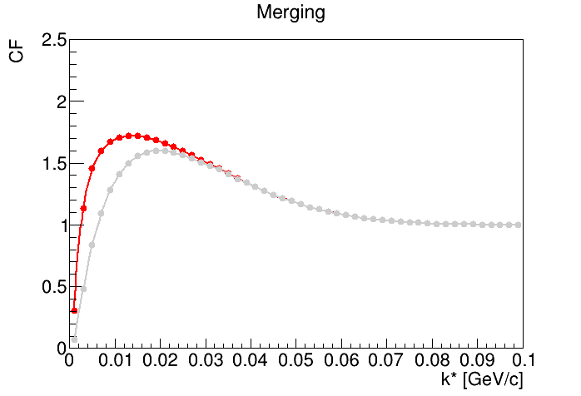
Femtoscopy in CBM

Slide 14
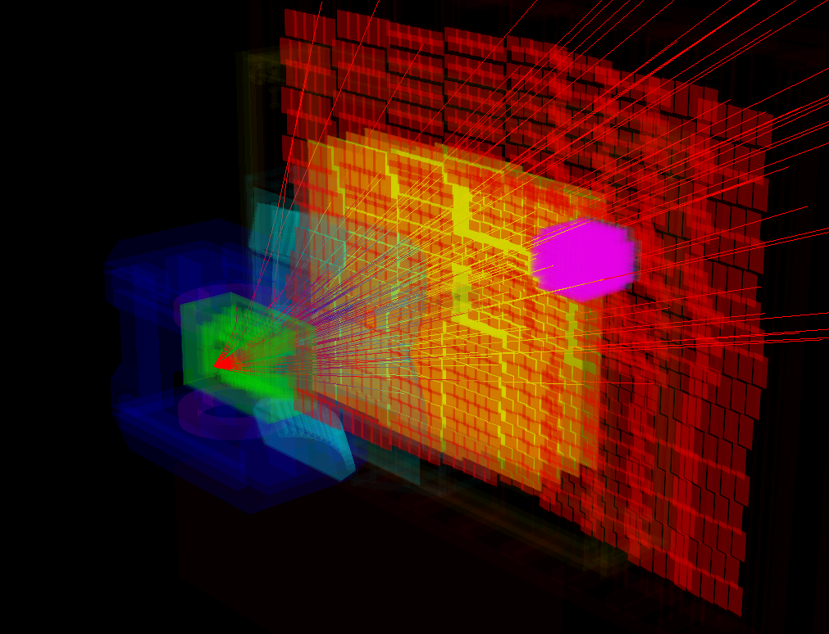
Femtoscopy in CBM
How to deal with two-particle effects:
Apply the cuts on pure MC model (UrQMD does not have correlations) until flat correlation function will be achieved
Two-track cuts that remove merging/splitting must remove pairs that potentially are merged or splitted but cannot base on q_{inv} (we don’t want to remove region of correlation peak) example two particle cuts:
  STS exit separation – distance between two trajectories at the end of the STS detector
  N_{STS} hits it’s less probable that pair with larger number of total hits will be from merging/splitting
  X,Y – position of particle during passing through given STS station (some STS layers overlaps)
  Δη*Δφ* - Δη Δφ between two particles but at given distance from vertex
  ΔX ΔY – distance between two trajectories at given distance from event vertex

Slide 15
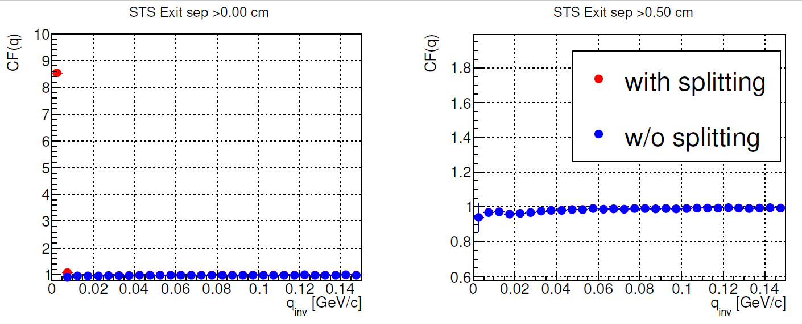
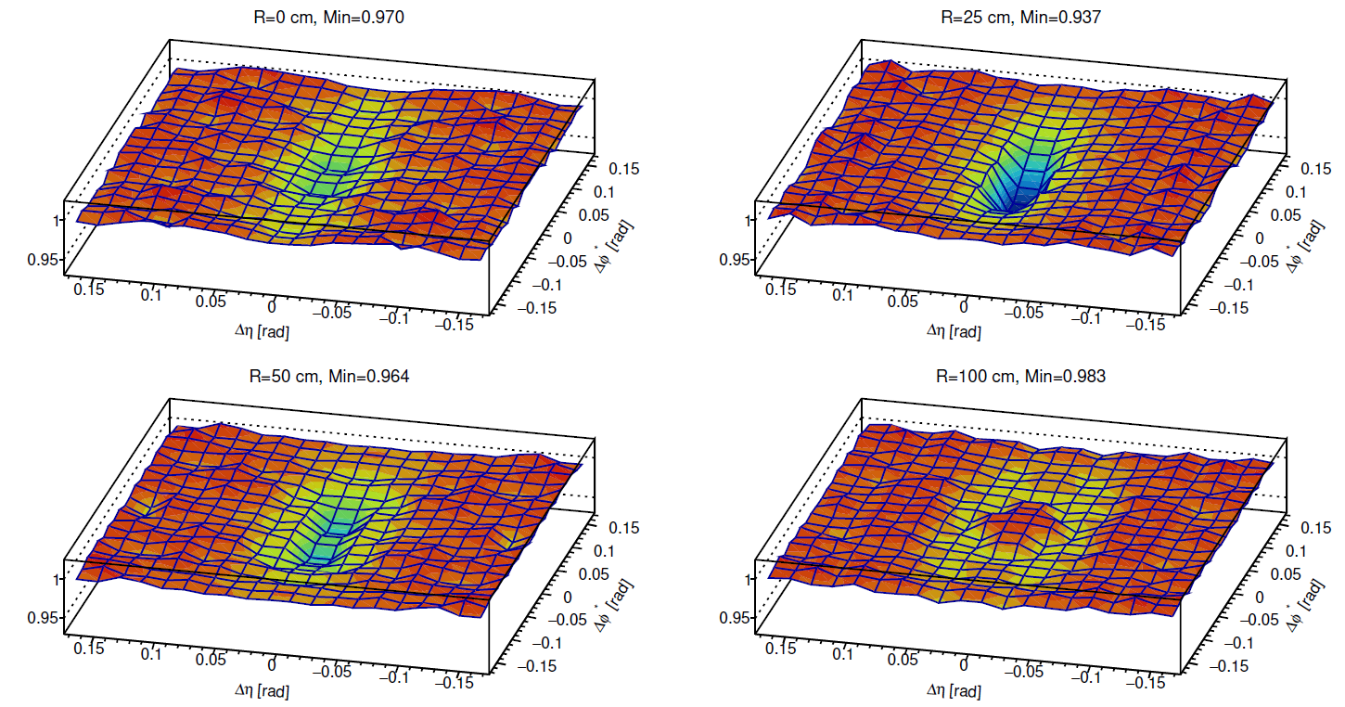
Femtoscopy in CBM – negative pions
Anti-splittng cut – STS exit separation
Anti merging cut – Δη*Δφ* cut

Slide 16
Femtoscopy in CBM
Fraction of correlated pairs
$$C\left(q\right)=N\left(1+λC_{purity}\left(q\right)\left(C_{map}\left(q,R\right)−1\right)\right)$$
Fraction of pion-pion pairs
Normalization
CF for gaussian source
Spherically symmetrical
PRF frame
Numerical map
Impurity
  $$C_{purity}\left(q\right)=1−(A+Be^{−qC})$$

Slide 17
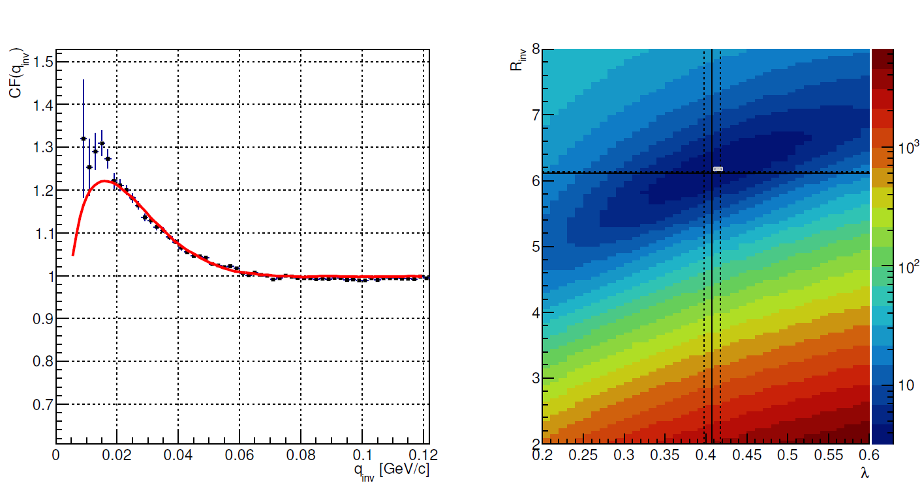
Femtoscopy in CBM – negative pions
After analysis of 1M central AuAu events
Systematic uncertainty is estimated to be around 9-10%
It’s worth to stress that assumed source (3-dimensional gaussian) is not well described by 1-dimensional gaussian model.

Slide 18
Femtoscopy in CBM: protons
Similar sample of data – central UrQMD events, 1M of events. Track cuts optimized to select primary protons.
Input – gaussian source with R=3.5 fm and lambda = 1 – radius taken from UrQMD model.

Slide 19
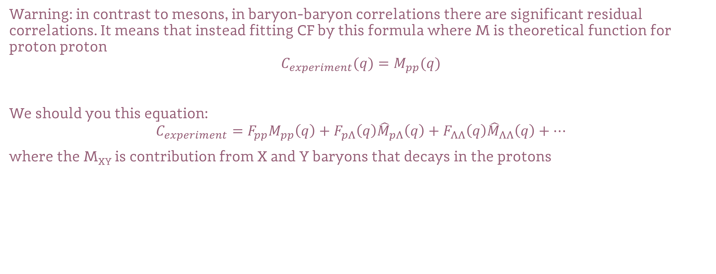
Femtoscopy of protons (WIP)
Warning: in contrast to mesons, in baryon-baryon correlations there are significant residual correlations. It means that instead fitting CF by this formula where M is theoretical function for proton proton
$$C_{experiment}(q)=M_{pp}(q)$$
We should you this equation:
$$C_{experiment}=F_{pp}M_{pp}\left(q\right)+F_{pΛ}\left(q\right){\hat{M}}_{pΛ}\left(q\right)+F_{ΛΛ}\left(q\right){\hat{M}}_{ΛΛ}\left(q\right)+…$$
where the M_{XY} is contribution from X and Y baryons that decays in the protons

Slide 20
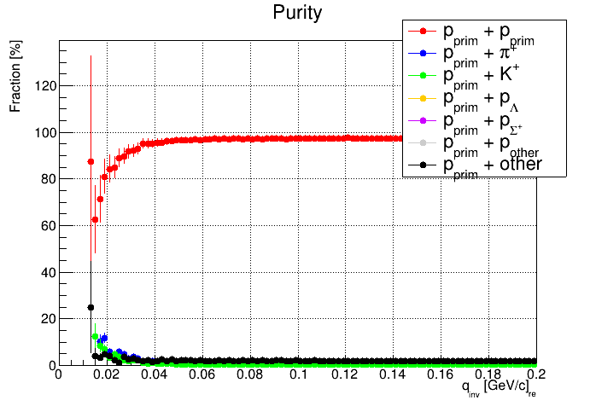
Femtoscopy of protons
The good news – there is no significant contribution from residual correlations in CBM!

Slide 21
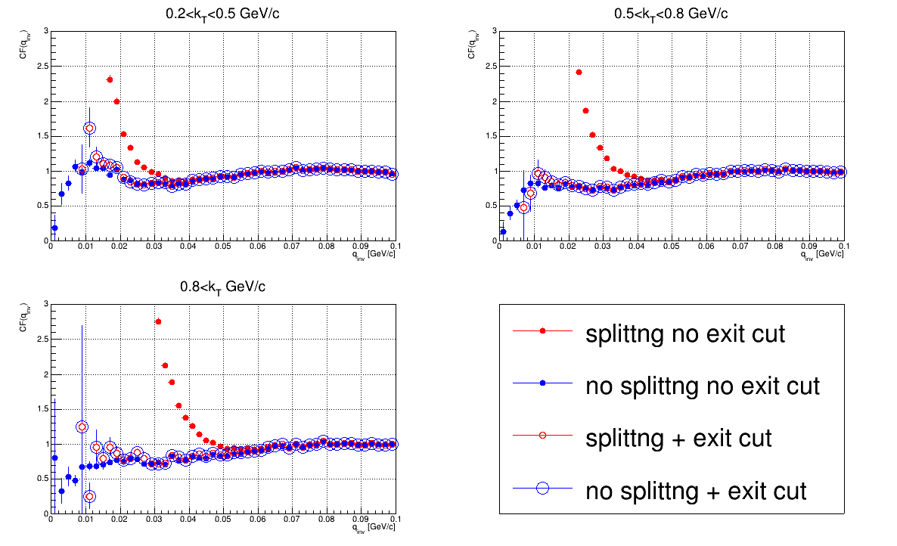
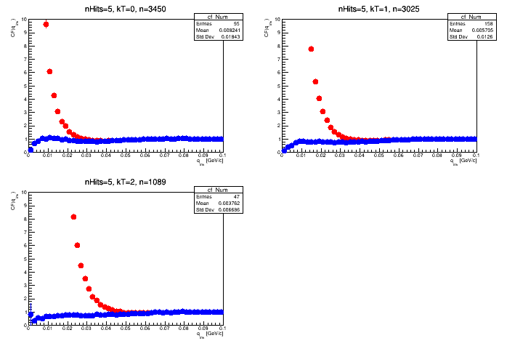
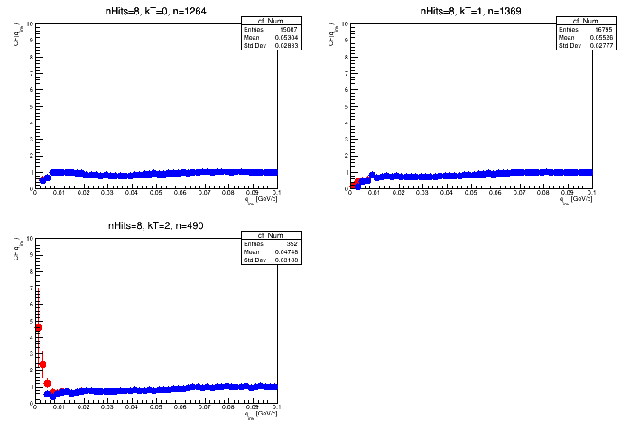
Anti splitting cut
STS hits >=5
STS hits >=8
STS exit cut = 1 cm
(for pions it was 0.5 cm)

Slide 22
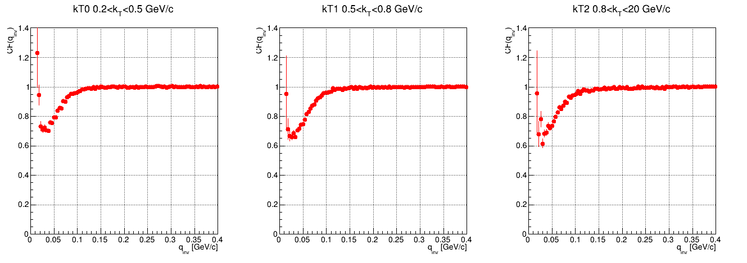
Merging – corrected by dividing the denominator

Slide 23
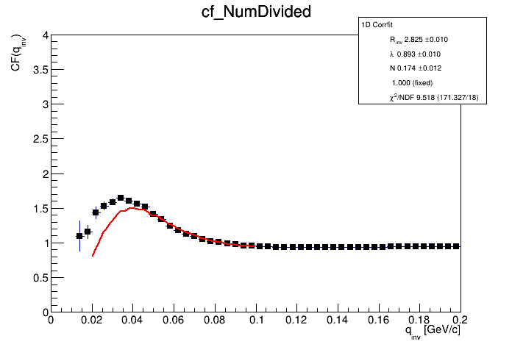
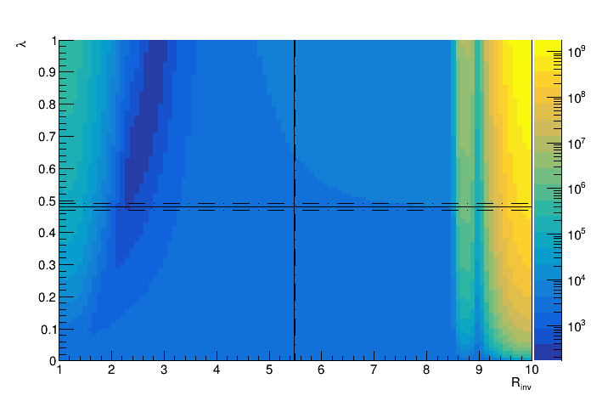
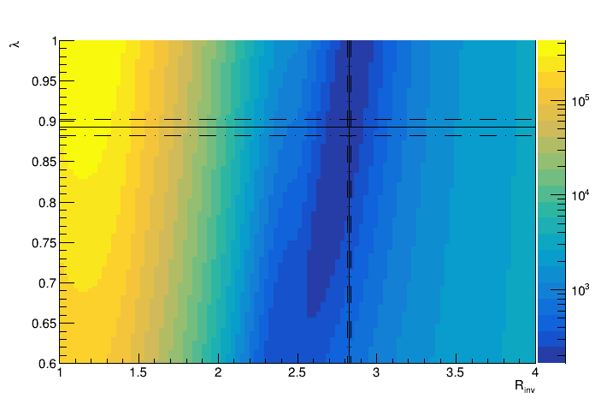
Fitting
NicaFemto + pp-map (no momentum smearing included)
Normalization fixed from range of 0.2-0.3 GeV/c
Two step of fitting
Process is automatized

Slide 24
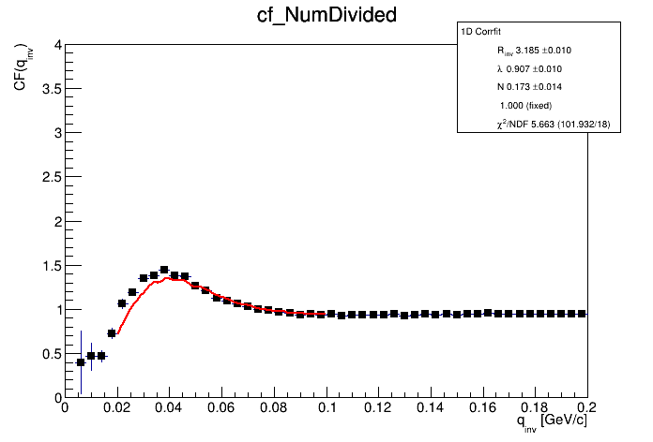
Results
Obtained radius are smaller (≈ 2.8 instead of 3.5 fm)
Lambdas are also smaller (0.85-0.9 instead of 1)
Relatively small statistical uncertainty (ΔR≈0.3%)
Large systematical uncertainties - ΔR≈55% - the biggest source of uncertainty – parametrization of „background”

Slide 25
Summary & plans
CBM seems to be very good detector for pion measurements
Protons correlation – further studies needed
There is no significant contribution of residual correlations into proton-proton HBT at 12 GeVA
TODO:
  Study the other correlations (exotic baryons, 3-dimensional femtoscopy etc.)
  Testing model predictions
  …

Slide 26
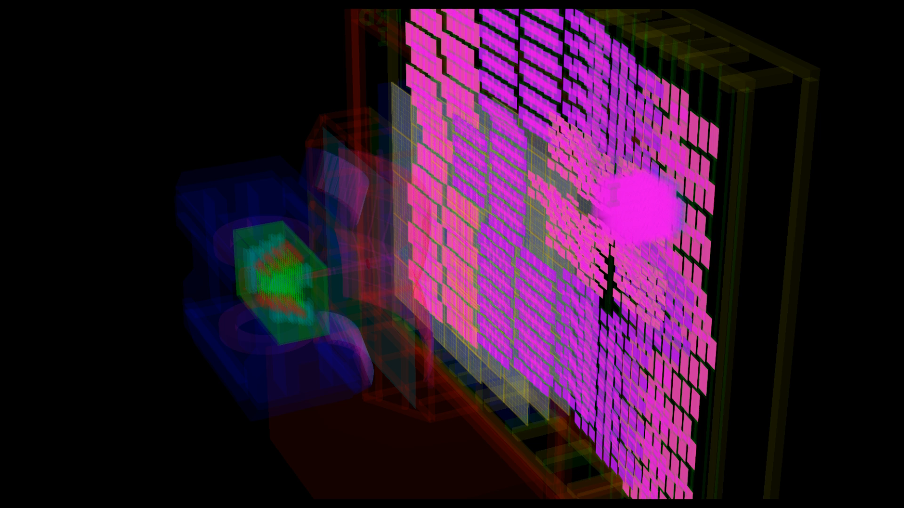
Thank you for your attention

Slide 27
The interesting part ☺

Slide 28
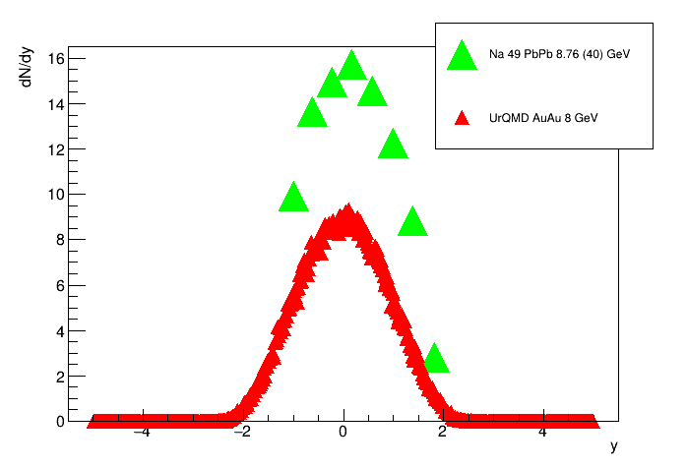

Slide 29
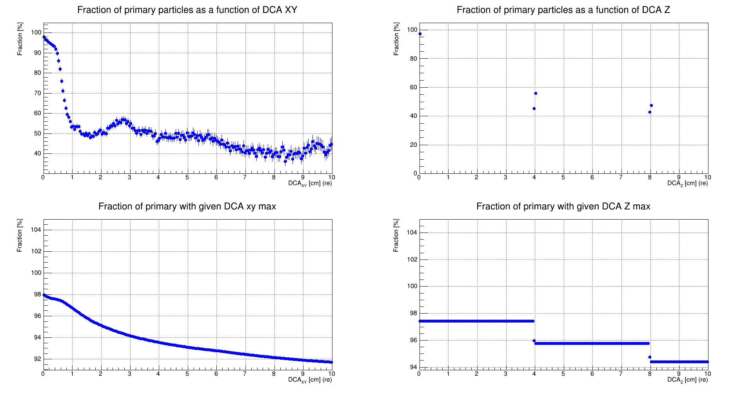
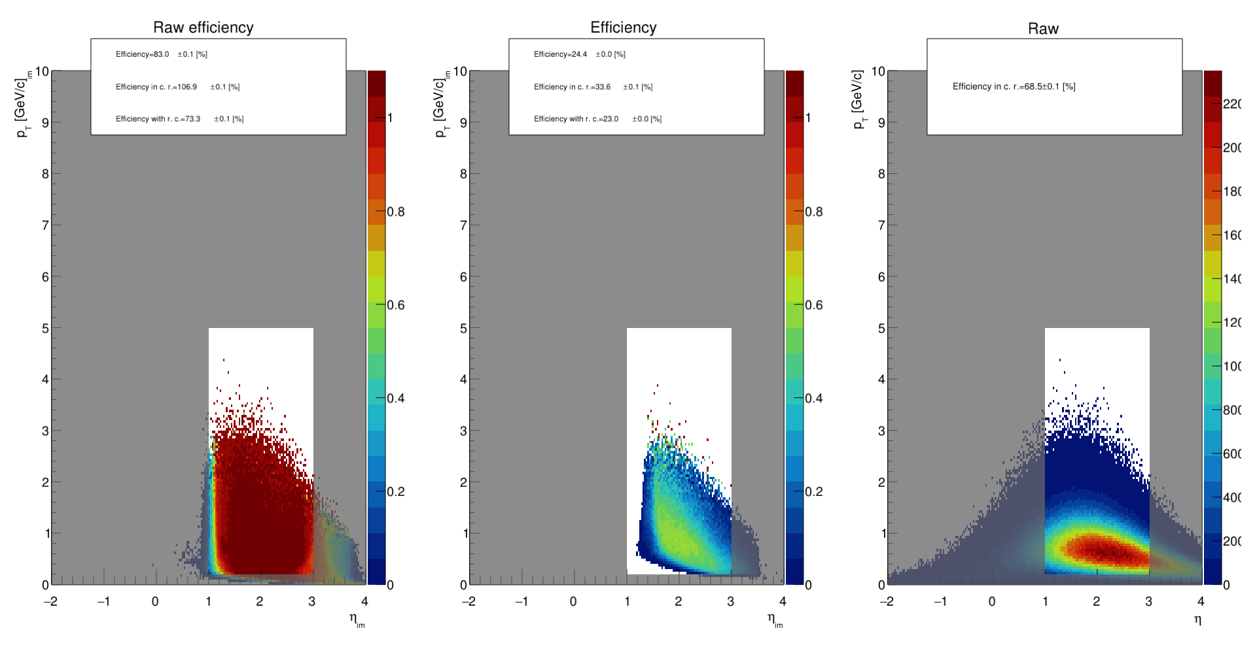
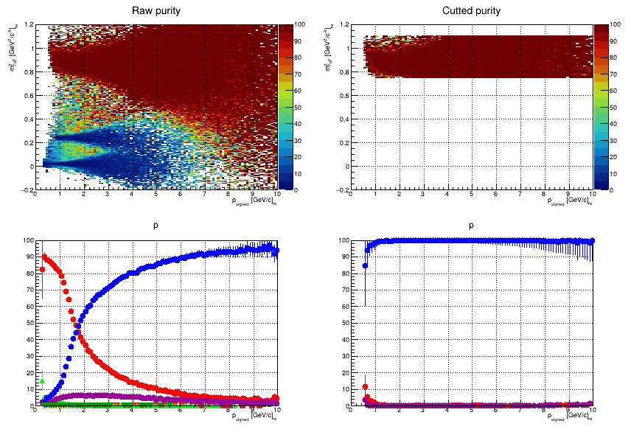
Cut optimization

Slide 30
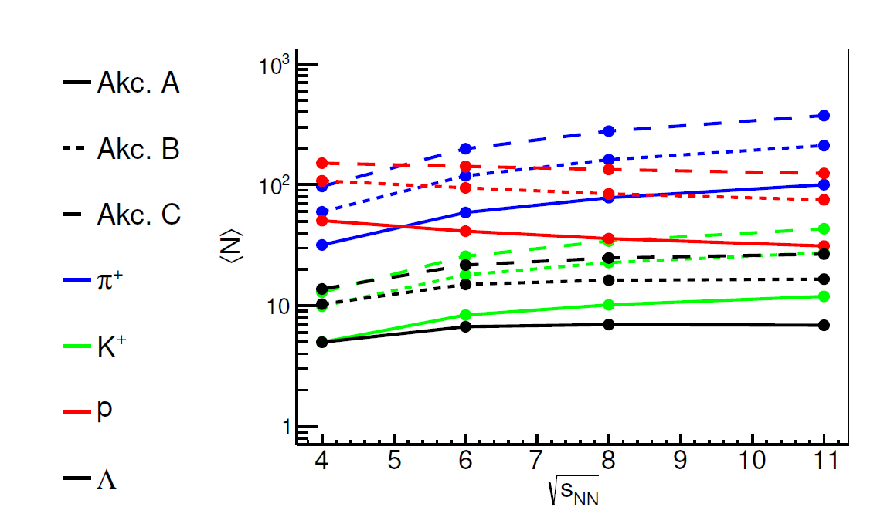
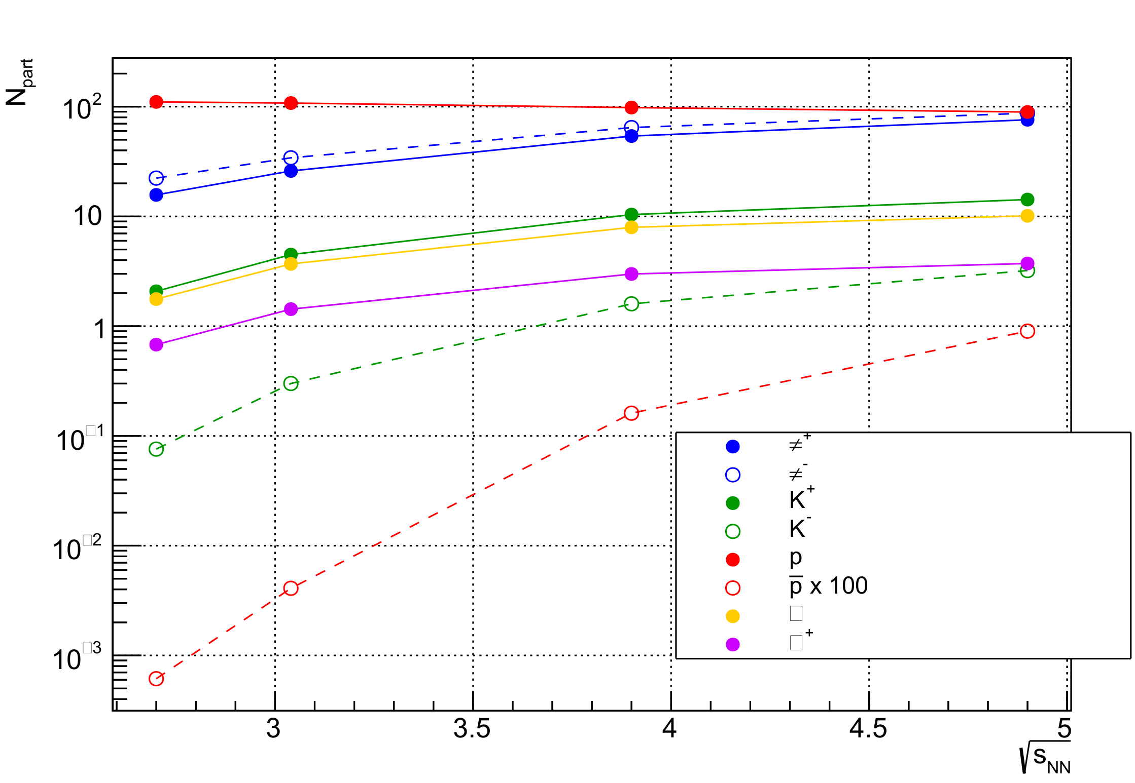
Physics in CBM – model predictions
Central AuAu events (0-5%) production at midrapidity
D. Wielanek PhD Thesis

Slide 31
Two particle cut monitors

Slide 32
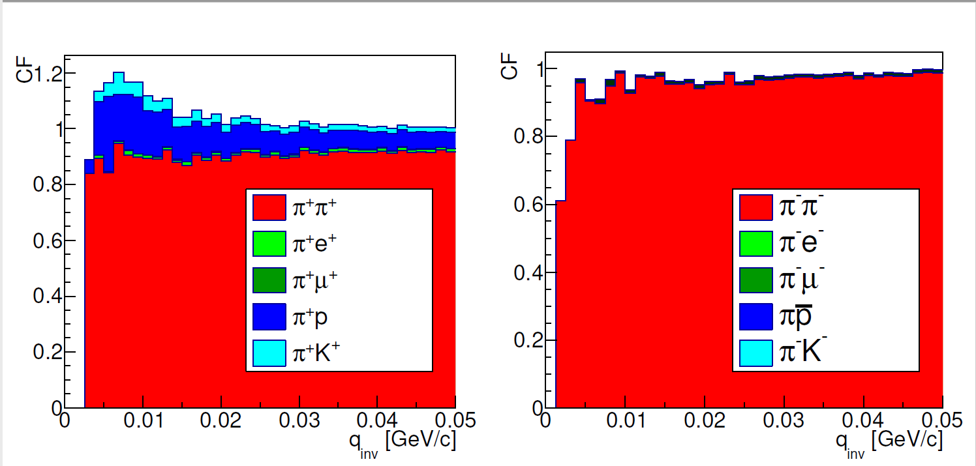
Femtoscopy in CBM
Pions:
Selected by m2 from TOF (negative pions chosen because positive one are strongly contaminated by protons)
DCA used to rejection of secondary pions

Slide 33
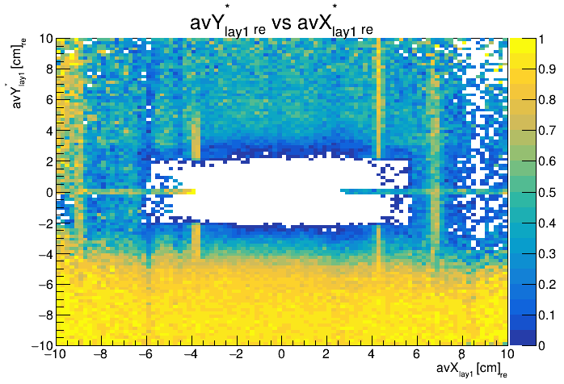
Strange splitting

Slide 34
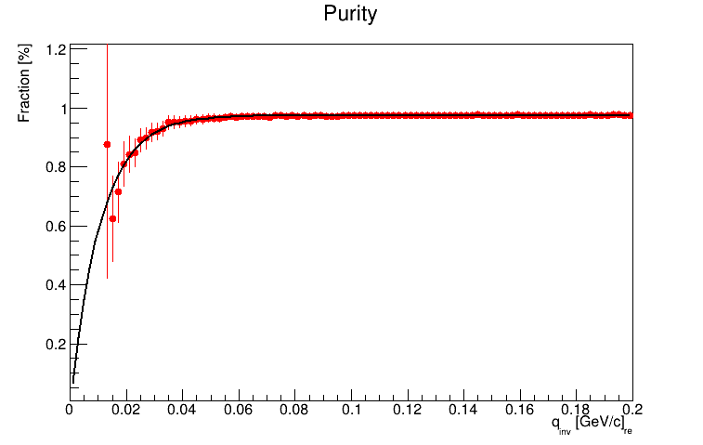

Slide 35
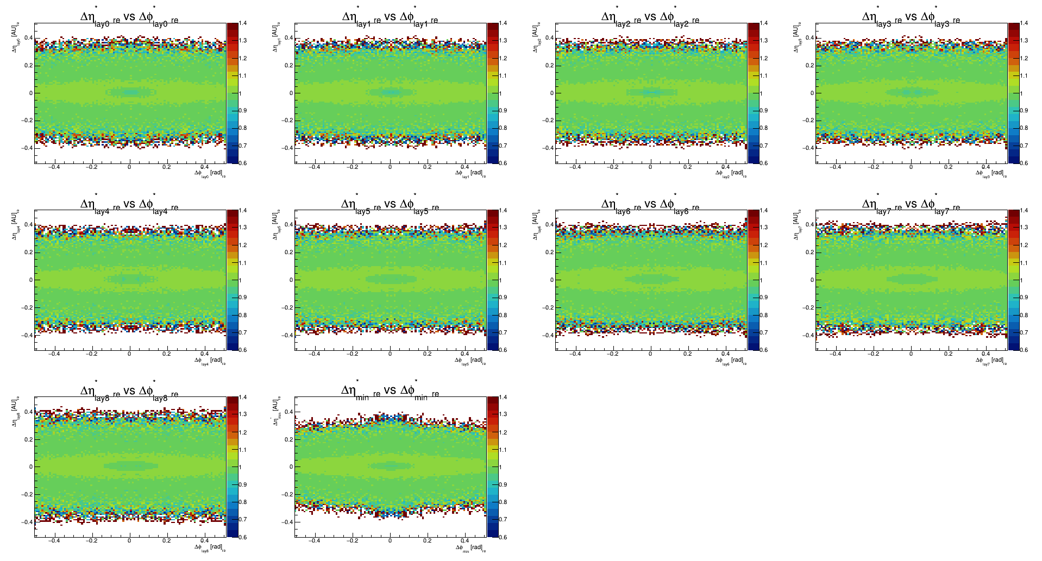

Slide 36
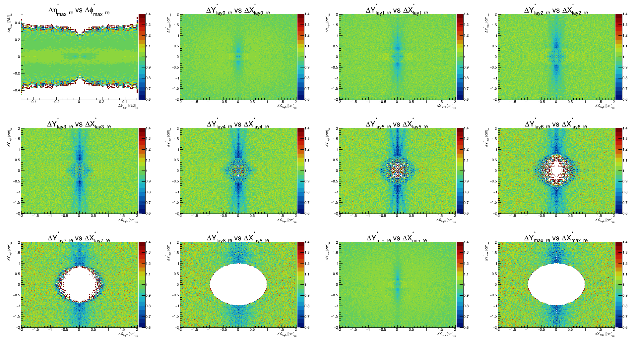

Slide 37
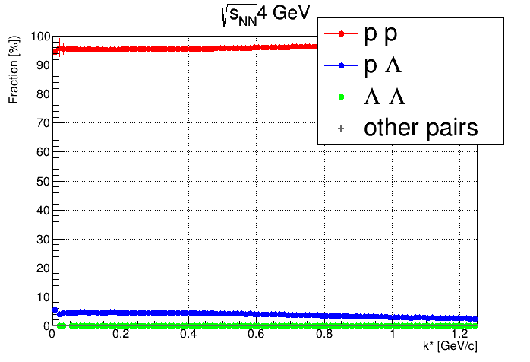

Slide 38
