Slide 1
Aging studies and resulting design change considerations for MRPC3/4
Yongjie Sun
USTC

Slide 2
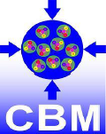
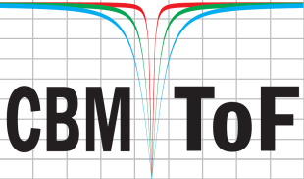
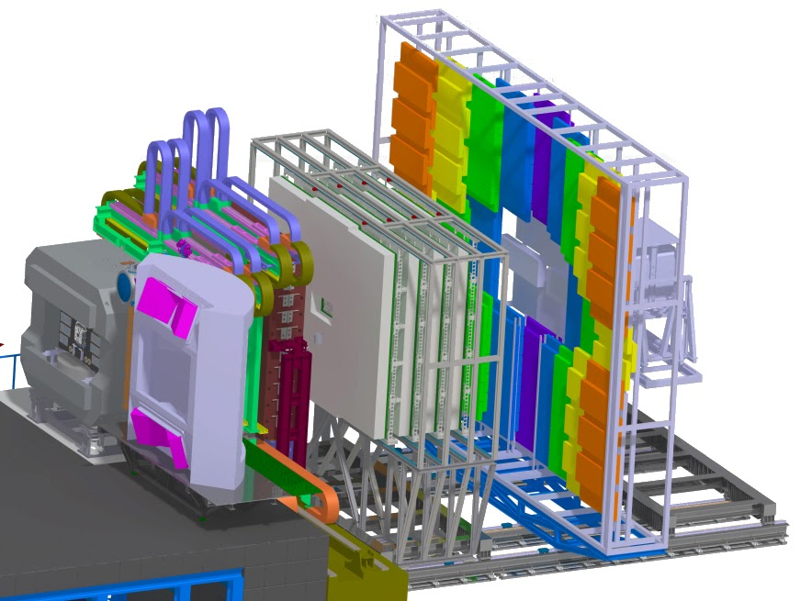
CBM-TOF
TOF
Hadron identification at CBM is provided by measuring the momentum and the time of flight of the respective particles.
CBM-TOF Requirements
Full system time resolution $σ_{T}$~ 80 ps
Efficiency> 95 %
Rate capability < 150 kHz/cm²
The low rate region of ToF-wall will consists of MRPC3 and MRPC4

Slide 3
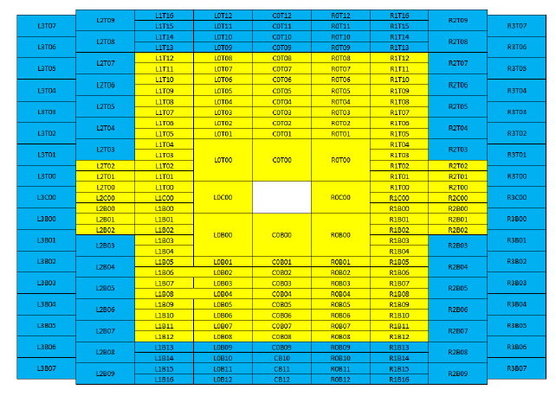
Requirements
For the region A, the MRPC requirements:
Time resolution in the order of 50ps.
Efficiency better than 95%.
Occupancy smaller than 5%.
A rate capability about 1${kHz/cm}^{2}$.
Impedance matching at high rate.
A

Slide 4
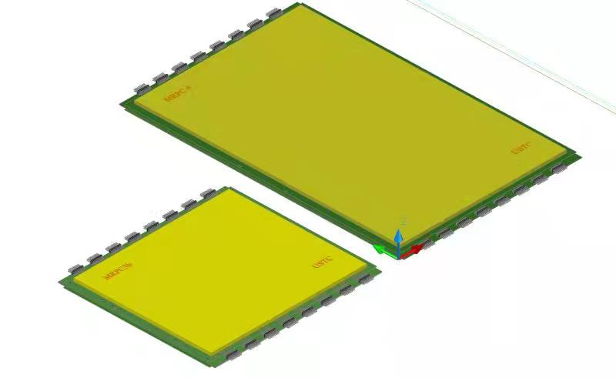
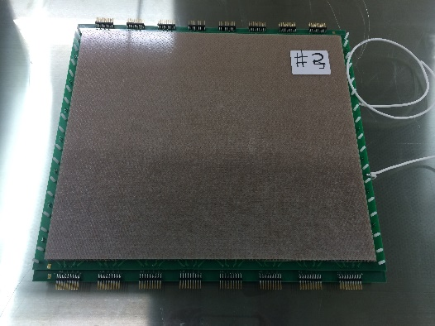
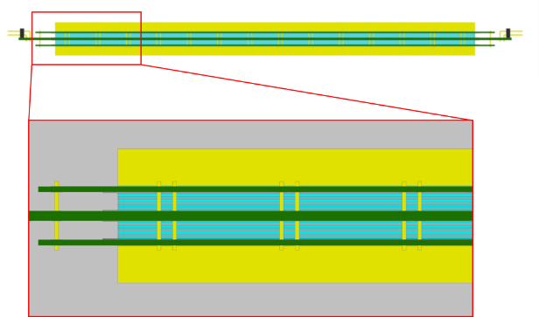
MRPC3 and MRPC4 structure
 |  | MRPC 3 | MRPC 4
 |  | Double-stack
Glass | Type | ultra-thin float
 | Size | 330 x 270 x 0.23 mm | 330 x 540 x 0.23 mm
Gaps | Size | 0.230 mm
 | Number | 5 x 2
Readout strips |  | (0.7 cm + 0.3 cm) x 32 ,double-end strip readout
Impedance |  | 50 Ω differential signal to PADI
Active area |  | 320 mm × 270 mm | 320 mm × 540 mm
Detector size |  | 377 ×324 mm | 377 × 588 mm
MRPC4

Slide 5
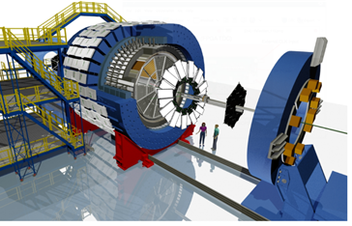
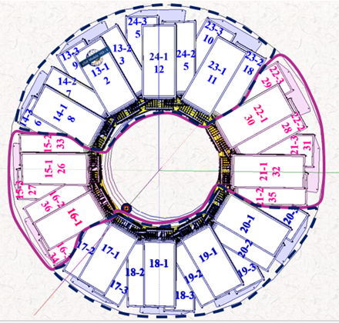
CBM/STAR endcap TOF Upgrade
MRPC3b (the former name of MRPC3) for CBM – STAR eTOF installation by 2018-12
24 modules ( =72+8 MRPCs) from USTC
- 3 layers
- 12 sectors
- 6912 channels
- Sector counting matches the TPC sectors

Slide 6
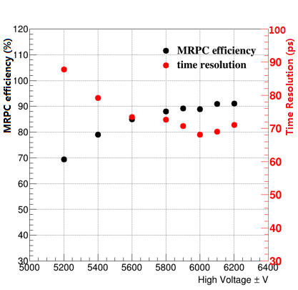
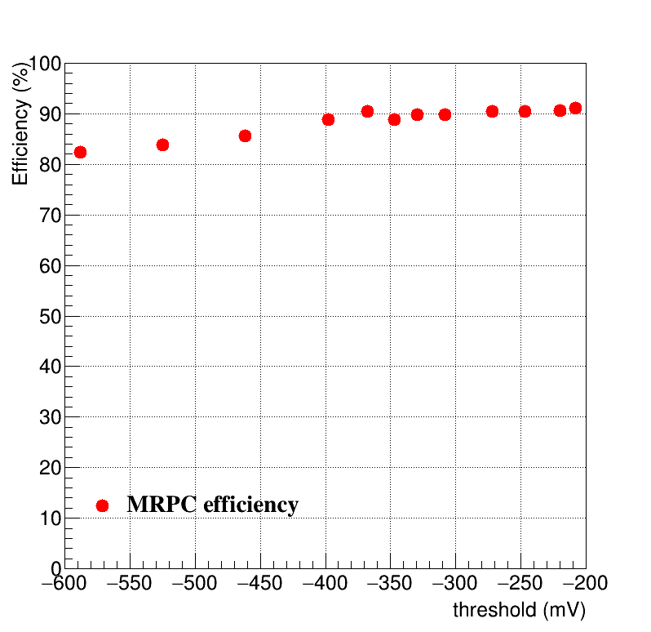
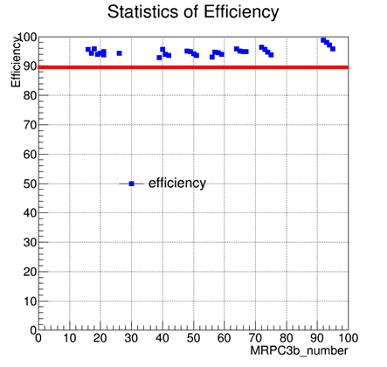
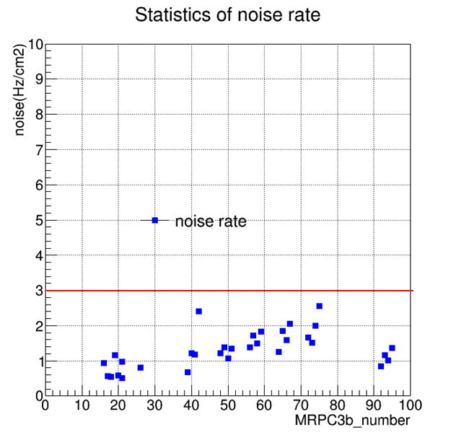
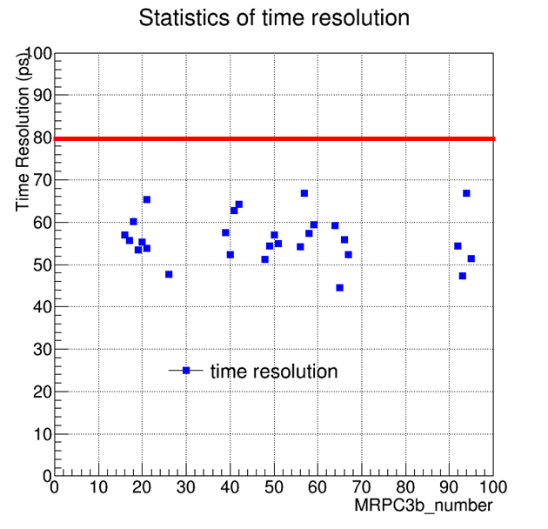
MRPC3b cosmic Test
Set ± 6000V as the work voltage. （95% Freon + 5% C₄H₁₀）
Set -347.2 mV as the work threshold
MRPC3b: Meet time resolution, noise rate and efficiency requirements

Slide 7
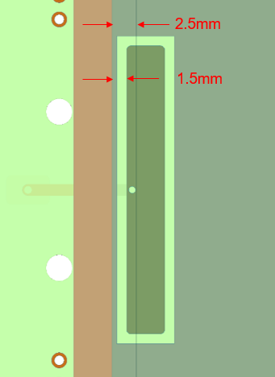
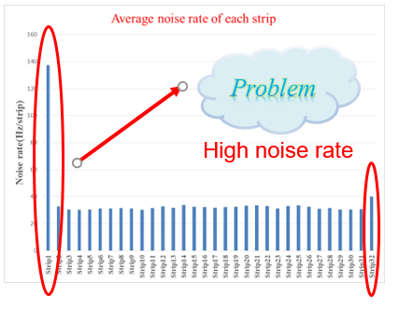
MRPC3b
For MRPC3b:
Basically, main goals achieved.
➔ Still, some improvements needed:
Weak high voltage connection
High noise rate on edge strips
Weak HV point of initial MRPC3b design:
Around the HV connection point, the copper edge to the glass edge is 1.5 mm.
Improvement made before the production.

Slide 8
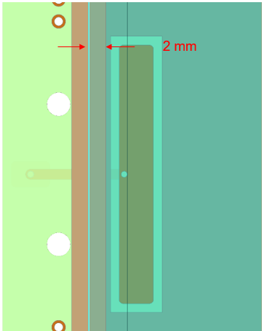
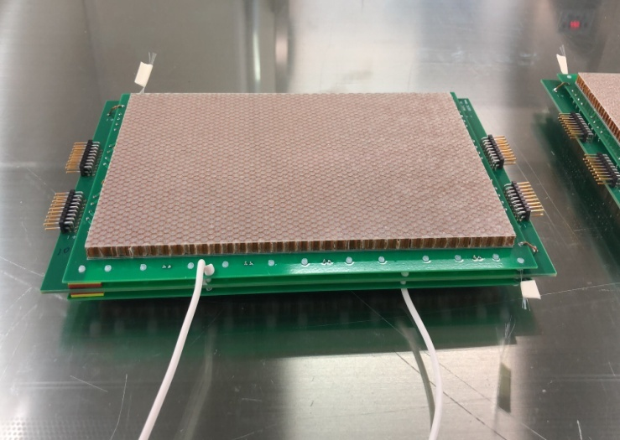
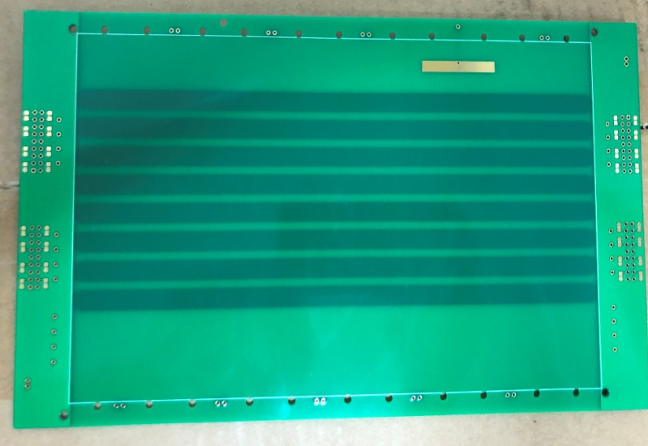
Improvements
For HV connection
Extend the outer glass by 2 mm along the HV input edge in the latest MRPC3b version.
In total 3.5 mm distance provides stronger HV protection than before.
For high noise rate
Simulation with CST software
Different HV pad shapes (long/short rectangle + round), distances between HV pad and nearest strip, have been simulated.
MRPC prototypes been built and tested according to the simulation results.
Test MRPC

Slide 9
Test results
3 prototypes configurations:
S6: HV pad 8 mm x 15 mm, HV to closest(8th) strip 6 mm, Edge distance 25 mm
R4: HV pad 4 mm x 30 mm, HV to closest(8th)strip 4 mm, Edge distance 31 mm
R8: HV pad 4 mm x 30 mm, HV to closest(8th)strip 8 mm, Edge distance 27 mm
Current: HV pad 4 mm x 30 mm, HV to closest(8th)strip 2 mm, Edge distance 5 mm
Chamber_strip

Slide 10
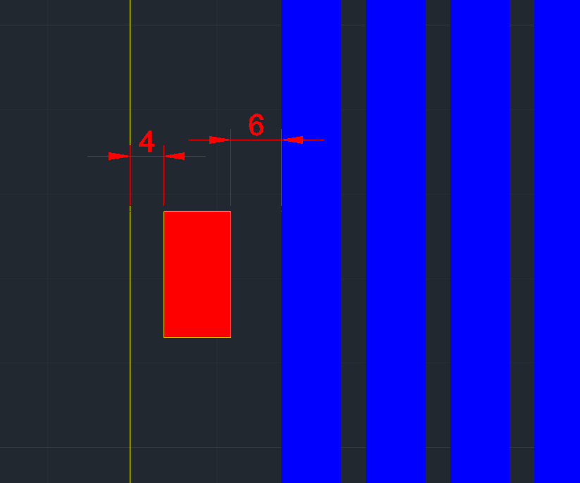
Improvement of counter structure
Increase distance between HV pad and first strip:
2 mm→6 mm
Increase distance between glass edge and last strip:
5 mm→18 mm
Change dimension of HV pad :
4 mm x 30 mm→8 mm x 15 mm

Slide 11
Noise test results for new MRPC3
Test results show edge effect and HV pad shape are related to noise.
The noise counting rates on two-side strips are reduced

Slide 12
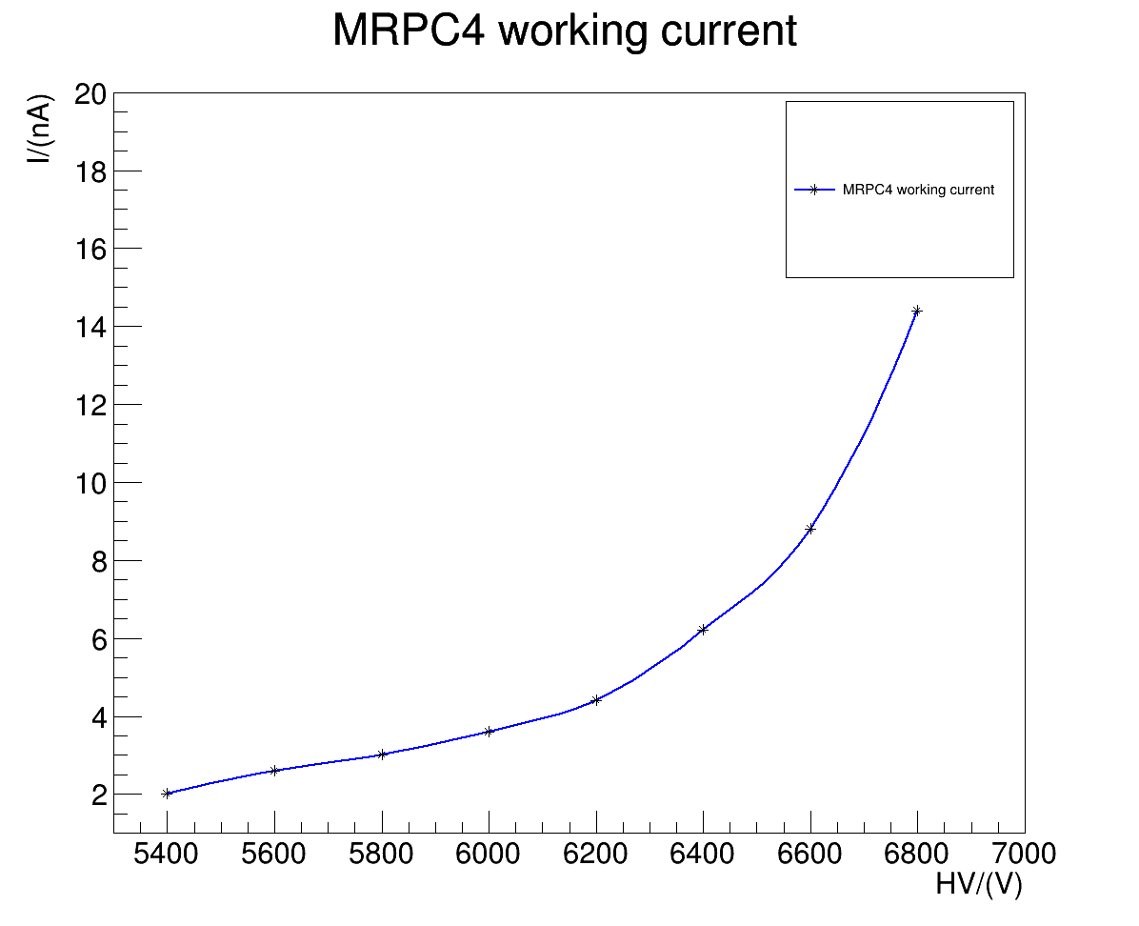
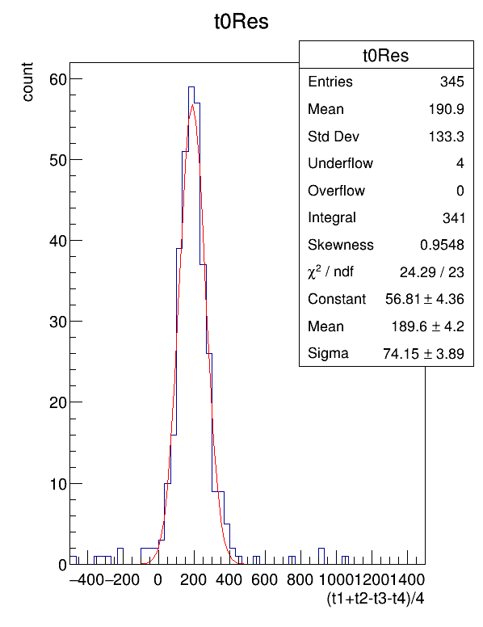
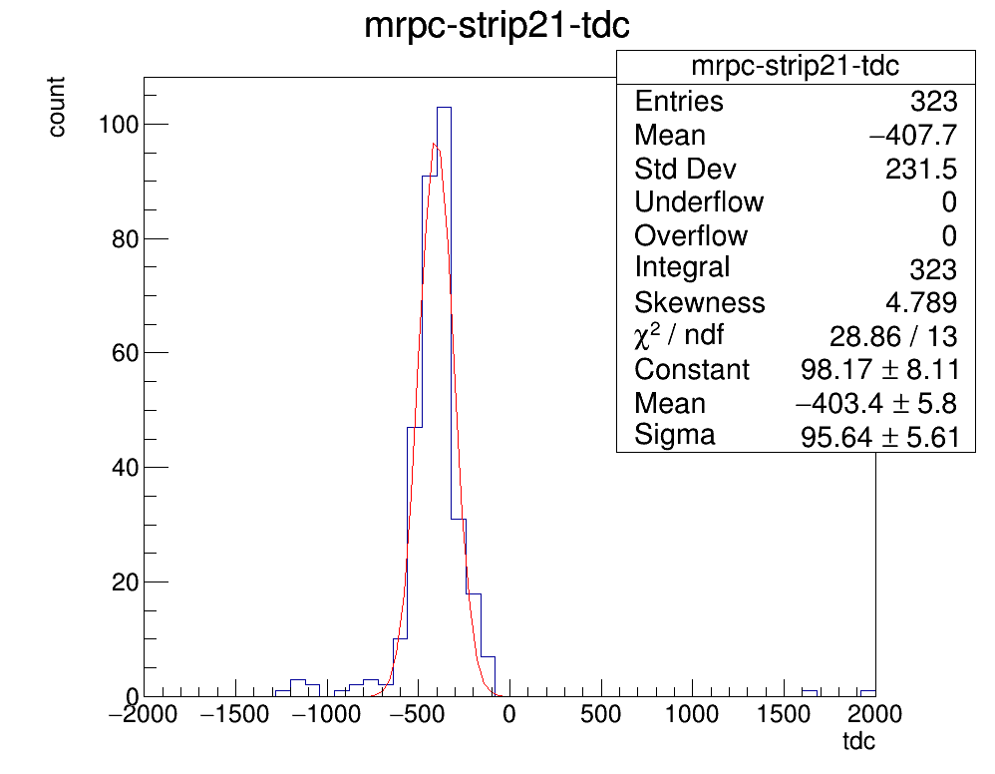
MRPC4 cosmic ray test
Cosmic ray platform
The working current is low and stable 3.6nA@6000V
$$σ_{T}=\sqrt{({95.64}^{2}−{74.15}^{2})}=60ps$$

Slide 13
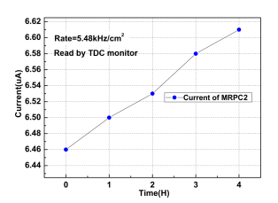
Gas aging & pollution
Gas pollution effect observed at RHIC-STAR MTD
Gas pollution effect observed at mCBM at high rate (about 5 – 10 kHz/cm²)
Gas pollution effect was reproduced at IRSAM (Bucharest) with high gamma flux
X-Ray test at Beijing confirmed the gas pollution effect
From CBM Progress Report 2020

Slide 14
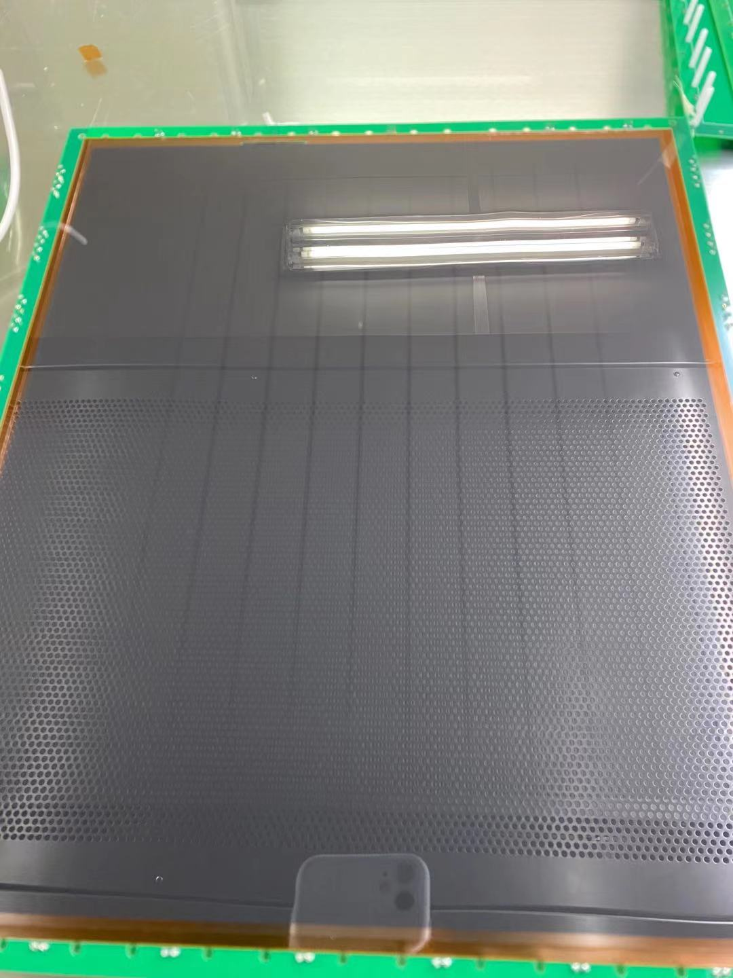
Inspection on returned MRPC3b
Obvious tracks caused by fish line
Can’t be erased by alcohol

Slide 15
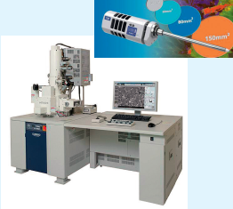
Inspection on returned MRPC3b
Side A
Side B
SEM test stand
Stains were found within ~20 microns of the fish line

Slide 16
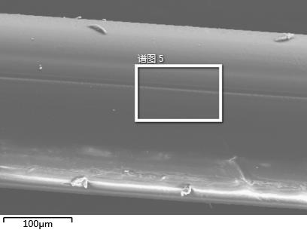
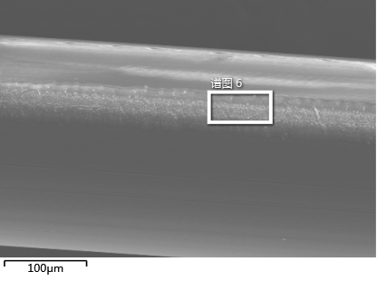
Inspection on returned MRPC3b
Unused fishing line
The elements in the gas and glass are shifted
Stains can be found on the fish line and on the glass around the fish line
The movements of elements in the stained areas are much more than other areas
The gas pollution effect may be much more obvious around the fishing line
Used fishing line

Slide 17
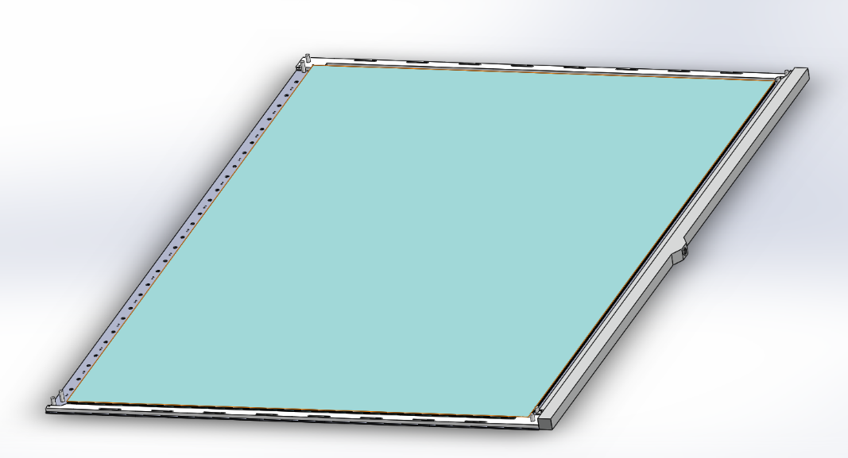
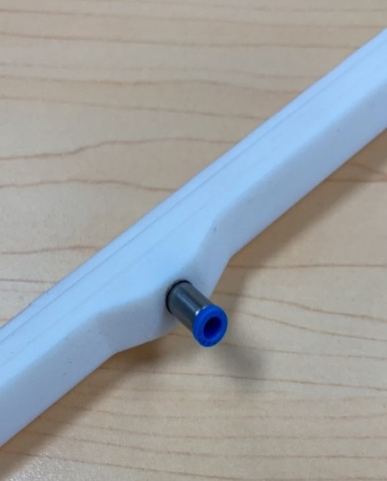
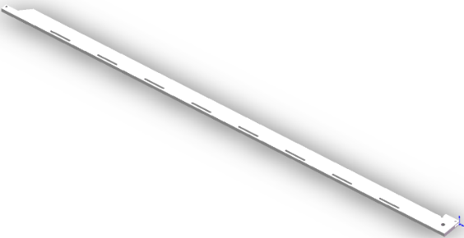
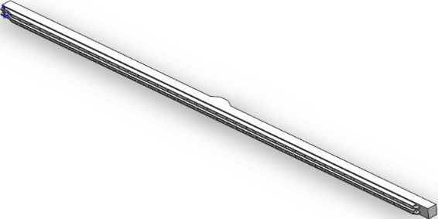
Design of semi-sealed MRPC4
Outlets
Φ3
Inwall of gas guider
Balance tube
Tubes of different sizes are placed at different distances to balance the flow of each outlets
Blocker
Gas guider
Blockers and gas guider are fixed by nylon screws and signal pins

Slide 18
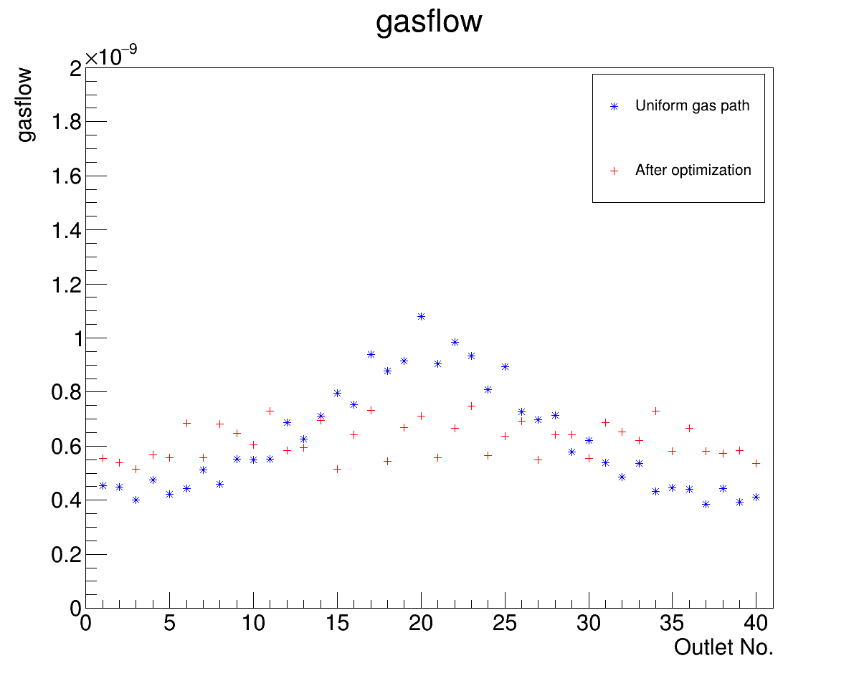
Simulation of gas guider
By use of balance tubes, gas path of the gas guider is optimized to make gas flow more even
The total gas flow is 50 ccm
The serial numbers are arranged from one end to the other
Gas flow is more even after optimization
18

Slide 19
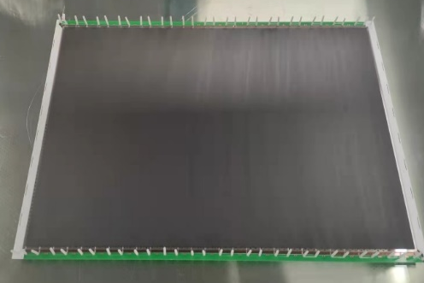
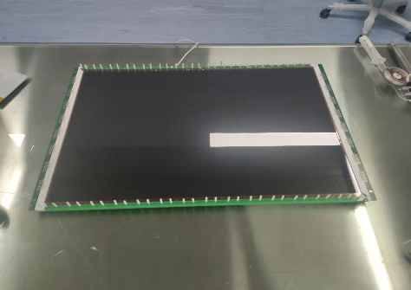
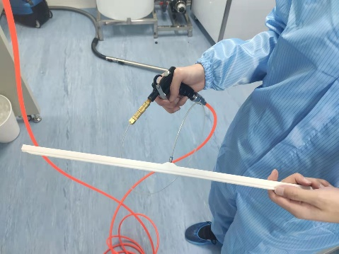
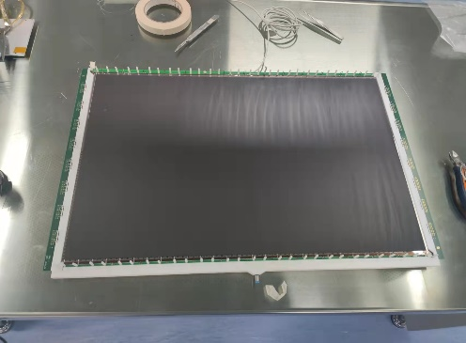
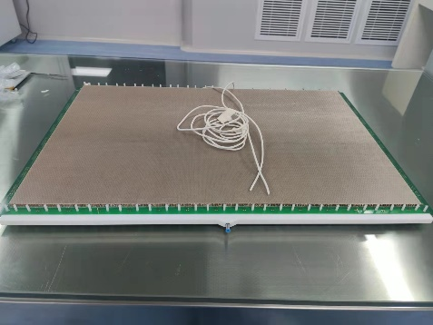
Assembling of MRPC4 (ongoing)
Blocker
Gas guider
1. Install the blockers of lower stack
2. Install the lower stack
3. Install the blockers of upper stack
4. Clean guider with blowing dust gun
5.Install the gas guider
The semi-sealed MRPC4

Slide 20
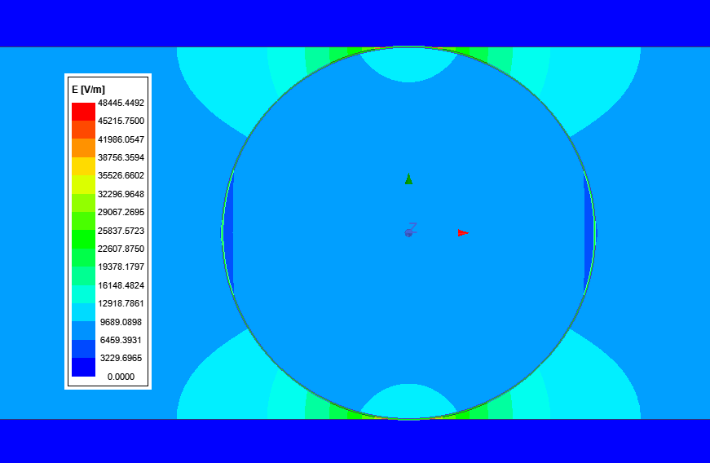
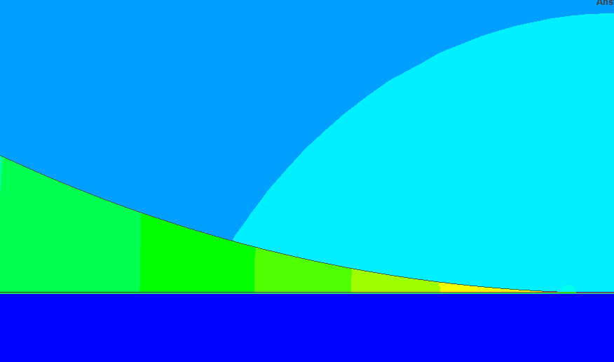
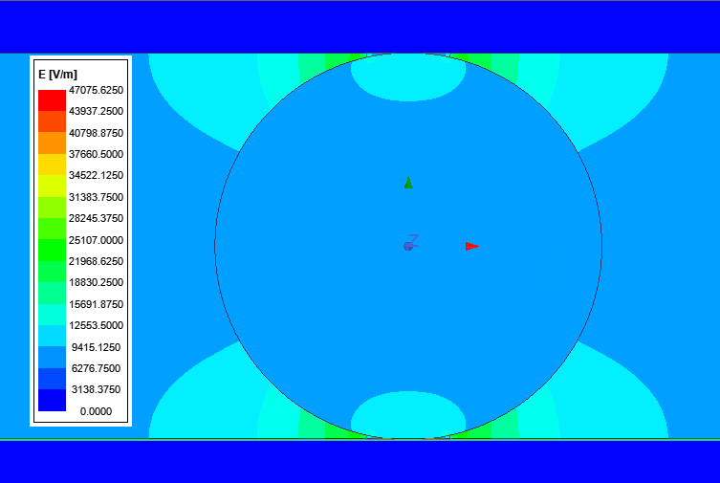
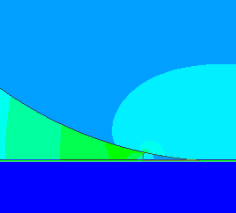
Electrostatic field simulation
electrode
The electric field around the fish line is 4 times higher
The gas exchange in this region may be poor
High noise rate because of the high field
May lead to serious gas pollution problems
Fish line
May reduce the effect by coat silicone grease on the fishing line
The electric field in the fishing line contact area decreases
No gas will enter the contact area → reduce the gas aging effect
silicone grease that covers the fishing line

Slide 21
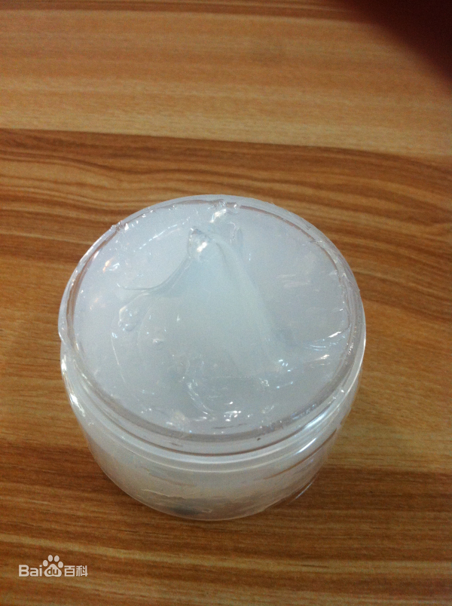
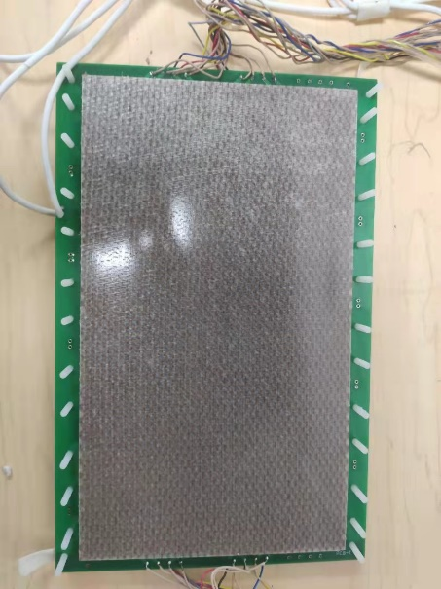
MRPCs with Silicone grease coated fish line
Silicone grease: a waterproof grease made by combining a silicone oil with a thickener.
High insulation
Low volatility, hard to evaporate
Chemical stability
Silicone grease coated fish line
Made a MRPC prototype
1x3 gaps
gap width 0.23mm
8 readout strips
Strip: 20mm x 7mm
Regular fish line

Slide 22
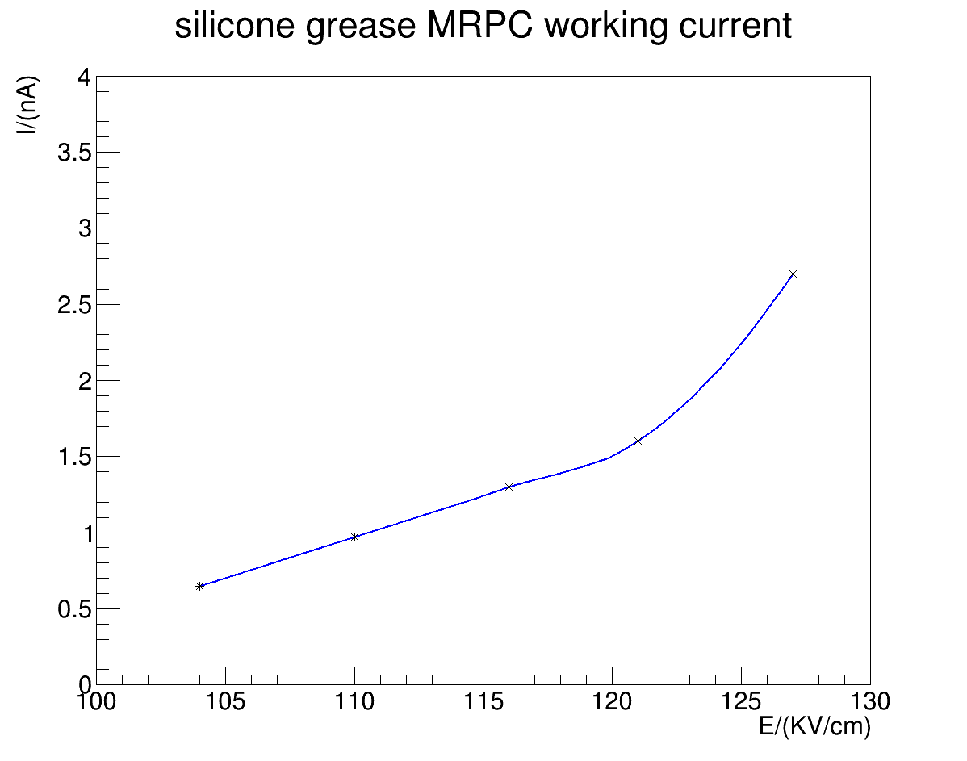
MRPCs with Silicone grease coated fish line
Working efficiency ~84%@110kV/cm, reasonable for a 3 gas-gaps detector
After 40 days high voltage test, the leak current goes up to 20 nA @110kV/cm
Grease trace
Try to use less silicon grease
Use other rectangular materials as spacers
A 2mm × 400mm × 0.204mm Teflon tape has been ordered to be used as spacer
The grease flowed and spread to about 2 mm width

Slide 23
Conclusions
The design, test and operation of MRPC3/4 show very reliable results.
All the required performances have been achieved.
→ Time resolution, efficiency, granularity, rate capability, noise rate, impedance matching, …
The aging effect may relate to gas changing rate and electrical field around fishing line.
The gas-guide structure is under construction and to be test soon.
The rectangular spacer will be applied in MRPC4.
The grease/oil treating mothed need a much longer time scale...

