Slide 1
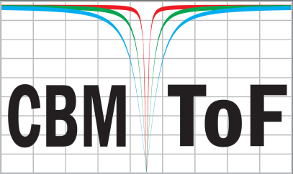
Design change considerations for input protection of the CBM TOF FEE
Jochen Frühauf
GSI Helmholtzzentrum für Schwerionenforschung GmbH(GSI)

Slide 2
Outline
1st PADI damage @ STAR Experiment
2nd PADI damage @ STAR Experiment
Simulation
Outlook

Slide 3
First PADI damage @ STAR 2019/2020
no additional ESD protection diodes on FEE
we lost a substantial amount of PADI channels (50%)
this was the first time we observed such an issue

Slide 4
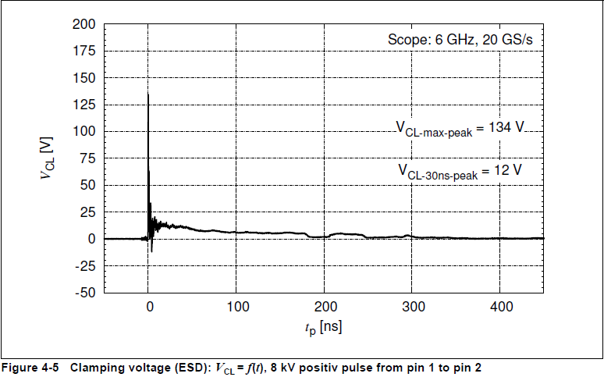
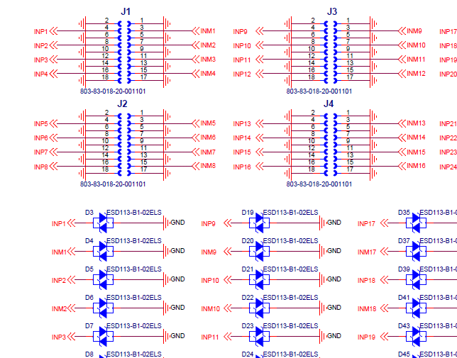
First ESD Protection: ESD113-B1
placed before coupling C

Slide 5
Destructive Test
pulses with an adjustable output voltage up to 400V and pulse-width between 25ns and 100ns were injected
analogue and digital output of PADI were checked
PADI with ESD protection can handle
400V / 25ns /10KHz (~800nC)
400V / 100ns /1Hz (~3,2uC)
400V / 100ns /10Hz => damaged
PADI without ESD protection can handle
40V / 25ns /1Hz (~80nC)
63V / 25ns / a few pulses=> damaged (126nC)
since only 50% of the FEE channels were damaged, we assumed the injected charge was just on the threshold level
we suspected our new protection scheme is sufficient

Slide 6
Second PADI damage @ STAR 2020/2021
with the new protection no complete losses of PADI channels were observed
an unexplained loss of efficiency was detected during the data inspection
the result of further investigation:
positive side of PADI has a low impedance to GND
high threshold value is applied due to leakage current inside the ASIC
ESD protection was presumably not sufficient enough

Slide 7
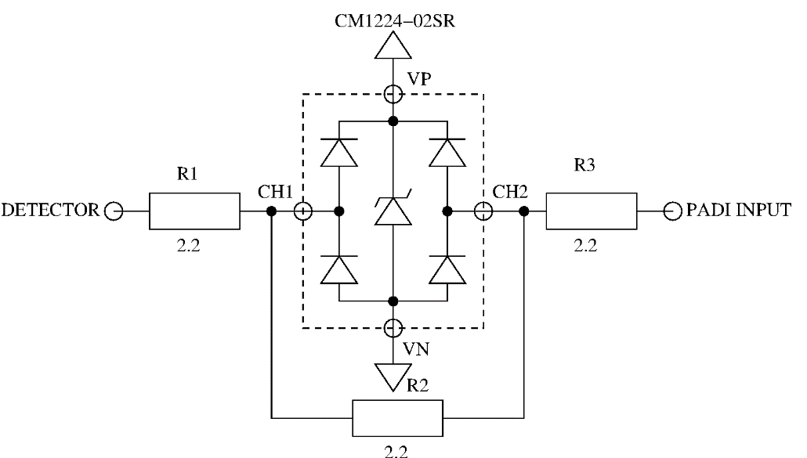
Simulation
for the internal ESD Protection Diodes of PADI a maximum current of +/-1.26A was evaluated.
we (Dr. Mircea Ciobanu) simulated the input current for different type of input protection schema:
no protection / PADI + ESD113 / PADI + CM1224
in simulation the FEE is connected to a 8kV-IEC generator
simulation indicates that with the current solution (PADI + CM1224) no more improvment is needed
protection | I @ PADI Input
PADI | +/- 26A
PADI + ESD113 | +/- 1.3A
PADI + CM1224 | +2mA /-0.5mA

Slide 8
CM1224 is approved by other groups
literature search has revealed that the same protection mechanism was selected for
the NINO FEE @ STAR (MRPC)
the SAMPA FEE @ ALICE (TPC)

Slide 9
New PCBs available soon
PCBs with new protection schema available soon
components are already delivered
PCB will arrive within the next week
equipping planned for December (latest January)
Test:
performance tests @ laboratory Dec 21/ Jan 22
destruction test with 400V pulser
destruction test with “ESD Pistol”
performance tests @ mCBM Feb / Mar 22
preparation for preproduction of ~20000 Channel launched Nov. 21
includes the possibility for STAR upgrade late summer 2022

Slide 10
Thank You

Slide 11
Backup

Slide 12
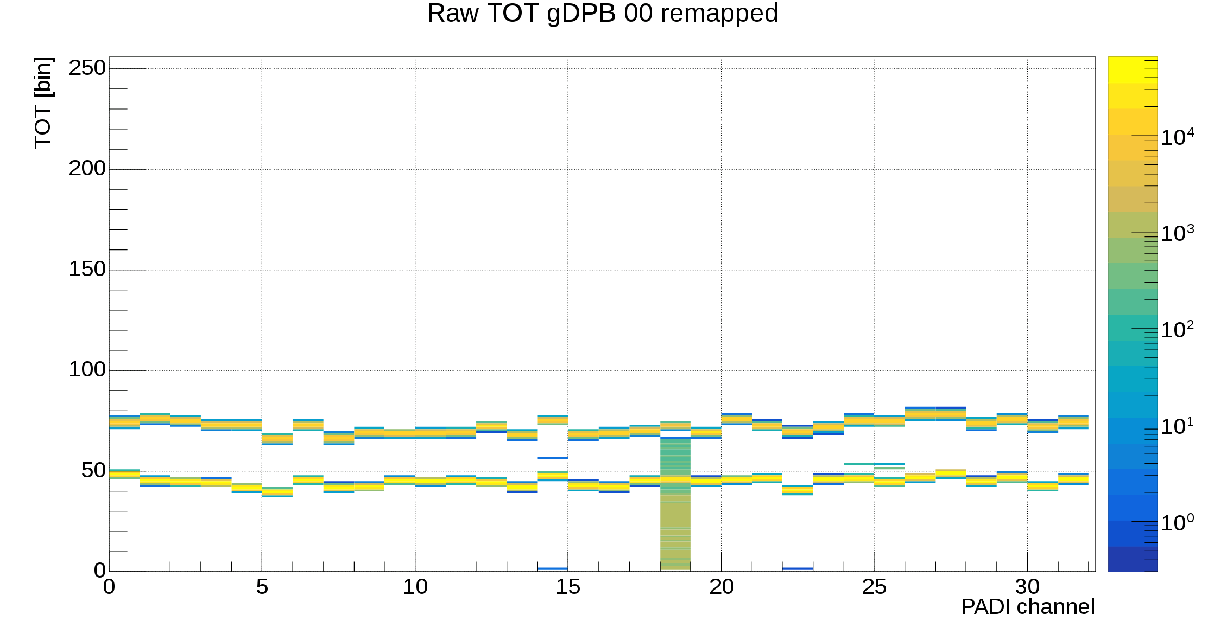
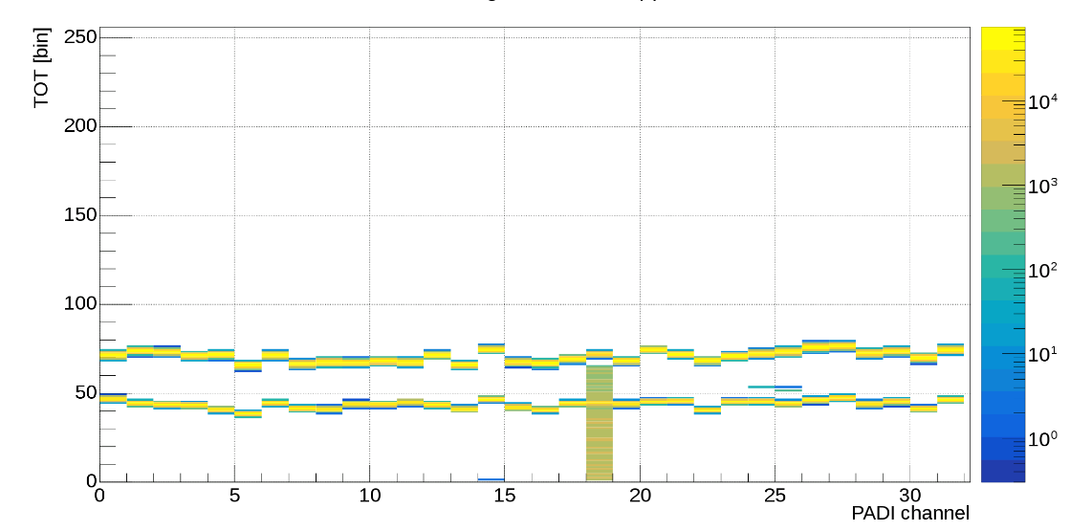
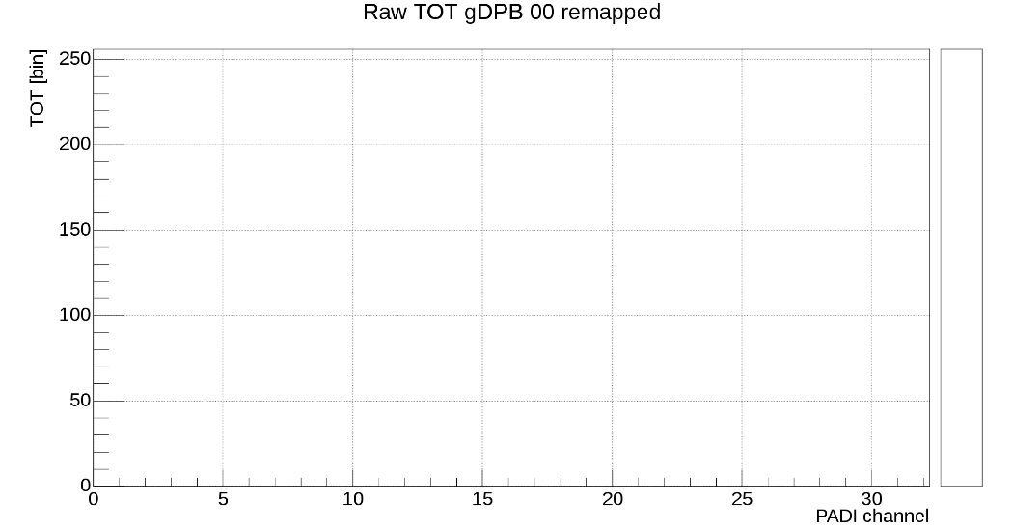
TOT Measurements: Example of a good PCB
-615mV and -200mV (pos input)
50 Ω
2.2 nF
0 mV
-200 mV
2.2 nF
50 Ω
-615mV and -200mV (neg input)
+615mV (has no entries)

Slide 13
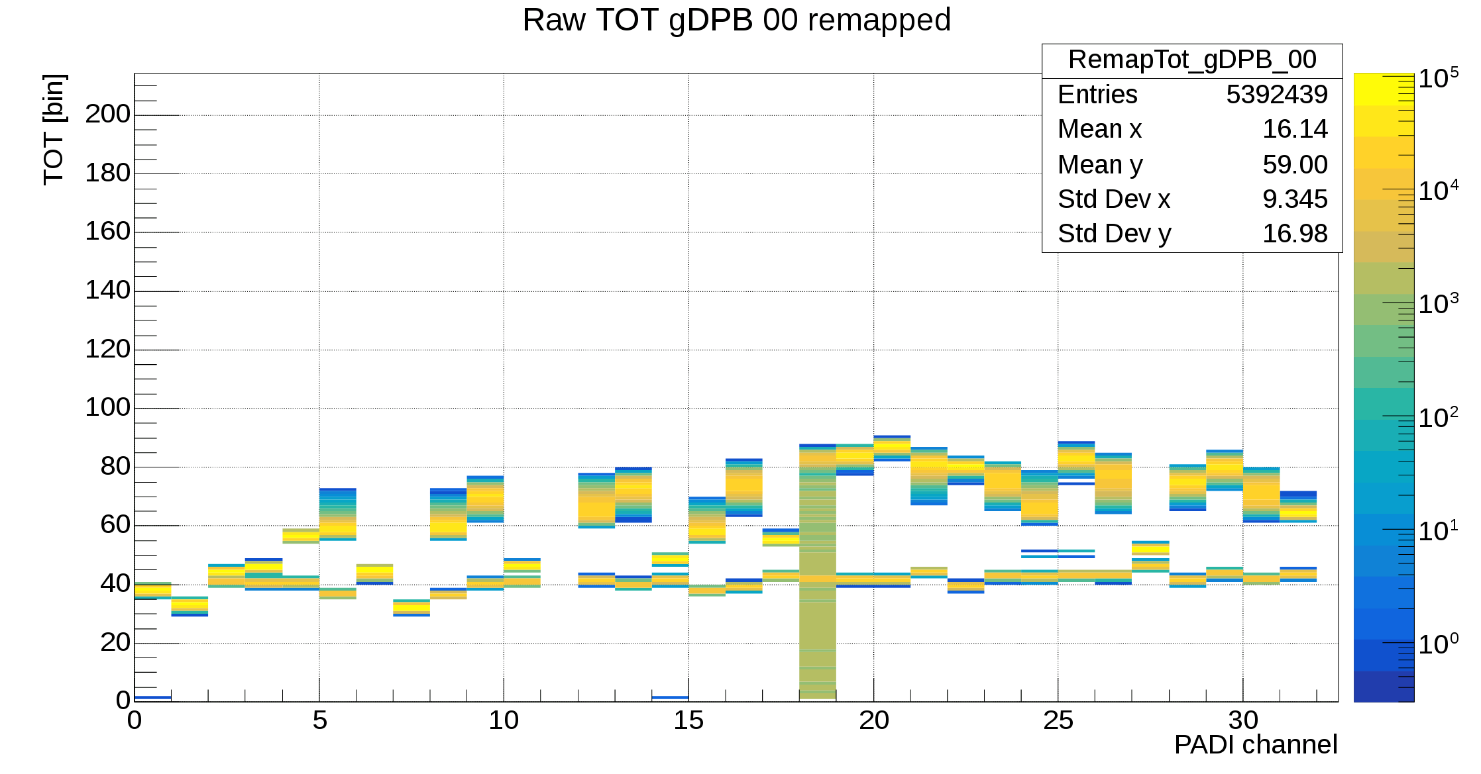
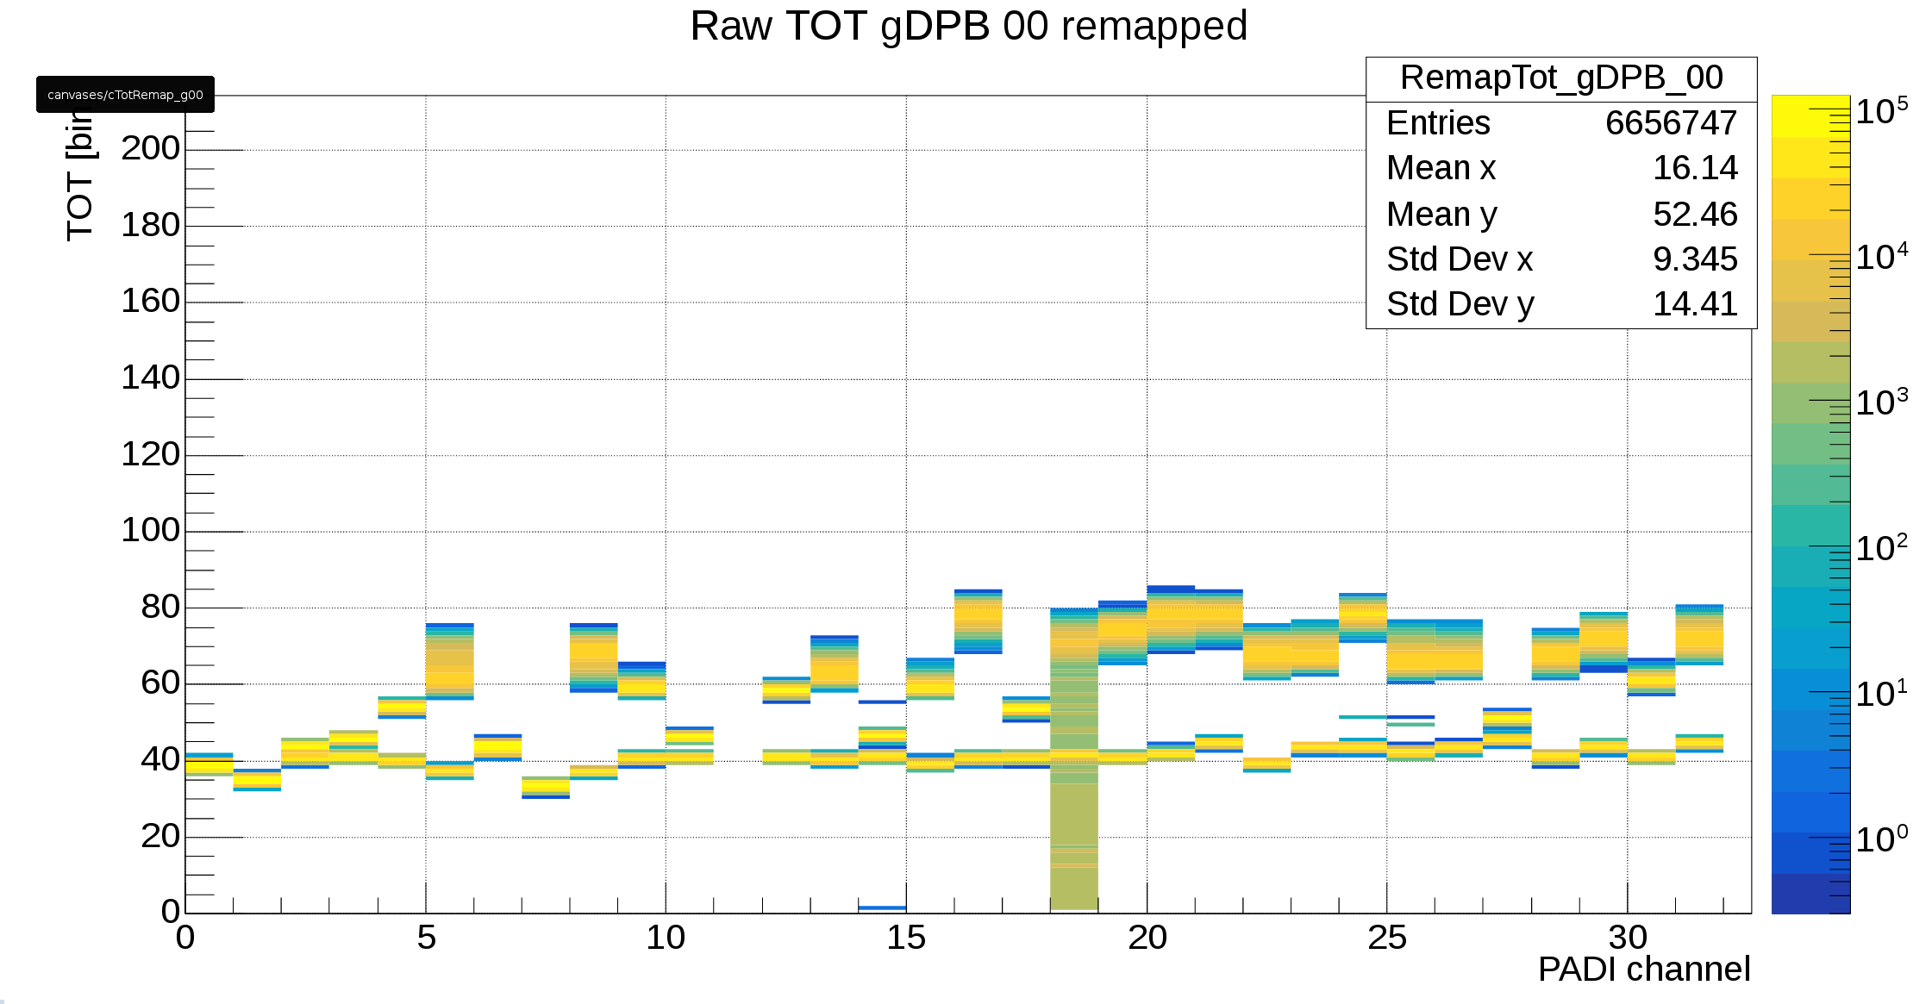
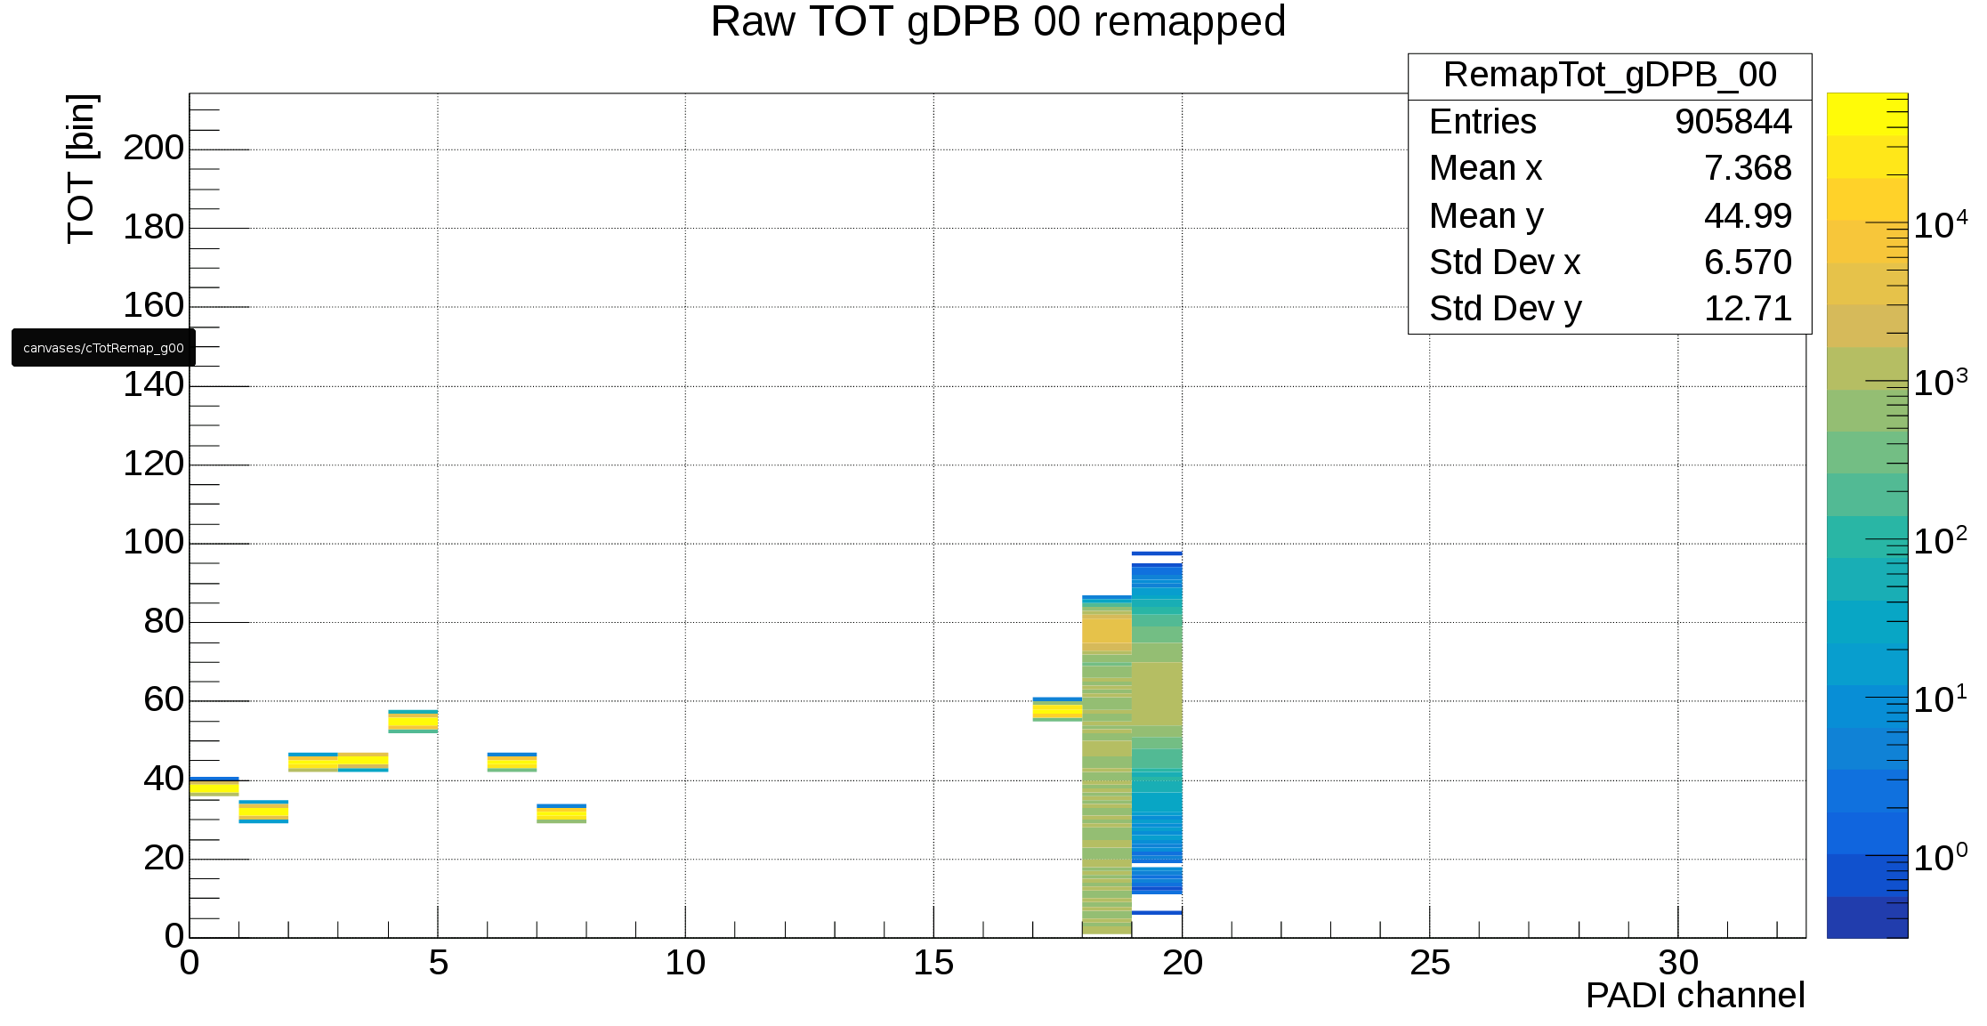
TOT Measurements: example of PADI PCB #2 right
-615mV and -200mV (pos input)
Chip 1
Chip 2
Chip 3
Chip 4
Ch1
Ch1
Ch1
Ch1
+615mV (should have no entries)
-615mV and -200mV (neg input)

Slide 14
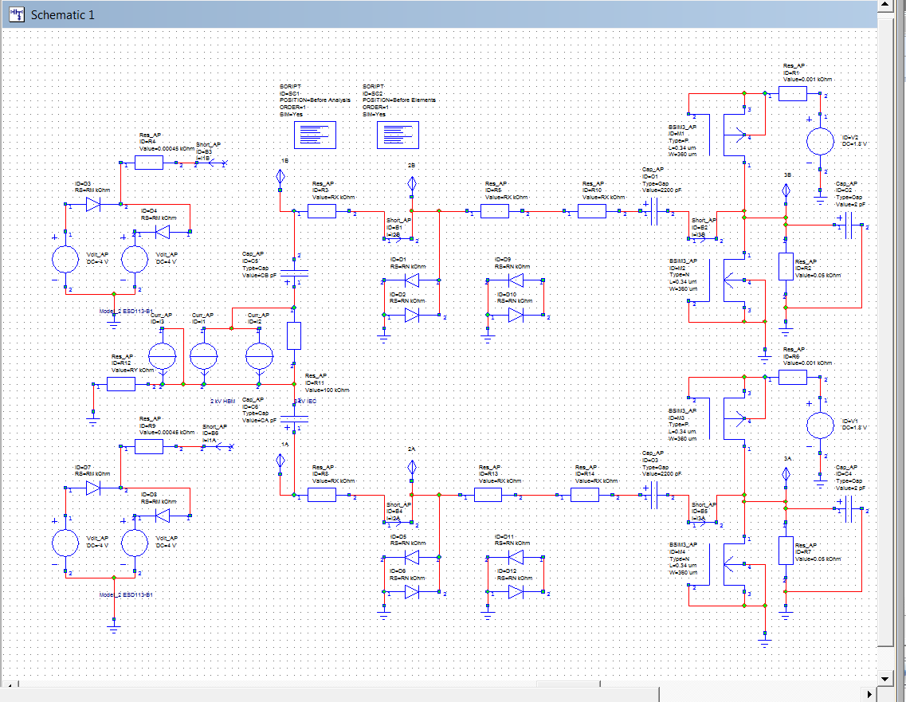
Schematics of Simulation

Slide 15
Simulation Results
connection | V1A,V1B (V) | I1A, I1B (A) | V3A,V3B (V) | I3A, I3B, (A)
PADI | +/- 400 | +/- 26 | +35 / -8 | +/- 26
PADI+ESD113 | +/- 16 | +/- 26 | +4 /-1 | +/- 1.3
PADI+ESD113+CM1124 | +/- 16 | +/- 26 | +/- 0.6 | +2m/-0.5m
PADI+CM1224 | +/- 300 | +/- 26 | +/- 0.6 | +2m/-0.5m
PADI+CM1224mod. | +/- 300 | +/- 26 | +/- 0.6 | +2m/-8m
PADI+CM1224mod.+ESD113 | +/- 16 | +/- 26 | +/- 0.6 | +3m/-4m

