Slide 1
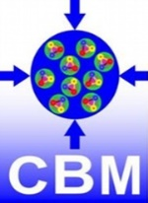
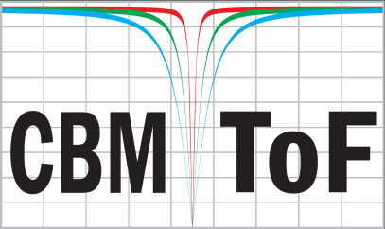
MRPC design review meeting
Introduction to this meeting, to CBM TOF and observed aging effects
Ingo Deppner
Physikalisches Institut, Heidelberg University
23.11.2021

Slide 2
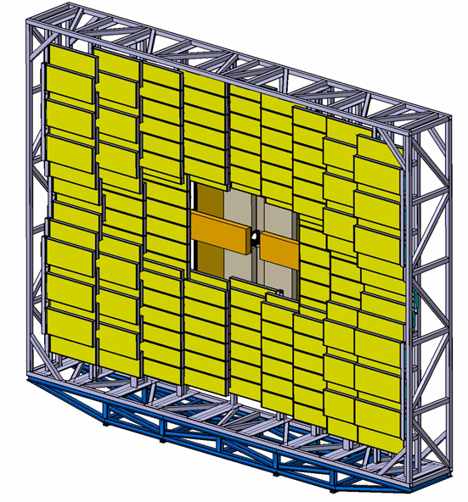
Outline
A few introductory words
Introduction to CBM TOF
TOF FAIR Phase 0 program
• eTOF at STAR/BNL
• mTOF at mCBM at SIS18/GSI
- Beam test results
- Aging of MRPC gas and implications
STOP HERE -> See other presentations
Conclusions for the CBM TOF gas system
Summary and time line
2

Slide 3
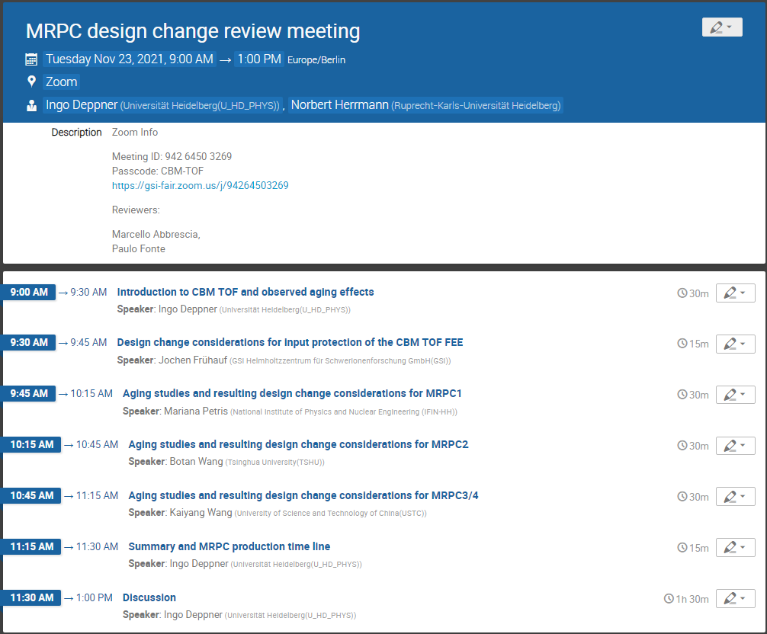
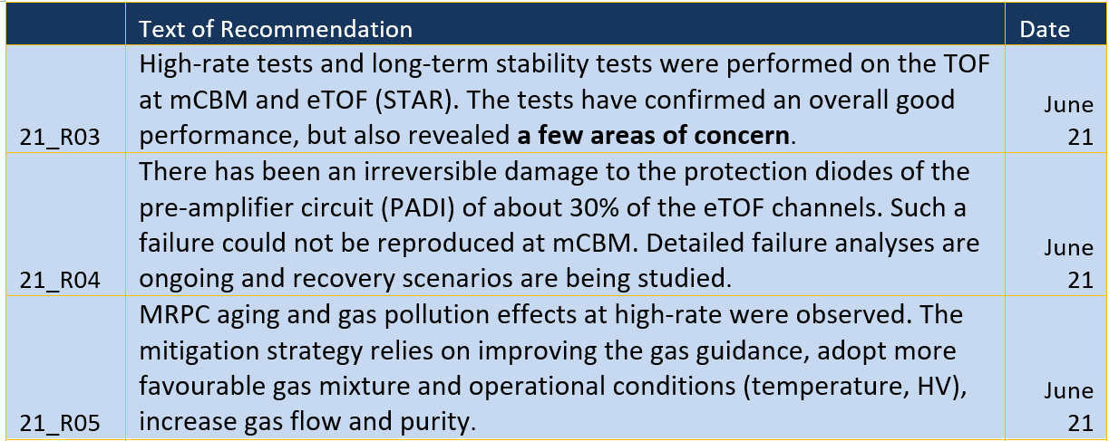
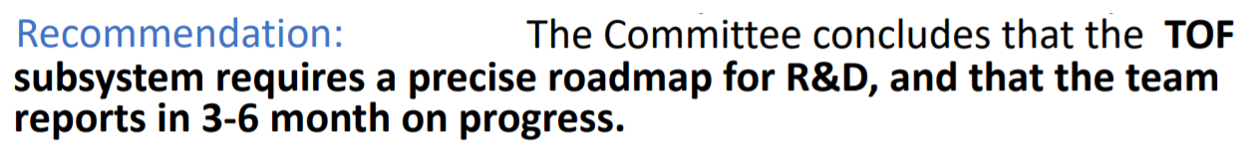
Introduction
External Reviewers:
- Marcello Abbrescia, CMS and EEE (Bari)
- Paulo Fonte, HADES (Coimbra)
What do we expect from the reviewers?
- Recommendations regarding R&D effort,
new MRPC designs, project time line
Joint FAIR ECE 14 and ECSG 05 meeting (31.05.2021)
Joint FAIR ECE 15 and ECSG 06 meeting (03.11.2021)
3

Slide 4
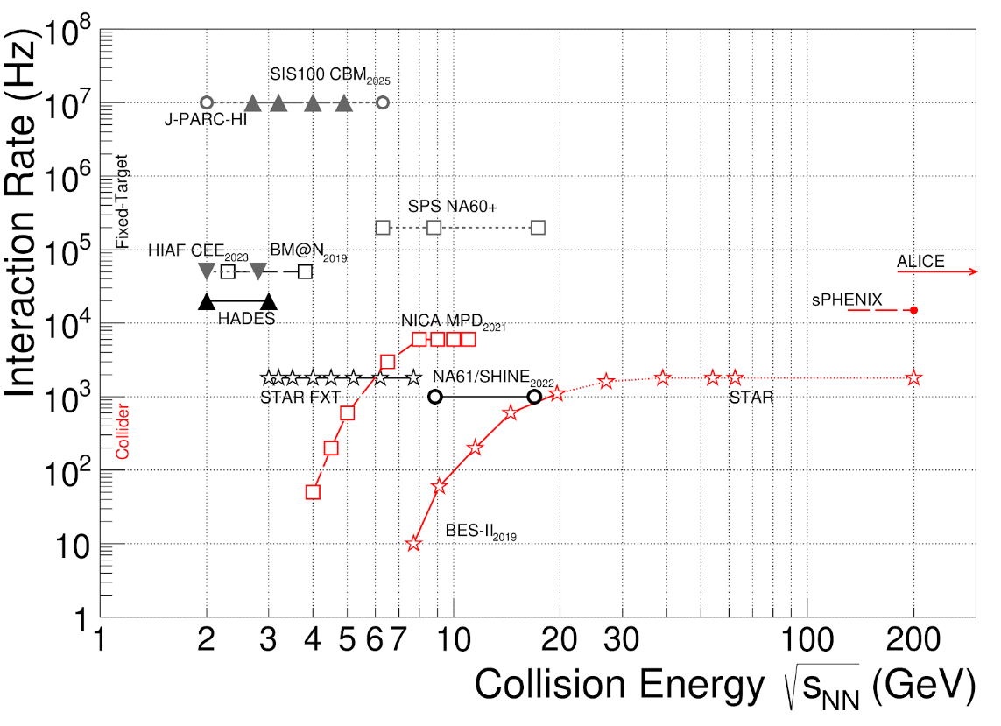
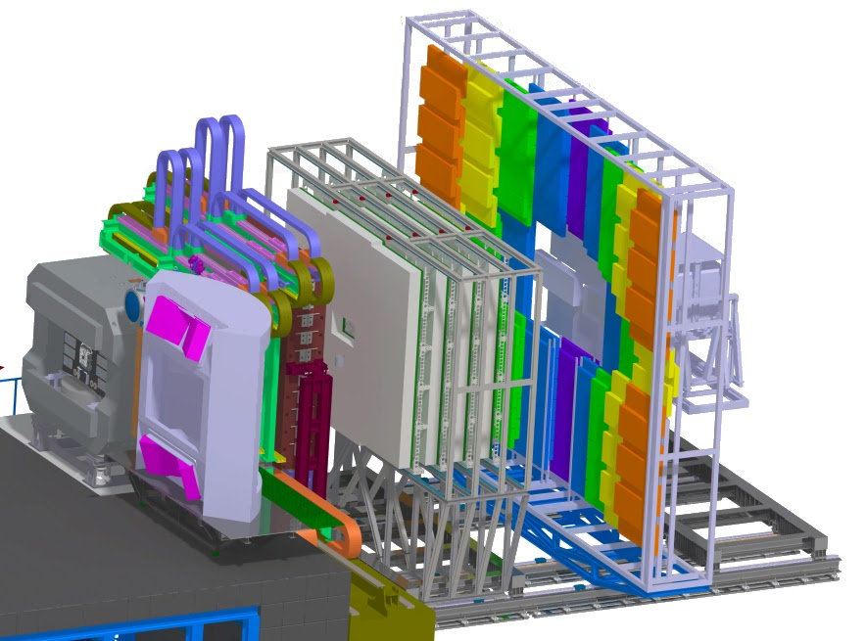
Introduction CBM
Compressed Baryonic Matter (CBM) Experiment
CBM Collaboration, EPJA 53 3 (2017) 60
T.Galatyuk, NPA982 (2019), update (2021)
Charged hadron identification is provided by Time-of-Flight (TOF) measurement
MVD: Micro Vertex Detector*
STS: Silicon Tracking System*
* inside magnetic field
MuCh or RICH
Muon Chamber System /
Ring Imaging Cherenkov Detector
TRD: Transition Radiation Detector
ToF: Time-of-Flight Detector
PSD: Projectile Spectator
Detector
TOF
MuCH
TRD
Dipole magnet
PSD
MVD +
STS
RICH
Tracking acceptance: 2.5º < θ_{Lab} < 25º
Peak R_{int} is 10 MHz for Au+Au
Fast & radiation hard detectors
Free-streaming DAQ
4D tracking (space, time)
Online event selection and reconstruction
Data rate: 1 TB/sec
4

Slide 5
Introduction CBM TOF
Multi-gap Resistive Plate Chambers (MRPC) are the most suitable TOF detectors fulfilling our requirements
FLUKA simulation: Au + Au collisions at E_{kin} = 11 AGeV, 10⁷ interactions
Flux [Hz/cm²]
Y [cm]
CBM-TOF Requirements
Full system time resolution σ_{T} ~ 80 ps
Efficiency > 95 %
Rate capability ≤ 150 kHz/cm²
Polar angular range 2.5° – 25°
Active area of 120 m²
Occupancy < 5 %
Low power electronics
(~100.000 channels)
Free streaming data acquisition
Anna Senger
X [cm]
5

Slide 6
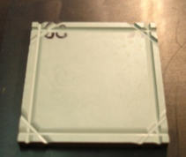
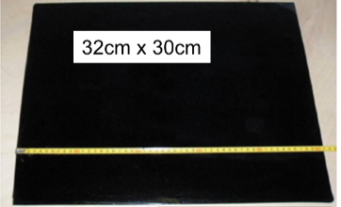
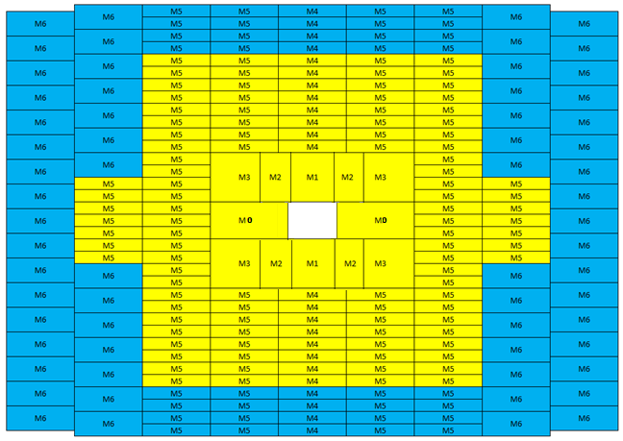
Introduction CBM TOF
Low resistivity glass
Ceramics
8.75 m
thin float glass,
ρ ≈ 10¹² Ω cm
low resistivity glass,
ρ ≈ 10¹⁰ Ω cm
ceramic ρ ≈ 10⁹ Ω cm
Active area
≈ 118 m²
13.5 m
6

Slide 7
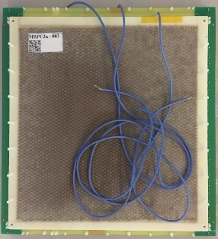
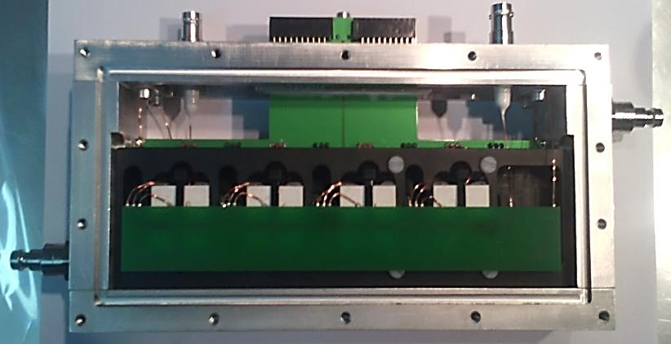
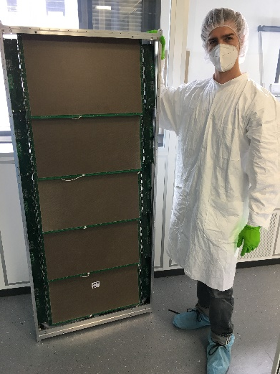
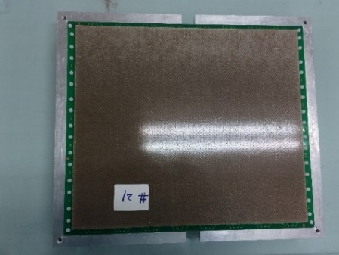
Introduction CBM TOF
Low resistivity glass
BFTC* (ITEP Moscow)
M4 Module (HD)
Full size counter with close to final design for all regions build and tested
M4 and M6 full size modules constructed and installed at mCBM
MRPC2 (Tsinghua)
thin float glass,
ρ ≈ 10¹² Ω cm
low resistivity glass,
ρ ≈ 10¹⁰ Ω cm
ceramic ρ ≈ 10⁹ Ω cm
M6 Module (HD)
MRPC3/4 (USTC)
≈ 230 + 20* modules
≈ 1400 MRPCs
≈ 90000 channels
MRPC1a and 1b (NIPNE Bucharest)
BFTC* - Beam Fragmentation T0 Counter
7

Slide 8
CBM TOF MRPC key parameters
 | MRPC1a | MRPC1b | MRPC1c | MRPC2 | MRPC3 | MRPC4
# Gaps | 2 x 5 | 2 x 5 | 2 x 5 | 2 x 4 | 2 x 5 | 2 x 5
Gap size | 200 μm | 200 μm | 200 μm | 250 μm | 230 μm | 230 μm
Glass type | Low res. | Low res. | Low res. | Low res. | Float | Float
Glass thickness | 700 μm | 700 μm | 700 μm | 700 μm | 230 μm | 230 μm
MRPC size | 30 cm x 6 cm | 30 cm x 10 cm | 30 cm x 20 cm | 32 cm x 27 cm | 32 cm x 27 cm | 32 cm x 53 cm
# Strips | 32 | 32 | 32 | 32 | 32 | 32
Strip length | 6 cm | 10 cm | 20 cm | 27 cm | 27 cm | 53
Pitch | 0.90 cm | 0.90 cm | 0.90 cm | 1.0 cm | 1.0 cm | 1.0 cm
Impedance | 100 Ω | 100 Ω | 100 Ω | 50 Ω | 50 Ω | 50 Ω
Developed at | IFIN-HH (RO) | IFIN-HH (RO) | IFIN-HH (RO) | Tsinghua (CH) | USTC (CH) | USTC (CH)
Initially planed gas mixture: Tetrafluorethane/iso-Butan/SF₆: 90%/5%/5%
Currently planed gas mixture: Tetrafluorethane/SF₆: 97.5%/2.5%
8

Slide 9

FAIR phase 0
FAIR Phase 0 programs of CBM-TOF
eTOF project at STAR@BNL (6912 channels)
for long term stability test and physics results purpose
mTOF project at mCBM@SIS18 (1600 channels)
for high rate and system integration test purpose
9

Slide 10
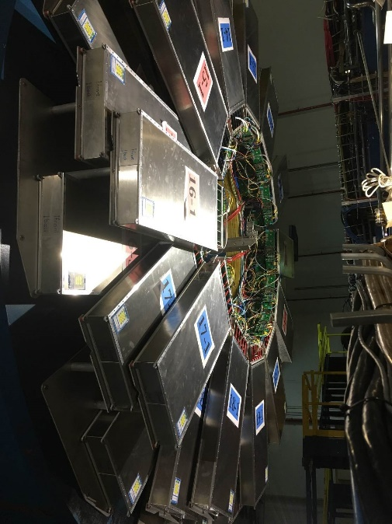
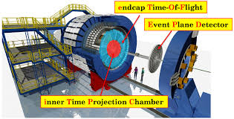
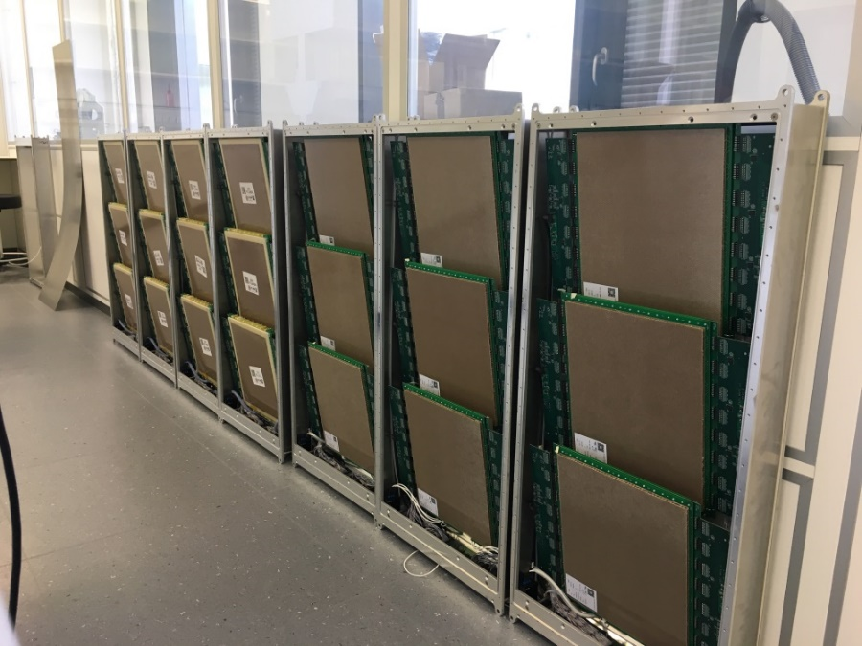
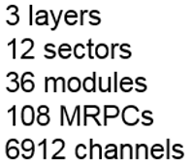
eTOF status
Matching efficiency with TPC
eTOF PID
eTOF successfully operated in RUN 19/20/21 (BES II)
Observation: FEE damages
TSU counter
USTC counter
Damaged channels
Matching efficiency with TPC dropped by 15%
Damage on 30% of PADI channels
A change of protection diodes foreseen
arXiv: 1609.05102
10

Slide 11
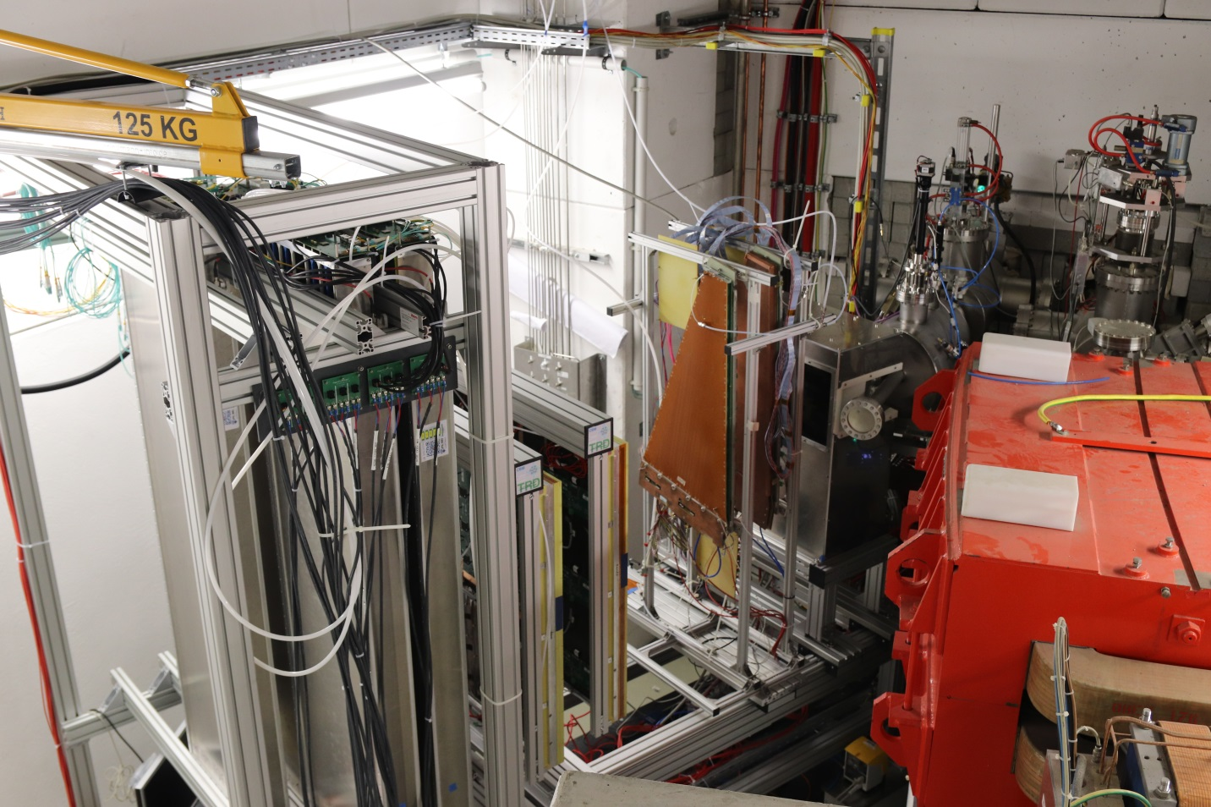
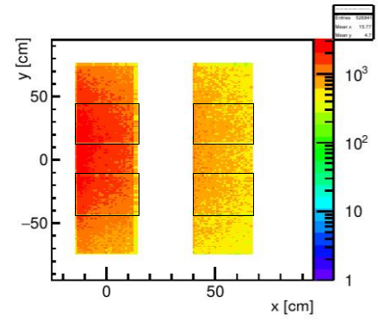
mCBM @ SIS18
FAIR Phase 0: mCBM setup @ SIS18
mTOF
N. Herrmann
mTRD
real Pb on Au collision
mRICH
mMuCH
mSTS
mPSD
Target chamber
Simulation: Au+Au @ 1.24 GeV mbias
mCBM is a full system test setup installed at SIS18/GSI dedicated for high rate detector and readout test including free streaming data acquisition and online event selection
Charged particle fluxes of up to 30 kHz/cm²
11

Slide 12
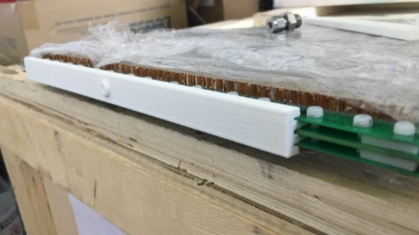
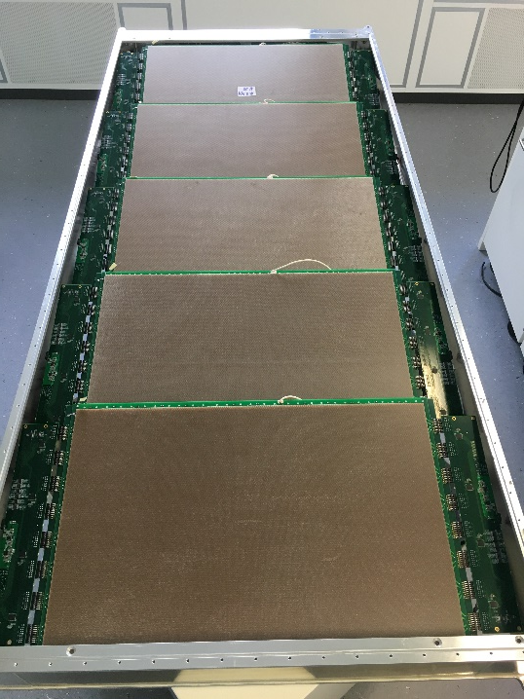
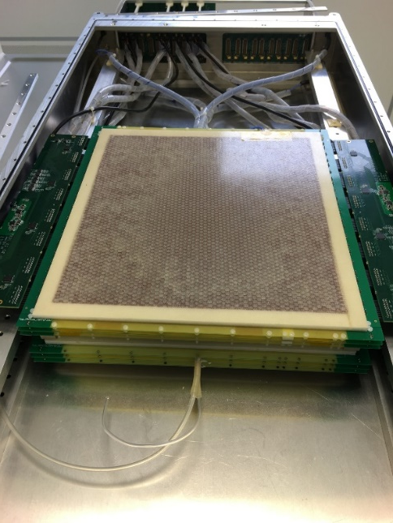
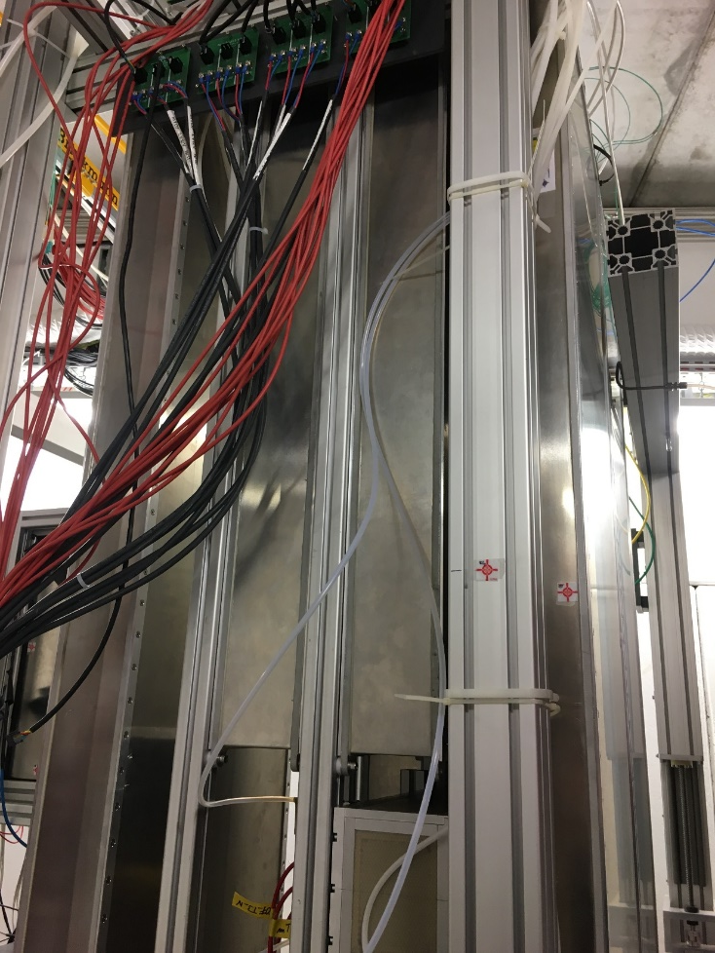
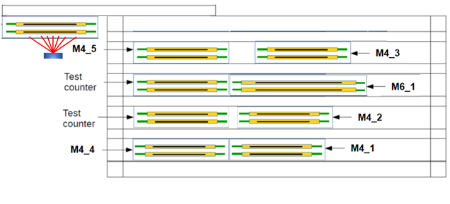
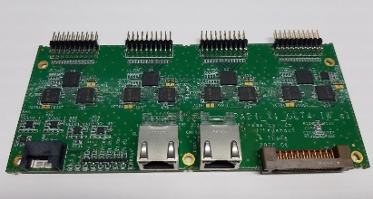
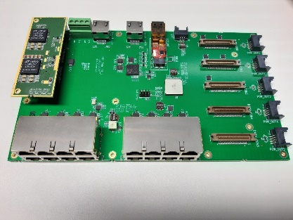
Test setup in 2021
M6_1 Module
Sealed MRPC2
Gas guided MRPC3
MRPC4
55 cm
Gas inlet of sealed MRPC
Triple stack
Double stack+
test counter
M4_5
MRPC3, 911 (USTC, float)
MRPC3, 910 (USTC, float)
MRPC2, 901 (sealed) (TSU)
MRPC2, 900 (TSU)
M4_3
MRPC1, 600 (Buc.)
MRPC1, 601 (Buc.)
New inner wall FEE tested
M4_5
911
910
(sealed) 901
900
M4_3
25°
12°
Beam
Target Au
Diamond T0
Destructive test
13
12

Slide 13
HV current example of 14 – 15 March
25 kHz/cm²
15 kHz/cm²
mTOF M4_4
mTOF M4_5
MVD+STS
2.5 kHz/cm²
3(4) different intensities
2-3 times CBM conditions at highest IR
5 times CBM conditions for float glass counter
Test counter reached max current of the power supply
0.5 kHz/cm²
911
100
13

Slide 14
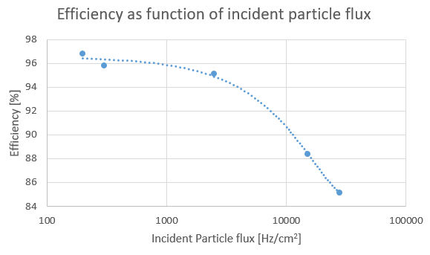
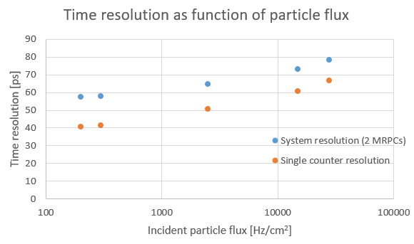
mCBM beam time results
MRPC3 (thin float glass counter)
MRPC3 (thin float glass counter)
Run 1459
Data loss issues (faced during beam time)
Bandwidth limitations
Get4 dropouts
Time slice losses
Next steps
Data analysis ongoing (much more to come)
Data losses have to be solved prior to 2022 beam time
More detector test at mCBM required
Run 1459
14

Slide 15
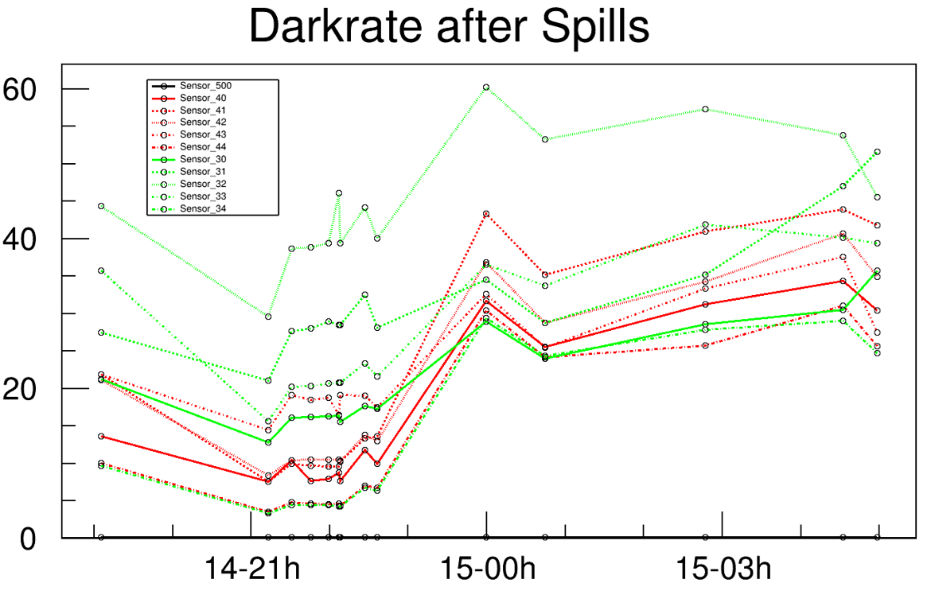
Counter dark rates
Dark rates measured in 2020
Dark rate [Hz/cm²]
About 1.5 h
Gas pollution effect, observed in 2020, could be reproduced in 2021
Dark rate goes in saturation
Position (=> rate) ordering observed
Date - Time
15

Slide 16
Gas aging & pollution
Observations @ mCBM 2020
Gas pollution effect observed at mCBM at high rate (about 5 – 10 kHz/cm²)
Gas pollution effect was reproduced at IRSAM (Bucharest) with high gamma flux
X-Ray test at Beijing confirmed the gas pollution effect
The effect was minimized by sealing the MRPC
Aging test in Bucharest
See CBM Progress Report 2020
16

Slide 17
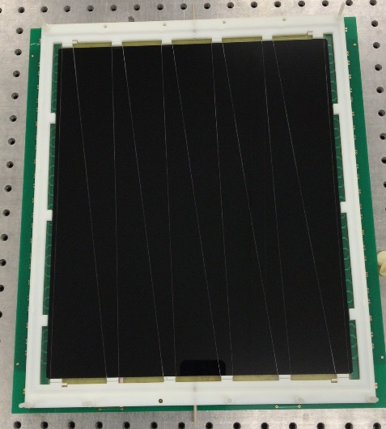
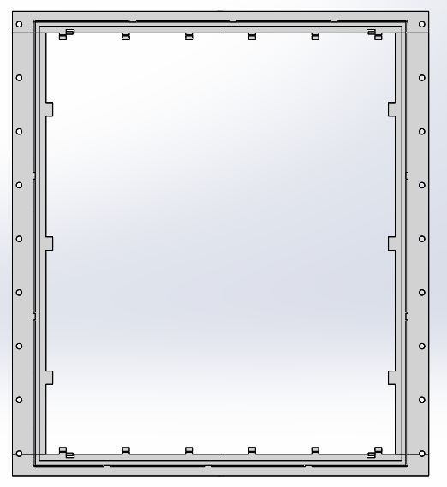
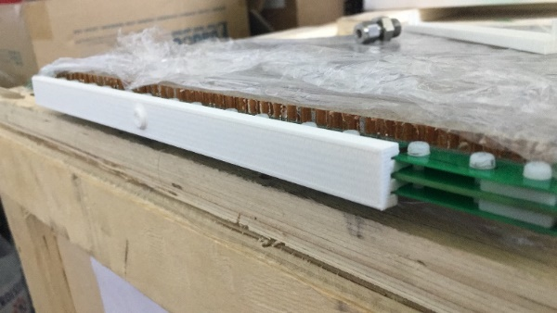
Gas aging & pollution
Observations: rapid increase of dark rate
Observed first @ mCBM 2020
Confirmed @ mCBM 2021
MRPC1
MRPC2
Expected ‘ideal’
MRPC3/4
Gas outlet
Mitigation strategy:
MRPC with clever gas management required (1 sealing and/or 2) forced gas flow through gaps)
Only parallel fishing lines proposed
=> new R&D round and beam tests required
New prototypes from the entire MRPC family will be tested at mCBM
First prototypes are being tested in cosmic test
Gas flow
Gas inlet
17

Slide 18
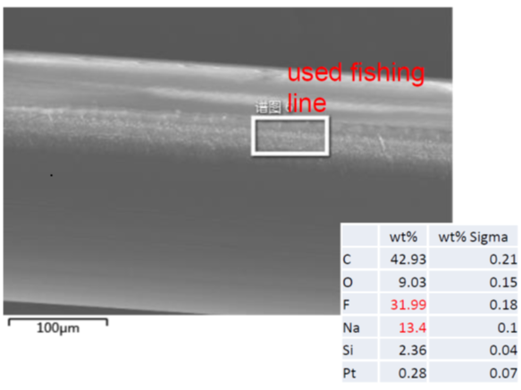
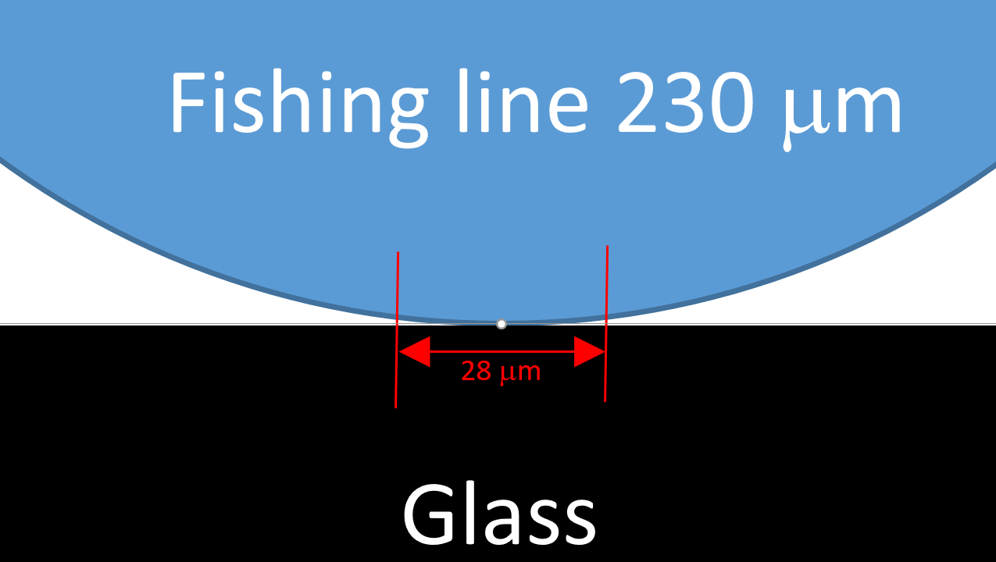
Gas aging & pollution
Observations: continuous increase in dark rate
Traces of NaF was found on the glass surface
Electrical field simulations performed
Mitigation strategy
Search for rectangular spacers
Increase gas flow
=> new R&D round and beam tests required
New prototypes will be tested at mCBM
Counter PRR shifted to 5/22 after mCBM test
Electrical field simulations
glass plate
spacer
glass plate
18

Slide 19
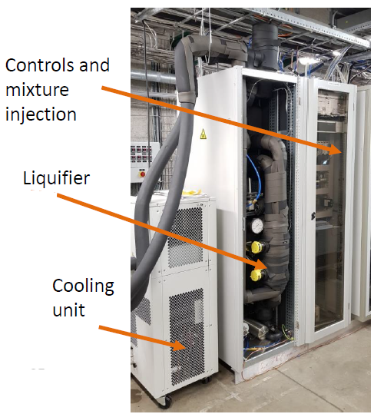
Conclusions for the TOF gas system
Stay with R134a
(enhanced F-ion production for HFO in high rate environment)
Abandon iso-Butan (Aging)
Reduce fraction of SF₆ to 2.5% (reduction of GWP, difficult to recycle)
Increase the flow rate (gas exchange in gaps within ? s)
Use clever gas management on MRPC (sealing, forced gas flow through the gaps)
Go for a recuperation system (reuse of gas, cost reduction, GWP reduction)
Recuperation system has to be developed
230 modules
Total gas volume 25 m³
fresh counter gas
N₂
Recuperation system
filter
gas flow in one modul
purge mode 200 ml/min
cycling mode ? l/min
gas flow in all moduls
purge mode 46 l/min
cycling mode ? l/min
recycling station
circulation pump;
? l/min
Roberto Guida (CERN)
19

Slide 20
Conclusion and Time line
High rate (mCBM) and long term stability (eTOF) test performed
- float glass counter performed beyond specs
Damage on preampl. observed at STAR, could not be reproduced with highest intensity beam and distructive test at mCBM
MRPC aging and gas pollution effects at high rates observed
- mitigation strategies developed => more R&D required => one more beam test needed
Sealed and gas guided MRPC designs presented – Recommendations highly welcome
Conclusions for the TOF gas system discussed
Preparation for the upcoming beam time ongoing (counter development)
Layout of gas system with recuperation drafted (First discussions with ICSI/RO)
20

Slide 21

Conclusion and Time line
Time line and major milestones
MRPC design review meeting: 23.11.2021 (today)
ASIC and Electronics PRRs: Q4/2021
mCBM beam time: 02/22 – 04/22
Counter PRR Q2/2022
Counter production start: Q3/2022
Module production start: Q4/2022
TOF ready for beam: end of 2024
21

Slide 22



Thank you for your attention
Contributing institutions:
Tsinghua Beijing,
NIPNE Bucharest,
GSI Darmstadt,
TU Darmstadt,
USTC Hefei,
PI Heidelberg,
ITEP Moscow,
HZDR Rossendorf,
CCNU Wuhan,

Slide 23
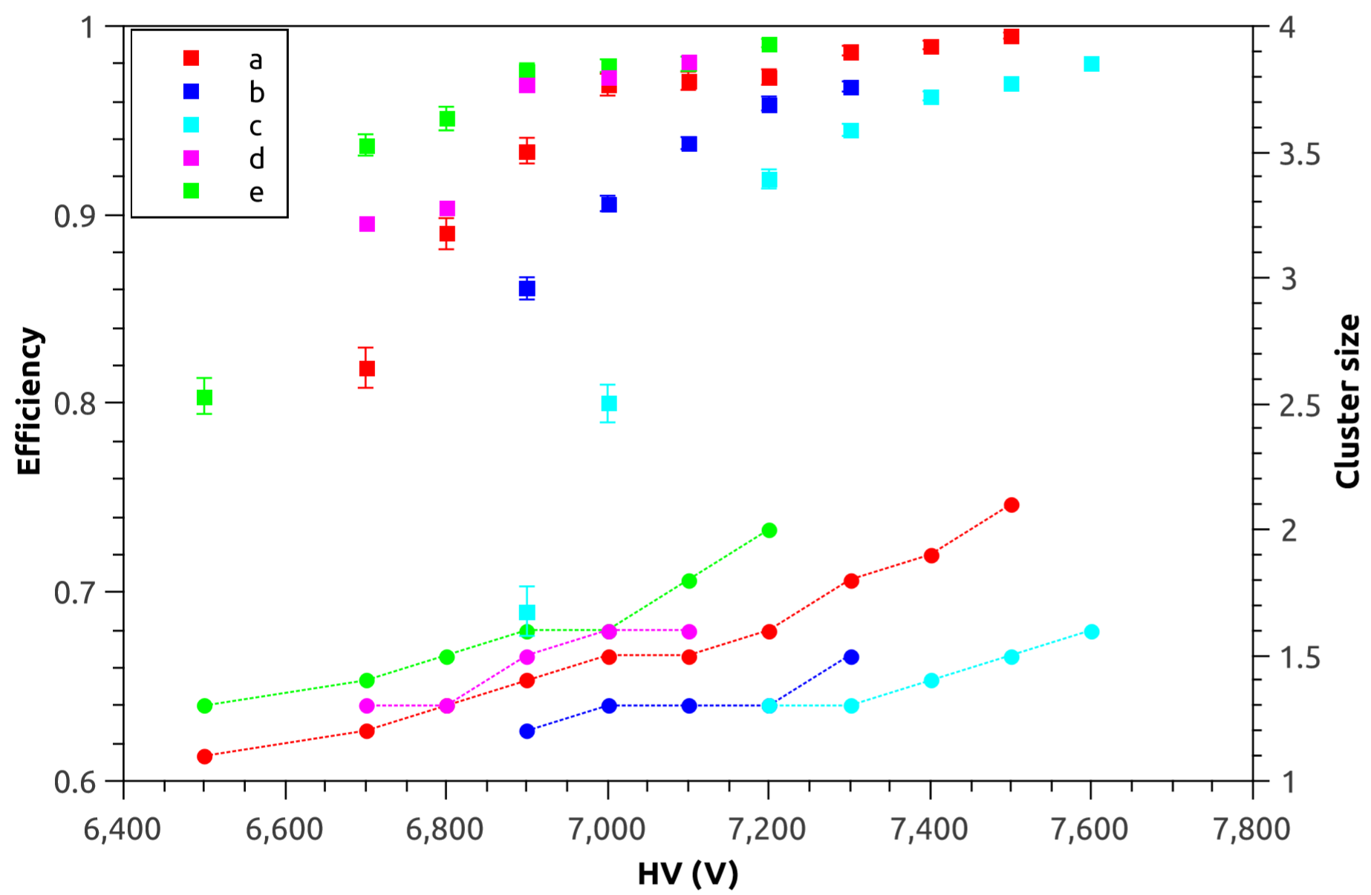
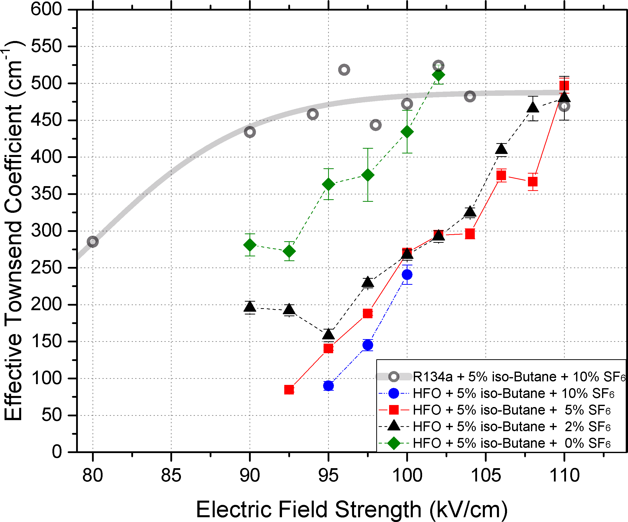
Alternative gas search in CBM TOF
Alternative gas mixtures were investigated
Time resolutions in the order of 80 ps to 100 ps were obtained
Gas mixtures with HFO fulfil our TOF requirements
Working point is shifted by about 2000 V
Measurements of the eff. Townsend coefficient show no major difference for gas mixtures with more than 2 % SF₆
The instability of HFO in comparison to R134a is counterproductive in a high rate environment
(a) Pure HFO
(b) HFO/i-C₄H₁₀/SF₆ 90/5/5
(c) HFO/SF₆ 95/5
(d) HFO/i-C₄H₁₀ 97/3
(e) HFO/i-C₄H₁₀ 95/5
(RPC2020)
Wang Botan, Wang Yi
Xingming at 16:35
18

Slide 24
Gas aging & pollution
Gas pollution effect observed at mCBM at high rate (about 5 – 10 kHz/cm²)
Gas pollution effect was reproduced at IRSAM (Bucharest) with high gamma flux
X-Ray test at Beijing confirmed the gas pollution effect
The effect was minimized by sealing the MRPC => See Botans talk
MRPC with clever gas management required (forced gas flow through gaps)
=> new R&D round and beam tests required
Observations: rapid increase
of dark rate
Observed first @ mCBM 2020
Confirmed @ mCBM 2021
See Marianas talk
Aging test in Bucharest
See CBM Progress Report 2020
Observations: continuous increase in dark rate
glass plate
spacer
glass plate
13

Slide 25
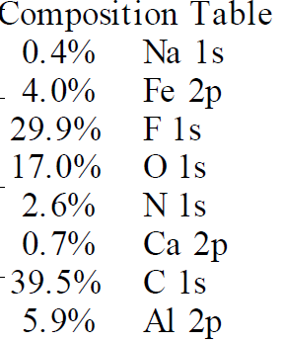
Gas aging & pollution
Aging test performed at IRASM (360 kCi)
Glass inspections performed with various methods (SEM, XPS, AFM RBS, non-RBS, THz-TDS)
Glass resistivity remains unchanged
Aging test in Bucharest
Aging test in Bucharest
Mihai Petrovici
Mihai Petrovici
22

Slide 26
Inspection of low resistivity glass
F. Carnesecchi et al. NIMA A 908 (2018) 285-290
23

Slide 27
Inspection of float glass
10 μm
28 μm
Unused float glass
Yongjie Sun, Kaiyang Wang, Xinjian Wang
24

Slide 28
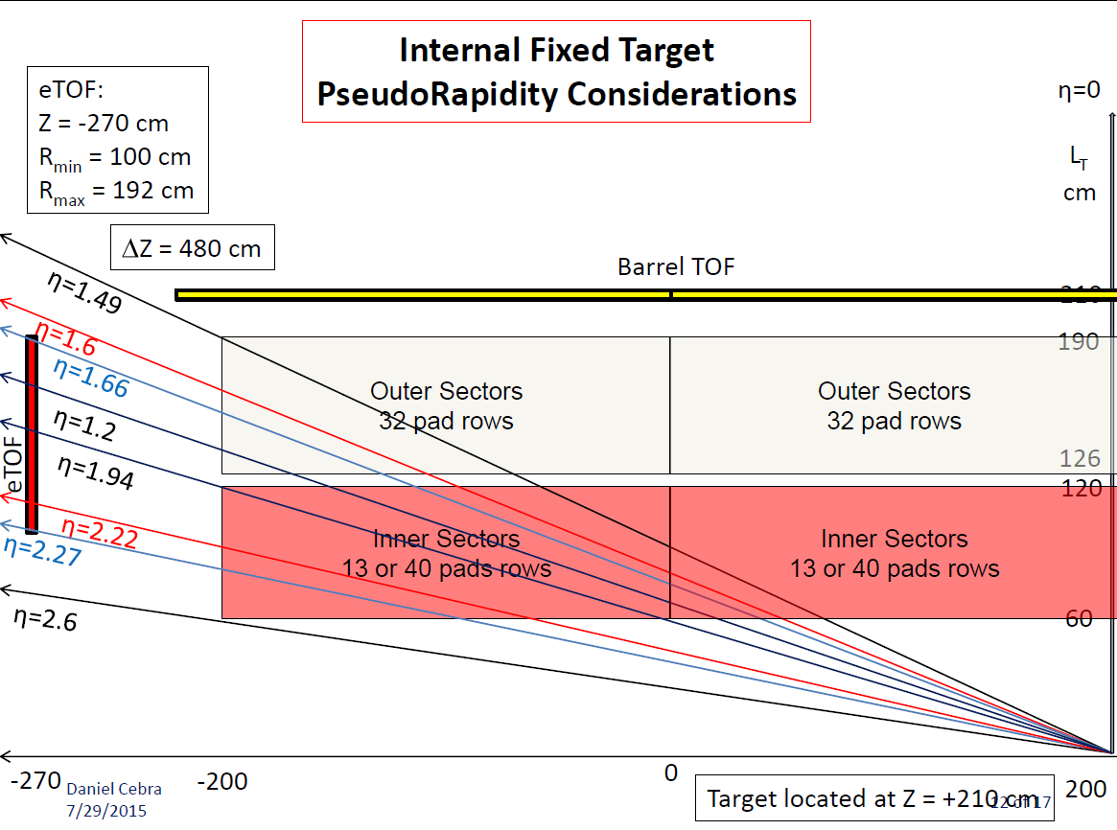
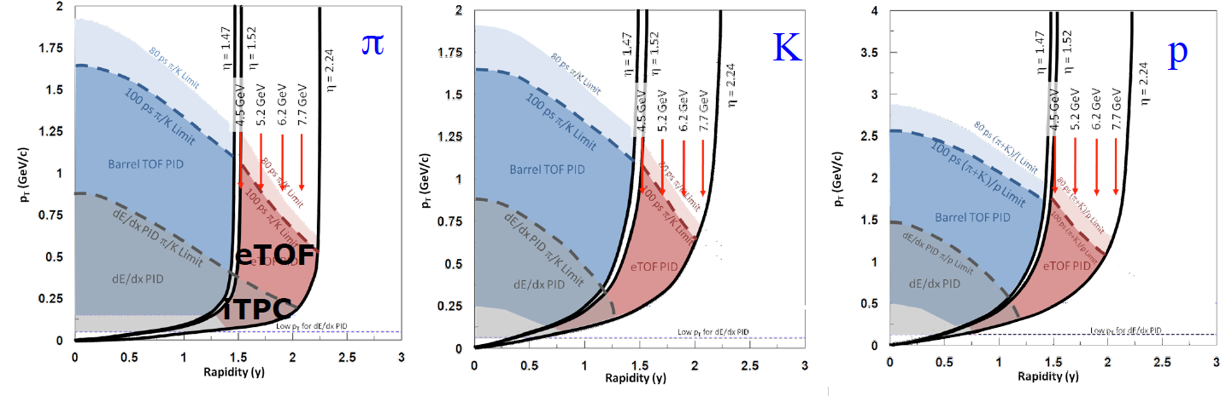
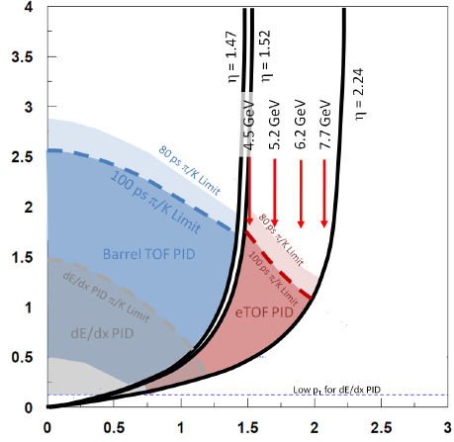
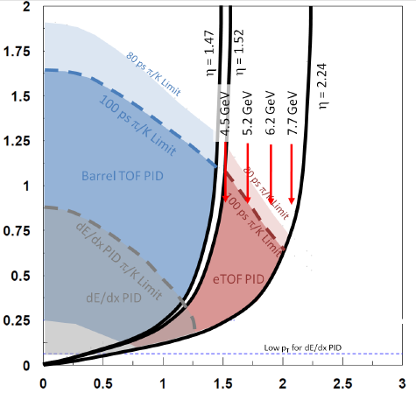


eTOF introduction
eTOF successfully operated in RUN 19/20/21 (BES II)
Fixed target mode
Gold target
√s_{NN} /GeV | # coll. Events | Year
3.0 | 2 B | 2021
3.5 | 100 M | 2020
3.9 | 50 M | 2020
4.5 | 100 M | 2020
5.2 | 100 M | 2020
6.2 | 100 M | 2020
7.7 | 50 M | 2020
9.2 | 50 M | 2021
11.5 | 50 M | 2021
13.7 | 50 M | 2021
Collider mode
√s_{NN} /GeV | # coll. Events | Year
7.7 | 100 M | 2021
9.1 | 150 M | 2020
11.5 | 230 M | 2020
14.6 | 320 M | 2019
19.6 | 580 M | 2019
arXiv: 1609.05102
Fixed target mode
25

Slide 29
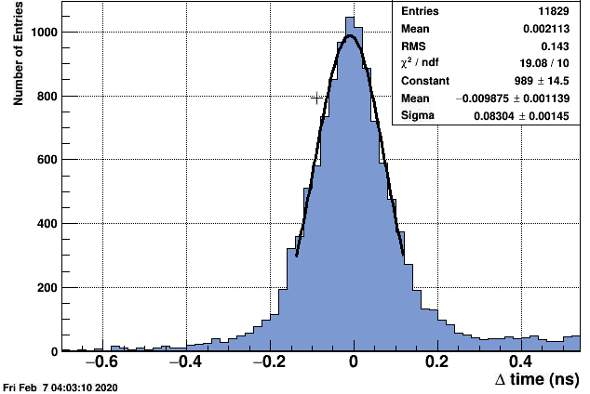
eTOF status
System synchronization on the level of 35 ps
System time resolution better than 85 ps
PID capability demonstrated
Physics analysis started
Matching efficiency with TPC
eTOF PID
Timing resolution
Fixed Target √s = 7.7 GeV
Preliminary
26

Slide 30
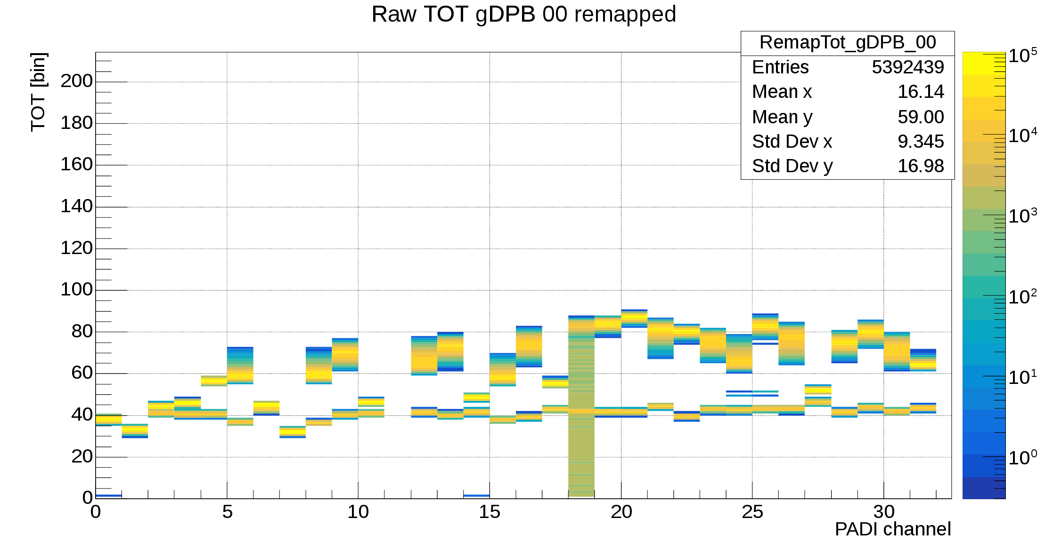
FEE: PADI damages at BNL
Observation
Observation
TSU counter
USTC counter
Threshold setting for individual channels not possible after damage
Chip 1
Chip 2
Chip 3
Chip 4
Ch1
Ch1
Ch1
threshold
Matching efficiency with TPC dropped by 15%
Ch1
-200mV
Damaged channels
-615mV
Damage on 30% of PADI channels
Reason for damage not fully clear
Characteristic of damage understood
Damage could not be provoked in mCBM
A change of protection diodes foreseen
Not a likely risk for CBM
Protection diodes
Negative input resistors lose nom. value
50 Ω
2.2 nF
•
•
•
2.2 nF
50 Ω
27

