Slide 1
KHuK Annual Meeting
10 Dec 2021

Slide 2
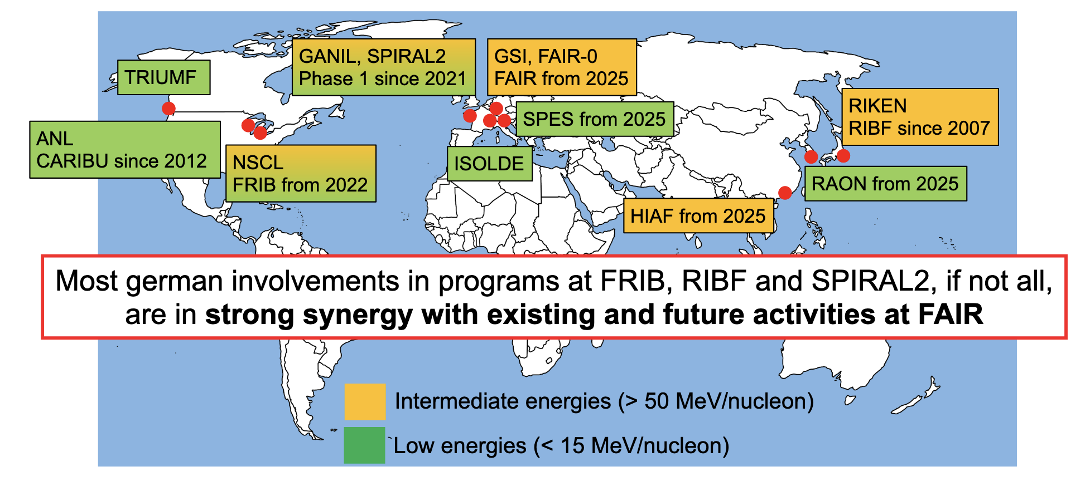
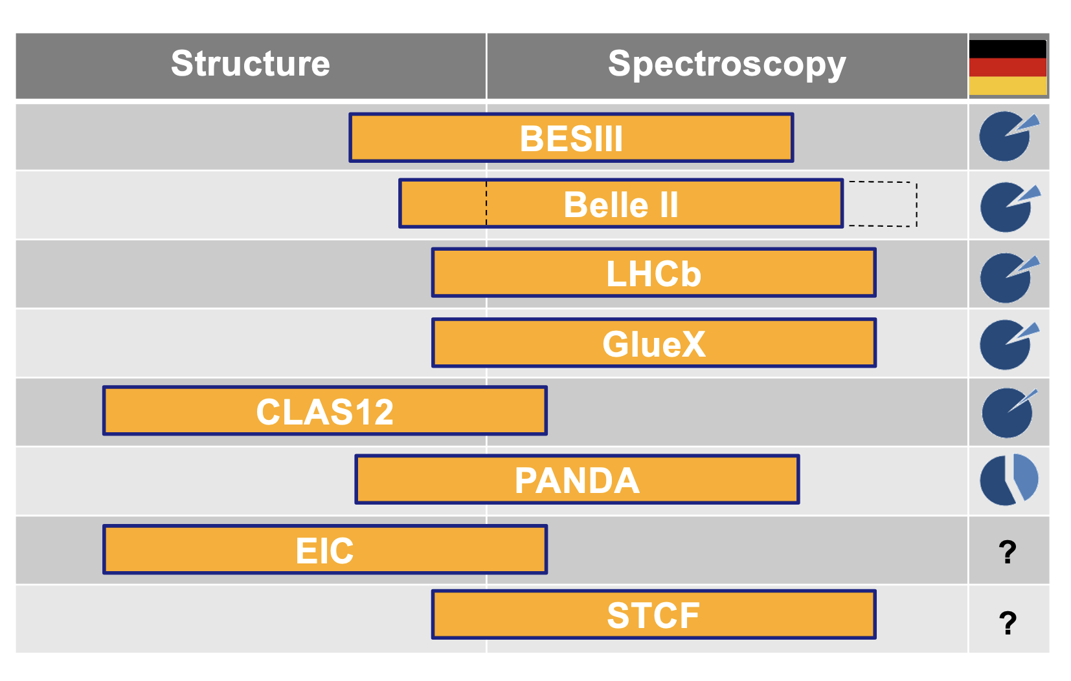
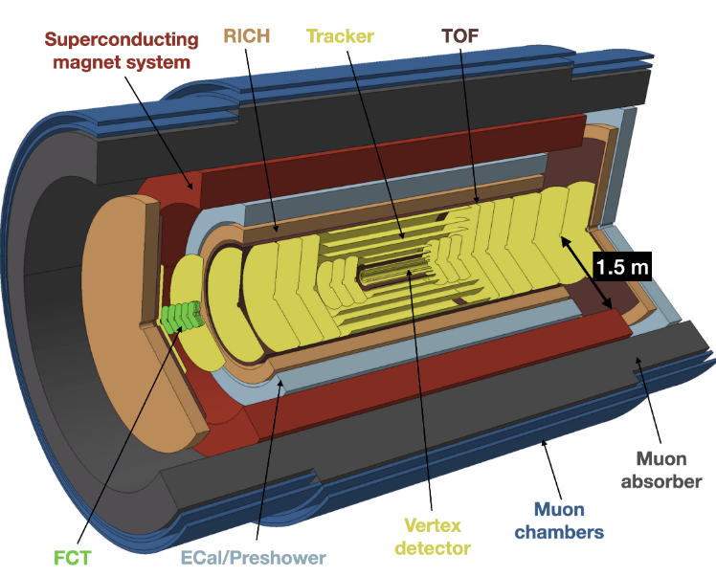
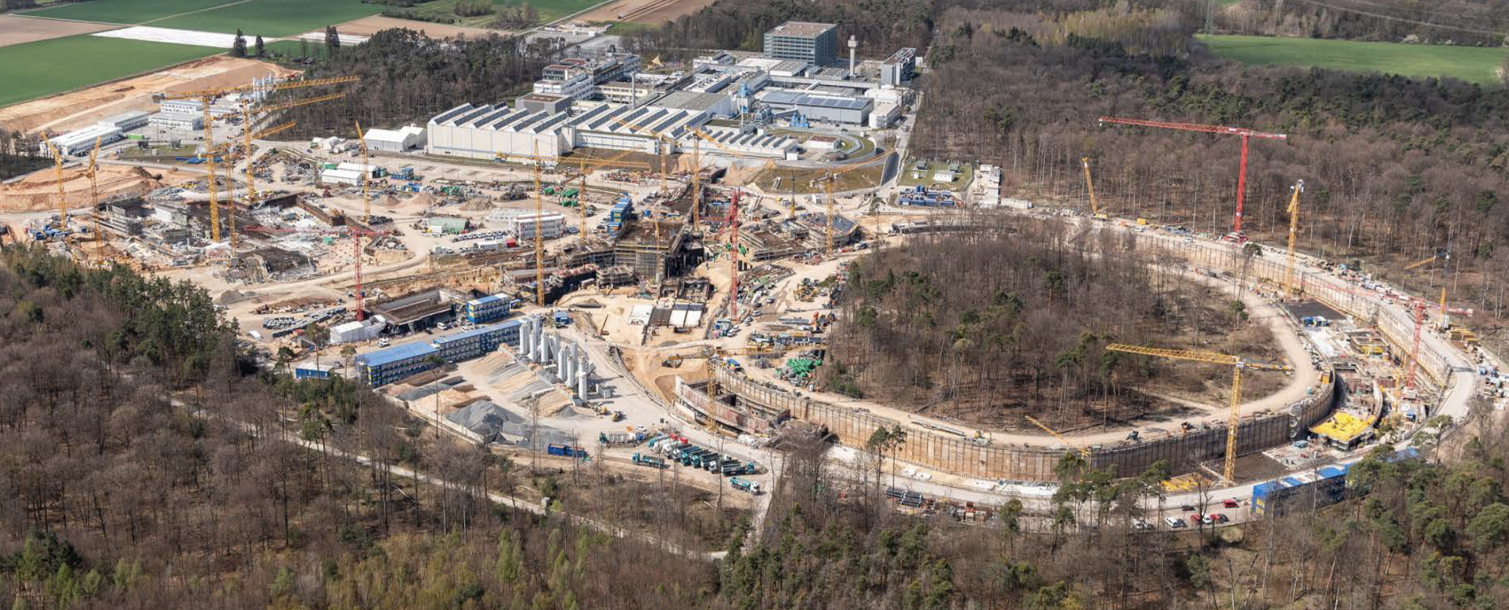
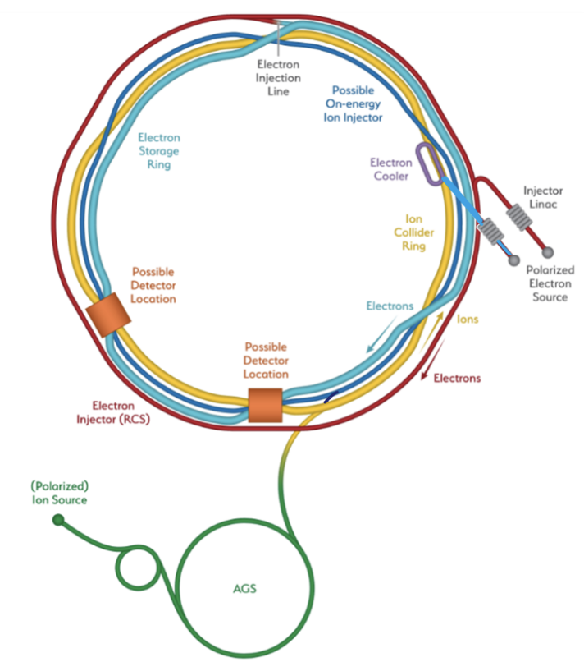
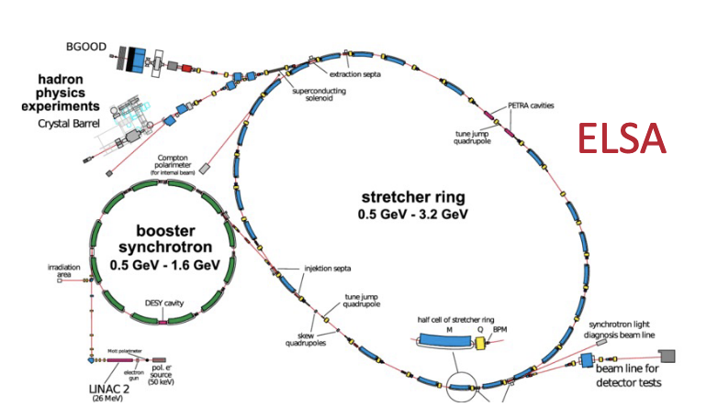
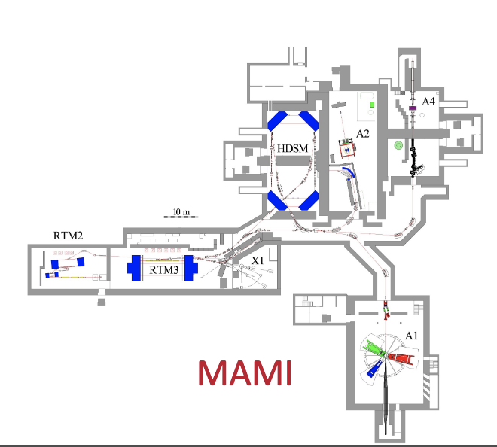
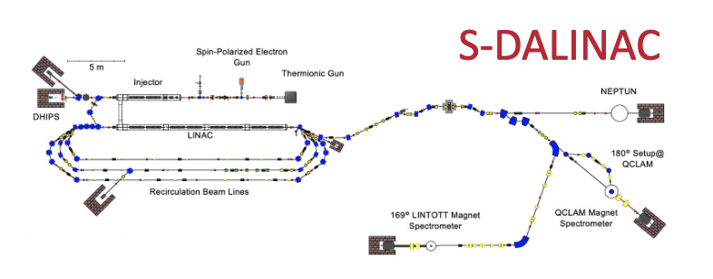
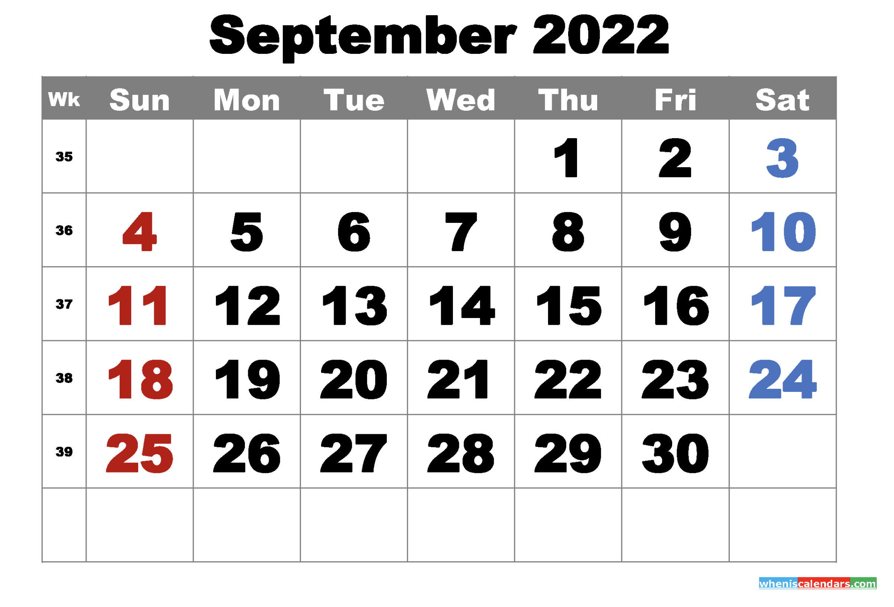
This KHuK meeting
enter into a discussion anticipating the upcoming KHuK town meetings
get input on new initiatives and developments (also from neighboring fields)
ALICE3
Many thanks to all the speakers for accepting our invitation to prepare overarching talks and for their excellent presentations!
EIC
FAIR bejond MSV
identify topics for KHuK town meeting(s) in 2022
(early 2023) provide BMBF with a coherent view of the hadron and nuclear physics community on priority research topics and projects for strategy meeting
KHuK town meeting
Bad Honnef?

Slide 3
Das KHuK-Team
Von ganzem Herzen wünschen wir Euch und Euren Liebsten
ein harmonisches und besinnliches Weihnachtsfest
sowie ein WUNDER-volles 2022 mit viel
Glück!
Gesundheit!
Erfolg!
Entspannung!
Genuss!
Sonne!
Freude!
Zufriedenheit!

