Slide 1
Overview
Personnel Access System –
PAS for FAIR
Dennis Gaßmann

Slide 2
Content
Introduction
Radiation Protection Areas at FAIR
NE-Areas
Access Areas
Beam Off Groups and Safe Access
Radiation Protection Assessment
Material Transport Procedure
Summary
2

Slide 3
Introduction
PAS = Personnel Access System (former: PSS)
Scope
  Access control for radiation protection areas (controlled and restricted areas) for the accelerators and the experiments - so called NE-Areas.
  Guard for the accelerators and the experiments with respect to prompt dose-rate from beam operation.
System function
  Personnel access and beam operation simultaneously in different parts of the facility.
  Secure NE-Areas against beam operation during personnel access.
  Stop beam operation in case of access violation and loss of integrity of NE-Areas.
System requirements
  Beam Off Groups to stop / prevent beam operation. (s. slide 12 f.)
  Access control to check access permissions. (s. slide 9 ff.)
  Enclosure of NE-Areas to fence off radiation protection areas.
GSI Context:
  PAS is the modern version of the established and proven access system ZKS at GSI

Slide 4
Radiation Protection Areas at FAIR
Buildings at FAIR are at minimum classified as surveillance areas. (“Überwachungsbereiche” compliant with German StrlSchV)
Radiation protection areas at FAIR in context of the PAS are defined always enveloping complete rooms to simplify the access control for these areas.
Controlled areas (incl. restricted areas) can be classified at FAIR. (“Kontroll- und Sperrbereiche” compliant with German StrlSchV)
  Controlled areas caused by beam operation → NE-Areas
  (Prompt and residual dose-rate in vicinity of the accelerator)
  → Access via PAS
  Controlled areas caused by residual dose-rate from exchanged parts and activation of supply media, etc. → BSA (“Bereiche mit Strahlenschutzanforderung”)
  (residual dose-rate and activation of media and components in storage and installation
  rooms)
  → Access via ZBS
  Controlled areas in shafts caused by prompt dose-rate from beam operation and activation of supply media which are accessed only once per year → BSA Schacht
  → Access via Key

Slide 5
Radiation Protection Areas at FAIR
GSI
Premises
ZBS
FAIR
Premises
ZBS
Buildings
Surveillance Area
PAS
Controlled Area
due to activation
BSA
Installation Rooms
Handling Rooms
PAS
NE-Area
ZBS
Controlled Area
due to
beam operation
BSA
Schacht
Controlled Area

Slide 6
NE-Areas (Modules I)
NE-Areas are defined as the areas enclosed by PAS including controlled and restricted areas directly caused by beam operation.
Boundaries of NE-Areas are set by the structural situation in the buildings and due to the later operational scenarios (separation of beam operation and personnel access for maintenance)
Presently FAIR is divided into 34 NE-Areas
  20 Mainareas
  14 corresponding Subareas
Main- and Subareas are built in a modular way
  The 34 areas can be reduced in three modules
    → Mainarea
    → Internal Subarea
    → External Subarea
  Each module is also built in a modular way and consists of standard components, which will be adequately assigned to the individual modules.

Slide 7
NE-Areas (Modules II)
Modular differences
Mainarea:
  One (or more) personnel access gate with material door and personnel contamination monitoring. (see door types)
  Main entrance to the accelerators and the experiments.
Internal Subarea:
  Only accessible via the dedicated Mainarea.
  No personnel access gate. (s. door types)
  Area with higher dose-rate (prompt and/or residual) compared to the dedicated Mainarea.
  Enables faster access to the Mainarea, while the Subarea remains restricted.
  Reduces the effort for the search procedure and residual radiation measurements.
External Subarea:
  Access not via the dedicated Mainarea.
  No personnel access gate. (s. door types)
  After shut down of beam operation in principle immediately accessible.
  No residual dose-rate from activation expected.

Slide 8
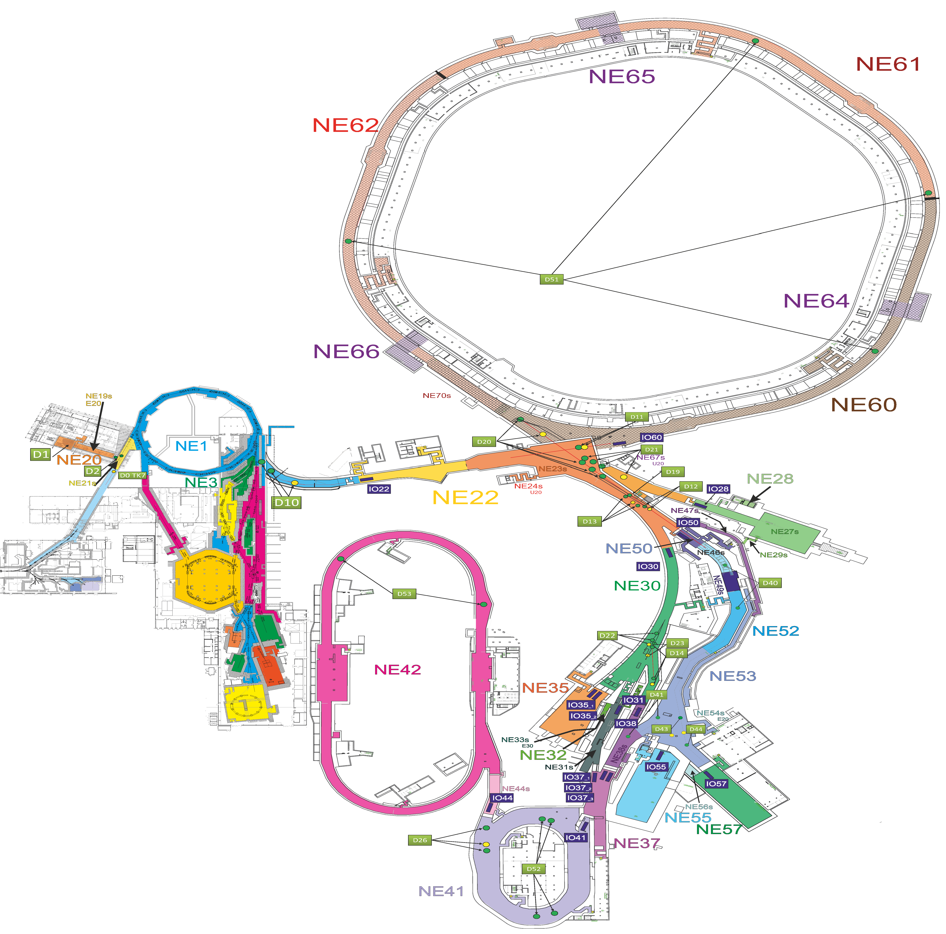
NE-Areas (Overview)
FAIR:
20 Mainareas
14 Subareas
Radiation Protection Areas (§ 52 StrlSchV) | Attribute of PAS
Überwachungsbereich (surveillance area) | Not controlled by PAS (only ZBS at building entrance)
Kontrollbereich (controlled area, residual dose-rate, local marked out restricted areas possible) | Controlled access with check of personnel access permissions
Sperrbereich (restricted area, beam operation) | No access

Slide 9
NE-Areas (Access Modes)
Access to the NE-Areas can be classified in principle in three different modes:
  Uncontrolled Access (Access for everyone)
  Controlled Access (Access only with specified permissions)
  Closed Access (No access allowed)
For closed access, in preparation of beam operation, it is necessary that there are no persons left in the NE-Area.
This will be achieved by alarming the area and through a Search-procedure by the radiation protection department.
The Search-procedure is necessary to check whether all personnel has left the NE-Area and to create a defined state for the PAS to switch in an access mode with higher restrictions.
The start and success of the procedure will be confirmed by a key switch.
To avoid the search-procedure before switching from controlled access to closed access, controlled access is also available with a Personnel-Access-Key (PA-Key) which allows the PAS to count the persons inside the NE-Area in a safe way. If a PA-Key is missing, beam operation is disabled. (Maybe based on RFID technology – work in progress and search for suitable systems is ongoing)

Slide 10
NE-Area (Door Types I)
Entries and exits of NE-Areas are possible through six standard-door types.
All door types are equipped with safety switches which will stop beam operation immediately in case of an access violation when the area is entered without permission.
Presently 111 doors are controlled by the PAS.
# | Type | Function
1 | PAG – Personnel Access Gate | Identification and separation of personnel and check of the access permissions
2 | MAD – Material Door | Transport of material in and out of NE-Areas
3 | AAD – Area to Area Door | Escape door between two NE-Areas
4 | ECD – Escape Door | Escape door out of NE-Areas
5 | SAD – Sub-Area Door | Access door to Subareas
6 | RSD – Radiation Shielding Door | Reduction of dose-rate and barrier

Slide 11
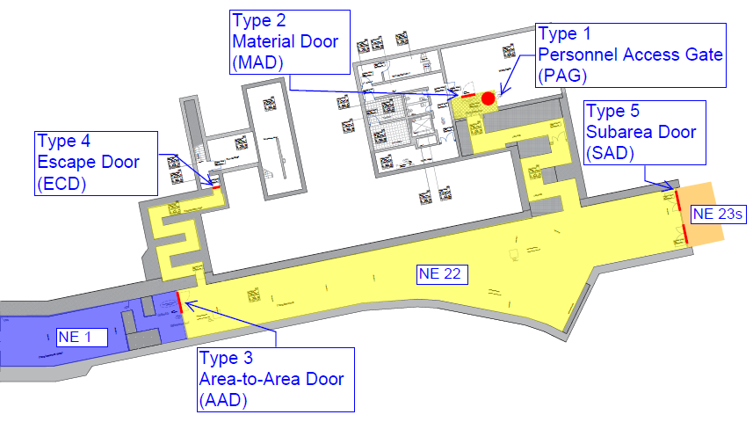
NE-Area (Door Types II)
Example of an NE-Area in G004a and T101

Slide 12
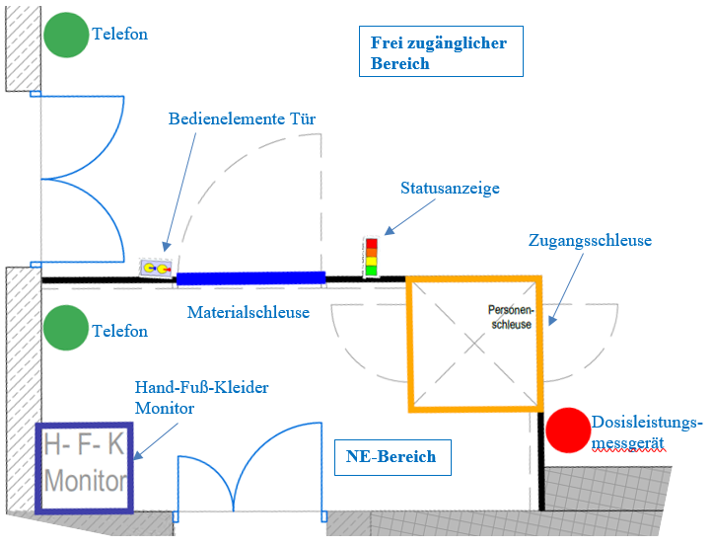
Access Area (Overview)

Slide 13
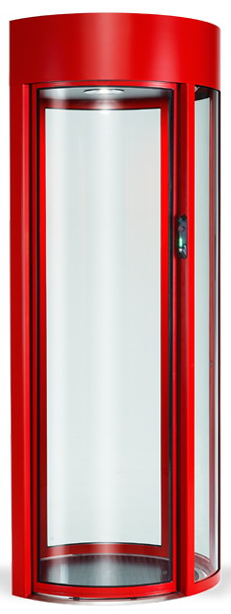
Access Area (Personnel Access Gate)
Interior View
Exterior View
Ultrasonic-Sensor
Monitor
Hand-Vein-Scanner
PA-Key
Dosimeter-
Station
QR-Code
Scanner
Safety Mat

Slide 14
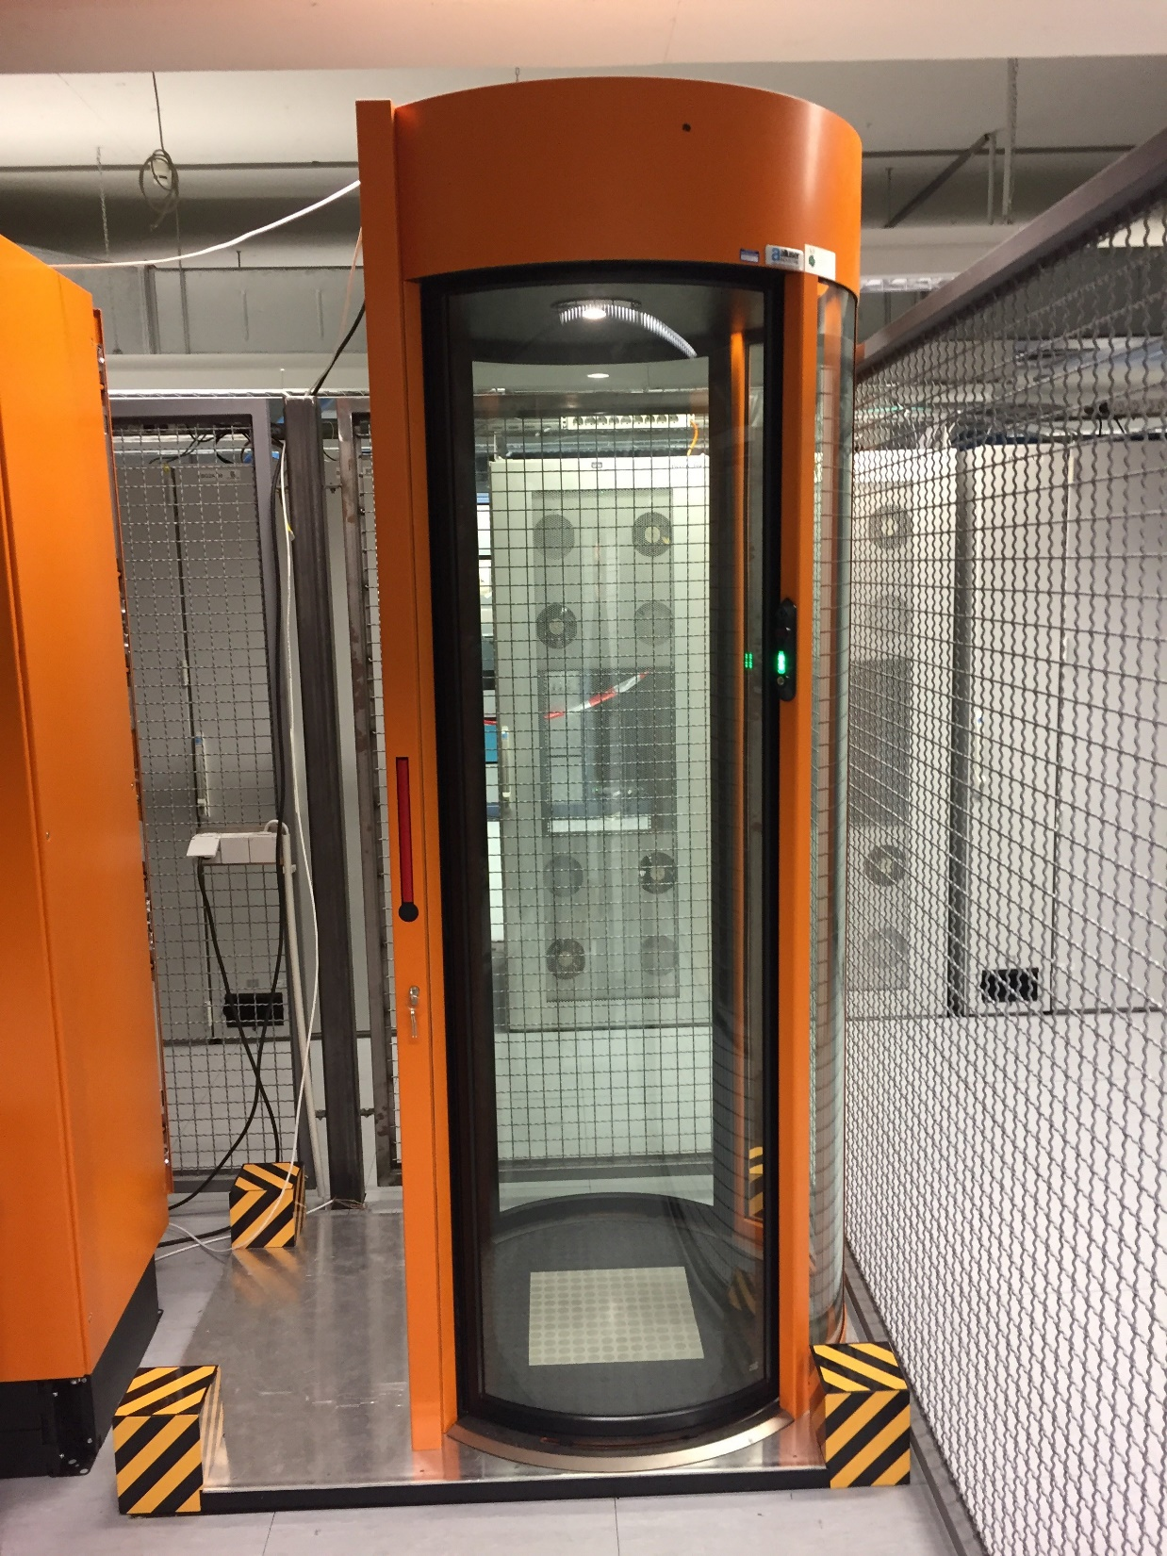
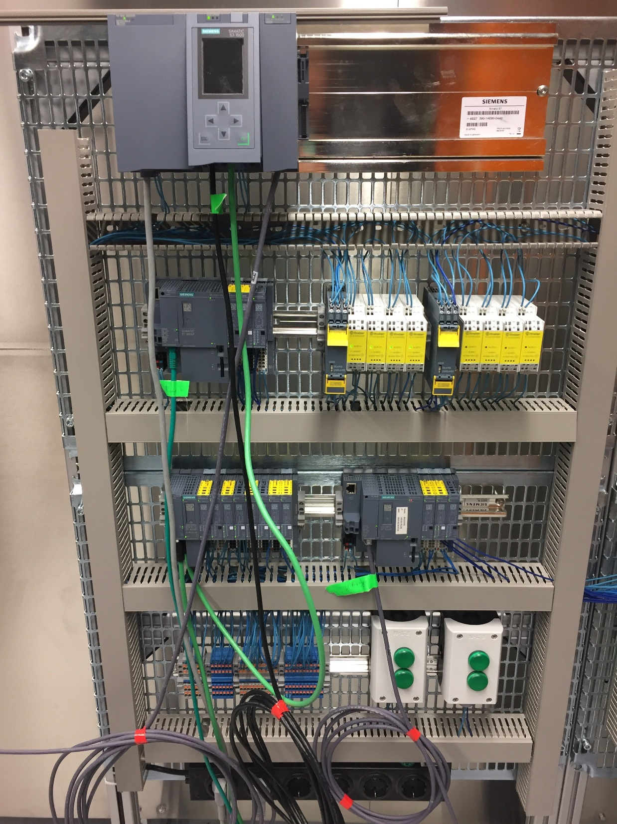
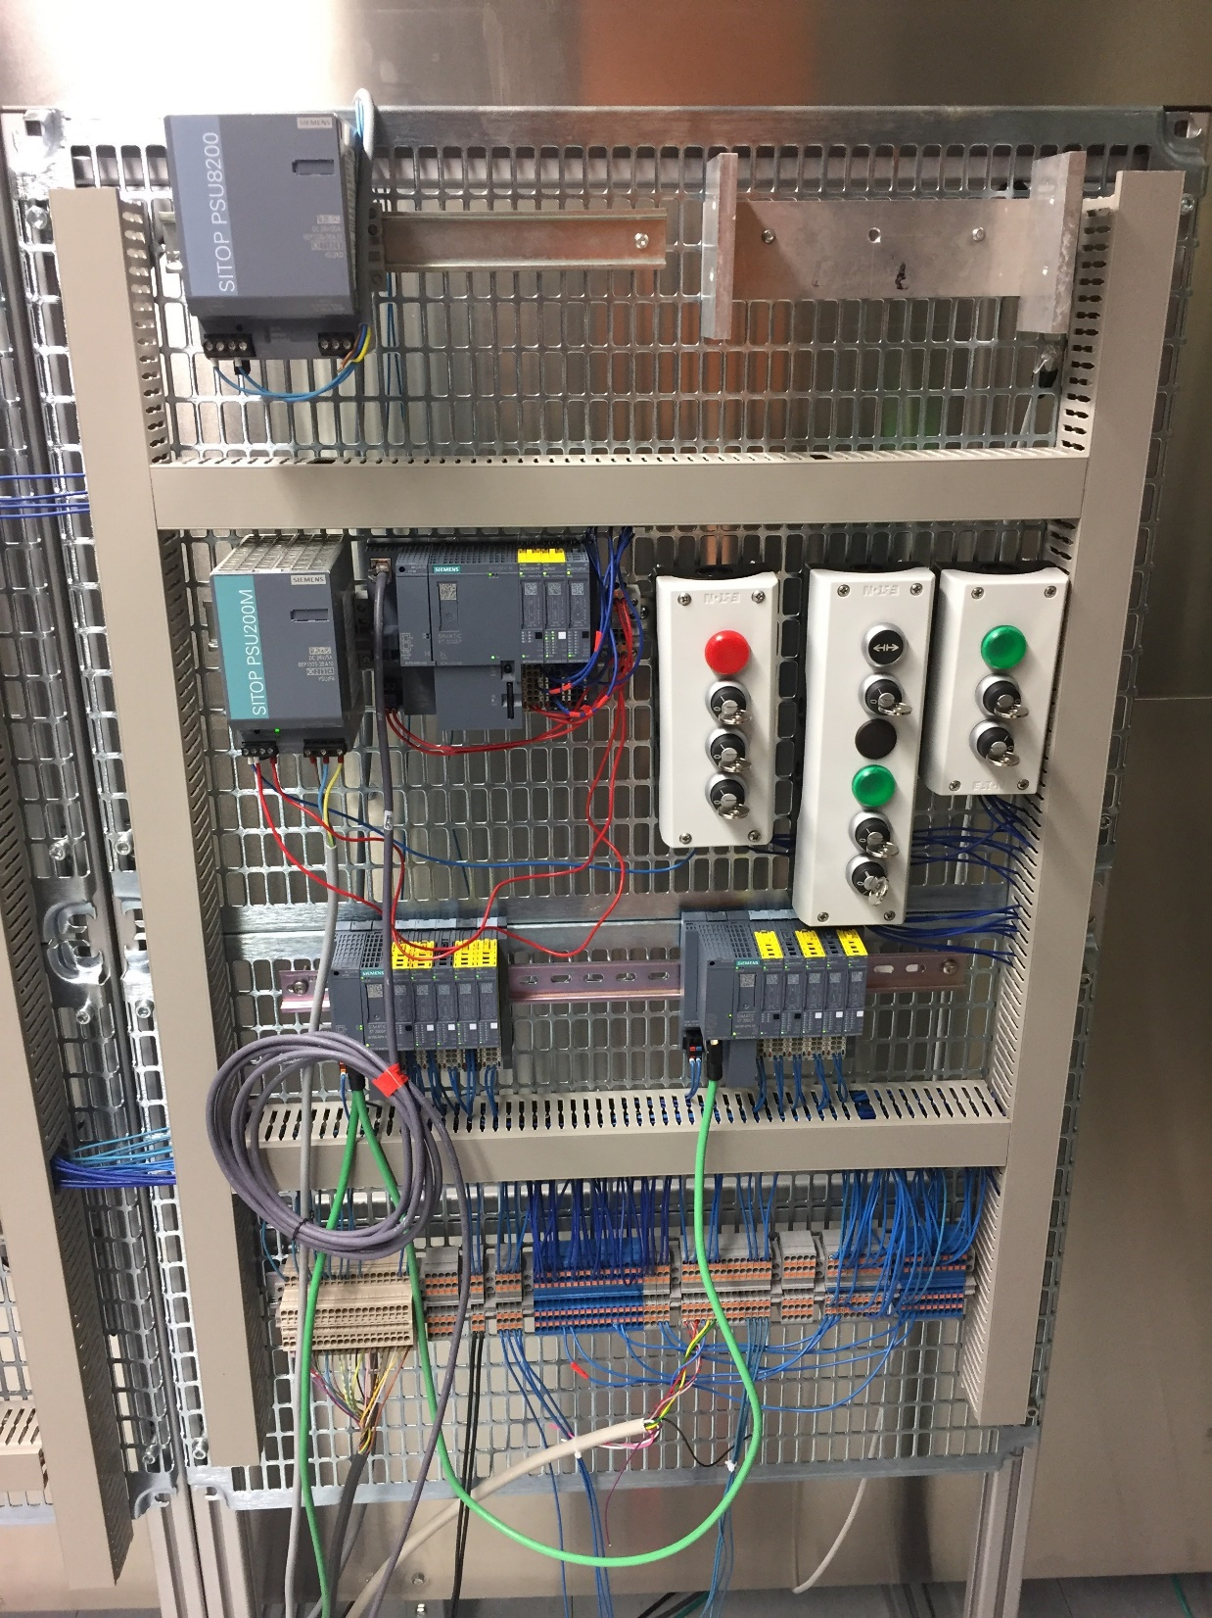
Access Area (Prototype)
Hardware structure for test software → First steps to the prototype in collaboration with colleagues from CERN.
Continuous development of the test prototype to the simulation of the complete functions of an NE-Area.
ISE
CPU 1512F
UBOG
CPU 1512F
DBOG
SYSTEM
INPUTS
CPU 1516F
NE AREA
CPU 1512F
BOG
ET 200SP
PAG
SYSTEM
OUTPUTS
ET 200SP
MAD
ET 200SP
ECD

Slide 15
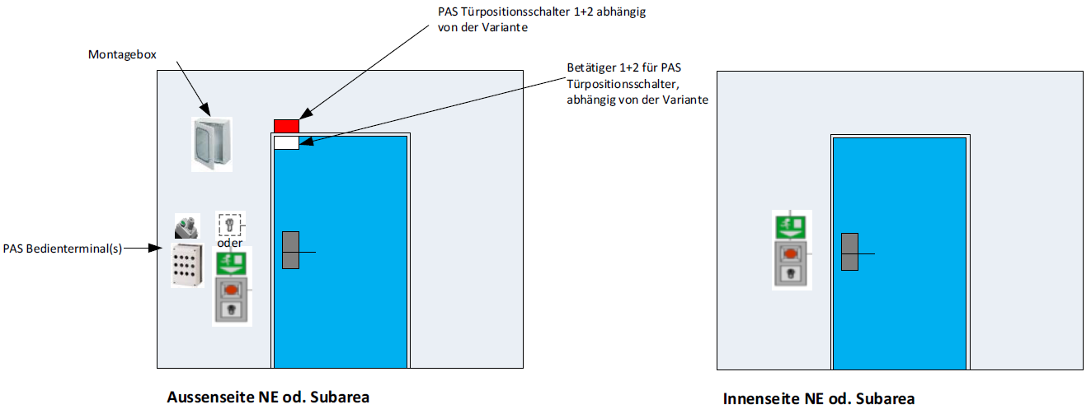
Access Area (Door Equipment)

Slide 16
Beam-Off-Groups and Safe Access
Important Safety Elements – ISE (Beam): Components which are important for beam operation with a link to PAS
  ISE have two states: SAFE / UNSAFE.
  SAFE: These components prevent beam operation in the dedicated NE-Area.
  UNSAFE: The components are ready for beam operation. (PAS point of view)
Beam-Off-Group – BOG: Group of ISE, which prevents beam operation in a dedicated NE-Area.
  Two or more ISE (Beam), e.g. two Dipole-magnets.
  The BOG disables the deflection of the beam into a dedicated NE-Area and therefore prevents beam operation in that area.
  With switching the BOG to SAFE, the ISE switch into the SAFE state and stop beam operation.
  While switching to the SAFE state the BOG sends a leading signal to the Machine Protection System to provoke an imminent beam abort.
  Safe while personnel access.
  Safe in case of access violation due to opening the safety switches at the doors without permission.
  Safe in other cases leading to the loss of integrity of the NE-Area.

Slide 17
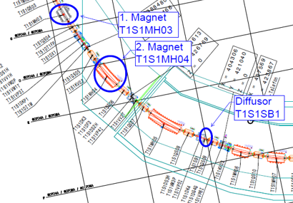
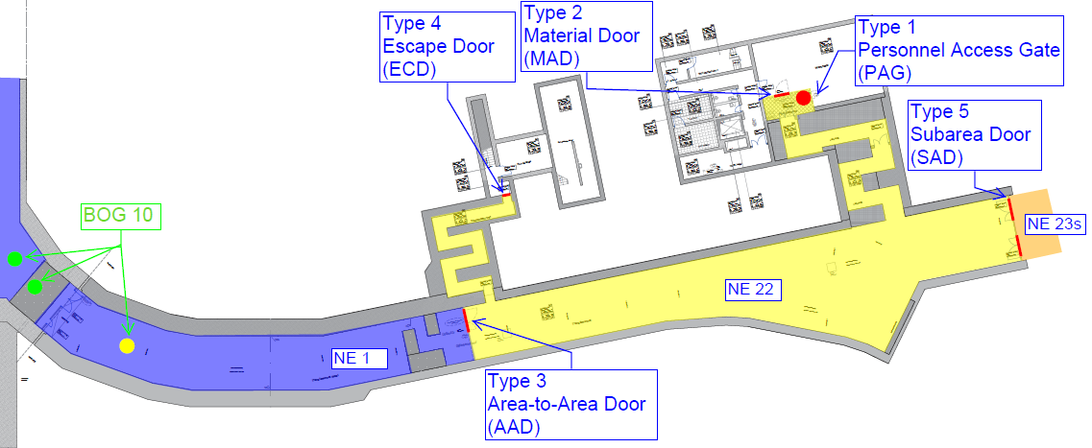
Beam-Off-Groups and Safe Access
Each NE-Area is dedicated to at least one BOG.
Presently 21 BOGs are planed.
A BOG enables safe access to an NE-Area but only with respect to prompt dose-rate!

Slide 18
Beam-Off-Groups and Safe Access
For hazards other than prompt dose-rate caused by beam operation the PAS provides three types of interfaces for risk mitigation strategies of third party systems.
The following interfaces allow a third party system to use synergy effects with the PAS infrastructure.
  Access control to NE-Areas with different levels of access permissions (administrative controls)
  Standard interface to the BOG to trigger safety functions (engineering controls, in case a performance level for functional safety is required)
  Standard interface to the NE-Area to alarm the area and/or restrict the access (administrative controls, in case no performance level for functional safety is required)

Slide 19
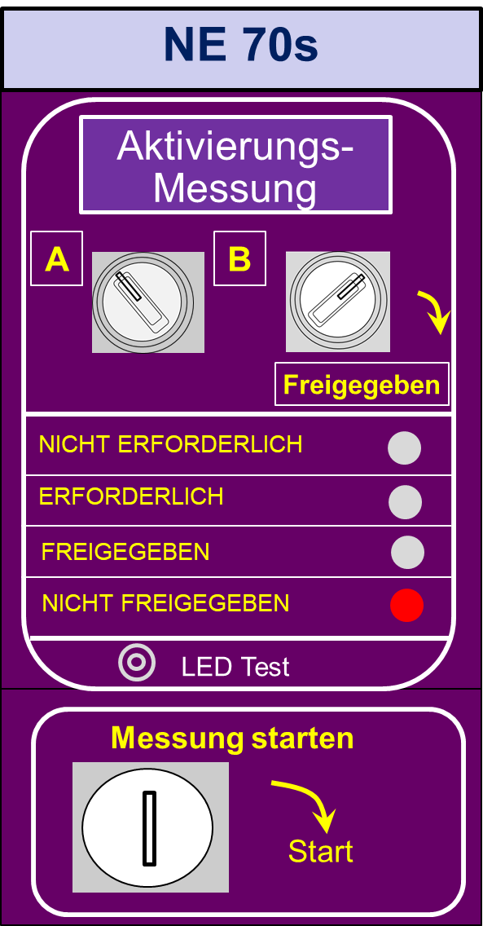
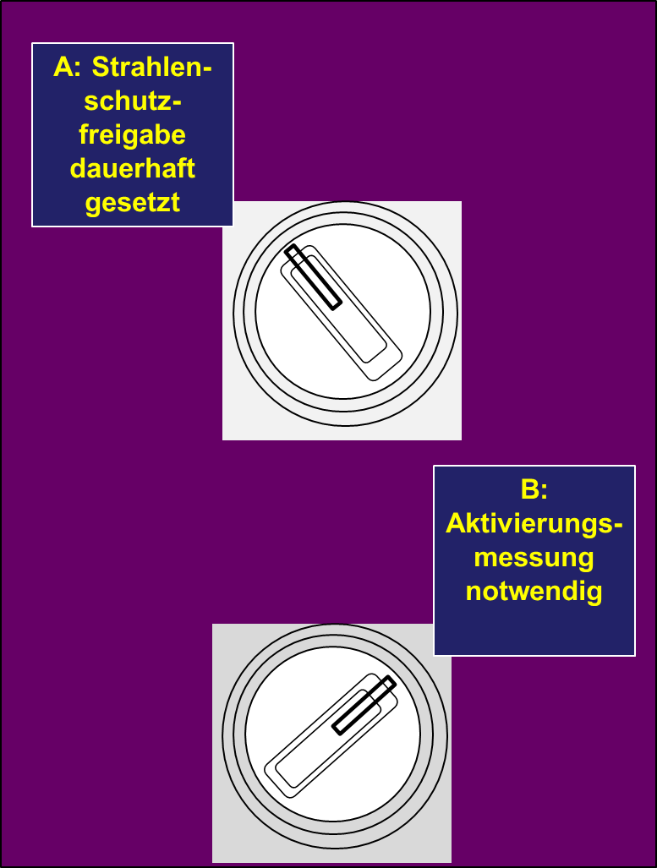
Radiation Protection Assessment
After beam operation before personnel access to an NE-Area is allowed a Radiation Protection Assessment of the NE-Area is necessary.
Each NE-Area will be classified by the corresponding SSB before beam operation:
  No measurement of residual dose-rate is necessary before personnel access is allowed. This is the case for all areas with no residual dose-rate expected.
  A measurement of residual dose-rate is necessary before personnel access is allowed. This is the case for all areas with significant residual dose-rate.
The classification will be set by the SSB with a key-switch.
The classification can be changed if the circumstances change (e.g. beam parameter).
If the assessment is not positive or the assessment is not confirmed with the key-switch, the PAS does not allow the switch of an access modes into a mode with personnel access.
Bewertung Strahlenschutz

Slide 20
Material Transport Procedure
Request of material transport by phone to enable the transport-key (transport into NE-Area) or the transport will be assisted by the radiation protection department (transport out of NE-Area).
The procedure starts, the light curtain is activated and the PAG will be disabled for entrance and exit procedures.
The MAD can be opened and the material will be placed inside the transport zone w/o loosing the searched state of the area and no access violation alarm.
The MAD will be closed again and the area between the light curtain and the MAD will be searched by radar whether there are persons left in the area.
If the area is clear the procedure will be finished and the light curtain is disabled. The PAG will be enabled for entrance and exit procedures again.
Light Curtain or Door Safety Switch
TransportZone
PAG
Radar Monitored Area
MAD
Transport-Key, Phone and State-Monitor

Slide 21
Summary
Modular infrastructure of PAS (NE-Areas, Doors, Components)
Three modes of access to NE-Areas
  Uncontrolled Access (Access for everyone)
  Controlled Access (Access only with specified permissions, different permission levels)
  Closed Access (No access allowed)
Search procedure to generate a defined state of the NE-Area for the PAS.
BOG = Group of ISE, preventing beam operation in a dedicated NE-Area.
BOG = Safe access to an NE-Area but only prompt dose-rate.
For third party systems the principle should be safety by design.
If safety by design is not achieved there are three options for third party systems to include the PAS into their risk mitigation strategies.
  1. Access control to NE-Areas with different levels of access permissions
  2. Standard interface to the BOG (switch off equipment or trigger other safety functions)
  3. Standard interface to the NE-Area (close the entrance to and/or alarm the NE-Area)
Radiation Protection Assessment to assess residual dose-rate before switching to personnel access.
Material Transport into / out of NE-Areas without loss of “Search” state and access violation alarm.

Slide 22
Thank you!

