Slide 1
PANDA COLLABORATION MEETING
HESR-PANDA Chicane Dipole Magnet
STATUS AND PLANS
25-29 October 2021

Slide 2
Main Specifications for Dipole Magnet
Field integral along beam axis (z-direction) 2.0 T·m
Aperture angle horizontally ± 10°, vertically ± 5°
Yoke laminated to reduce eddy currents, lamination ~ 10 cm
Total weight 240 tons
Steel quality of yoke St-10
Coil windings made of water cooled copper conductors
Total dissipated power ≤ 400 kW

Slide 3
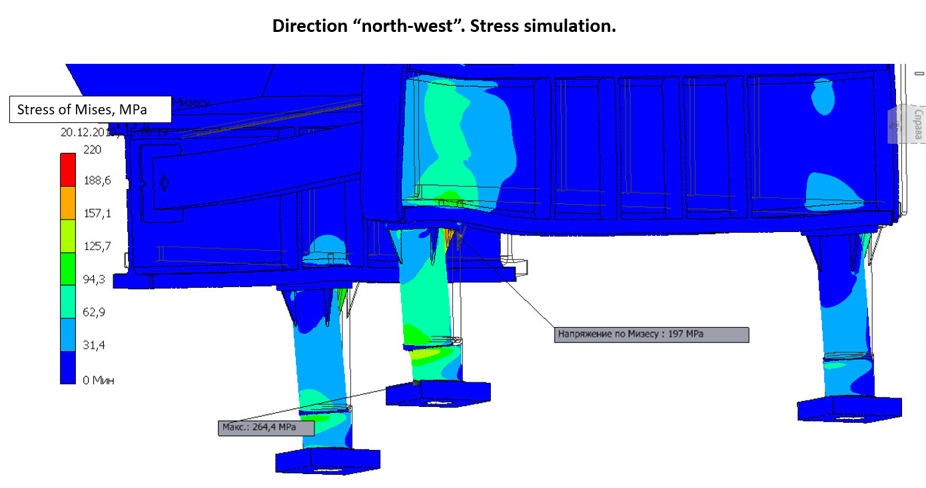
Stress analysis-2
To further reduce the stress and displacement:
The leg wall thickness was increased from 20 to 30 mm.
Six triangle girders are now installed under the flange of each of the 3 leg.
The design of the ground plate for a common alignment of the support legs was improved.
Finally there is no area anymore with stress above the yield strength of 255 MPa for St10.

Slide 4
Status
Stress analysis and magnetic field simulations completed.
Design and 3D model for entire magnet completed.
2D drawings derived and uploaded to EDMS server.
Final report had been accepted as conditional acceptance, including
Installation manual and other related documents.
Magnetic mapping system is under detail design.
Contract with steel maker concluded.
Contract with copper maker concluded.
Yoke machinery workshop had been selected as Krasnodar Factory.
Contract text and related documents had written and approved by BINP legal
department and Krasnodar legal departments. Signing is expected by this week.
Tooling manufacturing for coil winding and impregnation had been ordered to
BINP workshop.
- Parts for yoke production (electric steel insulation sheets and etc.) had been ordered.

Slide 5
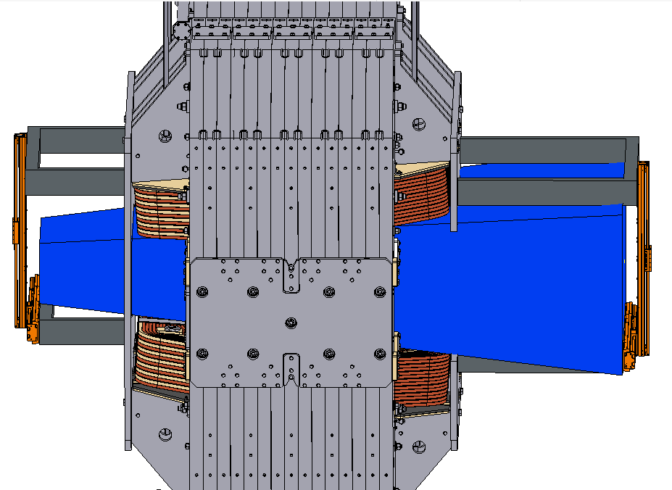
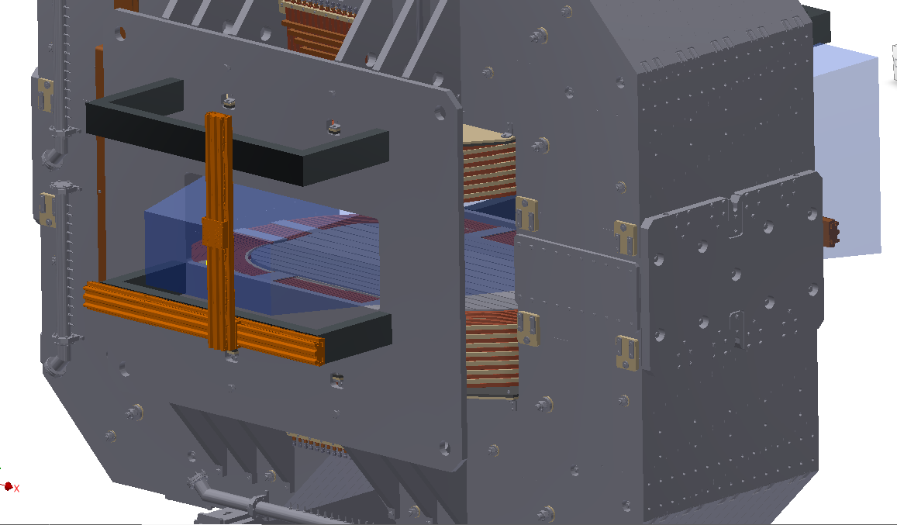
Magnetic measurement system for dipole.
Boundary conditions:
using one 3D Hall sensor
covering all area inside magnet gap
accuracy 1 Gauss
measuring positions in X, Y, Z.
common control unit with Solenoid field mapping system

Slide 6
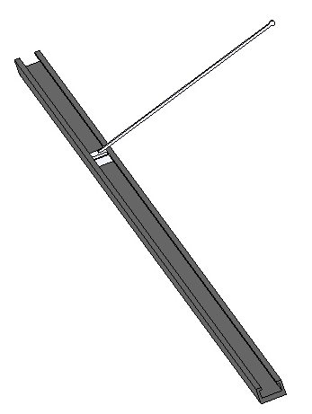
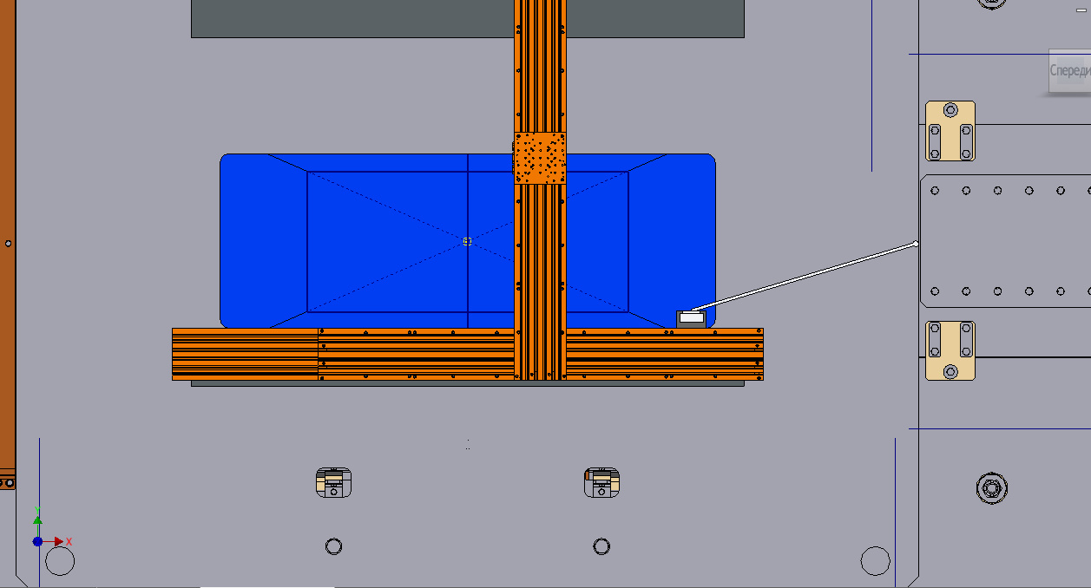
Magnetic measurement system for dipole-2.
Location of 3D Hall Sensor and Laser Reflector
XY moving system can only move inside the area marked by blue (restriction imposed by a hole in the upstream field clamp)
Carbon fiber plastic
Guideline and carriage
Using this shape of the carriage, it is possible to measure the field near the pole surface inside the magnet gap while the guide is placed in the area of possible movement. The elongation height of the carriage was chosen so that measurements could be started below the median plane.

Slide 7
Magnetic measurement system for dipole-3.
Guide line of carbon fiber plastic (weight 16 kg for 6 m)
Sag of guide line is 1.5 mm (inclination angle is 0.06 deg.) => at points with large Bz the error to By is about 4-5 G.
=> Carriage with 3 tracker mirrors and one 3D Hall sensor (weight 2 kg) for measuring field, coordinates and angle.
Selecting a reliable and inexpensive moving system (NEWPORT is good, but expensive).
Detailed drawings are in preparation.
Selection of maker for guideline is in process. We have three candidates.

Slide 8
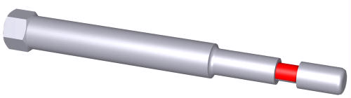
Fuses used to fixate the aligned magnet-1
The feet of the support legs are resting on special greased PTFE bearings which are needed for the alignment.
In case of a seismic event of medium magnitude (equivalent static acceleration 0.3 to 0.4 m/s², or 0.03 to 0.04 g, resp.), the friction in the PTFE bearings will be big enough to keep the magnet in place. A seismic event of bigger magnitude would cause the magnet to slide. To prevent this, at least up to an equivalent static acceleration of 0.8 m/s², specially tailored bolts (fuses) will be applied.
In the very unlikely case of an even bigger seismic event (> 0.08 g), these fuses have to yield reliably in order to avoid a horizontal overload of the support legs.
Three series of fuses have been tested to determine their yield behaviour. All were made of steel St10X with notch diameters of 5.6 mm to 9.8 mm (notch length 1.25 times notch diameter). In all 3 series it appeared that there was a clear cut yielding at about 800 MPa (± 2%).
notch

Slide 9
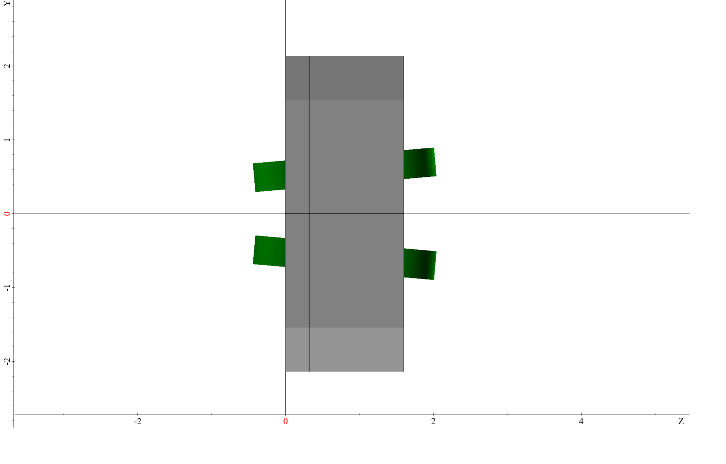
3D code, based on Maxwell tensor method, for precise simulations of repelling forces acting on yoke parts.
Magnetic field forces applied to the block shown in picture below have been calculated using MASTAC.
Magnetic force as the derivative of total energy
volume mesh elements | 16320 | 60724 | 235200
W, J | 2442996.512 | 2430393.340 | 2437341.847
W (dz = 5 mm), J | 2443792.667 | 2432117.126 | 2439065.881
dW / dz , kN | 159.231 | 344.757 | 344.807
dW / dz , t | 16.248 | 35.179 | 35.184

Slide 10
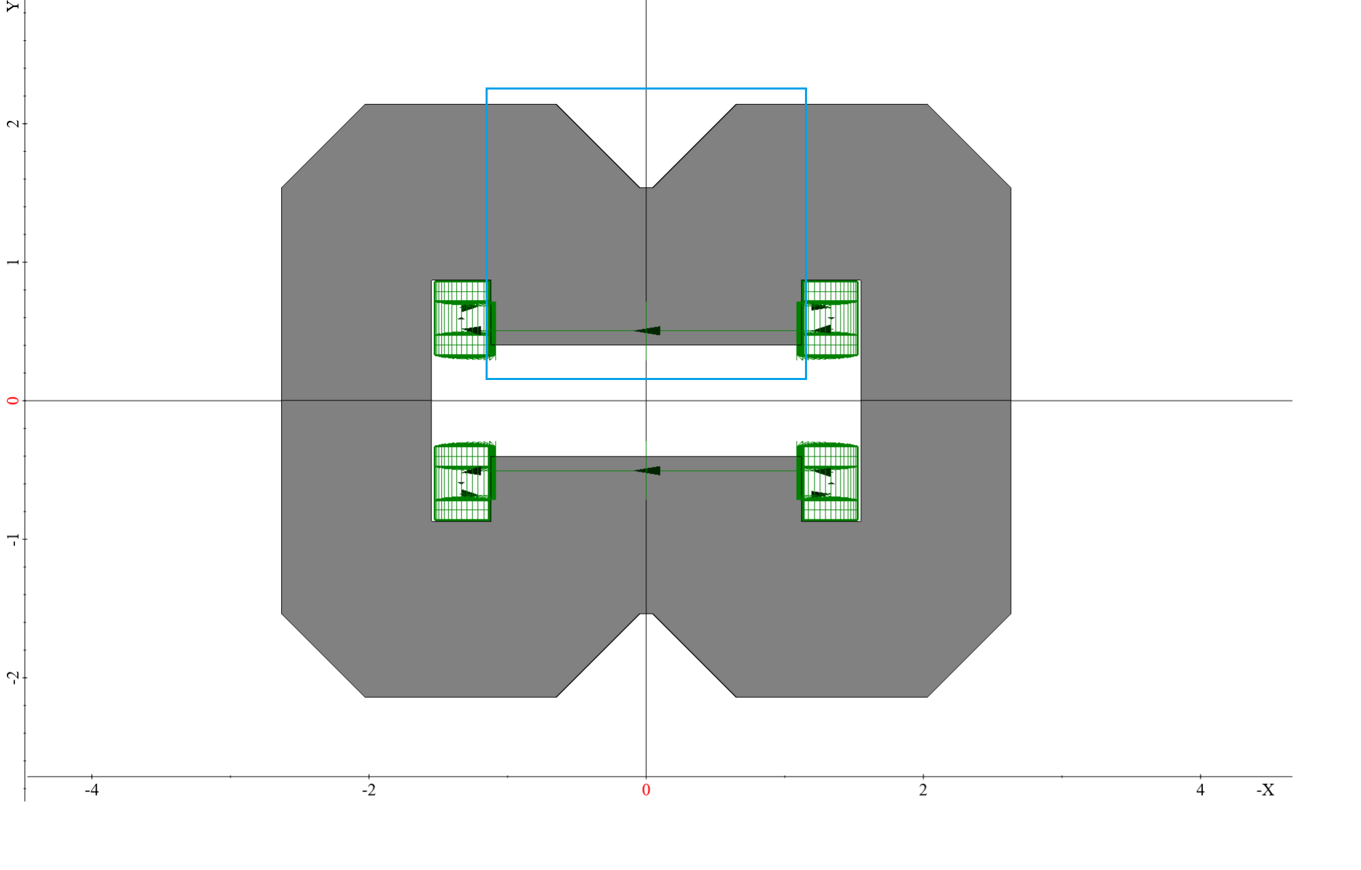
3D code, based on Maxwell tensor method, for precise simulations of repelling forces acting on yoke parts.
Another way how to calculate magnetic force is to use Maxwell stress tensor. Two different surfaces have been considered for this method: surface around middle part of the top half and surface around the whole block
Middle part of top half (vertical component)
surface mesh elements | 3750 | 15000 | 60000
Fy, N | -976064 | -831338 | -830284
Fy, t | -99.598 | -84.830 | -84.723
Calculations of Fz using Maxwell method with complex surface mesh are in progress (preliminary results are shown in Table below).
elements: 3750 | Middle part of top half | Whole block
Fz, N | -244491 | -312069
Fz, t | -24.948 | -31.844

Slide 11
Plans
Conditional acceptance of final report to be completed.
Magnetic mapping system design will be completed soon in detail.
Checking 3D code, based on Maxwell tensor method, for precise simulations of repelling forces acting on yoke parts.
Launching milling processing of plates on the South plant of heavy machinery (Krasnodar).

