Slide 1
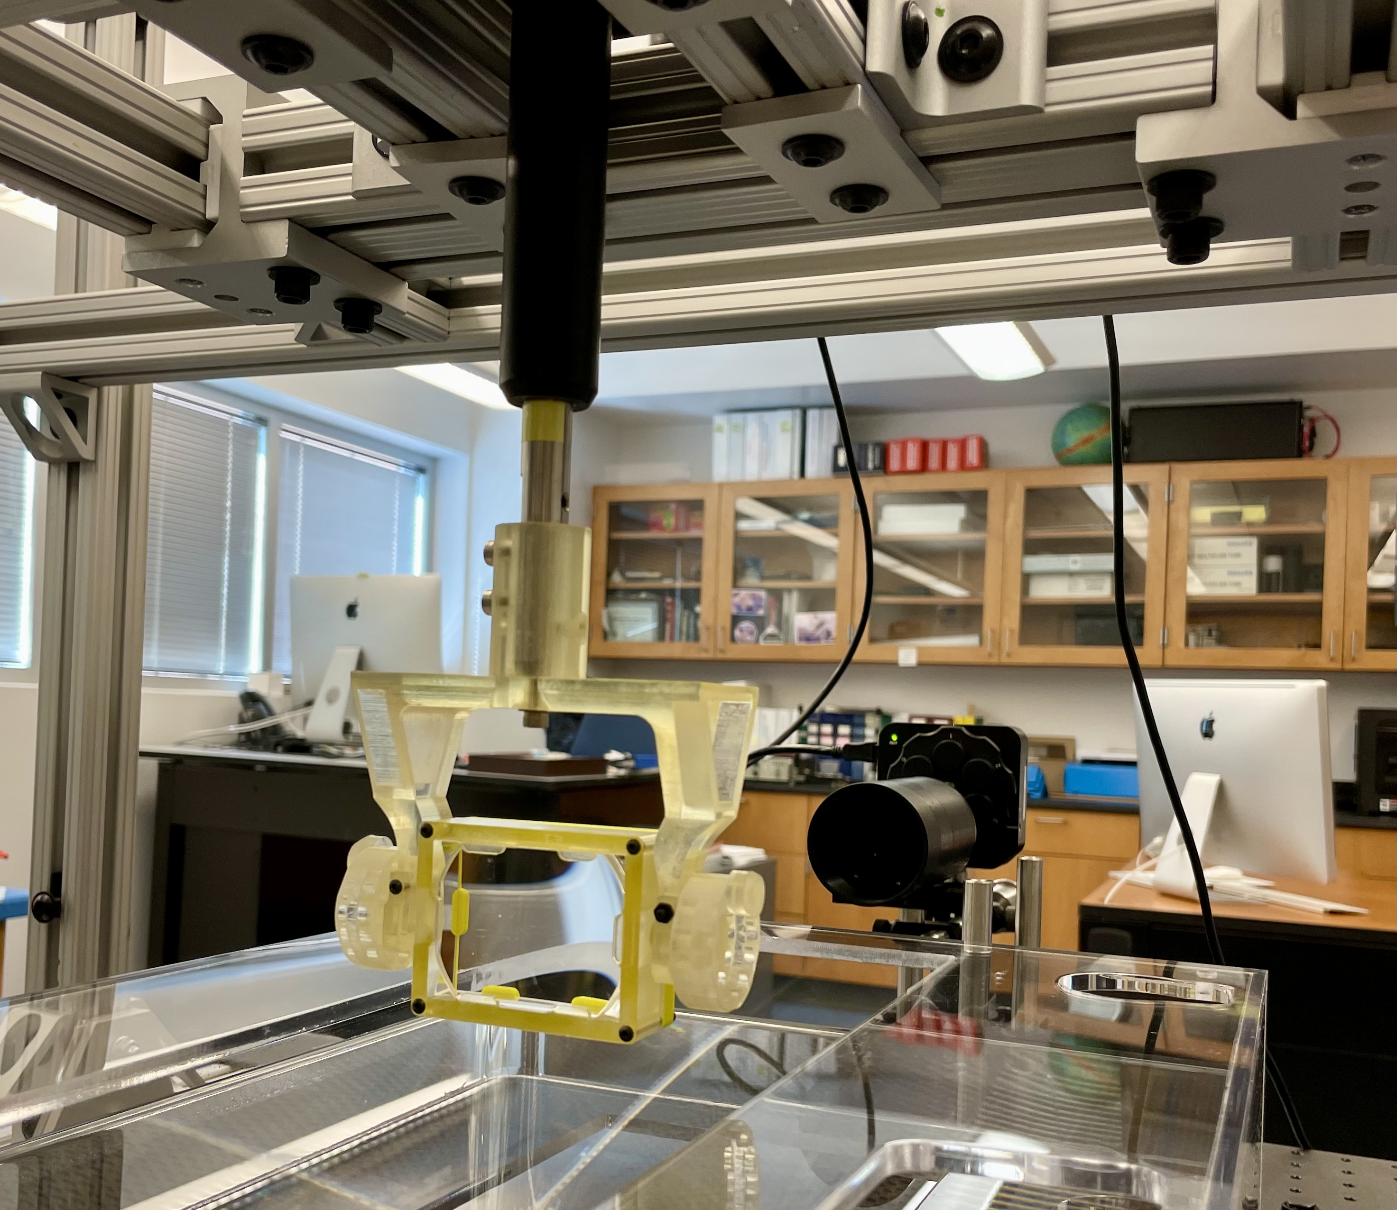

Mapping Focal Plane of 3-layer Lens
3-layer focussing lens
Prototypes
Setup to map focal plane
Simulation
Initial results
Greg Kalicy
October 26 2021
Notes:
<number>

Slide 2
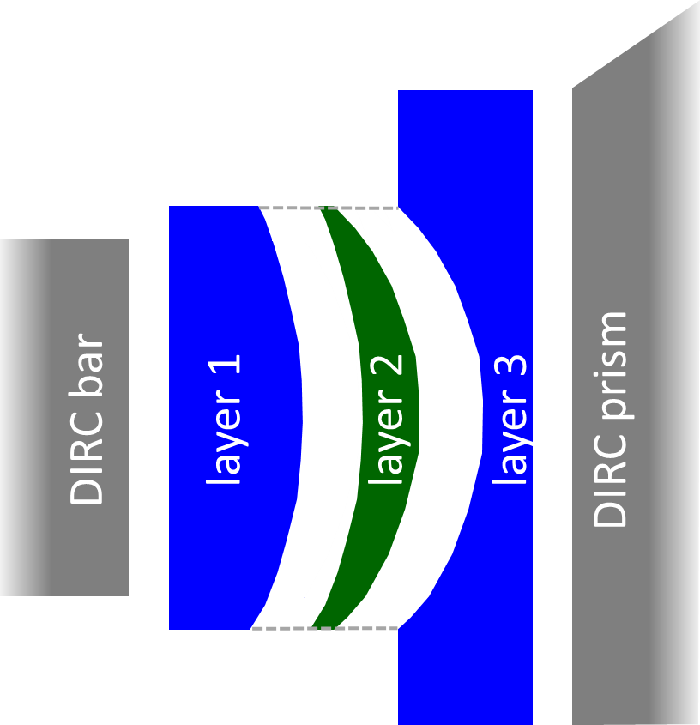
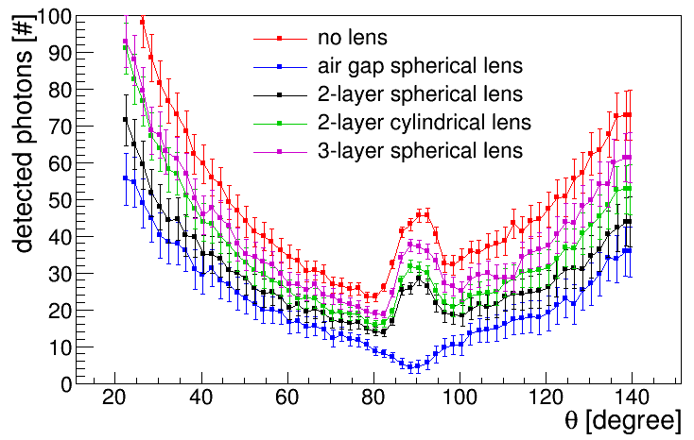
3-layer Lens Concept
3-layer compound lens (without air gap) is key element of hpDIRC design:
Creates flat focal plane – matched to fused silica prism shape
Avoids photon loss and barrel PID gap
Successfully produced prototype lenses and validated performance with particle beams at CERN and GSI
layer of high-refractive index material (focusing/defocusing) sandwiched between two layers of fused silica
Source: PANDA Barrel DIRC TDR
doi:10.1088/1361-6471/aade3d

Slide 3
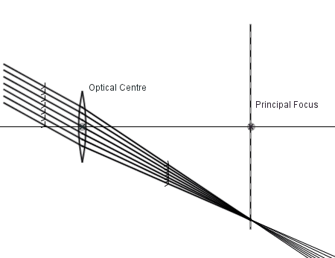
3-layer Lens Concept
3-layer compound lens (without air gap) is key element of hpDIRC design:
Creates flat focal plane – matched to fused silica prism shape
Avoids photon loss and barrel PID gap
Successfully produced prototype lenses and validated performance with particle beams at CERN and GSI
layer of high-refractive index material (focusing/defocusing) sandwiched between two layers of fused silica

Slide 4
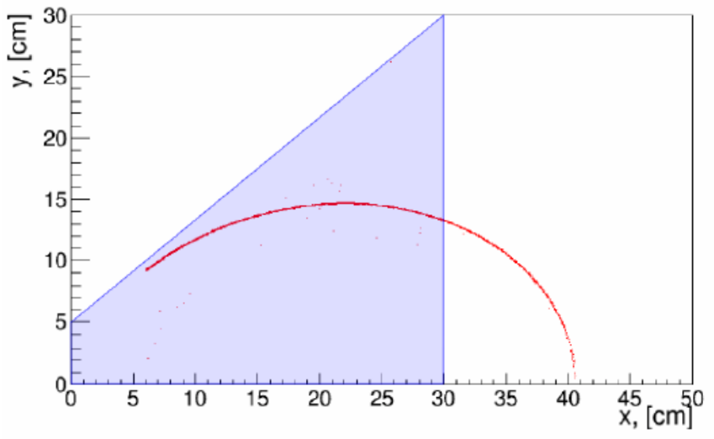
3-layer Lens Concept
3-layer compound lens (without air gap) is key element of hpDIRC design:
Creates flat focal plane – matched to fused silica prism shape
Avoids photon loss and barrel PID gap
layer of high-refractive index material (focusing/defocusing) sandwiched between two layers of fused silica
Geant4 simulation of focal plane:
air gap lens 3-layer lens
Geant Simulation

Slide 5
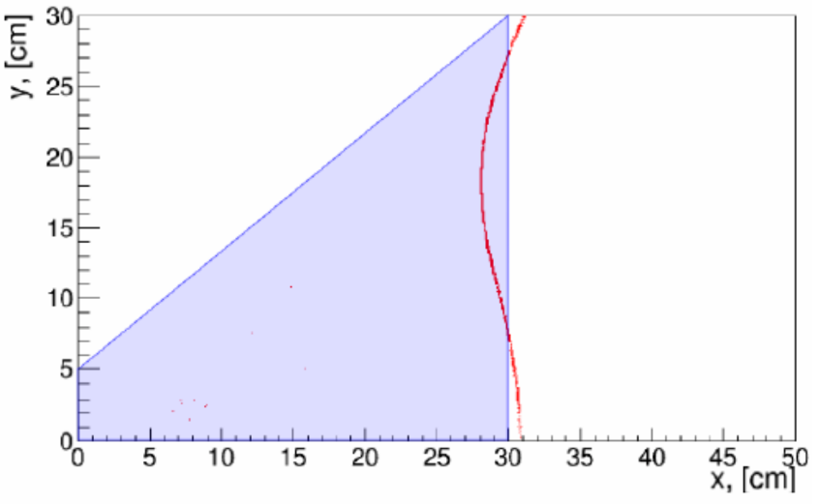

3-layer Lens Concept
3-layer compound lens (without air gap) is key element of hpDIRC design:
Creates flat focal plane – matched to fused silica prism shape
Avoids photon loss and barrel PID gap
layer of high-refractive index material (focusing/defocusing) sandwiched between two layers of fused silica
Geant4 simulation of focal plane:
air gap lens 3-layer lens
Geant Simulation

Slide 6
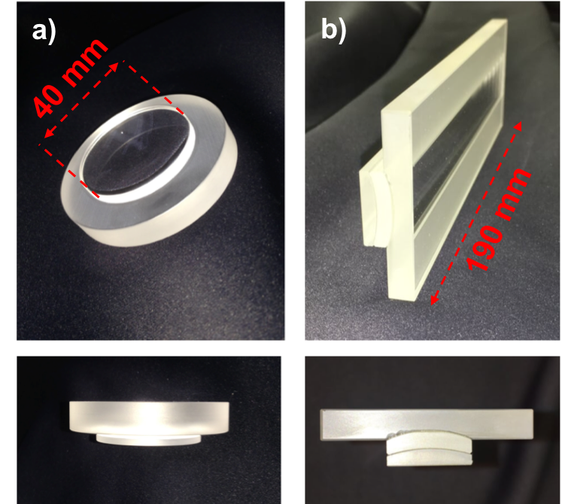
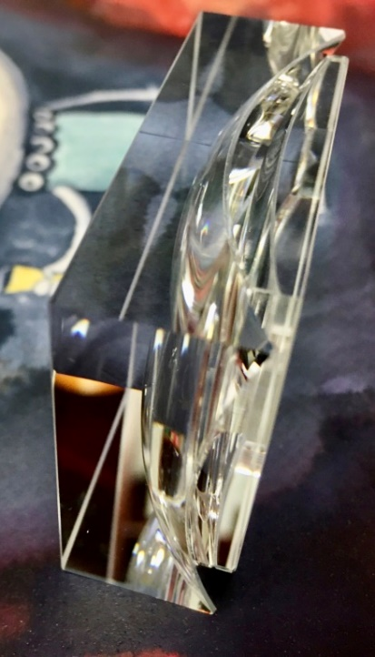
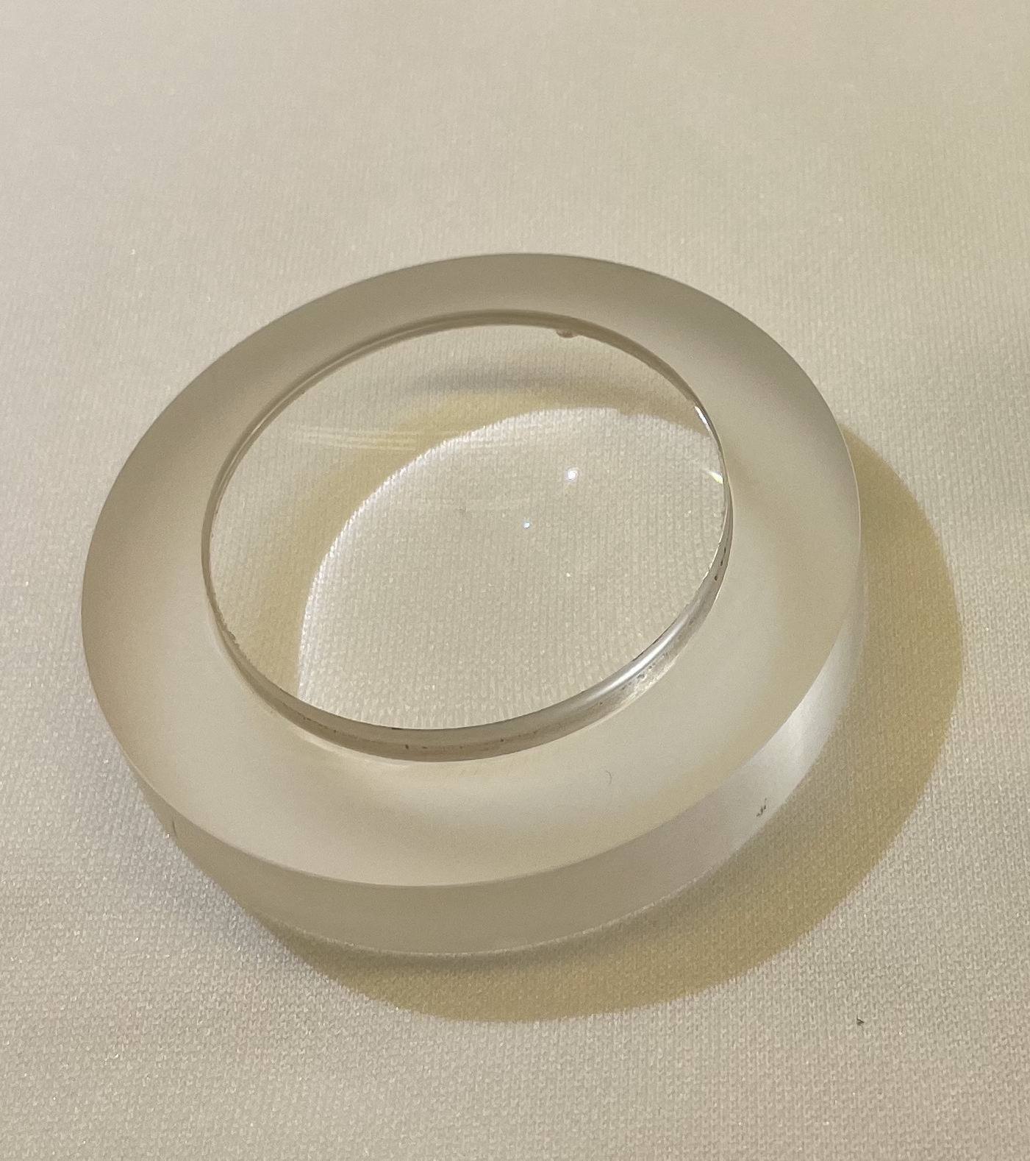
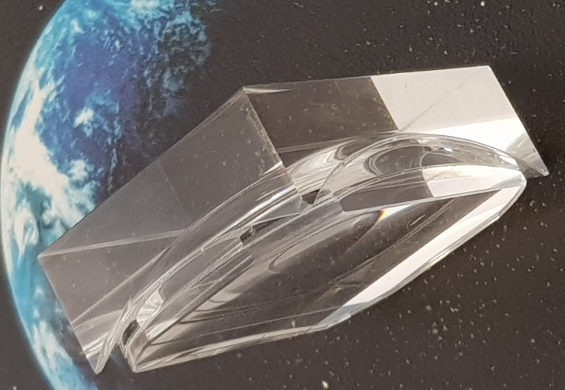
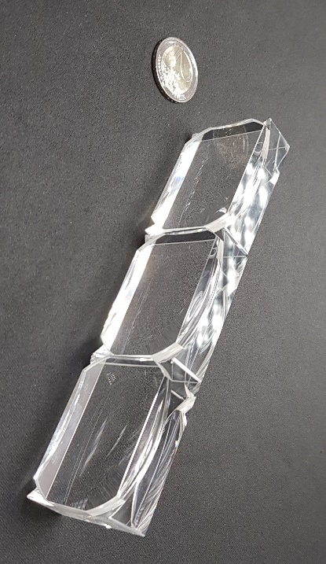
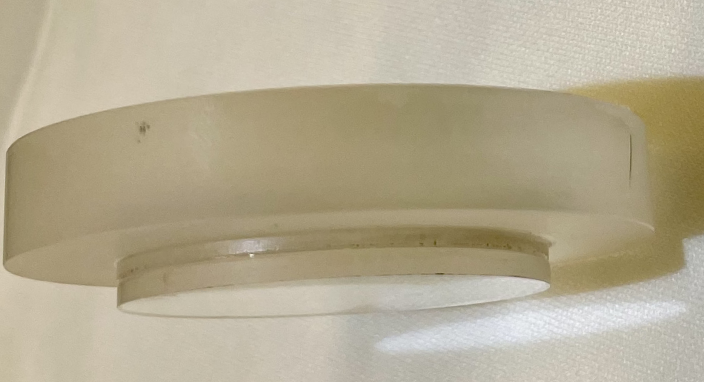
3-layer Lens Prototypes
Several prototypes build for PANDA and EIC R&D programs with different radii ratio and middle layer material
Most relevant here (c) and (d) with lanthanum crown glass
Spherical (NLaK33)
Cylindrical (S-YGH51)
Spherical (S-YGH51)
Spherical (LaK33)
Spherical (Sapphire)
Spherical (PbF₂)
c)
d)
e)

Slide 7

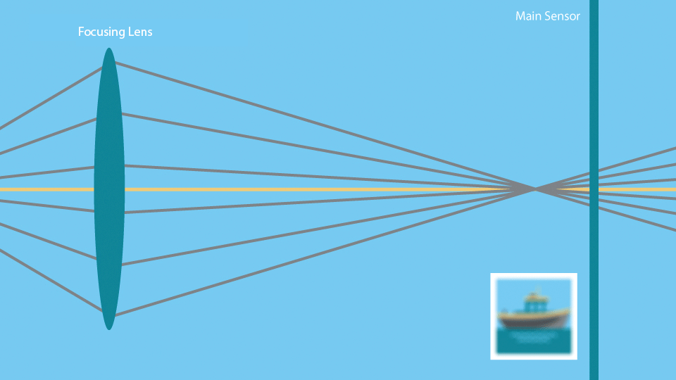
Measuring Focal Length

Slide 8
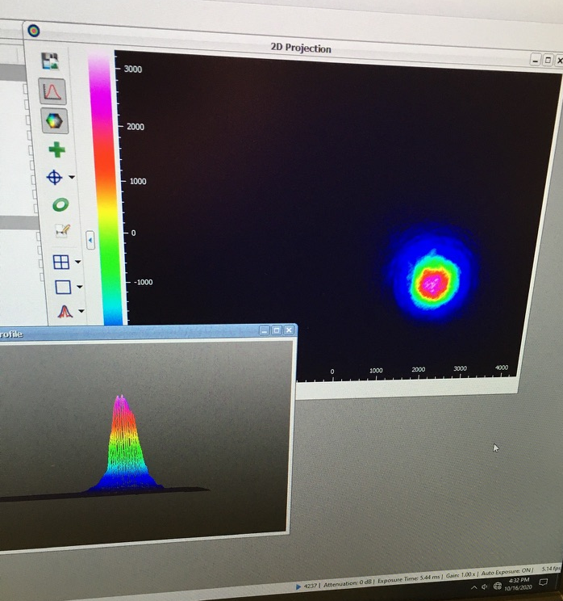
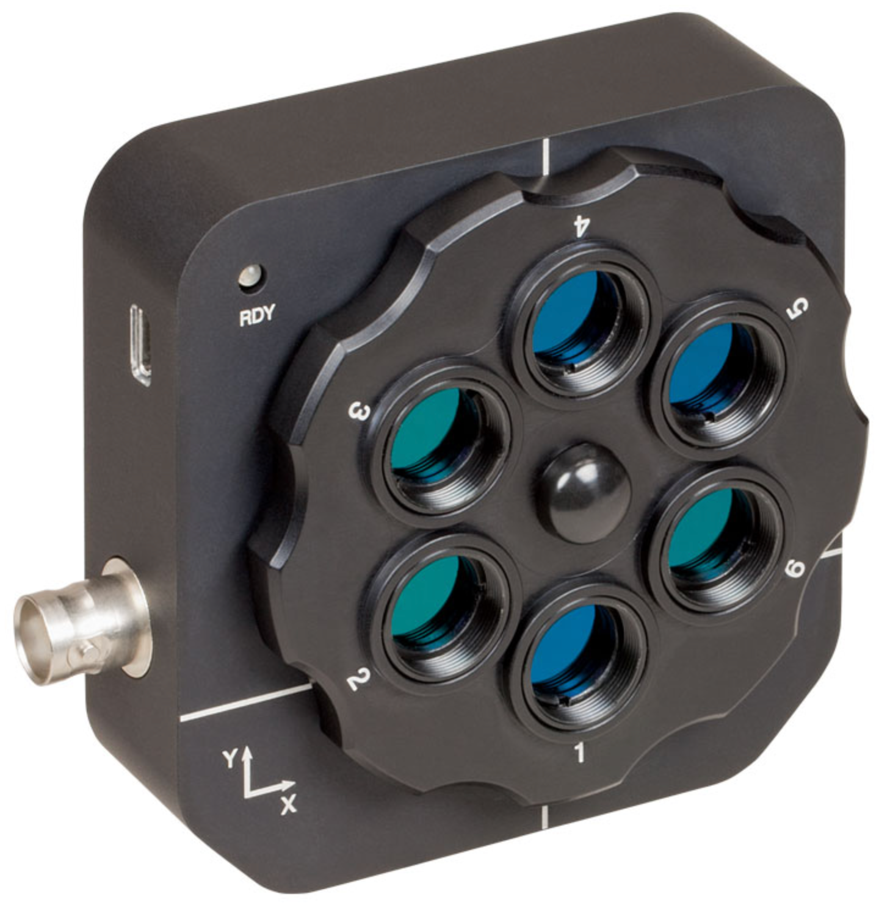
Measuring Focal Length
CCD Beam Profiler from Thor Labs as Senssor

Slide 9
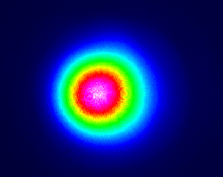
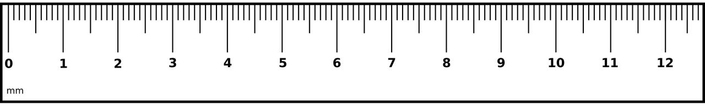
Measuring Focal Length
Optical fiber used to achieve clean, collimated gaussian laser beam profile
Polarising Filters used to control beam intensity
Mirror (M3) on 3D micrometre control stage used to align and control beam

Slide 10
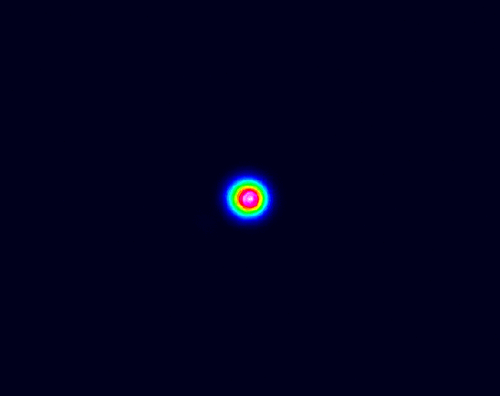
Measuring Focal Length
Unfocussed Beam Profile
Focussed Beam Profile

Slide 11
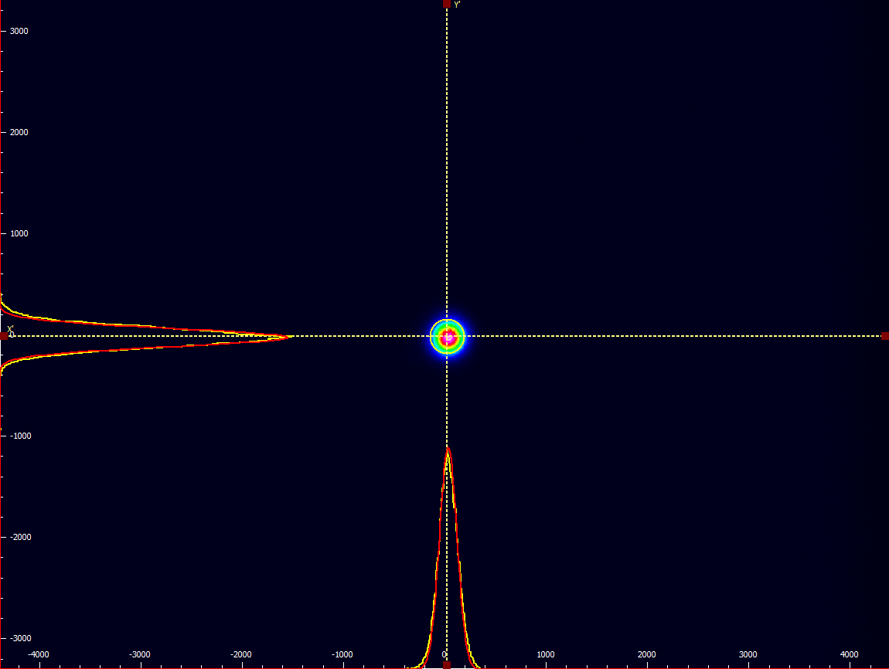
Measuring Focal Length
Unfocussed Beam Profile
Focussed Beam Profile

Slide 12
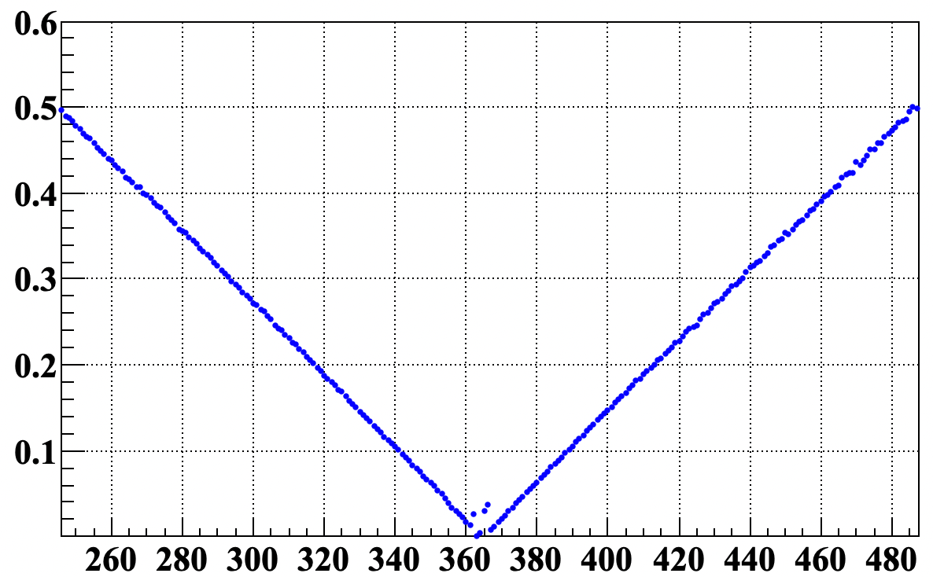
Measuring Focal Length
Moving lens along laser beam towards the sensor and measuring beam width
Minimum beam width indicates the best focussing position – focal length
Geant4 Simulation
Beam X diameter [mm]
Sensor-Lens [mm]

Slide 13
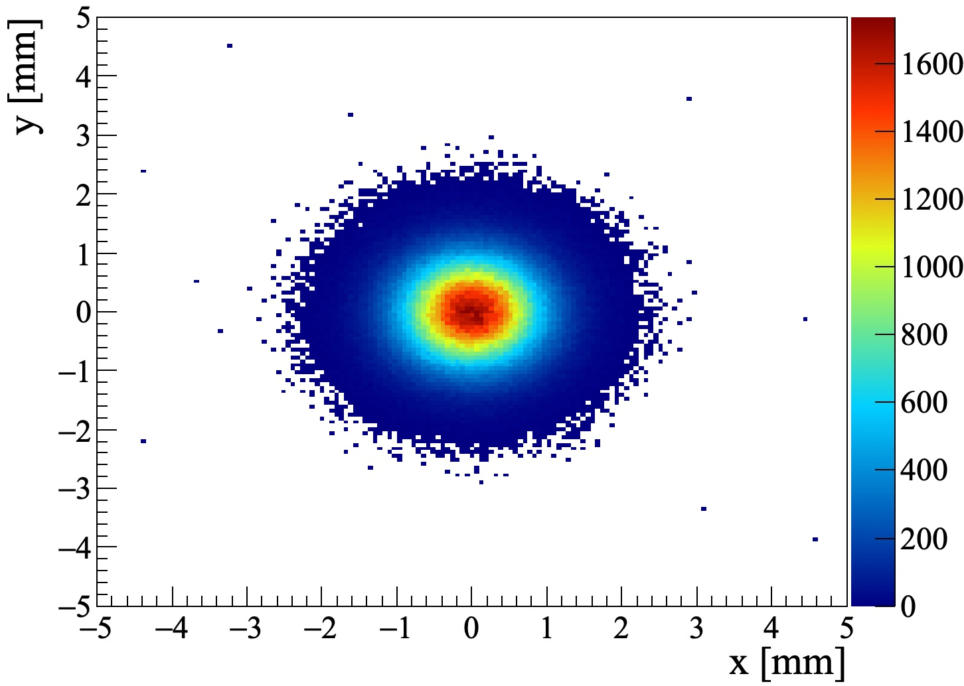
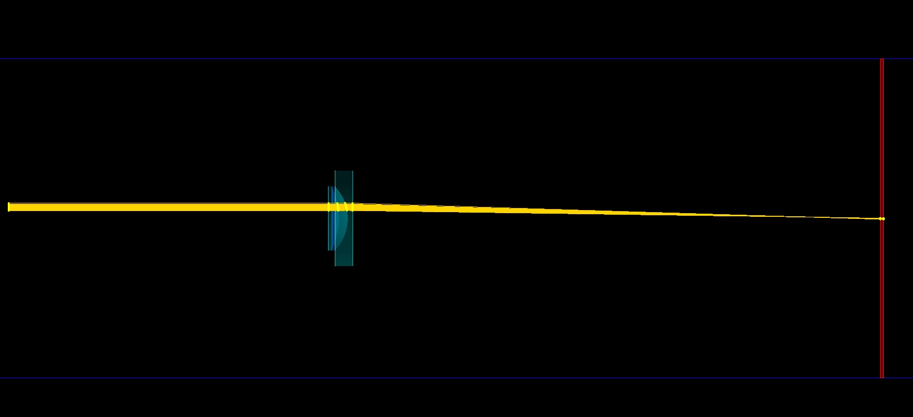
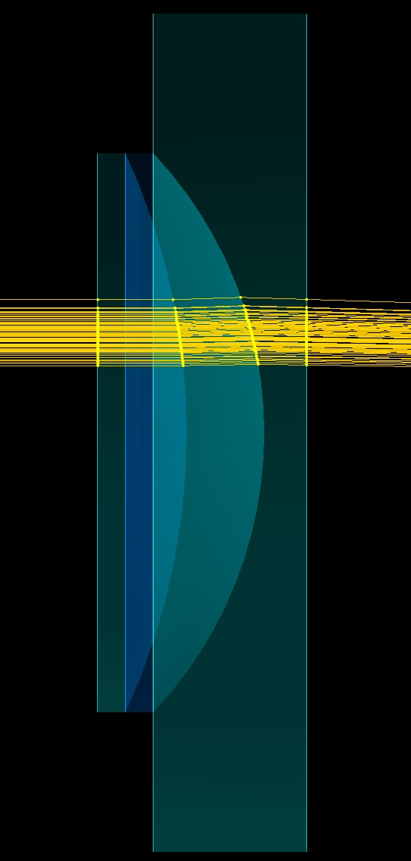
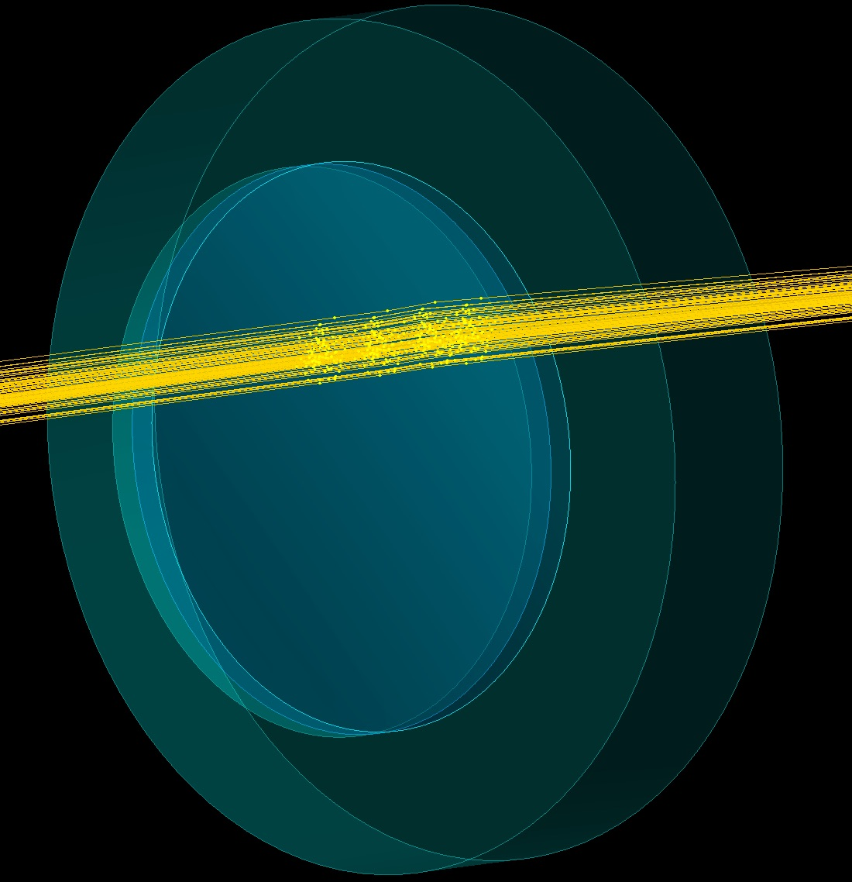
Simulation
Geant4 Simulation same as one used to evaluate DIRC performance
Comparing not only focal length but also shape of beam profile will allow to see how well optical aberrations are represented in simulation

Slide 14
Measuring Focal Length
Moving lens along laser beam towards the sensor and measuring beam width
Minimum beam width indicates the best focussing position – focal length
But in the DIRC detector lens is working in between fused silica pieces not air – significant refractive index difference
Geant4 Simulation
Beam X diameter [mm]
Sensor-Lens [mm]

Slide 15
Measuring Focal Length
Mineral oil has matching refractive index with fused silica and can simulate detector environment
Challenge to image beam profile on sensor without placing it in oil can be resolved using 2f-2f Relay lens system to shift the imaged spot outside of tank
Oil Tank

Slide 16
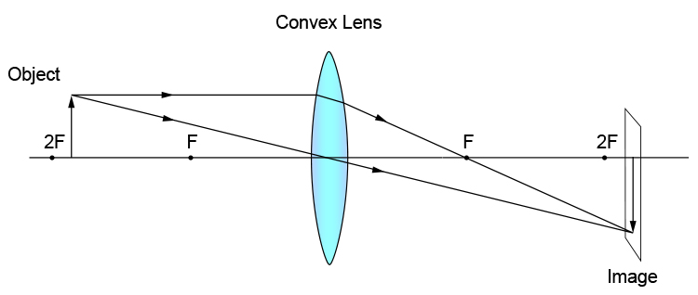
Measuring Focal Length
2f – 2f Relay lens system
Oil Tank

Slide 17
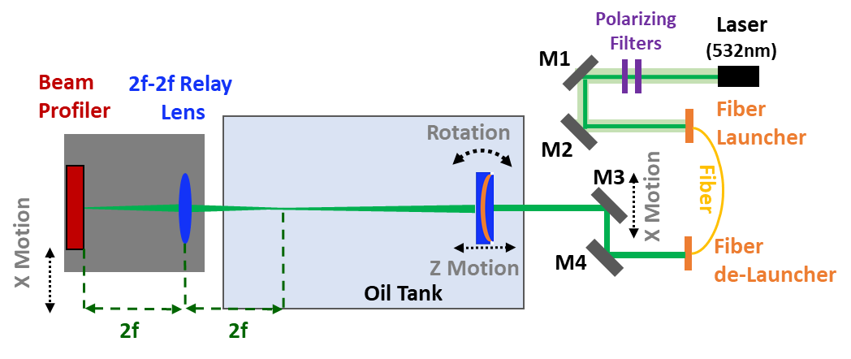
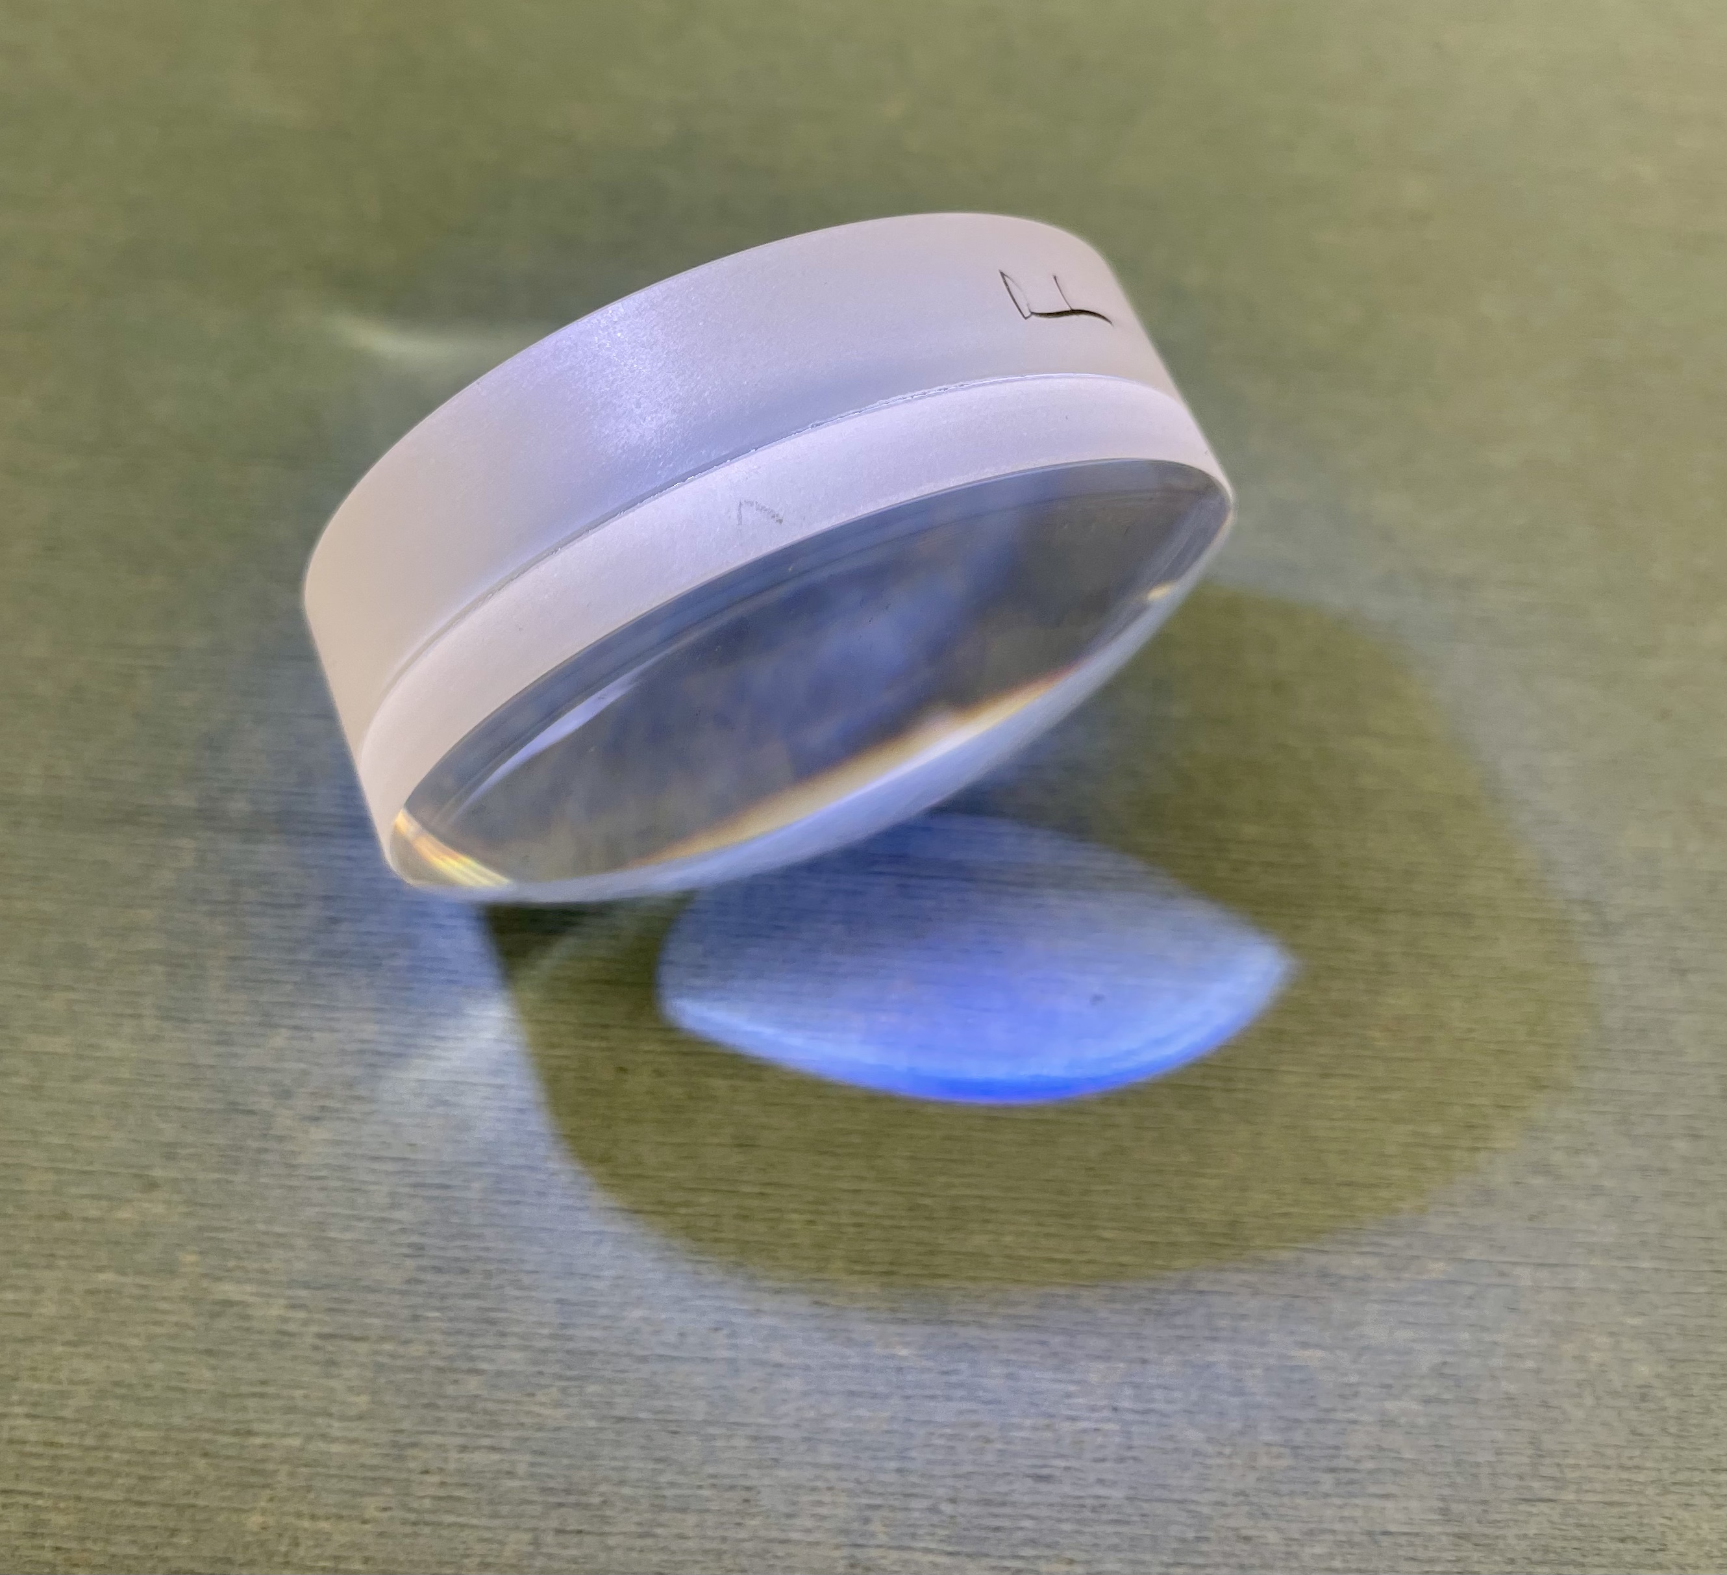
Measuring Focal Length
75mm Achromat lens used to shift the beam image by around 300mm, outside of oil tank

Slide 18
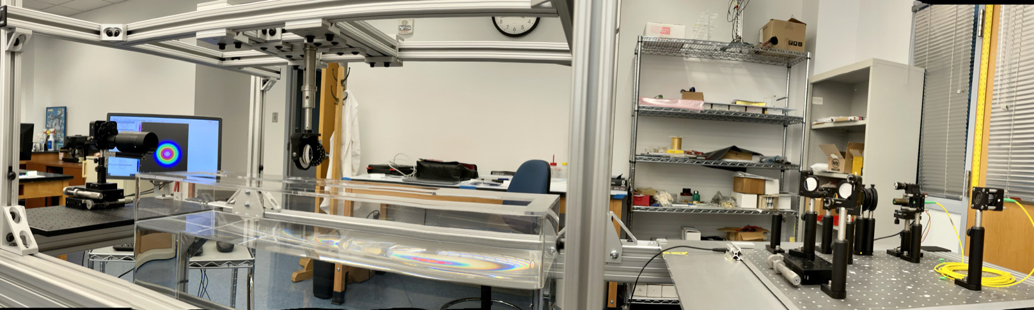
Measuring Focal Length
75mm Achromat lens used to shift the beam image by around 300mm, outside of oil tank
Oil tank on X-table to make lens changes and air measurements easier
Two Achromat lenses used to validate setup. One as measured lens, one as Relay lens

Slide 19
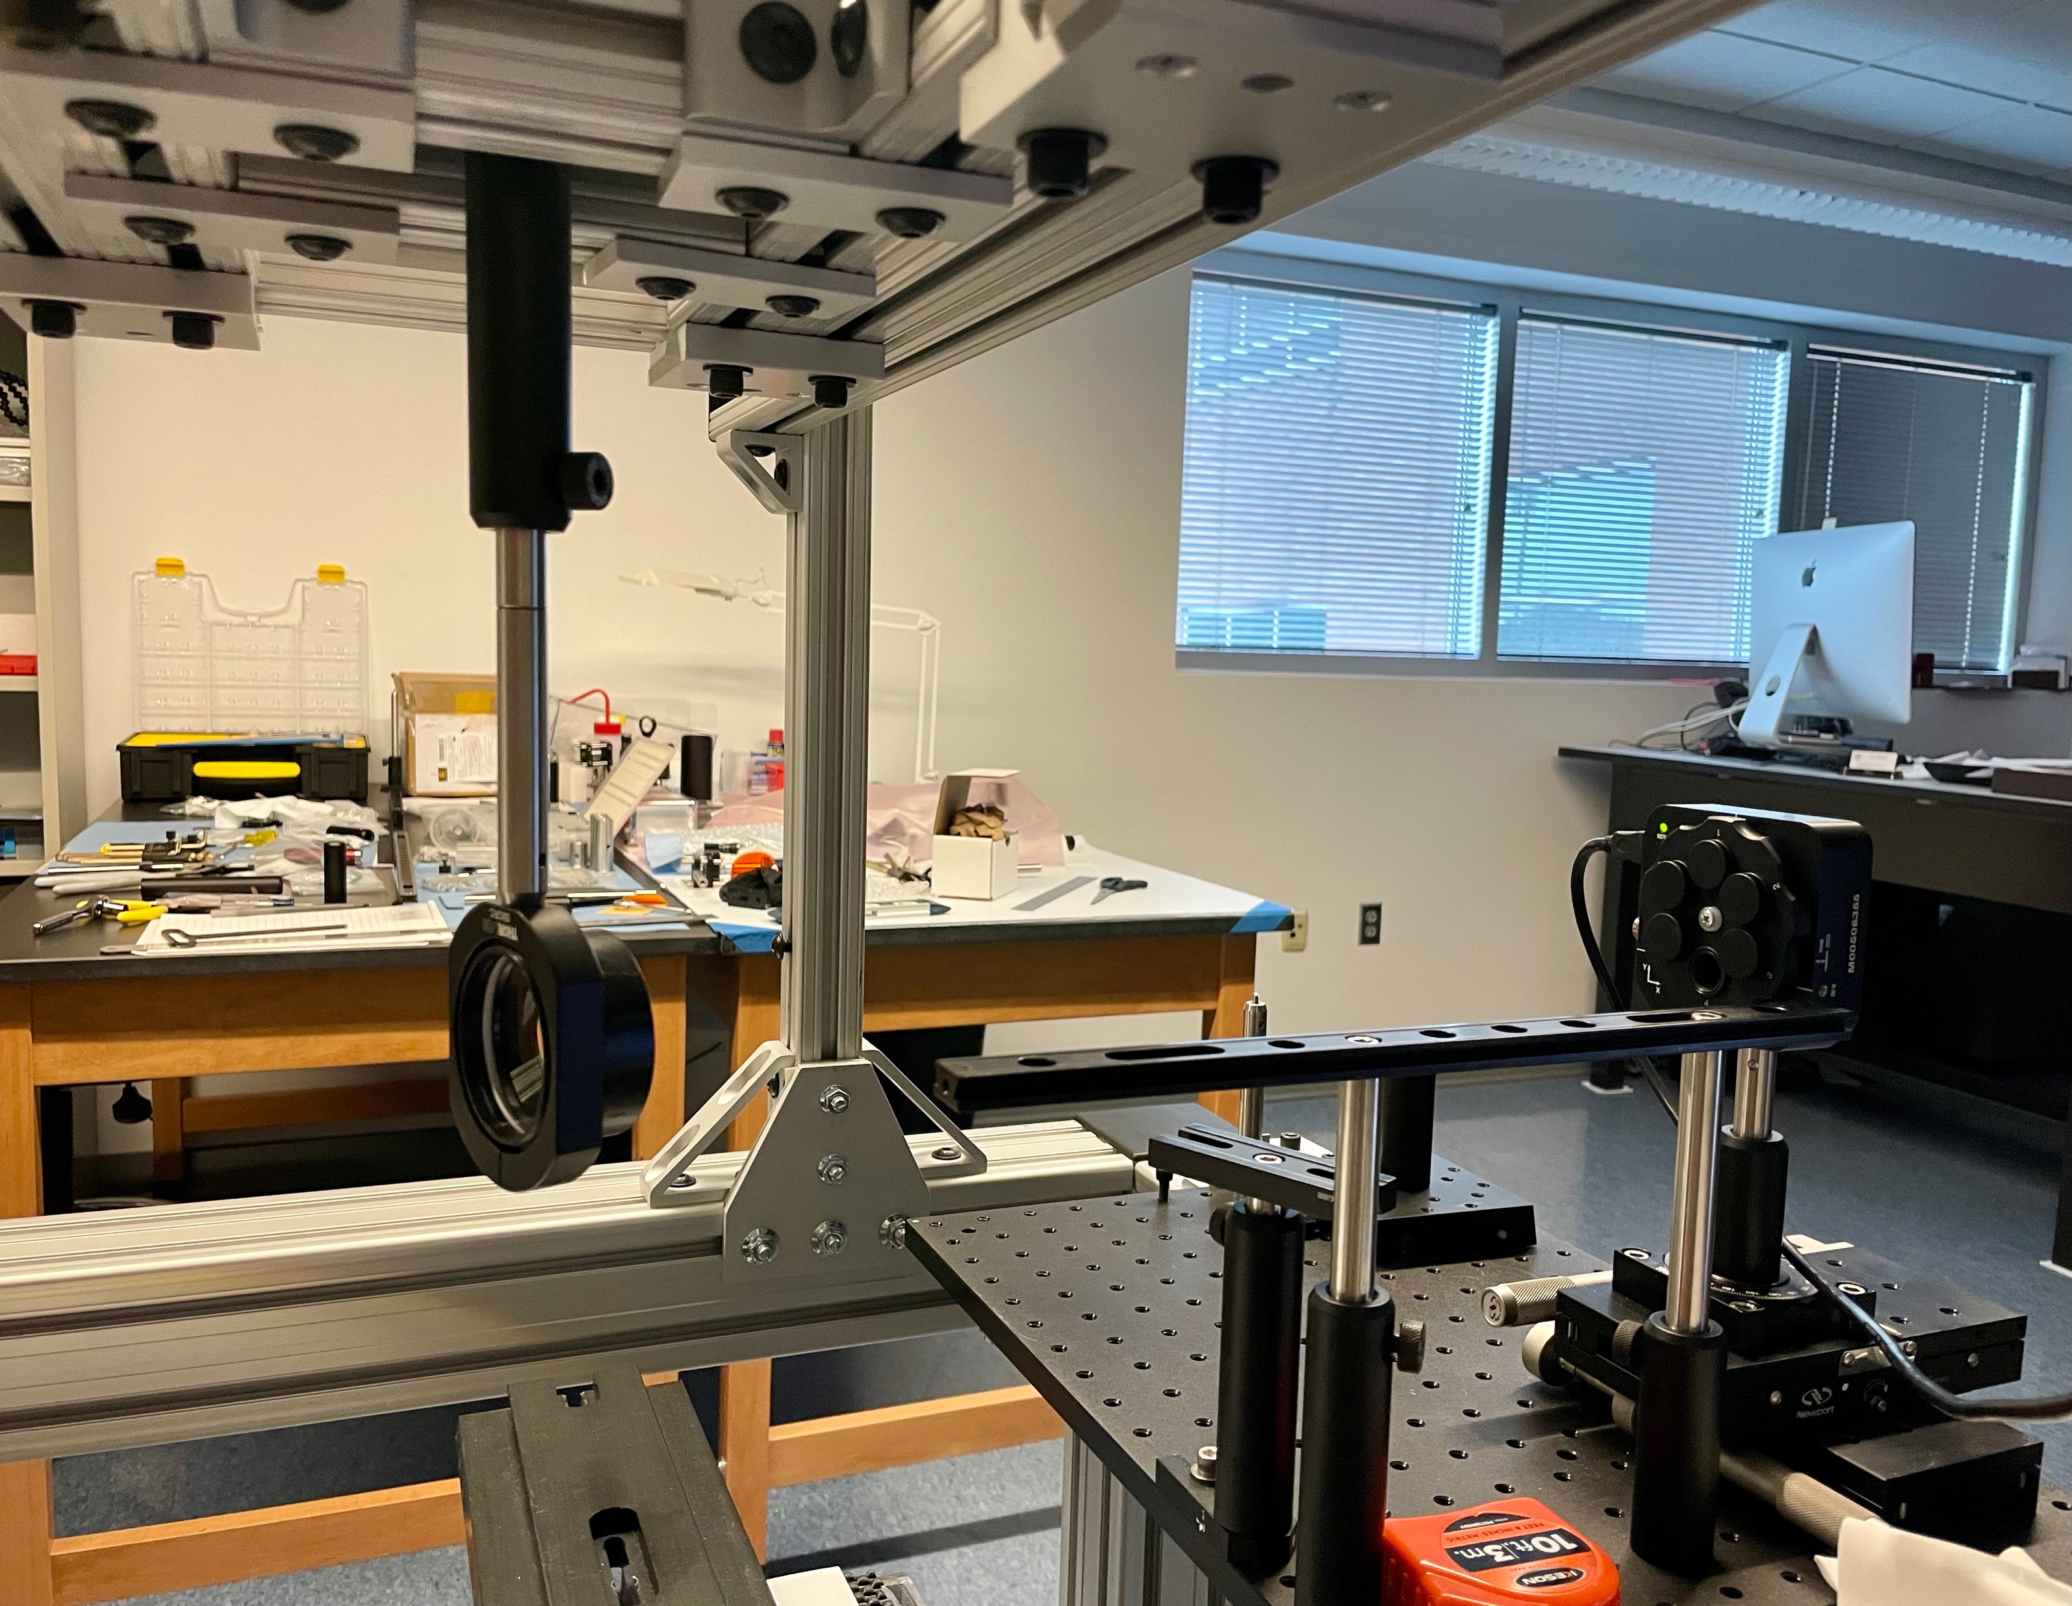
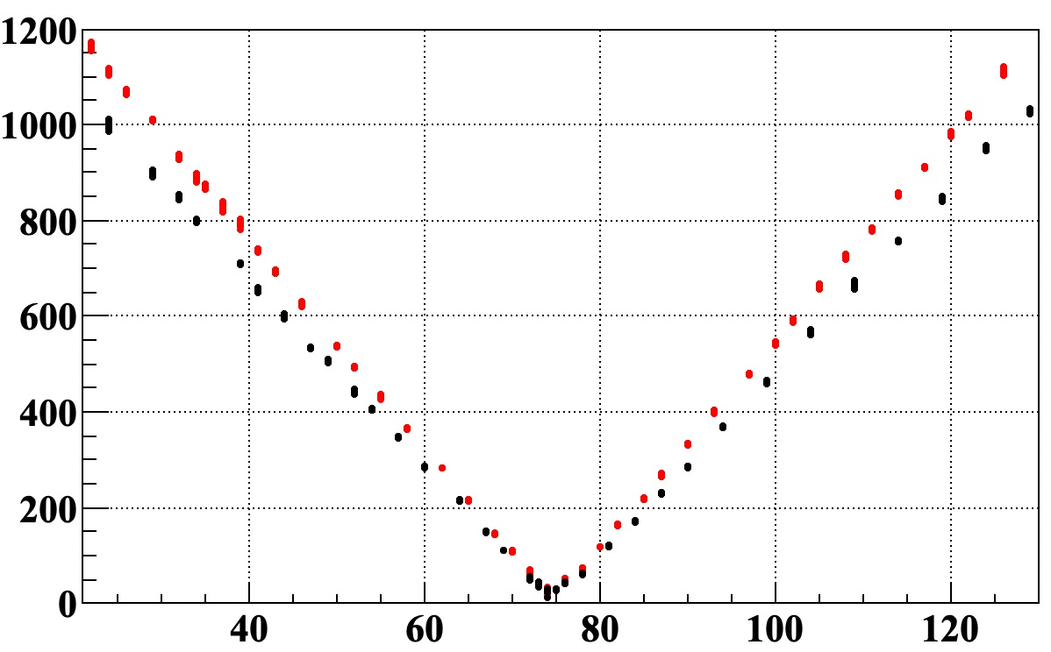
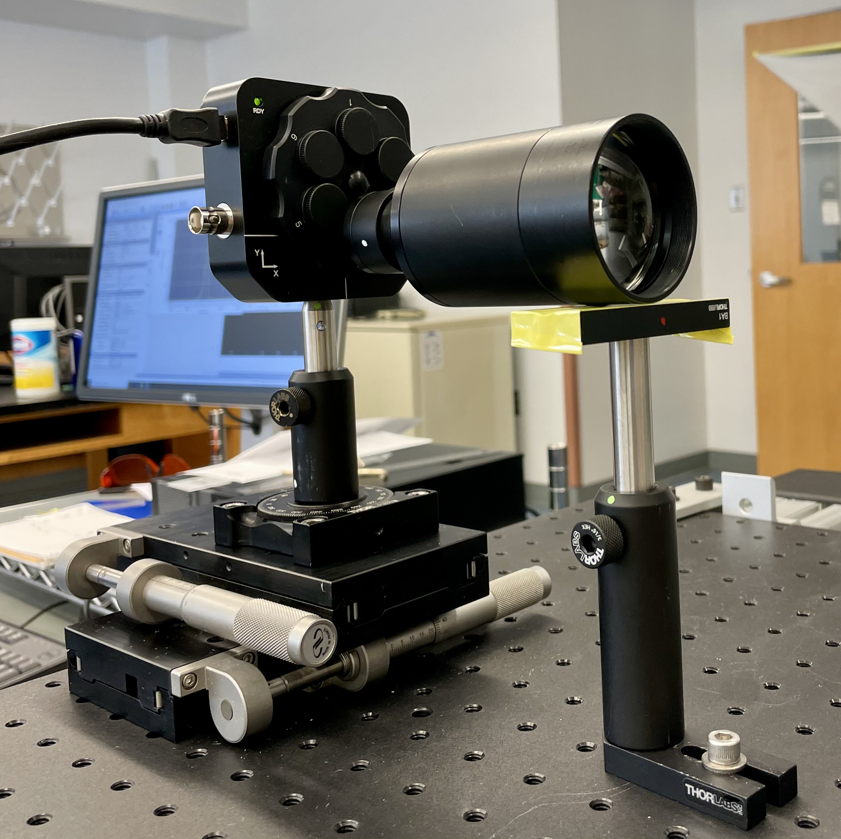
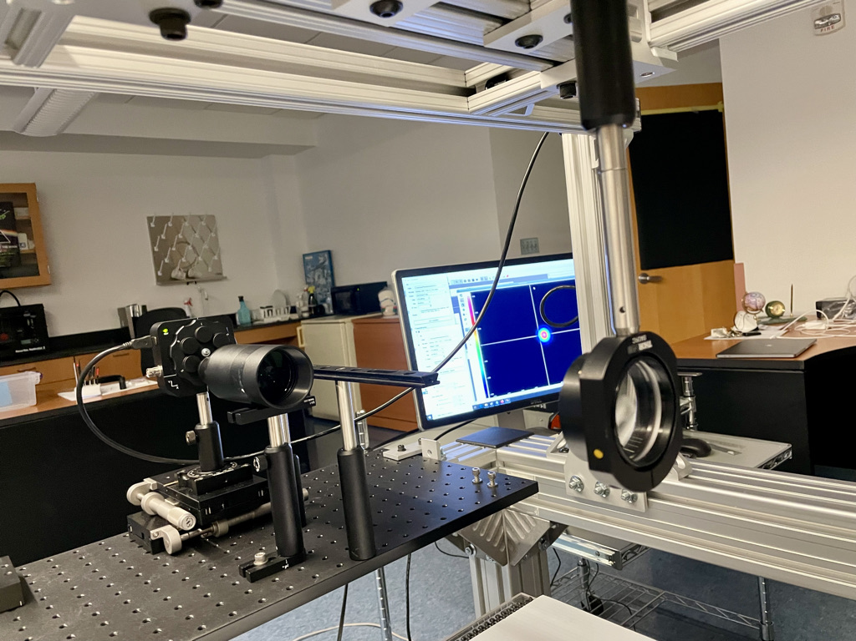
Measuring Focal Length
Perfect match of focal length measurement directly on CCD beam profiler and measurement with Relay lens shift.
Measured Data:
- Just CCD
- CCD + Relay lens
Beam X Width [𝛍m]
Sensor-Lens [mm]

Slide 20
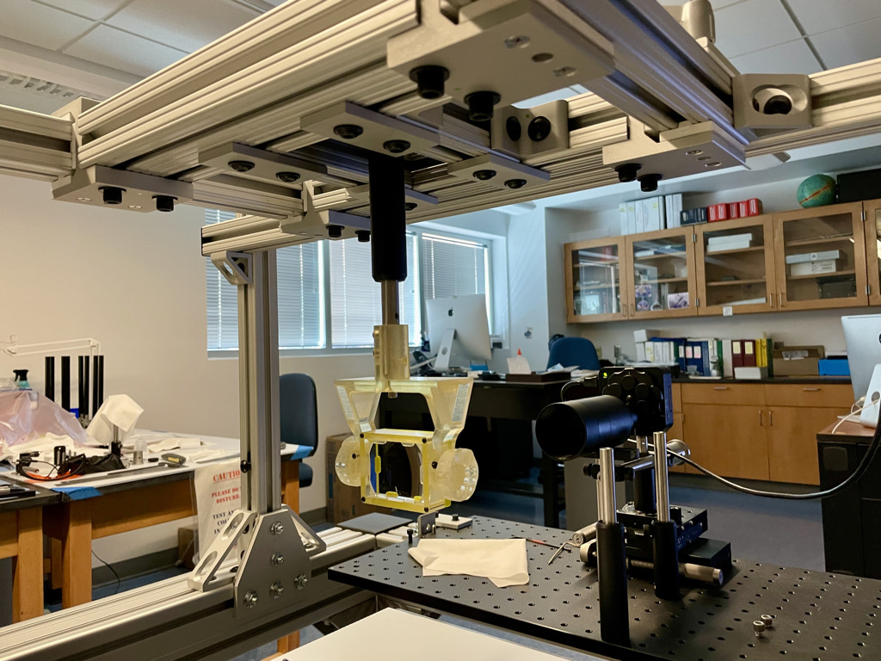
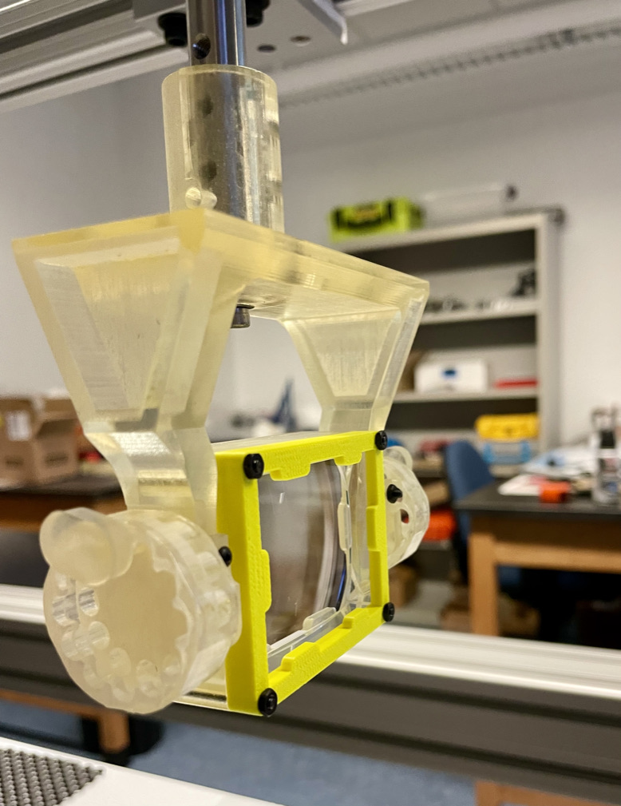
Beford Prototype

Slide 21
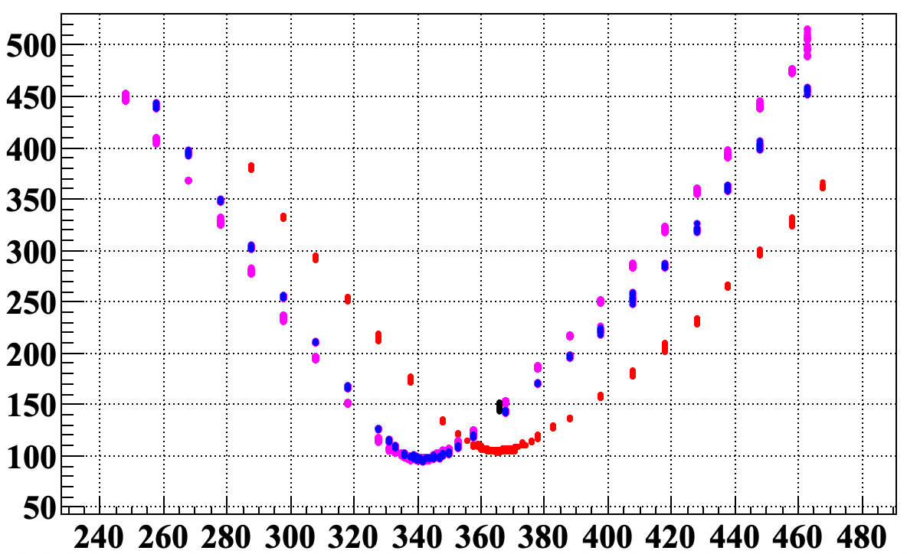
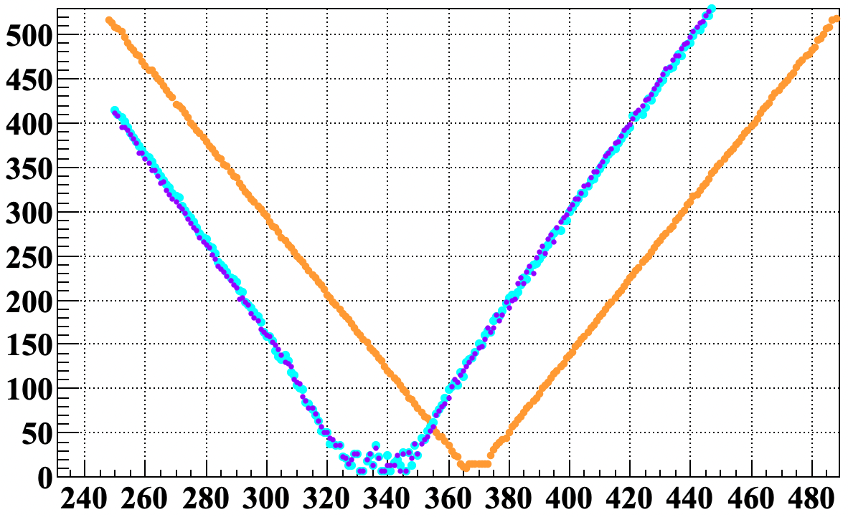
Very well match of measured and simulated data for laser beam cantered on the lens in air and three incidence angles.
Lens Rotation: 0, 20, -20
Measured Data
Beam X diameter [𝛍m]
Sensor-Lens [mm]
Lens Rotation: 0, 20, -20
Geant4 Simulation
Beam X diameter [𝛍m]
Sensor-Lens [mm]

Slide 22
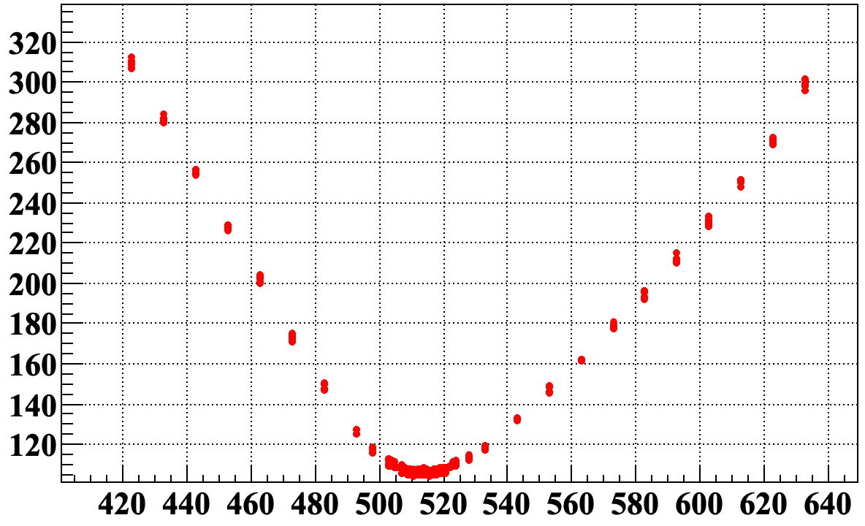
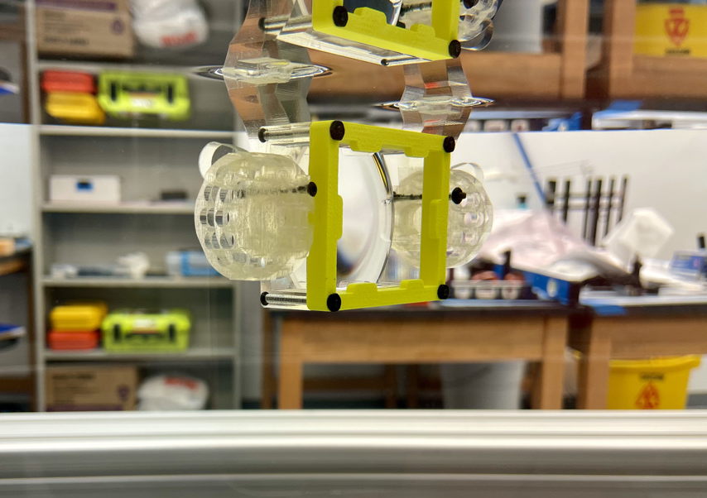
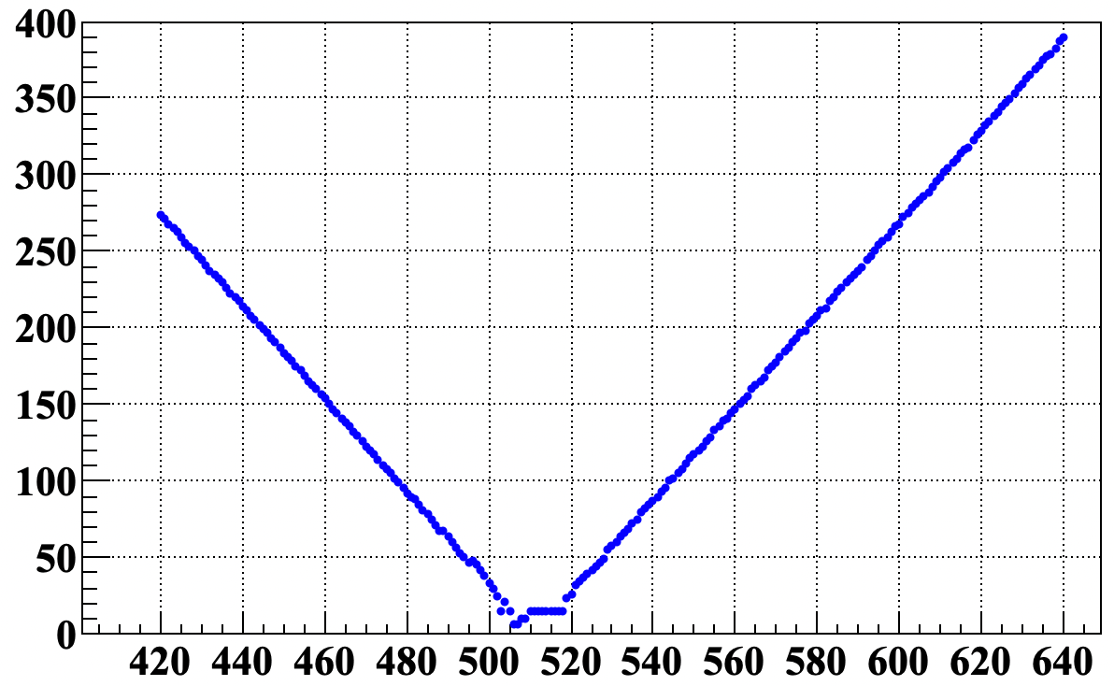
Mapping Focal Plane
Very well match of measured and simulated data for perpendicular laser beam cantered on the lens in oil
Measured Data
Beam X diameter [𝛍m]
Sensor-Lens [mm]
Geant4 Simulation
Beam X diameter [𝛍m]
Sensor-Lens [mm]

Slide 23
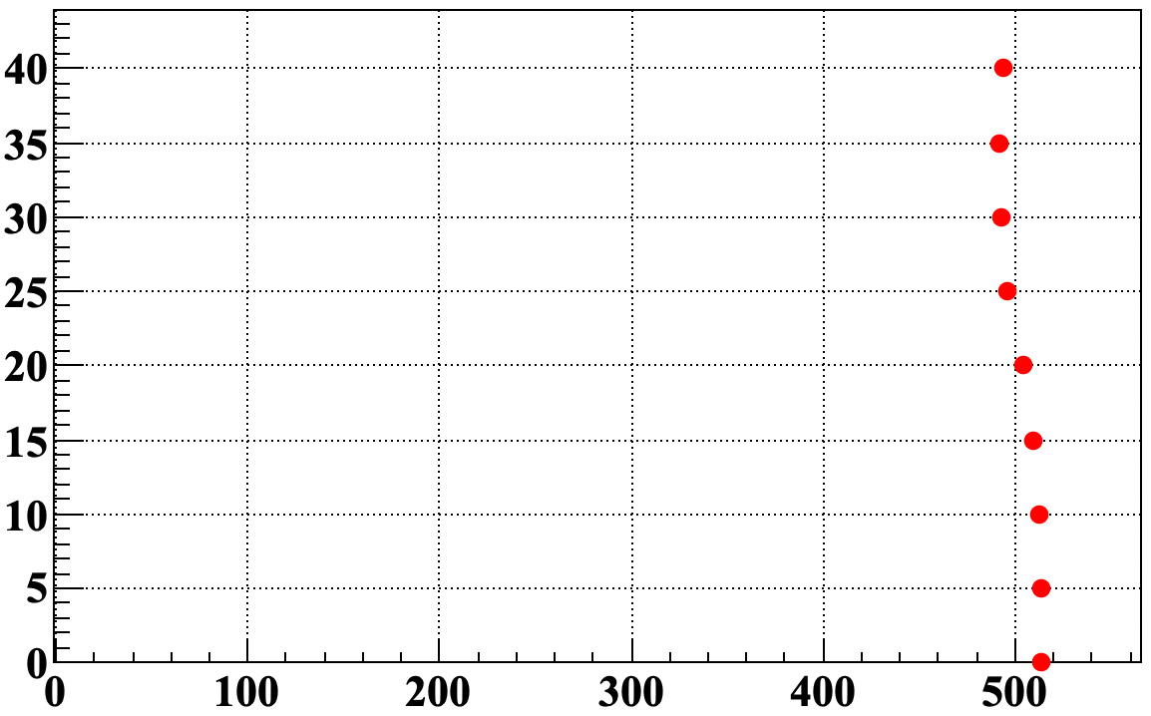
Mapping Focal Plane
Very well match of measured and simulated data for perpendicular laser beam cantered on the lens in oil
Measured Data
Beam X diameter [𝛍m]
Sensor-Lens [mm]
Measured Data
Lens Rotation [deg]
Focal Length [mm]

Slide 24
Summary
Setup for evaluation of the shape of the focal plane of prototype lenses build at ODU
Stable, heavy mechanical support, laser fiber launcher, 2f-2f relay lens, CCD camera beam profiler with commercial software
Developed Geant simulation of setup to improve understanding of aberrations
Setup validated using commercial Achromat lens
Scanning of PANDA prototype lens made by Beford in progress
Initial results match predictions from simulation

