Slide 1
ToASt ASIC status
D. Calvo, F. Cossio, G. Mazza, M. Mignone, R. Wheadon
INFN – Sezione di Torino

Slide 2
ToASt ASIC development status
Submitted in April 28
The foundry shipped the chips on September 30
The chips were delivered on October 15th to INFN
Due to the radiation tolerance design, the ASIC was declared as dual use design (Italy and Germany)
Only one PCB was completed with some components de-soldered from cards of an other activity in Torino
The delivery of the SN74AUP1T34DCKR components is scheduled for Feb. 2022 !

Slide 3
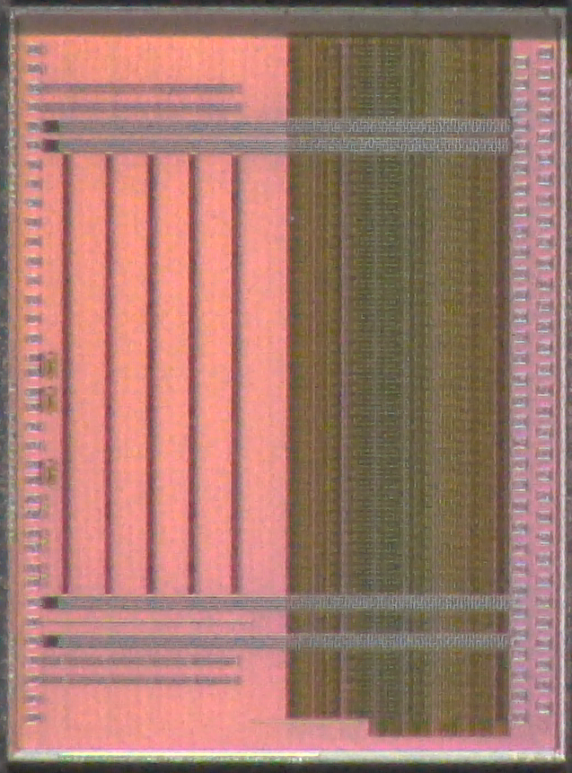
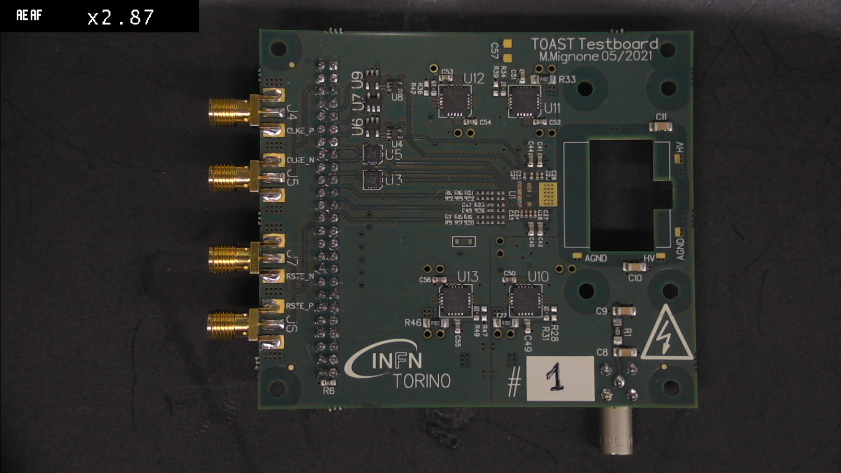
ToASt ASIC development status

Slide 4
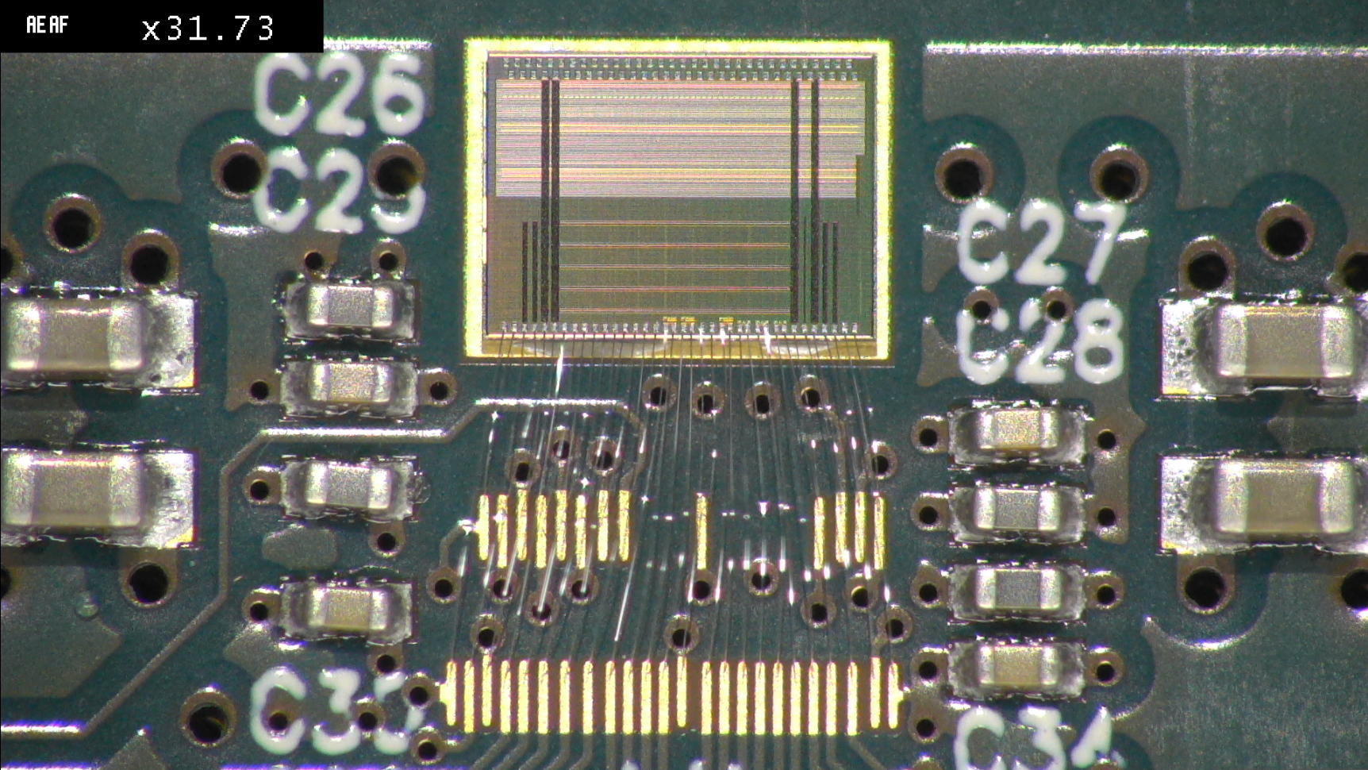
ToASt ASIC development status
The test board is now connected to the DAQ system in Torino based on a Kintex 7 FPGA and LabVIEW software
No high power consumption values have been detected, neither for the card nor for the chip operated simply with the clock and without any register configuration
The register configuration test is in progress

Slide 5
spares

Slide 6
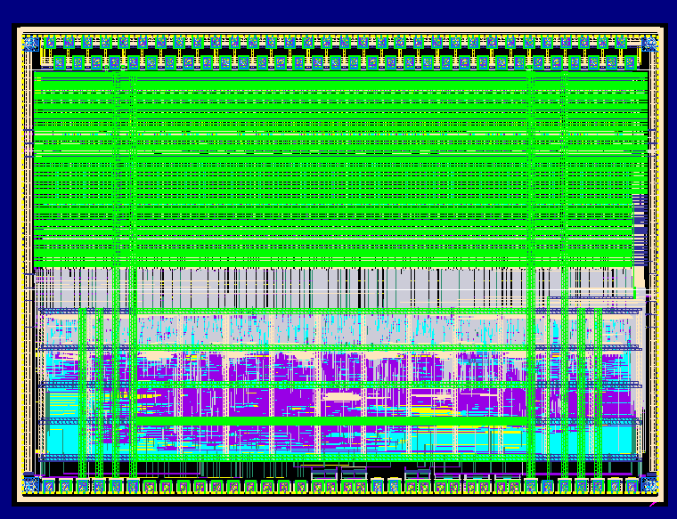
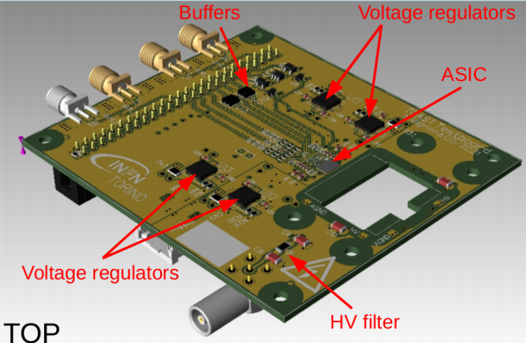
ToASt ASIC development status
ToASt main characteristics

Slide 7
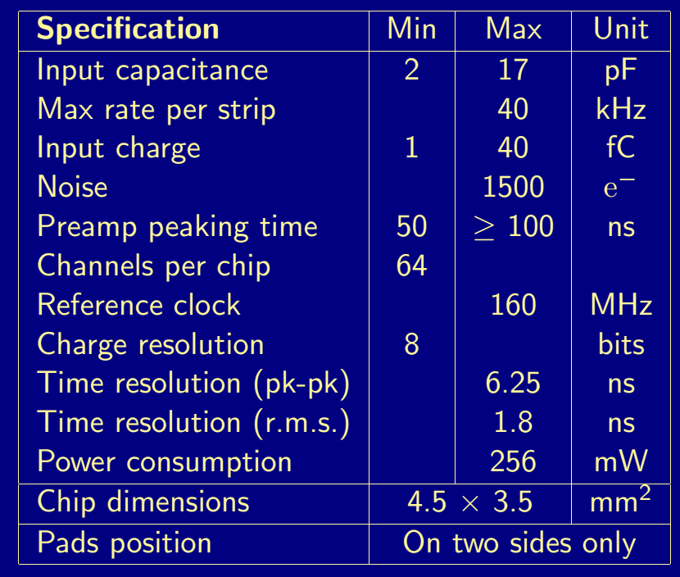
ToASt ASIC development status
The chip design meets the requirements except the power consumption

Slide 8
ToASt ASIC development status

