Slide 1
PANDA Beamline Update MEC Session, PANDA Collaboration Meeting 21/3 J. Lühning, GSI
PANDA chicane in HESR
Some of the advancements this year
Positions of flange connections to be opened frequently
Other flange connections
Pumping port between FT1 and FT2
Support option for FT1/FT2 setup
Choice of flange connections

Slide 2
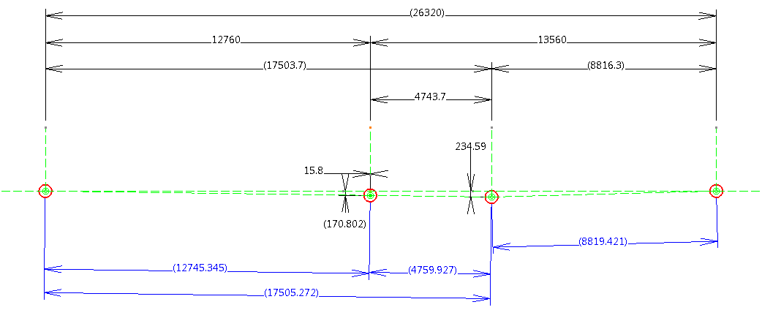
PANDA chicane in HESR
Position of magnets settled June/July 2017 after discussions among Raimund Tölle (FZJ), Bernhard Laatsch (FZJ), Jost Lühning (GSI). Uploaded to https://edms.cern.ch/document/2053635/1
dipole 13.4 mrad
dipole 26.6 mrad
solenoid
big dipole 40 mrad
Y (north)
Coordinates of PANDA magnets w.r.t HESR center
(X: west-east direction, Y: south-north direction, {X=0, Y=0} at geometric center of HESR-oval
Magnet | Y-coordinate /[mm] | X-coordinate /[mm]
1st dipole | -12760 | 46294
Solenoid (IP) | -15.8 | 46294+170.80
2nd (big) dipole | 4743.7 | 46294+234.59
3rd dipole | 13560 | 46294

Slide 3
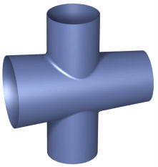
Some of the advancements this year
Beam-target-pipe meeting (online) 2021-02-19, one result: transition from Ø40mm section to Ø77.3mm section already 517 mm downstream of IP: improvement of downstream vacuum.
3D-model of beamline from cryo-pump section (upstream) to Luminosity detector (downstream), edited by Ralf Schmitz and Herbert Schneider (2021-04-26, FZ Jülich).
Prototype development of beam-target cross at FZ Jülich. The central part (s. figure) of this prototype was simplified for easier manufacturing: cone is now 55 mm long, upstream inner Ø 28 mm, downstream inner Ø 20 mm, target tube inner Ø 20 mm, wall thickness 0.2 mm.
Pumping port between detectors FT1 and FT2 modified.

Slide 4
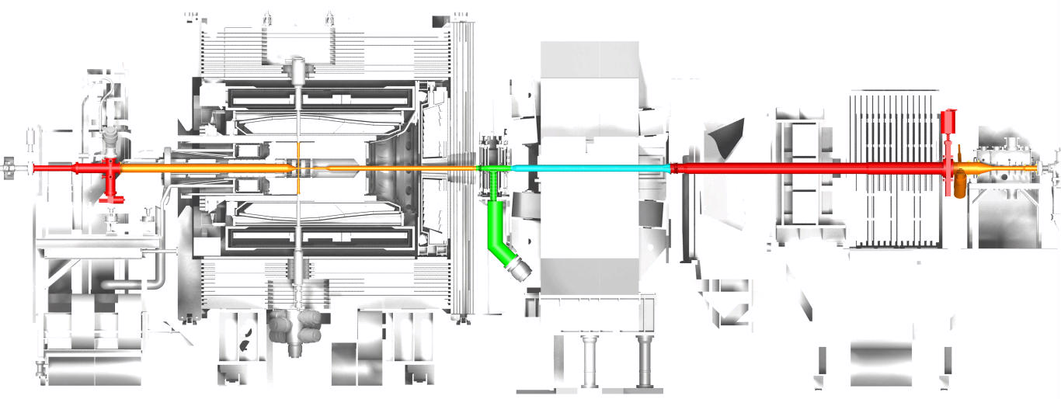
Positions of flange connections to be opened frequently
A
B
C
D
IP
The red and orange sections between A and B indicate the beamline components which will be rolled out with the TS.
The green and turquoise sections indicate the beamline components in the dipole area which will always stay in place.
The red and orange sections between C and D indicate the beamline components which will be rolled out with the FS.
Z-coordinates (Z=0 at IP) of flange connections to be opened frequently:
Z(A) = -4331mm (downstream side of DN 89-shutter),
Z(B) = 2900mm,
Z(C) = 6070mm,
Z(D) = 12138mm (downstream side of DN 89-shutter).

Slide 5
Other flange connections
E
F
G
IP
Z-coordinates of other flange connections:
Z(E) = -2913mm, upstream of E (red) cryo-pump section designed by WWU Münster
Z(F) = 3464mm, upstream of F (green) pumping port between FT1 and FT2 designed by GSI
Z(G) = 10682mm, downstream of G (orange) vacuum section of Luminosity Detector, in charge: JGU Mainz

Slide 6
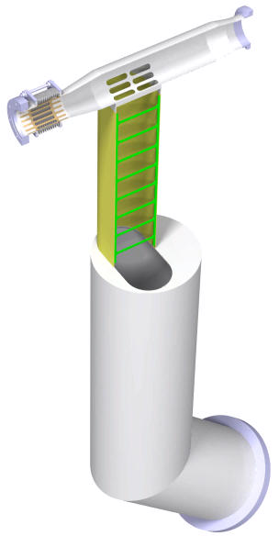
Pumping port between FT1 and FT2
Port slits, conductance cross section 70 cm², molecular conductance for H₂ about 3000 liters/s
Tube with oval cross section between FT1 and FT2, inner width 108 mm, length 49 cm, wall thickness 2 mm (confirmed by FEM analysis), conductance cross section 210 cm², molecular conductance for H₂ about 2900 ltr/s
Ø 250 mm tube, length about 105 cm, 210 cm², molecular conductance for H₂ about 5700 ltr/s
In-series conductance of these components about 1170 ltr/s
Effective pumping speed with a 1000 ltr/s turbo pump 540 ltr/s.
Effective pumping speed with a 1500 ltr/s turbo pump 660 ltr/s.

Slide 7
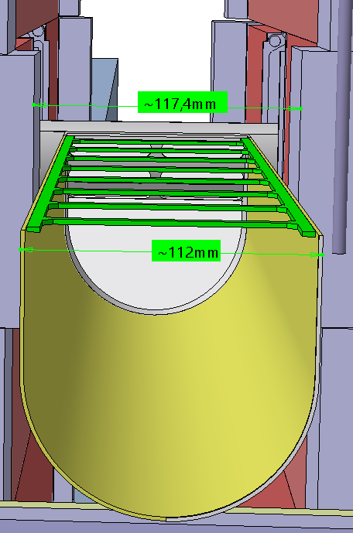
Pumping port between FT1 and FT2
View from the bottom of the (yellow) pumping port: The clearance to the narrowest components of FT1 and FT2 is about ±2.7 mm.
There are considerations to increase the clearance.
The nominal center of both the FT1/FT2 setup and the pumping port is 3182 mm downstream of the IP.

Slide 8
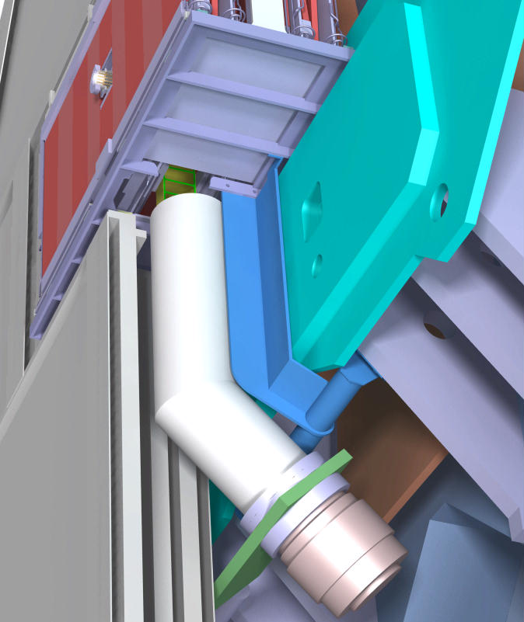
Support option for FT1/FT2 setup
FT1
FT1/FT2 desk
dipole field clamp
FT1/FT2 support (blue) fixed to field clamp supports.
DN250 vacuum tube
field clamp support
muon filter, western half
turbo pump

Slide 9
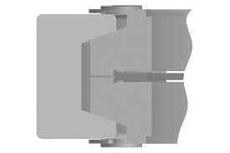
Choice of flange connections
conical surface
clamp chain
source: vacom.de
QCF compared to conventional CF:
Components with QCF flange can be mounted like rotatable flanges in any angular position
Same sealing principle (ISO 3669-2) and same standard copper gasket as the conventional CF connection
About 50% less axial space required. Outer Ø of flange smaller but with clamp chain 50% more radial space needed (at the screw heads)
Friction (azimuthal and radial) on the conical surfaces

Slide 10
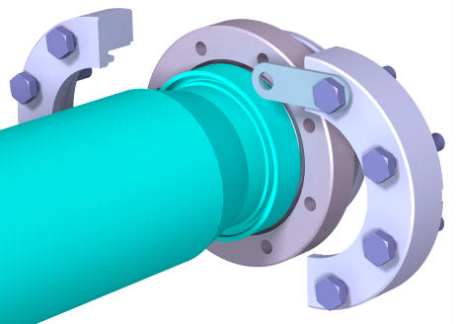
Choice of flange connections
small outer flange diameter
Horse-shoe flange, as used at the downstream end of the TS beam-pipe:
custom product
outer Ø not bigger than the Ø of the copper gasket

