Slide 1
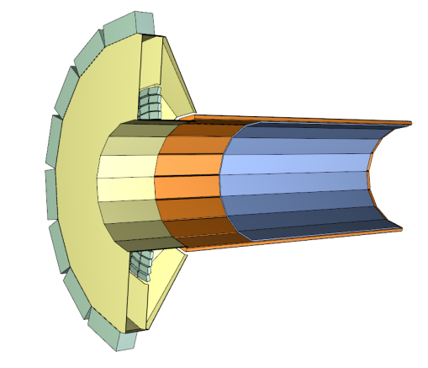
STATUS OF BARREL DIRC
MECHANICAL DESIGN
Doro Lehmann has started to update barrel DIRC in CATIA based on Jost’s spring 2011 barrel DIRC version (incl. first version of SciTil barrel).
Plan: update to current baseline design and implement main design options.
Goal: provide consistent set of DIRC mech drawings for EDMS.
Today: quick snapshot of the status.
Jochen Schwiening
PANDA CollabMeet Mechanical Design Session GSI, Sep 6, 2011

Slide 2

PANDA BARREL DIRC DESIGN
Current PANDA Barrel DIRC baseline design:
Barrel radius ~50 cm; expansion volume depth: 30 cm.
16 bar boxes, all identical in size.
5 radiator bars per bar box, synthetic fused silica 17mm (T) × 33mm (W) × 2500mm (L).
Focusing optics: doublet lens system, air gap between lens and expansion volume.
Compact photon detector: 30 cm oil-filled expansion volume (removable), Photonis MCP-PMTs.
Mechanical principle: bar boxes slide into “drawers.”
Structure mirrored by SciTil.
Design options: mirror focusing, radiator plates, 16 optically isolated “cameras.” PhD students studying performance using simulation and prototypes.
Photon detectors and electronics
Radiator bars
Focusing optics
Expansion volume

Slide 3
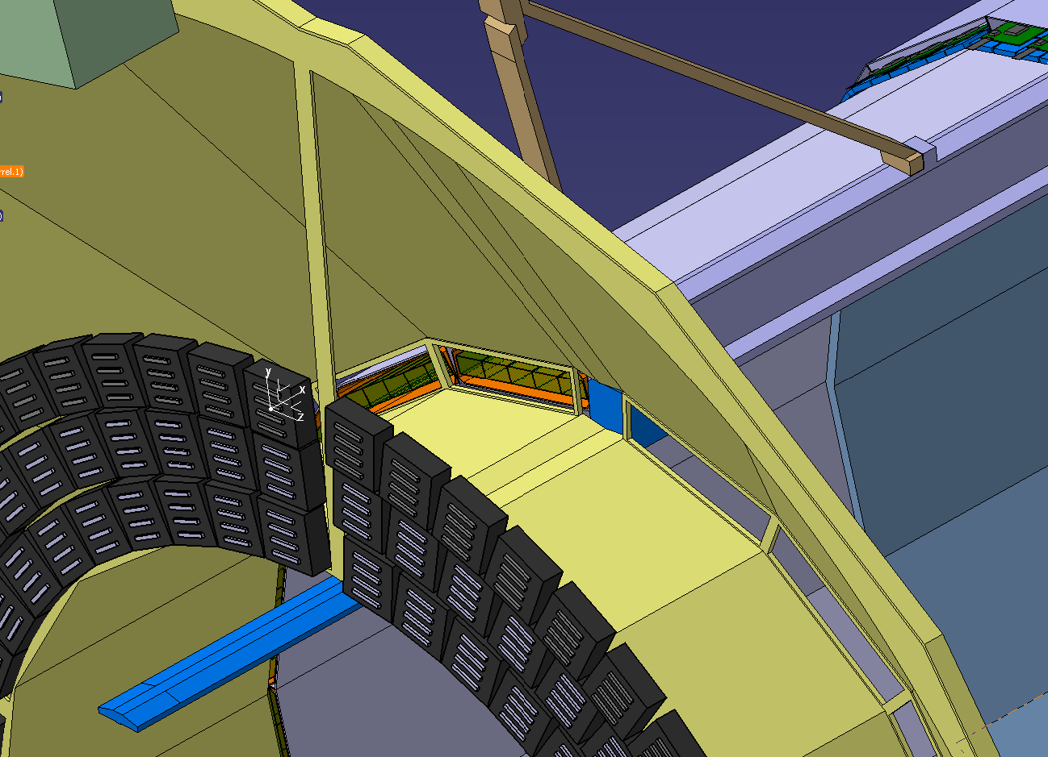
PANDA BARREL DIRC DESIGN
SciTil in slot
fused silica windows at front and back
5 bars per bar box
ROHACELL barrel for mechanical stiffness
MCP-PMT array (3 rows shown)

Slide 4
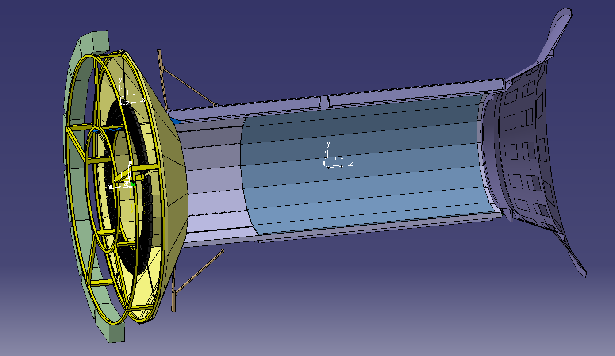
PANDA BARREL DIRC DESIGN
support frame for readout electronics, cabling
+1300mm
-1710mm
bar box end points in z:
+1300mm (or less)
-1190mm
DIRC readout in z:
EV starts at -1200mm
frame ends at -1710mm
end point of bar in +z TBD, depends on radius
approx 30mm required for mirror, spring, material
physics: DIRC PID to 22 degrees

Slide 5
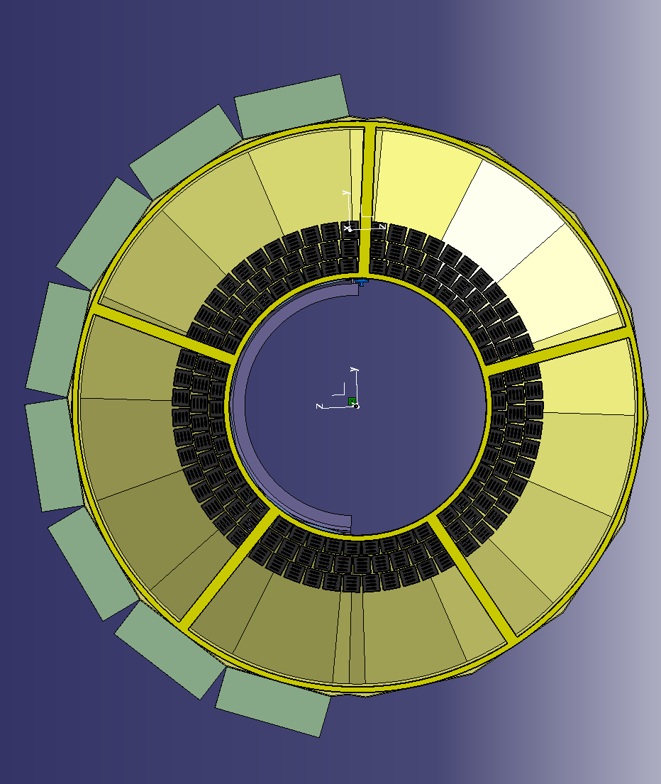
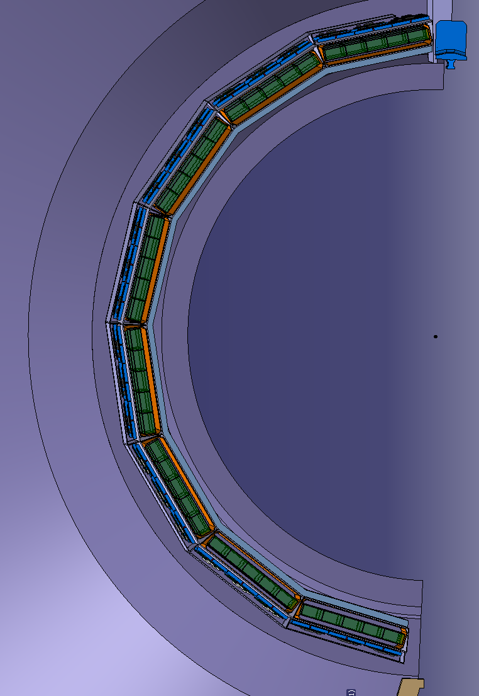
PANDA BARREL DIRC DESIGN
439mm
497mm
current radial dimensions of DIRC:
minimum radius ROHACELL barrel: 439mm
maximum radius bar box slot: 497mm
center of radiator bar: 469.5mm
final DIRC radius depend on SciTil dimensions

Slide 6
PANDA BARREL DIRC DESIGN
Snapshot of current baseline design implementation in CATIA shown today.
Radius values are minimum values, could move out by 10 – 15mm once SciTil design is optimized.
All SciTil + DIRC radius values well within “DIRC+TOF” volume defined in official PANDA 2D PDF.
To do:
Implement design alternatives (mirror, plate, cameras).
Start mechanical design of bar boxes, bar box slots, ROHACELL cylinder, etc.
Update design based on SciTil input.
Design path for DIRC supply lines.
Support for expansion volume (“oil tank”) → attach to yoke or cryostat?
Next: conclude check of dimensions, upload initial set of drawings to EDMS.

Slide 7
Backup slides for reference.

Slide 8
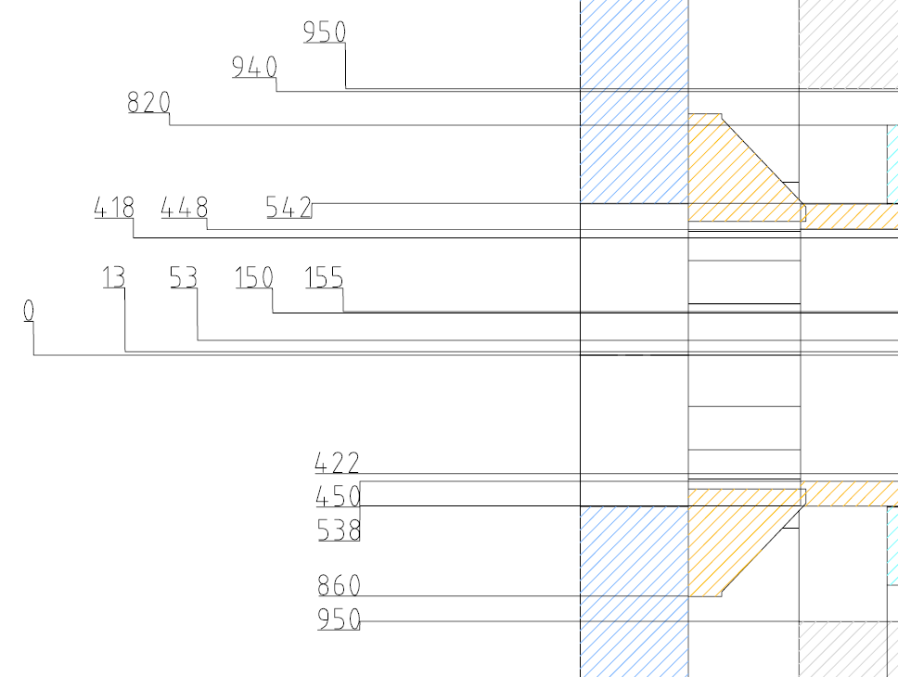
DIRC DIMENSIONS
For comparison: all DIRC numbers well within “DIRC+TOF” volume
PANDA Detector - Integration
latest official version of 2D file
PDF ver. 0.1.15 (2009-06-05)
From Feb 2011 TechBoard

Slide 9
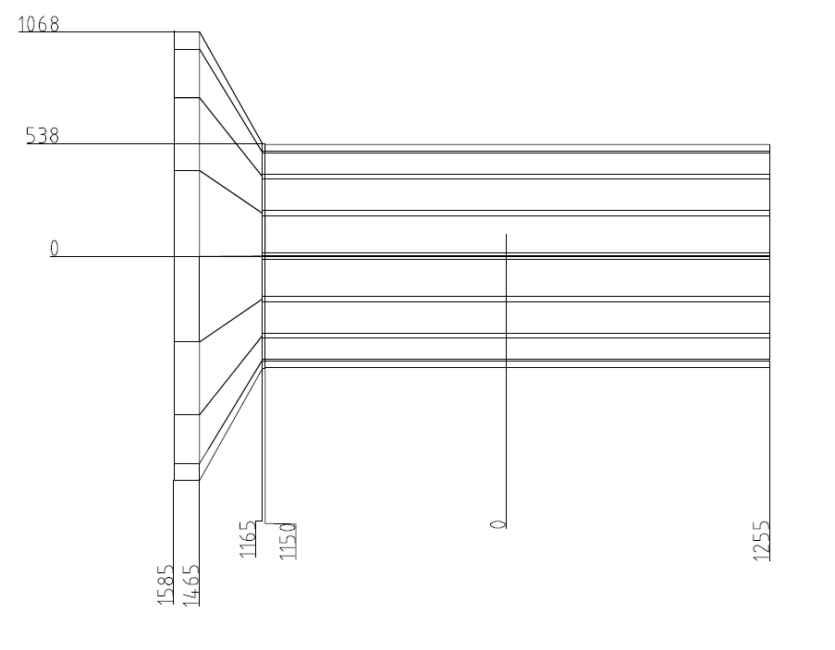
DIRC DIMENSIONS
End of bars incorrect here,
actually at -1200mm and at +1300mm.
PDF from Bernd in spring 2010
From Feb 2011 TechBoard

