Slide 1
Overview
Personnel Access System –
PAS for FAIR
Dennis Gaßmann

Slide 2
Content
Introduction
Radiation Protection Areas at FAIR
NE-Areas
Access Areas
Beam Off Groups and Safe Access
Workflows in context of PAS
2

Slide 3
Introduction
PAS = Personnel Access System (former: PSS)
Main-Tasks:
  Access control for radiation protection areas (controlled and restricted areas) for the accelerator.
  Guard for the accelerator with respect to prompt dose-rate from beam operation. (in combination with walls, floors and ceilings)
Challenges: Personnel access and beam operation at the same time in different parts of the facility
Legal base: i. a. § 52 and § 53 StrlSchV
GSI Context: PAS is the modern version of the established and proven access system ZKS at GSI

Slide 4
Radiation Protection Areas at FAIR
Buildings at FAIR are at minimum classified as surveillance areas. (“Überwachungsbereiche” compliant with German StrlSchV)
Radiation protection areas at FAIR in context of the PAS are defined always enveloping complete rooms to simplify the access control for these areas.
Controlled areas (incl. restricted areas) can be classified at FAIR. (“Kontroll- und Sperrbereiche” compliant with German StrlSchV)
  Controlled areas caused by beam operation → NE-Areas
  (Prompt and residual dose-rate in vicinity of the accelerator)
  → Access via PAS
  Controlled areas caused by residual dose-rate from exchanged parts and activation of supply media, etc. → BSA (“Bereiche mit Strahlenschutzanforderung”)
  (residual dose-rate and activation of media and components in storage and installation rooms)
  → Access via ZBS
  Controlled areas in shafts caused by prompt dose-rate from beam operation and activation of supply media which are accessed only once per year → BSA Schacht
  → Access via Key

Slide 5
Radiation Protection Areas at FAIR
GSI
Premises
ZBS
FAIR
Premises
ZBS
Buildings
Surveillance Area
PAS
Controlled Area
due to activation
BSA
Installation Rooms
Handling Rooms
PAS
NE-Area
ZBS
Controlled Area
due to
beam operation
BSA
Schacht
Controlled Area

Slide 6
NE-Areas (Modules I)
NE-Areas are defined as the areas enclosed by PAS including controlled and restricted areas directly caused by beam operation.
Boundaries of NE-Areas are set by the structural situation in the buildings and due to the later operational scenarios (separation of beam operation and personnel access for maintenance)
At the time FAIR is divided into 34 NE-Areas
  20 Mainareas
  14 corresponding Subareas
Main- and Subareas are build in a modular way
  The 34 areas can be reduced in three modules
    → Mainarea
    → Internal Subarea
    → External Subarea
  Each of the modules is in turn build in a modular way and consists of standard components, which will be adequate assigned to the single modules.

Slide 7
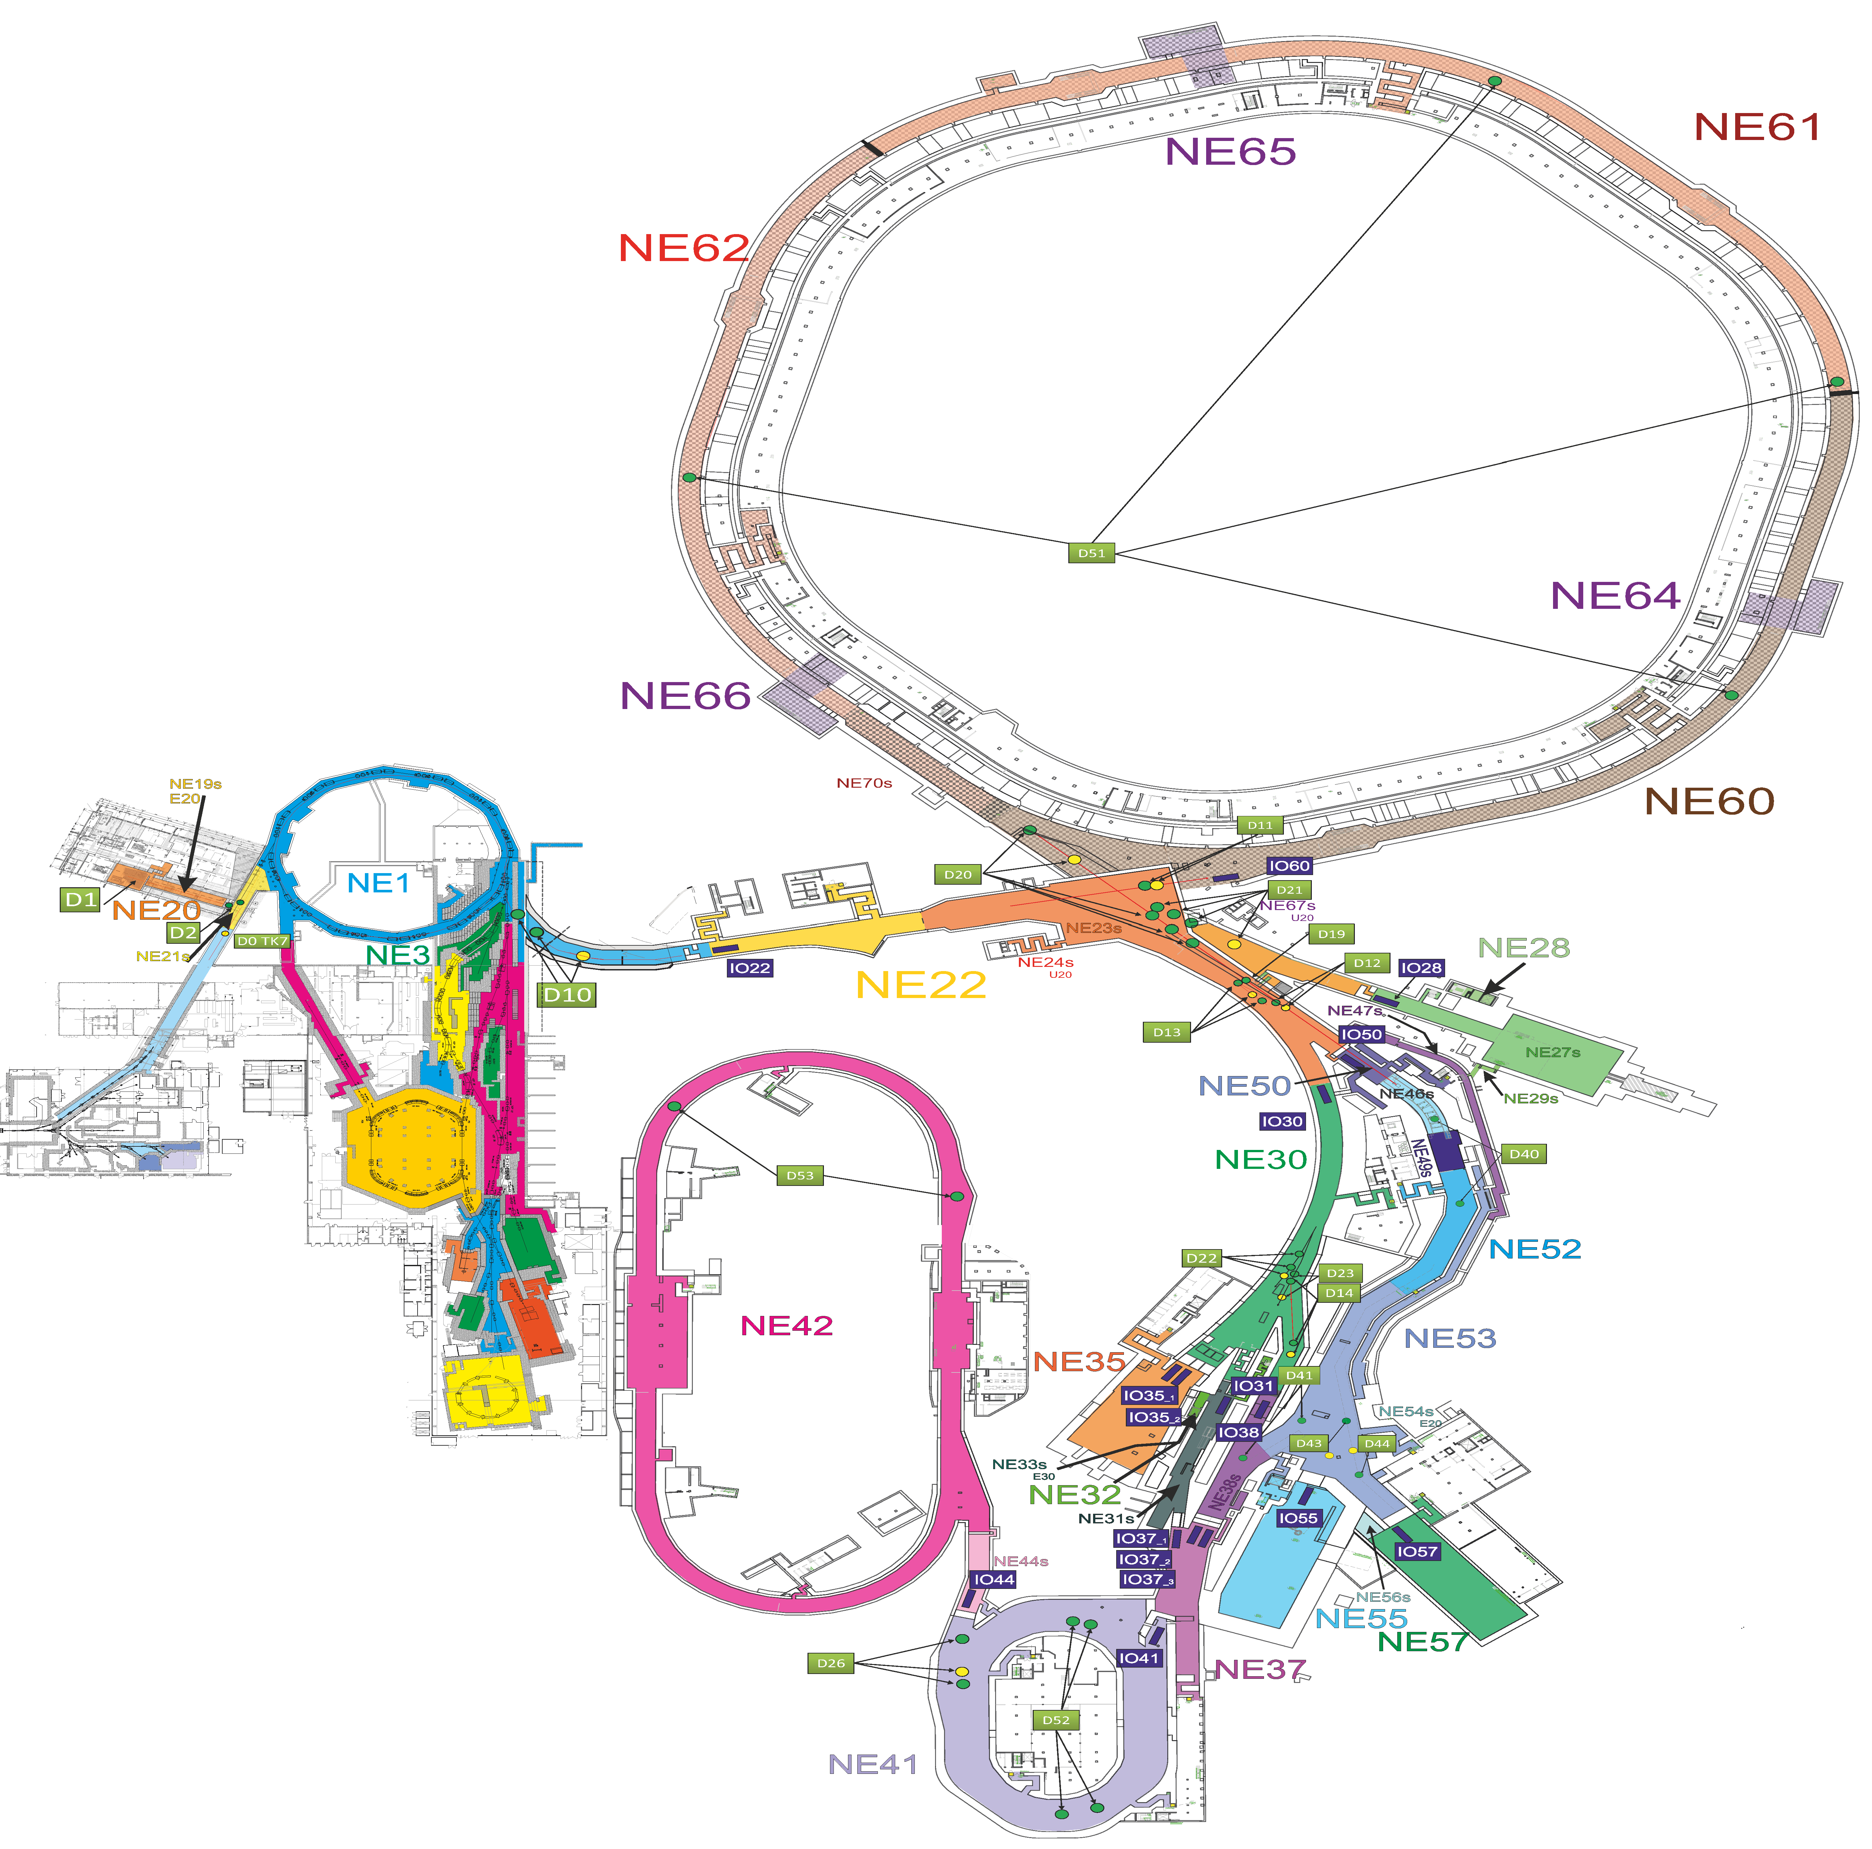
NE-Areas (Overview)
FAIR:
20 Mainareas
14 Subareas
Radiation Protection Areas (§ 52 StrlSchV) | Attribute of PAS
Überwachungsbereich (surveillance area) | Not controlled by PAS (only ZBS at building entrance)
Kontrollbereich (controlled area, residual dose-rate, local marked out restricted areas possible) | Controlled access with check of personnel access permissions
Sperrbereich (restricted area, beam operation) | No access

Slide 8
NE-Areas (Access Modes)
Access to the NE-Areas can be classified in principle in three different modes
  Uncontrolled Access (Access for everyone)
  Controlled Access (Access only with specified permissions)
  Closed Access (No access allowed)
For closed access in preparation of beam operation it is necessary that there are no persons left in the NE-Area. This will be achieved by alarming the area and through a search-procedure by the radiation protection department.
This is also valid for switching from Uncontrolled Access to Controlled Access to generate a defined state for the area.
To avoid the search-procedure before switching from controlled access to closed access controlled access is also available with an Personnel-Access-Key (PA-Key) which allows the PAS to count the Persons inside the NE-Area in a safe way.

Slide 9
NE-Areas (Modules II)
Modular differences
Mainarea:
  Not less than one personnel access gate with material transport door and personnel contamination monitoring. (s. door types)
  Main entrance to the accelerator.
Internal Subarea:
  Only accessible via the dedicated Mainarea.
  No personnel access gate. (s. door types)
  Area with higher dose-rate (prompt and/or residual) compared to the dedicated Mainarea.
  Enables faster access to the Mainarea, while the Subarea stays restricted.
  Reduces the size for the search procedure and residual radiation measurements.
External Subarea:
  Access not via the dedicated Mainarea.
  No personnel access gate. (s. door types)
  After shut down of beam operation in principle immediately accessible.
  No residual dose-rate from activation expected.

Slide 10
NE-Area (Door Types I)
Entries and exits of NE-Areas are possible through six standard-door types.
All types are equipped with safety switches and stop beam operation immediately in case of access violation when the area is entered without permission.
# | Type | Function
1 | PAG – Personnel Access Gate | Identification and separation of personnel and check of the access permissions
2 | MAD – Material Door | Transport of material in and out of NE-Areas
3 | AAD – Area to Area Door | Escape door between two NE-Areas
4 | ECD – Escape Door | Escape door out of NE-Areas
5 | SAD – Sub-Area Door | Access door to Subareas
6 | RSD – Radiation Shielding Door | Reduction of dose-rate and barrier

Slide 11
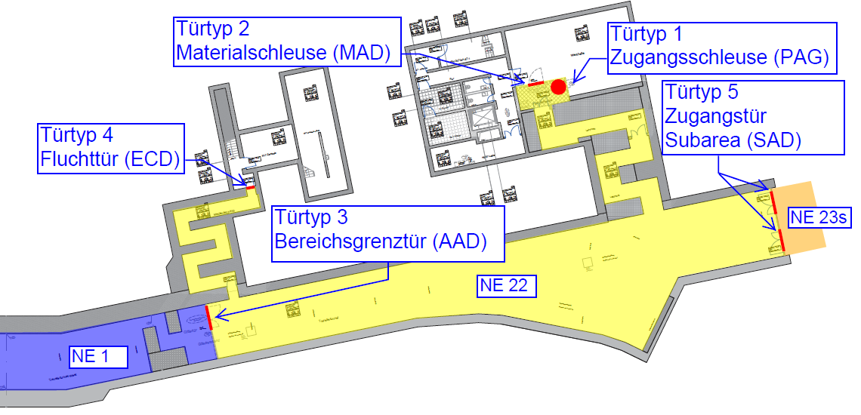
NE-Area (Door Types II)
Example of an NE-Area in G004a and T101

Slide 12
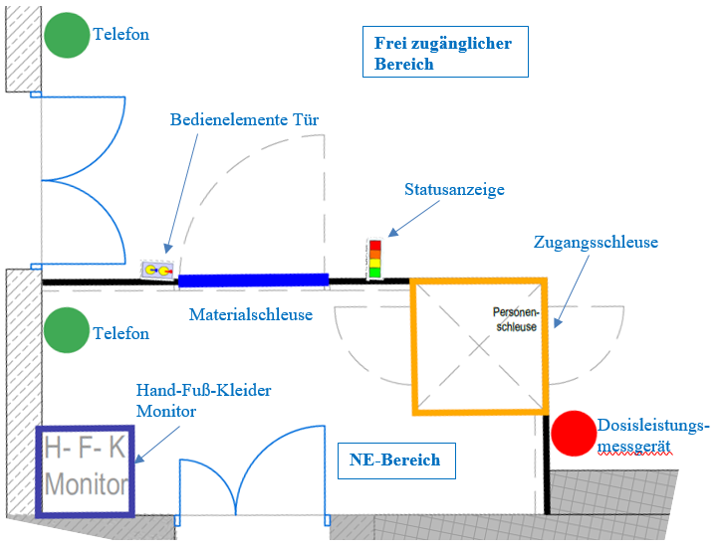
Access Area (Overview)

Slide 13
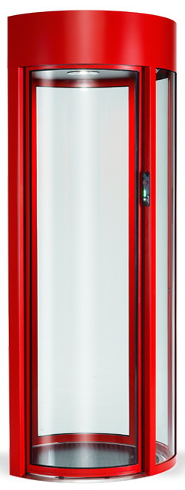
Access Area (Personnel Access Gate)
Interior View
Exterior View
Ultrasonic-Sensor
Monitor
Hand-Vein-scanner
PA-Key
Dosimeter-
Station
QR-Code
Scanner
Safety Mat

Slide 14
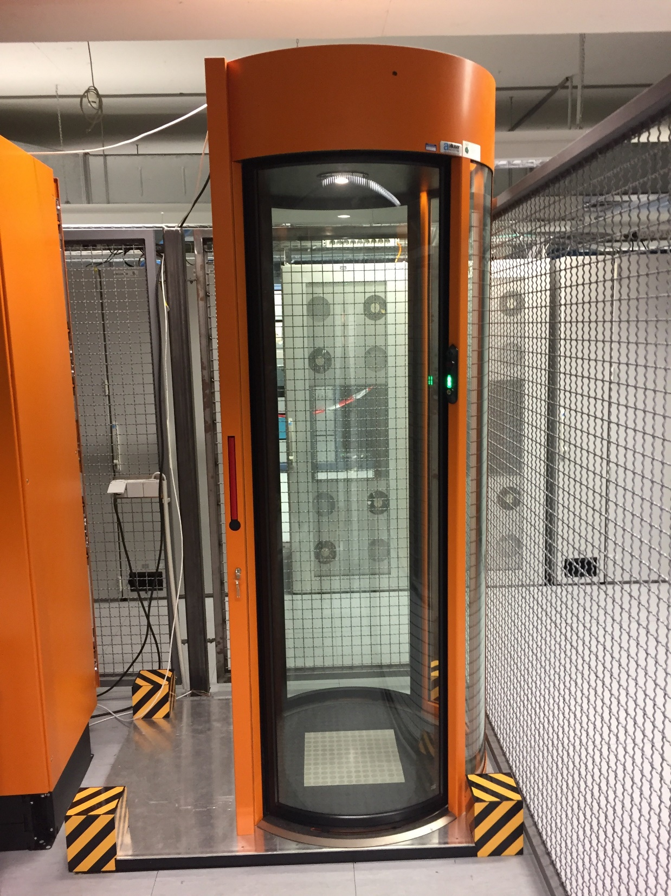
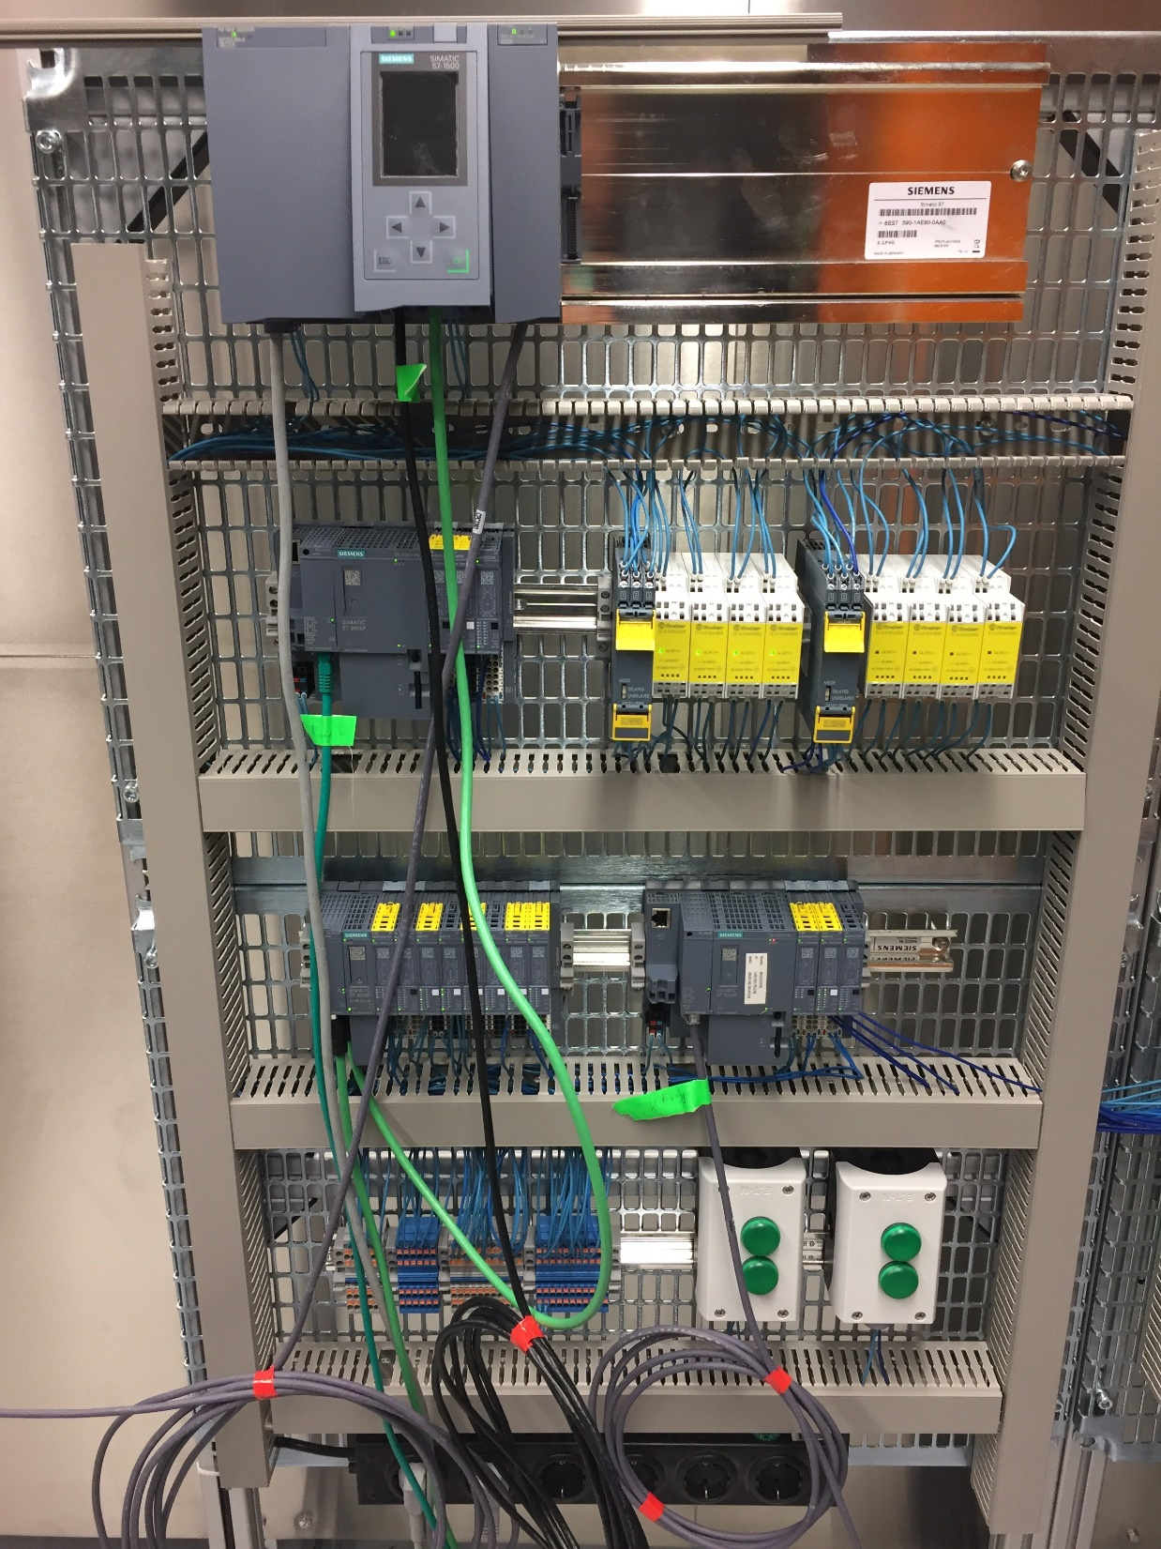
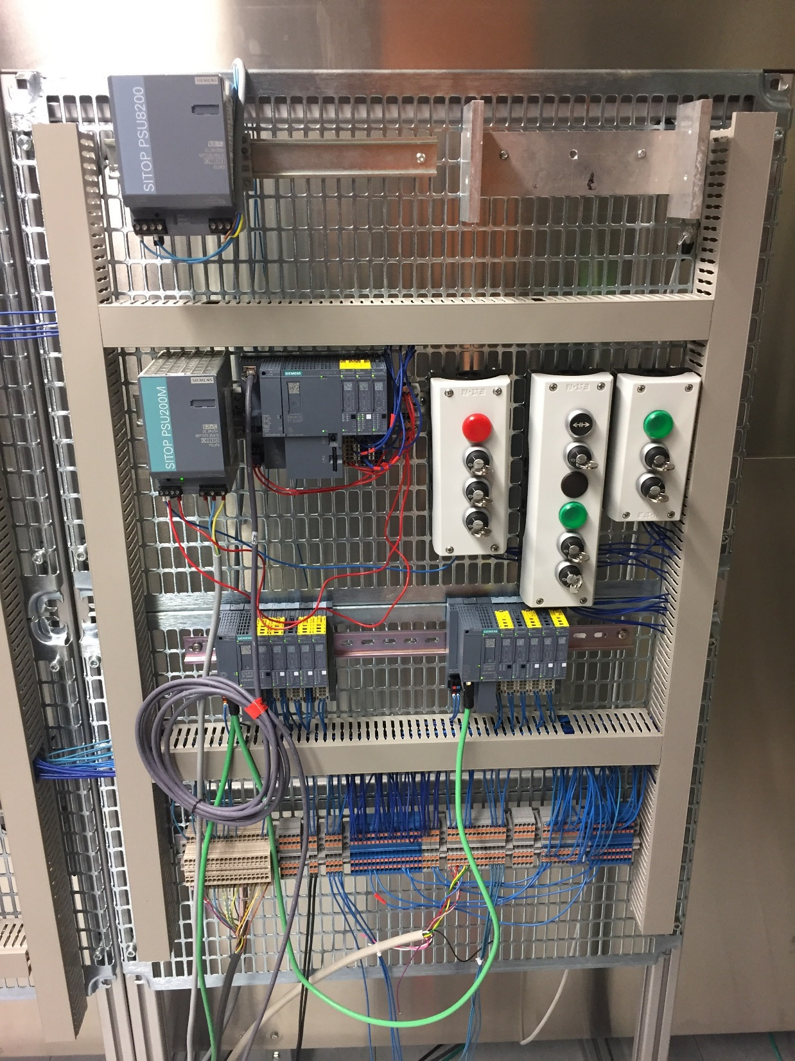
Access Area (Prototype)
ISE
CPU 1512F
UBOG
CPU 1512F
DBOG
SYSTEM
INPUTS
CPU 1516F
NE AREA
CPU 1512F
BOG
ET 200SP
PAG
SYSTEM
OUTPUTS
ET 200SP
MAD
ET 200SP
ECD
  Hardware structure for test software
  First steps to the prototype
  Continuous development of the test prototype to the simulation of the complete functions of an NE-Area

Slide 15
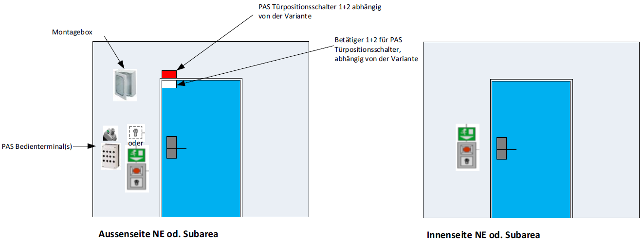
Access Area (Door Equipment)

Slide 16
Beam-Off-Groups and Safe Access
PAS:
Access control and guard with respect to prompt dose-rate from beam operation.
  Secure NE-Areas against beam operation while personnel access.
  Stop beam operation in case of access violation and loss of integrity of NE-Areas
Important Safety Elements – ISE (Beam): Components which are important for beam operation with a link to PAS
  ISE have two states: SAFE / UNSAFE.
  In SAFE state these components prevent beam operation in the dedicated NE-Area.
  In UNSAFE state the components are ready for beam operation from PAS point of view.
Beam-Off-Group – BOG: Group of ISE, which prevents beam operation in a dedicated NE-Area.
  A BOG consists of two or more ISE (Beam), e.g. two Dipole-magnets, which will be shut down safely, which disables the deflection of the beam into an dedicated NE-Area and therefor prevents beam operation in that area.
  While personnel access or in case of access violation through opening the safety switches at the doors without permission or in other cases which lead to the loss of integrity of the NE-Area the dedicated BOGs of the NE-Area will switch in the safe state and stop beam operation.

Slide 17
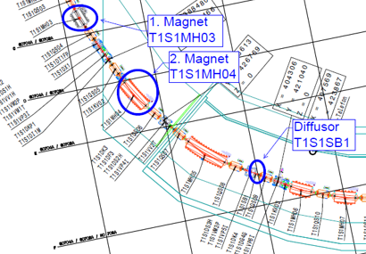
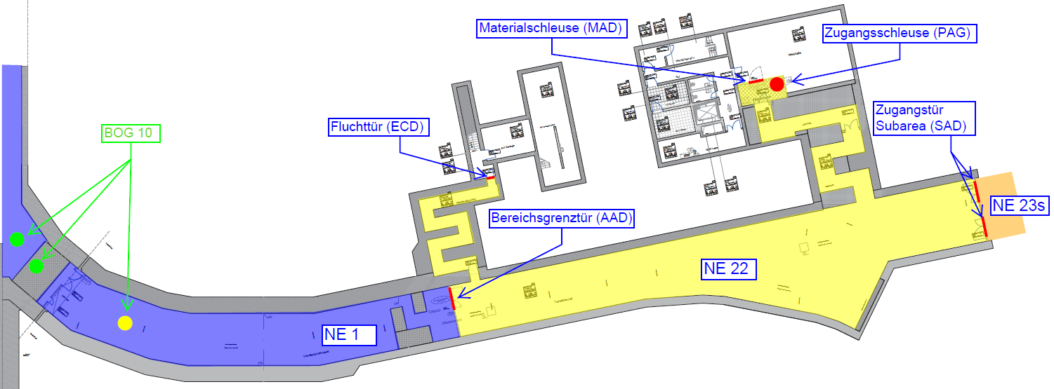
Beam-Off-Groups and Safe Access
Each NE-Area is dedicated to at least one BOG.
Each BOG is dedicated to at least one NE-Area.
At the time 21 BOGs are planed
Example: BOG 10 (T101) which prevents beam operation in NE 22:
A BOG enables safe access to an NE-Area but only with respect to prompt dose-rate!

Slide 18
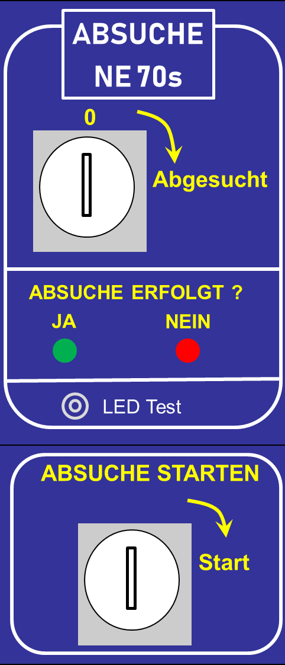
Workflows in Context of PAS
Concept of the Search-Procedure:
Search-procedure analogous to Search-procedure at GSI
The Search-procedure is necessary to check whether all personnel has left the NE-Area and to check the closed state of all boundary doors.
The state of the boundary doors (open/closed of the safety switches) will also be monitored and displayed by the PAS.
A Search is necessary for switching access modes of the PAS
  in case of access violation
  for switching from uncontrolled access to controlled access
  for switching from controlled access to controlled access with PA-Key
The start of the Search-procedure is initiated by a key-switch.
The success of the Search-procedure will be confirmed by the leader of the search-team with an additional key-switch.

Slide 19
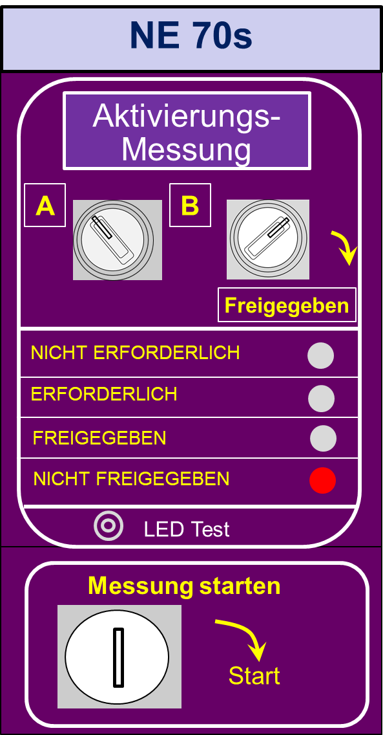
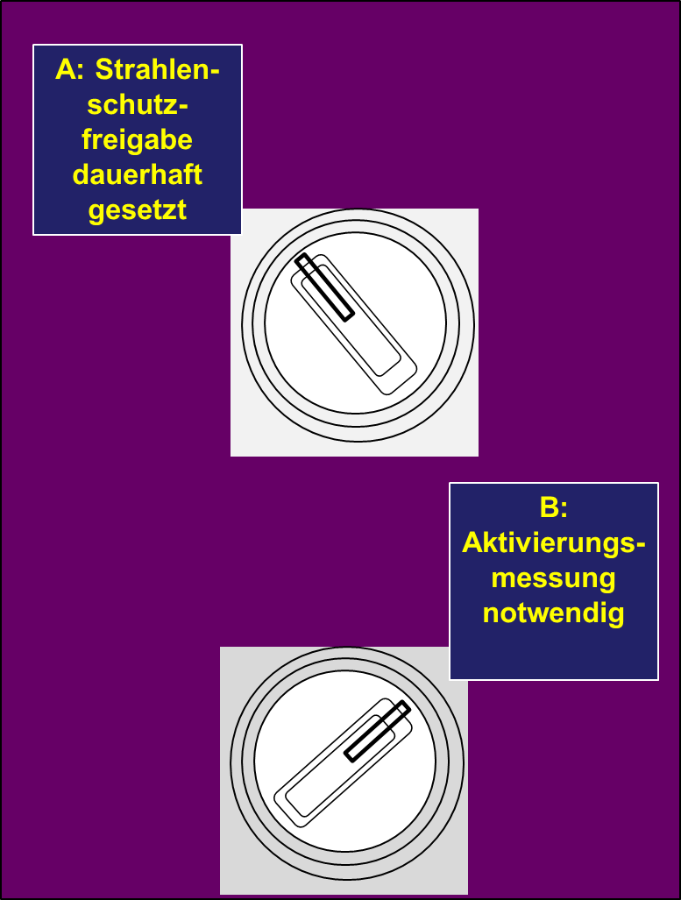
Workflows in Context of PAS
Concept of the Radiation Protection Assessment:
After beam operation before personnel access to an NE-Area is allowed a radiation protection assessment of the NE-Area is necessary.
Each NE-Area will be classified by the corresponding SSB before beam operation:
  No measurement of residual dose-rate is necessary before personnel access is allowed. This is the case for all areas with no residual dose-rate expected.
  A measurement of residual dose-rate is necessary before personnel access is allowed. This is the case for all areas with significant residual dose-rate.
The classification will be set by the SSB with a key-switch.
The classification can be changed if the circumstances change (e.g. beam parameter).
If the assessment is not positive or the assessment is not confirmed with the key-switch the PAS does not allow the switch of access modes for personnel access.
Bewertung Strahlenschutz

Slide 20
Workflows in Context of PAS
Concept for the Material-Transport-Procedure:
Material transport is allowed through the Material Door MAD.
Personnel access is allowed through the Personnel Access Gate PAG exclusively.
Request of material transport by phone at the radiation protection department.
The transport-key will be enabled (transport into NE-Area) or the transport will be assisted by the radiation protection department (transport out of NE-Area).
The Material-Transport-procedure starts, the light curtain is activated and the PAG will be disabled for entrance and exit procedures.
Light curtain
Transport- zone
PAG
Radar monitored Area
MAD
Transport-Key, Phone and State-Monitor

Slide 21
Workflows in Context of PAS
The MAD will be opened and the material will be placed inside the transport zone.
Afterwards the MAD will be closed again and the area between the light curtain and the MAD will be searched by radar whether there are persons left in the area.
If the area is clear the Material-Transport-procedure will be finished and the light curtain is disabled. The PAG will be enabled for entrance and exit procedures again.
Light curtain
Transport- zone
PAG
Radar monitored Area
MAD
Transport-Key, Phone and State-Monitor

Slide 22
Thank you!

