Slide 1

Design of a prototype for Personnel Access System at GSI
CERN:
Michał Kalinowski TE-MPE-MI
Alain Antoine TE-MPE-MI
Jan Uythoven TE-MPE-MI
External advisor:
Rüdiger Schmidt
GSI:
Christine Betz
Christian Müller
Matias Salinas

Slide 2
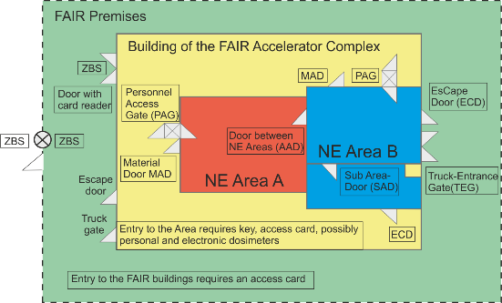
NE Area
Courtesy of GSI
Number of Entry (NE) Area - a radiation protection zone within a particle accelerator complex that is strategically delimited to perform a certain task.

Slide 3
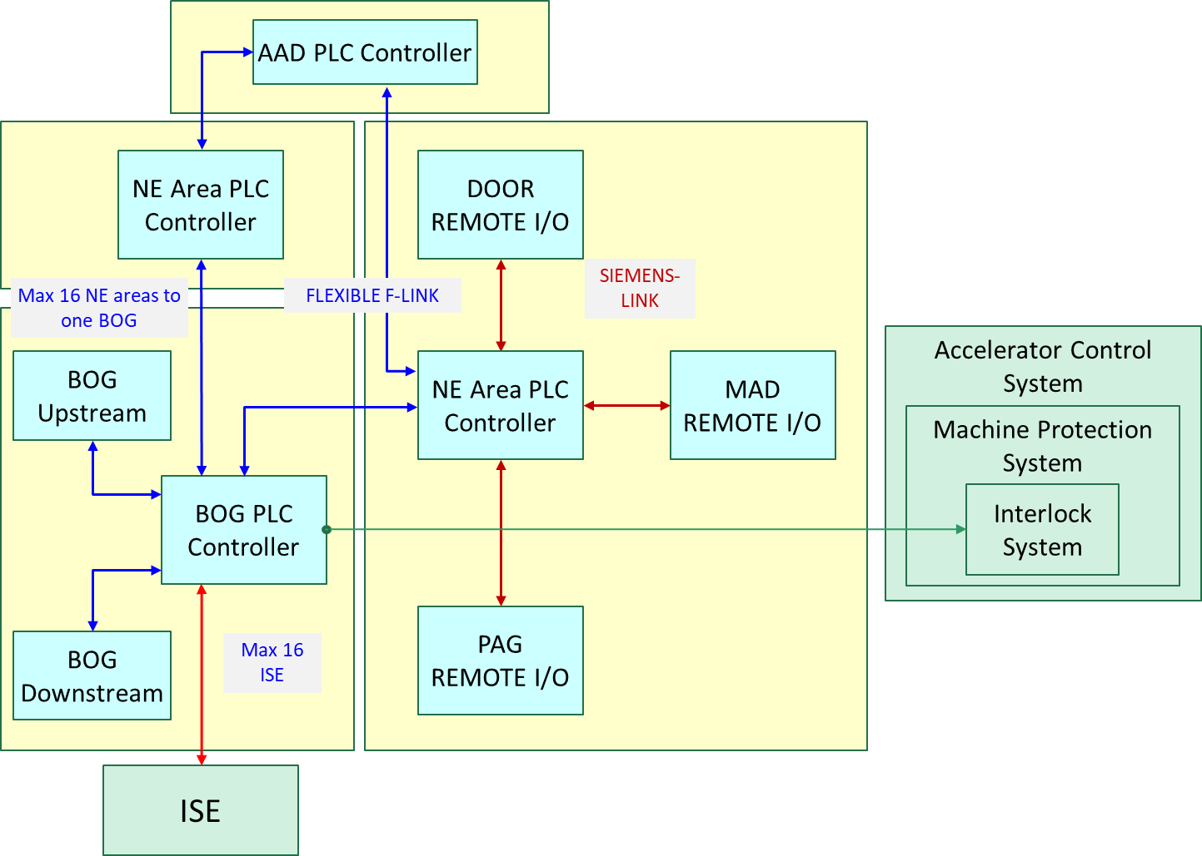
Beam-off-Group
BOG Upstream
BOG
Direction of beam
BOG Downstream
Courtesy of GSI
Beam-Off-Group (BOG) - the part of the Personnel Access System (PAS) responsible for preventing beam presence in a NE Area in case of authorized access and stopping the beam in case of unauthorized access it includes several Important Safety Elements (ISE) (at least two).
Important Safety Elements (ISE) - devices that are used to prevent presence of beam in a NE Area (i.e dipole magnets power supplies, diffusors and beam stoppers).

Slide 4
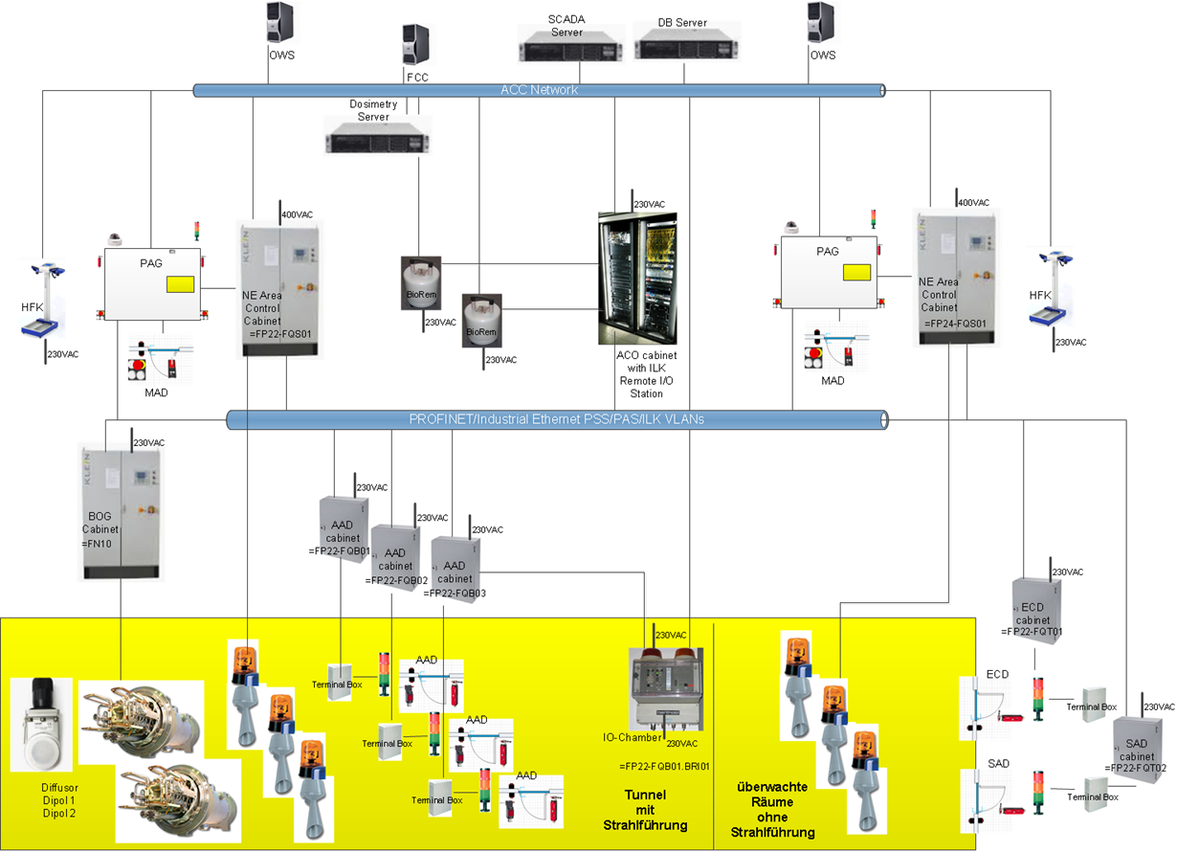
PAS System Architecture
Notes:
NE Area with PAG and MAD
Add some warning system to it
Most of the NE areas will have ECDs and SADs – each with own control cabinet
Add some network so it can communicate
Most of the cases many NE areas connected together
And have AADs between them
At least 1 BoG is looking over such configuration
And has directly overseeing the ISEs
Lets not forget about equipment which is responsible for radiation detection – IO Chambers
And Bio Rems
Radiation trackin station
And it is all connected to global network

Slide 5
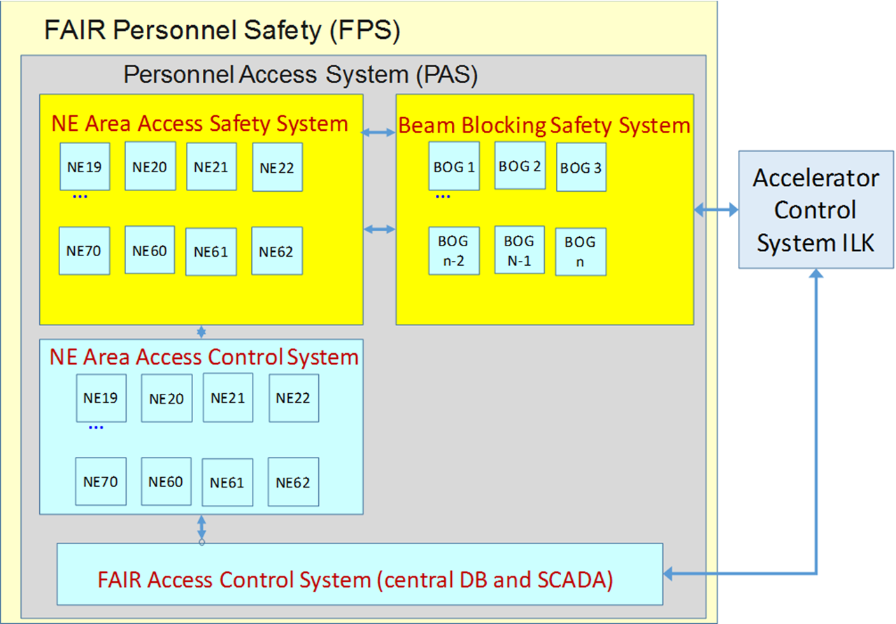
Personnel Access System Layout

Slide 6
Safety Instrumented Function (SIF)
What is it:
The Safety Instrumented Function, whose abbreviation is SIF, is a protection layer whose objective is to achieve or maintain a safe state of the process when a specific dangerous event occurs.
The Safety Instrumented Function is composed of any combination of sensor, logic solver (PLC), actuator and all necessary interfaces (cables, tubing, process connection, etc.).
Purpose:
Mitigate consequences of industrial hazard to persons.
Characteristics:
Each SIF is assigned a certain level of protection (Safety Integrity Level or Performance Level).

Slide 7
SIF_1: SIF STOP Beam/Components and PREVENT from starting Beam/Components
SAFETY ACTIONS of SIF_1:
Switch ISE’s (important safety elements: dipoles) of the related BOG’s or the upstream BOG’s to safe state (safety devices)
Open the alarm chain to hazardous components of the accelerator (safety relay)
Lock inner door of PAG in case of “closed access” or BOG ISE’s in unsafe state (safe locking device)
Reset the search (from “area is searched” to “area is not searched”) for the main area (internal signal)
Reset the search (from “area is searched” to “area is not searched”) for each external subareas (internal signal)

Slide 8
SIF_1: SIF STOP Beam/Components and PREVENT from starting Beam/Components
1. Logic of SIF_1:
a door to an NE area is open (except PAG)
OR
signal “PAG door logic ok” = 0 from SIF 2
OR
signal “MAD door logic ok” = 0 from SIF 3
OR
the operational mode is not “closed access”
OR
passivation state of any PLC related
OR
BOG is switched to “beam blocking mode”
the safety actions 1,2 (BOG ISE’s+acc. components) are triggered

Slide 9
SIF_1: SIF STOP Beam/Components and PREVENT from starting Beam/Components
2. Logic of SIF_1:
operating mode is “closed access” is requested
OR
BOG ISE’s are in unsafe state
the safety lock for the inner door has to be locked (safety action 3)
3. Logic of SIF_1:
a door to an external subarea is open
OR
the operational mode of the external subarea is not “closed access”
the search of the external subarea will be reset (safety action 5)

Slide 10
SIF_1: SIF STOP Beam/Components and PREVENT from starting Beam/Components
4. Logic of SIF_1:
the operating mode is “closed access” AND a door is open (except PAG outer door)
OR
the operating mode is “controlled access with key” AND a door is open (except PAG and MAD doors)
OR
switching to one of the operating modes without monitoring of the access keys (“controlled access without key” or “uncontrolled access”)
OR
passivation state of any PLC related
OR
signal “PAG search logic ok” = 0 from SIF 2
OR
signal “MAD search logic ok” = 0 from SIF 3
the search will be reset (safety action 4)

Slide 11
SIF_1: SIF STOP Beam/Components and PREVENT from starting Beam/Components
Acknowledgment of SIF_1:
the search has been acknowledged (ack. key=1) for the main NE area and all its external subareas
AND
all access keys are inside the PAG key panel
AND
an operator selected and acknowledged the operational mode “closed access”
AND
NE system is OK
AND
BOG system is OK
AND
AAD system is OK
the SIF is acknowledged (safety actions 1 and 2 are removed => release BOG’s and hazardous equipment to UNSAFE, safety action 3 “lock PAG” is triggered)

Slide 12
SIF_2: SIF PAG/SAD Entrance/Exit Procedure
SAFETY ACTIONS of SIF_2:
Switch ISE’s of the related BOG’s or the upstream BOG’s to safe state (“PAG door logic ok” = 0)
Open the alarm chain to hazardous components of the accelerator (“PAG door logic ok” = 0)
Reset the search (from “area is searched” to “area is not searched”) for the main area and its subareas (PAG search logic ok = 0)
Set/Reset the “radiation safe” signals for the main and its subareas
Questions:
Is this a SIF or should we realize Safety Actions 1+2 inside SIF_1?
Where else to realize the safety relevant logic for the “search logic ok” and the “radiation safe” signals?

Slide 13
SIF_2: SIF PAG/SAD Entrance/Exit Procedure
1. Logic of SIF_2:
the inner door is open
AND
BOG ISE’s are not safe
the safety actions (BOG ISE’s + acc. components + reset search) are triggered (PAG door logic ok = 0)
2. Logic of SIF_2:
the inner door is open
AND
the outer door is open
the safety actions (BOG ISE’s + acc. components + reset search) are triggered (PAG door logic ok = 0)

Slide 14
SIF_2: SIF PAG/SAD Entrance/Exit Procedure
3. Logic of SIF_2:
the inner door is open
AND
the safety lock for the inner door is locked
the safety actions (BOG ISE’s + acc. components + reset search) are triggered (PAG door logic ok = 0)
4. Logic of SIF_2:
the inner door is open
AND
the inner door is not released to be opened for entrance or exit
the safety actions (BOG ISE’s + acc. components + reset search) are triggered (PAG door logic ok = 0)

Slide 15
SIF_2: SIF PAG/SAD Entrance/Exit Procedure
5. Logic of SIF_2:
the outer door is open
AND
the outer door is not released to be opened for entrance or exit
the safety actions (BOG ISE’s + acc. components + reset search) are triggered (PAG door logic ok = 0)
6. Logic of SIF_2:
the inner OR outer door is open
AND
Counter safety keys changes
the safety action 3 “reset search” is triggered

Slide 16
SIF_2: SIF PAG/SAD Entrance/Exit Procedure
7. Logic of SIF_2:
entrance OR exit is not requested
AND
Counter safety keys changes
the safety action 3 “reset search” is triggered
8. Logic of SIF_2:
entrance OR exit is requested
AND
Counter safety keys increase > 1 OR decrease < -1
the safety action 3 “reset search” is triggered

Slide 17
SIF_2: SIF PAG/SAD Entrance/Exit Procedure
9. Logic for main area “radiation safe”:
operating mode is not “closed access”
AND
BOG’s ISE in safe state
AND
the safety lock for the inner door is unlocked
AND
radiation evaluation has been executed (start key=1) AND acknowledged (ack.key=1) OR radiation evaluation is not necessary (selector=not necessary)
-> set main area radiation safe
BOG’s ISE in unsafe state
-> reset main area radiation safe

Slide 18
SIF_2: SIF PAG/SAD Entrance/Exit Procedure
9. Logic for sub area “radiation safe”:
operating mode is not “closed access”
AND
BOG’s ISE in safe state
AND
the safety lock for the inner door is unlocked
AND
radiation evaluation has been executed (start key=1) AND acknowledged (ack.key=1) OR radiation evaluation is not necessary (selector=not necessary)
-> set sub area radiation safe
BOG’s ISE in unsafe state
-> reset sub area radiation safe

Slide 19
SIF_2: SIF PAG/SAD Entrance/Exit Procedure
Acknowledgment of SIF_2:
the search has been acknowledged (ack. key=1) for the main NE area and all its external subareas
AND
all access keys are inside the PAG key panel
AND
an operator selected and acknowledged the operational mode “closed access”
AND
NE system is OK
AND
BOG system is OK
AND
AAD system is OK
the SIF is acknowledged (safety actions 1 and 2 are removed => release BOG’s and hazardous equipment to UNSAFE)

Slide 20
SIF_3: SIF Monitoring Start/End and Execution Transport MAD
SAFETY ACTIONS of SIF_2:
Switch ISE’s of the related BOG’s or the upstream BOG’s to safe state (“MAD door logic ok” = 0)
Open the alarm chain to hazardous components of the accelerator (“MAD door logic ok” = 0)
Reset the search (from “area is searched” to “area is not searched”) for the main area and its subareas (MAD search logic ok = 0)
Questions:
Is this a SIF or should we realize Safety Actions 1+2 inside SIF_1?
Where else to realize the safety relevant logic for the “search logic ok” signal?

Slide 21
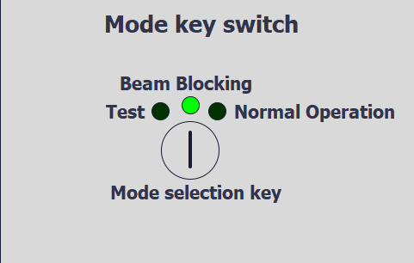
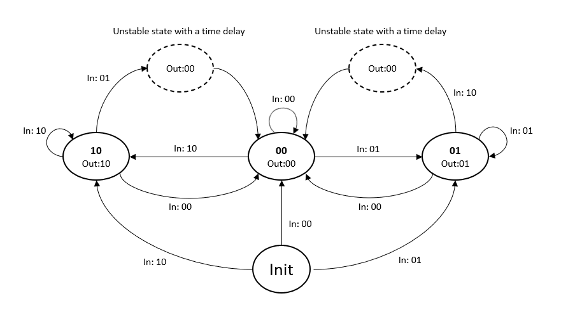
BoG prototype for PAS – Operating modes
The BoG was defined to be able to work in three modes, chosen by 3-position safety key switch.
States:
10 – Normal Operation Mode
00 – Beam Blocking Mode
01 – Test Mode
The key state machine was introduced in order to avoid a possibility of switching the key between two edge positions in one cycle – which could cause an error in the BoG’s state machine.

Slide 22
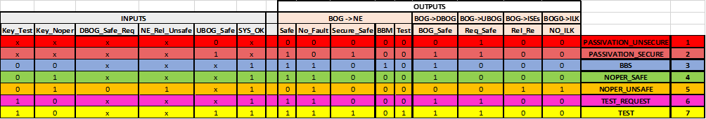
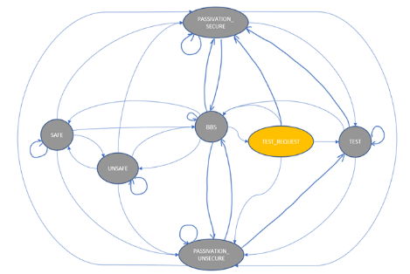
BoG prototype for PAS – State Machine
To define the BoG’s state diagram an analytic approach was used, treating it as synchronous sequential system.
Six input signals were identified to drive the BoG state machine 64 possible combinations.
After optimization (based on output vectors) 7 possible states were defined.
States definition
Transitions between the states were defined and based on them the state diagram on the right was created.

Slide 23
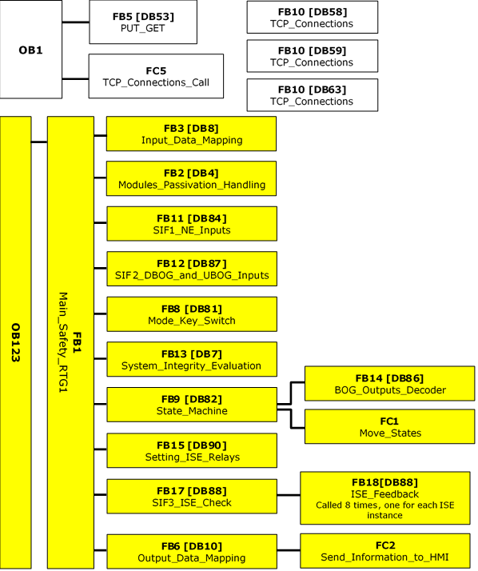
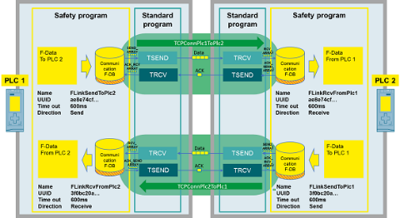
BoG prototype for PAS - Software
The software architecture of the BoG prototype for PAS is the following:
As the whole PAS will consist of 21 BoGs looking over 34 NE Areas, the designed software had to be generic and easy to implement for each of the BoGs instance.
Flexible F-Link – Fail-safe communication based on TCP connection was chosen as the communication method for PAS prototype.
Even though the F-Link uses standard communication mechanisms, thanks to introduced measures such as unique UUID for each connection and acknowledgment of received data the communication remains safe.
Notes:
:

Slide 24
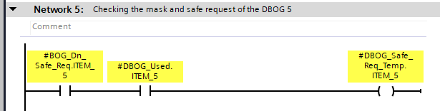
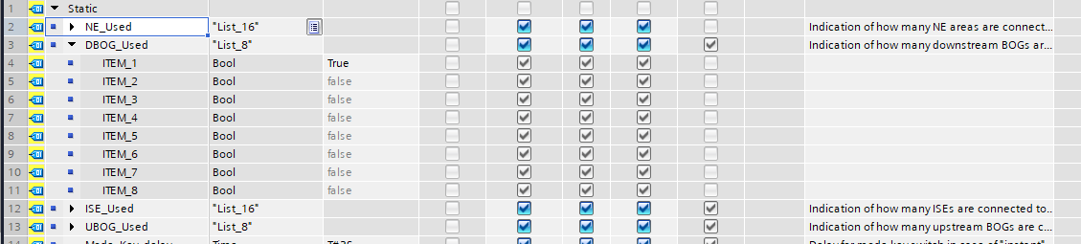
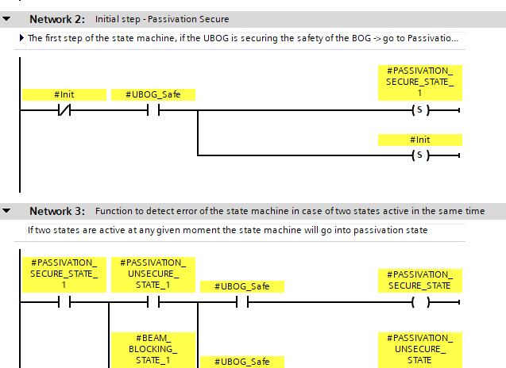
BoG prototype for PAS – Software 2
For the code to be generic, possibility of masking unused instances was introduced with a use of Configuration Data Block. The configuration cannot be changed during the operation.
To avoid errors in the state machine, functions detecting possible failures were introduced.
In case of detected error in any of the following:
Communication between the BoG and any its Upstream BoGs or depending NE areas
Main state machine
ISE feedbacks
Mode key state machine
The PLC passivates its outputs (sets the outputs to predefined safe state). The passivation lasts until the error is fixed and the board acknowledged by the user.

Slide 25
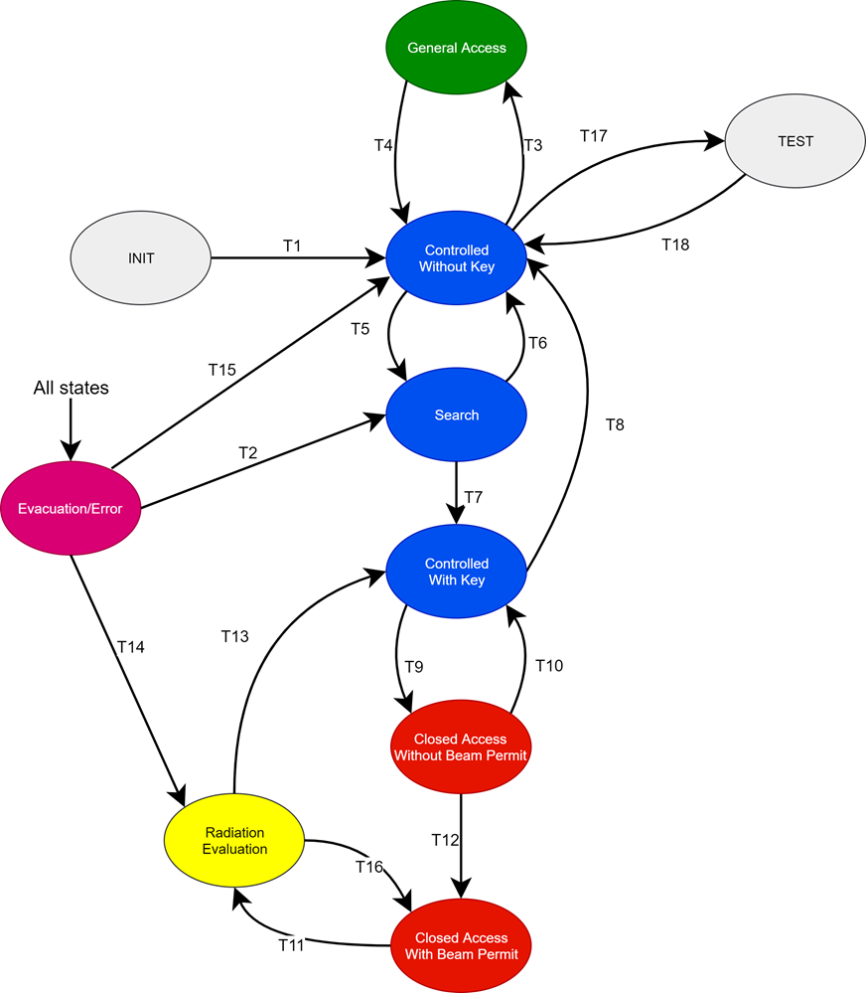
NE Area prototype for PAS – State Diagram
The NE area was defined to work in several different states depending on the Access Mode (General Access, Controlled Access, Closed Access). Based on these assumptions the state diagram on the left was defined.
Bit1 | Bit2 | Bit3 | BOG_Safe | Searched | Empty
0 | 0 | 0 | 0 | 0 | 0
0 | 0 | 0 | 0 | 0 | 1
0 | 0 | 0 | 0 | 1 | 0
0 | 0 | 0 | 0 | 1 | 1
NOTE: Unlike the BoG, the NE Area’s state machine is part of the standard part of the program. Which in contrary to safe part does not provide additional software integrity check during execution and does not restrict the user to the use of simplest functions.
.
.
.
1 | 1 | 1 | 1 | 1 | 1
State coding
Bit1 | Bit2 | Bit3 | State
0 | 0 | 0 | Error
0 | 0 | 1 | General Access
0 | 1 | 0 | Ctrl. with key
0 | 1 | 1 | Ctrl. without key
1 | 0 | 0 | Closed Access
1 | 0 | 1 | Test Mode
1 | 1 | 0 | Beam Permit
1 | 1 | 1 | Search
6 inputs = 64 combinations
The NE state machine will be driven by 6 inputs.
3 bits coming from SCADA panel – operator requesting transition to a different state
3 inputs from safe part of the program being conditions for requested transitions

Slide 26
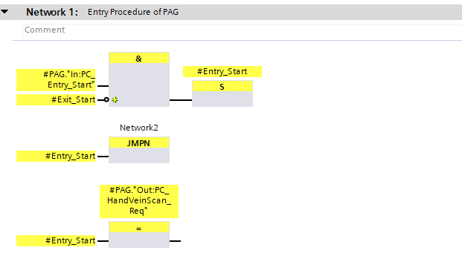
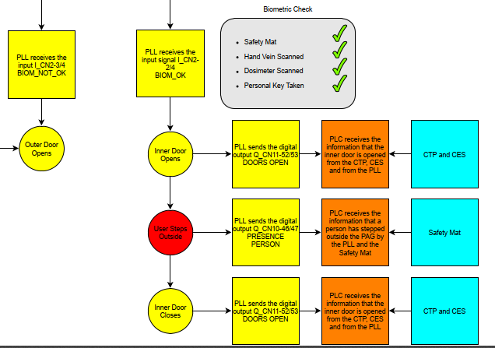
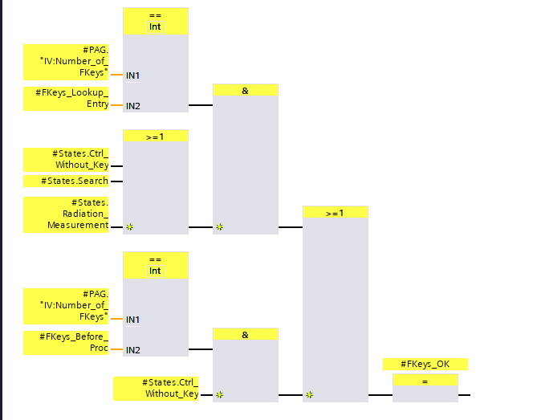
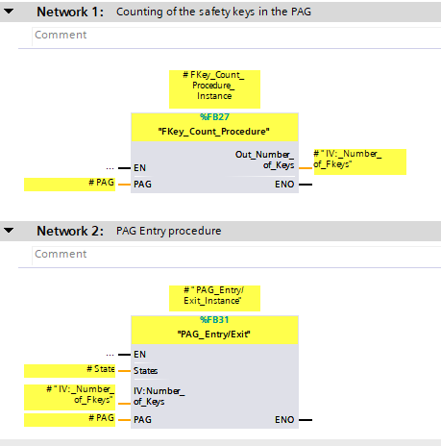
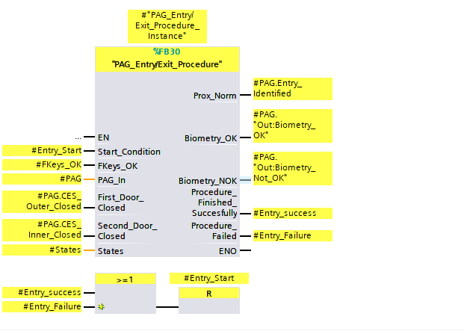
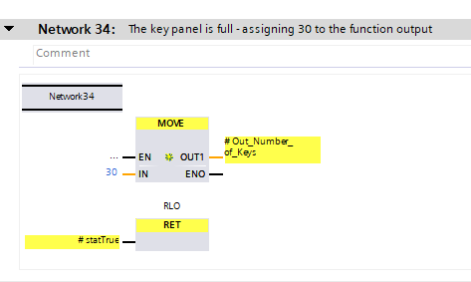
NE Area prototype for PAS – Software
The safety inputs to the state machine comes from the safe part of the software.
Entry/Exit authorization requires:
Positive identification
Presence of only 1 person inside of the PAG
Having appropriate rights
Taking/leaving 1 safety personal key (if Controlled Access with Key)
Safe procedure counting personal safety keys, keeps track of amount of people inside the area (in Controlled Access with key). It also prevents the user from taking/putting back more than 1 key at a time.
Notes:
:

Slide 27
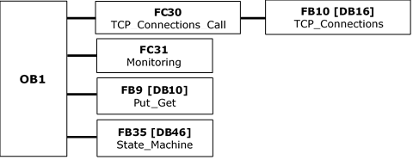
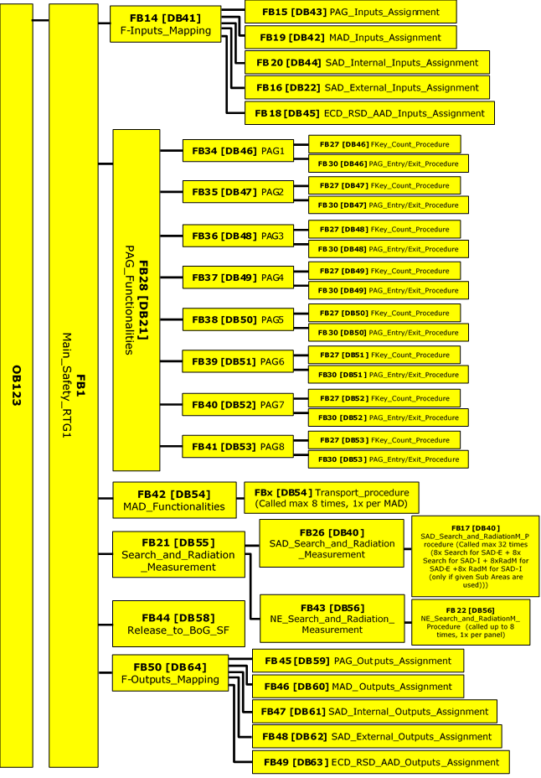
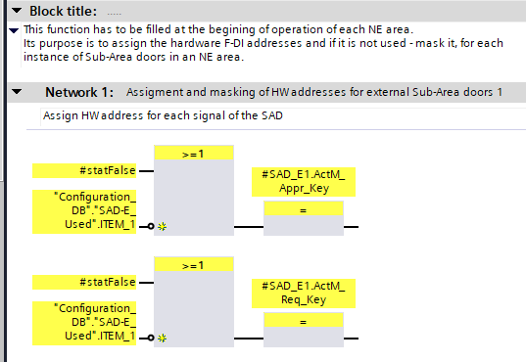
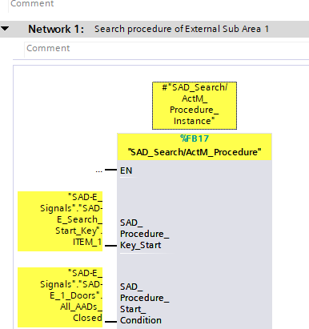
NE Area prototype for PAS – Software 2
The software architecture of the NE Area prototype for PAS.
As each of the 35 NE areas can have unique configuration of different type of doors, to keep the program generic the prepared software is modular with reusable FBs.
Masking signals of unused doors instances.
Reuse of FB for different procedures – i.e Search and Activation measurement.
Notes:
:

Slide 28
Summary of BoG and NE
BoG
The working states of the BoG were defined by analyzing input/output vectors of the system and a State Machine was built based on them.
The software was prepared using Siemens’ safety libraires to provide maximum level of reliability.
Safety functions monitoring correctness of program execution were introduced to further decrease risk of errors.
NE Area
The state machine of NE area is realized in unsafe part of the program, yet the transitions are driven also by safe inputs.
The amount of different Function Blocks was reduced by reusing FBs for different procedures (i.e NE area entry and exit procedure).
Few different measures were introduced in order to minimize the risk of personnel being exposed to radiation (i.e key counting, search procedure, PAG’s safety mat).
Notes:
BoG delivered, tested

Slide 29
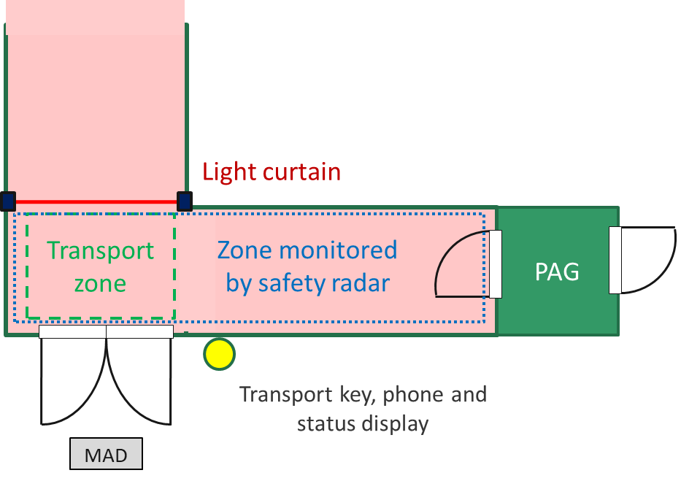
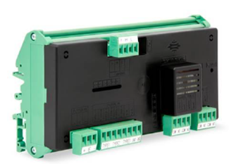
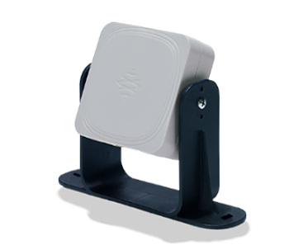
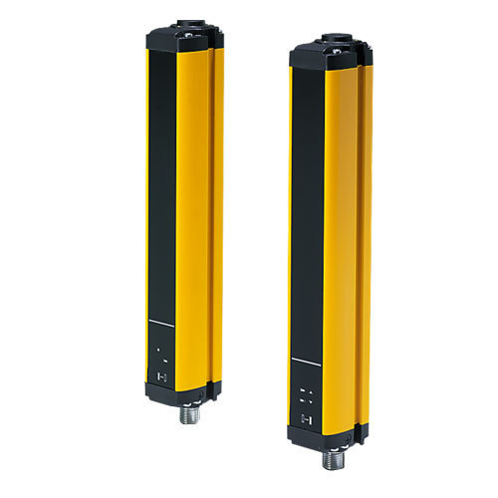
Material Transport to and from NE Areas
The purpose of this procedure is to allow a person to transport material without losing the search status of the NE Area.
Little to none supervision needed to perform a transport thanks to monitoring using radars and light curtain.
The radars ensure that nobody is in the transport zone before the MAD is opened and nobody stays inside the transport zone after closing the MAD.
The light curtain serves as a barrier to delimitate the transport zone to ensure no one enters the NE Area undetected.

Slide 30
Material Transport to and from NE Areas
It is programmed using set and reset blocks in order to indicate the current steps of the procedure.
Looking for advice on whether is it possible to program in such way and how to validate and verificate these type of programs.

Slide 31
Ideas for Collaboration
General approval of chosen solutions, ideas and principles
Support for having the PAS approved by authorities e.g. Berufsgenossenschaft
  Support in communication
Help in follow-up of the requests by the authorities
  Formal methods to proof the programming of the safety PLCs (state machines and sequencer)
  Risk analysis, functional safety management plan, specifications
  Required documentation

Slide 32
Thank you for your attention

Slide 34
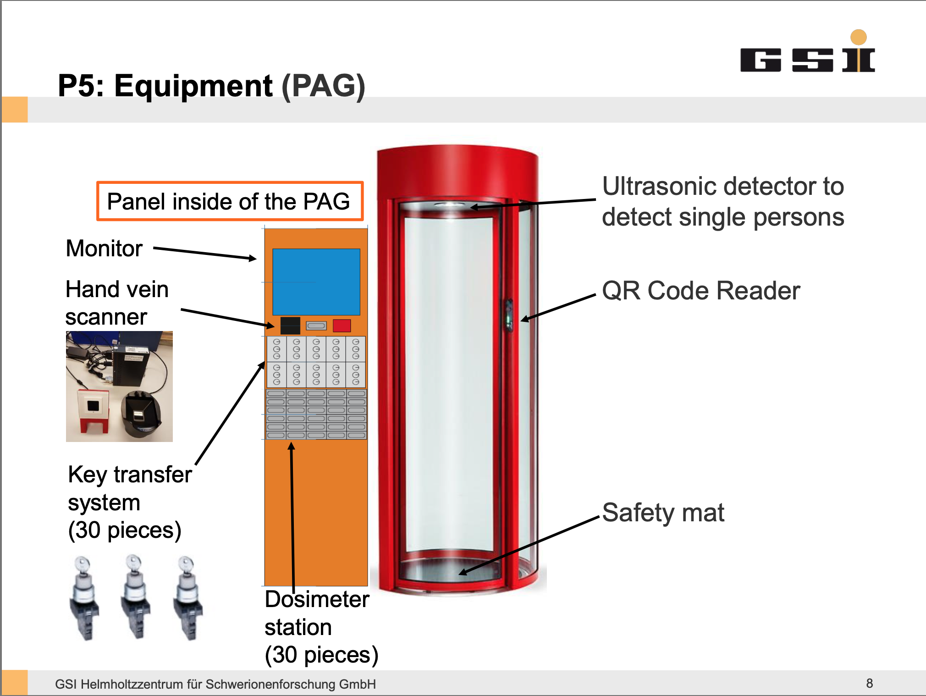

Slide 36
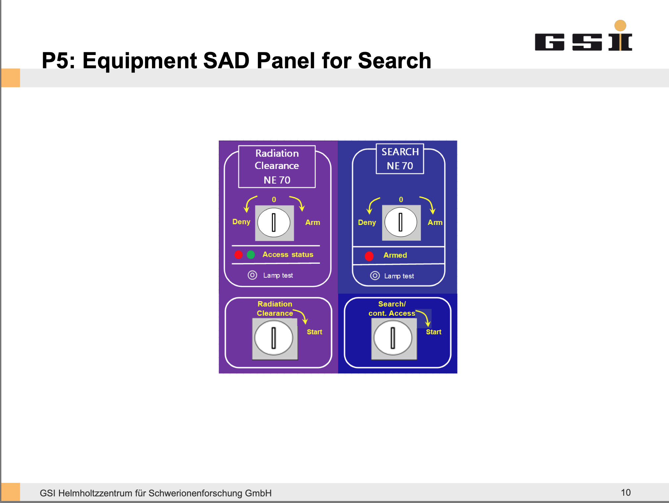

Slide 37
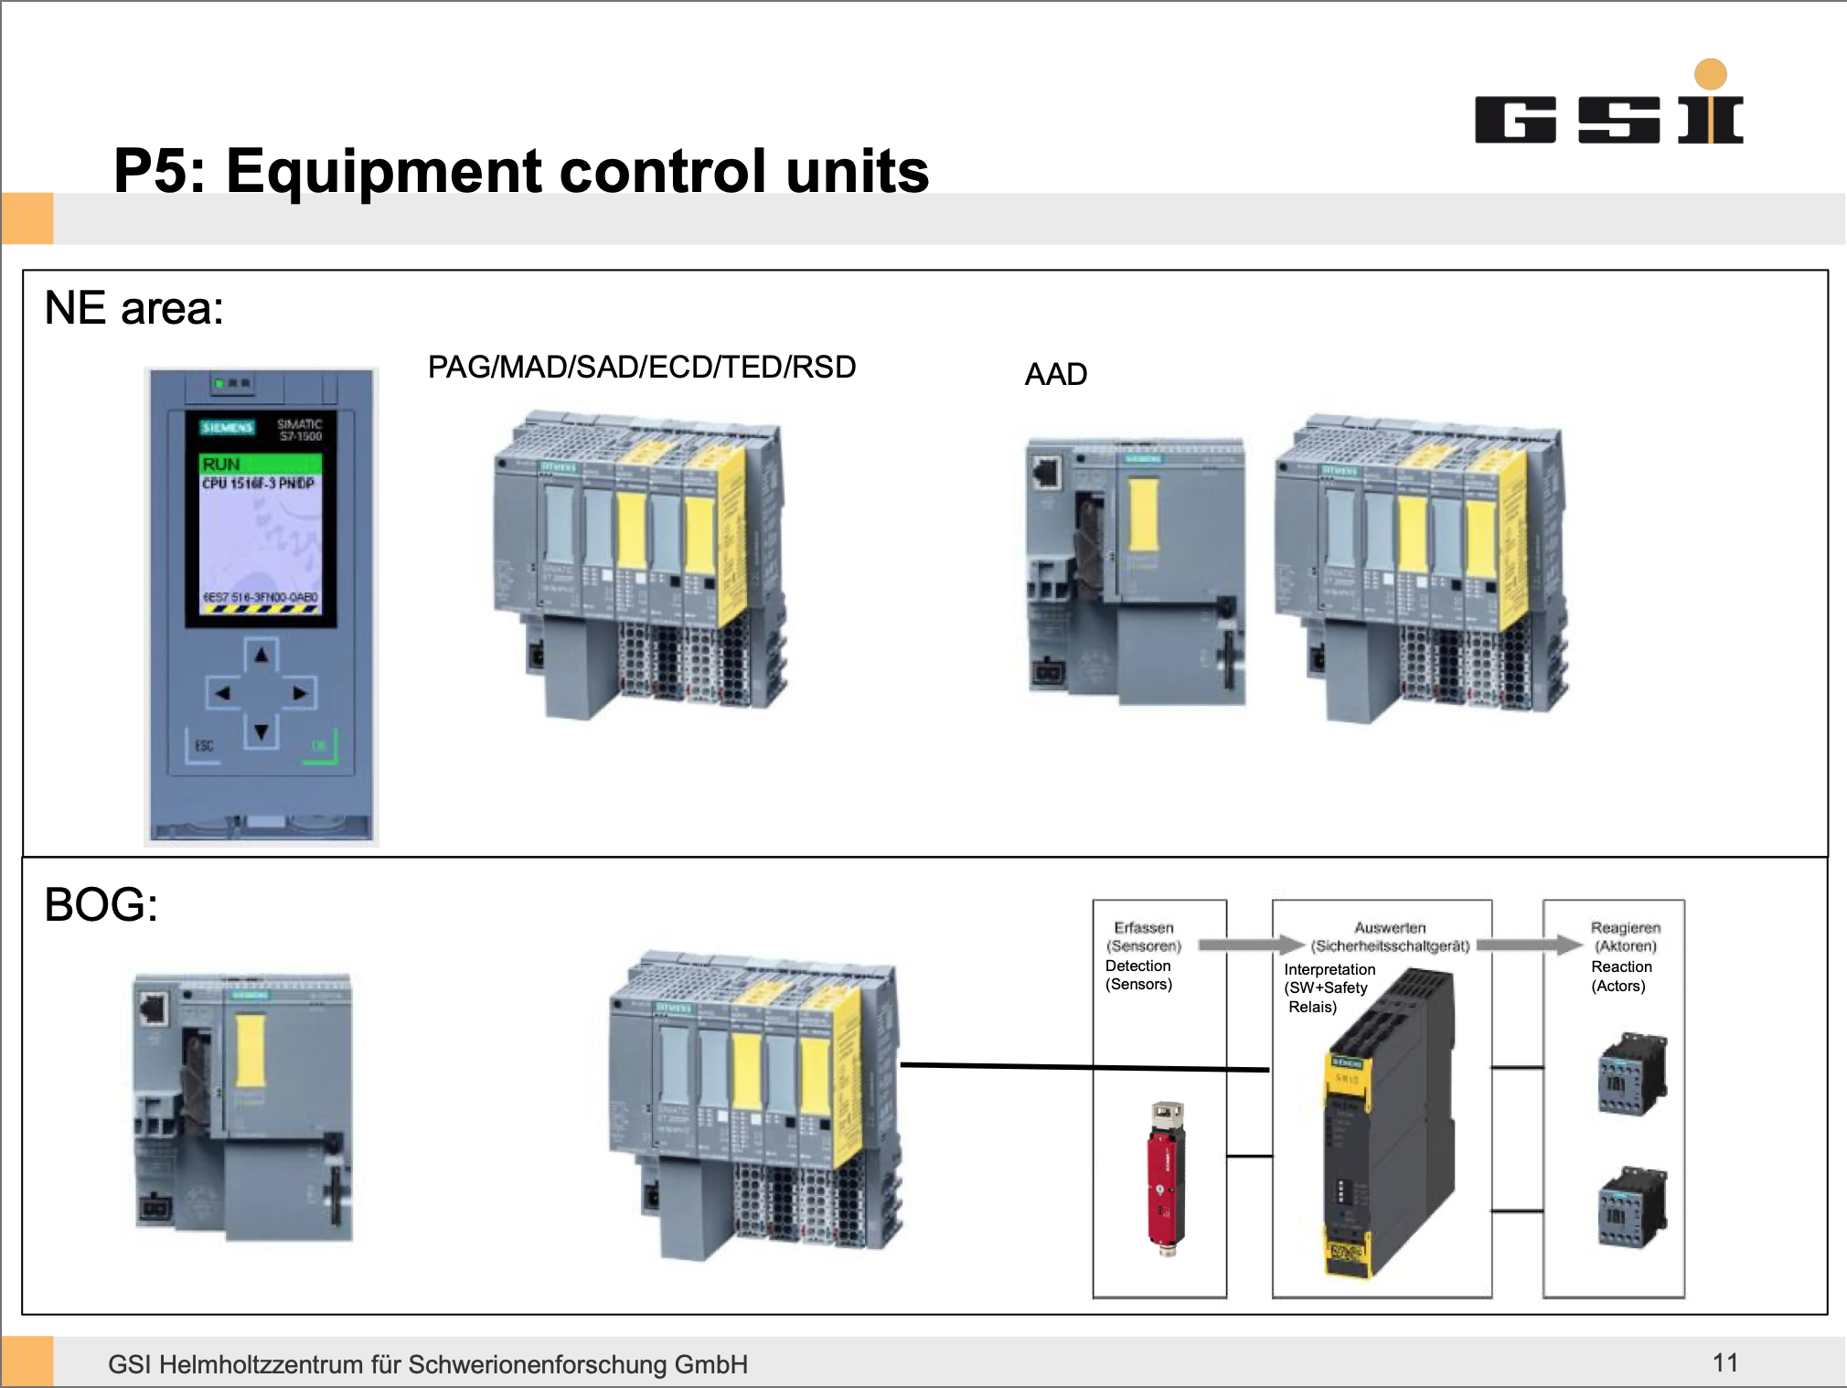

Slide 38
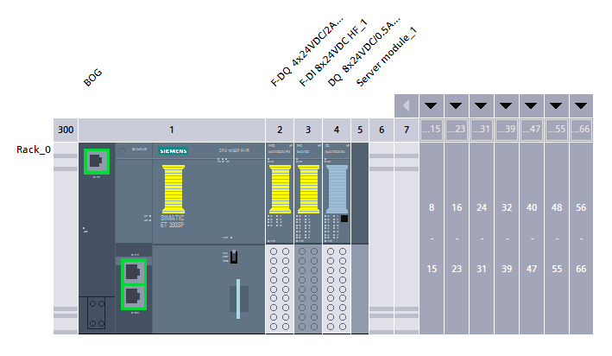
BoG prototype for PAS – Hardware choice
PLC based solution was chosen by the GSI for the PAS prototype.
The following PLC hardware configuration was identified for the BoG prototype:
1x CPU 1512SP F-1 PN (part number: 6ES7 512-1SK01-0AB0)
1x Fail-safe digital output module F-DQ 4x24VDC/2A PM HF_1 (part number: 6ES7 136-6DB00-0CA0)
1x Fail-safe digital input module F-DI 8x24VDC HF_1 (part number: 6ES7 136-6BA00-0CA0)
1x Digital output module DQ 8x24VDC/0.5A HF_1 (part number: 6ES7 132-6BF00-0CA0)

Slide 39
BoG prototype for PAS – State Machine 1
The BoG’s “heart” is its state machine, defined by input and output vectors of the system.
Six input signals were identified to drive the BoG state machine 64 possible combinations
Two inputs coming from the same 3-position safety key switch
(1,1) input combination is impossible state (indicated by red color in the table)
48 possible states for which output vectors were defined

Slide 40
BoG prototype for PAS – State Machine 2
Seven unique vectors of outputs were defined
Table minimized to seven possible states
Next step:
Define possible transitions between the identified states
Optimization

