Slide 1




Meeting 3rd September 2021

Slide 2
Participants according to invitation
GSI
Betz, Christine
Matias Salinas Rodriguez
Dennis Gaßmann
Ralf Fuchs
Torsten Radon
CERN
Jan Uythoven
Michal Kalinowski
Alain Antoine
TU Darmstadt / CERN / GSI
Rudiger Schmidt
ISS
Thomas Termin
Dustin Witte
Kai-Dietrich Wolf
Max vom Stein
Sabine Kranz

Slide 3
Objective
Is there an interest for (some kind of) collaboration on the safety aspects of the FAIR Personnel Access System?
Besteht Interesse an einer (wie auch immer gearteten) Zusammenarbeit bei den Sicherheitsaspekten des FAIR-Personalzugangssystems?

Slide 4
Programme
Introduction
Presentation of the participants in the workshop
Introduction of FAIR accelerators and their specific aspects related to protection of people (R.Schmidt)
Introduction to the FAIR access system (D.Gassmann)
Introduction to ISS with regard to its focal points and possible connecting points for FAIR PAS safety controls (ISS)
Controls for the Personnel Access System (M.Kalinowski and M.Salinas)
  Presentation of method and status of the FAIR Safety-Related Application Software under development
  Development of SRASW (Safety-Related Application Software) – Functional Safety Management
  Interface with and requirements from authorities
Discussion: Next steps for FAIR, possibilities of collaboration between GSI/CERN/ISS

Slide 6
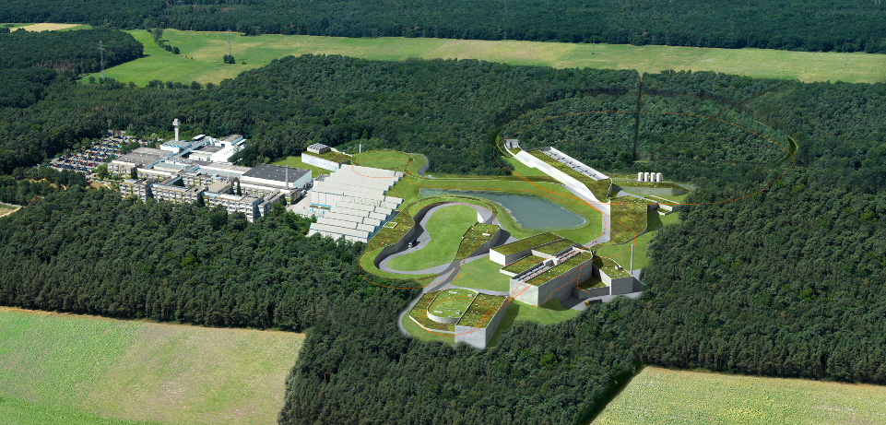
FAIR at GSI
FAIR at GSI
Rüdiger Schmidt, 3 September 2021
ISS Universität Wuppertal

Slide 7
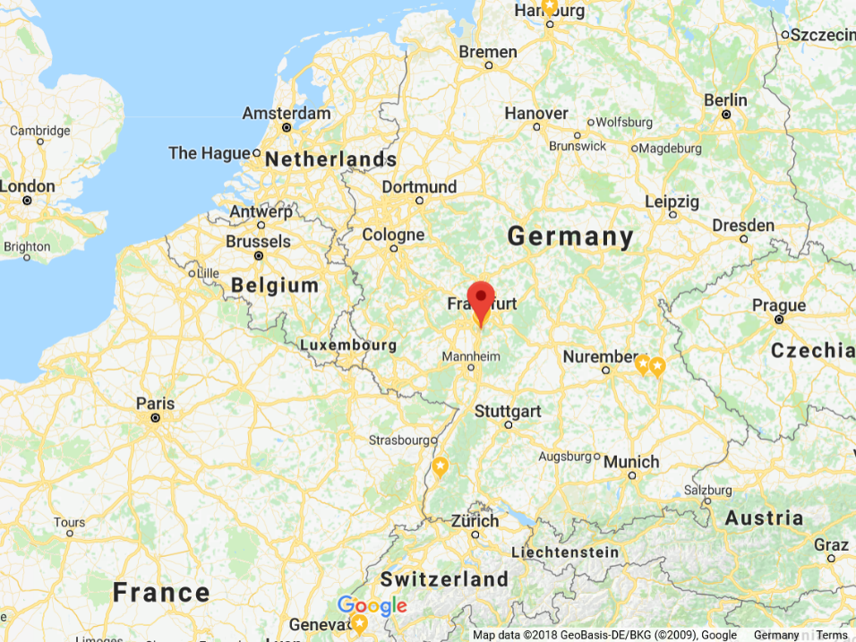

Location

Slide 8
GSI
Research with particle accelerators as tool

Slide 9
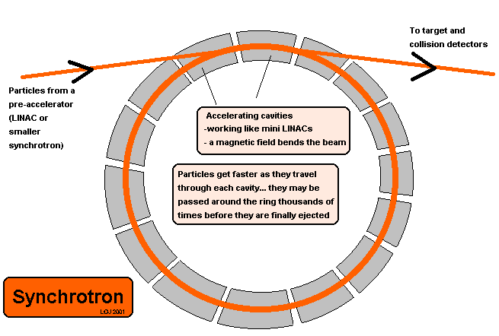
Using particle accelerators for experiments

Slide 10
GSI Helmholtz Centre for Heavy Ion Research
Basic and applied research in physics and related natural science disciplines. Main fields of study include
Plasma physics
Atomic physics
Nuclear structure and reactions research
Biophysics and medical research
Main tools today are heavy ion accelerator facilities:
UNILAC, the Universal Linear Particle Accelerator (energy of 2 - 11.4 MeV per nucleon), commissioned in 1975
SIS 18, the heavy-ion synchrotron (0.010 - 2 GeV/u), 1990
ESR, the experimental storage ring (0.005 - 0.5 GeV/u), 1990

Slide 11
Medical applications
Use of heavy ion beams for cancer treatment (from 1997)
Instead of using X-ray radiation, carbon ions are used to irradiate the patient.
The technique allows tumours which are close to vital organs to be treated, which is not possible with X-rays. This is due to the fact that the Bragg peak of carbon ions is much sharper than the peak of X-ray photons.
A facility based on this technology, called Heidelberger Ionenstrahl-Therapiezentrum (HIT), built at the University of Heidelberg Medical Centre began treating patients in November 2009
GSI was an essential contributor to HIT

Slide 12
GSI History
1969 Foundation of Gesellschaft für Schwerionenforschung mbH
1975 First experiments with linear accelerator UNILAC
1981 until 2010 Discovery of six new chemical elements and their official recognisation by IUPAC in the Periodic Table of the Elements: Bohrium, Hassium, Meitnerium, Darmstadtium, Röntgenium, Copernicium
1997 First patient treatment with carbon ions at GSI therapy facility
2003 Green light for the new accelerator facility FAIR
2007 FAIR Start Event – official start of the project
2009 Opening of the Heidelberg Ion-Beam Therapy Center (HIT)
2017 Start of civil construction for FAIR

Slide 13
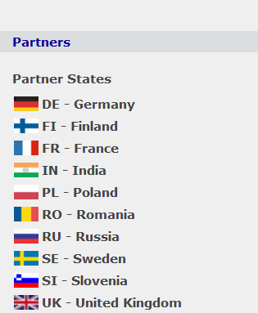

GSI Facts
Employees of GSI and FAIR: 1,400 employees
Scientific users of the FAIR facility: 3000 researchers from about 50 countries
Total cost of FAIR: likely to exceed 3000 M€

Slide 14
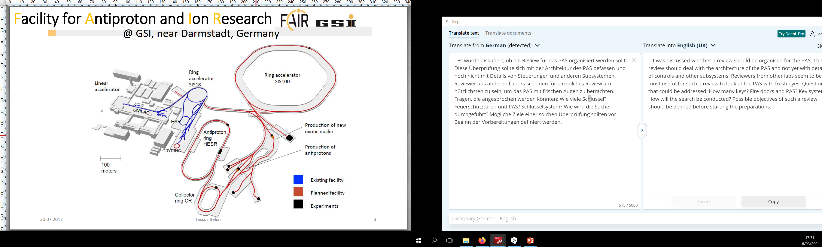
Layout
UNILAC Linear accelerator ions & p
SIS18 Synchroton accelerating ions & p

Slide 15
Layout
pLinac for protons
SIS 100
Synchroton for p & ions
HEBT - Beam Transport
HESR – High Energy Storage Ring
SFRS –Super Fragment Separator
CR – cooler ring for p & ions

Slide 16
FAIR accelerator complex
UNILAC – Linear accelerator for ions and protons
SIS 18 - Synchrotron accelerating protons and ions
P-LINAC - Linear accelerator for protons
SIS 100 – Synchrotron accelerating protons and ions
SuperFRS –Super Fragment Separator
CR – cooler ring
HESR – High Energy Storage Ring
HEBT - High Energy Beam Transport

Slide 17
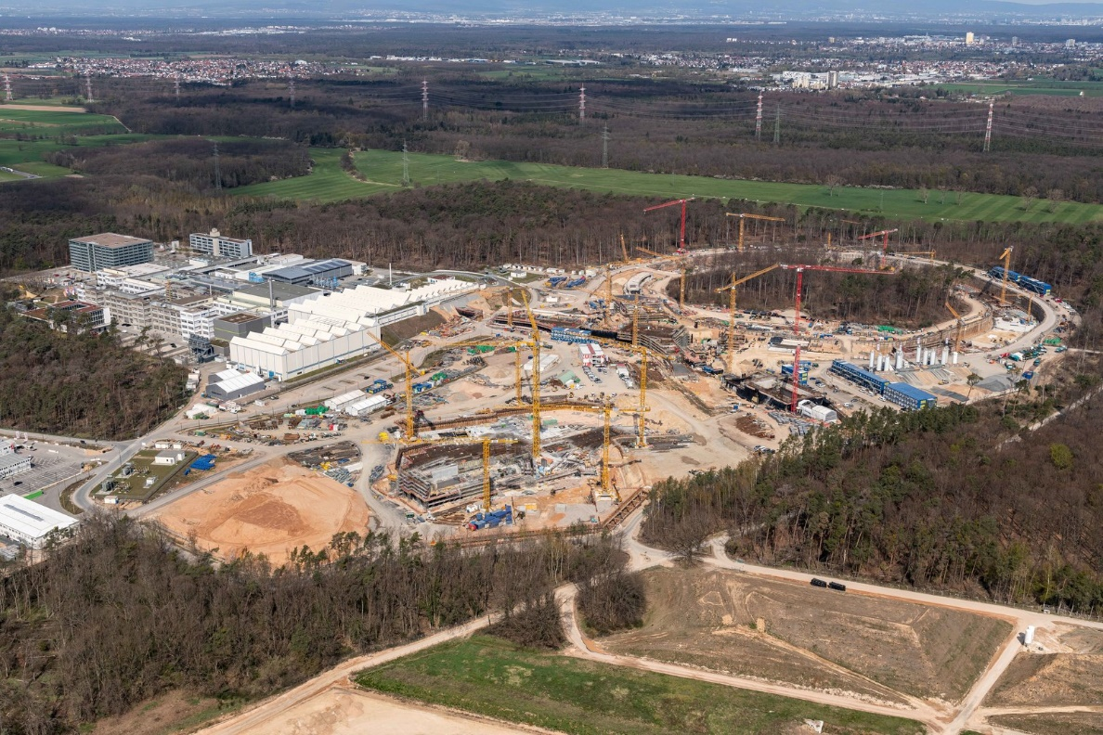
FAIR construction site - Darmstadt

Slide 18
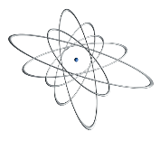
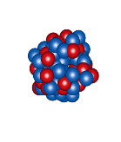
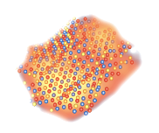

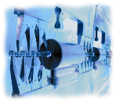
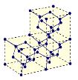
Main Physics Programme for FAIR
Nuclear Physics & Physics with Hadrons
Nuclear Reaction from lowest to highest Energies
Super-heavy Elements
Compressed Baryonic Matter
Anti-matter Research
new: PANDA (QCD)
Atomic Physics
Atomic Interactions
Precision Spectroscopy of highly charged Ions
Bio-Physics and Bio-Medical Applications
Plasma Physics
Radiobiological effects of ions
Cancer therapy with ion-beams
Hot dense Plasmas
Ion-Plasma Interactions
Material Science
Ion-Condensed-Matter Interactions
Nano-structures using ion-beams
Accelerator Technology
Linear accelerators
Synchrotrons and Storage Rings

Slide 19
FAIR experiments
NUSTAR: 2 x 10¹¹/pulse U²⁸⁺ @ 400-1500 MeV/u
bunch compression to 70 ns
highest gain factors for exotic nuclear beams
CBM: Heavy-ion beam intensities of 10¹⁰ particles/s
@ 11 (34@SIS300) GeV/u for U⁹²⁺
PANDA: pbar in wide momentum range (1.5 - 15 GeV/c)
High luminosity and high momentum resolution
FLAIR: Cooled antiprotons in the 20 keV range
SPARC: Cooled and high brilliance beams of rare isotopes
Plasma Physics: High intensity beams, bunch compression to 70 ns

Slide 20
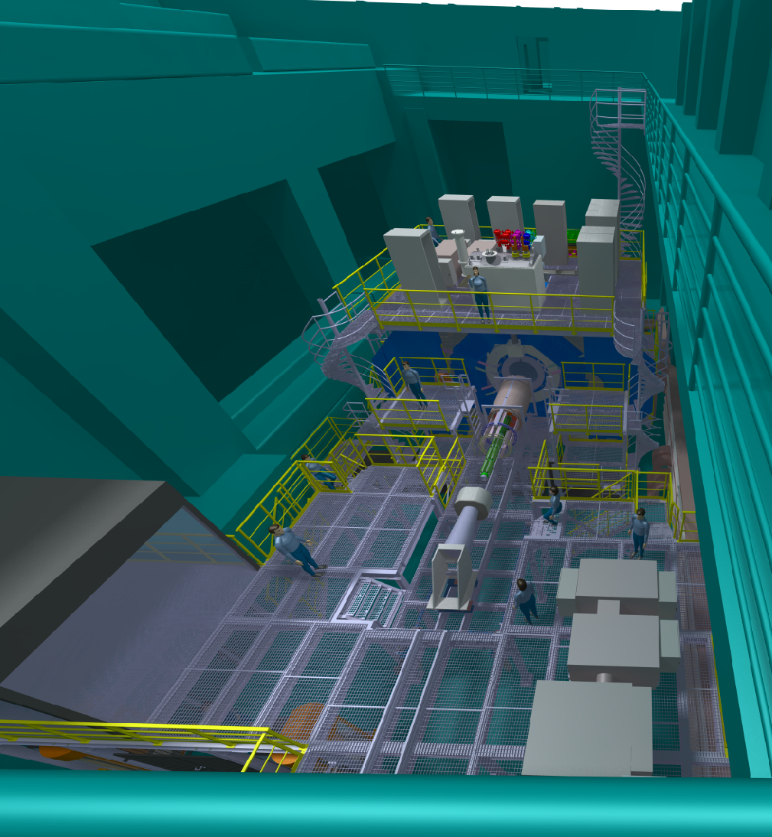
PANDA

Slide 21
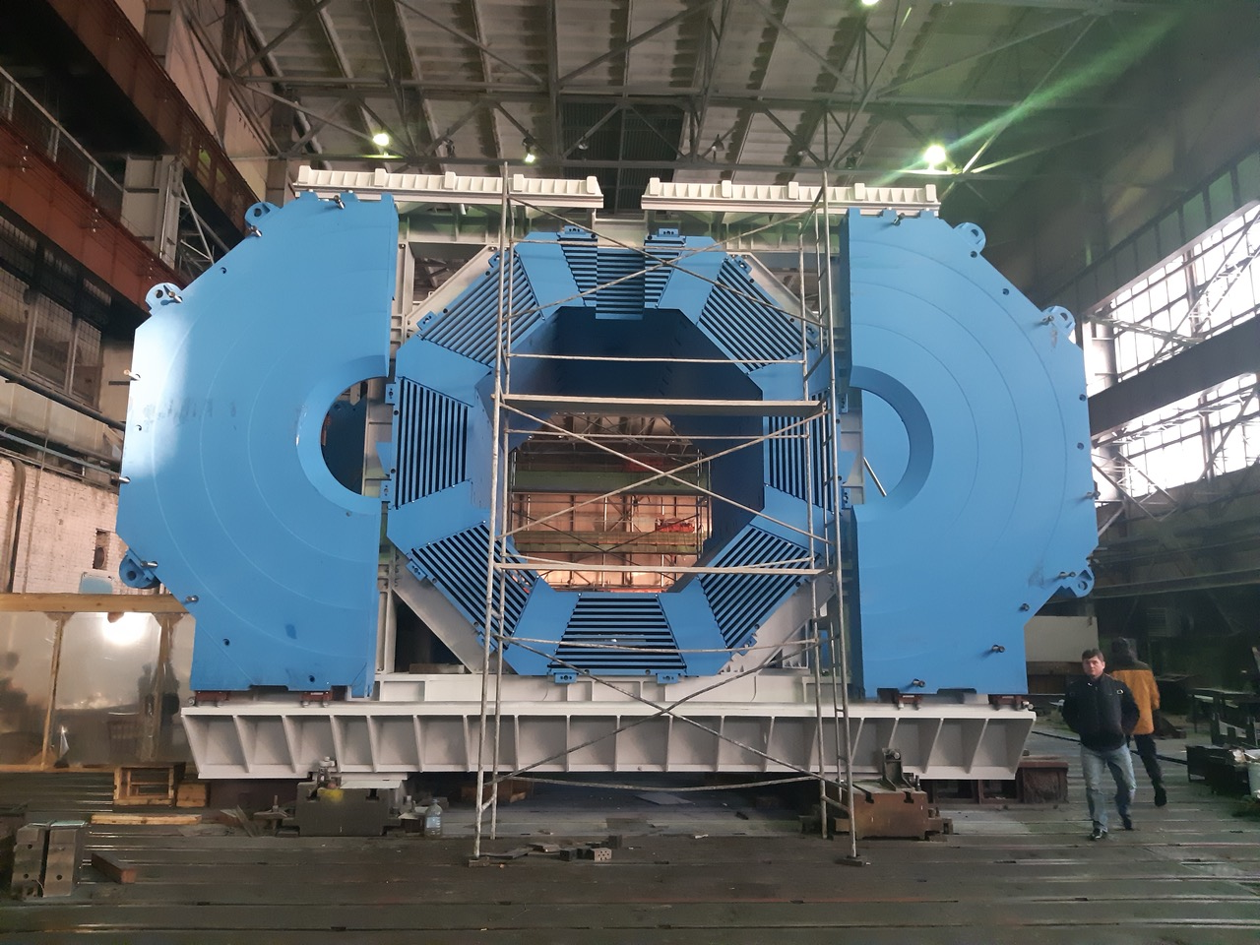
Magnet for PANDA

Slide 22
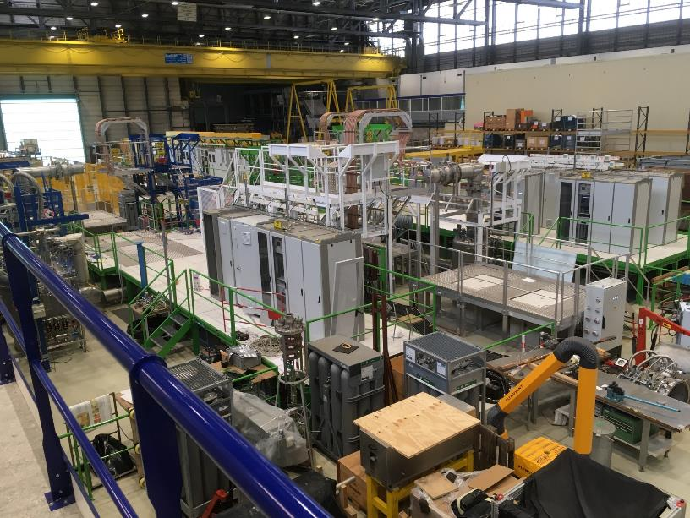
Test station for SFRS magnets at CERN
First magnet arrived in 2020
Test program expected to take about 5 years

Slide 23
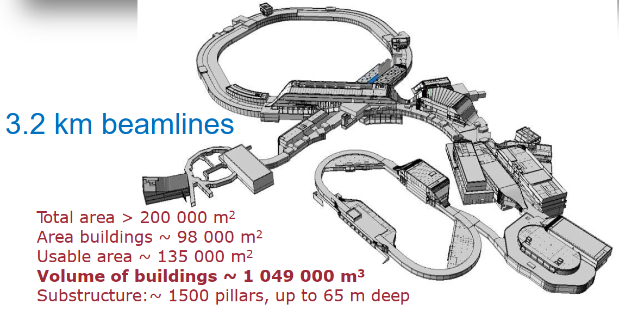

Slide 24
Plasma physics
HHADES & CBM
Atomic physics
HADES & CBM
PANDA
High energy experiments
Low energy experiments

Slide 25
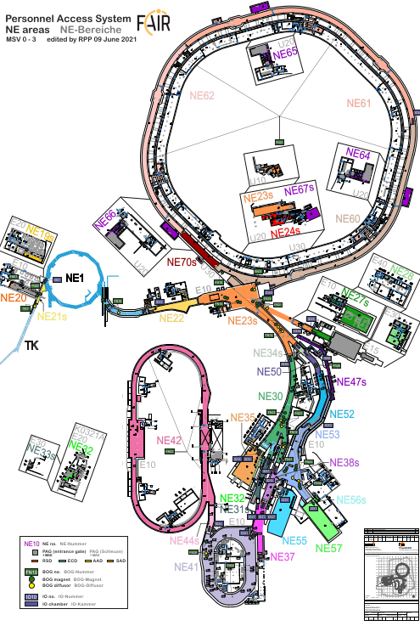
NE areas at FAIR (independent access to each NE area)

Slide 26
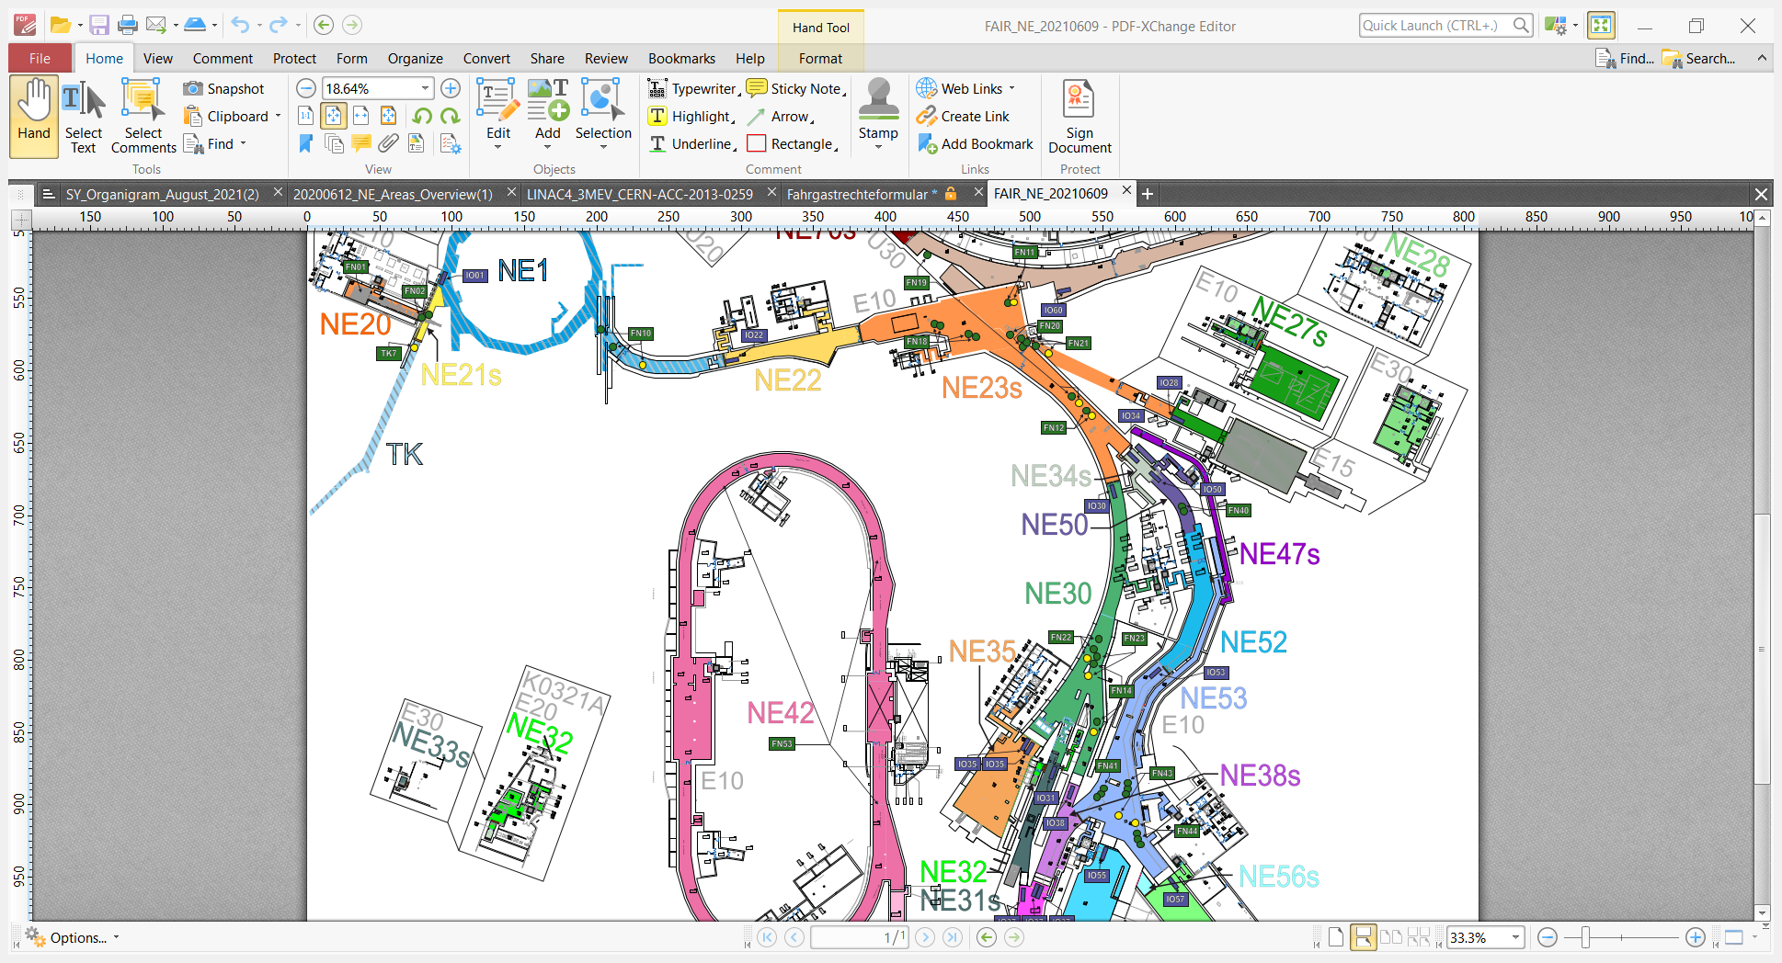
NE areas at FAIR
zoom

Slide 27

deflecting magnets
Beam travels to NE35,
but a repair is required in NE35

Slide 28

Beam is sent to NE38s,
and must not travel to NE35
Switch of safely deflecting magnets = BOG (Beam Off Group)

Slide 29
PAS challenges – NE areas and Beam-Off-Groups
FAIR is very complex with many NE areas (potentially radiation from particle beams)
Beam can be send to many different experiments or targets
It should be possible to send beam to one area of the FAIR while accessing other areas
For each NE area, one or more Beam-Off-Groups make sure that beam cannot reach this area
Before beam is send to an NE area, it must be made sure that nobody is inside the area !
In case this condition is violated, the beam to this area must be stopped
Before persons enter a NE area, experts are verifying the there is not harmful residual radiation in this area (..activation from particle beam)

Slide 30
Remarks
FAIR is one of the largest research projects worldwide, an extremely interesting and challenging accelerator project
The GSI faces quite big challenges in building FAIR
Apart from FAIR construction, the existing accelerators need substantial upgrade / replacements
CERN contributes in several areas, controls, magnet testing, electromagnetic-calculations, magnet protection, access system, ...
https://www.youtube.com/watch?v=cjmUyp0My38 April 2021

Slide 31
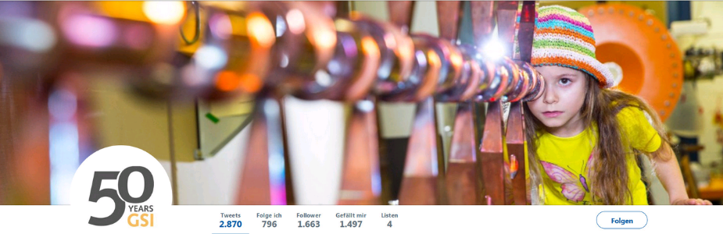
That it is, folks

Slide 32
PhD theses at CERN related to protection and availability
CERN-THESIS-2015-023
Machine Protection: Availability for Particle Accelerators
Apollonio, Andrea (TU Vienna ; CERN)
http://cds.cern.ch/record/2002820?ln=en
CERN-THESIS-2010-215
LHC Machine Protection System: Method for Balancing Machine Safety and Beam Availability
Wagner, Sigrid (Zurich, ETH)
http://cds.cern.ch/record/1349317?ln=en
CERN-THESIS-2006-012
Reliability of the Beam Loss Monitors System for the Large Hadron Collider at CERN
Guaglio, G (CERN ; Clermont-Ferrand U.)
http://cds.cern.ch/record/939785?ln=en
CERN-THESIS-2020-362
Dependable System Development Methodology and Case Study for the LHC Beam Loss Monitoring System at CERN
Schramm, Volker (CERN), Stuttgart, GER : Berichte aus dem Institut für Maschinenelemente
http://cds.cern.ch/record/2779400?ln=en
Availability of particle accelerators : requirements, prediction methods and optimization
Rey Orozco, Odei, 2020
Stuttgart : Institut für Maschinenelemente
https://elib.uni-stuttgart.de/handle/11682/11591

