Slide 1
$ψ(3686)$decays with a $K_{S}$ final state
Yitong Guo
(On behalf of the BESIII Collaboration)
Nankai University, Tianjin, China
The 15th International Workshop on Heavy Quarkonium
Sept 26 - 30 2022, Darmstadt, Germany

Slide 2
Outline
01
Introduction
02
BF of $ψ(3686)→K_{S}^{0}+anything$
03
BF of $ψ(3686)→ωK_{S}^{0}K_{S}^{0}$
04
Summary

Slide 3
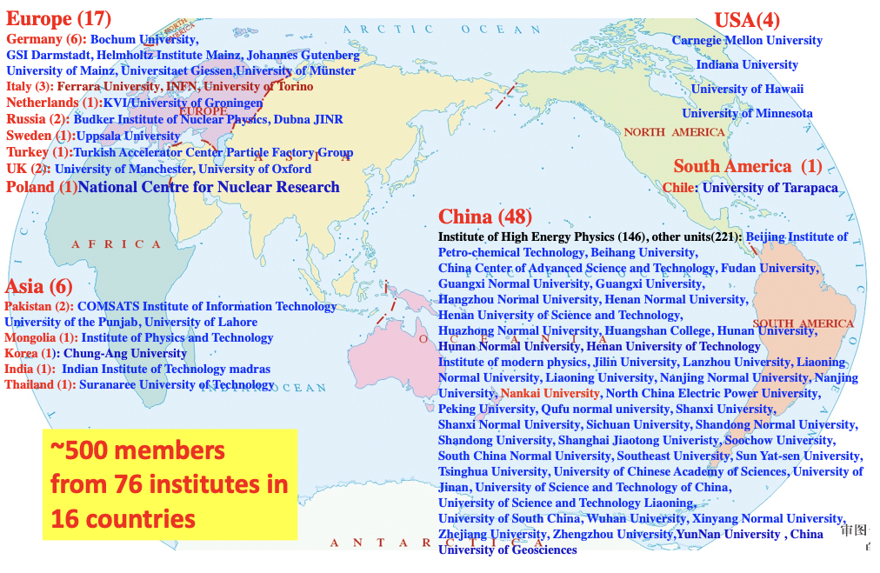
01 Introduction: BESIII Collaboration

Slide 4
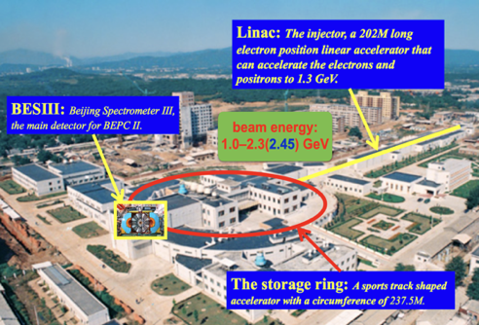
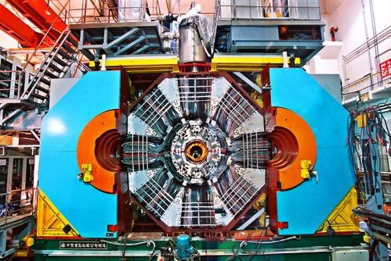
01 Introduction: BESIII experiment
BEPCII is an $e^{+}e^{−}$ collider operating at τ-charm energy region
First collision in 2008, physics program started in 2009
BEPCII reached designed luminosity of $1×{10}^{33} cm^{−2}s^{−1}$@1.89 GeV in April 2016
Suitable for precision measurement: high luminosity, low background, large statistics, hermetic detector with good performance

Slide 5
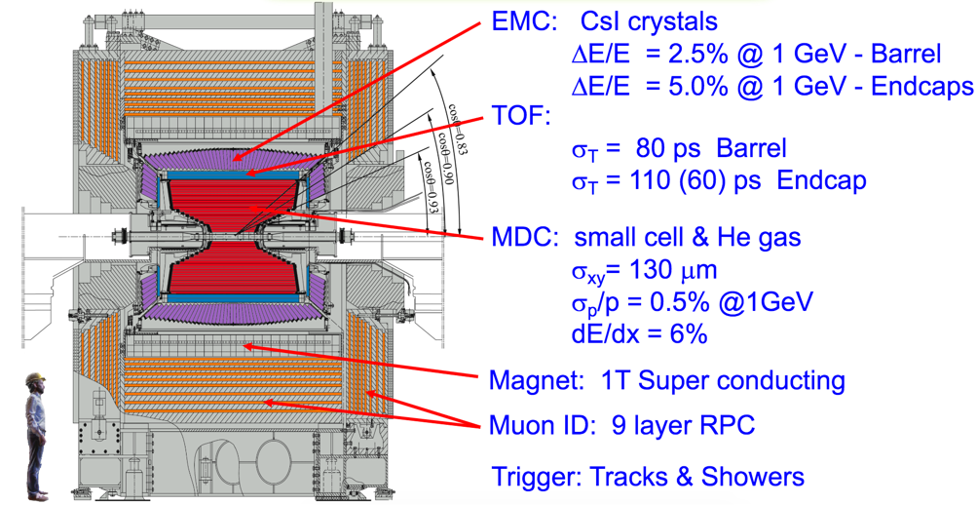
01 Introduction: BESIII Detector
NIMA614(2010)345

Slide 6
01 Introduction: Data Sample
 | Data Sample | Comparison
ψ(3686) | 2.7 B (448 M) | 120 (20) CLEO-c
Scan data | 5.9 /pb (22 points between 3.645 and 3.701 GeV) | Unique
World largest charmonium data sets directly produced from $e^{+}e^{−}$ collision on ψ(3686) resonance, fine scan data sets taken at center-of-mass energies 3.645 to 3.701 GeV

Slide 7
02 BF of $ψ(3686)→K_{S}^{0}+anything$
PLB 820,136576(2021)
Unsaturation of $ψ(3686)$ decay：although been studied for more than 40 years, the sum of its BFs is only ~90%, many missing decays.
Explore new decay channels: inclusive BFs contains transitions, radiative decays and hadronic decays, can guide the search for new exclusive decays, not only for $ψ(3686)$ but also for $J/ψ$, $χ_{cJ}$.
Test QCD calculations: more established BFs can help to better understand strong interaction in the low energy region.
$K_{S}^{0}$ inclusive production: provide some information about strange quark production at $ψ(3686)$ energy region.

Slide 8
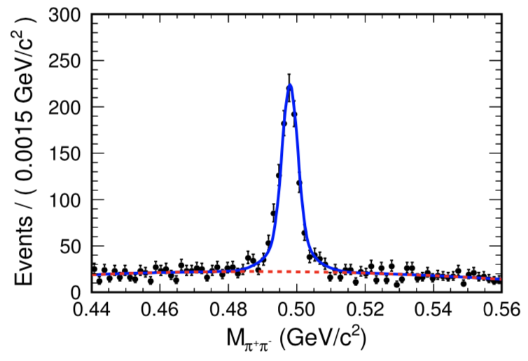
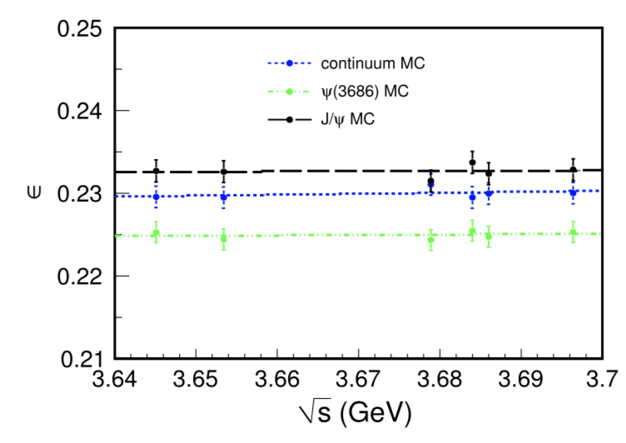
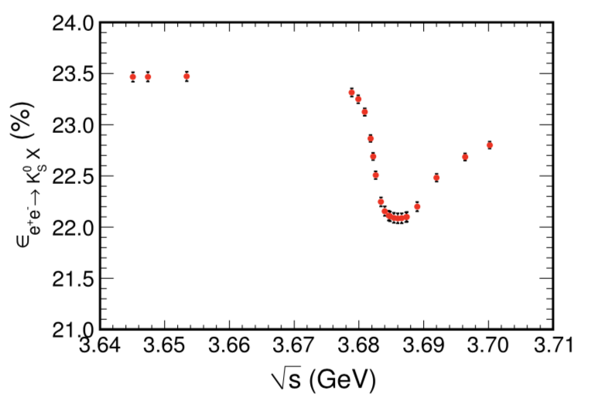
02 BF of $ψ(3686)→K_{S}^{0}+anything$
5.9 $pb^{−1}$ energy scan data sets between 3.645 and 3.701 GeV.
Signal Shape: Double Gaussian
Bkg shape: 2nd order Chebychev
$$N^{obs}=961.3±36.8$$
$$σ_{e^{+}e^{−}→K_{S}^{0}X}^{obs}=\frac{N^{obs}−N^{bkg}}{L×ε^{e^{+}e^{−}→K_{S}^{0}X}}$$
$$N^{bkg}=L×η^{ψ\left(3686\right)→K_{L}^{0}Y}×σ^{ψ\left(3686\right)→K_{L}^{0}Y}$$
$$ε^{e^{+}e^{−}→K_{S}^{0}X}=\frac{{ε^{ψ(3686)}⋅σ}^{ψ\left(3686\right)}+{ε^{J/ψ}⋅σ}^{J/ψ}+ε^{con}⋅σ^{con}}{σ^{ψ\left(3686\right)}+σ^{J/ψ}+σ^{con}}$$

Slide 9
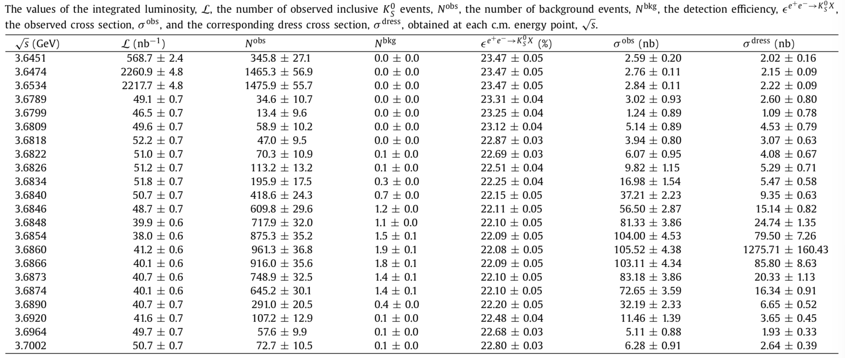
02 BF of $ψ(3686)→K_{S}^{0}+anything$
$$σ_{e^{+}e^{−}→K_{S}^{0}X}^{obs}=σ_{K_{S}^{0}X}^{ψ\left(3686\right)}+σ_{K_{S}^{0}X}^{J/ψ}+σ_{K_{S}^{0}X}^{con}$$
$$σ^{Dress}\left(s\right)=\frac{12πΓ^{tot}Γ^{ee}B(ψ→f)}{{\left(s−M^{2}\right)}^{2}+{\left(Γ^{tot}M\right)}^{2}}$$
$$σ^{obs}\left(s\right)=\int_{0}^{∞}{ds^{′}G(s,s′)}\int_{0}^{1}{dx⋅σ^{Dress}\left(s\left(1−x\right)\right)F(x,s)}$$
Fit to $σ_{e^{+}e^{−}→K_{S}^{0}X}^{obs}$ as a function of c.m. energy, together with $ψ\left(3686\right), J/ψ$ and con. contributions.

Slide 10
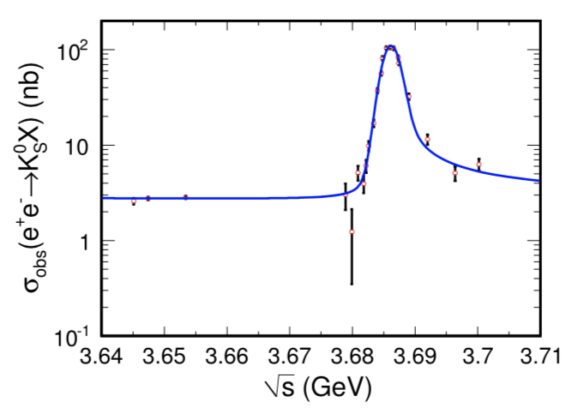
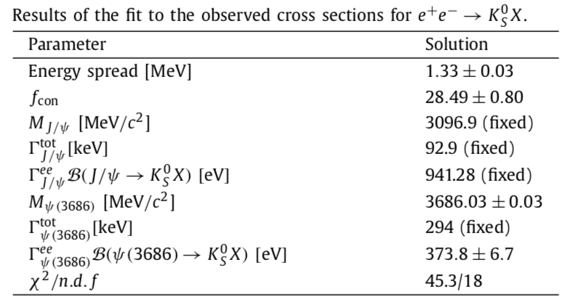
02 BF of $ψ(3686)→K_{S}^{0}+anything$
$B(ψ\left(3686\right)→K_{S}^{0} + anything) = (16.04±0.29±0.90)\%$ is measured for the first time.
Sum of all BFs of $ψ\left(3686\right)$ decays to exclusive $K_{S}^{0}$ final states including transitions followed by $J/ψ$ and $χ_{cJ}$ decays is ~5.95%.
The BESIII result suggests many undiscovered exclusive channels.

Slide 11
03 BF of $ψ(3686)→ωK_{S}^{0}K_{S}^{0}$
PRD 104,092003(2021)
12% rule：predicted by pQCD, discrepancies are observed in many decays, and various mechanisms have been introduced, however, no single mode can explain all violations.
Result from $ψ\left(3686\right)→ωK^{+}K^{−}$ is $\left(18.4±3.7\right)\%$, no significant violation. Result from $ψ\left(3686\right)→ωK_{S}^{0}S_{S}^{0}$ is needed.
Isospin symmetry: $B_{ψ\left(3686\right)→ωK^{0}K^{0}}$ = $B_{ψ\left(3686\right)→ωK^{+}K^{−}}$, then $B_{ψ\left(3686\right)→ωK_{S}^{0}K_{S}^{0}}$ is expected to be 2.

Slide 12
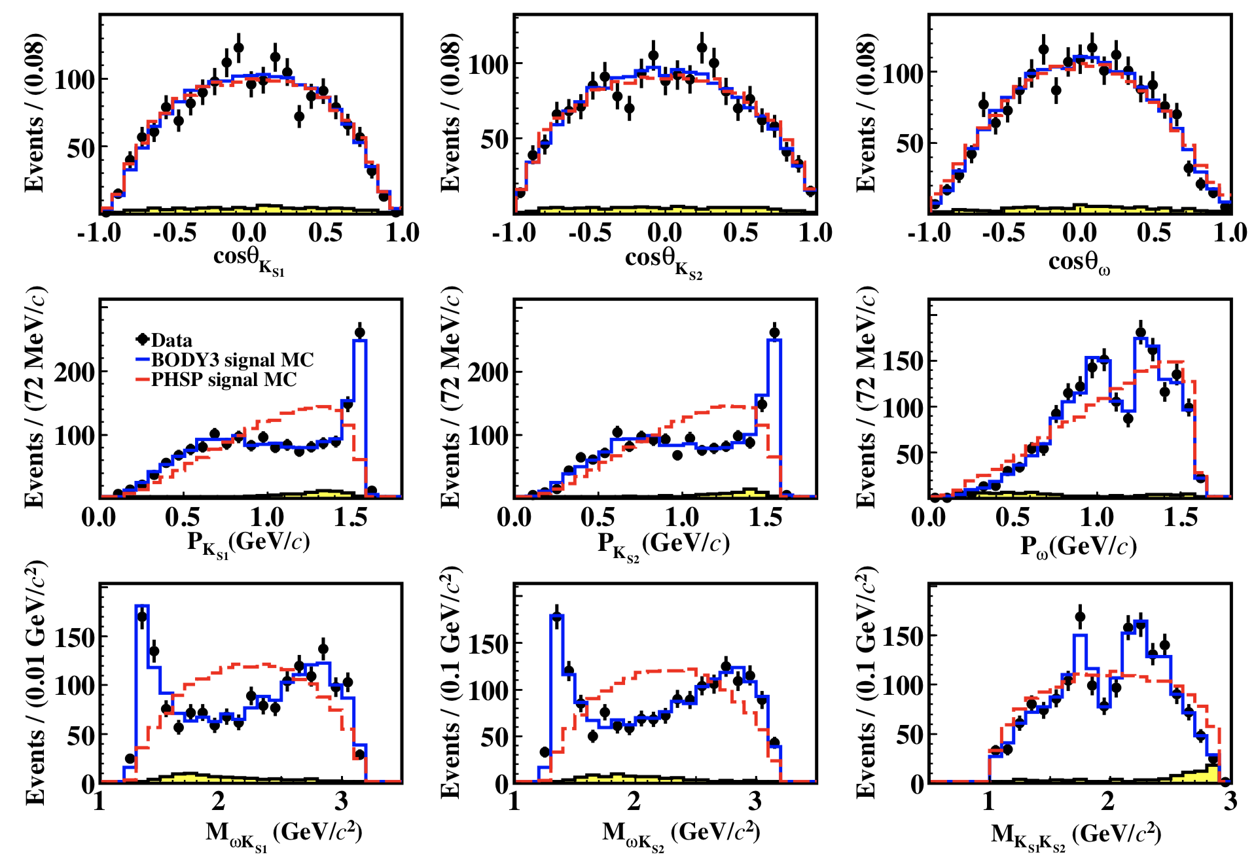
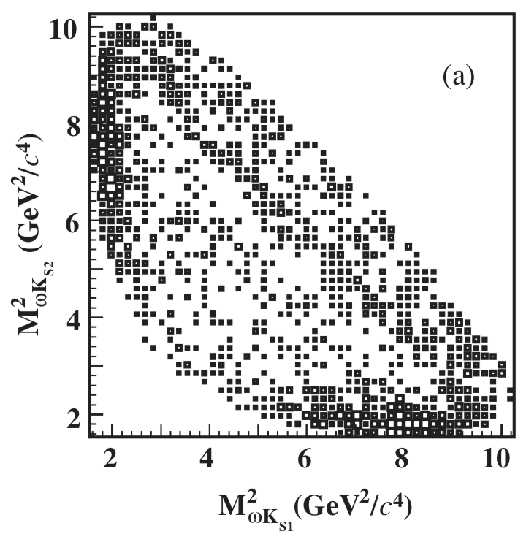
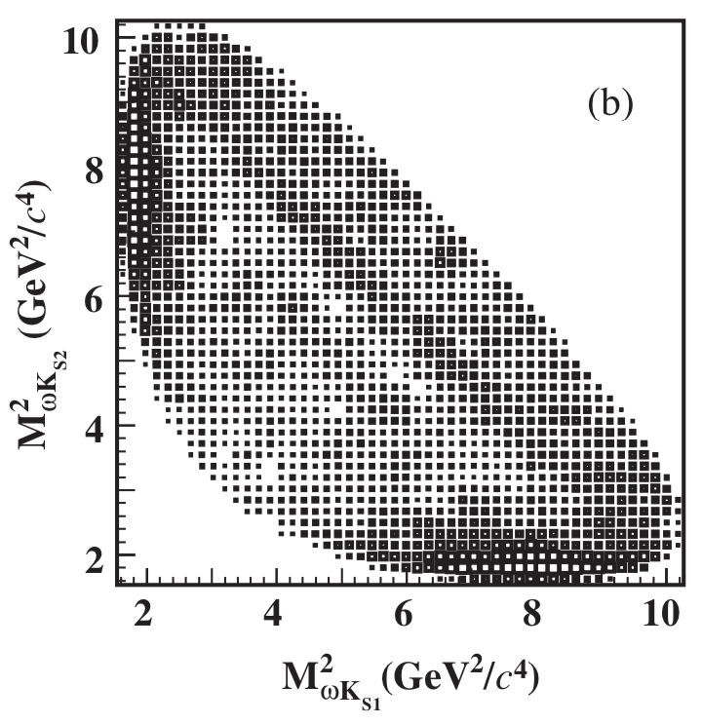
03 BF of $ψ(3686)→ωK_{S}^{0}K_{S}^{0}$
$\left(448.1±2.9\right)×{10}^{6}$ $ψ(3686)$ events accumulated at $\sqrt{s}=3.686$ GeV.
Data
MC

Slide 13
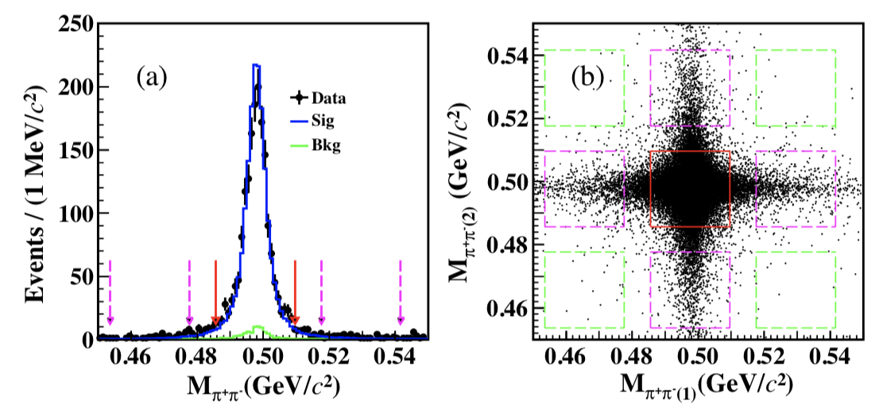
03 BF of $ψ(3686)→ωK_{S}^{0}K_{S}^{0}$
$$B_{ψ\left(3686\right)→ωK_{S}^{0}K_{S}^{0}}=\left(7.04±0.39±0.37\right)×{10}^{−5}$$
Data
$$Q_{ωK_{S}^{0}K_{S}^{0}}=\frac{B_{ψ\left(3686\right)→ωK_{S}^{0}K_{S}^{0}} }{B_{J/ψ→ωK_{S}^{0}K_{S}^{0}} }=\left(14.8±3.2\right)\%$$
$$\frac{B_{ψ\left(3686\right)→ωK^{+}K^{−}} }{{2⋅B}_{ψ\left(3686\right)→ωK_{S}^{0}K_{S}^{0}}}=1.11±0.07±0.07$$
Signal
region
Sideband-2
region
Sideband-1
region

Slide 14
04 Summary
With the fine energy scan data between 3.645 and 3.701 GeV, we obtain the branching fraction of $ψ\left(3686\right)→K_{S}^{0}+anything$ for the first time. Our result suggests that there are many undiscovered exclusive channels for $ψ\left(3686\right)$decay to final states containing $K_{S}^{0}$.
With the world largest $ψ(3686)$ sample including 448 million $ψ(3686)$ events, we present the first observation of $ψ\left(3686\right)→ωK_{S}^{0}K_{S}^{0}$. The results are consistent with isospin symmetry and 12% rule in charmonium decay.
New scan data sets and $ψ\left(3686\right)$data had been accumulated, more charmonium results can be expected.

Slide 15
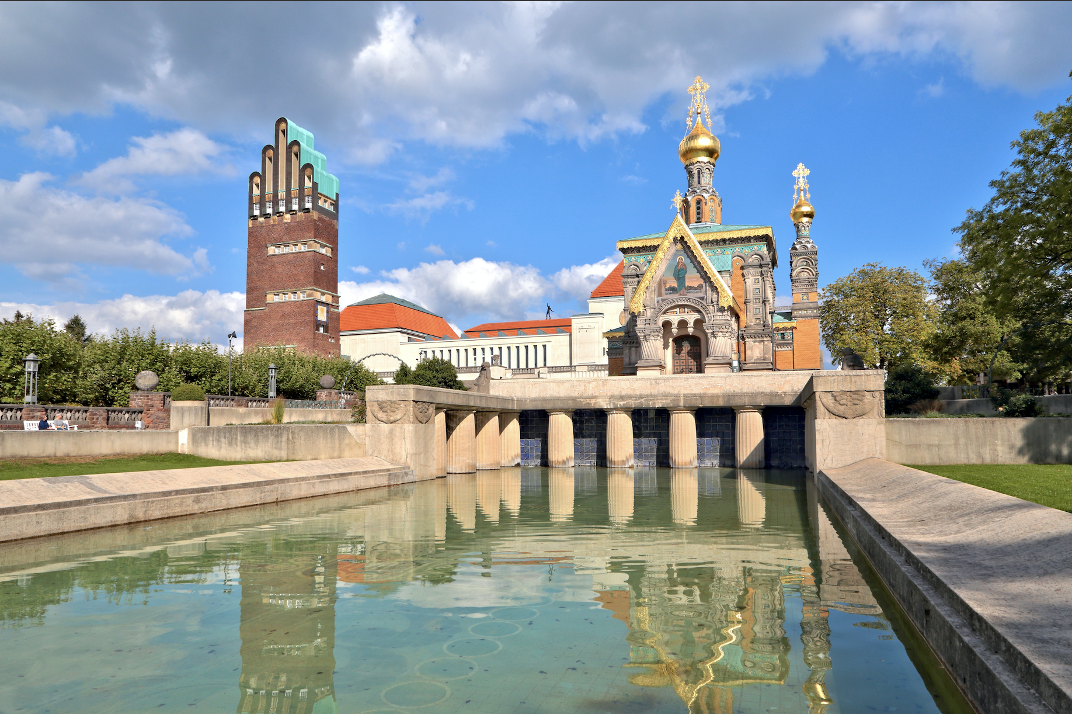
Danke!
谢谢！
THANKS

