Slide 1



Collectivity of Charmonia at the LHC
Ralf Rapp
Cyclotron Institute +
Dept of Phys & Astro
Texas A&M University
College Station, TX
USA
15th International Workshop on Heavy Quarkonium
GSI Darmstadt (Germany) / online, Sept. 26-30, 2022

Slide 2
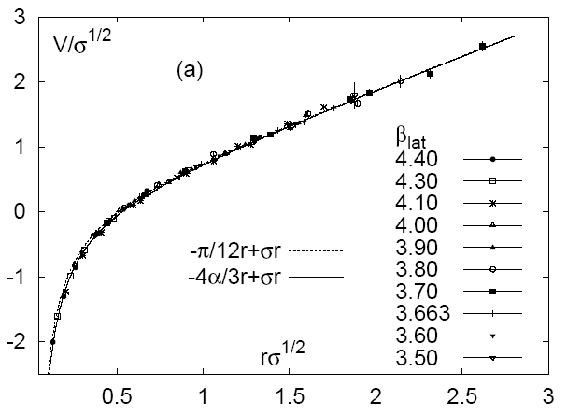
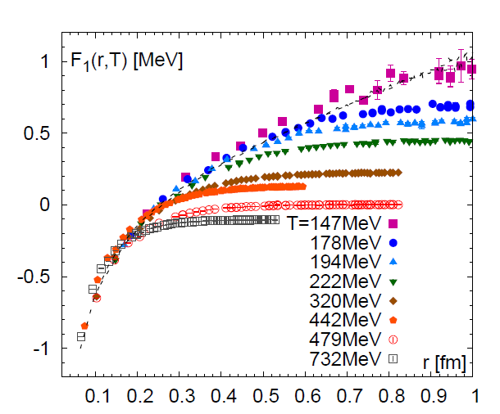
1.) Heavy Quarks: A “Calibrated” QCD Force
V [½ GeV]
[GeV]
r [½ fm]
[Bazavov et al ‘13]
Vacuum quarkonium spectroscopy well described
Confinement ↔ linear part of potential
Goal: find medium-modifications of QCD force
⇒ transport + spectral properties of heavy flavor
Exploit m_{Q} >> Λ_{QCD} , T_{c} , T_{RHIC,LHC}

Slide 3

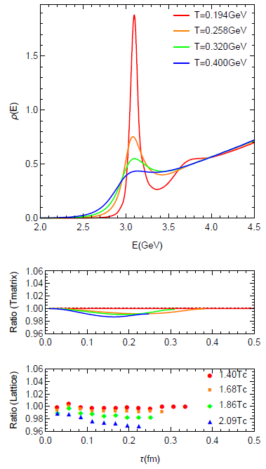
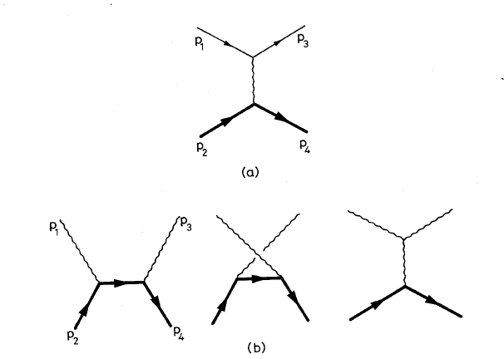
1.2 Quarkonia in Medium
Spectral Function
In-medium spectral functions:
- Mass / binding energy E_{B}(p,T)
- Inelastic reaction rate G(p,T;E_{B})
ϒ(1S): color-Coulomb force
J/y, ϒ(2S), …: confining force
Connection to open heavy-flavor transport
1⁻
J/y
vacuum
QGP
Q
−
Q

Slide 4
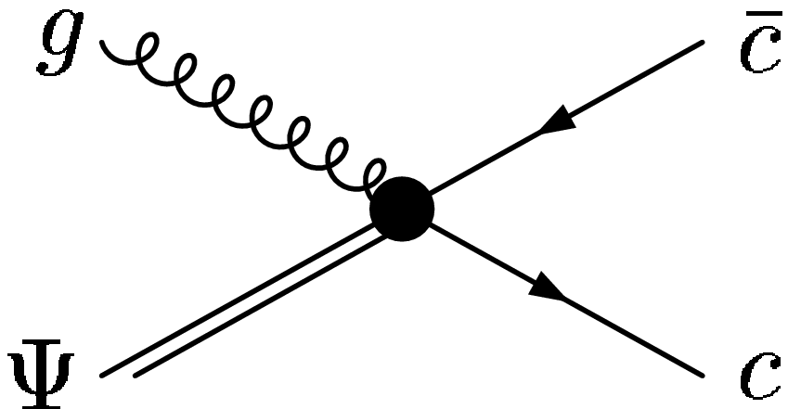
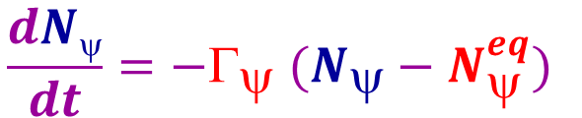
2.) Quarkonia Transport in Heavy-Ion Collisions
[PBM+Stachel ’00, Thews et al ’01, Grandchamp+RR ‘01,
Gorenstein et al ’02, Ko et al ’02, Gossiaux et al ‘05,
Zhuang et al ’05, Ferreiro et al ‘11, Strickland et al ’11, …]
Semi-classical
Boltzmann eq. p^{μ} ∂_{μ}f^{ψ} = − Γ_{ψ} f^{ψ} + β
→ Rate eq.
⟩
D
-
J/ψ
D
$$\frac{dNψ}{dt}=−Γ_{ψ} (N_{ψ}−N_{ψ}^{eq})$$
-
c
c
J/ψ
Transport coefficients
- Equilibrium limit: N_{y}^{eq}(E_{B},T; N_{cc}) = g_{c}² n_{y}(m_{y},T) V_{FB}
depends on cc Xsec + (thermal) environment: s_{cc} ~ N_{cc} ~ g_{c} n_{c}(m_{c},T) V_{FB}
- Reaction rate: G_{y}[p,E_{B},T]
“Large” binding E_{B} ≥ T
“Small” binding E_{B} ≤ m_{D}
i i
gluo-dissociation (“singlet-to-octet”)
• “quasi-free”/ Landau damping

Slide 5
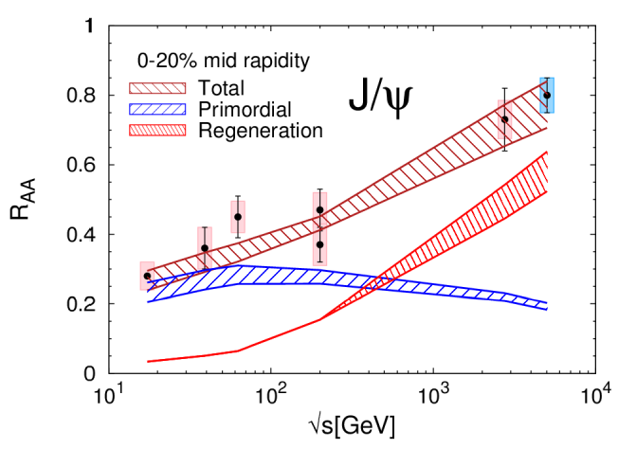
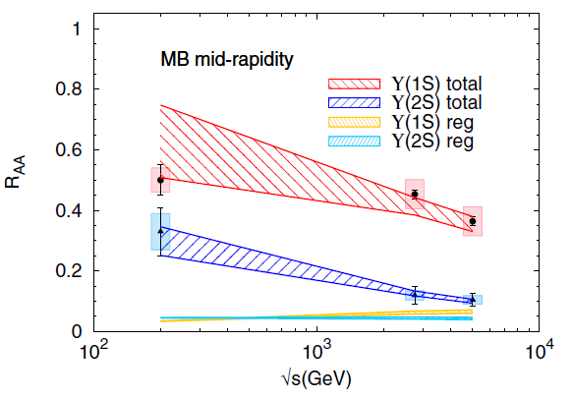
2.2 Excitation Functions in AA: SPS - RHIC - LHC
Charmonium Bottomonium
[Rapp+Du’17]
Gradual increase of total J/ψ R_{AA}
Regeneration and suppression increase
Gradual suppression
Regeneration (N_{ϒ}^{eq}) small
Data: NA50, PHENIX, STAR, ALICE, CMS

Slide 6
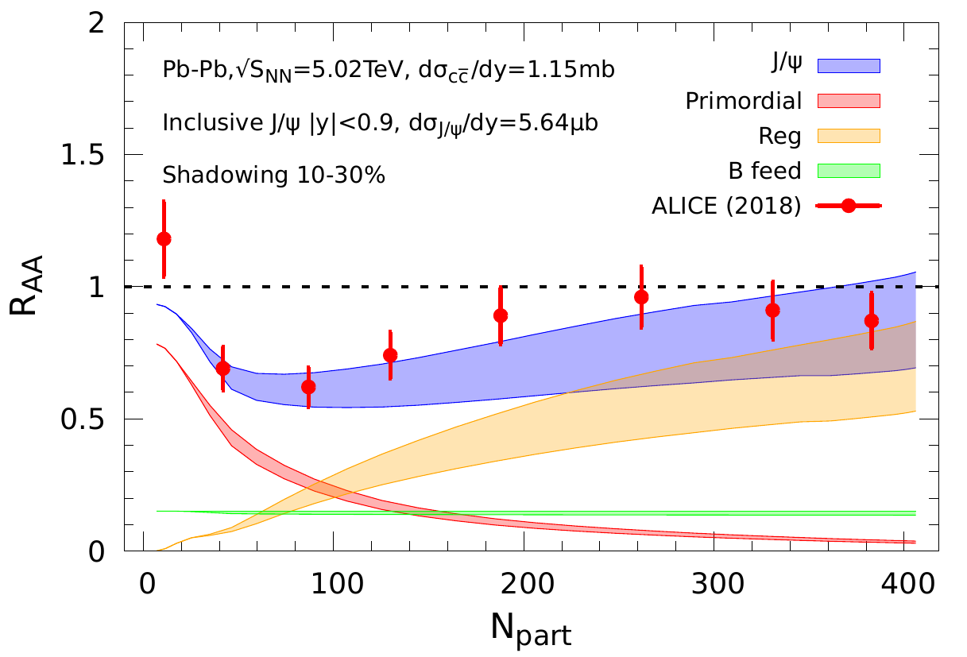
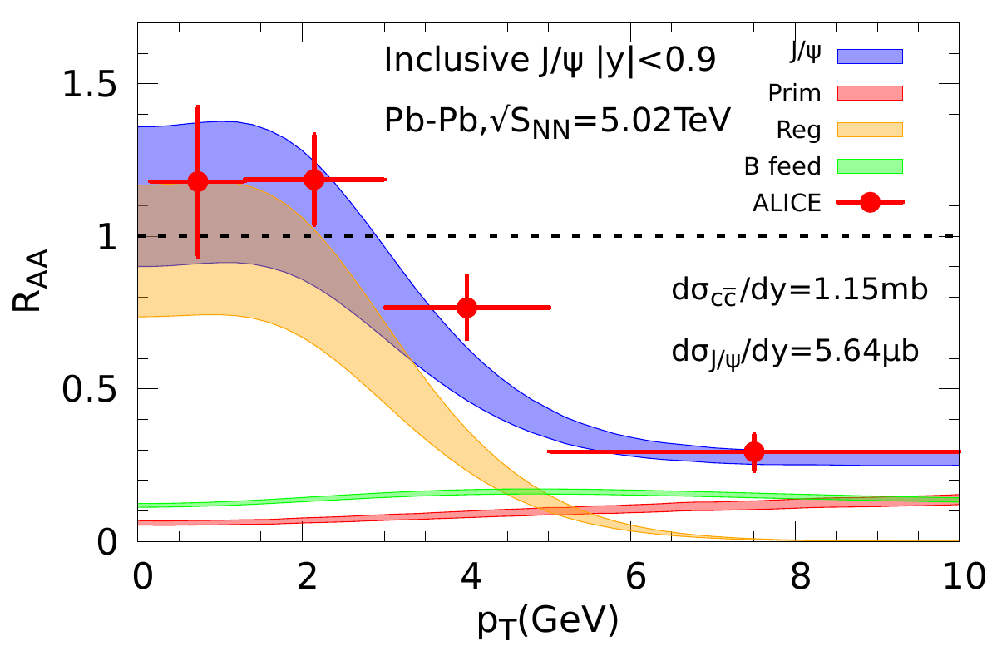
2.3 Differential Charmonia Transport: LHC
Centrality p_{T} Dependence
Mid-
Rapidity
Forward
Rapidity
substantial regeneration, concentrated at low p_{T}

Slide 7
2.4 J/ψ “Elliptic-Flow Puzzle”
Elliptic Flow Nuclear Modification Factor
Low-p_{T} v₂ well described (regeneration in blast wave approximation)
Problems at p_{T} ≥ 4 GeV (also in R_{AA}?!)

Slide 8
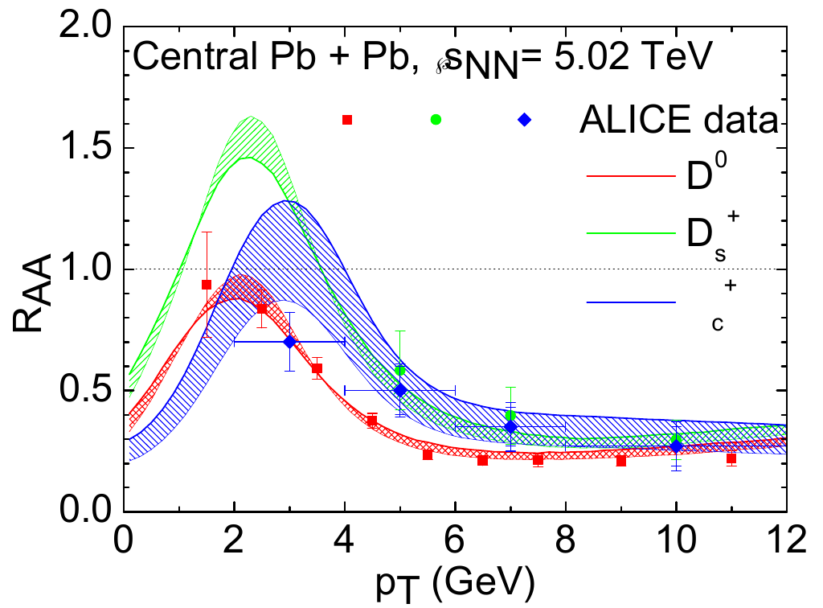
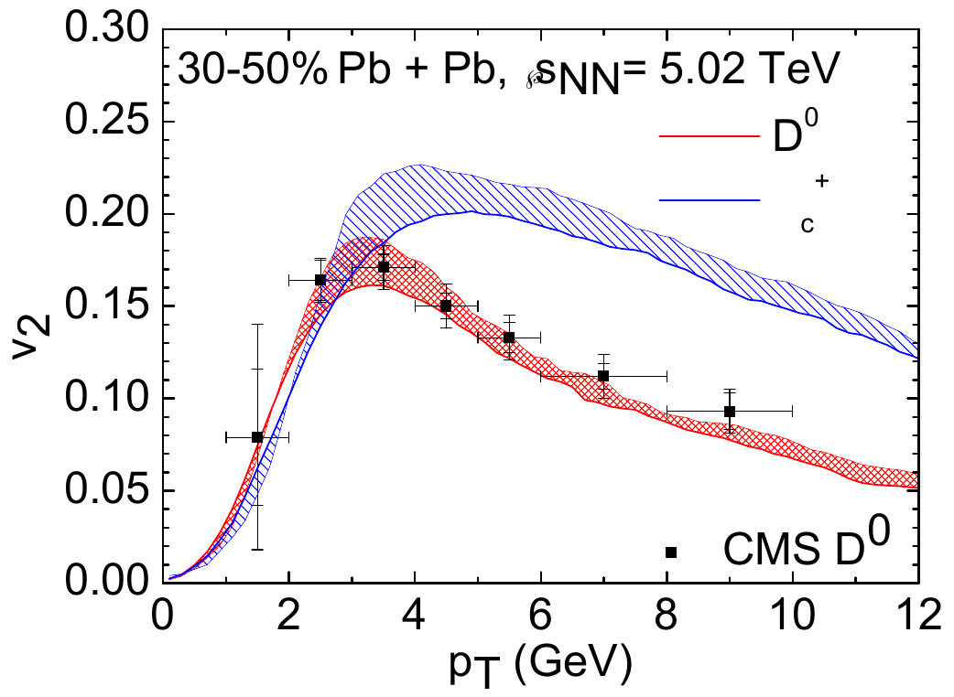
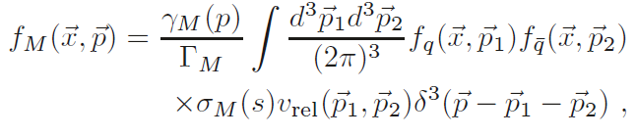
3.) Charmonium p_{T} Spectra Revisited
[He,Wu+RR ’22]
Main Idea: Use transported c-quark spectra from Langevin simulations
⇒ implement into Resonance Recombination Model
(derived from Boltzmann equation)
- σ_{Μ} (s) v_{rel} ~ |T_{QQ} |² : charmonium amplitude
- regeneration yield normalized to rate equation result
- include space-momentum correlation (SMCs)
Central Pb+Pb (√s_{NN} = 5 TeV)
30-50% Pb+Pb (√s_{NN} = 5 TeV)
[He+RR ’20]
Λ
Q
Λ
[Ravagli et al ‘07,
He et al ‘12]

Slide 9
3.2 Updated J/ψ v₂ and R_{AA}
Off-equilibrium c-quark spectra +
space-momentum correlations
recombination out to p_{T} ~ 8 GeV
much improved description of v₂

Slide 10
3.3 Coupled Quarkonia + Open-HF Transport
QGP
Boltzmann:
-
c
c
Gain term:
Simultaneous c-quark diffusion +
charmonium kinetics (same M²_{pQCD} * K)
J/y yield + spectral shape require K ≥ 5
Strong coupling for open + hidden HF
[Du+RR ’22]

Slide 11
4.) Summary
Coupling of open + hidden HF sectors provides new insights + strong constraints on QGP phenomenology
Large non-perturbative interaction strength in heavy-quark diffusion required to produce sufficient low-p_{T} J/ψ yields
Off-equilibrium effects in HQ diffusion instrumental to extend charmonium regeneration to p_{T} ~ 8 GeV + generate large v₂

Slide 12
3.2 Interplay of Transport Coefficients: Charmonia
Phenomenological constraints on G_{y} from d/p-A:
J/y suppressed in QGP, y(2S) in hadronic matter
Transport in AA:
J/y / y(2S) near equilibrium in
late QGP / hadronic phase
→ “Sequential Regeneration” [Du+RR ’15]

Slide 13
1.3 Heavy-Flavor Diffusion
Q
Brownian motion via elastic interactions
(radiation suppressed: q₀ ~ q²/2m_{Q} << q ~ T << m_{Q})
Thermalization delayed by m_{Q}/T ⇒ measure of interaction strength
Scattering rates: collisional width ↔ quantum effects
⇒ Implications for QGP structure
Non-perturbative interactions
Hadronization: c → D, D_{s}, Λ_{c}, … (m_{Q} >> T_{c})
QGP
Q

Slide 14

2.2 Transport Coefficients
Fokker-
Planck
Q
thermalization rate momentum diffusion coefficient
γ p = ∫ d³q w_{Q}(q,p) q
~ ∫ |T_{Qi}|² (1-cosθ) f ^{i}r_{i} r_{i}’
D_{p} = ∫ d³q w_{Q}(q,p) q²
Relaxation time τ_{Q} = 1/γ
Spatial diffusion constant: D_{s} = T / γ (p=0) m_{Q}
Quantum effects via thermal-parton spectral functions ρ_{i}(k₀,k)
Key ingredients: - heavy-light scattering amplitude T_{Qi}
- ambient medium properties

Slide 15
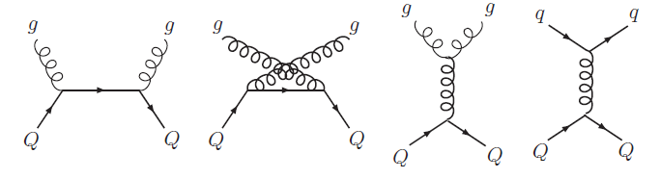
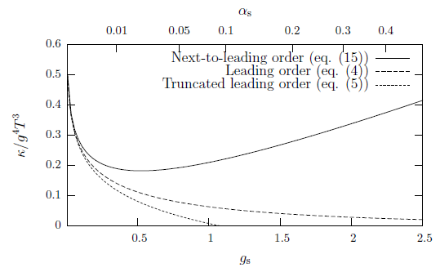
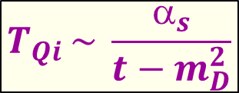
2.3.1 Heavy-Light Interaction: Perturbative QCD
Leading Order
screened 1-gluon exchange
$$T_{Qi }\sim \frac{α_{s}}{t−m_{D}^{2}}$$
[Svetitsky ’88, Mustafa et al ’98, Molnar et al ’04, AMPT,
Teaney+Moore’04, Torino, Catania, PHSD, BAMPS, LBT,…]
τ_{c} ≥ 20 fm/c (T≤ 300MeV, α_{s}=0.4)
pQCD*: running coupling with reduced Debye mass
[Nantes ‘08]
Next-to-Leading Order
bad convergence (even for α_{s} ~ 0.1)
uncontrolled result
γ m_{Q}/T²
[Caron-Huot+Moore ‘08]

Slide 16

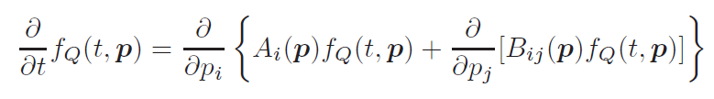
2.1 Transport Equations
Boltzmann equation for HQ phase-space distribution f_{Q}
Collision term: semiclassical simulation of medium + HQ quasiparticles
Fokker-Planck equation
follows from Boltzmann with p² ~ m_{Q} T >> q² ~ T² (ok for m_{Q}/T ≥ 5)
does not require quasi-particle medium
→ well suited for strongly coupled medium where E_{th} ≤ Γ_{q,Q} < m_{Q}

Slide 17
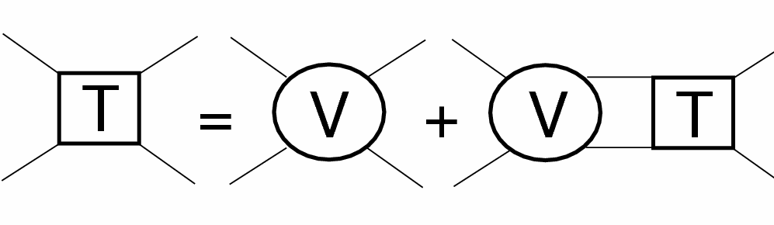
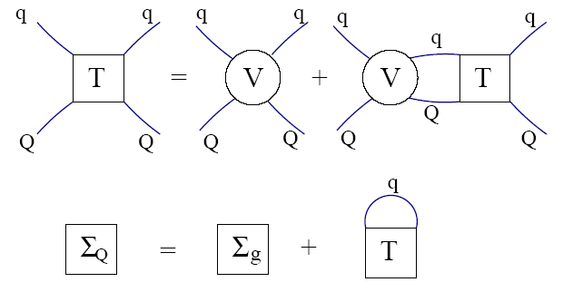
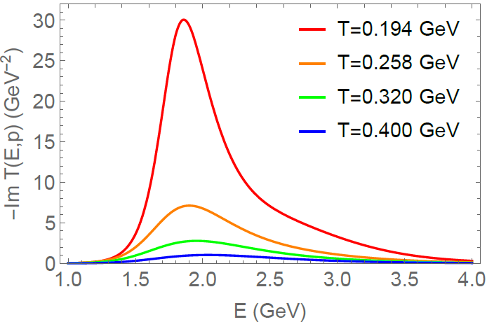
2.3.2 Heavy-Light Interactions: T-Matrix
Q
i=q,g
Σ
=
Strong coupling → resummation: T_{Qi} = V_{Qi} + ∫ V_{Qi} D_{Q} D_{i} T_{Qi}
Key input: in-med potential V_{Qi} ,
constrained by lattice QCD
→ “string” force above T_{c}
Non-perturbative effects:
- thermalization time τ_{c} ≈ 3-4 fm/c
- hadronization
[TAMU ’05-’18]

Slide 18
2.5 Charm-Hadron Spectra from pp to AA
“Flow bump” vs. yield enhancement:
control over equilibrium limit essential for interpretation

Slide 19
Outline
1.) Introduction
2.) Open Heavy-Flavor Transport
● Transport Equations + Heavy-Light Interaction
● Implications for Bulk Medium
3.) Quarkonia in Medium
● Production Models + Transport Coefficients
● Connection to Open Heavy Flavor
4.) Conclusions

Slide 20
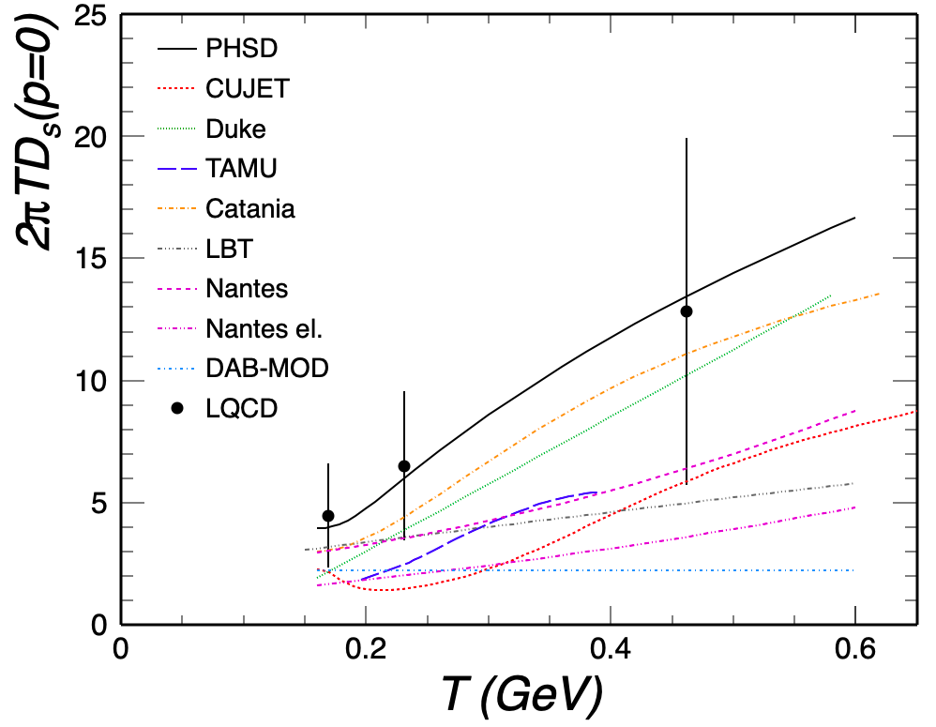
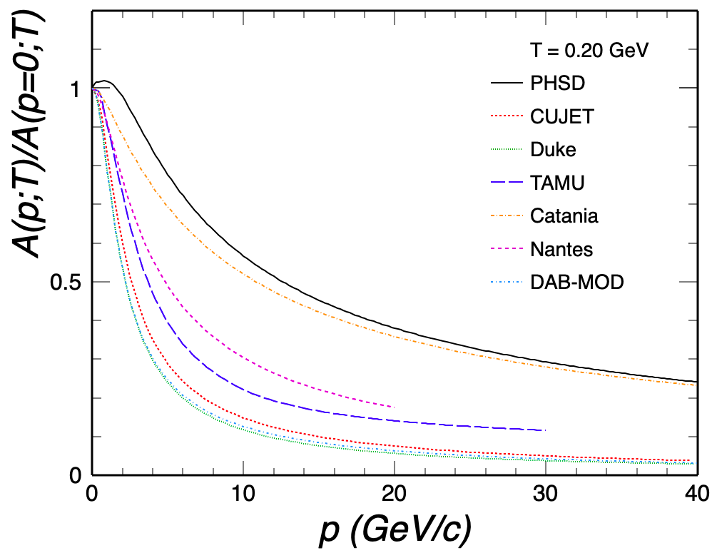
2.4 Momentum Dependence of Relaxation Rate
[ECT* HF workshop ’21 ]
correlation: large D_{s} ↔ weak p-dependence
need handle on momentum dependence

Slide 21
2.2 Many-Body Theory of Heavy Flavor in QGP
Microscopic Transport in Test in
Theory HI collisions Experiment
Lat-QCD HQ
free energy
HQ interactions
in QGP (D_{s})
Open HF
observables
Heavy-quark
potential
Quarkonium
reaction rate Γ_{Ψ},
equil. limit N_{Ψ}^{eq}
Quarkonium
observables
Quarkonium
binding E_{B}

Slide 22
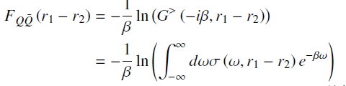

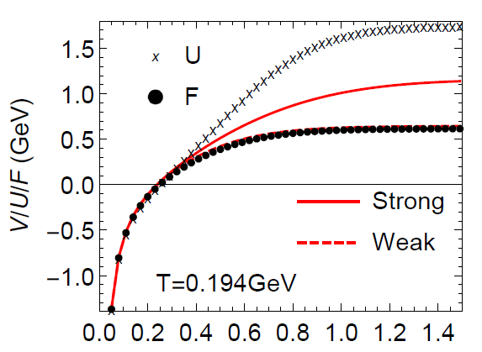
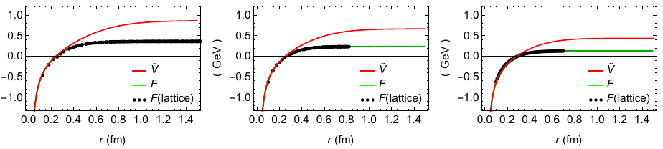
2.3 Thermodynamic T-Matrix Approach
T-matrix
equation
Q
Q
In-medium potential?
Free energy:
Spectral function:
⇒ infer in-medium potential
Large imaginary parts Σ_{I} ⇒ V > F
Remnants of confining force above T_{c}!
V
T=258 T=320 T=400
r [fm]
[TAMU ’05-’18]

Slide 23


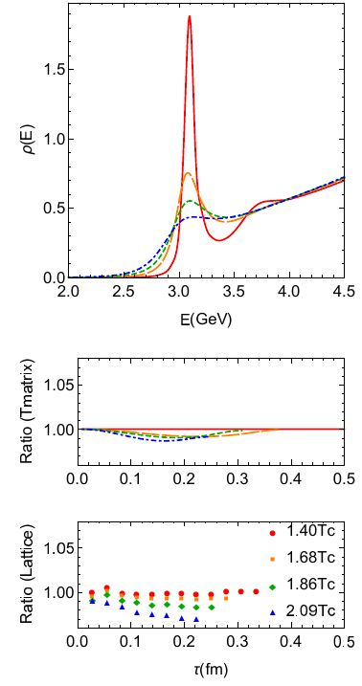
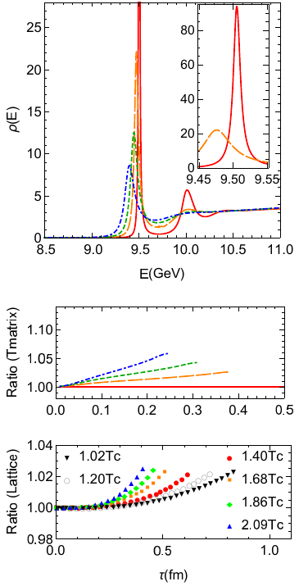
2.4 More lQCD Constraints: Euclidean Correlators
Charmonium Bottomonium
[Liu et al ’18]
[Aarts et al ’18]
J/y “melts” near T ~ 250-300 MeV
ϒ(1S) survives until T > 400 MeV

Slide 24
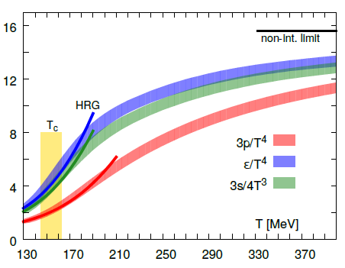
1.) QCD Matter and In-Medium Force
Equation of State Heavy-Quark Free Energy
μ_{Β} = 0
[GeV]
[Bazavov
et al ’13,’14]
- - -
Change in dofs above T ~ 170MeV
F_{QQ} = U_{QQ} – T S_{QQ}
Non-perturbative above T_{c}
Heavy-quark diffusion and quarkonia sensitive to long-range forces
in medium, probing non-perturbative QGP structure

Slide 25
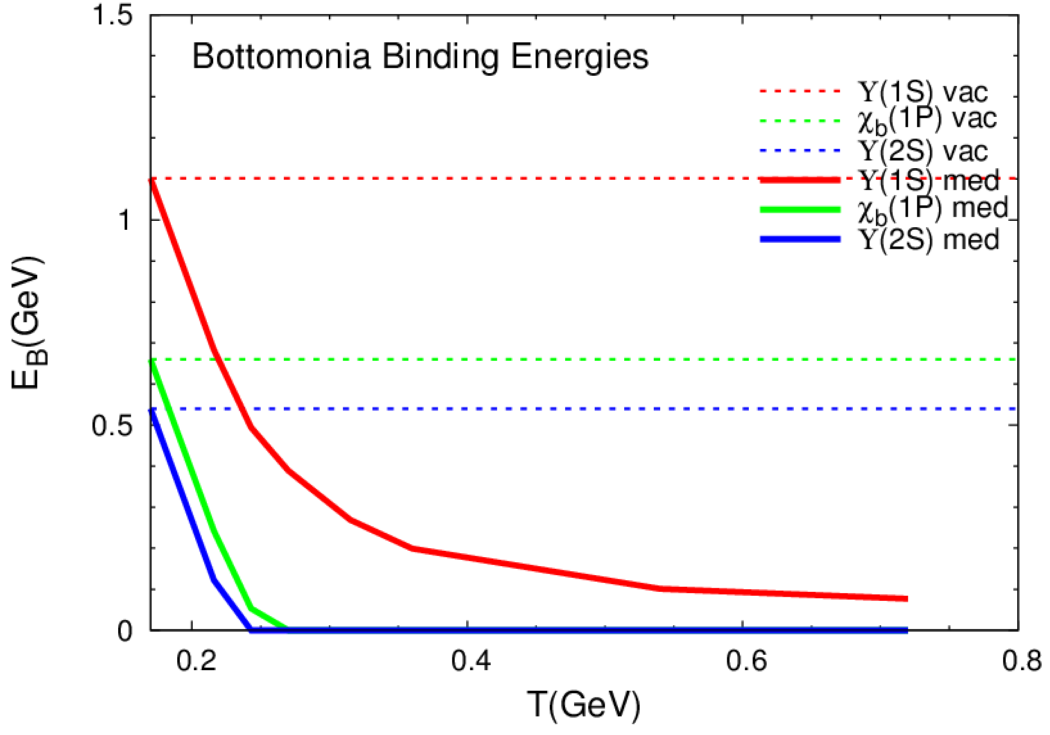
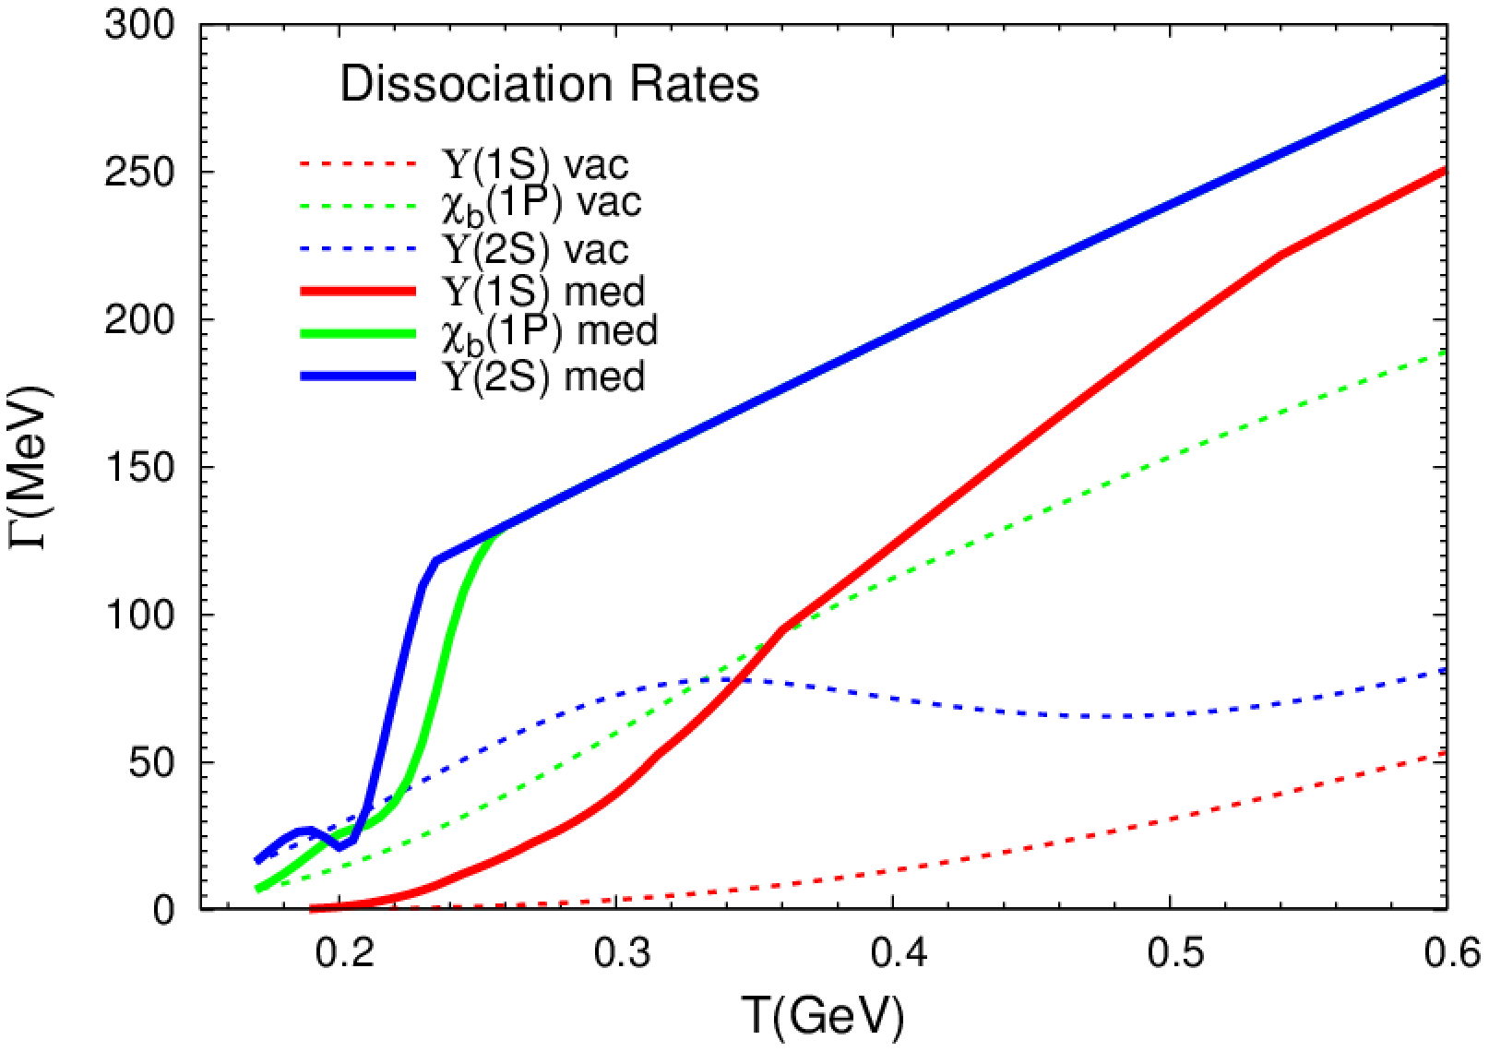
2.5 Binding Energies + Reaction Rates: Y States
1S
1P
2S
2S
1S
1P
1P
1S
2S
[Du et al ’18]
Reduced binding “accelerates” dissociation (opens phase space)
Dissociation rate depends on “medium” particle distribution

Slide 26
2.6 Quarkonium Formation Times
Pair production time t_{QQ} ≤ 0.1 fm/c
Bound-state formation time t_{form} ~ 1/E_{B} ~ 0.2 - 2 fm/c
Build-up of wave function
reduces dissociation rate
Relatively small effect in heavy-ion collisions
Microscopically: quantum evolution of wave package

Slide 27
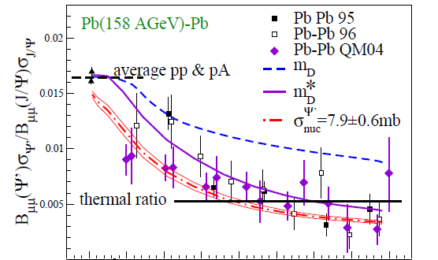
3.4 Charmonia at SPS Energy (√s=17 GeV)
J/ψ ψ′(3686)
[PBM+
Stachel ‘00]
0 100 200 300 400
N_{part}
Large contributions from initial
“nuclear absorption” at low √s
requires high-energy N-Ψ Xsec
ψ′ dissociation in hadronic matter
important in transport models
[Sorge et al ‘97, Grandchamp et al ‘03, .…]

Slide 28
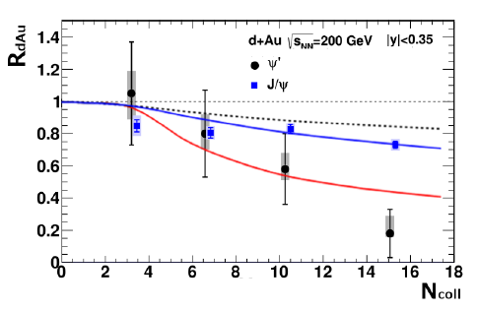
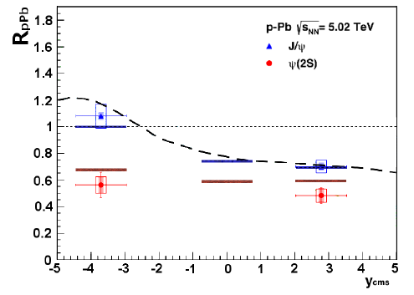
3.5 ψ(2S) in d/p-A Collisions
d-Au (0.2TeV) p-Pb (5.02TeV)
[PHENIX]
[ALICE]
- - EPS09
noticeable ψ′ and little J/ψ suppression, consistent with “comovers”
supports fireball formation with:
τ_{FB} Γ(ψ′) ~ 1 ⇒ Γ_{avg}(ψ′) ~ 50-100 MeV similar to thermal
τ_{FB} Γ(J/ψ) << 1 ⇒ Γ_{avg}(J/ψ) < 20 MeV widths at T≈ 200MeV
[Ferreiro ‘15]
[Du et al ‘15]

Slide 29
2.3 Upshot of Quarkonium Phenomenology
Use temperature estimates from hydro/photons/dileptons to infer:
T₀^{SPS} (~240) < T_{melt}(J/ψ,ϒ′) ≤ T₀^{RHIC} (~350) < T_{melt}(ϒ) ≤ T₀^{LHC} (~550)
Remnants of confining force survive at SPS [hold J/ψ together]
Confining force screened at RHIC+LHC [“melts” J/ψ + ϒ(2S)]
Color-Coulomb screening at LHC [ϒ(1S) suppression]
Thermalizing charm quarks recombine at LHC [large J/ψ yield]
1.5
1
0.5
0
-0.5
-1
350
240
550
ψ(2S)
J/ψ, ϒ(2S)
ϒ(1S)
r [fm]
0.25 0.5 0.75 1 1.25 1.5

Slide 30

2.4 Heavy-Quark Potential Extraction from ϒ Data
Ansatz for
in-med. potential
Parameterize T-dependence of m_{D}~ aT, 1/R_{SB} ~ m_{S}(T;b,g,d)
⇒ determine in-med. binding energies E_{Y}(m_{D},m_{S})
Compute G_{Y} [E_{Y}]
QGP
also requires HQ-medium coupling
perturbative: a_{s} ~ 0.3
non-perturbative: K ≥ 5
_
Q
Q
Deploy transport approach to fit (a,b,g,d; K) to ϒ data at RHIC + LHC
[Du,Liu+RR ‘19]

Slide 31
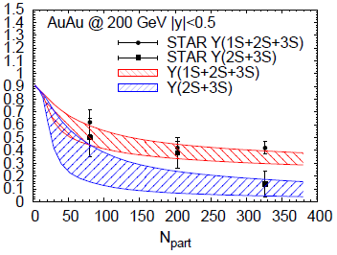
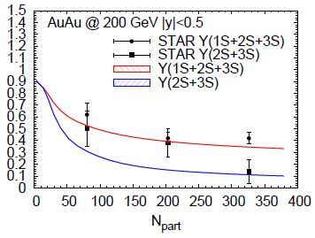
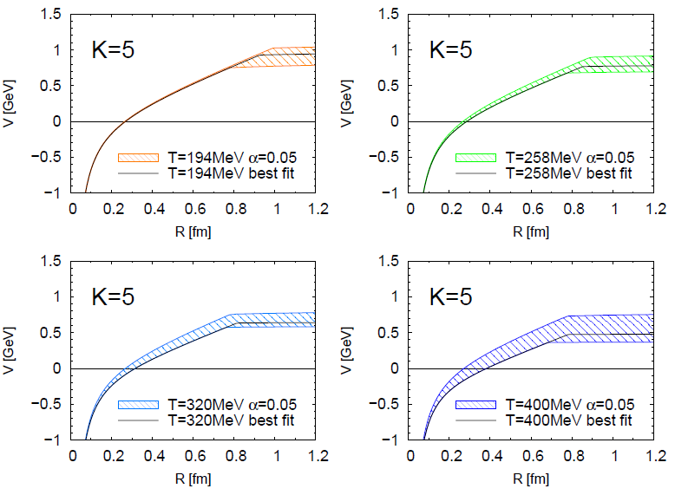
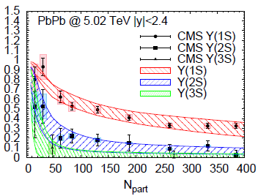
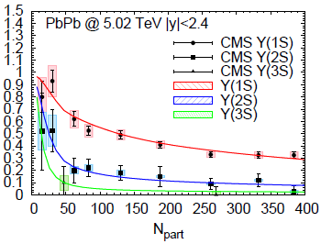
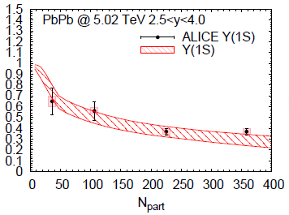
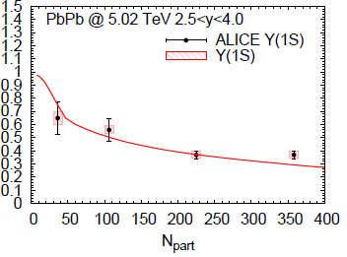
3.4 Statistical Extraction of Heavy-Quark Potential
Fit Results In-Medium Potential
“Strongly-coupled” solution:
remnants of confining force
survive well above T_{c}
Not unique …
c²/dof ≤ 1
[Du et al ‘19]

Slide 32
3.5 X(3872)
Does X(3872) production in heavy-ion collisions reveal
internal structure information?
Larger size (molecule vs. tetraquark) ⇒ larger yield -- or else?
With R_{AA}^{exp}(y(2S)) ~ 0.14, R_{AA}(X) compatible with unity
p_{T} > 15GeV might be outside coalescence/regeneration regime

Slide 33
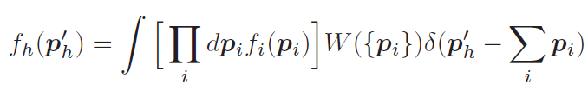
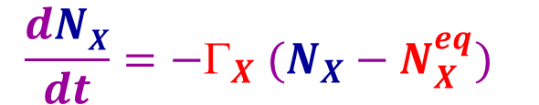
3.5.2 In-Medium X(3872) Production Models
Coalescence Models: partons (f_{i}) projected on hadron wave fct. (W)
[Cho et al ’11, Fontoura et al. ‘19, …]
W=W(s) with hadron radius σ
N_{X} ~ s³ ⇒
N_{mol} >> N_{tetra}
[H. Zhang et al ’20]
Transport Approach:
$$\frac{dNX}{dt}=−Γ_{X} (N_{X}−N_{X}^{eq})$$
[B. Wu et al ’20]
Reaction rate larger for weakly bound molecule
⇒ molecule freeze-out later than tetraquark
Equilibrium limit drops with T ⇒ N_{mol} < N_{tetra}

Slide 34
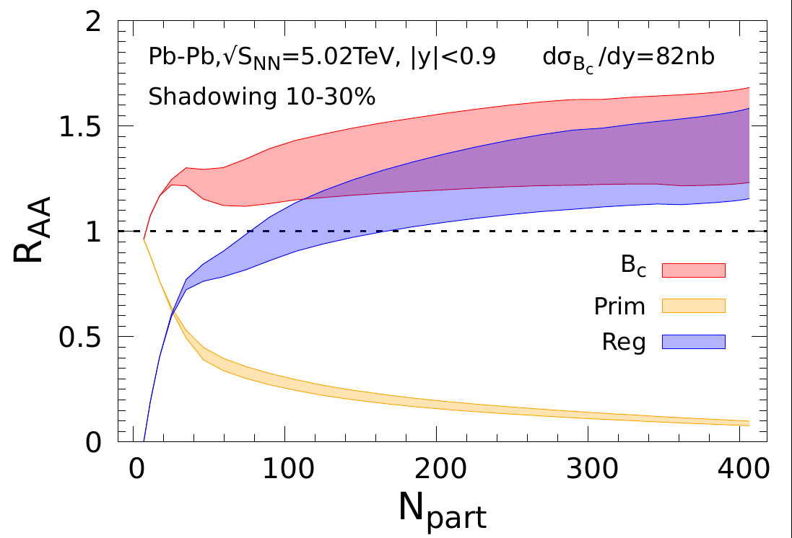
3.6 B_{c}(6275)
Critical “universality test” for transport models
Expect large yields in AA relative to pp [dN_{c}/dy ~ 30 in PbPb(5TeV)]
Need to control pp production cross section (denominator):
R_{AA} (p_{T}) ≡ (dN/dp_{T})_{AA} / N_{coll} (dN/dp_{T})_{pp}
Theory Prediction [Wu et al. ‘21] CMS Data
Predictions appear to agree with data…
caveats: pp cross section, p_{T} range (theory: p_{T} > 0, data: p_{T}^{3m} > 6 GeV)

Slide 35
2.1 Quarkonium Transport in URHICs
0 0.5 5 10
| | | |
fireball time
τ [fm/c]
c
-
c
production +
evolution of
cc wave pack.
c-quark
diffusion
in QGP
~ T_{melt}:
ψ can
form
QGP
kinetics
c+c ↔ ψ
~ T_{pc}:
c and c
hadronize
-
-
hadronic
kinetics
-
t_{form}~1fm/c t_{c}^{eq} ~5fm/c t_{y}^{eq} ~ 1/ G_{y}
[Satz et al, Capella et al, Spieles et al, PBM et al, Thews et al, Grandchamp et al, Ko et al, Zhuang et al, Zhao et al,
Chaudhuri, Gossiaux et al, Young et al, Ferreiro et al, Strickland et al, Brambilla et al, …]

