Slide 1
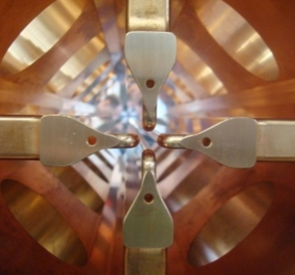
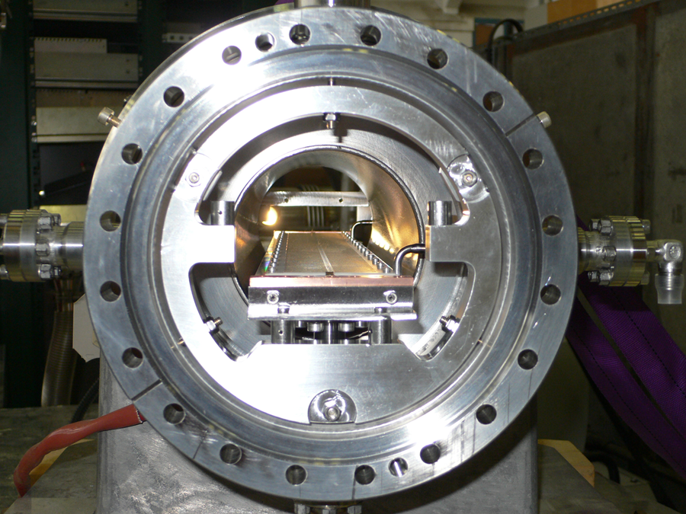
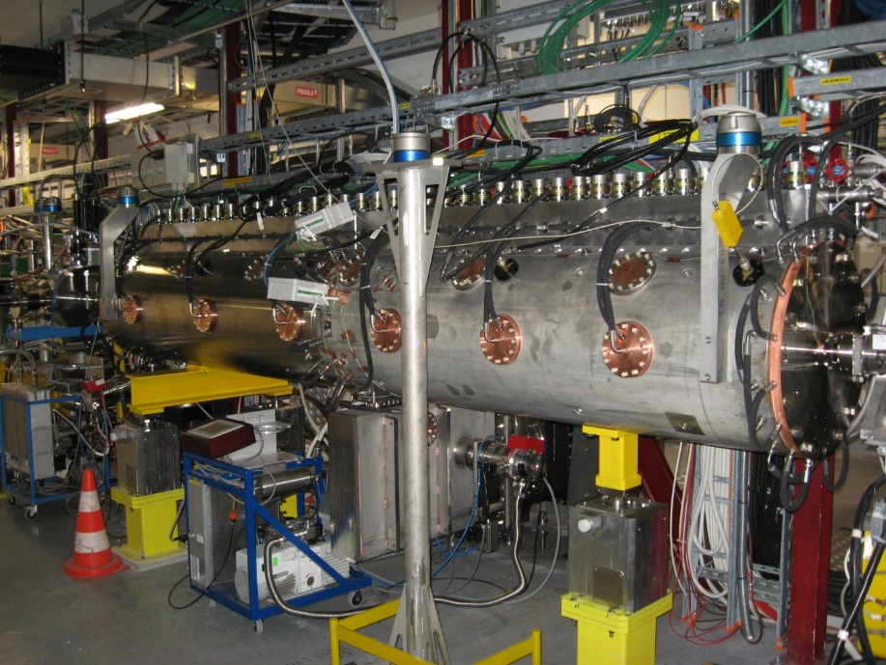
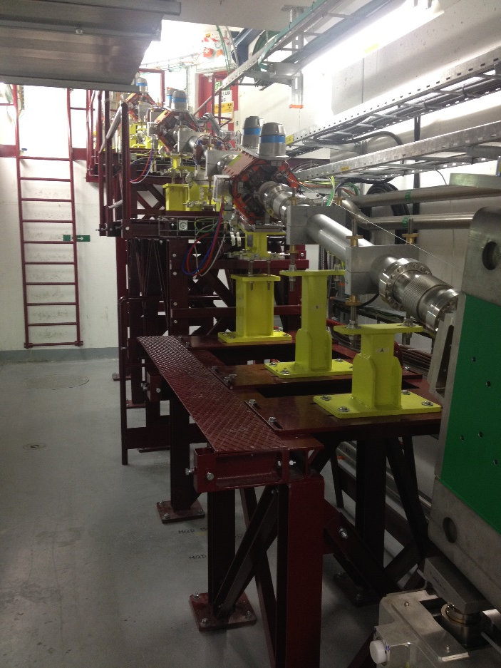


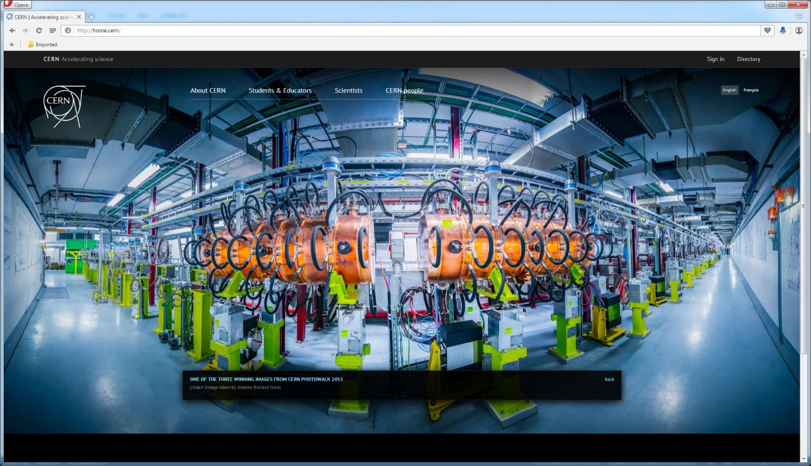
Commissioning experience of LINAC4 at CERN Alessandra M Lombardi for the LINAC4 Team

Slide 2








Oliver.Abevrle,Davide.Aguglia,Luca.Arnaudon,Philippe.Baudrenghien, Giulia.Bellodi Caterina.Bertone,Yannic.Body,Jan.Borburgh,Enrico.Bravin,Olivier.Brunner,Jean-Paul.Burnet,Marco.Buzio,Christian.Carli,Etienne.Carlier,Miguel.Cerqueira.Bastos,julie.coupard,Jean-Marc.Cravero,Pierre.Dahlen,Benoit.Daudin,Jurgen.de.Jonghe,Nuno.Dos.Santos,L.Ducimetiere,Tony.Fowler,jean-frederic.fuchs,Delphine.Gerard,Frank.Gerigk,jean-michel.giguet,Silvia.Grau,Jean-Claude.Guillaume,Louis.Hammouti,Klaus.Hanke,Michael.Hourican,Mark.Jones,Quentin.King,Ioan.Kozsar,Jean-Baptiste.Lallement,Gilles.Le.Godec,Franco.Lenardon,Alessandra.Lombardi,Luz.Lopez-Hernandez,Serge.Mathot,Stefano.Moccia,Eric.Montesinos,Antony.Newborough,David.Nisbet,Mauro.Paoluzzi,Aurelie.Pascal,Daniel.Perrin,Jerome.Pierlot,Serge.Pittet,Bruno.Puccio,Uli.Raich,Suitbert.Ramberger,Carlo.Rossi,Richard.Scrivens,Lars.Soby,Jocelyn.Tan,Hugues.Thiesen,Pierre.Alexandre.Thonet,Giovanna.Vandoni,Maurizio.Vretenar,Wim.Weterings,Christos.Zamantzas,Thomas.Zickler, Elena.Benedetto,Alessandro.Bertarelli,Etienne.Carlier,Jean-Pierre.Corso,julie.coupard,Yves.Cuvet,Alessandro.Dallocchio,L.Ducimetiere,Gilles.Favre,Alan.Findlay,Jan.Hansen,Lars.Jensen,Rhodri.Jones,Detlef.Kuchler,Jean-Michel.Lacroix,Bettina.Mikulec,Dominique.Missiaen,john.molendijk,Benoit.Riffaud,Federico.Roncarolo,Carlo.Rossi,Jose-Luis.Sanchez.Alvarez,Andrzej.Siemko,Marco.Silari,Lars.Soby,Didier.Steyaert,Jocelyn.Tan,Pierre.Alexandre.Thonet,joachim.vollaire,Rolf.Wegner,Sylvain.Weisz, Michel.Arnaud,Luca.Arnaudon,Sonia.Bartolome,Cedric.Baud,cyrille.patrick.bedel,aurelio.berjillos,christian.marc.bernard,Ana-Paula.Bernardes,Alessandro.Bertarelli,Sebastien.Bertolo,thomas.william.birtwistle,Jan.Blaha,Sebastien.Blanchard,Yannic.Body,philippe.boisseaux-bourgeois,robert.borner,Olivier.Brunner,pawel.andrzej.burdelski,Didier.Chapuis,Ahmed.Cherif,Laurent.Colly,Fabio.Corsanego,Jean-Pierre.Corso,julie.coupard,Christophe.Coupat,Jean-Marc.Cravero,Olivier.Crettiez,Maryse.Da.Costa,Alessandro.Dallocchio,jose.delagama,gian.piero.di.giovanni,Tobias.Dobers,Gerald.Dumont,John.Etheridge,Gilles.Favre,ja.ferreira,Ramon.Folch,Katy.Foraz,Robert.Froeschl,jean-frederic.fuchs,Anne.Funken,javier.galindo,georgi.minchev.georgiev,Frank.Gerigk,jean-michel.giguet,Gael.Girardot,David.Glenat,Paulo.Gomes,Marine.Pace,Silvia.Grau,Jean-Louis.Grenard,Damien.Grenier,Serge.Grillot,jean-francois.gruber,Roberto.Guida,greta.guidoboni,Jean-Claude.Guillaume,abel.gutierrez,Louis.Hammouti,Jan.Hansen,Steve.Hutchins,Stephane.Joffe,Mark.Jones,Ioan.Kozsar,Jean-Michel.Lacroix, David.Landre,raphael.langlois,jean.marc.lassauce,patrick.lelong,Jacques.Lettry,Yann.Lupkins,Jose.Marques,Christophe.Martin,alex.martinez,Pablo.Martinez.Yanez,Albert.Masson,Christian.Mastrostefano,Simon.Mataguez,Serge.Mathot,Bettina.Mikulec,Stefano.Moccia,Richard.Mompo,Boris.Morand,richard.francis.morton,Antony.Newborough,Christophe.Nicou,Pierre.Ninin,David.Nisbet,Remy.Noulibos,Miguel.Ojeda-Sandonis, Francesco.di.Lorenzo, Micheal.o.Neil, Chiara Bracco, Federico Roncarolo

Slide 3
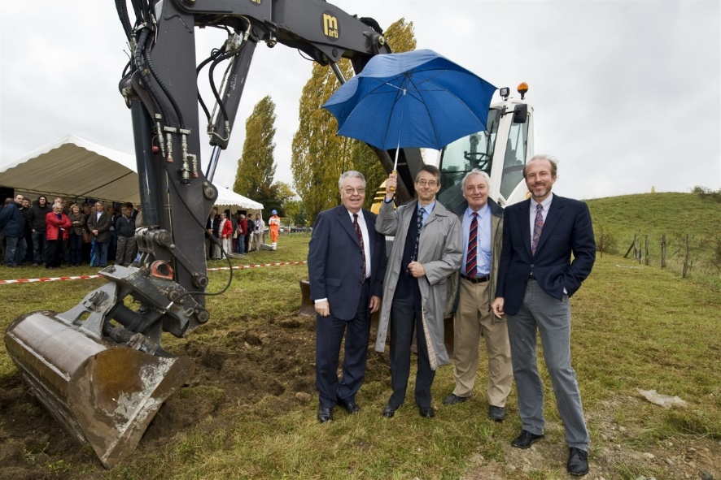
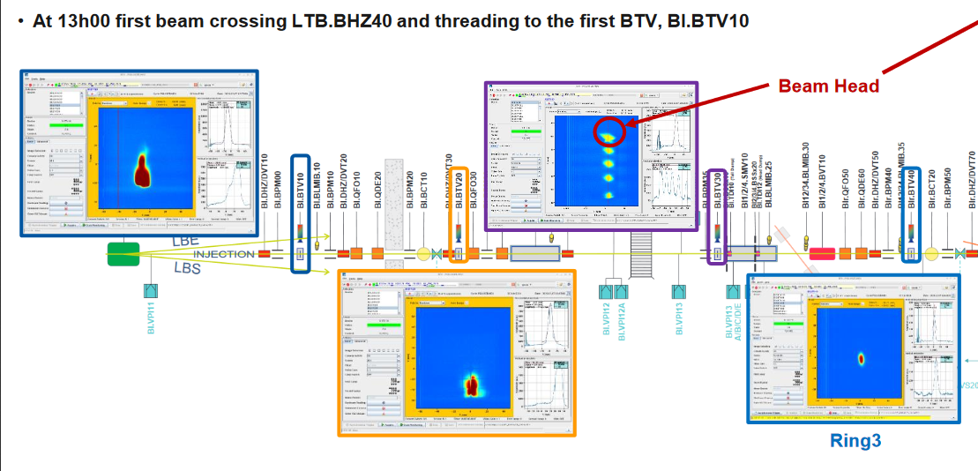

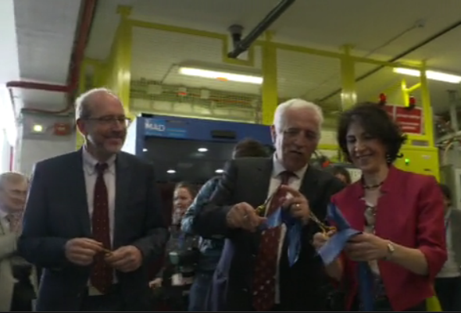
Proposals (1996-2006)
Decision in 2007 R. Aymar director general
Ground Breaking ceremony : 16 October 2008
Injection in PSB : 7 December2020
Inauguration : 9 May 2017
In its June 2007 session the CERN Council has approved the White Paper "Scientific Activities and Budget Estimates for 2007 and Provisional Projections for the Years 2008-2010 and Perspectives for Long-Term", which includes construction of a 160 MeV H- linear accelerator called LINAC4, and the study of a 5GeV, high beam power, superconducting proton Linac (SPL).

Slide 4
Baseline beam parameters
LINAC4 – CDR -2006 | LINAC4 – achieved (2016)
H- | Stripping and more tested in Half Sector Test
70mA peak at the source 65 ma peak at 3 MeV 40 mA after chopping | 50mA peak (in twice the acceptance of the RFQ) 30 mA peak at 3 MeV (record) 20 mA after chopping | Peak current from the source Average beam current after chopping (LEBT and RFQ transmission and chopping factor)
160 MeV | 160.48 MeV | All RF structures performing to specs
0.4 π mm mrad | 0.3 π mm mrad (at 160MeV) | Smaller emittance , allows for more turns injected
400 µsec 1Hz (4 rings) | Up to 600 µsec 1Hz | Longer injection in the PSB (100-150turns)
Fast Chopping at 3 MeV 2µsec inj kicker rise-time | Demonstrated , including transmitted beam quality | Unprecedented flexibility, to be exploited Beam from 1µsec to 150µsec
Energy painting with the last accelerating modules

Slide 5
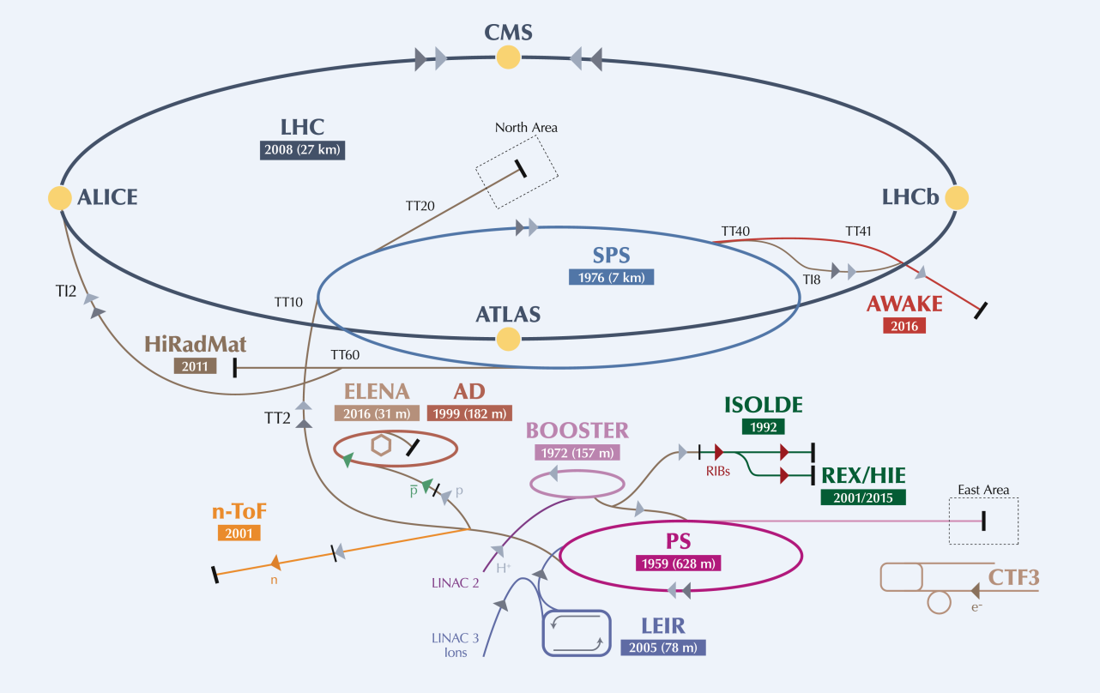
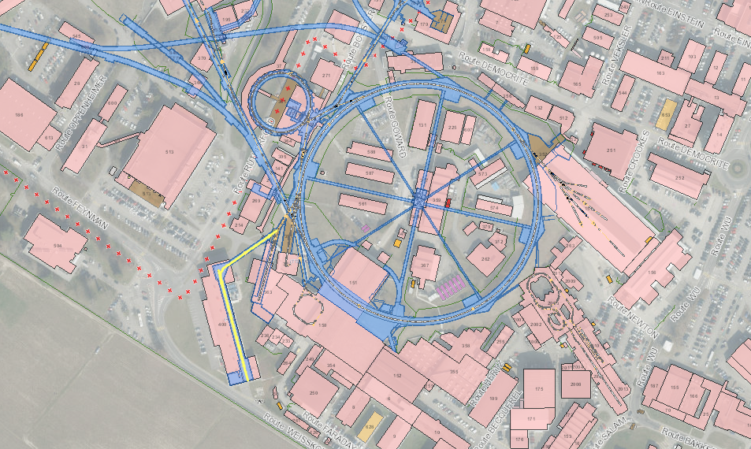
Frequency : 352 MHz
Duty cycle for PSB : 0.06 %
Max duty cycle : 5%
Located 12m underground
Notes:
Add lines to indicate the PSB and the PS

Slide 6
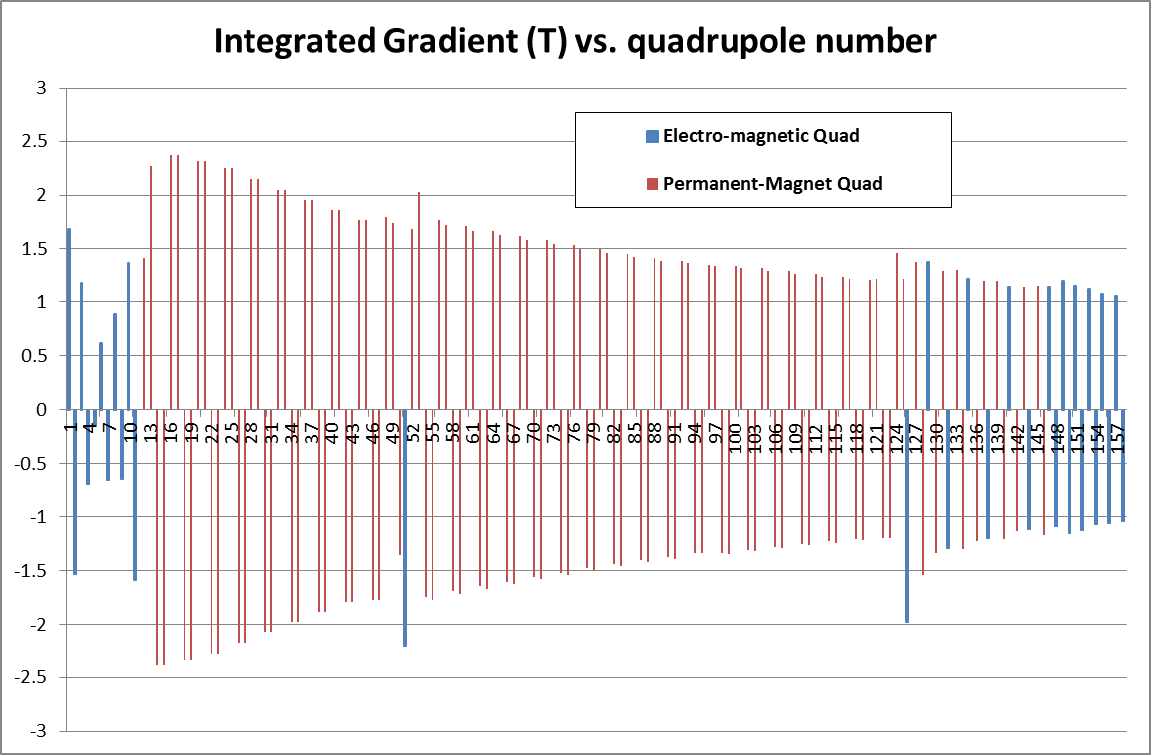
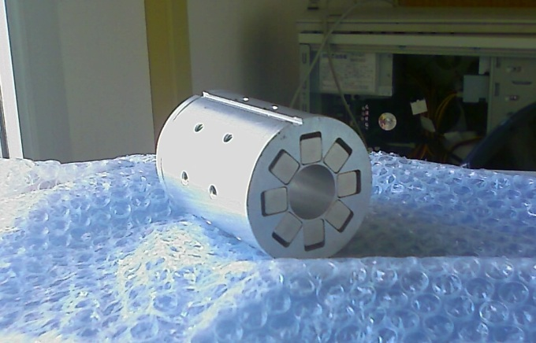
Quadrupoles :mostly PMQ (127/158)
-Flexibility in matching and chopping 0-80 mA currents from the pre-injector.
-Flexibility in bringing beams with energy from 50 MeV onwards to the PSB.
PMQ for tank2 , 60 mm in diameter and 80 mm in length
Notes:
Permanent magnets /

Slide 7
Accelerating Gaps (262) voltage and phase
Quasi-synchronous structures with external focusing from 50MeV
Sequence of 3 identical gaps from 100MeV and 7 identical gaps from 160MeV
Total of about 25 amplitude and phase to set

Slide 8
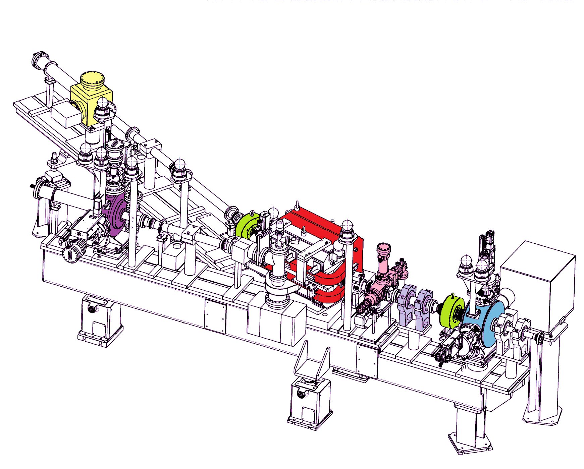
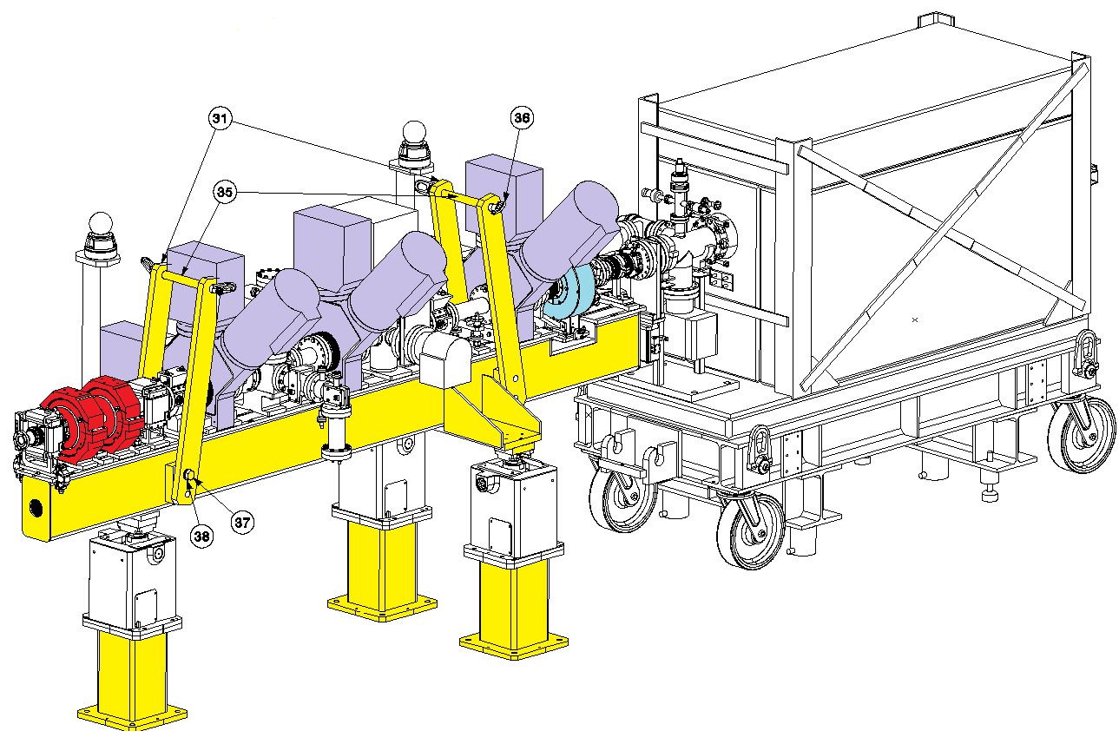
Temporary measurement benches
Low energy test bench at 3 and 12 MeV
Direct measurements:
Transverse emittance with slit-grid.
Energy – Energy spread with a spectrometer.
Taking data for preparing and gaining confidence in higher energies commissioning strategy.
High energy test bench at 50 and 107 MeV
Indirect measurements:
Transverse emittance with 3 profile monitors.
Longitudinal emittance with bunch shape monitor.
Energy with Time of Flight.
Permanent measurement line in the transfer line for 160 MeV
4 profile monitors, beam current transformer and BPMs.

Slide 9
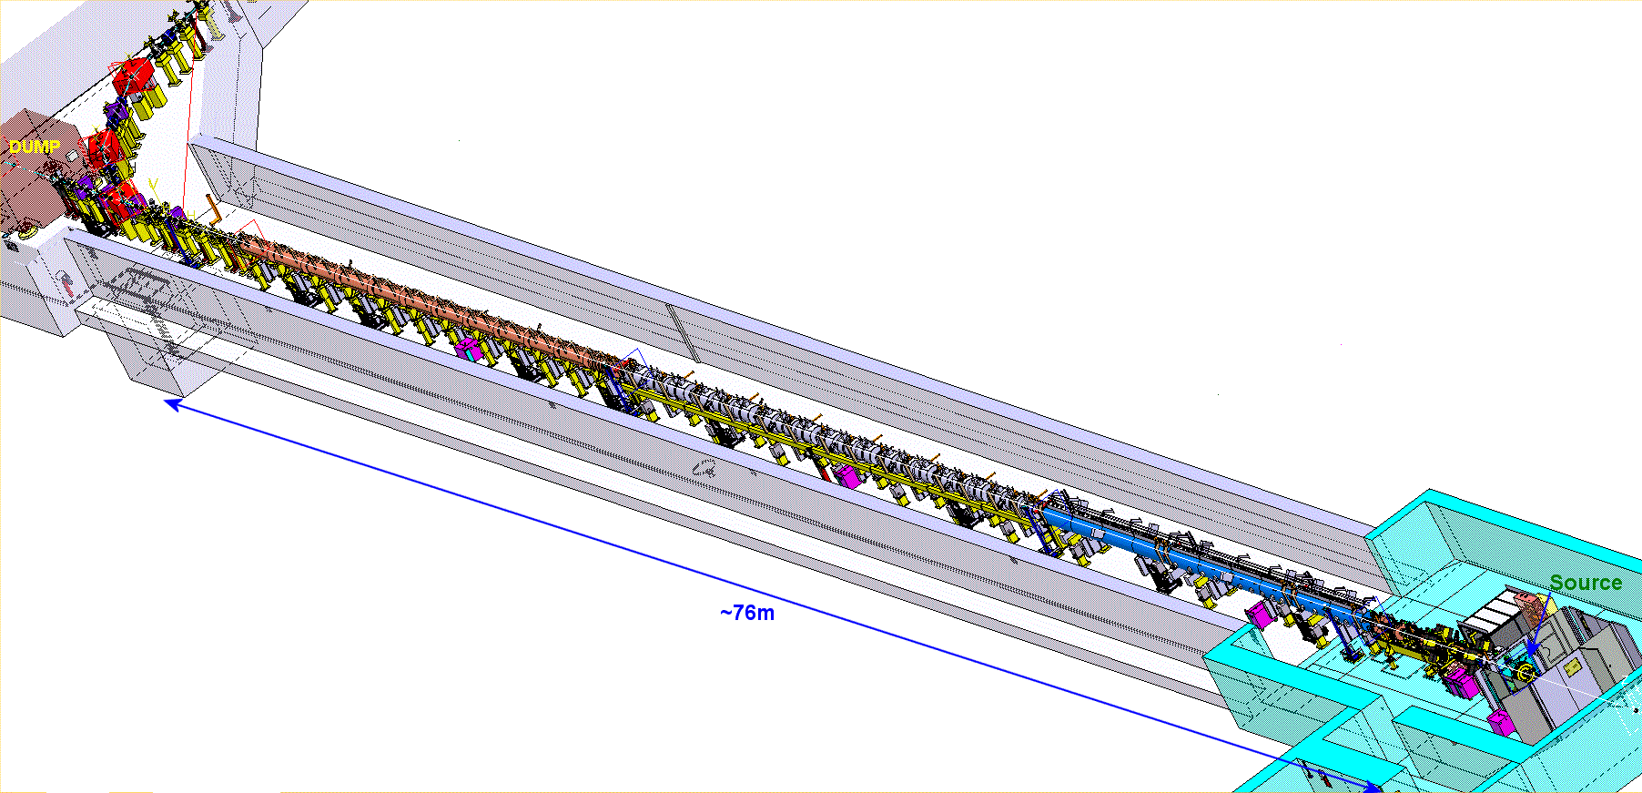

Commissioning in stages of increased energy
Oct 2013
3MeV
30 mA
Nov 2016
160 MeV 18mA
Jun 2016
105 MeV 20mA
Nov 2015
50 MeV
20 mA
Safely on the dump.
It has been stripped.
It has been delivered to the Half Sector Test.
Aug 2014
12 MeV
20 mA
45 keV
50 mA

Slide 10
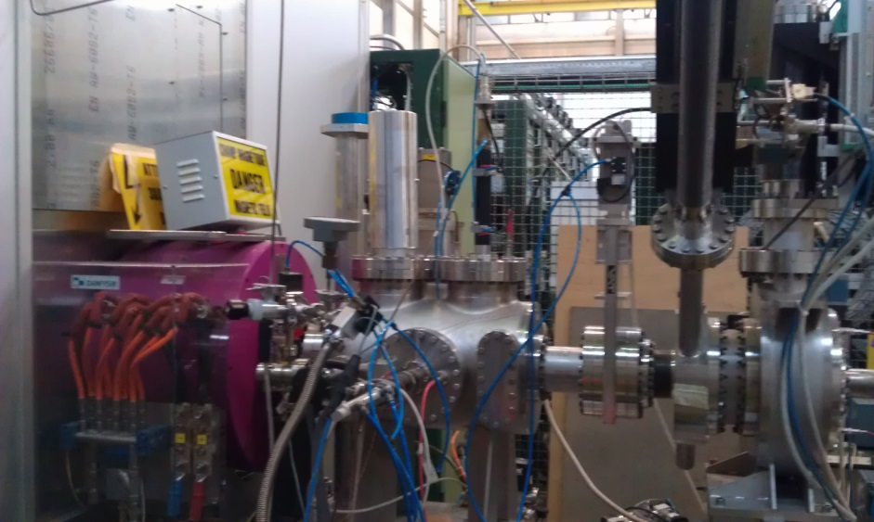
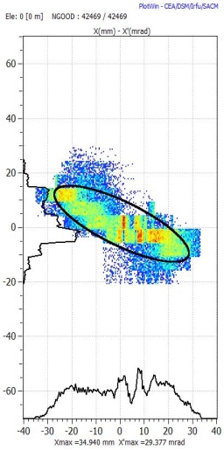
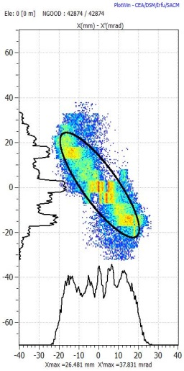
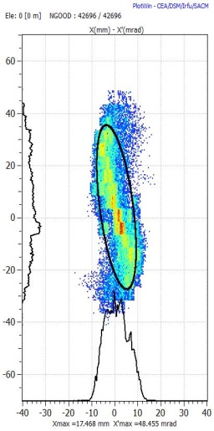
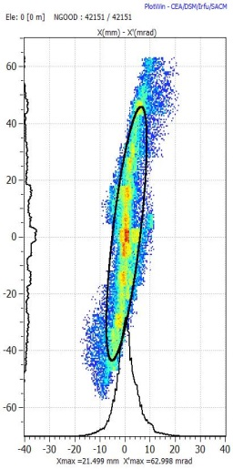
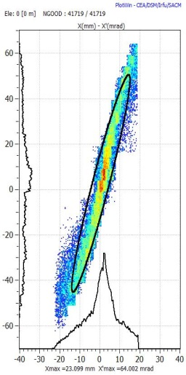
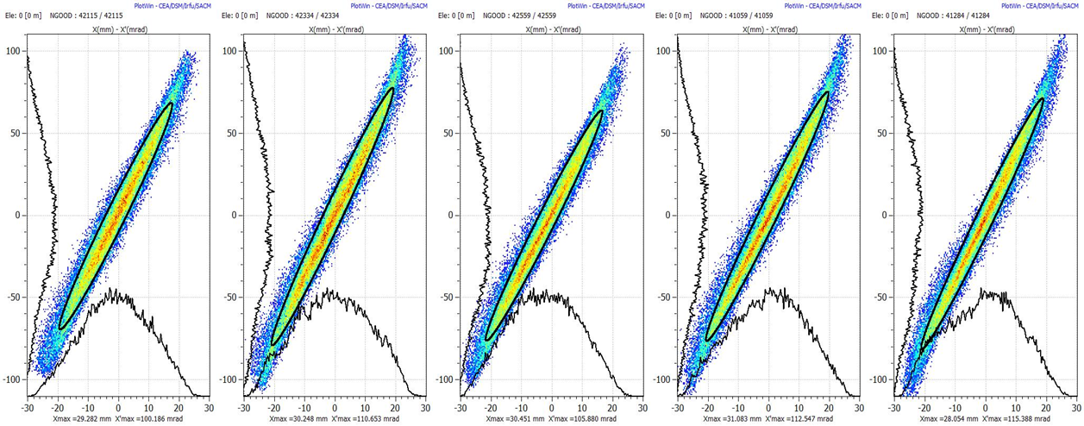
Extensive measurements at 45 keV
This turned out to be a CRUCIAL STEP-see next slide
1- take measurements varying solenoidal field and generate in tracking code
source
Solenoid
Emittance metre
2 – back-trace to source out
3 - Result : we have an empirical input beam distribution that very well represents the dynamics in the LEBT and the rest of the accelerator.

Slide 11
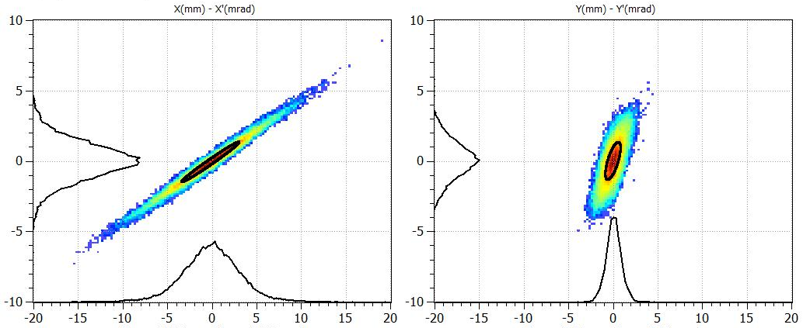
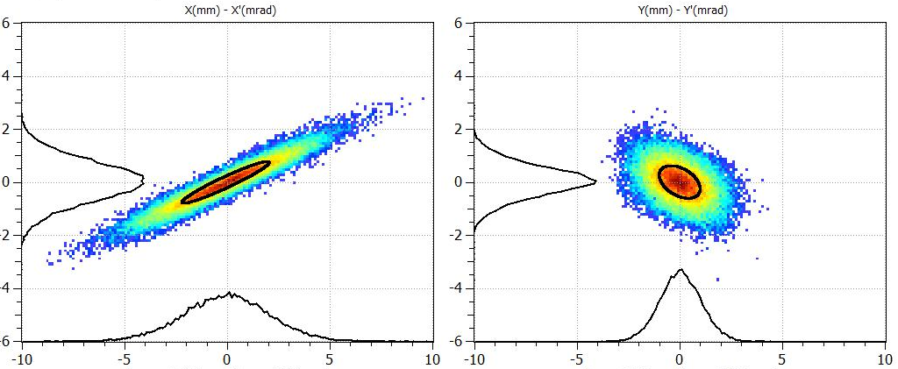
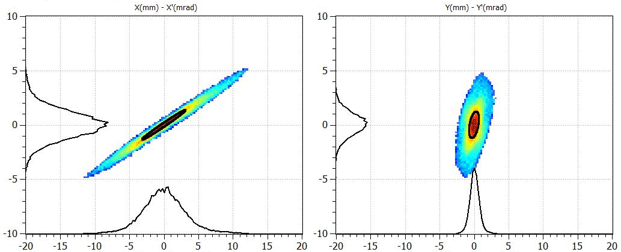
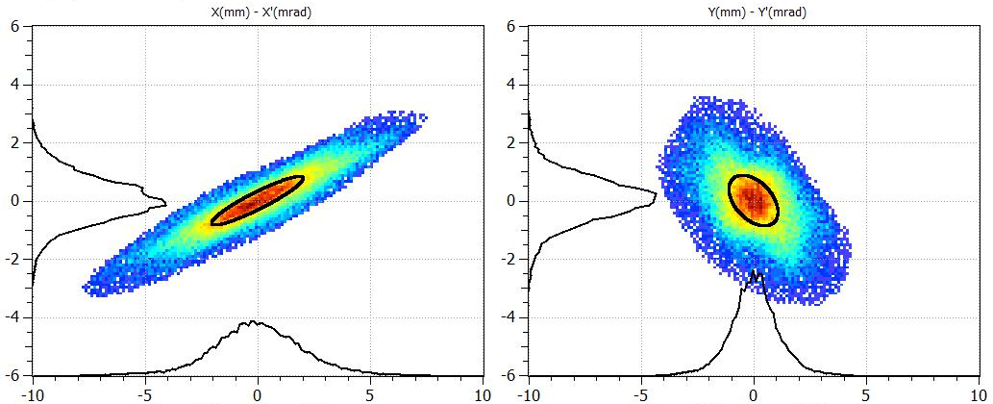
Transverse emittance at higher energies
@ 50 MeV
@ 107 MeV
Expected from simulations
Transverse emittances were indirectly measured with:
the “Forward method”
the “Hybrid Tomographic method”
Both based on: The 3 profiles method – Including the space charge forces with multi-particle simulation codes.
Measured

Slide 12
Pre-injector
3 MeV/ 352 MHz/ 3 m long RFQ
Commissioned with beam 2013
Fast chopper, functionality validated 2013
Risetime<10nsec/ extinguish factor 100%

Slide 13
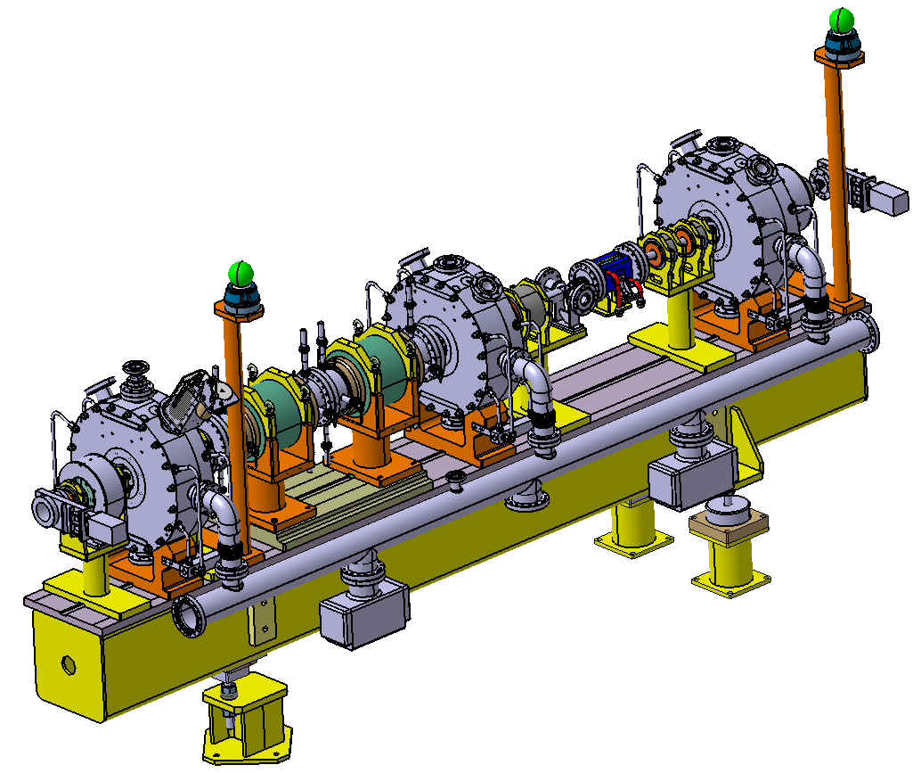
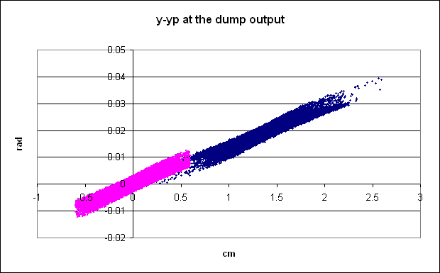
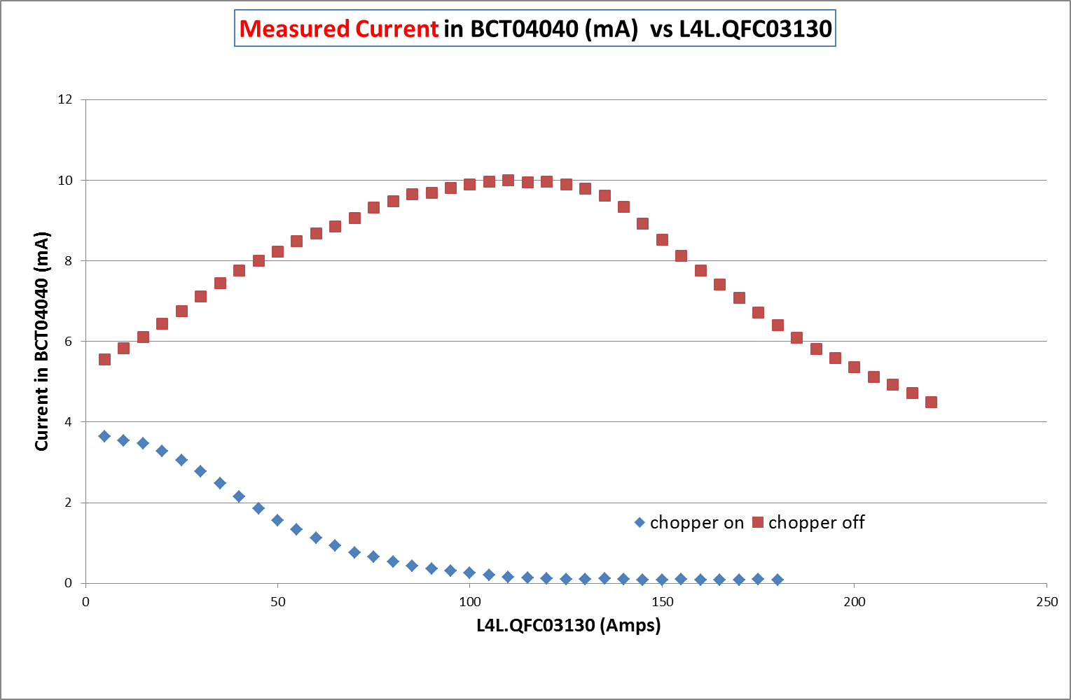
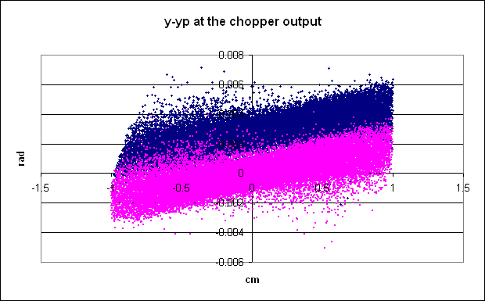
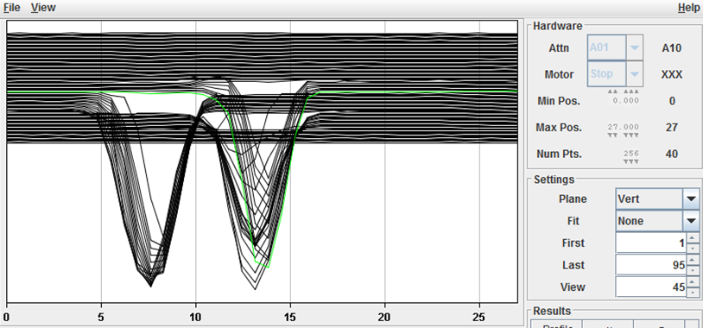
Measuring at 3 MeV : CHOPPING emoving microbunches (150/352) to adapt the 352MHz linac bunches to the 1 MHz booster frequency
Match to the DTL
Match from the RFQ
Chop
Meas 2014
Beam current downstream the dump

Slide 14
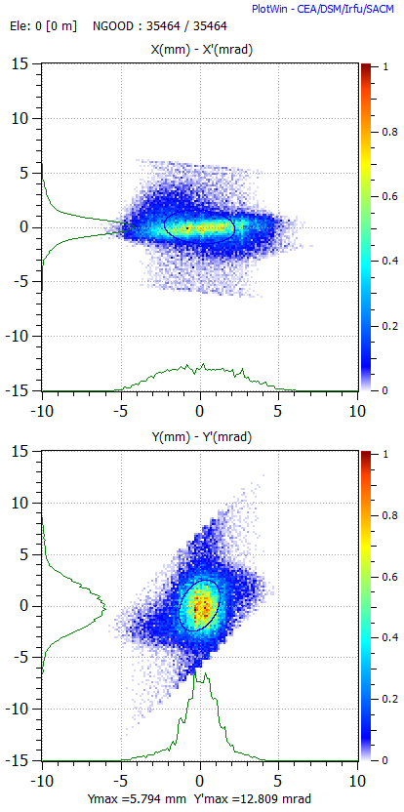
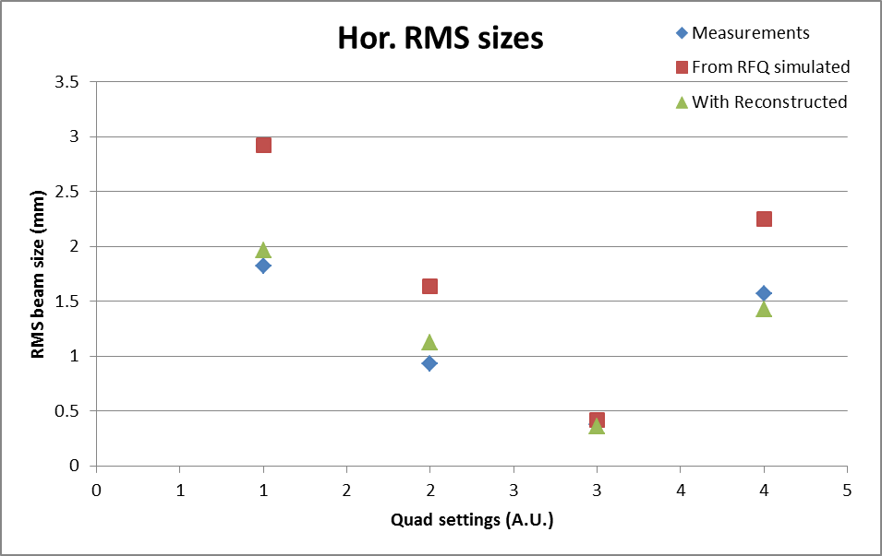
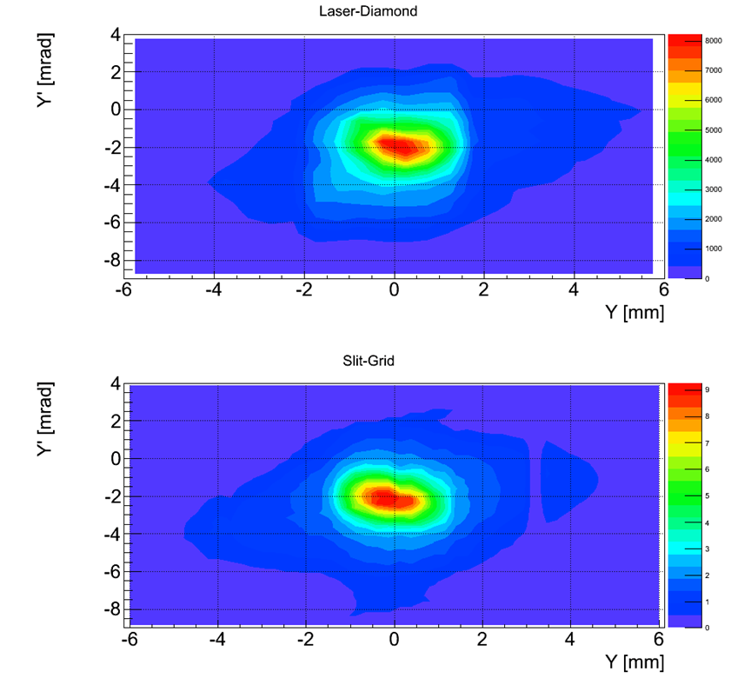
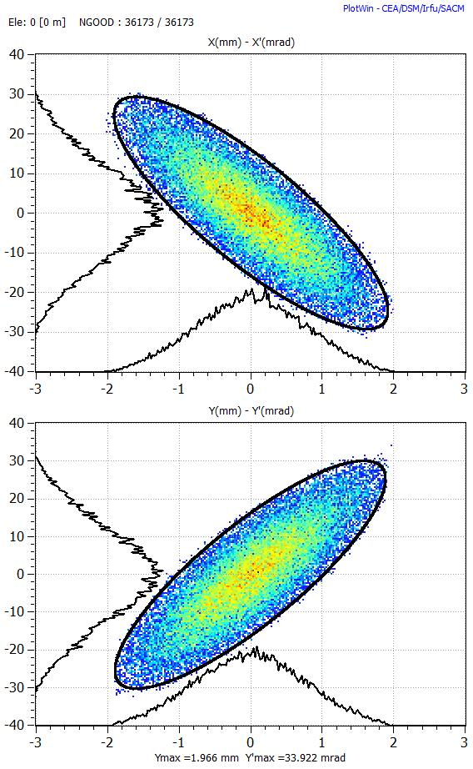
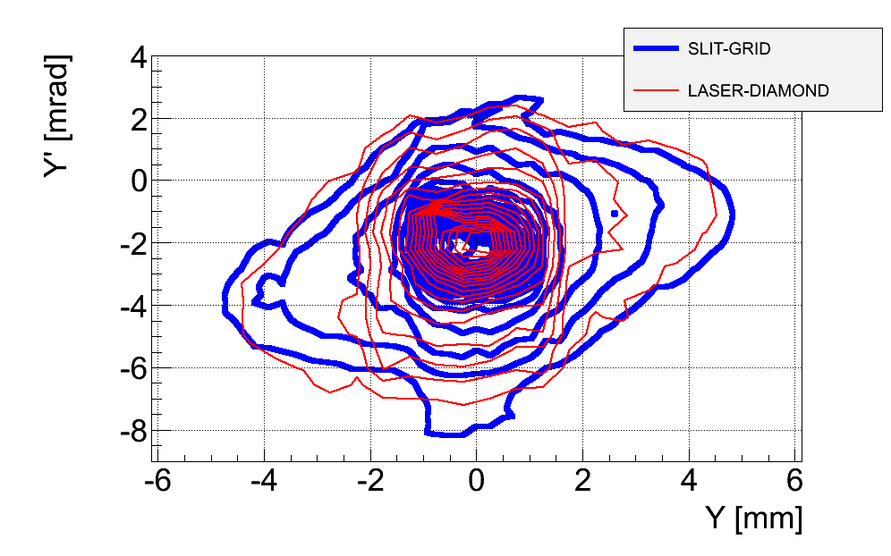
Measuring at 3 MeV : validation of diagnostics and emittance reconstruction
Slit-and-grid | From profile meas | Laser + diamond
rms normalised Transverse emittance at 3 MeV measured by 3 independent systems is 0.3 pi mm mrad

Slide 15
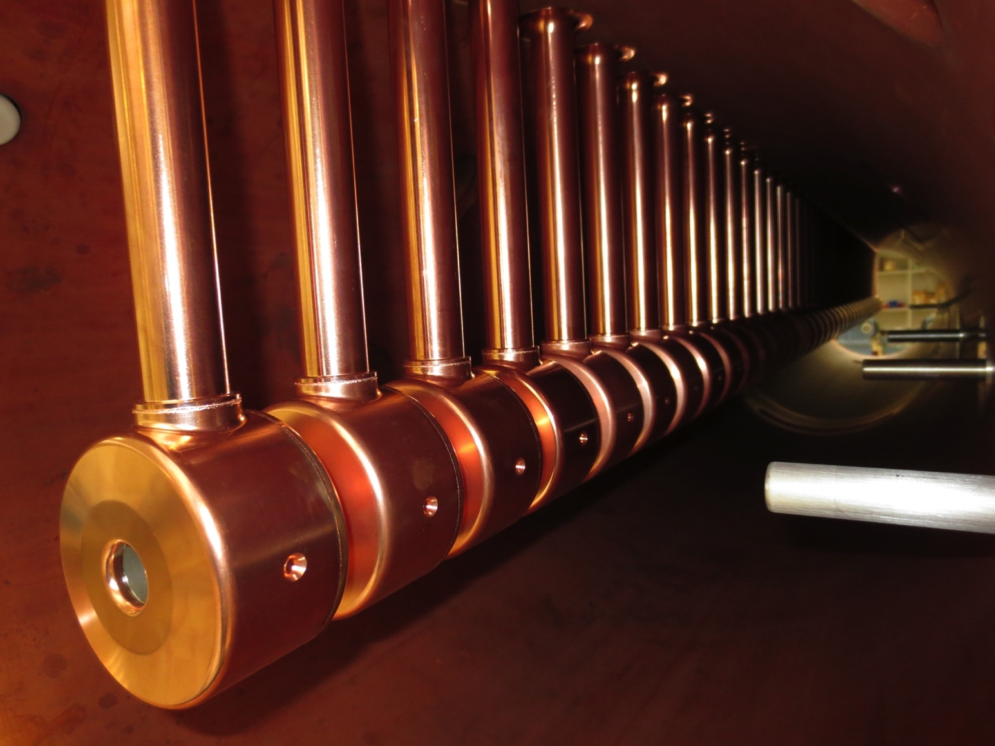
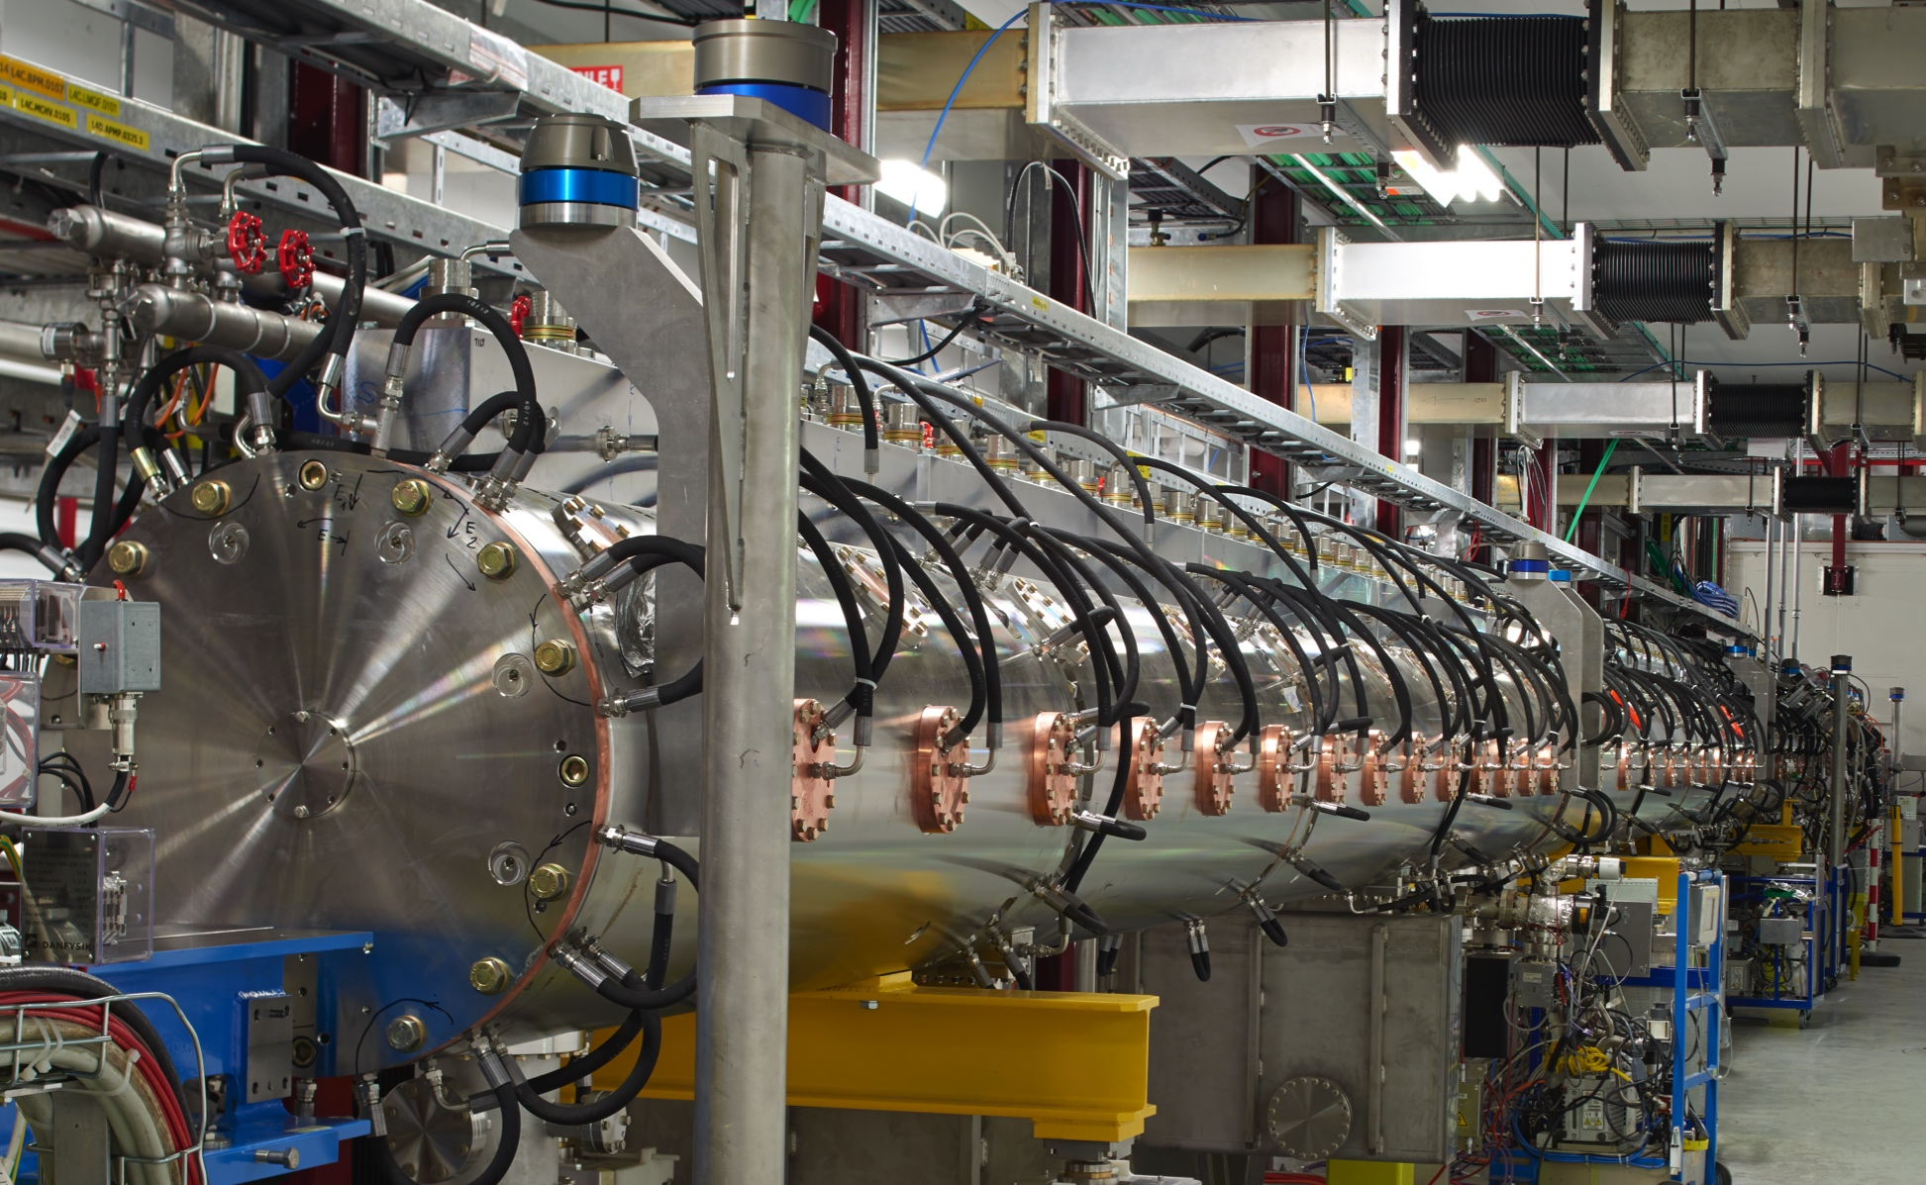
Drift Tube Linac : 3-50 MeV (3-12-30-50 MeV, commissioned in 2 stages Aug 14 and Nov 15)
3 tanks

Slide 16
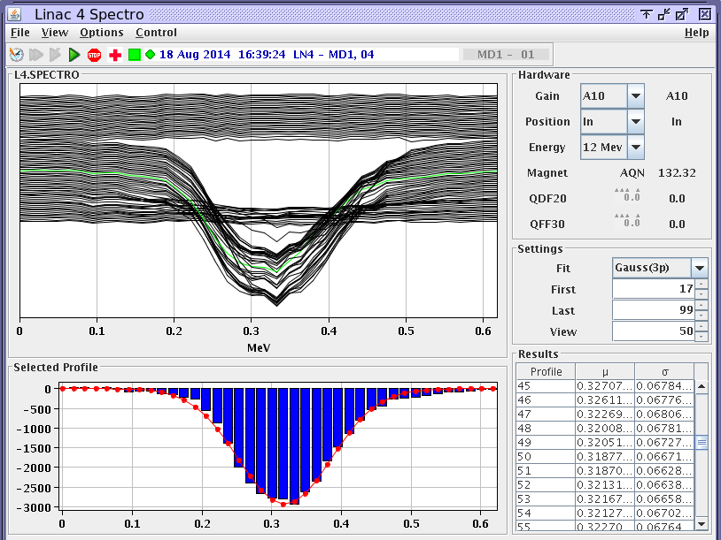
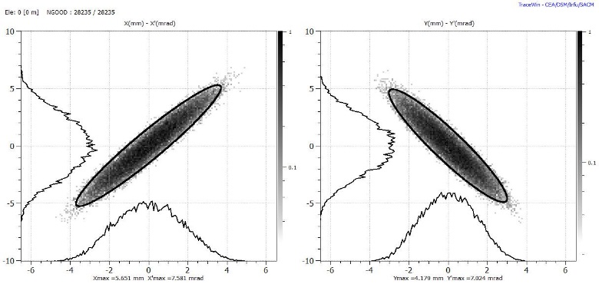
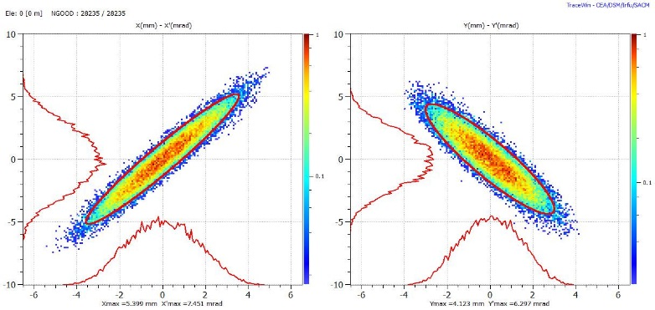
Measurements at 12 and 50 MeV : Drift tube LINAC
This stage was important but not crucial
Expected - Measured
Spectrometer (bending + grid) measurements indicate an rms energy spread of 52.8 keV (vs 49.2 keV expected) after DTL tank1,12MeV, August 2014
Transverse emittance at 50 MeV
after the Drift Tube Linac, Nov 2015

Slide 17
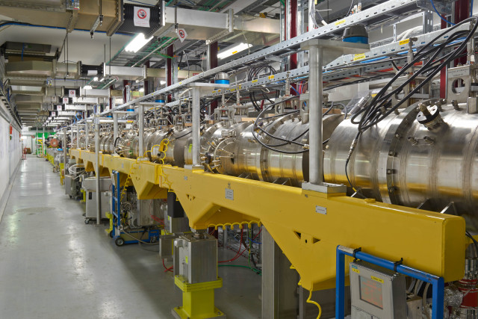
Cell Coupled Drift Tube LINAC : 50-100MeV (commissioned June 16)
7 modules of 3 accelerating cavities (3 gaps each) and 2 coupling cells,
quadrupoles outside of RF structure,
first-ever CCDTL in a working machine!

Slide 18
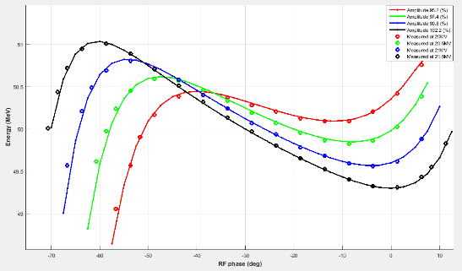
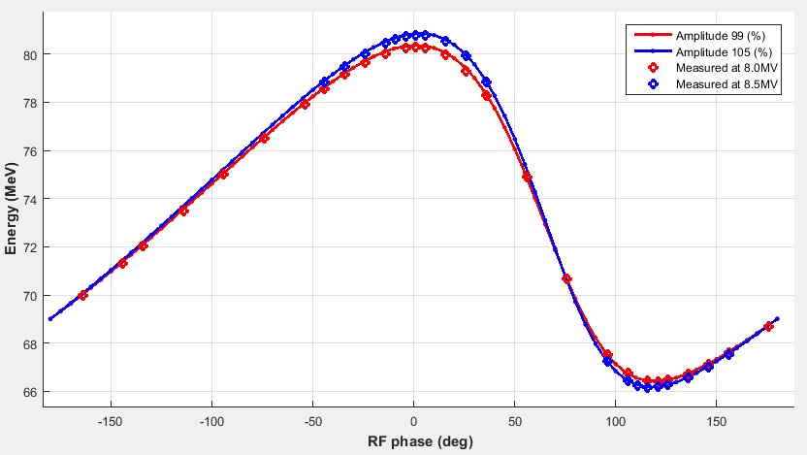
50-100MeV : validation of the ToF and the phase and amplitude setting strategy
DTL3
CCDTL5

Slide 19
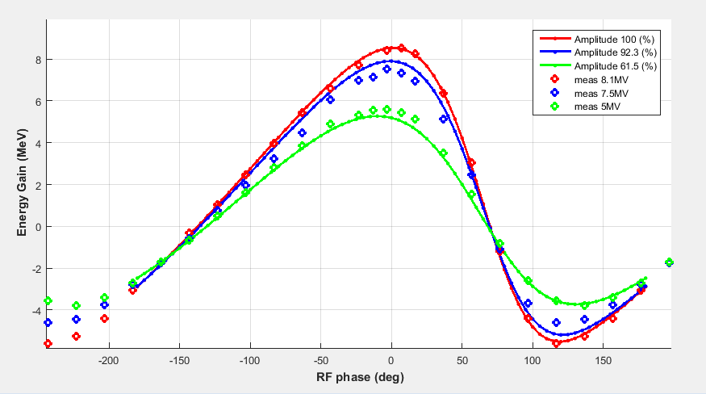
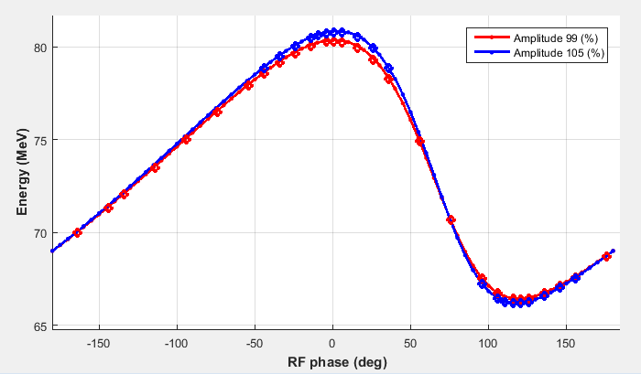
CCDTL beam measurements
Average energy vs cavity phase for CCDTL module 3 and 4 measured June 2016 with Time-of-Flight
Refer to F. Roncarolo MOPAB120
Notes:
If it all works out like this is because all systems (RF, vacuum control, …) are working up to their specs

Slide 20
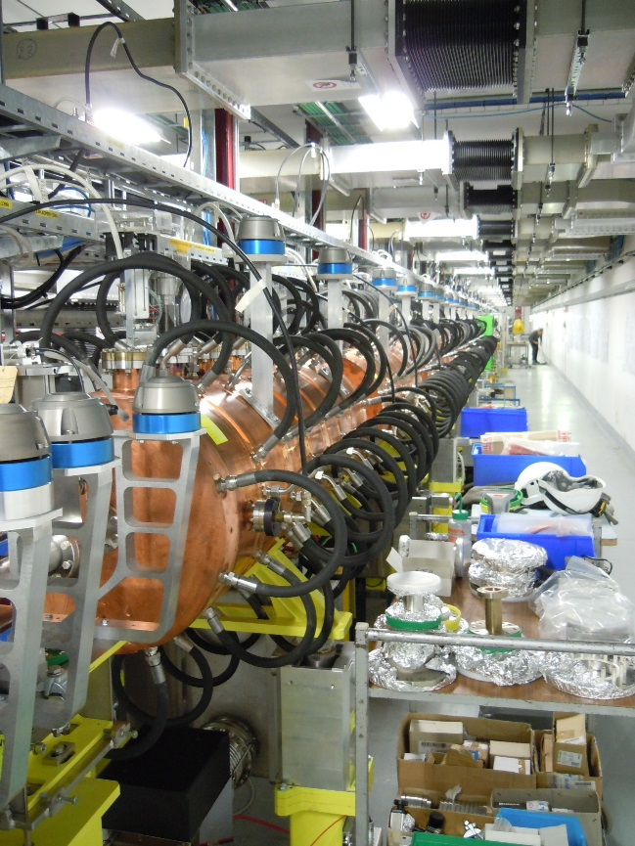
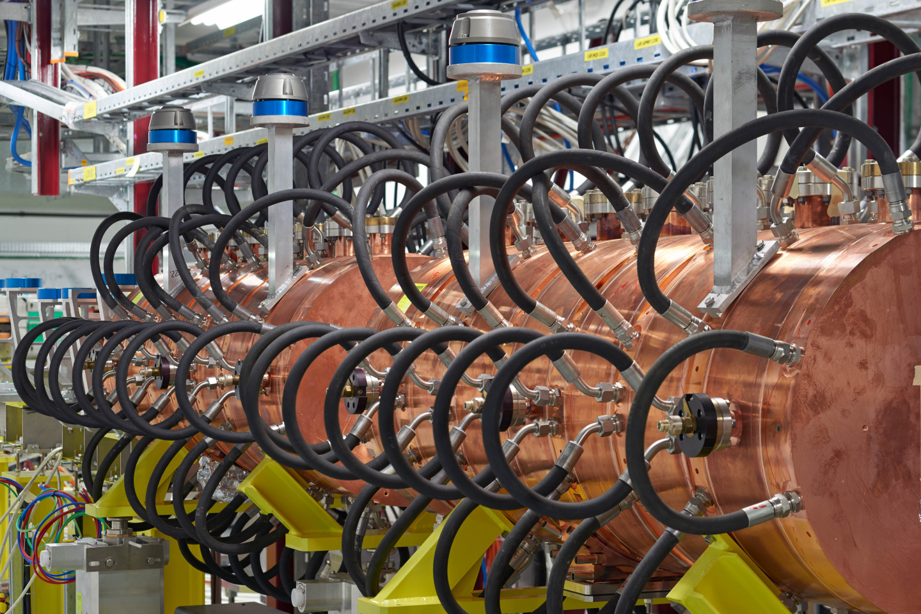
Pi-mode structure : 100-160 MeV (commissioned Oct 16)

Slide 21
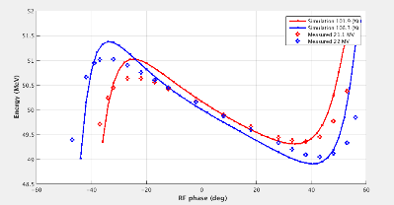
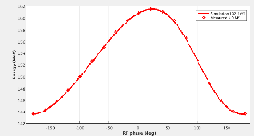





Reaching the final energy
Characteristic curves : energy out of an RF cavity as function of amplitude and phase.
Solid line : simulations,
Dotted : measurements

Slide 22


From 1 day to 1 hour to set-up the RF phase and amplitude
Via beam-loading measurements:
Initial setup: automatic phase scan of each cavities with beam loading measurement. Offline analysis to fit the data.
Via energy measurements (ToF technique):
Fine tuning of the setting points.
TOF application validated, human discernment needed for correct data interpretation + offline analysis / fits.
Average energy vs cavity phase
ToF sufficiently precise to allow setting each RF cavity to:
± 0.5 % in amplitude
± 0.5° for the phase

Slide 23


Half Sector Test (Oct 2016-mar2017)
Run the beam through half the injection chicane with aim of mitigating risks for Future PSB H⁻ Injection Section
Temporary
dump
Chicane
magnets +
H⁰/H⁻ dump
Stripping foil
system
Beam transverse footprint – stripped – 160 MeV at BTV1077 , Mar 2017
Refer to MOPIK04, MOPB120, MOPIK041

Slide 24

160 MeV on the dump
Insure a smooth transition from commissioning to operation: train operators, necessary software development, learn to deal with the increased flexibility.
Find any weak points and mend them in time for the connection
Achieve a beam-availability for the PSB as high as possible and possibly above 90% : importance of the fault tracking system
All about emittance and reliability
Criterium for LINAC4 availability: Current in BCT before the dump
LINAC4 run 24/7 in parallel to normal operation on best-effort basis with:
Operators deal with issues where possible
Expert availability and interventions only during working hours
Faults are fully tracked (Accelerator Fault Tracker AFT)
Stop AFT Clock during off-hours when fault needs expert intervention & during MDs
Thorough logbook verification w/ Timber/LASER information

Slide 25

First availability run
Period: 13/07/2017 – 15/05/2018
Last update: 05/06/2018
Availability | Fault Count | Operation | Suspended OP | Effective Operation | Fault Mean Time to Repair
91.5% | 449 | 23 weeks | ~ 8 weeks | ~15 weeks | ~29 min
Average 91.5 %
Week 47: Anode module change 2x, Pre-Chopper connector to feedthrough to vacuum

Slide 26


Availability data
Period: 13/07/2017 – 15/05/2018
Last update: 05/06/2018
Average: 21
Fault counts / week
(not including parallel faults)
Mostly short faults < 15’
Notes:
Emphasize that most faults are short, that better training of the operators will still shorten that, and that the LHC filling time is 15’

Slide 27

Extrapolated Availability
Period: 13/07/2017 – 15/05/2018
Last update: 15/05/2018
Availability | Fault Count
91.5% | 449
Faults fixed permanently after the Technical Stop:
Power supply of klystron vacuum pump in RF cavities
Flow meter on the Radio Frequency CCDTL tank
Source/Autopilot -> Source Tuning
Fault to be solved in the 2018/19 stop:
R2E issue with the Arc Detectors electronics -> move location
Expect availability of ~93-94% once these known issues are fixed
Mostly short faults < 15’
Notes:
Source tuning; gas optimization; Lesson learned: don’t touch the machine for higher availability (i.e. no tuning)

Slide 28
Into the transfer line : beam quality run
2018: 3 months re-commissioning after scheduled RF upgrade and maintenance activity
2019: 3 months running with LBE line (emittance measurement)

Slide 29




Beam to the LBE !
LBE
Availability
93.9%
Beam phase spread at 160 MeV – in specs.
Pre-injector
Accelerator
Transfer Lines
96% transmission from 3 MeV to the LBE – 23mA suitable for all pre-LS2 beams
Emittance measurements in LBE – as expected

Slide 30

Beam Intensity and Transmission
Excellent transmission from 3 MeV to the LBE
Routinely 23mA (un-chopped) that allows the production of all the pre-LS2 beams
Pre-injector
Accelerator
Transfer Lines
H- beam intensity on the 15 transformers along the linac and transfer lines

Slide 31


Pulse Flatness and chopping
Zoom into start of Ring 4 with nominal chopping pattern;
Top: BCT in transfer line; bottom: output voltage (neg./pos.) of chopper plates.
600 μs long 25.5 mA pulse just upstream the LINAC4 dump (red curve). The pulse flatness meets the specification for each of the 4 Booster rings

Slide 32

Longitudinal stability and painting
Measured phase variation for 100 μs long pulse when a energy variation is programmed along the pulse –proof of principle of energy painting
The beam phase spread along the pulse is within specs – RF regulation is ok

Slide 33


Beam quality measurements – stability at 160 MeV
Current/position stability along pulse
H/V position on L4T pick-up
Ring 3
Ring 2
Ring 1
< +-1mm
Beam intensity on L4Z BCT (3 rings)
Ring 3
Ring 2
Ring 1
< +-2%

Slide 34


Beam quality measurements - chopping
Chopping pattern for typical LHC pulses for PSB
Notes:
Nominal 60%

Slide 35


Beam quality measurements – longitudinal shape
Beam Shape Monitor Commissioning
BSM1
BSM2
Caterpillar beam
Notes:
BSM1: beam is chopped; BSM2 beam is not chopped (or differently);

Slide 36
LINAC4: measured beam characteristics
Parameter | Measurement
Peak intensity at 160 MeV | 25 mA
Emittance rms normalized | 0.3 π mm mrad
Max usable pulse length | 600 μs
Stability shot-to-shot | 2%
Pulse flatness | 2% for 160μs pulse 5% fpr 600μs pulse
Beam position jitter along the pulse at the linac dump | +/- 1mm
Fast Chopping at 3 MeV | Rise time < 10ns Extinction factor close to 100% Unprecedented flexibility: beam 1- 600 μs
AVALIABILTY 2021 : 99%

Slide 37
What went well – chronological order
Thorough preparation of machine model : always compare with expectations
Tracking codes adapted to LINAC and transfer lines
Verification of the calibration constants and machine layout
Machine model coupled with real diagnostics (e.g. rough phase setting by looking at transmission)
A lot of time spent to obtain a good beam particle distribution at low energy
Reliability run proved very useful experience allowing to identify issues beyond the possibilities during pure commissioning
Number of teething problems identified, strategies for mitigation for implementation in 2018
Gain further experience with a complex system
Run time used to measure and improve performance
Identification of areas that need strengthening
Test stand and staged commissioning
Importance of a test-stand that includes the full pre-injector and staged commissioning
Importance of a validated machine model and accuracy of particle tracking codes

Slide 38
What could have been improved (a personal view)
Design phase :
Integrated design of the pre-injector (source as part of the accelerator)
Integrated design of the diagnostics
More diagnostics at the low energy end (beam profiles, beam current transformers, vacuum, source plasma diagnostics)
Build more flexibility into critical system (e.g. chopper dynamics is very rigid)
Initial commissioning phase (stand-alone):
Obsession with the measurement of the emittance (pi mm mrad) instead of concentrating on concepts like acceptance, matching.
Early involvement of operators would have been good (but it wasn’t possible)
Discourage too early adoption of machine-learning//trial-and-error techniques

