Slide 1
COLLABORATION AND SYNERGIES
CRISP FP7 PROJECT
CRISP: Cluster of Research Infrastructure for Synergies in Physics

Slide 2
Contact to other projects within the cluster
E-ELT: European Extremely Large Telescope
Josef Strasser & Rowena Sirey

Slide 3
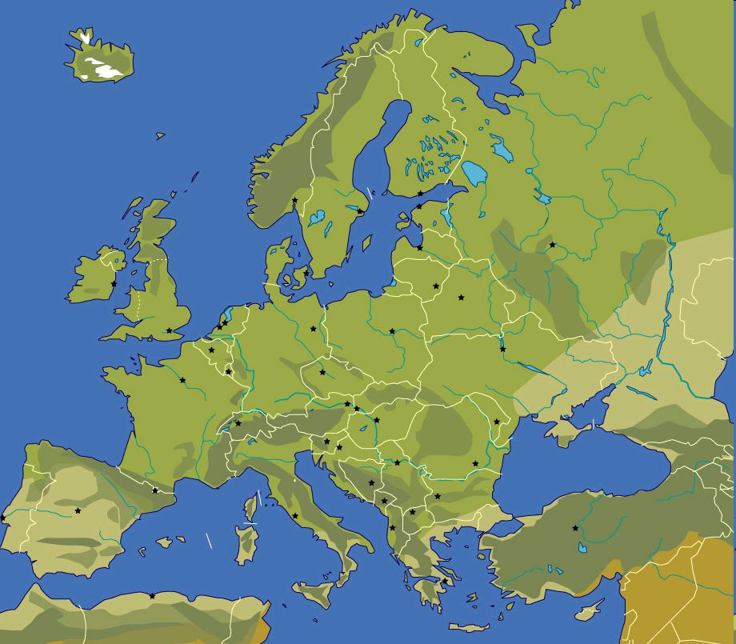























Research Infrastructures and Participants
11 Research Infrastructures & 16 Participating Institutions

Slide 4
Management Aspects
Notes:
Bottom-up and participatory approach, as open and interactive as possible
Due to complexity and diversity of project, introduction of an additional layer

Slide 5
Topic “Detectors and Data Acquisition”
Johann M. Heuser, Topic Leader
GSI Helmholtz Center for Heavy Ion Research GmbH, Darmstadt, Germany
J.Heuser@gsi.de

Slide 6
The work packages:
WP12: High-throughput detector data streaming
  WP leader: P. Fajardo, ESRF
  participating RIs: ESRF, DESY, XFEL, IFIN-HH, UOXF.DB
WP13: CO₂ cooling
  WP leader: D. Abbaneo → P. Petagna, CERN
  participating RIs: CERN, GSI, DESY, XFEL
WP14: Innovative solutions for neutron and gamma-ray detectors
  WP leader: M. Lewitowicz, GANIL
  participating RIs: GANIL, GSI, XFEL, ROMA1
WP15: Large-area thermal neutron detectors using ¹⁰B films
  WP leader: B. Guerard, ILL
  participating RIs: ILL, GANIL, ESS

Slide 7
WP12: High-throughput detector data streamig
Objective:
To select, define and implement techniques and methods to reduce, transmit and process high throughput data streams produced by advanced detectors under development for the participating RIs XFEL, ESRFUP, EuroFEL (DESY), ELI (IFIN-HH), and SKA (UOXF.DB). The main goals are to ease the design and construction of these complex detectors and simplify their deployment across facilities as well as reducing the investment and operation costs.

Slide 8
WP12: High-throughput detector data streamig
Work plan:
T1 Define of a common timing interface for detectors for pulsed light sources. Design and prototype a hardware and software API. Proposal of a standard definition of timing signals. (DESY, XFEL)
T2 Define conventions and architecture of a scalable data acquisition system for area detectors based on aggregation of multiple data links relying on standard protocols. Build a prototype implementing the main key components. (ESRF, XFEL)
T3 Evaluate techniques for the rejection of non-valid data frames in light pulse applications at the detector front-end to avoid frame digitisation and reduce data payload. Consider the use of VETO-like dedicated signals available from other auxiliary detectors. (DESY, XFEL)
T4 Design and evaluate data rejection and compression schemes of images using FPGA and GPU processing hardware immediately after or on the detector head electronics or in a next downstream computing layer. (DESY, XFEL, UOXF.DB, IFIN-HH)
T5 Extend the stream-processing frameworks implemented on SKA pathfinders to accept data inputs from other detectors and evaluate 'plug-and-play' capabilities for pipeline processing. Build a prototype framework. (UOXF.DB, XFEL)
T6 Coordinated technology prospection and forecasting activities of new industry standards for high speed data transmission and processing (All facilities).

Slide 9
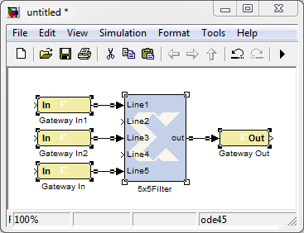
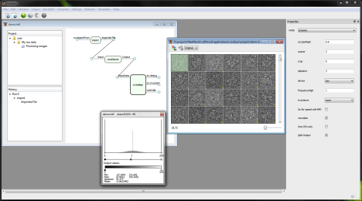
WP12 – T4 FPGA and GPU based image processing
Pipelined processing of images allows reduction or compression of data before saving
Possible powerful platforms could be FPGAs or GPUs
Building up a framework speeds up customization of algorithms and provides access to non technical experts
Important steps are
  Identify the most suitable software tools and platforms
  Develop prototype framework
  Evaluate the prototype framework in the sense of easy and fast programming, efficiency, bandwidth and resources
FPGA
GPU
Storage
Detector

Slide 10
WP13: CO₂ cooling
Objective:
An efficient and lightweight cooling system is a component of paramount importance for advanced particle detectors, notably trackers requiring low-temperature operation.
For example, CO₂ two-phase cooling has been chosen as baseline for the
upgrade of the tracking systems of the LHC detectors at CERN.
Silicon imaging and tracking detectors under design at FAIR (GSI), EuroFEL (DESY), and XFEL
CO₂ has excellent thermo-dynamical properties and is likely to be the technological choice for most future particle tracking detectors, as well as for the refrigeration industry in general, while fluorocarbon fluids will be progressively banned by increasingly stringent environmental regulations.

Slide 11
WP14: Innovative solutions for neutron and gamma-ray detectors
Objective:
Development of innovative electronics and algorithms for the new advanced European gamma-ray tracking (AGATA, EXOGAM2, PARIS) and neutron arrays/detectors (ERBSS, NEDA) in a close collaboration between the RI projects ELI (INFN, IFIN-HH), FAIR (GSI) and SPIRAL2 (GANIL). The subsequent tests of electronics and calibration/post-processing ERBSS should permit them to be ready for the first experiments at FAIR/NUSTAR and SPIRAL2.

Slide 12
WP14: Neutron and gamma-ray detectors
Work plan:
T1 Innovative digital electronics for advanced gamma and neutron arrays
Digital electronics modules developed for the AGATA and EXOGAM2 advanced Ge-detector arrays shall be produced and implemented für future use in the arrays at SPIRAL2 and FAIR/NUSTAR. The aim of the work is to integrate hard- and firmware, optimize the production costs and migrate to new platforms to allow a broader use of these electronics for fast-scintillator neutron and high-energy gamma-ray detectors like NEDA, PARIS, and others. (GANIL, GSI, INFN, IFIN-HH)
T2 Extended Range Bonner sphere spectrometer (ERBSS)
The ERBSS and its calibration/post-processing shall be used for measuring neutron production obtained in different conditions. These include neutron production in different accelerator facilities in order to verify safety and radioprotection constraints. They are also potentially useful to study laser-driven neutron production. Our aim is to standardise the use of ERBSS, make it accessible to different facilities and to test there the neutron production (ELI, EuroFEL, SPIRAL2, etc). This will require adaptation of the post-processing software (called FRUIT) to different measuring conditions. (GANIL, GSI, INFN, IFIN-HH, ROMA1)

Slide 13
WP15: Large-area thermal neutron detectors using ¹⁰B films
Objective:
Neutron instrumentation for condensed matter studies strongly depends on the availability of LADs (Large Area Detectors). Nowadays, most of them are using ³He as the neutron converter because its high detection efficiency and low gamma sensitivity. But ³He is not available anymore and several planned instruments in neutron institutes have been postponed. Developing ³He -free LADs has been identified as a priority to support the development of new instruments, in particular at ESS and ILL.
This work package aims at building a LAD demonstrator based on the “¹⁰B thin film Multi-grid” design developed during ILL20/20, and to demonstrate that this technique is competitive in performance and cost with the ³He detectors.
13

Slide 14
Objectives
WP 8: Time resolved studies
This project seeks to develop new scientific tools for optimised sample excitation and emitted x-ray detection in ultrafast pump-probe experiments at the typically high repetition rates existing at synchrotron (ESRF) and FEL facilities (EuroFEL, ESRF). These include ultrafast auto/cross correlators (fs and sub-fs time resolution), wavelength-changing devices (UV-vis) and wavelength dispersive x-ray spectrometers.

Slide 15
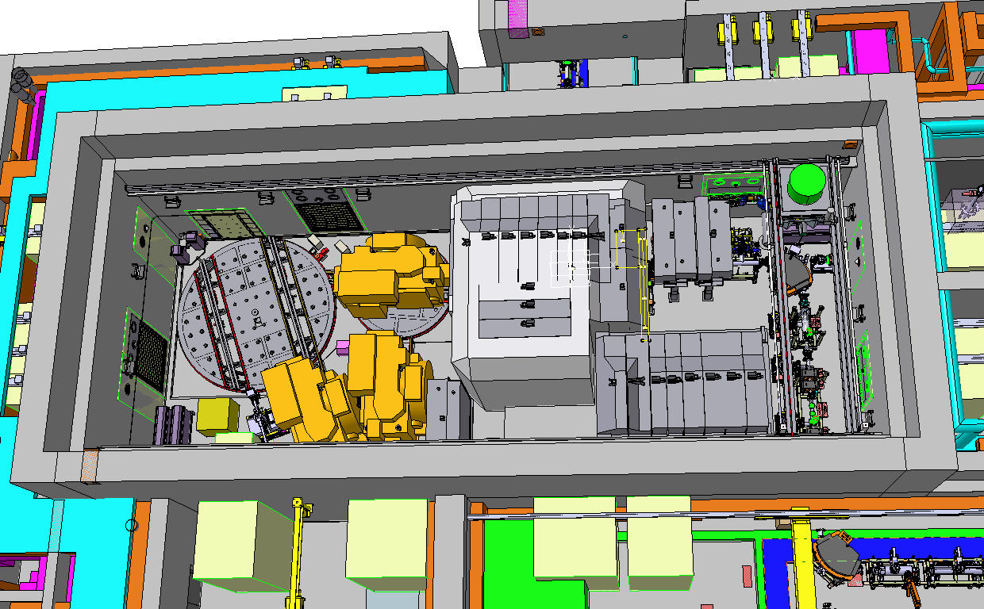
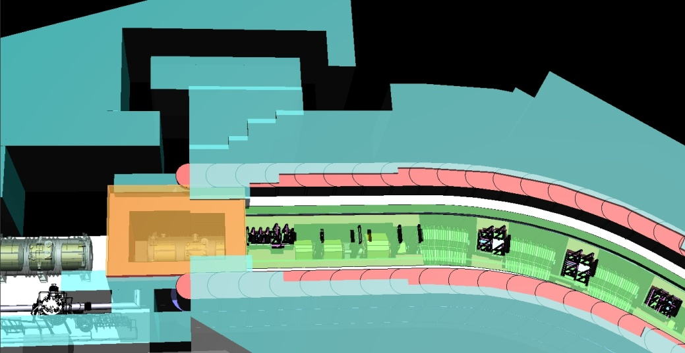
Introduction
WP 9: Tools for Radiactive nuclear beam environment
Objectives:
Conception and design of high-radiation dominated areas and equipment to be used there
Goal:
Maximize delivery time of secondary beams
→ define common strategies, concepts , system designs and related tooling with respect to high-radiation areas
Target area
Beam catcher

Slide 16
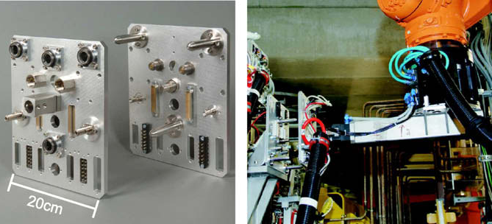
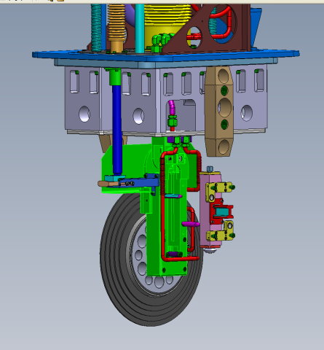
WP 9: Tools for Radiactive nuclear beam environment
9.1 Remote Handling (RH) mountable/dismountable of media supplies
Internal/external media supplies
(HV, control signals, cooling water, gases, exhausts air, …)
Tooling for MS & power manipulators
9.2 Fail safe diagnostics
Validate beam characteristics
→ safety authorities
→ proper system functioning
→ prevent damage on sensitive components

Slide 17
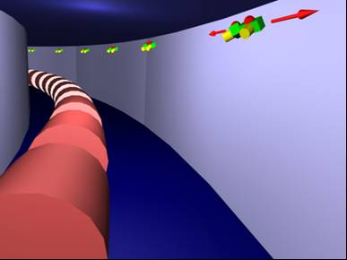
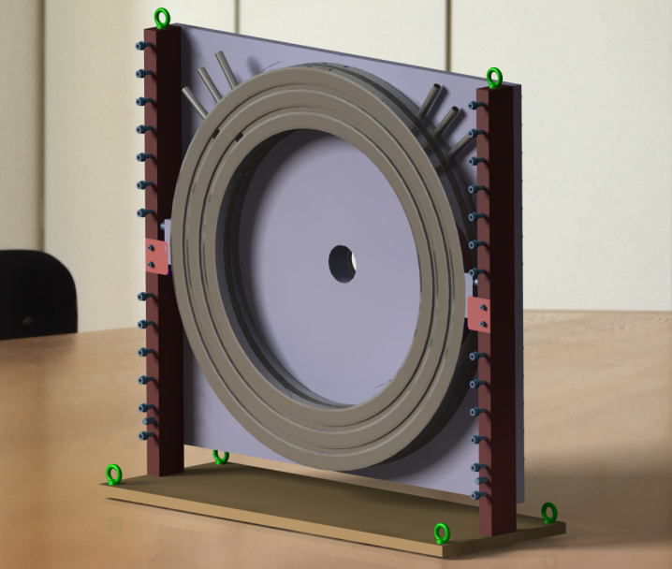
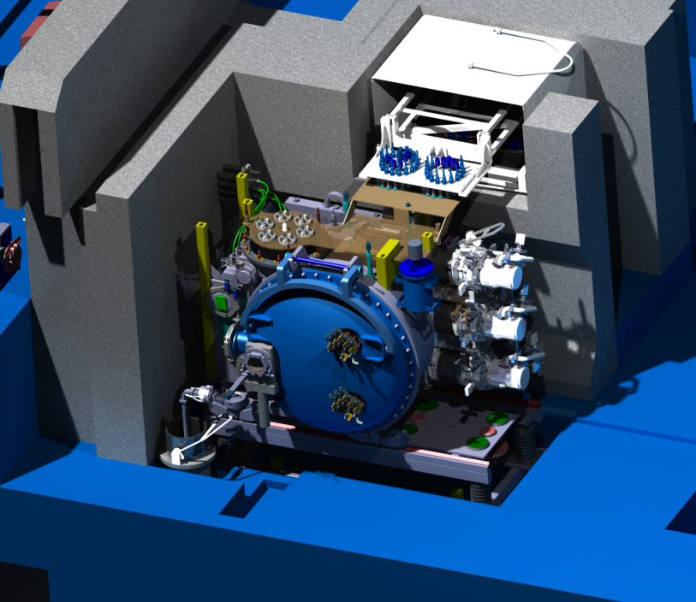
WP 9: Tools for Radiactive nuclear beam environment
9.3 Survey & Alignment
Human access to radiation dominated zones is restricted or forbidden.
Defining of specific equipment
Tooling for RH alignment
RH capable vacuum-tight radiation resistant sealing
Large area pillow-seals
Quick disconnecting solutions based on metal sealing
→ surface treatment
Waste compatibility
Vacuum
Pre-vacuum
Intermediate vacuum

Slide 18
Within the Accelerator Topic Nine ESFRI Projects Participate in the Different Tasks
  ACC/WP3 Ion Sources and Beam Diagnostics
  ACC/WP4 Access to SRF Test Infrastructures
  ACC/WP5 Fast Ramped Superconducting Magnets
  ACC/WP6 Novel Compact Particle Sources
  ACC/WP7 Solid State Amplifiers Using Cavity Combiners
Existing synergies within the accelerator based ESFRI projects will be strongly supported by the tasks defined within this proposal.
  Superconducting technology, either applied to radio-frequency cavities or to beam transport magnets, will be used for most of the upcoming large scale accelerator projects;
  the use of solid state amplifiers adapted to a variety of accelerating structures strongly support this.
  All participating projects require ambitious particle sources design, either for high intensity ion beams or to drive free-electron lasers with their high brilliance electron beams.
These initiatives will push accelerator facilities to performances beyond state-of-the-art.
18
October 17th, 2011 CRISP Kick-off Meeting – Accelerator Topics Hans Weise / DESY

Slide 19
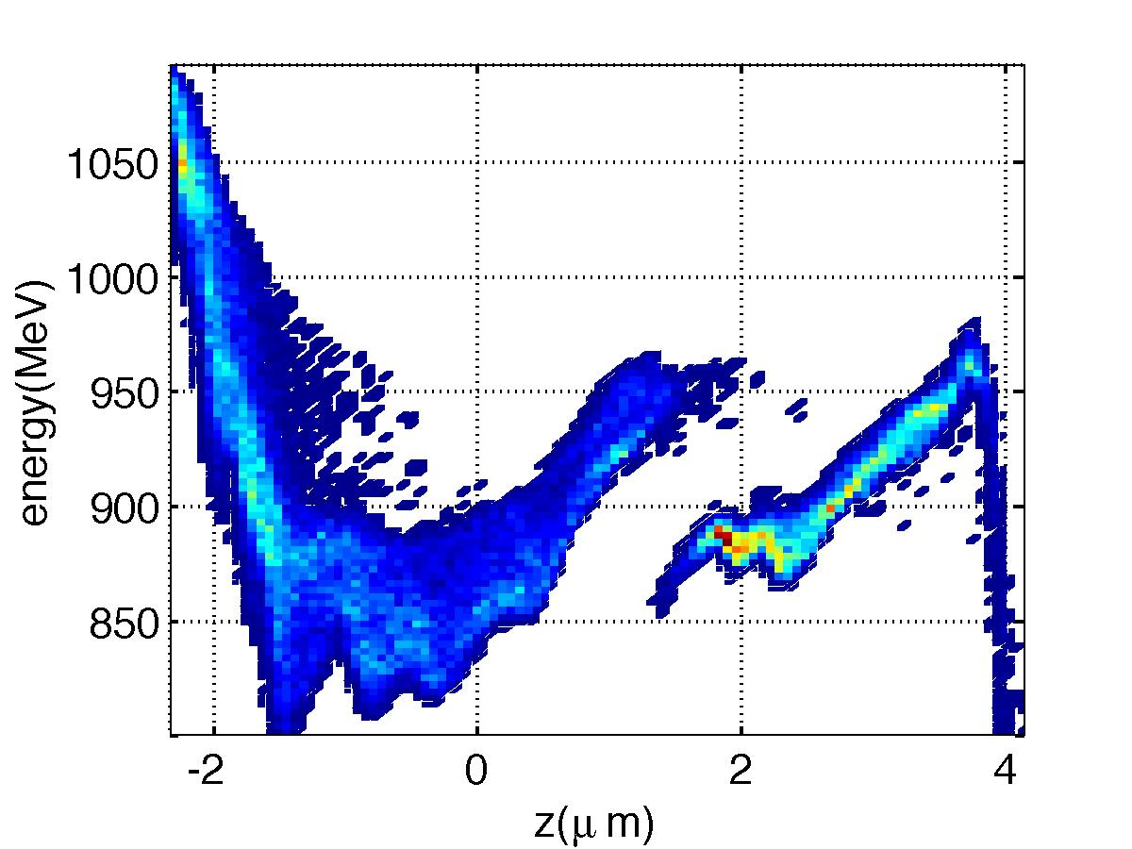
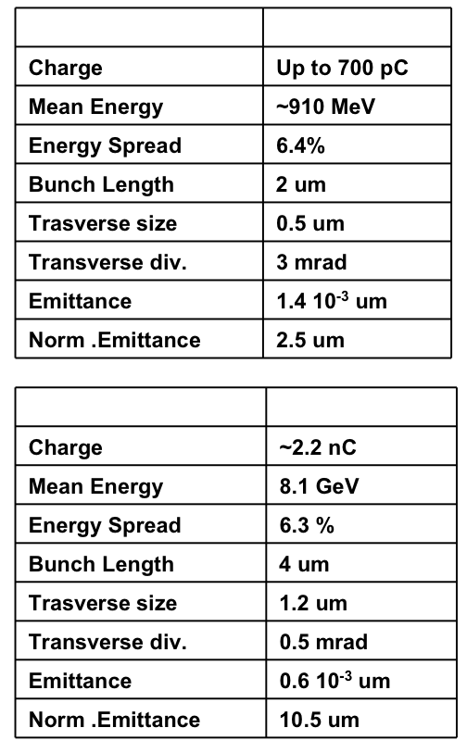
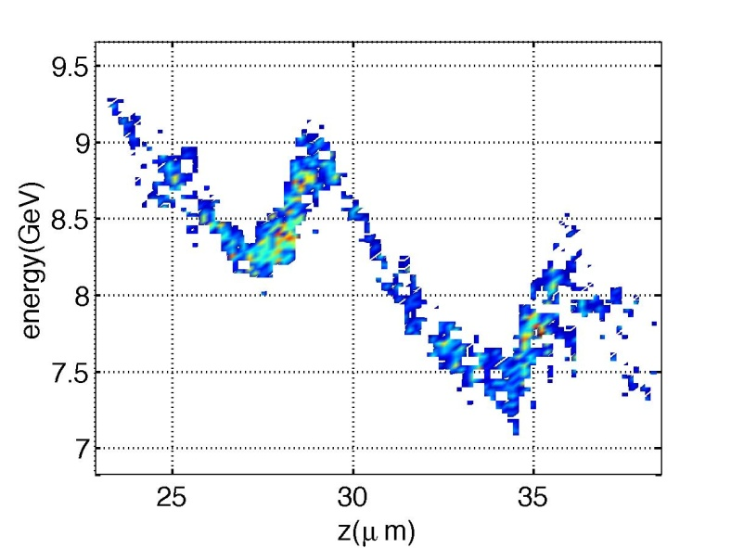
ACC / WP6
Novel Compact Particle Sources
Laser accelerated electron beams
A promising field! Different electron distributions can be obtained from PIC codes.
Courtesy of P. Antici
19
October 17th, 2011 CRISP Kick-off Meeting – Accelerator Topics Hans Weise / DESY

Slide 20

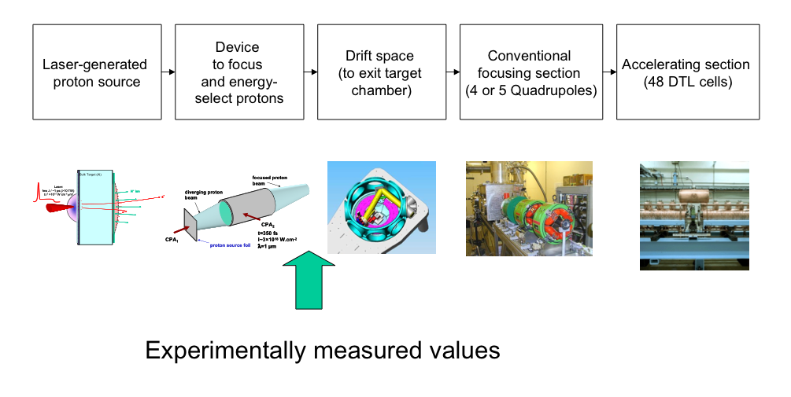
ACC / WP6
Novel Compact Particle Sources
Laser generated proton beams
Proton post acceleration based on conventional accelerator structures.
Courtesy of P. Antici
20
October 17th, 2011 CRISP Kick-off Meeting – Accelerator Topics Hans Weise / DESY

Slide 21
CONCLUSION
CRISP project successfully started, join it if interested!

