Slide 1
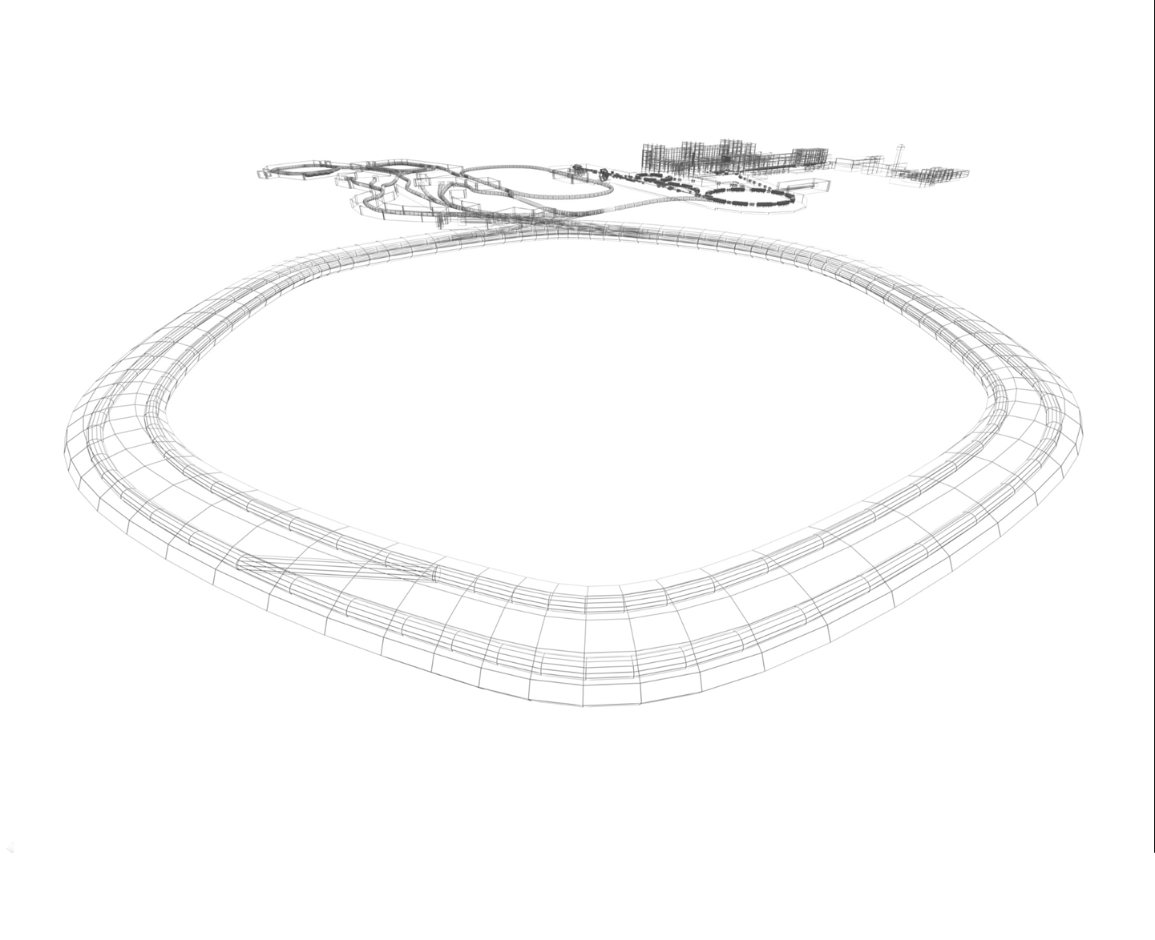
CR Power Converters
6th Joint BINP-FAIR CC Workshop
26.04 - 30.04.2021
Status

Slide 2
CR+TCR1 Power Converters
6th Joint BINP-FAIR CC Workshop
26.04 - 30.04.2021
CR DPC type
CR QPC Type
CR SPC Type
CR OPC Type
CR CPC Type
1 CR Dipole magnets Power
Converter
15 CR Quad magnets Power
Converters
6 CR Sext magnets Power
Converters
12 CR Octupol magnets Power
Converters
48 CR Steer. magnets Power
Converters
2 TCR1 Dipole magnets Power
Converters
2 TCR1 Sext magnets Power
Converters
7 TCR1 Steer. magnets Power
Converters
6 TCR1 Quad magnets Power
Converters
1 PC
23 PCs
8 PCs
12 PCs
55 PCs

Slide 3
DPC Current status
6th Joint BINP-FAIR CC Workshop
26.04 - 30.04.2021
Concept
Discussed and agreed
Specifications
Released
Call for tender near finish
CDR is preparing

Slide 4
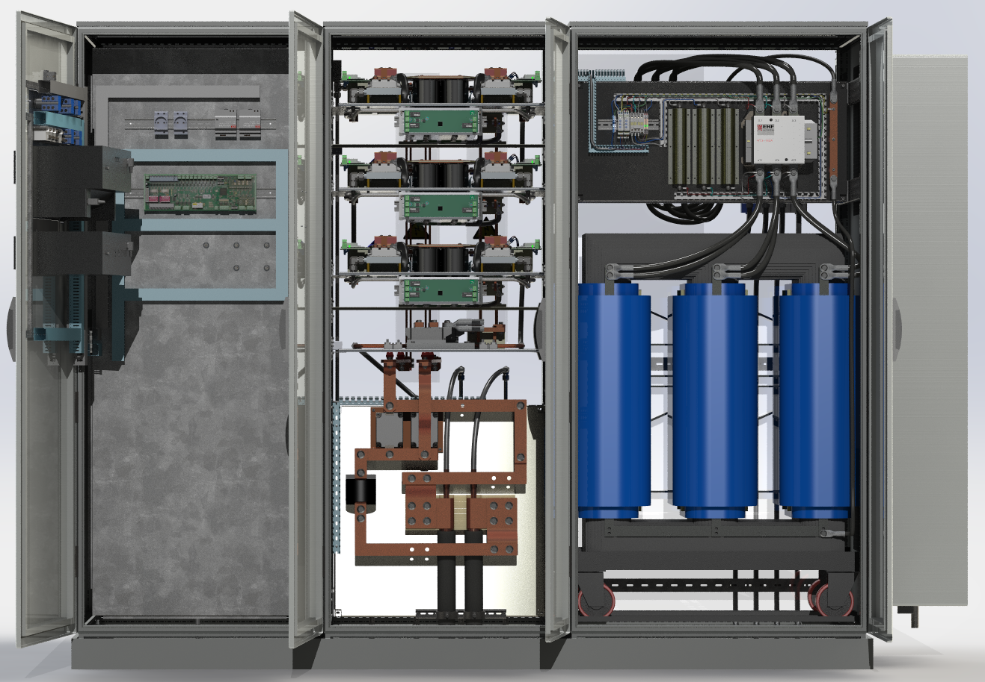
QPC Current status not changed
6th Joint BINP-FAIR CC Workshop
26.04 - 30.04.2021
Concept
Discussed and agreed
Specifications
Released
CDR
Released
FDR
Under preparation
Prototype
Planned Nov 2021

Slide 5
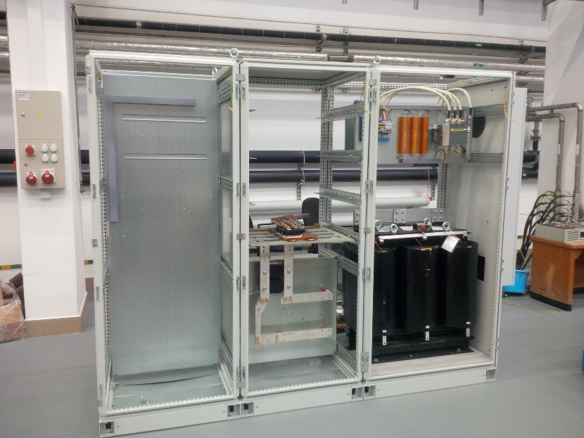
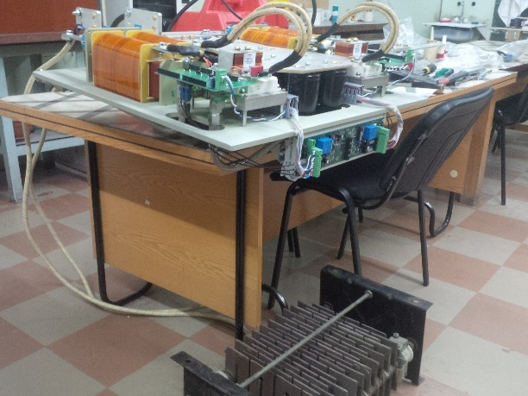
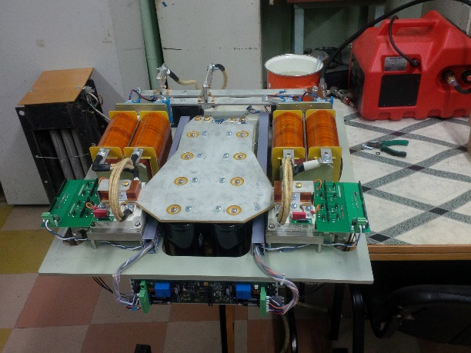
Dipole Test Facility PC (QPC Prototype)
6th Joint BINP-FAIR CC Workshop
26.04 - 30.04.2021
Current status
Power transformer has been received (only one)
All power section were produced.
Busbars was produced.

Slide 6
Thank you for attention
6th Joint BINP-FAIR CC Workshop
26.04 - 30.04.2021

