Slide 1
CR
Main Magnetic Elements
STATUS
Alexandr Starostenko
November 2021

Slide 2
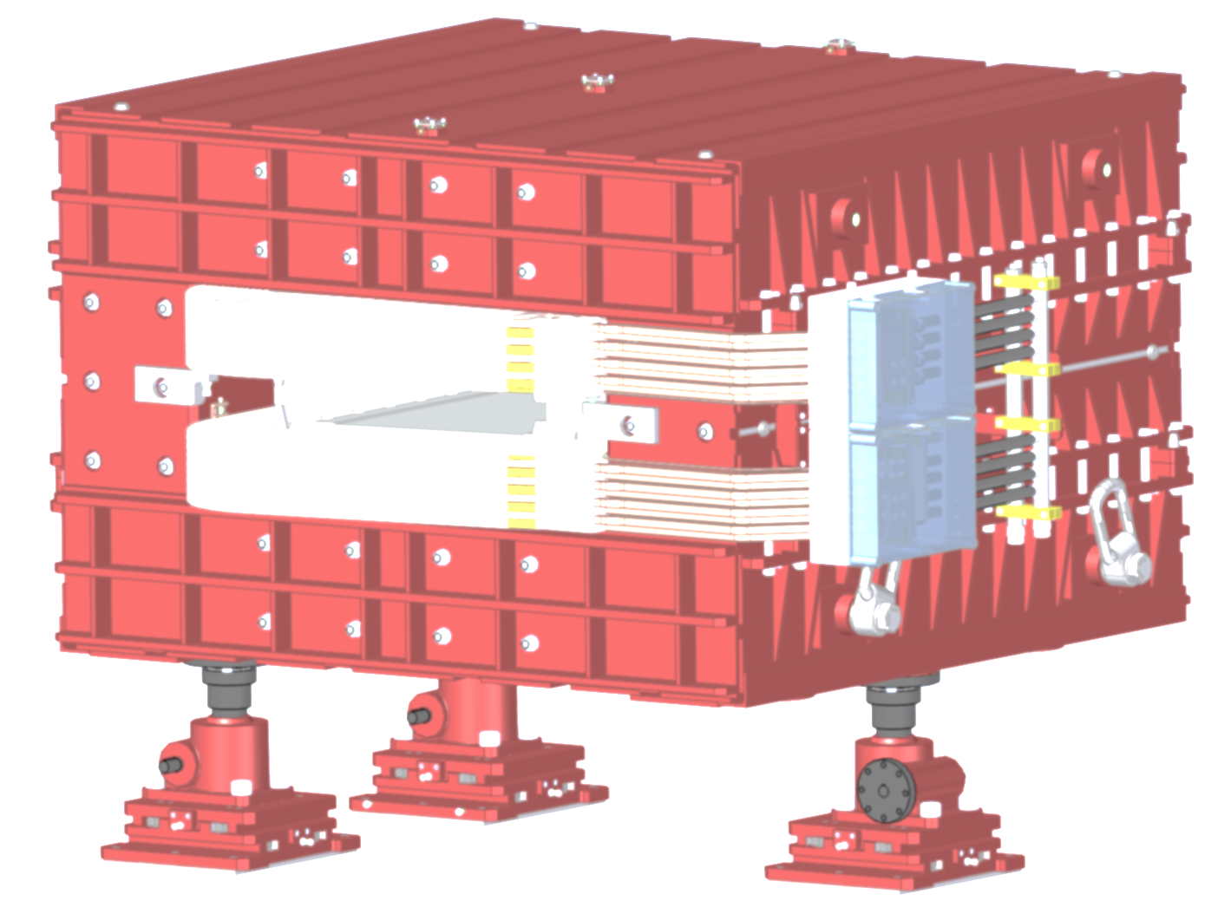
CR dipole

Slide 3
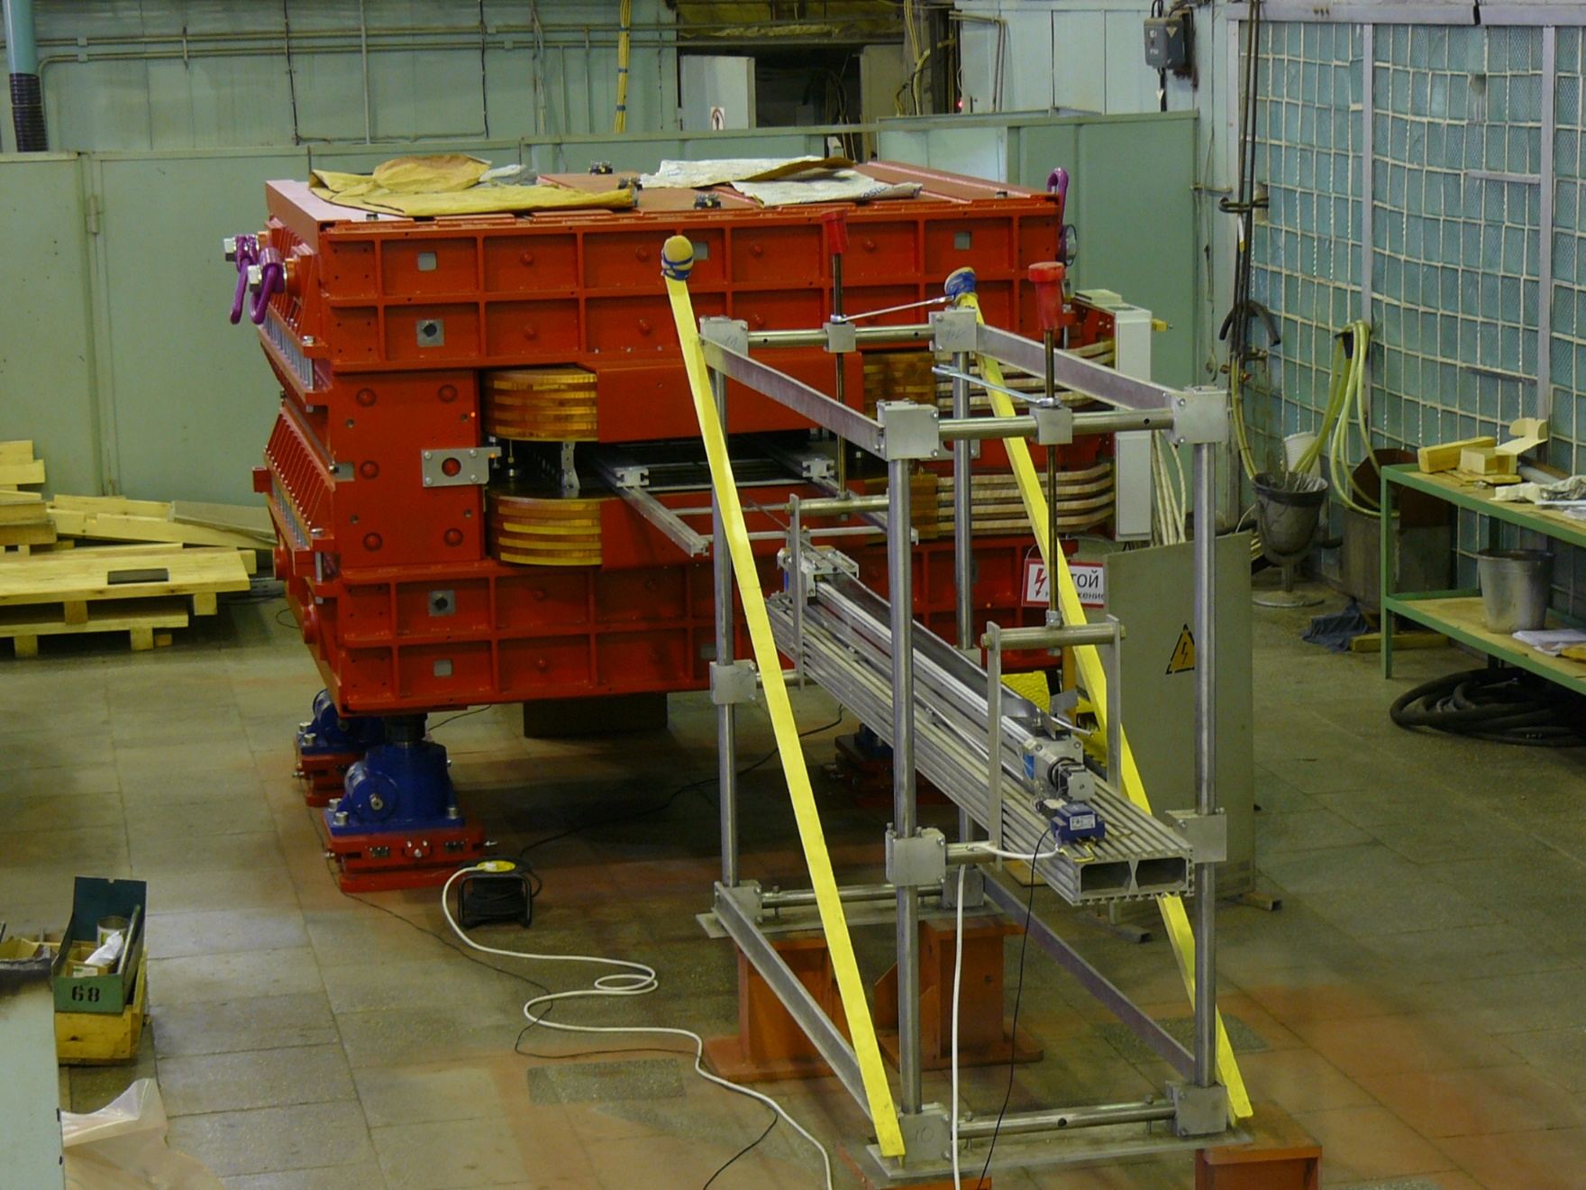
Assembled Dipole on the MMS

Slide 4
Magnetic measurements results

Slide 5
Magnetic measurements results

Slide 6
Magnetic measurements results

Slide 7
Magnetic measurements results

Slide 8
Magnetic measurements results

Slide 9
CR
quadrupoles
and
sextupoles

Slide 10
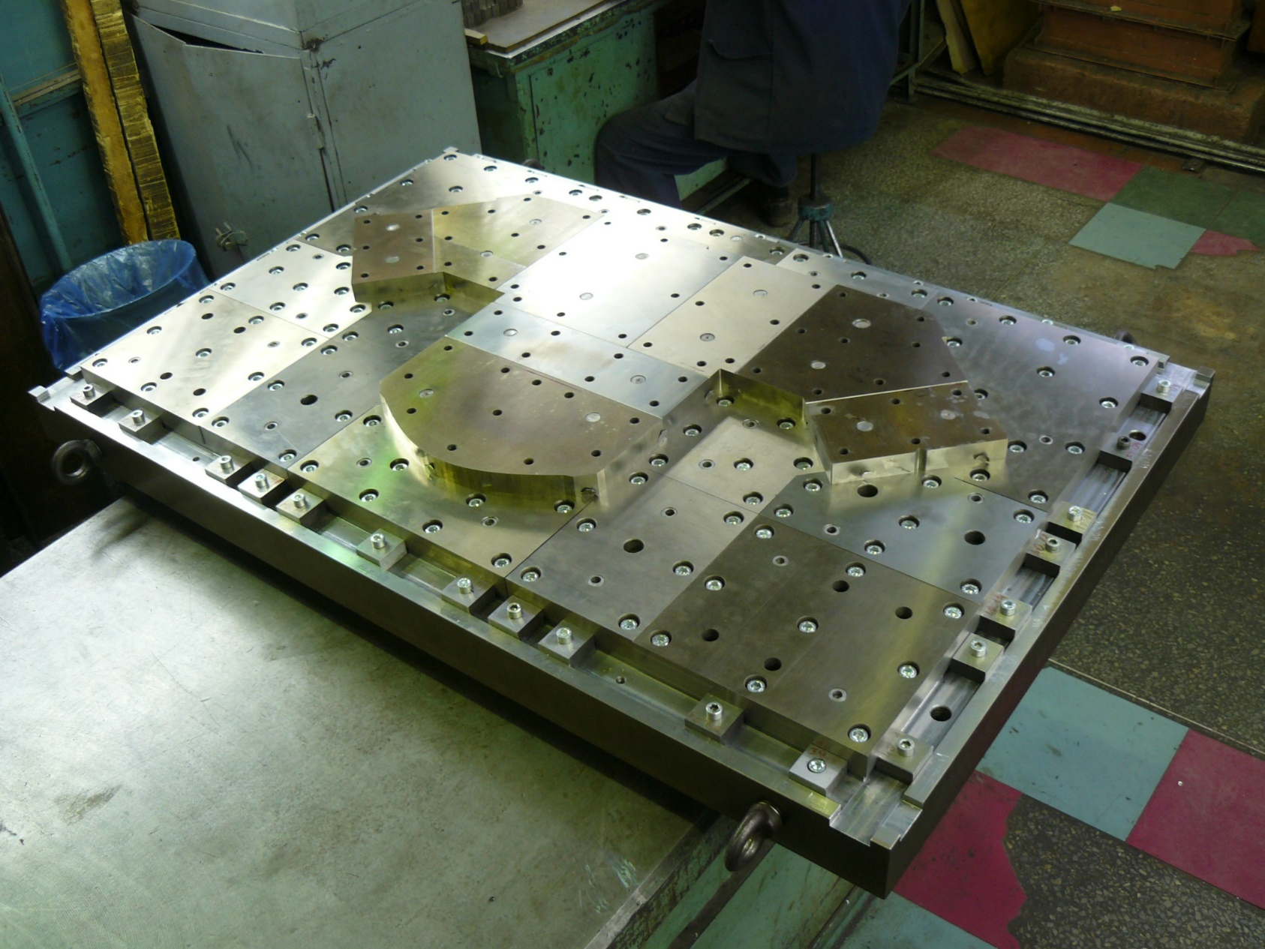
Wide quadrupole stamp under assembling

Slide 11
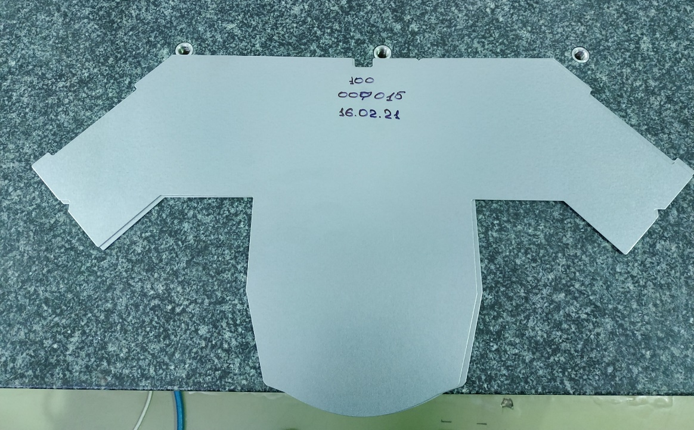
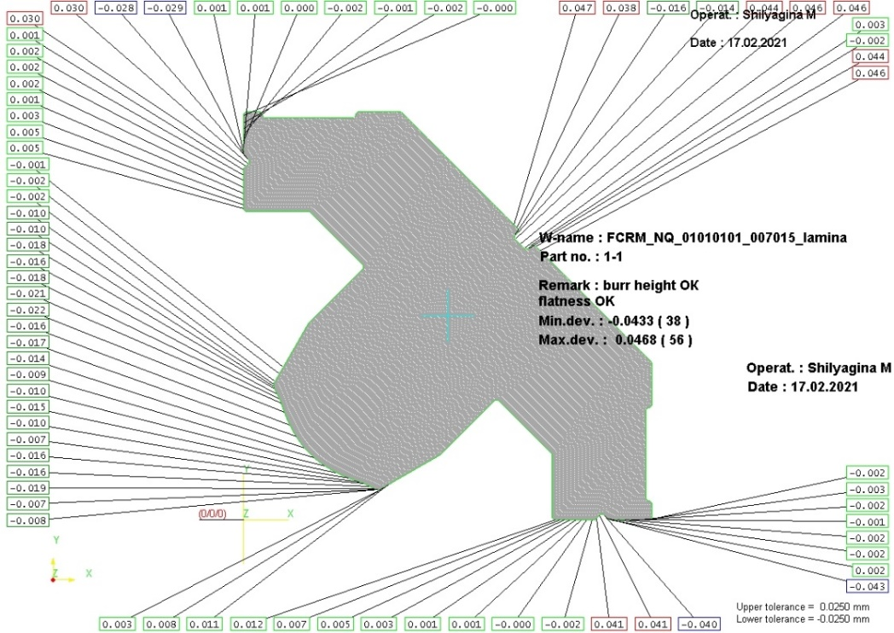
Narrow quadrupole lamina.
Stacking tool under construction…

Slide 12
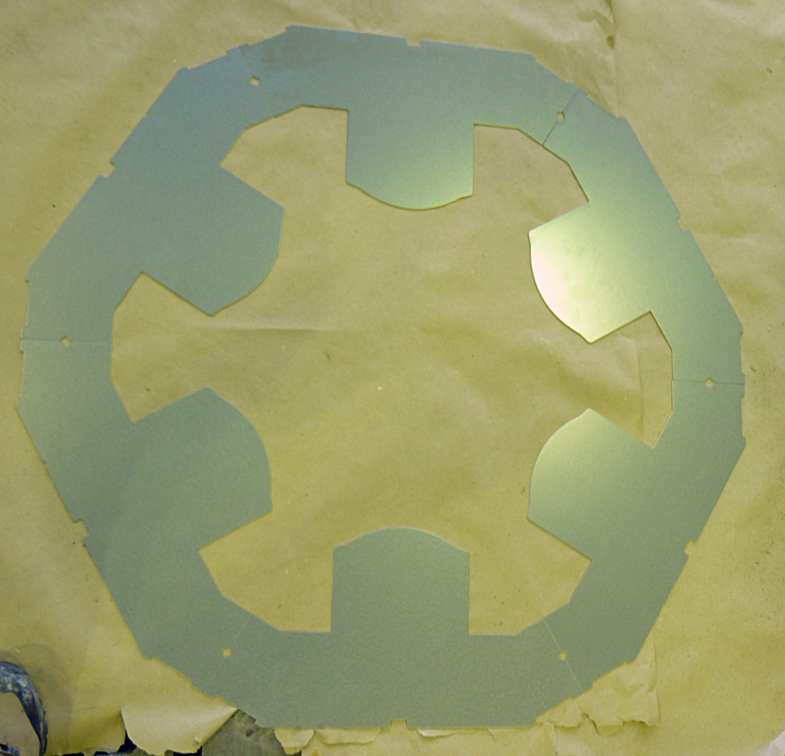
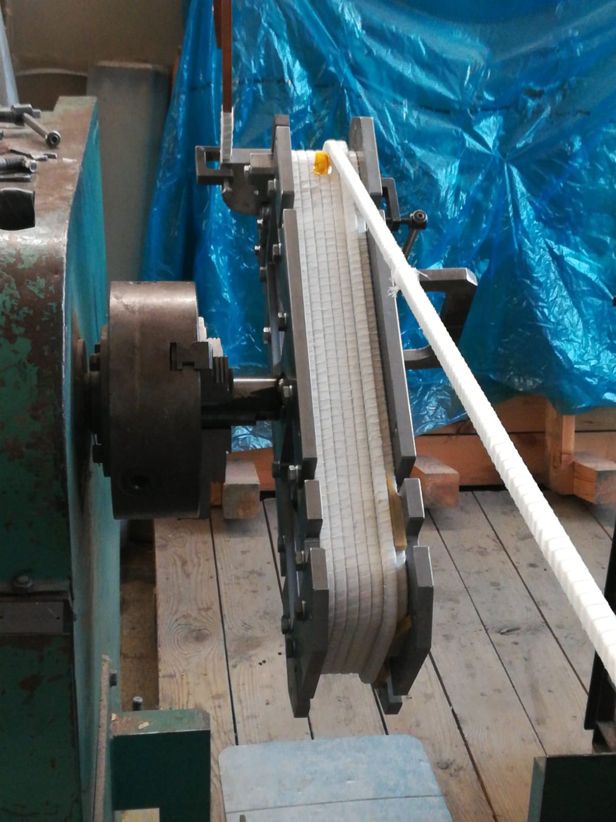
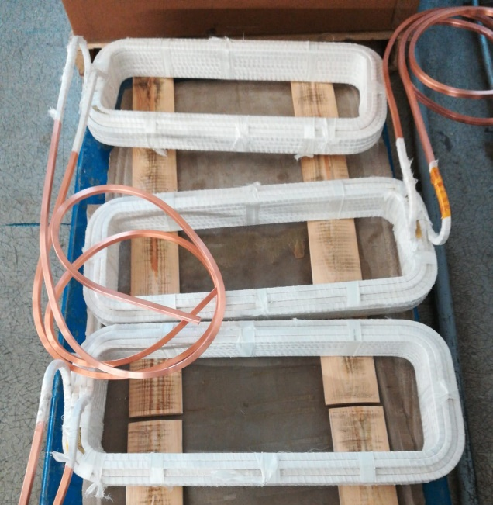
Ready Sextupole parts.
First Sextupole in work…

Slide 13
Thanks!

