Slide 1
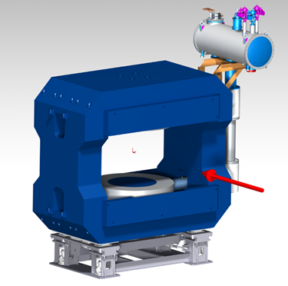
CBM SC magnet Nov. 2021
Peter Senger, 7th BINP-FAIR Workshop, Nov. 7 – 12, 2021
Status:
➢ Official confirmation of delivery date 04/23 ✓
Production of yoke ongoing ✓
Production of power supply ongoing ✓
Layout of cryogenic system almost final
Preparation of mockup coil production (?)
Detailed calculations and test of support strut (?)
Magnet control system: discussion started
1

Slide 2
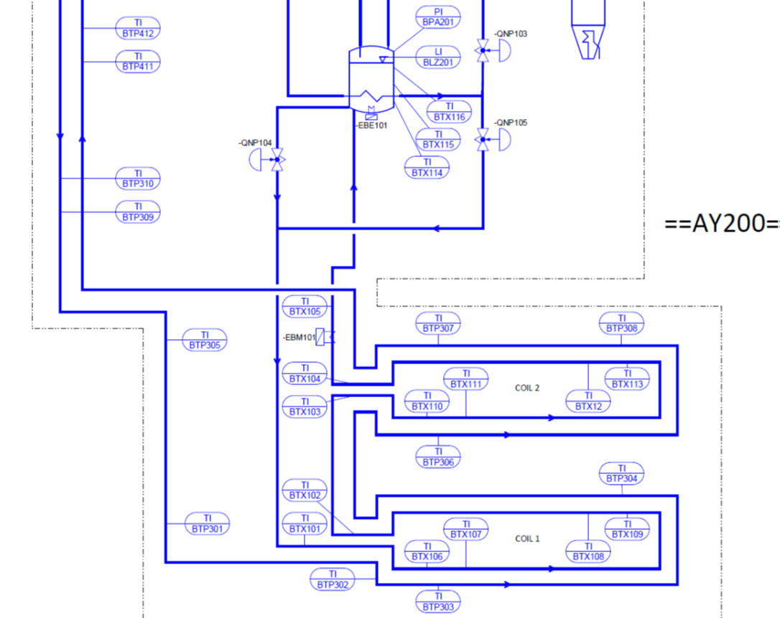
Cryogenic system
Some of the open questions:
Calculation of safety valves
Number of safety valves
Supports of the transfer line
Number of sensors
Finalization of instrumentation list
Dimensioning and fixation of the 3 heaters
…

Slide 3
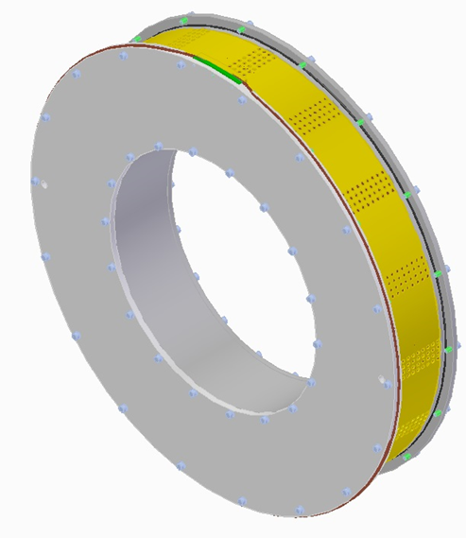
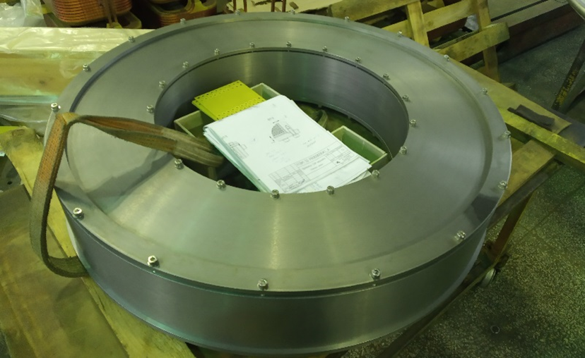
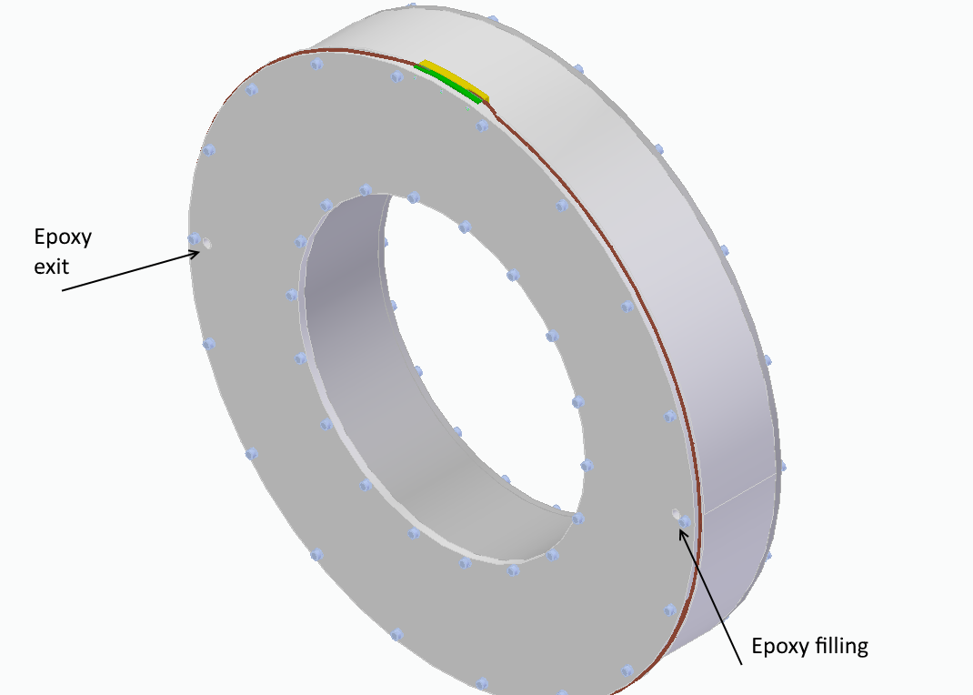
Mockup coils
Production of 2 prototype coils with insulated copper wire in order to test:
Winding tools and winding procedure
Impregnation: epoxy compound, temperature, size of channels, isolation layers, …

Slide 4
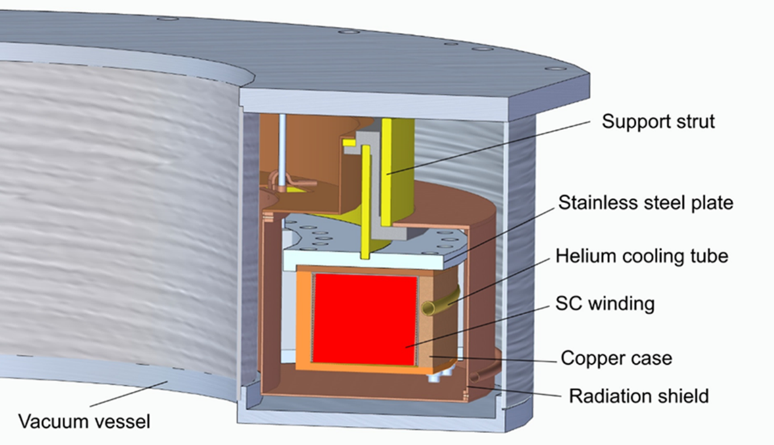
CBM SC magnet: Coil design

Slide 5
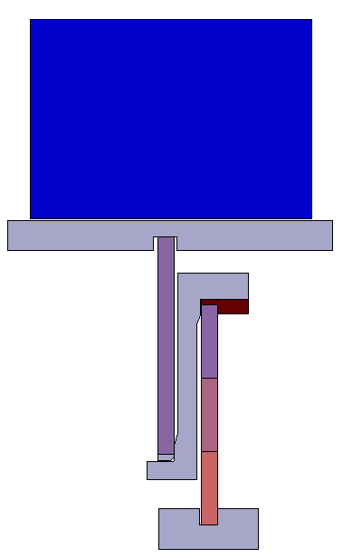
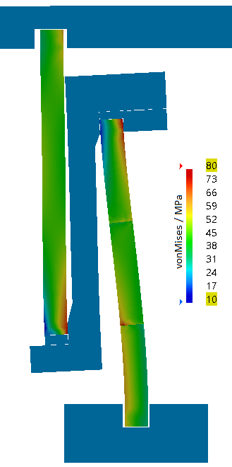
FEM model of the single ring coil strut (J. Lühning)
stress peaks in GFRP cylinders
coil
vM-stress > 80 MPa
Important parameter is the thickness t of the GFPR cylinder:
Critical load ≈ t³
Heat flow ≈ t
Present design:
t =12 mm
inner GFRP cylinder
vM-stress > 80 MPa
inner GFRP cylinder
BINP copper ring
radial degree-of-freedom constrained (no relative movement)
warm plate
warm plate

Slide 6
CBM SC magnet time line
FDR coils 12/21 ?
Coil construction
time critical
FDR Cryogenics ?
Delivery to GSI 04/23

Slide 7
CBM SC magnet: Crucial next steps
Preparation of the FDR of the cryogenic system
(branch box, transfer line, and cryostat).
Impregnation tests with a realistic mockup coil
Single ring support strut (GFRP):
- confirmation of the buckling stress calculations
- stability test with a 1000 t press
- if required: improving stability
Magnet control system to be linked to the GSI
control systems for cryogenics and vacuum.
Risk: Stability of GFPR coil support
Critical path: Coil production

