Slide 1
Open topics
BINP-GSI Workshop Nov. 2021

Slide 2
Design status
2 more unfinished models (due to ECRs 537 and 538);
TPP2QS05 -> FT-BEQS-ZU-0000087
TSN1QS08 -> FT-BEQS-ZU-0000367
CDR almost complete except:
2x Quad11 (FHTQS056AS,FHTQS157AS)
1x S100 (FHTKV030AS, FHTKV010AS)
s13 (all models, see Carstens slides)
46x dip19 (only minor changes due to drawing corrections)
Drawings of all base models except Quad2 long are approved or in final discussions
Drawings of many stands for Quad2 and Quad11 have not been submitted, yet.
90% ready

Slide 3
FAT Status as of 08.11.2021 (excluding already shipped components)
Approved for shipment:
2x Quad11, 12x Quad2, 5x s100, 2x s18 = 21 Magnets
Inspected this week:
1x dip10, 23x Quad2, 65x s100, 2x s18
FAT in progress
dip13¹, dip16¹, 4x Quad11, 4x Quad2, 8x s100, 4x s18
¹OK by GSI FAT Team
OK

Slide 4
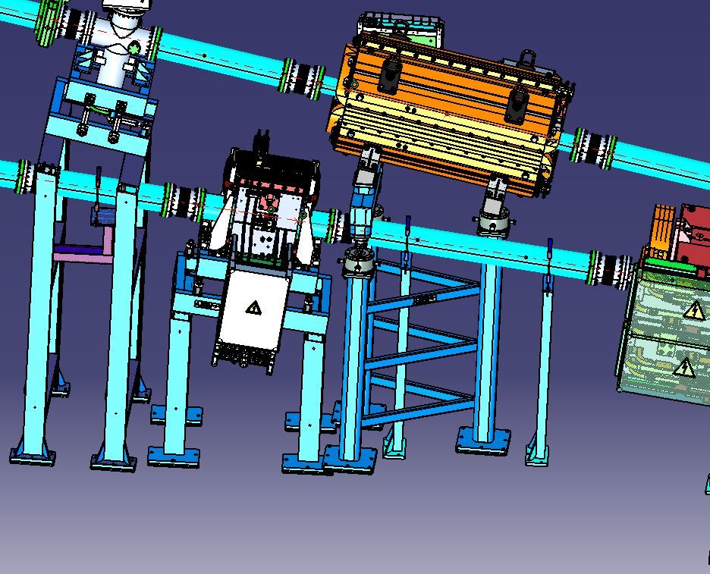
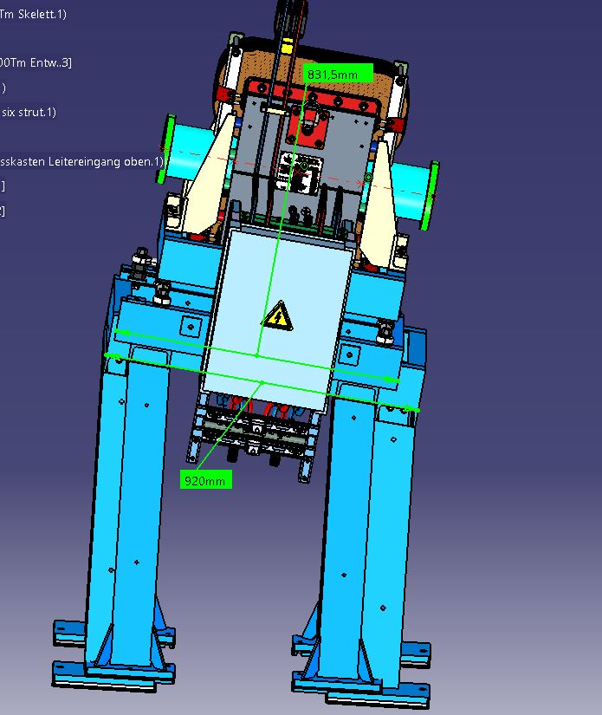
FAT Status as of 08.11.2021 FHTKV030AS
Latest stand was too high and too long (was communicated)

Slide 5
Remaining Tasks Before Shipment (as of 08.11.2021)
Six strut docs
18-001-00001-1
18-002-00001-0
18-002-00012-6
18-002-00017-1
18-002-00019-5
18-002-00023-2
18-002-00024-9
18-002-00026-3
18-000034-13-0
18-000034-15-4
18-000034-14-7
18-000034-16-1
Finish remarks list
18-001-00001-1
18-002-00012-6
18-002-00017-1
18-002-00019-5
18-002-00023-2
18-002-00026-3
18-000036-10-3
18-000036-26-4
18-000036-68-4
Installation instructions for Quad on inclined plane
18-00004-032-2
18-00004-033-9
18-00004-034-6
18-00004-035-3
Rework
18-000036-10-3
18-000036-37-0
18-00004-032-2
18-000034-13-0

Slide 6
Quad2 44-5
Permission given by V. Vostrikov
Are we allowed to do this?

Slide 7
Progress Report of Oct. 2021
Four more steerers are „ready for delivery“
18-002-00007-2
18-001-00018-9
18-000034-34-5
18-000034-35-2
Delivered (?) but not „ready for delivery“
18-00004-044-5
18-00004-046-9
Approved by GSI, but not „ready for delivery“
18-00004-067-4
18-000034-04-8
Will be checked and corrected.

Slide 8
Appendix

Slide 9
List of unsubmitted drawings
FHTQS323AS
FHTQS047AS
FHTQS049AS
FHTQS051AS
FHTQS053AS
FHTQS056AS
FHTQS120AS
FHTQS133AS
FHTQS135AS
FHTQS137AS
FHTQS139AS
FHTQS141AS
FHTQS146AS
FHTQS155AS
FHTQS157AS
FHTQS158AS
FHTQS160AS
FHTQS162AS
FHTQS165AS
FHTQS204AS
FHTQS008AS
FHTQS031AS
FHTQS035AS
FHTQS109AS
FHTQS114AS
FHTQS181AS
FHTQS183AS
FHTQS185AS
FHTQS187AS
FHTQS189AS
FHTQS191AS
FHTQS193AS
FHTQS195AS
FHTQS208AS
FHTQS363AS
FHTQS360AS
FHTDI040AS
FHTKH036AS
FHTKH011AS
FHTKV001AS
FHTVA214AS
FHTKV015AS

Slide 10
Not approved drawings in all stages
FHTMH065AS
FHTMH160AS
FHTMV034AS
FHTMV068AS
FHTMV010AS
FHTMV062AS
FHTMV064AS
FHTMV066AS
FHTMH033AS
FHTMH037AS
FHTQS217AS
FHTQS323AS
FHTQS047AS
FHTQS049AS
FHTQS051AS
FHTQS053AS
FHTQS056AS
FHTQS120AS
FHTQS133AS
FHTQS135AS
FHTQS137AS
FHTQS139AS
FHTQS141AS
FHTQS146AS
FHTQS155AS
FHTQS157AS
FHTQS158AS
FHTQS160AS
FHTQS162AS
FHTQS165AS
FHTQS118AS
FHTQS204AS
FHTQS008AS
FHTQS031AS
FHTQS035AS
FHTQS044AS
FHTQS109AS
FHTQS114AS
FHTQS181AS
FHTQS183AS
FHTQS185AS
FHTQS187AS
FHTQS189AS
FHTQS191AS
FHTQS193AS
FHTQS195AS
FHTQS208AS
FHTQS212AS
FHTQS363AS
FHTQS360AS
FHTDI472AS
FHTDI037AS
FHTDI038AS
FHTDI039AS
FHTDI040AS
FHTDI041AS
FHTDI061AS
FHTDI454AS
FHTKH015AS
FHTKH018AS
FHTKH026AS
FHTKH032AS
FHTKH034AS
FHTKH036AS
FHTKH038AS
FHTKH039AS
FHTKH047AS
FHTKH049AS
FHTKH060AS
FHTKH142AS
FHTKV010AS
FHTKV012AS
FHTKV014AS
FHTKV020AS
FHTKV022AS
FHTKV030AS
FHTDI436AS
FHTDI440AS
FHTKH157AS
FHTDI009AS
FHTDI011AS
FHTDI089AS
FHTKH001AS
FHTKH011AS
FHTKH012AS
FHTKH014AS
FHTKV001AS
FHTVA214AS
FHTKH002AS
FHTKV015AS

Slide 11
List on current design status
→see additional material

