Slide 1
Collector Ring express status report
Dmitry Shwartz
on behalf of the BINP team
7th BINP-FAIR Collaboration Coordination Workshop, online, 9 Nov 2021

Slide 2
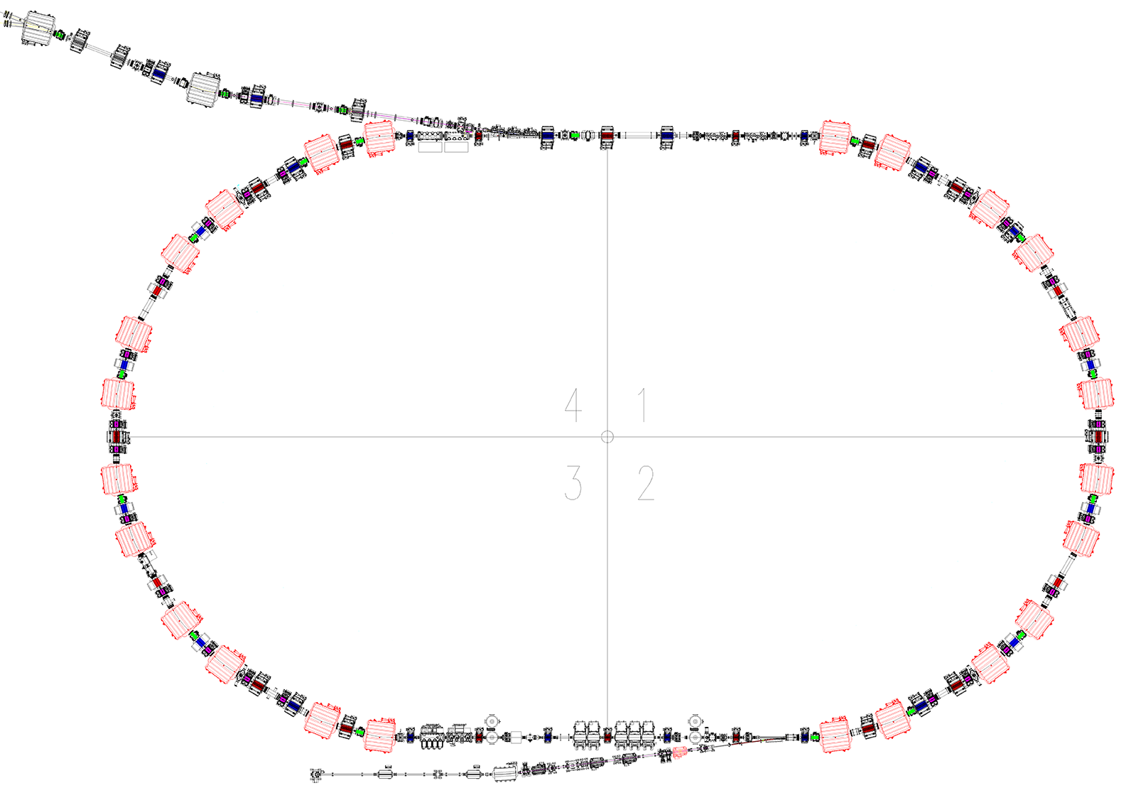
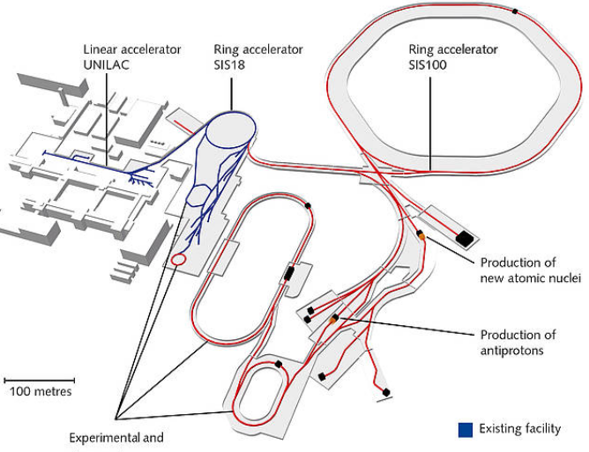
Collector Ring: huge work, _{low} priority
Beam from
p_bar & SFRS
Inj septa
EWQ
NQ
Dipole
WQ
SWQ
Stochastic cooling
kickers
Inj/Extr kickers
Beam scraper
HESR
Scintillating screen
Pickup
CR
Stochastic cooling
pickups
ToF detector
Sextupole
RF debunchers
Extr septa
Extraction to HESR

Slide 3
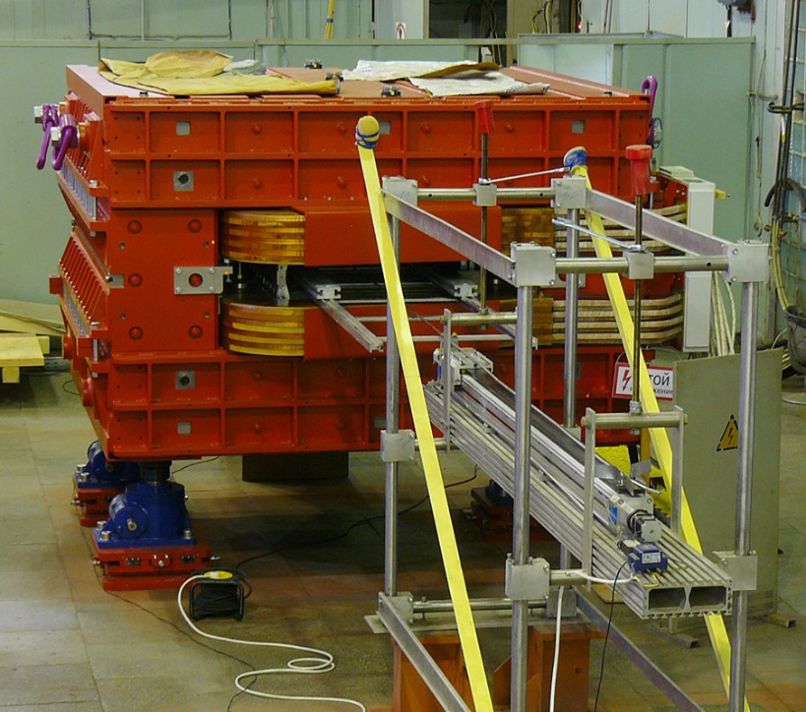
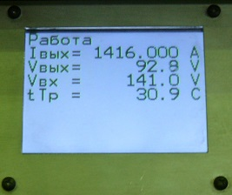
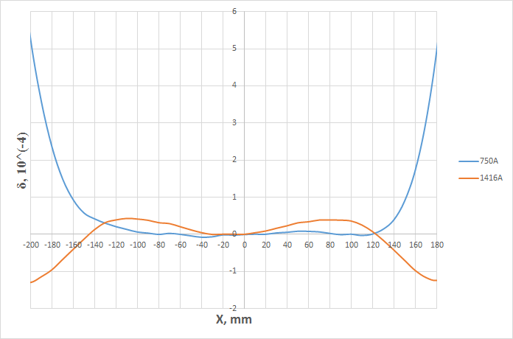
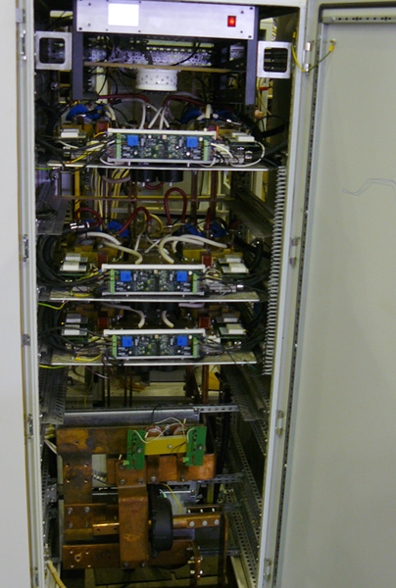
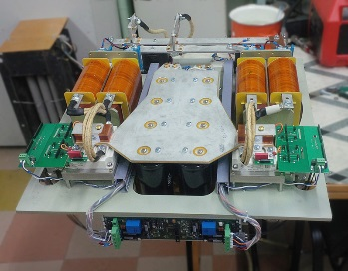
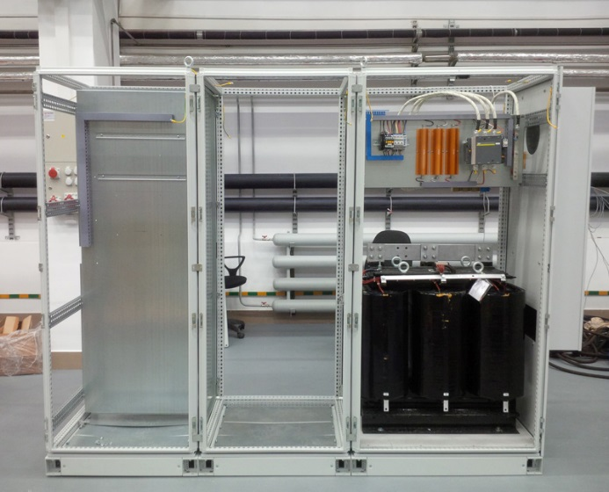
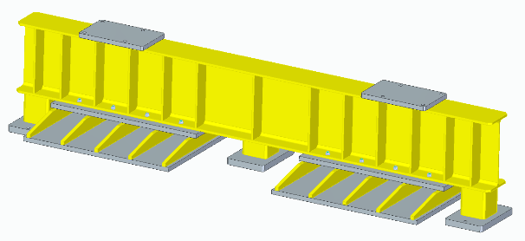
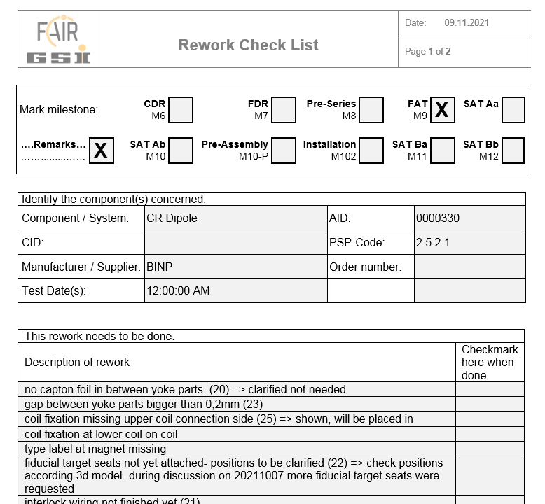
FoS Dipole: FAT ongoing, SAT on the horizon
QPC Prototype-1, working very well routinely at magnetic measurements stand
Field quality: (preliminary) within spec
Dipole @ magnetic measurements
FAT has been started, a dozen of non-critical remarks were obtained
Transport
frames: production ongoing
QPC Prototype-2, assembly is ongoing, 1st section under testing.
To be delivered for FoS dipole SAT at GSI/FAIR site
Talks by
A.Starostenko, Wed, 16:00
D.Senkov, Thu, 14:20

Slide 4
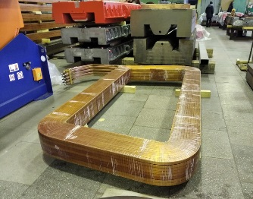
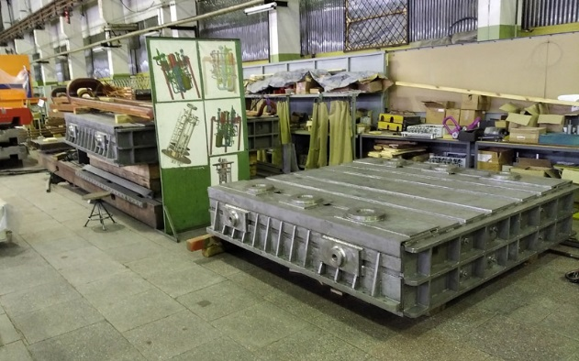
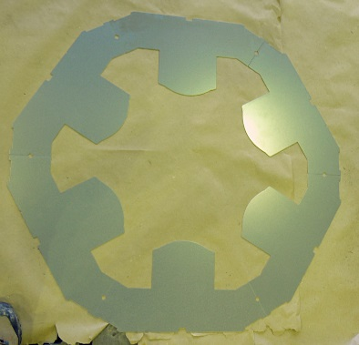
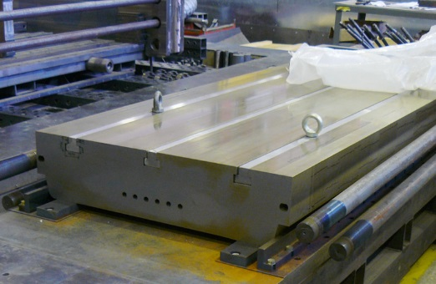
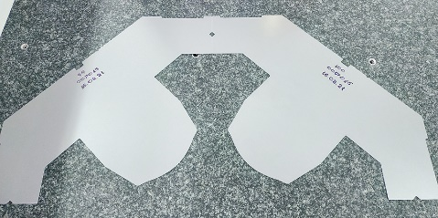
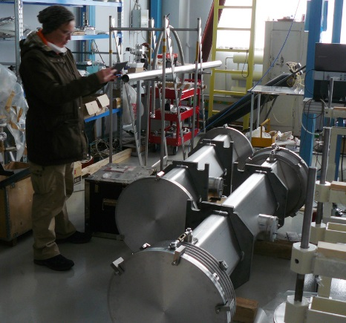
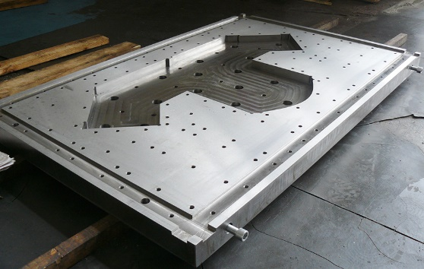
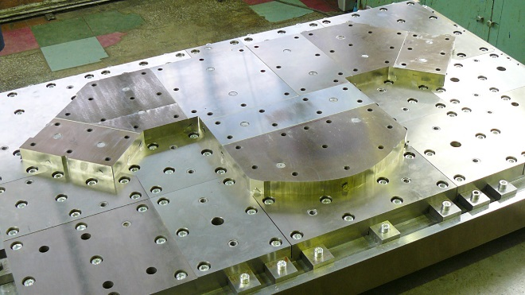
Magnet and vacuum systems
CR/TCR1/pbar sextupole: test laminas stamped; all the tooling is ready; we expect to get FoS magnet by the end of 2021
Serial (2nd) dipole parts production
Narrow quadrupole test laminas stamped, CDR ongoing, FDR underway
Wide quadrupole stamping tooling assembly
Reworked vacuum chambers prototypes, waiting for final vacuum testing

Slide 5
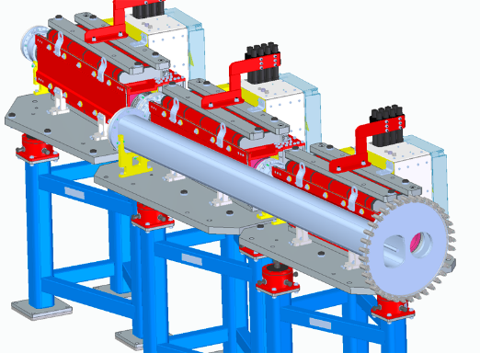
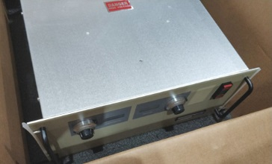
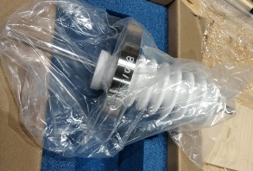
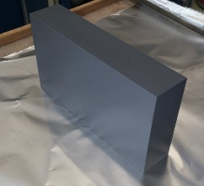
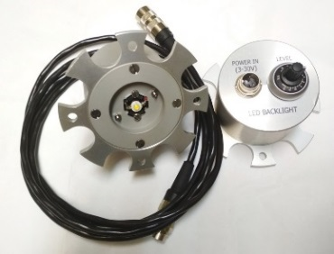
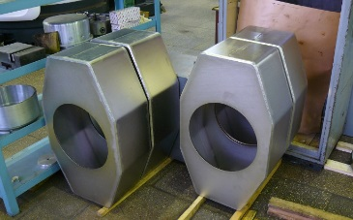
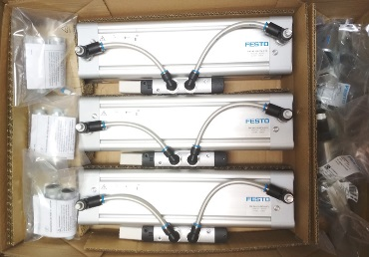
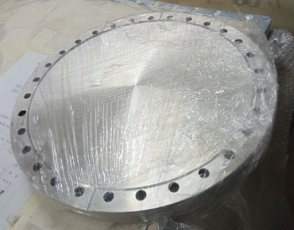
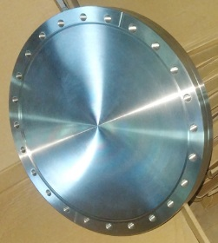
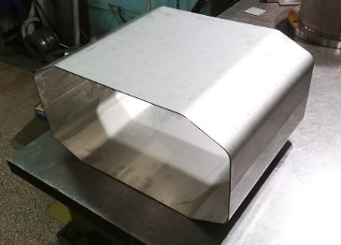
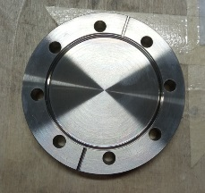
Other highlights
Injection septa: CDR ongoing, FDR underway (talk by P.Shatunov, Wed, 16:30)
Kickers: HV PS, ferrites and feedthroughs delivered to Novosibirsk; Power Supply – new concept (talk by A.Kasaev, I.Koop, Wed, 17:00)
Diagnostics: Scrapers and Stoppers FDRs released (talk by Yu.Rogovsky, Thu, 14:40)
Power converters: Dipoles PC nearly tendered via FAIR (talk by D.Senkov, Thu, 14:20)
Infrastructure: water distribution concept proposed by M.Chilikin & A.Rahimov (talk by T.Ziglasch, Thu, 15:00)
ITEP, Moscow: Schottky Pick-Up CDR released

Slide 6
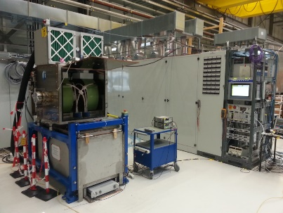
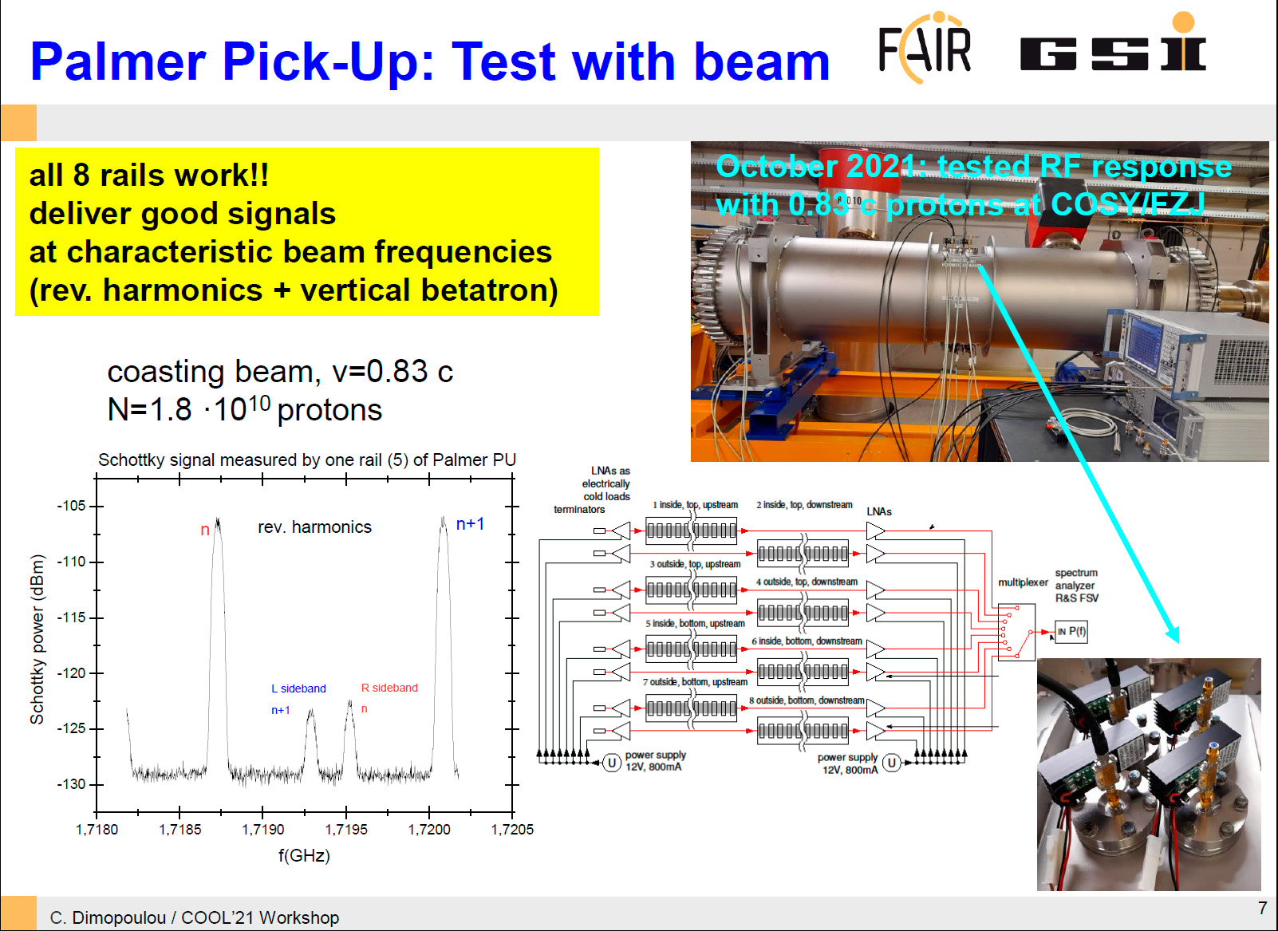
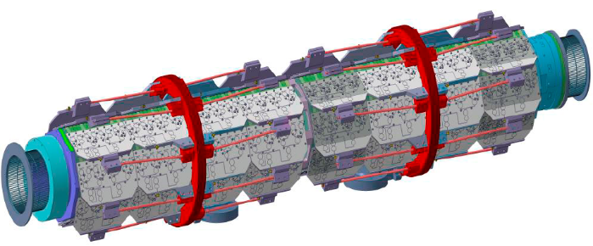
GSI in-kind: good progress
RF debuncher:
All 5 RF systems
delivered to GSI
SC Pick-Up: components production
ongoing (vacuum tanks, Ag-coated
foils, slotline electrodes, etc)
SC Kicker: CDR and contract with FZJ
are underway

Slide 7
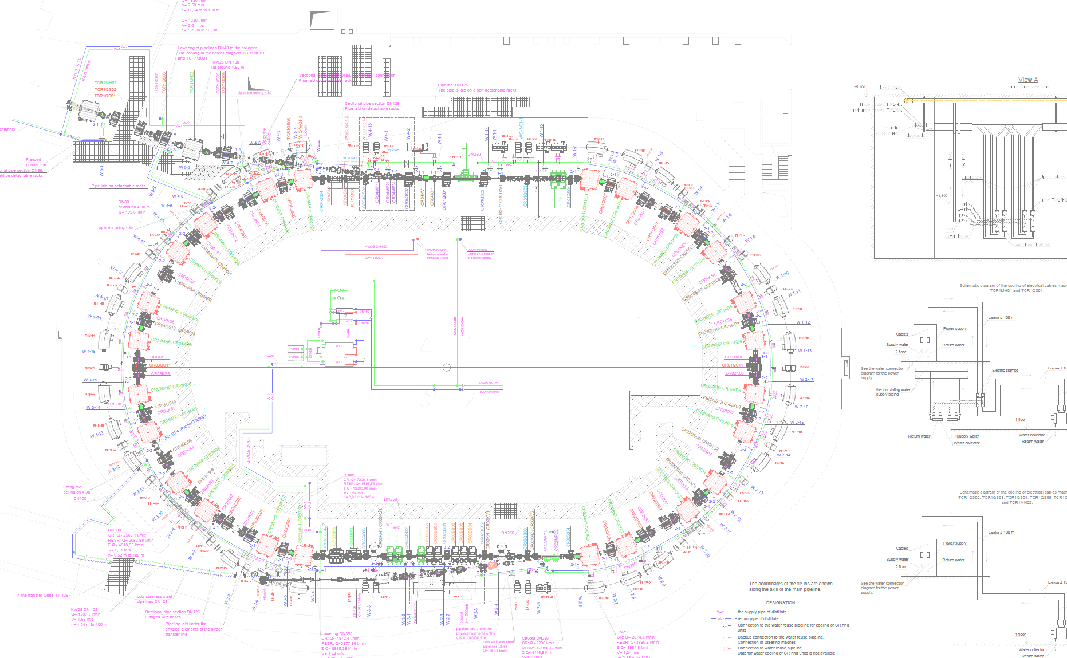
Thank you
for your attention!

