Slide 1
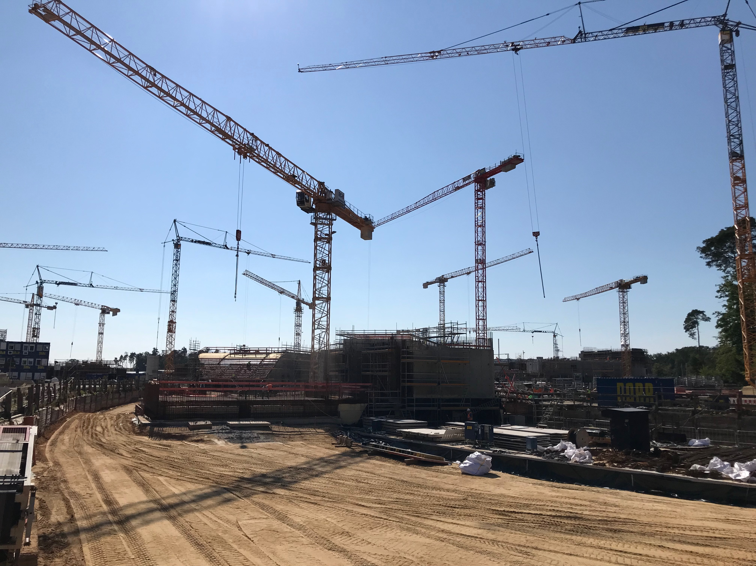
Report from GSI beam time coordinator
Daniel Severin

Slide 2
Upcoming beam time 2022
Next beam time 2023+24
Physics beam time 2025 and beyond

Slide 3
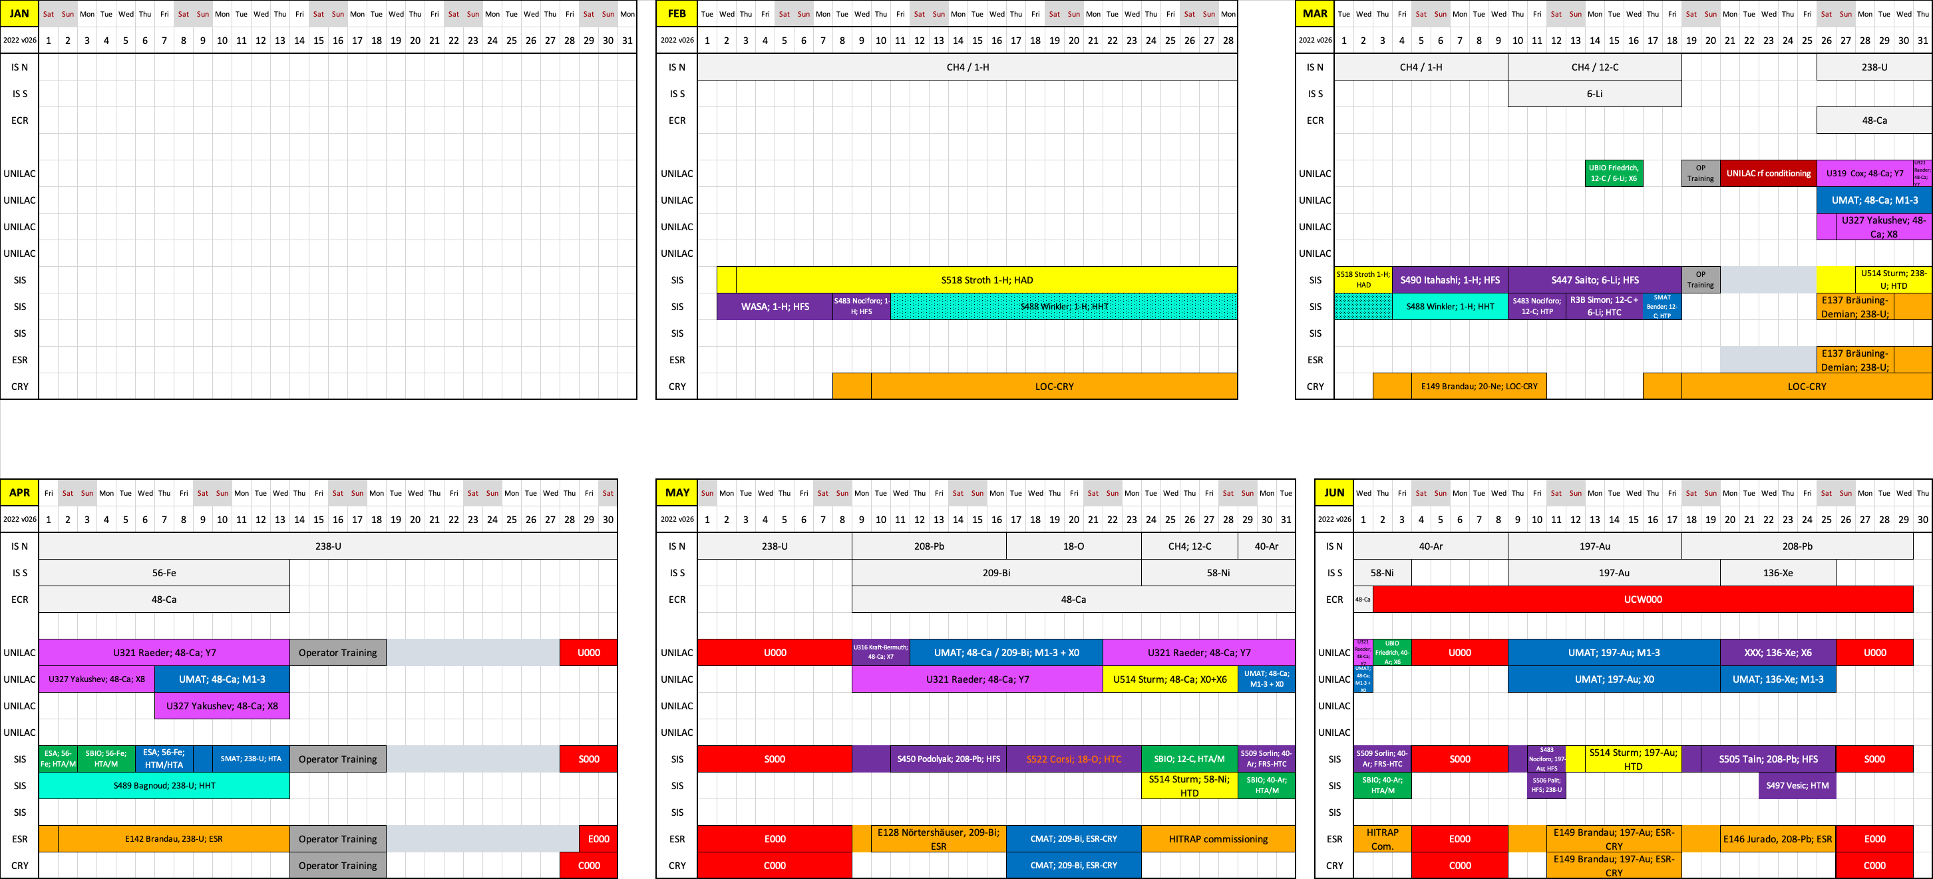
Upcoming beam time 2022
Beam time schedule 2022 v027
Online: www.gsi.de/beamtime

Slide 4
Upcoming beam time 2022
Light beams
WASA program with p and Li
R3B and S-FRS Detector tests
Uranium block
FRS blocked due to WASA dismounting
Heavy beams
Regular FRS operation
Discussion about scheduling details ongoing
3x experiments with FRS
S-FRS Detector tests
R3B exp. with direct beam to HTC

Slide 5
Upcoming beam time 2022
Next beam time 2023+24
Physics beam time 2025 and beyond

Slide 6
Next beam time 2023+24
Supernumerary G-PAC meeting Dec. 2021
Strategic few of the next years
Perspectives and planning of large scale installations
Note: limited resources due to FAIR installation
Transition to FAIR
Special new operation modes (development)
G-PAC Meeting 2022 (for beam time 2023/24)
Regular call for two years (3 month physics beam time per year)
Call open (end spring) / deadline in summer
G-PAC meeting end Sep. 2022
Beam time schedule 2023 published end 2022

Slide 7
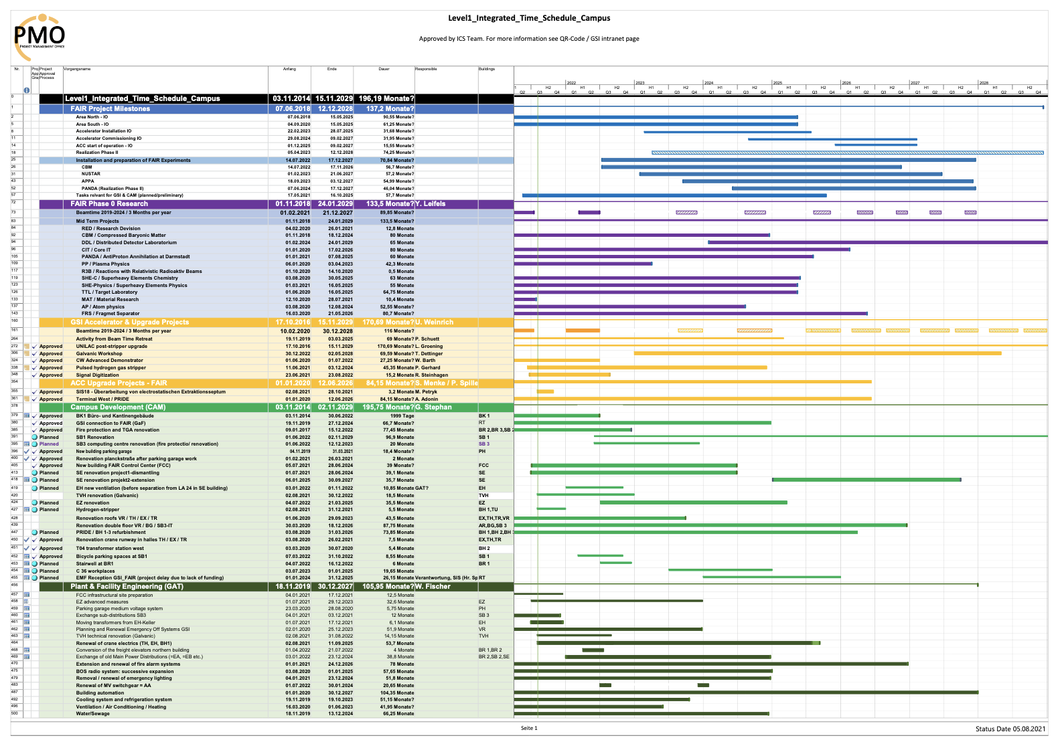
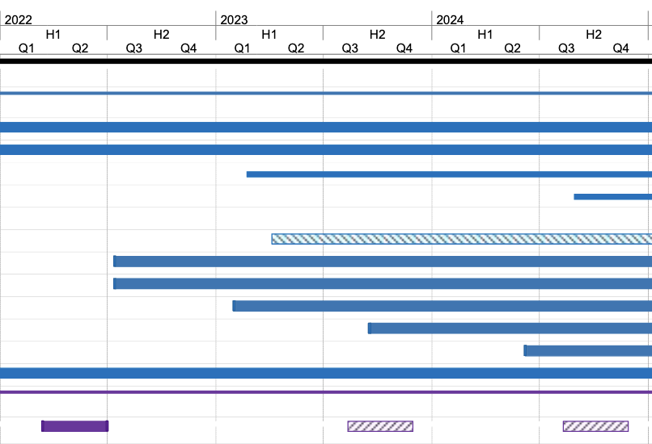
Next beam time 2023+24
Integrated Campus Schedule

Slide 8
Upcoming beam time 2022
Next beam time 2023+24
Physics beam time 2025 and beyond

Slide 9
Physics beam time 2025 and beyond
A few personal thoughts
Transition phase
FAIR commissioning with beam
Possible parallel operation with physics program
Clear set of available beam parameters
Different foci for each (sub) collaboration (installation / commissioning / beam time)
FAIR regular operation
Parallel operation will be one of the key figures of the facility, BUT also one of the main challenges

Slide 10
Open questions presented by Wolfram
Requirements for FAIR phase-0 and Day-1 operation
Overall intensity increase from SIS18 (min. 5.10⁹ p/spill ²³⁸U⁷³⁺ for early physics)
Routine operation of pulsed H stripper
Overall improvement of the transmission UNILAC-SIS18-FRS
Fast ramping and 2.7 Hz ion source operation
Open questions
Can the spill structure limitations for slow-extraction beams from SIS18 be solved for SIS100 operation ?
Optimization not only needed for the NUSTAR pilot beam (²³⁸U), but also for other “standard” beams (²⁰⁸Pb, ¹³⁸Xe, ⁴⁰Ar, ¹⁶O, ….)
Parallel operation of SIS18/FRS and SIS100/S-FRS for experiments ?
Plans for FAIR operation during UNILAC upgrade (202x) ?
🧐
🤔
🧐
Presented at the Beam Time Retreat 2021
Courtesy of W. Korten

Slide 11
FAIR commissioning
integrated campus schedule
FAIR Installation of Accelerator Components
FAIR-Hardware-Commissioning
FAIR Beam-Commissioning & early science
GSI operation
GSI operation
GSI operation
FAIR-injector operation
2021
2022
2023
2024
2025
reduced availability for users,
reduced parallel operation more machine related research
major restrictions for user operation on GSI campus (FAIR beam will have priority)
no long shutdown periods desired
Courtesy of S. Reimann

Slide 12
Beam time influencing projects
FAIR Installation of Accelerator Components
FAIR-Hardware-Commissioning
FAIR Beam-Commissioning & early science
GSI operation
GSI operation
GSI operation
FAIR-injector operation
The transition period needs to be defined -> discussions have started
More opportunities
within commissioning
with parallel operation
Your input is welcome and required
Pulsed Gas Stripper
Source Terminal
MCR -> FCC
Post Stripper Upgrade
HELIAC
ECR re-structuring
2022
2023
2024
2025
Future

Slide 13
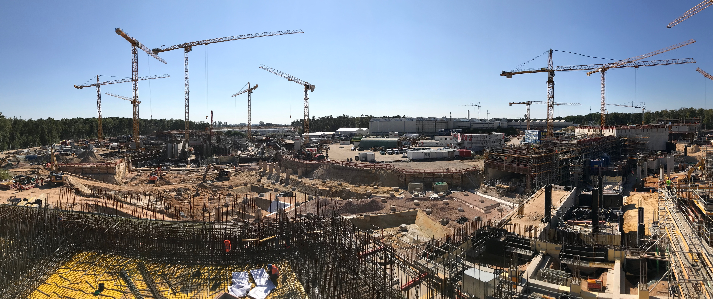
Thanks for you attention!

