Slide 1
PANDA COLLABORATION MEETING
HESR-PANDA Chicane Dipole Magnet
STATUS AND PLANS
14-18 June 2021

Slide 2
Main Specifications for Dipole Magnet
Field integral along beam axis (z-direction) 2.0 T·m
Aperture angle horizontally ± 10°, vertically ± 5°
Yoke laminated to reduce eddy currents, lamination ~ 10 cm
Total weight 240 tons
Steel quality of yoke St-10
Coil windings made of water cooled copper conductors
Total dissipated power ≤ 400 kW

Slide 3
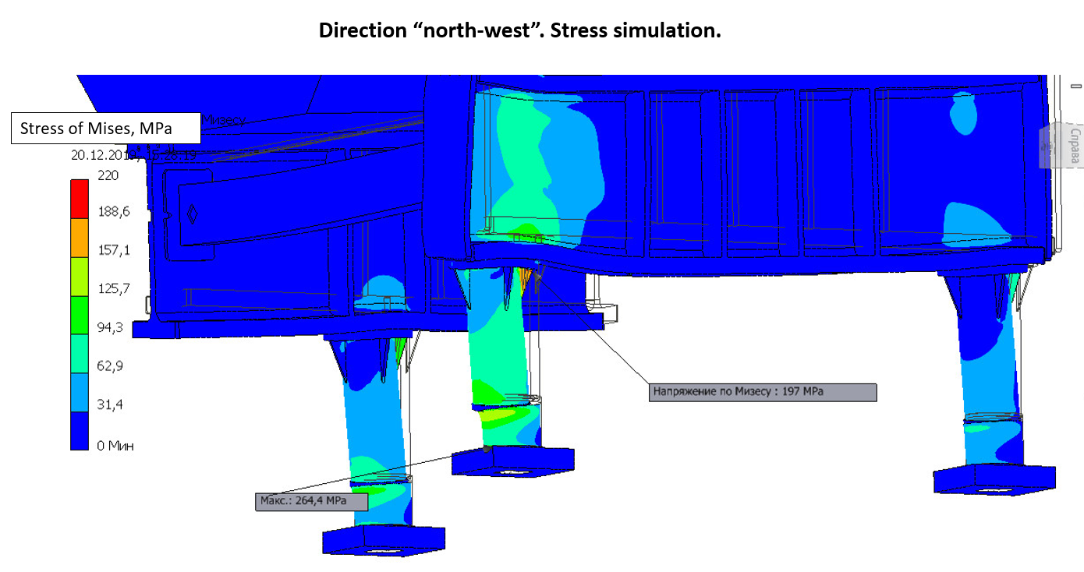
Stress analysis-2
To further reduce the stress and displacement:
The leg wall thickness was increased from 20 to 30 mm.
Six triangle girders are now installed under the flange of each of the 3 leg.
The design of the ground plate for a common alignment of the support legs was improved.
Finally there is no area anymore with stress above the yield strength of 255 MPa for St10.

Slide 4
Status
Stress analysis completed.
Magnetic field simulations completed.
Design of yoke (plates, blocks, halves, assembly) completed.
Design of support structure completed.
Design of coils completed.
Yoke machining technology developed.
3D model for entire magnet completed.
Intermediate report accepted.
2D drawings derived, uploaded to EDMS server and under checking/approval.
Final report had been accepted as conditional acceptance, including Installation manual and
other related documents.
Magnetic mapping system is under design.
New fuses setup had been tested aiming at reliable and sharp dipole relief
under seismic force distributed for each supporting leg.
- Tensile strength for steel “21848” had been done.
Negotiations with steel maker and yoke machinery workshops are in process.
Tendering procedure is under developing.

Slide 5
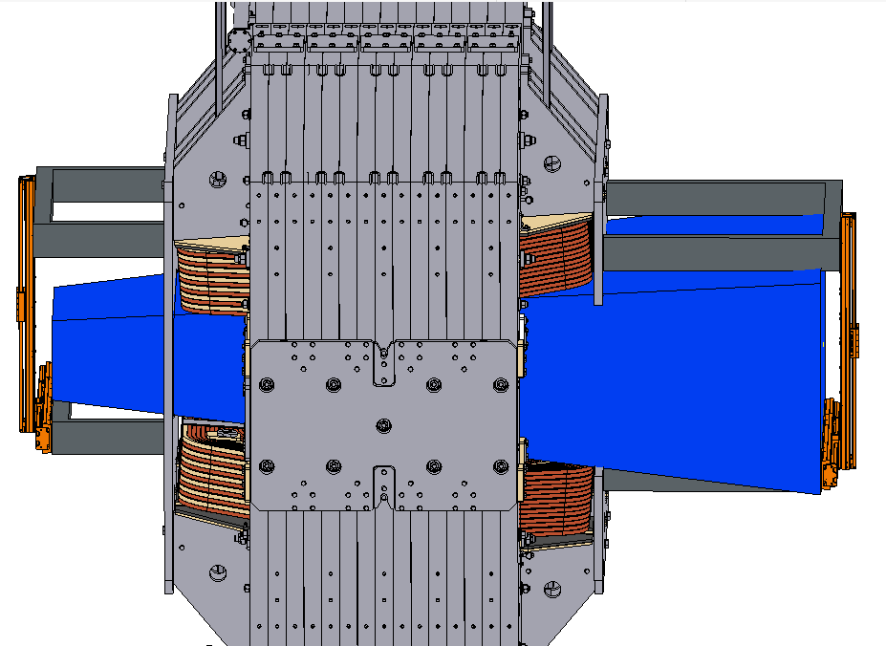
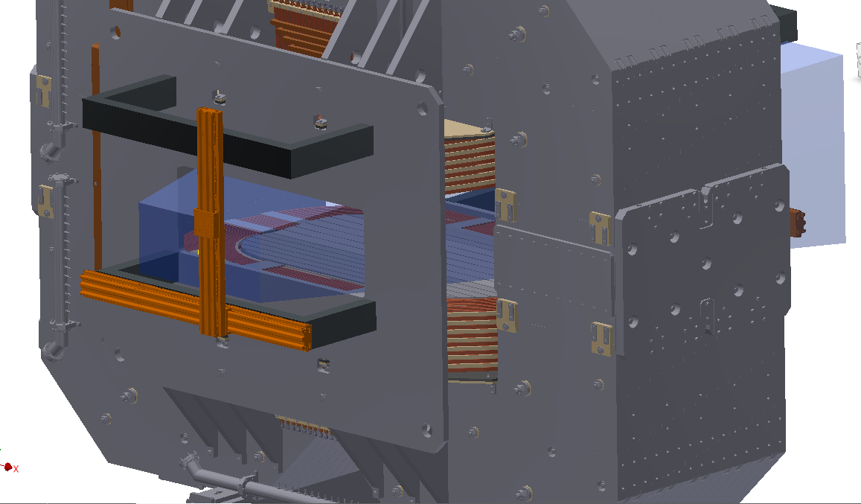
Magnetic measurement system for dipole.
Boundary conditions:
using one 3D Hall sensor
covering all area inside magnet gap
accuracy 1 Gauss
measuring positions in X, Y, Z.
common control unit with Solenoid field mapping system

Slide 6
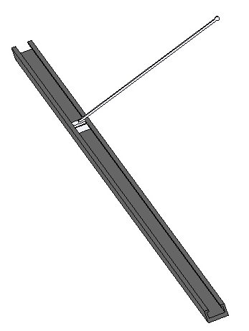
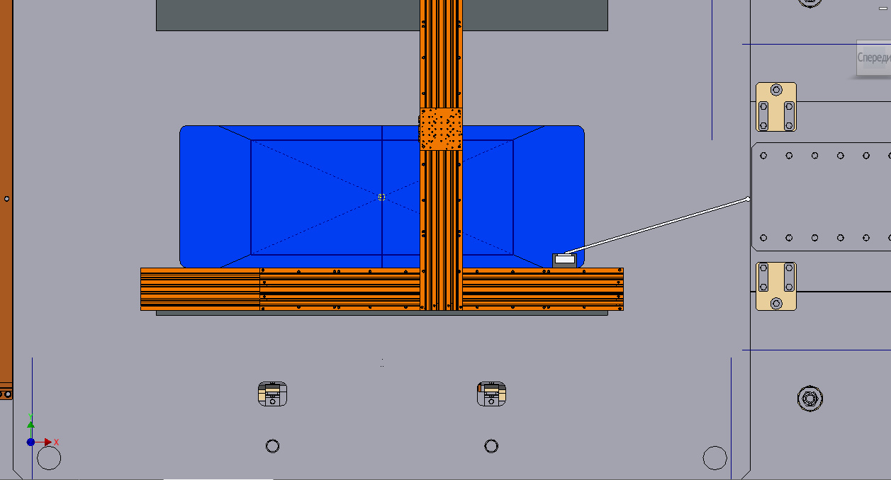
Magnetic measurement system for dipole-2.
Location of 3D Hall Sensor and Laser Reflector
XY moving system can only move inside the area marked by blue (restriction imposed by a hole in the upstream field clamp)
Carbon fiber plastic
Guideline and carriage
Using this shape of the carriage, it is possible to measure the field near the pole surface inside the magnet gap while the guide is placed in the area of possible movement. The elongation height of the carriage was chosen so that measurements could be started below the median plane.

Slide 7
Magnetic measurement system for dipole-3.
Guide line of carbon fiber plastic (weight 16 kg for 6 m)
Sag of guide line is 1.5 mm (inclination angle is 0.06 deg.) => at points with large Bz the error to By is about 4-5 G.
=> Carriage with 3 tracker mirrors and one 3D Hall sensor (weight 2 kg) for measuring field, coordinates and angle.
Selecting a reliable and inexpensive moving system (NEWPORT is good, but expensive).

Slide 8
Fuses used to fixate the aligned magnet-1
The feet of the support legs are resting on special greased PTFE bearings which are needed for the alignment.
In case of a seismic event of medium magnitude (equivalent static acceleration 0.3 to 0.4 m/s², or 0.03 to 0.04 g, resp.), the friction in the PTFE bearings will be big enough to keep the magnet in place. A seismic event of bigger magnitude would cause the magnet to slide. To prevent this, at least up to an equivalent static acceleration of 0.8 m/s², specially tailored bolts (fuses) will be applied.
In the very unlikely case of an even bigger seismic event (> 0.08 g), these fuses have to yield reliably in order to avoid a horizontal overload of the support legs.
Three series of fuses have been tested to determine their yield behaviour. All were made of steel St10X with notch diameters of 5.6 mm to 9.8 mm (notch length 1.25 times notch diameter). In all 3 series it appeared that there was a clear cut yielding at about 800 MPa (± 2%).
notch

Slide 9
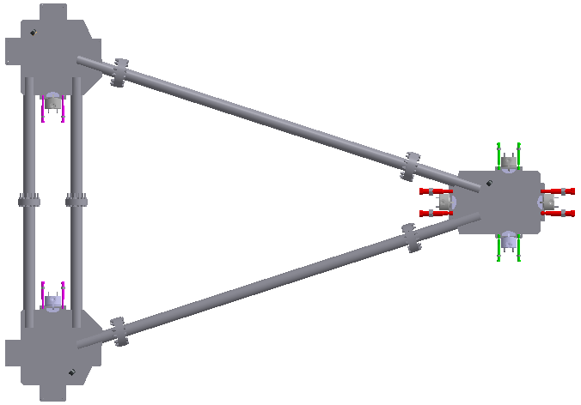
Distribution of fuses used at the support feet
North-west
Pairs of fuses fixating the top plates of the alignment bearings
East
Three types of fuses are applied. Their nominal yield forces are:
Red fuses (for east and west direction) 48 kN each
Magenta fuses (north and south direction) 32 kN each
Green fuses (north and south direction) 16 kN each
South-west
The notch diameters of the fuses are 8.8 mm, 7.2 mm, and 5.0 mm, respectively.
The size difference between the magenta and the green fuses is due to their different distance to the projected center-of-gravity of the magnet.

Slide 10
Fuses used to fixate the aligned magnet-2
Elongation vs. force for 8 mm notch fuse.
Elongation vs. force for
5.6 mm notch fuse.
Elongation vs. force for
9.8 mm notch fuse.

Slide 11
Plans
2D drawings: correction by BINP and checking by GSI to be completed.
Magnetic mapping system design will be completed soon.
Developing 3D code, based on Maxwell tensor method, for precise simulations of repelling forces acting on yoke parts.
Tendering procedure for yoke production will be open soon. We had got intention of four machinery factories to participate in yoke production tender, namely: Efremov (Novosibirsk), URALMASH (Ekaterinburg), South plant of heavy machinery (Krasnodar), PetrozavodskTyazhMash (Karelia).

