Slide 1
Electron Propagation
With GEANE and GENFIT
27.05.2021 Tobias Stockmanns

Slide 2
Original Work
Original work from Bisong MA
Tests limited to geane and Geante
Is there a difference with genfit and Geant4?
Can we correct also the propagated position of the electron?

Slide 3
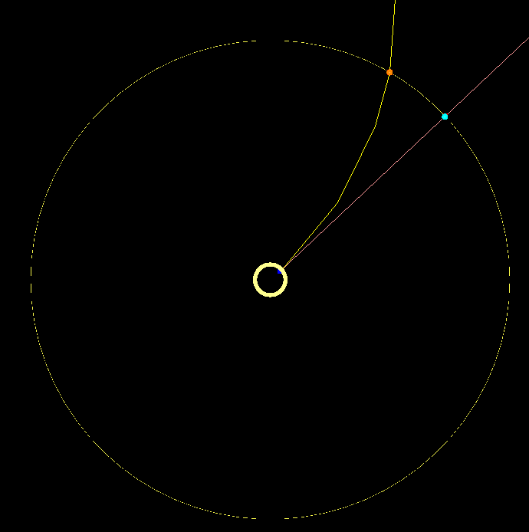
Setup
1000 electrons
Fixed
Theta 90°
Phi 20°
Mom 0.5 GeV/c
Geometry
Inner tube 10% X₀ at 3 cm (approx. MVD Pixel layer)
Outer tube at 54 cm (approx EMC layer)
Propagation
Electron / pion assumption with MC truth start
Question
How good do we know postion and momentum at outer tube?

Slide 4
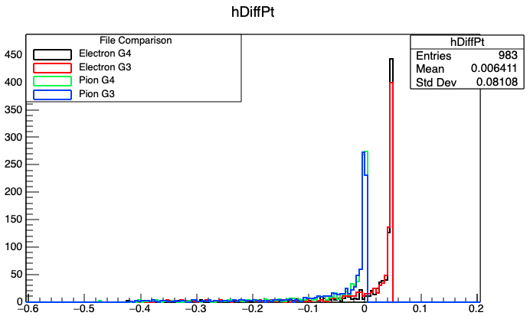
Momentum Difference
Clear difference between electron and pion hypothesis
Electron propagation takes bremsstrahlung into account.
Mean value is off from most probable value due to long tail
Pion propagation hits MPV better than electron propagation
No significant difference between G3 and G4
p_{t_MC}- p_{t-prop} / GeV/c

Slide 5
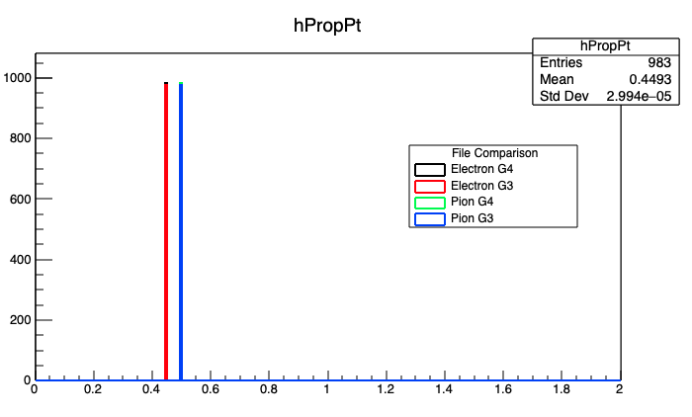
Propagate Momentum
Propagated pt value is different vor electrons and pions
p_{t} / GeV/c

Slide 6
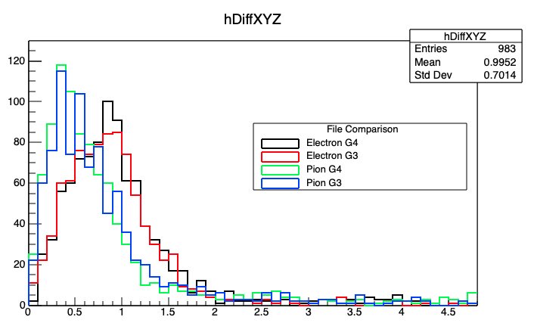
Position
Position of electron better matched by pion hypothesis
No difference between G3 and G4
Position difference / cm

Slide 7
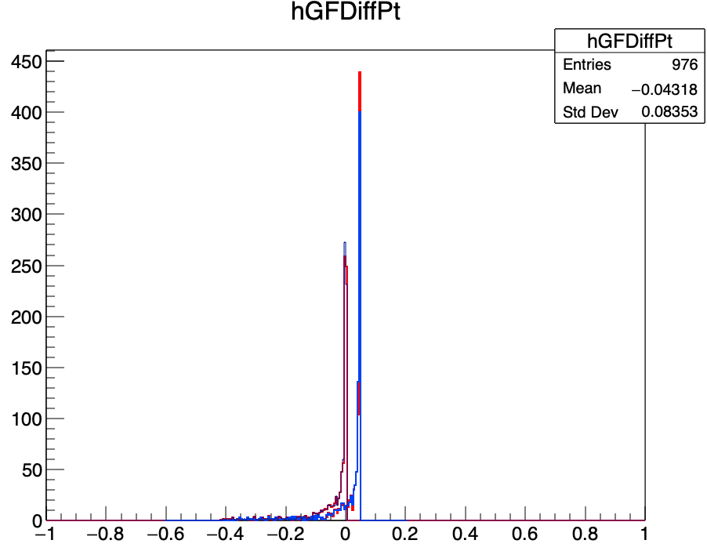
Geane vs GENFIT
Blue: GEANE (POCA) Electron/Pion
Red: Genfit (CYLINDER) Electron/Pion
No significant difference between GEANE and genfit in pt
p_{t_MC}- p_{t-prop} / GeV/c

Slide 8
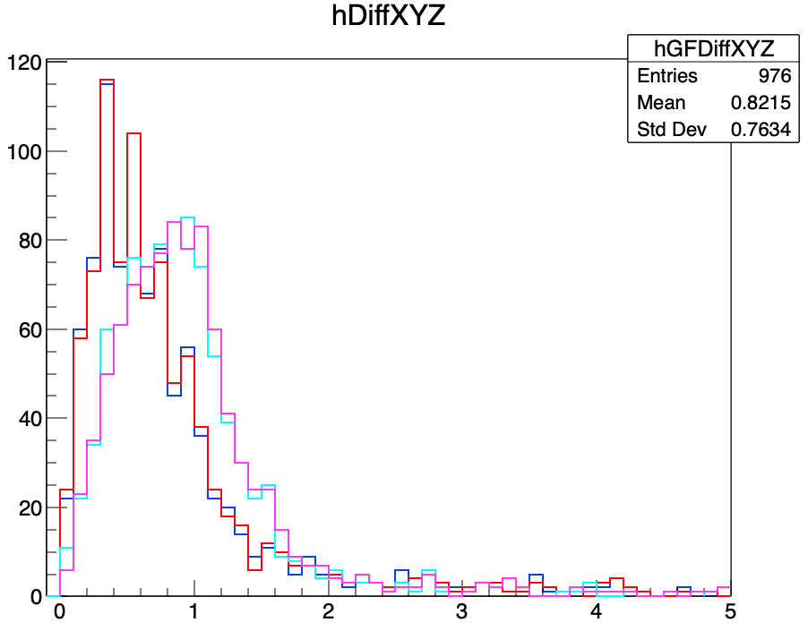
GEANE vs. GENFIT
Blue: GEANE (POCA) Pion
Red: Genfit (CYLINDER) Pion
Cyan: GEANE (POCA) Electron
Magenta: Genfit (Cylinder) Electron
No significant difference between GEANE and genfit in xyz
Position difference / cm

Slide 9
Correct for Bremsstrahlung
With two methods

Slide 10
Momentum Correction (Method A)
Take MC momentum vector at photon detector (blue arrow)
Propagate electron as pion with start momentum to middle of inner tube
Substract momentum from photon track in the middle of the inner tube from the electron momentum
Propagate electron as pion with reduced momentum

Slide 11
Momentum Correction (Method B)
Propagate electron as pion with start momentum to middle of inner tube
Take MC energy at photon detector (blue arrow)
Calculate direction vector between electron hin in inner detector and photon hit at outer detector
Scale vector by photon energy
Substract momentum from photon track in the middle of the inner tube from the electron momentum
Propagate electron as pion with reduced momentum

Slide 12
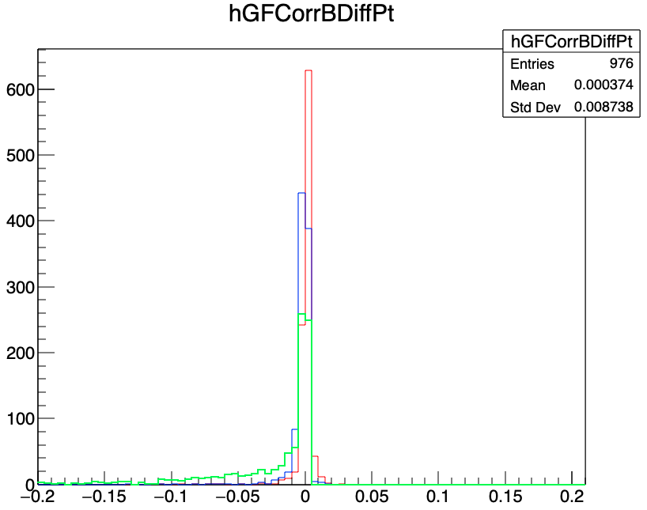
Momentum Correction
Blue: MC correction
Red: Hit correction
Green: No correction
Clear improvements due to correction methods
Hit correction better than MC correction ➔ needs further study
p_{t_MC}- p_{t-prop} / GeV/c

Slide 13
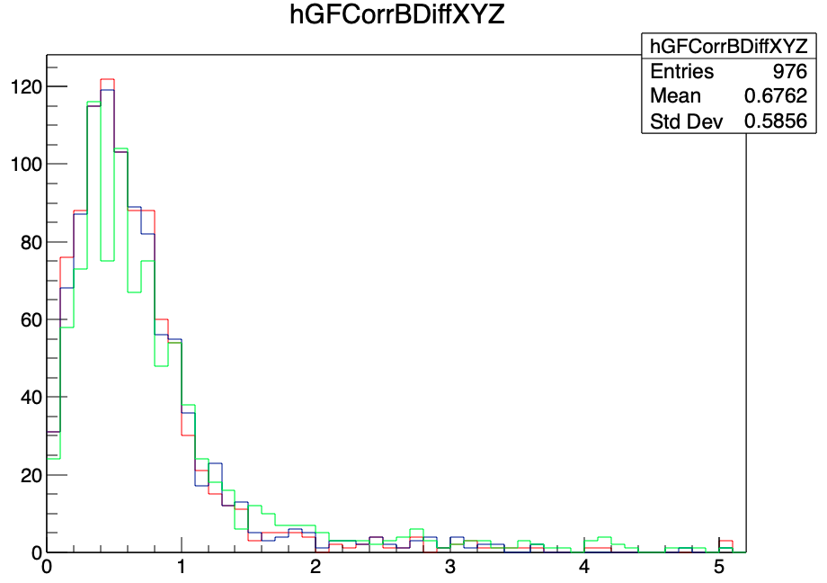
Position Correction
Blue: MC correction
Red: Hit correction
Green: No correction
Position difference / cm

Slide 14
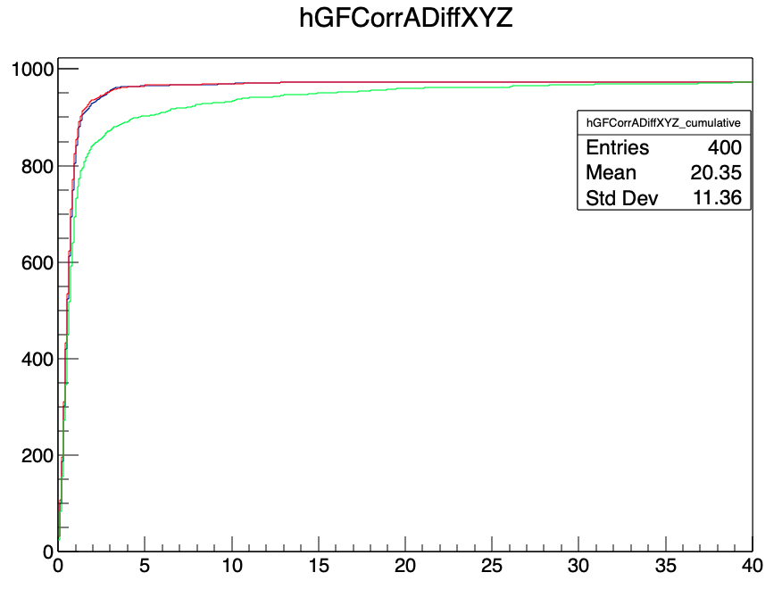
Integral of Position difference
Blue: MC correction
Red: Hit correction
Green: No correction
Clear improvements due to correction methods
Integral position difference / cm

Slide 15
Switch OFF Bremsstrahlung
For Electrons

Slide 16
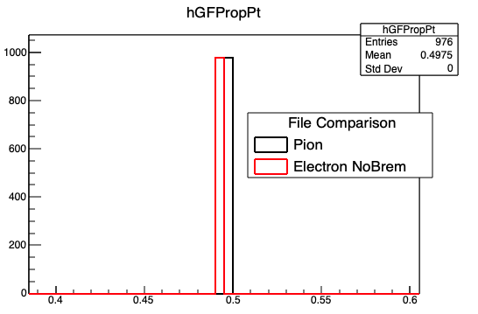
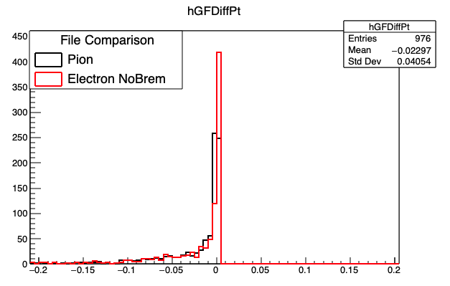
Electron propagation wo Bremsstrahlung
p_{t_MC}- p_{t-prop} / GeV/c
p_{t-prop} / GeV/c

Slide 17
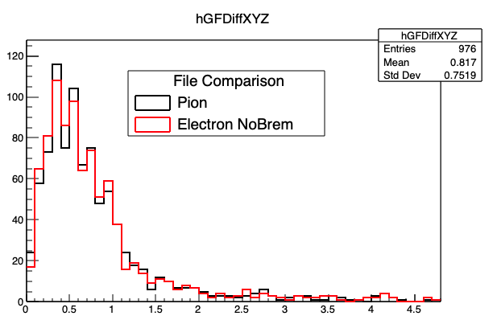
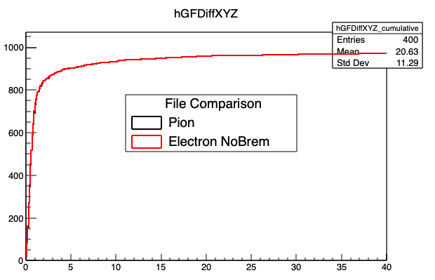
Position Resolution
Electron (w/o Bremsstrahlung) vs. pion hypothesis
Integral position difference / cm
Position difference / cm

Slide 18
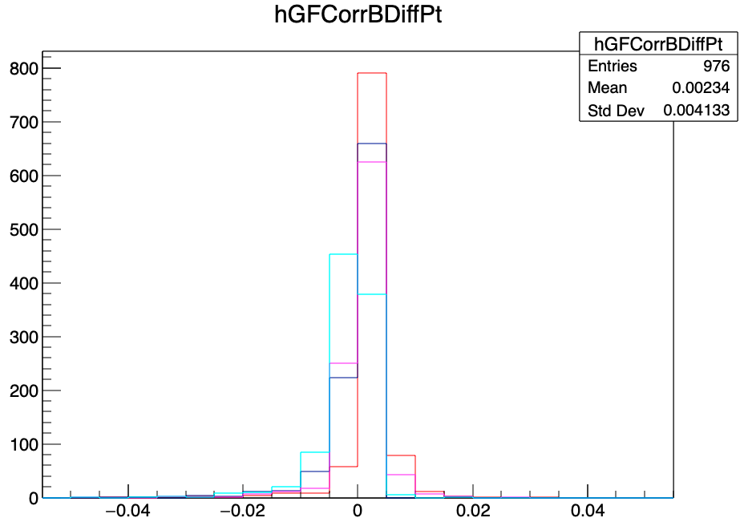
Momentum Resolution
Electron (wo Bremsstrahlung) vs. pion hypothesis
red: e hit correction
blue: e MC correction
pink: pi hit correction
cyan: pi MC correction
p_{t_MC}- p_{t-prop} / GeV/c

Slide 19
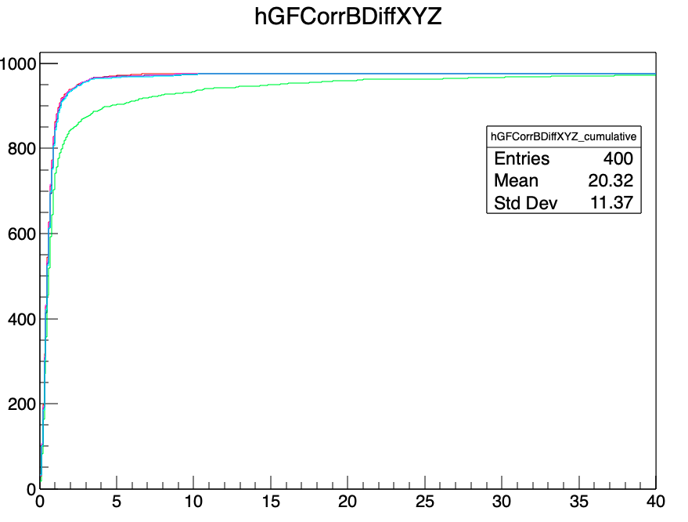
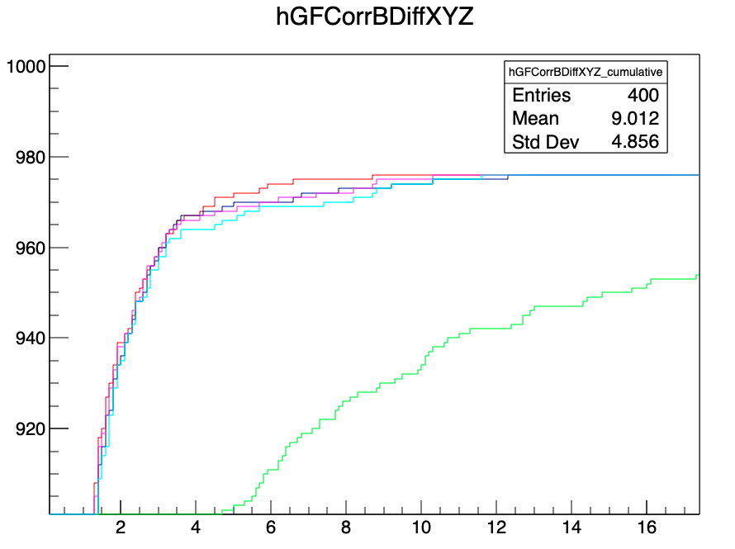
Spatial Resolution
red: e hit correction
blue: e MC correction
pink: pi hit correction
cyan: pi MC correction
green: pi no correction
Integral position difference / cm
Integral position difference / cm

Slide 20
Why is Hit Method better?

Slide 21
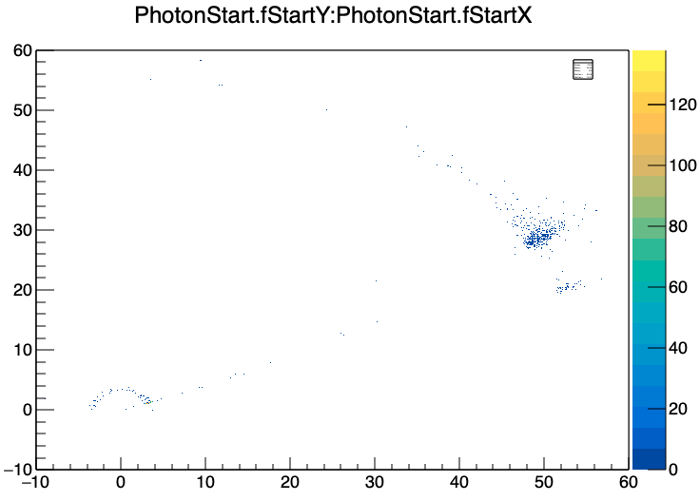
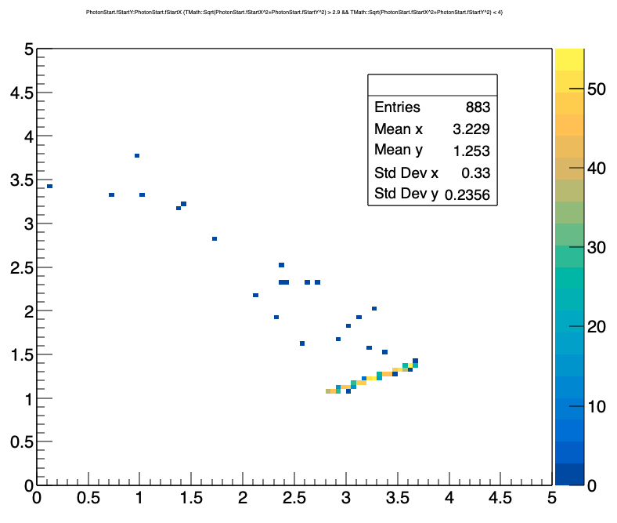
Photon Position

Slide 22
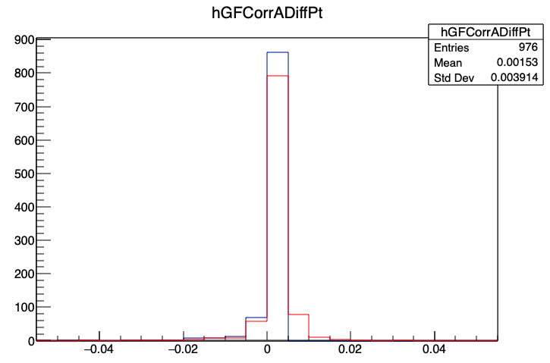
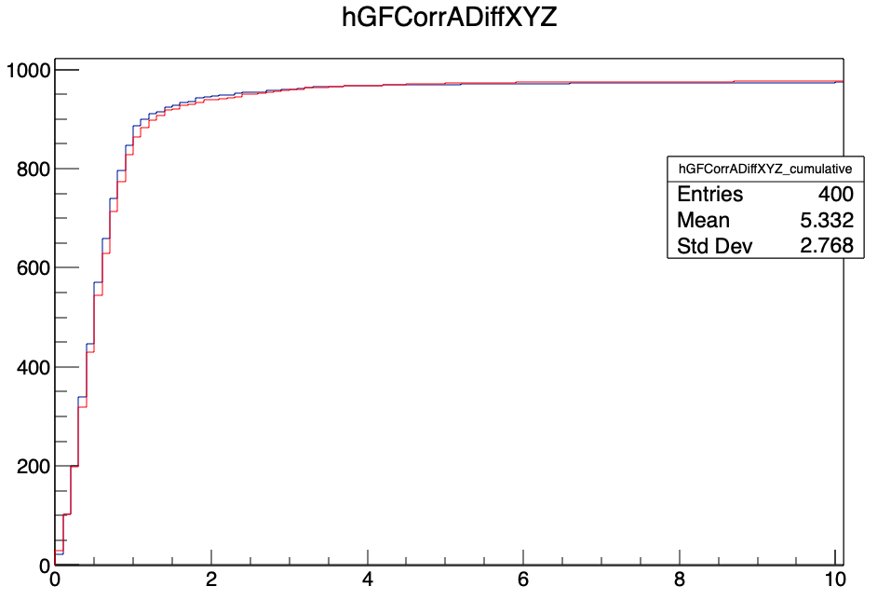
Cut for Correction Method A
Only photons from r < 4 cm
Blue: MC correction (with cut)
Red: Hit correction (without cut)
Integral position difference / cm
p_{t_MC}- p_{t-prop} / GeV/c

Slide 23
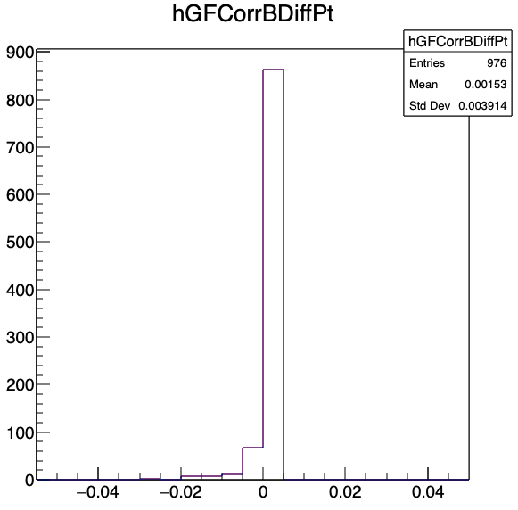
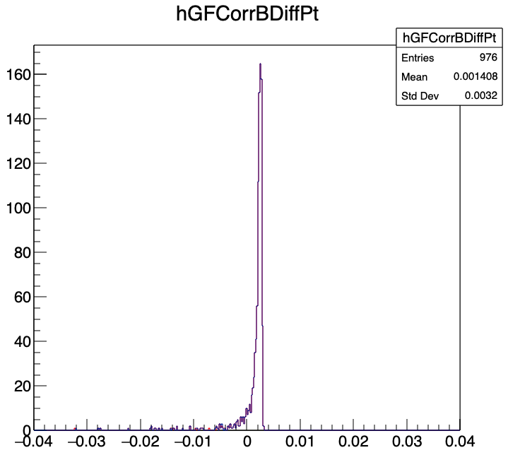
CuT for both correction methods
Only photons from r < 4cm
Blue: MC correction (with cut)
Red: Hit correction (with cut)
p_{t_MC}- p_{t-prop} / GeV/c
p_{t_MC}- p_{t-prop} / GeV/c

Slide 24
Solution
Both corretion methods take from all photon hits (which come from an electron) the momentum information and apply the correction in the middle of the inner tube
Not all photons come from the inner tube but are generated at different places. They cause an error onto the correction method.
This error is bigger for the MC method than for the hit method.
Solution: Apply a cut for the origin of the photon to be within r < 4 cm
This only works with MC information → not usable later in the experiment

Slide 25
Summary and Outlook
Bremsstrahlung causes significant errors in the propagation of electrons
GEANE and genfit treat the mean energy loss due to bremsstrahlung correctly but the correction is too large for the majority of electrons ➔ significant deviation in the propagated position of the electron
Better use electron propagation without bremsstrahlung or (slightly worse) pion hypothesis
Next steps: Improve existing bremsstrahlungs correction for position reconstruction

Slide 26
Additional Topics

Slide 27
PndHistoCombiner
Class to replace old comp_histo.C macro
New features:
Multiple input files (not only two)
Short names for histogram legend
Marking of histograms with failed Kolmogorov test
Select histograms to combine

Slide 28
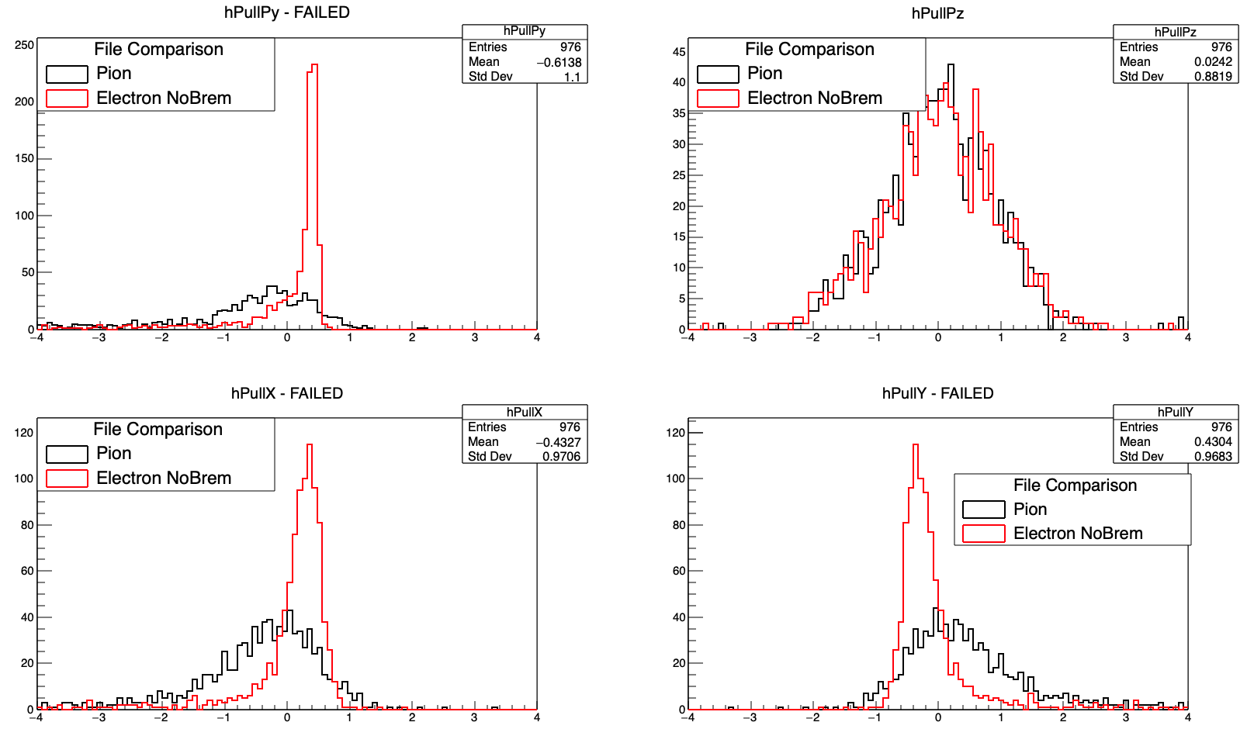
PndHistoCombiner

Slide 29
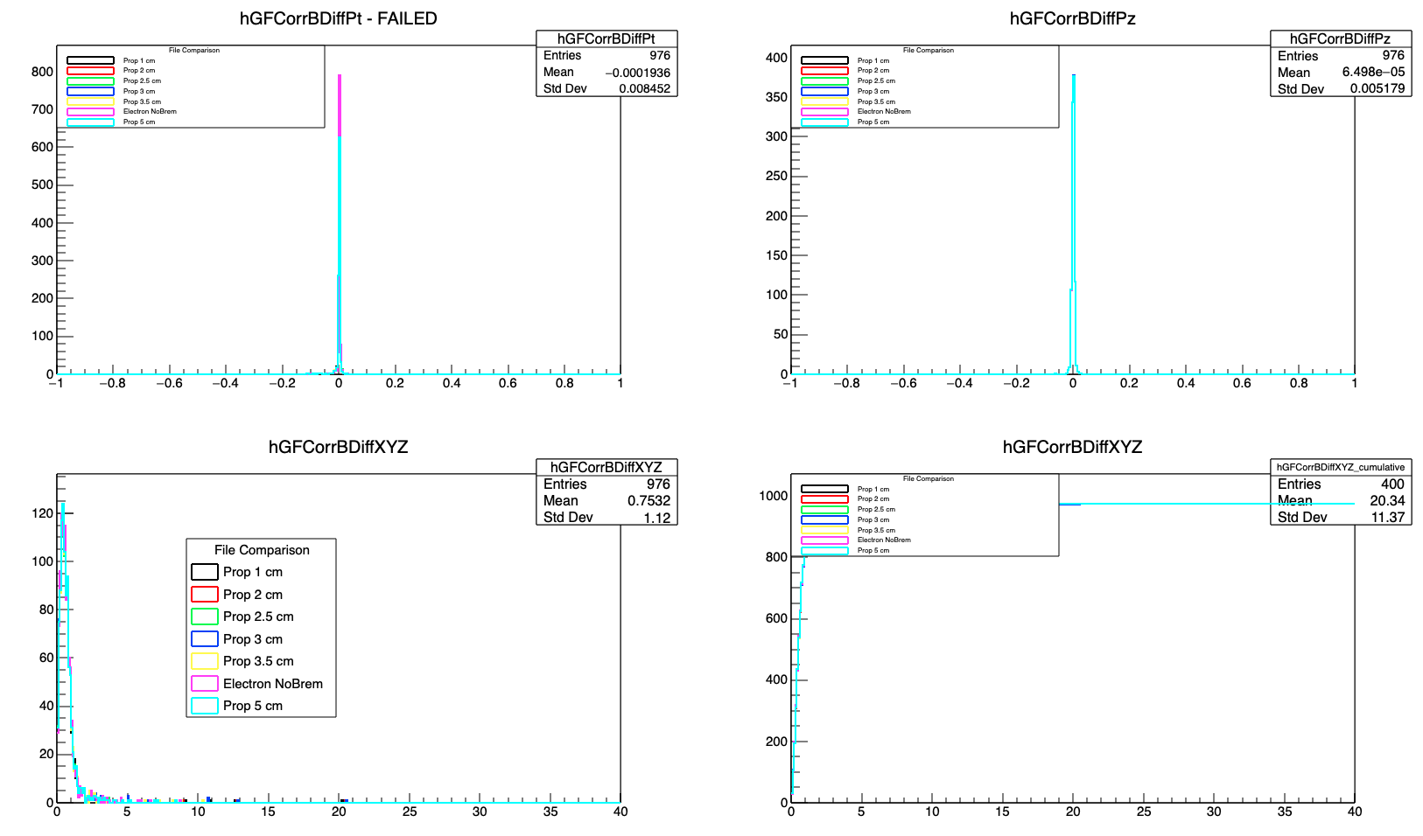

Slide 30
CHANGELOG.md
New file in repository to document the changes from one version to the next
Merge request contain this information but they are very detailed and it is not easy to extract from the various messages what has essentially changed.
Therefore: CHANGELOG.md
Contains four/five main categories:
Added: for new functionality
Changed: if an existing feature was modified
Fixed: if a bug was fixed
Removed: if a feature was removed
(Deprecated): if a feature will not be supported in the future
You as a devleoper should change this file whenever you make a larger change in PandaRoot

Slide 31
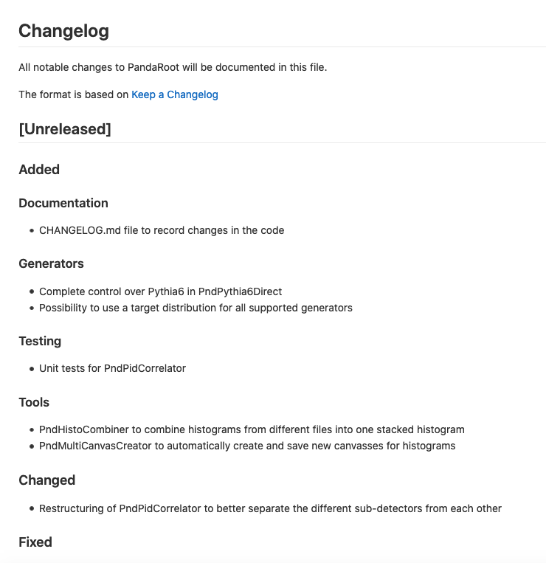
Changelog.md

