Slide 1
STATUS of BIG PROTOTYPES A. Piskun (for Dubna group) Protvino, 7 June 2011
_________________________________________________
Full Scale Prototype
Range System prototype:
- mechanical structure/absorber – 100% ready;
- MDT detectors (312 units)- 100% ready;
- strip boards – 87% ready;
- R/O electronics – mostly ready (enough to start RS cosmic tests);
- overall readiness for the start of RS proto tests is about 100%;
- FE electronics tuning with RS detecting layer (model of RS absorber gap)
- RS proto delivery to CERN – October/November 2011
HVS/A-8 card -> new approach for the Barrel FEE

Slide 2
Full Scale (2 x 4 m²) prototype in work position at CERN/COMPASS

Slide 3
DAQ VME crate 9U
VME crate 6U
VME crate 6U
COMPASS CATCH
Hot link cables
MWDB units
WIRE R/O
analog & digital
STRIP R/O
digital
to DAQ crate
RW-TDC QTC–16
ADB-32 (A-32)
analog
ASum-96
digital
A2DB-32
Range System Prototype Readout Scheme

Slide 4
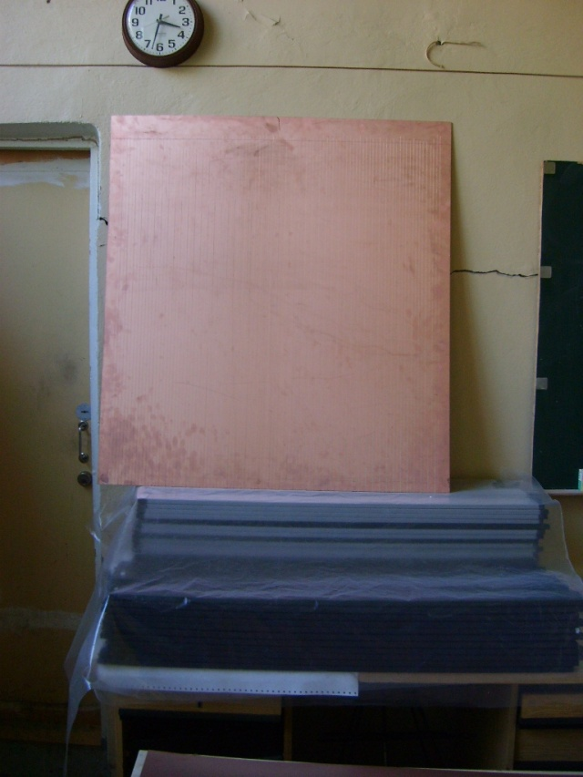
Range System prototype (Fe absorber and support structure) in Dubna in vertical position (for further tests with cosmic at CERN)
MDTs and Strip Board for RS proto
Strip board
MDTs
MDTs – 100% ready;
Strip boards – 20 (ordinary) of 23 total produced; remains to produce 3 special (Zero bi-layer strip boards)

Slide 5
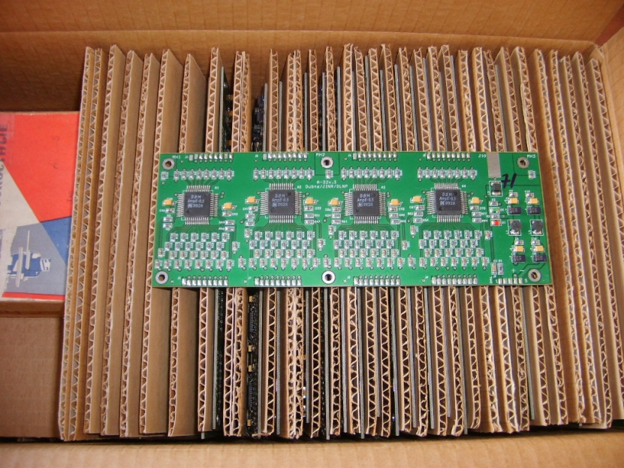
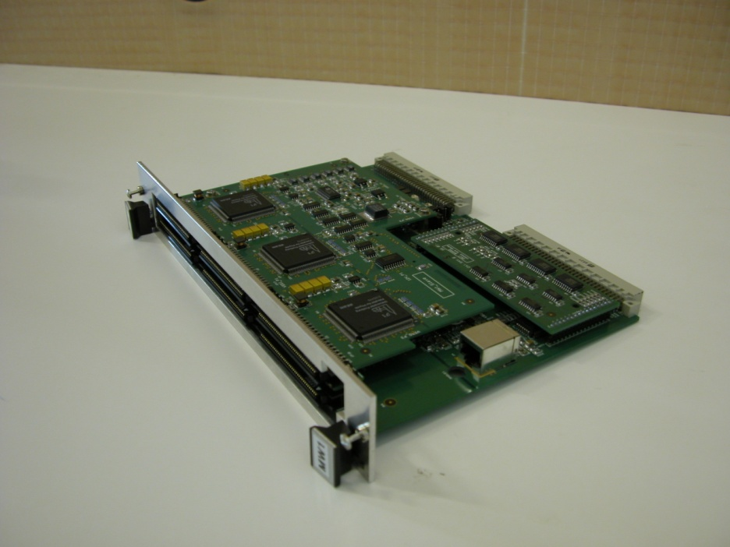
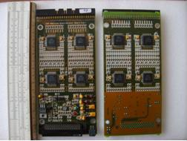
FEE for strip R/O of RS proto
A-32 -100% ready
MWDB card
ADB-32 – 100% ready
5 ready, need to produce 21 (plan to finish MWDB boards production by winter 2011/12)
Not a limiting factor for the start of RSP cosmic tests (we’ll use the boards of MW1, our own should be produced by the time of beam tests)!!!

Slide 6
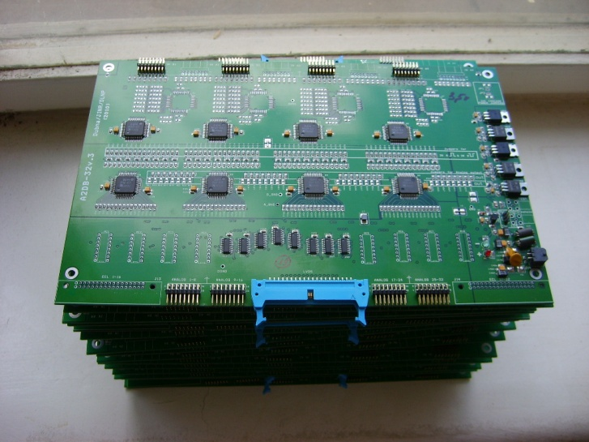
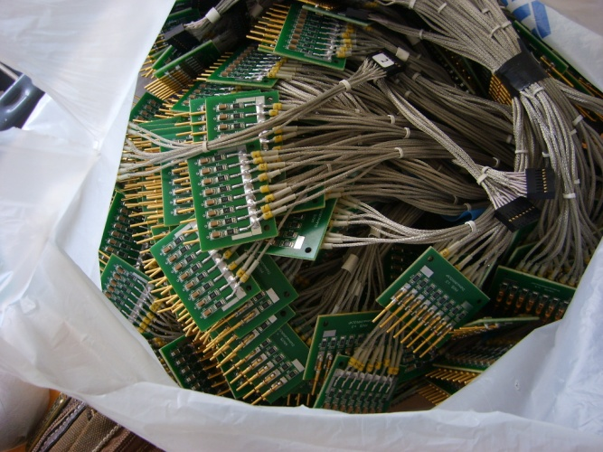
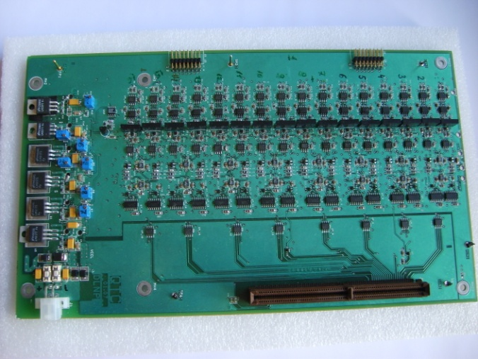
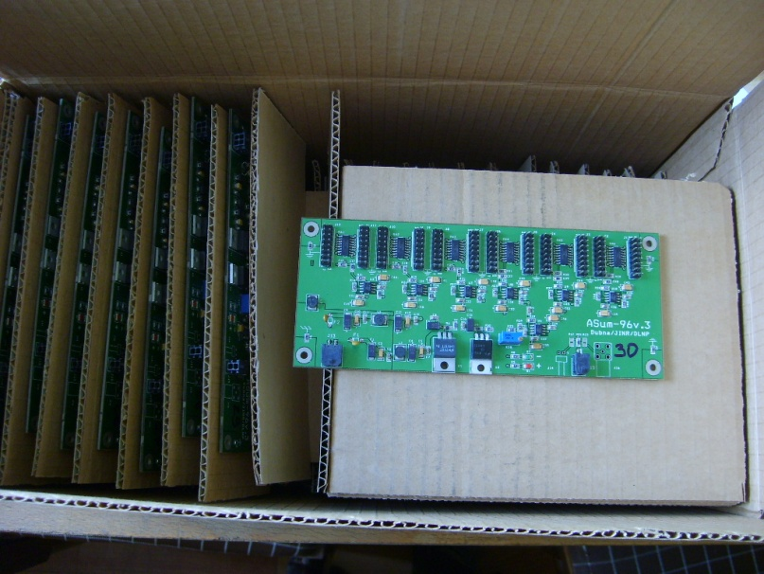
FEE for wire R/O of RS proto
HV/S-8 boards/cables -100% ready
A2DB-32 -100% ready
Asum-96 -100% ready
QTC-16- 100% ready
RW-TDC – 2 units will be borrowed from Rich Wall (COMPASS)

Slide 7
Status of Electronic Units and Signal Cables:
A2DB-32 | “Table-top” tested, passed debugging, 80 cards are manufactured (with spares) -100% ready
A-32 | 80 cards (with spares) are manufactured and tested - 100% ready
ADB-32 | 80 cards (with spares) are manufactured and tested - 100% ready
ASum-96 | 30 cards (with spares) manufactured and tested -100% ready
QTC-16 | “Table-top” tested, 2 boards produced - 100% ready
RW-TDC | Tested in COMPASS/CERN (RW), need to borrow 2 units from Rich Wall - 100% ready
MWDB | Tested in COMPASS/CERN (MW1), 24 needed, 5 boards produced, need to produce 21 (with spares) (not needed for the start of RSP tests – MW1 cards will be used)
CATCH | Need to borrow 2 units from COMPASS - 100% ready
Wire Cables | 2304 produced - 100% ready
Strip Cables/ (HVS/A-8) | 2304 cables produced with 312 HV/S-8 cards - 100% ready
Degree of FEE readiness is about 92%

Slide 8
RS prototype readiness:
MDTs - 100%
FEE cards (300) and cables (4600) - 92% (for the start of RSP tests (cosmic) – 100% ready)
Absorber plates and support structure - 100%
G10 strip boards – 87%
_________________________________________
Total ~ 100 % for the start of RSP tests (delivery to CERN/COMPASS - October/November 2011)

Slide 9
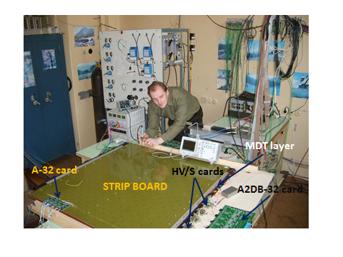
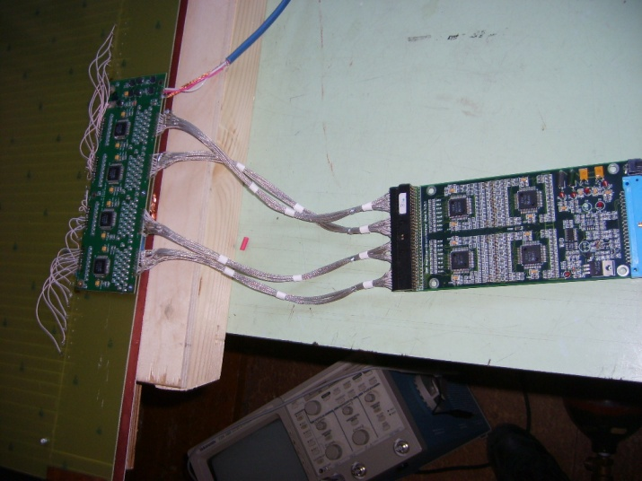
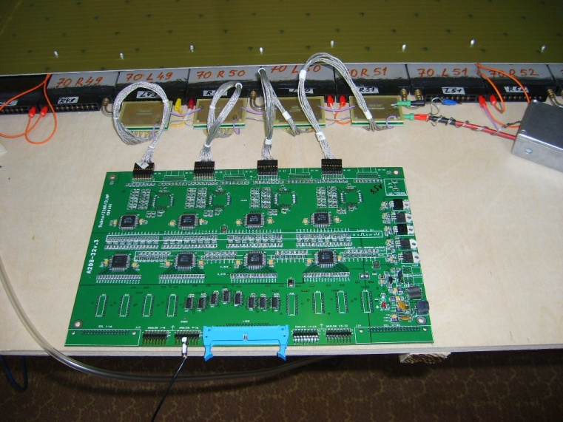
FE electronics tuning with the RS detecting layer
Strip R/O: A-32, ADB-32
Wire R/O: HV/S-8, A2DB-32

Slide 10
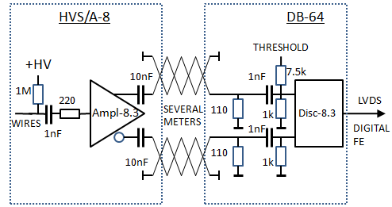
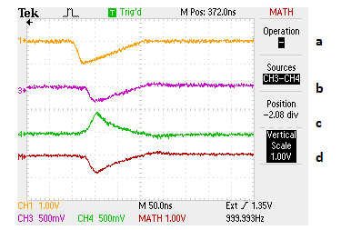
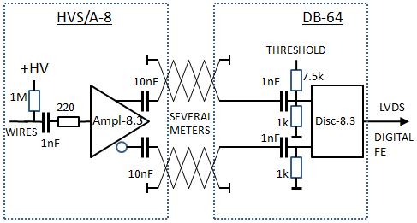
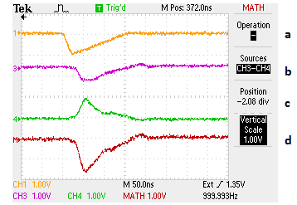
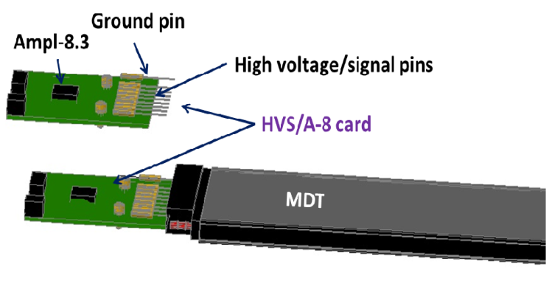
FEE for Barrel wire R/O
Block-diagram
FEE signals
a – input signal
With terminating resistors
b, c – negative / positive amplifier outputs
Without terminating resistors
d - differential signal on discriminator input.
Artistic view of HVS/A-8 attached to MDT

Slide 11
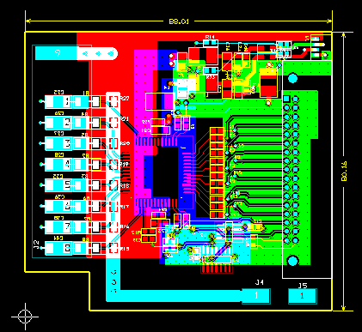
PCB design of HVS/A-8 card
Ready to start HVS/A-8 production for testing on the RS proto

Slide 12
CONCLUSION
Full Scale Prototype is in work position at CERN, we’re ready to start tests
Mechanical absorber structure and detecting part (MDTs, strip boards) of RS proto are ready (3 strip boards of zero bi-layers will be produced by the time of delivery to CERN - October / November 2011)
All FEE needed for the start of RS proto tests (on cosmic) is ready (MWDB cards are planned to be produced by the winter 2011/12 – will be needed only for the beam tests)
Testing and tuning of RS proto FEE with the model of the RS detecting layer is started in Dubna
New approach to the Barrel FEE is fixed and design is in progress

