Slide 1
PANDA Muon Group Meeting, Protvino 7 June 2011 G.Alexeev (for Dubna group)

Slide 2
→l⁺l⁻ + X process - selected as benchmark process for design/tuning of PANDA Muon System

Slide 3
Muon momenta distributions for different processes in the sector 0°– 20° of polar angle

Slide 4
The layout of Muon System using the technique of Range System (with the number of MDT detectors for each particular subsystem)

Slide 5
Mini Drift Tube cross section (left) and layout (right)

Slide 6
Basic numbers for Muon System instrumentation

Slide 7
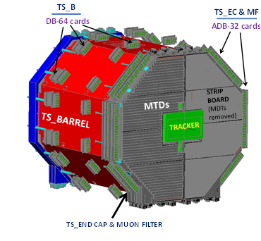
General view of the Target Spectrometer and the Muon Filter with front-end electronics (3D model)
×
×
×

Slide 8
Longitudinal cross section of a typical Barrel module

Slide 9
One of the detecting layers of a Barrel module positioned on the steel plate (strips running perpendicularly to MDTs are not shown)

Slide 10
One of the detecting layers of a Barrel module positioned on the steel plate (strips running perpendicularly to MDTs are not shown)

Slide 11
General view of the End Cap and Muon Filter with front-end electronics (a) and enlarged corner fragment(b)

Slide 12
General view of Forward Range System (FRS) with the electronic cards and beam pipe in the central hole (3D model)

Slide 14
Work packages and responsibilities
The five main work packages have been identified for the Muon System. Each package comprises the all basic stages of work: design, construction, tests, and transportation to Germany (Darmstadt and/or Juelich), assembly and commissioning (at FAIR). If some of the above items would require the R&D works it is implicitly included. The list of work packages comprises the following items:
1. The Mini-Drift Tube detectors for the whole PANDA Muon System – Barrel, End Cap, Muon Filter and Forward Range System. The overall responsibility is taken by JINR, Dubna.
2. The front-end electronics for the whole Muon System based on Ampl-8.3 and Disc-8.3 ASIC chips. This electronics comprises ‘on-chamber’ units which should permit amplification and digitization of the wire and strip signals – YES/NO hits in LVDS levels. The overall responsibility is taken by JINR, Dubna.
3. Strip boards (for second coordinate readout) made of copper foil plated fiberglass for the whole Muon System. The overall responsibility is taken by JINR, Dubna.
4. The Muon Filter laminated steel absorber structure. The overall responsibility is taken by JINR, Dubna.
5. The Forward Range System laminated steel absorber structure. The overall responsibility is taken by JINR, Dubna.
There is also very important work which does not require special budget and is being performed under the current funding of the participating groups – a creation of corresponding software tools. This work has already started in the muon group by preparing the description of the Muon System within PandaRoot and will continue towards the following main topics: development of pattern recognition algorithms, preparation of on-line and off-line programs for the beam tests of the Range System prototype, and it should conclude with creation of a full software package for the whole Muon System. This work is under joint responsibility of two groups - INFN, Torino and JINR, Dubna.

Slide 15
_____________________________________________________________________________
(*) – R&D and beam tests of prototypes are supposed to be conducted at JINR (test stand) and on the beam lines at CERN and then at FAIR
____________________________________________________________________________
(**) – FE electronics includes only ‘on chamber’ cards with amplifiers and discriminators

Slide 16
Conclusion
The work conducted within the muon group in dense cooperation with the members of PANDA Collaboration, in particular with the GSI colleagues, has led to issue of this Technical Design Report for the PANDA Muon System. This document contains the basic scientific motivation for the Muon System as well as its main engineering parameters.
The system is optimized for the registration of muons from processes of interest indicated in the physical program of PANDA experiment and for the suppression of background. This system serves for particle (muon) identification.
Most of technical decisions proposed for present design had been proved in other big systems. The modifications needed for the PANDA Muon System (mostly for the second coordinate readout) are based on the positive results of conducted R&D works. The expected R&D data from the beam tests of big prototypes should provide the final calibration of the Muon System.
Finally, we conclude that proposed Muon System being based on proposed detectors and electronics is up to its tasks and may be reliably constructed within the necessary time.

