Slide 1
Superconducting Magnets for FAIR overview and progress
SCM - C. Roux
GSI accelerator seminar, 10th of June, 2021

Slide 2
    Superconducting Magnets for FAIR
SIS100
dipole: summary
quadrupole doublet modules: technical overview, players and sites, first (series) results
Super-FRS
multiplets and dipoles: technical and organisational overview
first results from cold testing of a multiplet and status
Quench detection for FAIR
design and developments: status

Slide 3
    (partially) related or accompanying talks
vacuum: "Vacuum Requirements for GSI and FAIR“, Andreas Krämer
beam physics: "Simulation of intense beams in synchrotrons“, Adrian Oeftiger
SIS100 magnets: "Superconducting magnets for SIS100 from design to series testing“, Anna Szwangruber
beam physics: "Magnetic field and ion-optical simulations for the optimization of the Super-FRS”, Erika Kazantseva
beam physics: "Simulation of Fragment Separators“, Helmut Weick
beam physics: "Beam Dynamics for SIS100 of FAIR and for the Future Circular Collider (FCC)“, Vladimir Kornilov
SIS100: "SIS18/SIS100 Status and Perspectives“, Peter Spiller
Accelerator Seminar · https://indico.gsi.de/category/359/

Slide 4
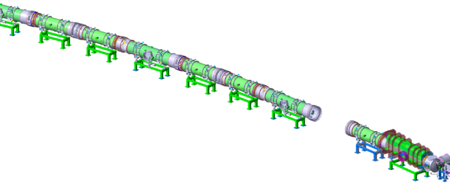

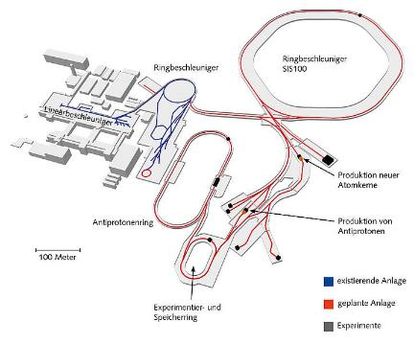


superconducting magnets for SIS100
SIS100
quadrupole doublet modules
main accelerator of FAIR
synchrotron
+ correctors
sc magnet zoo
dipoles | 108
quadrupoles | 166
sextupoles | 42
steerer | 83
multipole correctors | 12
special quadrupoles | 16
total | 427
dipoles

Slide 5
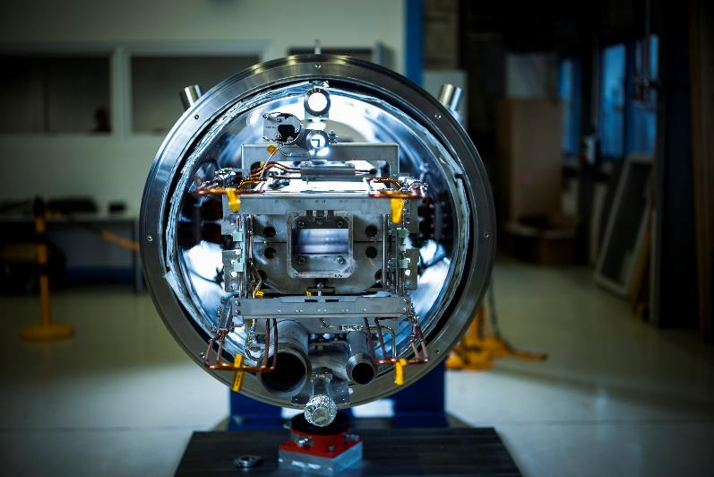
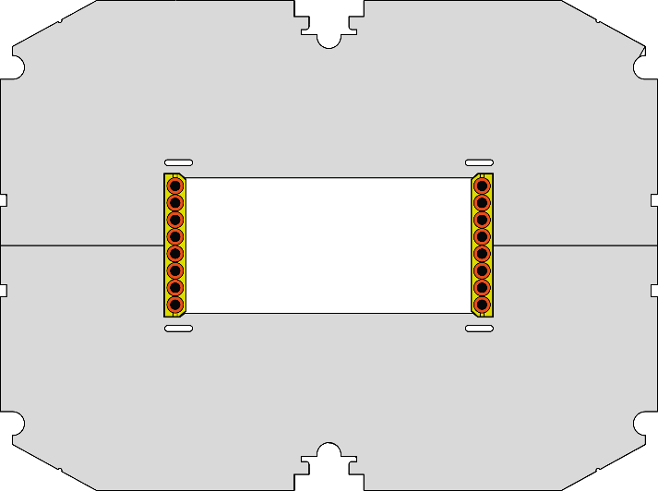
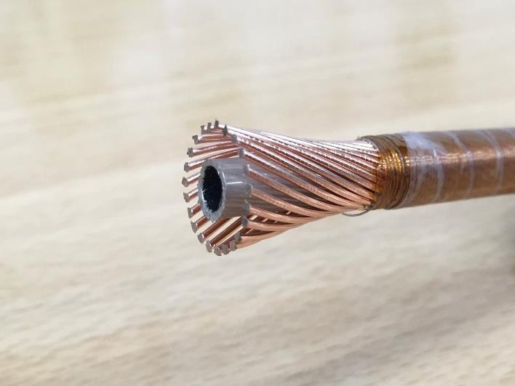
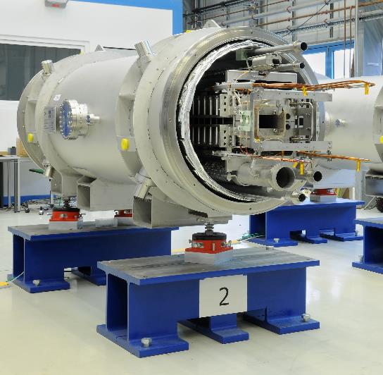
SIS100 dipole
type and specs
iron dominated – window frame
SIS100 dipole
Nuclotron cable
dipole yoke
with coil
Nuclotron NbTi cable
forced flow two-phase He
CrNi wire
vacuum vessel &
thermal shield
B | 1.9 T
I_{nominal} | 13.2 kA
ramp rate | 4 T/s
current ramp rate | 28 kA/s
deflection | 3 1/3°
aperture | 140 mm × 68 mm
length | ~ 3 m
weight | 3 t
CuNi tube
bus bars
NbTi within CuMn matric
cooling lines
J. Hosan / GSI Helmholtzzentrum für Schwerionenforschung GmbH

Slide 6
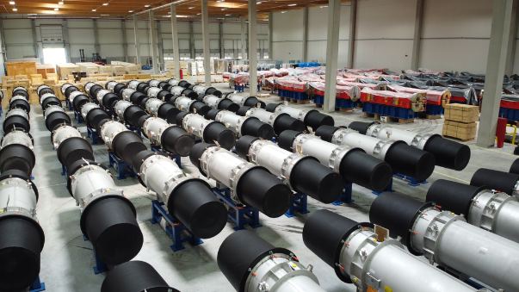
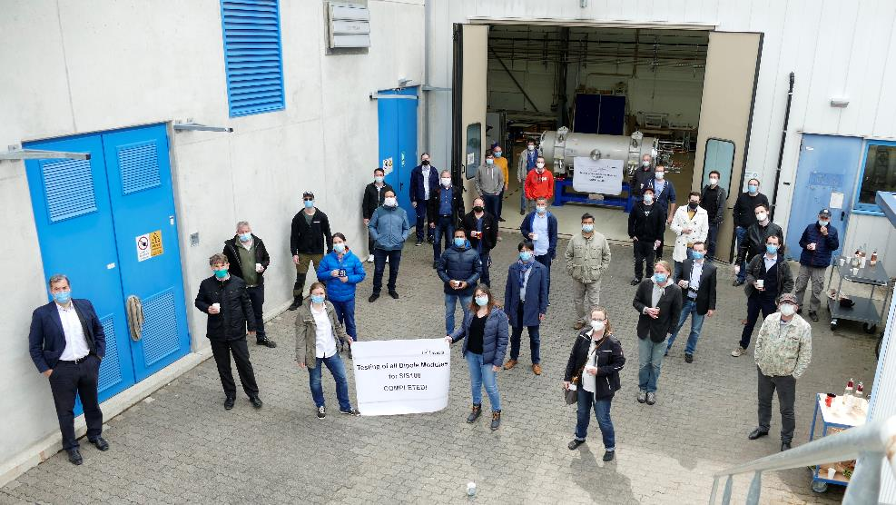
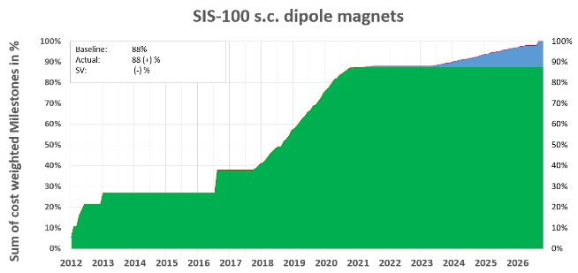
dipole project
  thanks to
  testing team(s)
  cry
  vac
  tri
  eps
  qua
  alignmnent
  mew
  mds
  and further
project progress and status
production and testing finished
straight delivery & testing
(after starting problems)
upcoming:
VC integration (not included here)
systematic issues
→ re-work
wiring quality
interface position
feedthroughs
series production & test
installation + commissioning
spent effort
up to 49 SATs/year
first series dipole: 29.09.17
FoS1 delivery: 03.06.13
release of series production: 22.07.16
FoS2 delivery: 09.10.15
100 steps per SAT
30 parameters to be investigated
and documented
highly efficient organisation and interplay of all actors

Slide 7
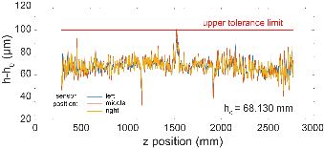
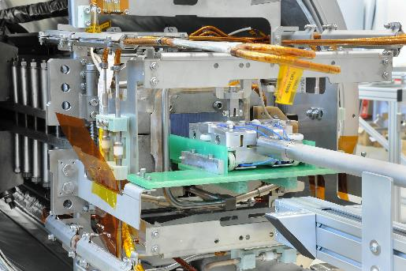
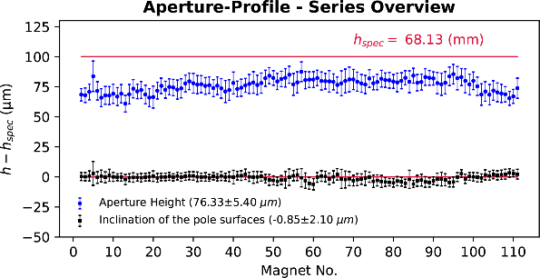
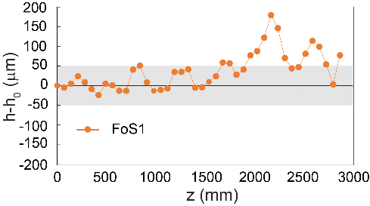
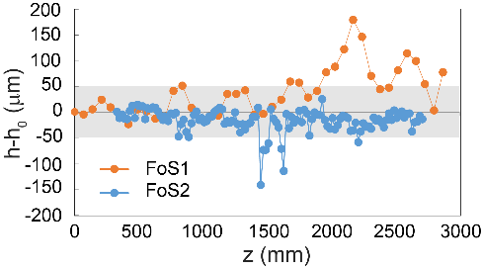
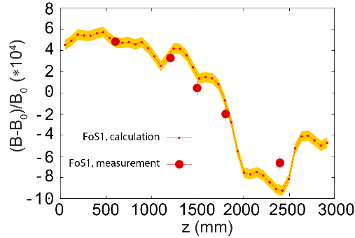
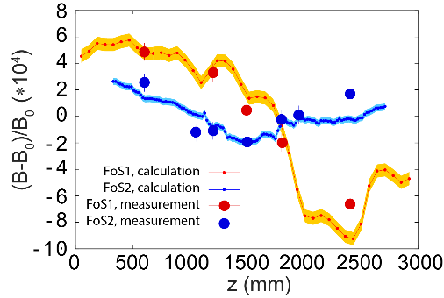
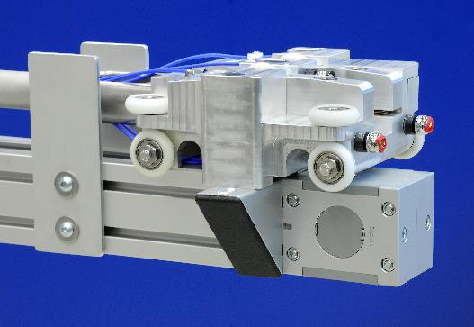
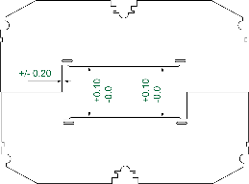
FoS reminder
example
insertion into yoke
FoS1: “proof of principle”
SIS100 dipole
steel
high current cable
single layer coil
first time:
spec
capacitive sensors
low losses, stable operation
targets
(laser tracker)
bad field quality
due to bad yoke quality
FoS2
precise stamping of lamination
laser welding:
minimization of tension
increase of reproducability
aperture measurement system

Slide 8
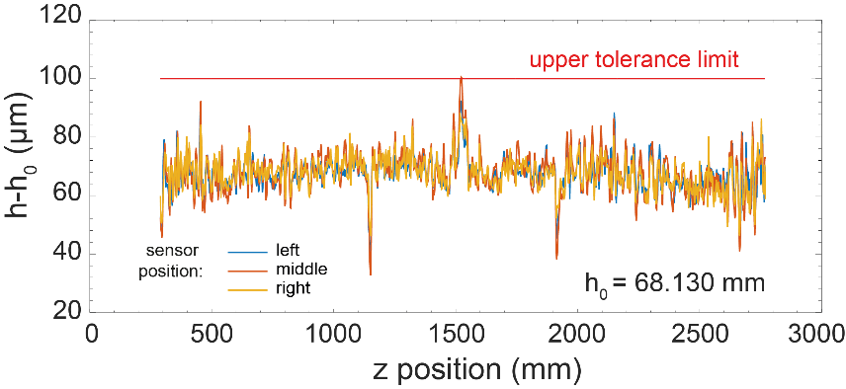
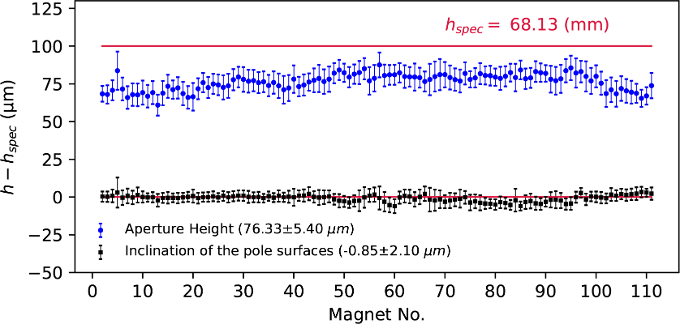
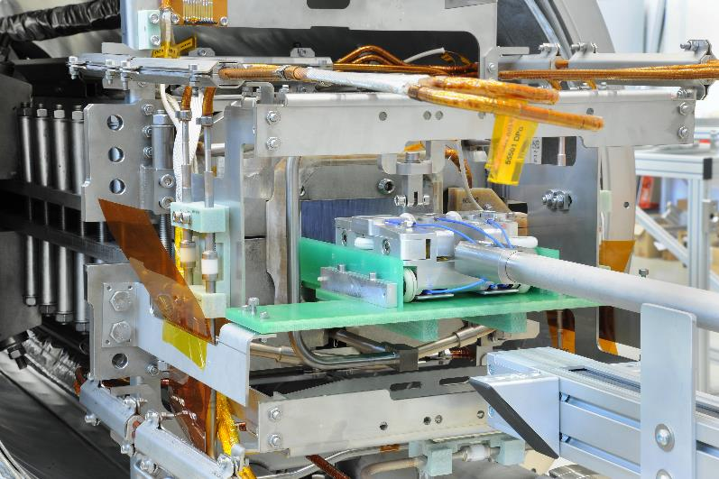

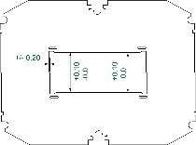
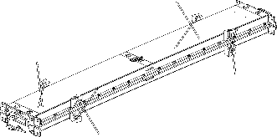
yoke precision – series
capacitive sensors
aperture tool
aperture tool
measurement system
capacitive sensors on carrier
laser targets to follow sag
functional @4 K
laser targets
aperture height
determines transfer function
spec: < 0.1 mm to limit spread along series
outstanding results
h₀

Slide 9
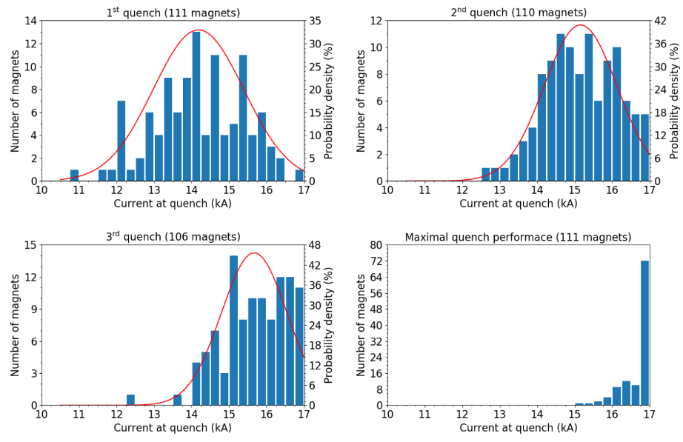
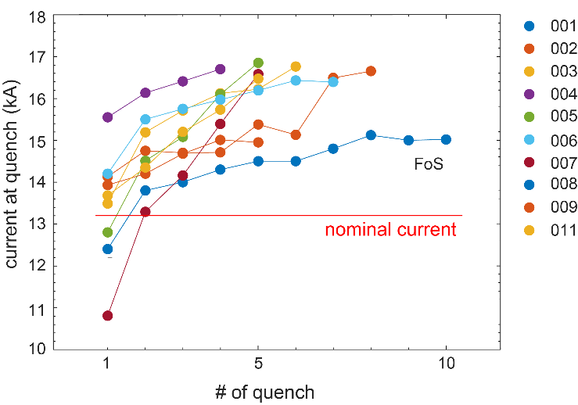
quench performance & ac losses
quench training
coil movement
cracks
…
strong forces →
Current | [kA]
Nominal (I_{n}) | 13.2
Acceptance criterion (110 % I_{n}) | 14.5
Power converter limit | 16.9
Theoretical cable limit | 17.8
recipe:
mechanical stability
efficient cooling
outstanding results along series
nominal
current
ac losses
acceptance
criterion
lower than expected
tolerable for cryo plant
power
converter
limit

Slide 10
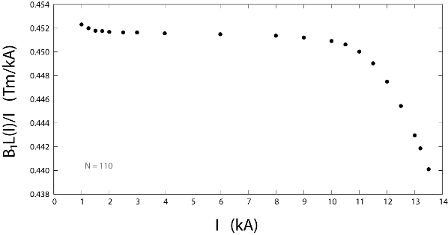
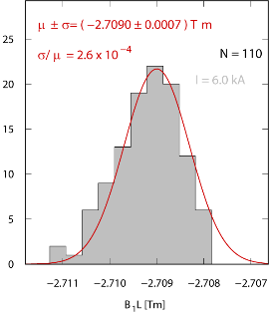
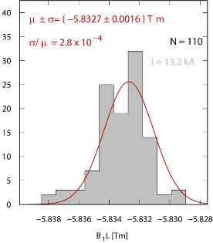
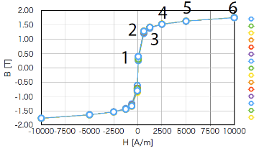
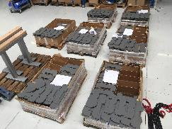
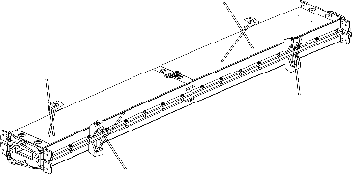
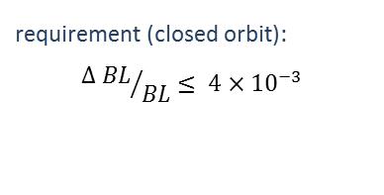
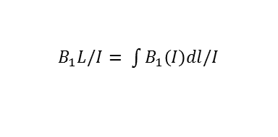
dipole field
transfer function
$B_{1}L/I= \int{B_{1}\left(I\right)dl/I}$
requirement (closed orbit):
$${∆ BL}/{BL}≤ {4×10}^{−3}$$
to control:
aperture height
yoke length
packing factor
material (H_{c}, µ)
material properties (Hc, µ)
measure &
sort
B (T)
results
measure length &
count lamination
10 times better than limit
H (A/m)

Slide 11
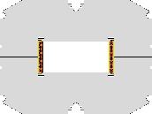
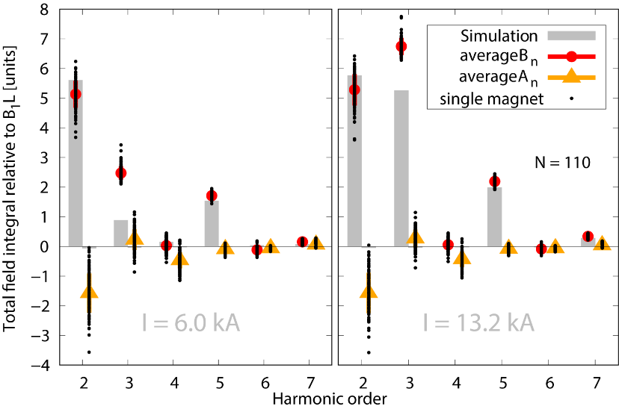
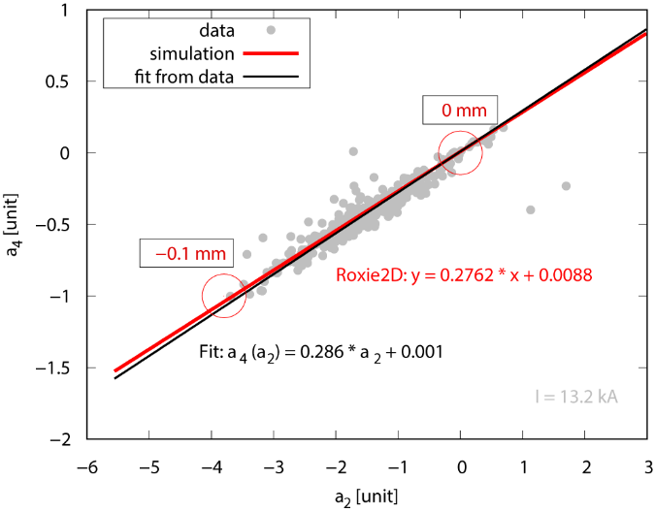
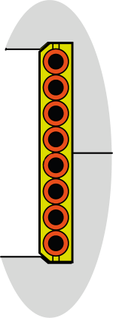
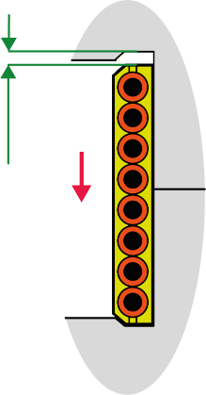
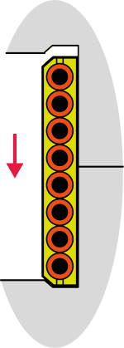

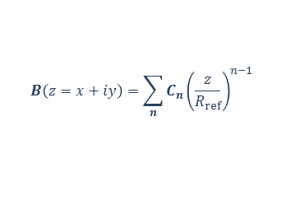
harmonics
harmonics
$$B\left(z=x+iy\right)=\sum_{n}{C_{n}{\left(\frac{z}{R_{ref}}\right)}^{n−1}}$$
$$C_{n}{=B}_{n}+{iA}_{n}$$
generally low
good agreement with expectation
except:
b₃ – systematic, correctable
a₂ – due to coil shift
results
beam losses acceptable

Slide 12
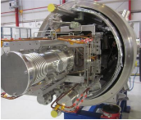
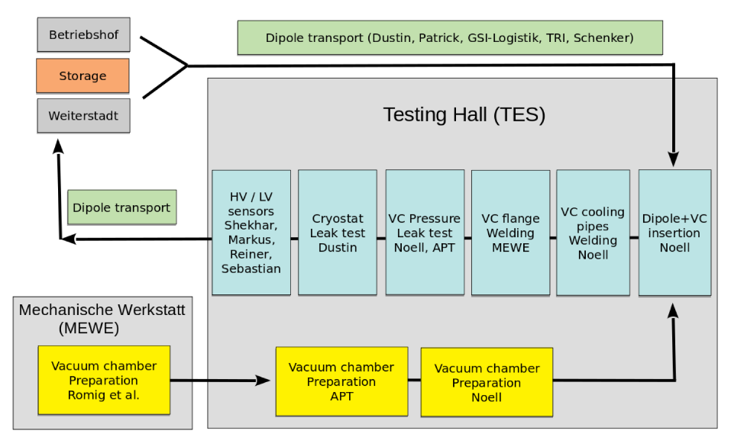
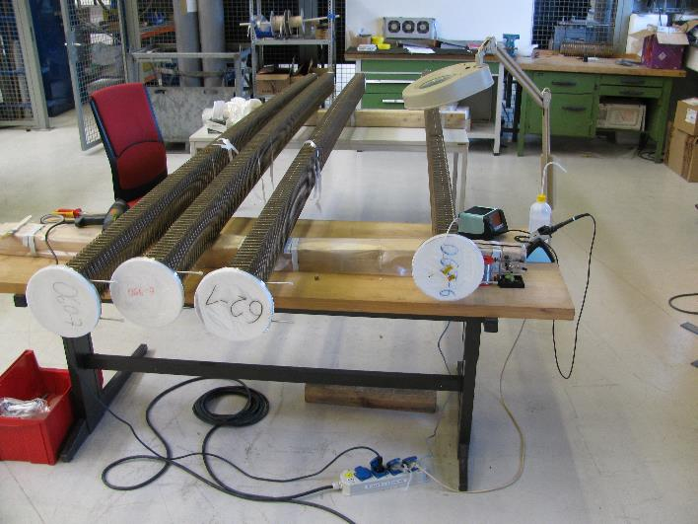
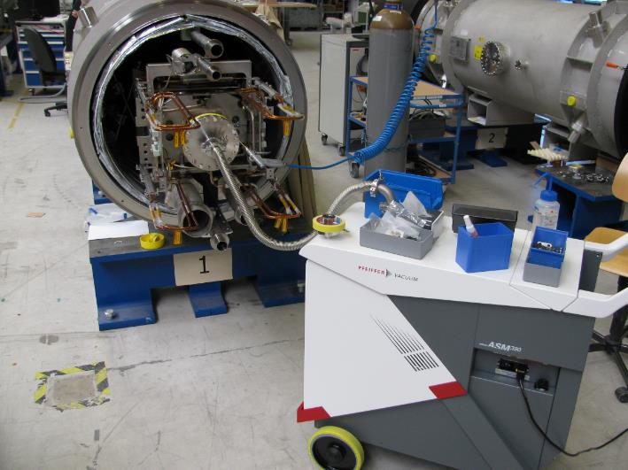
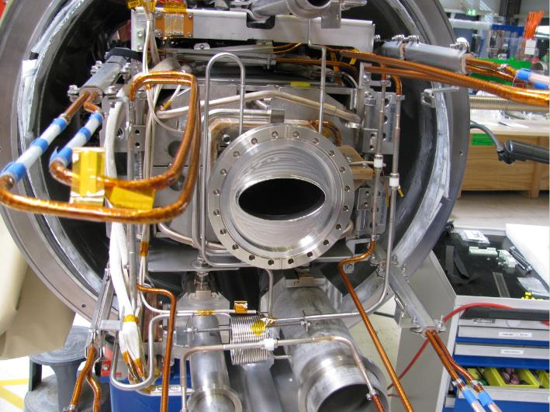

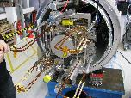
integration of vacuum chamber
leak checking
vacuum chambers
integrated chamber
(major) process steps
logistics
preparation of chamber
pipe welding (according to DGRL)
flange welding
testing

Slide 13
    SIS100 dipole
  series production and testing successfully finished (in time)
  vacuum chamber integration ongoing

Slide 14
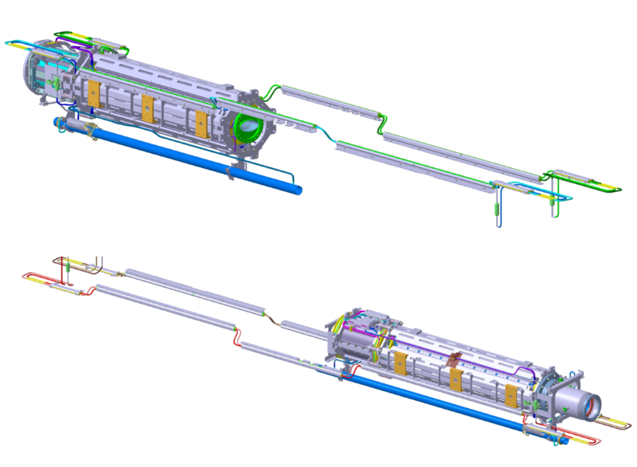

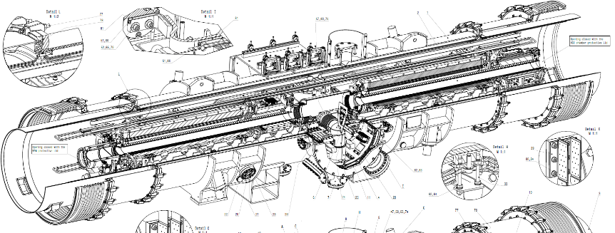

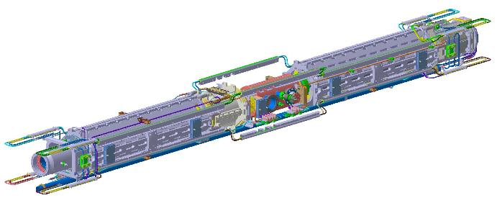

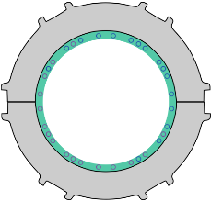




quadrupole doublet – design concept
SIS100 | field | #
quadrupole | B2 | 166
sextupole | B3 | 42
steerer | B1, A1 | 83
multipole | B2, A3, B4 | 12
special quad | B2 | 16
GESAMT |  | 427
quadrupole units (166 pcs.)
configuration | short name | #
QDB-TRP-SF2 | 2.123 | 15
QDB-TRP-SF2s | 2.13s | 2
QDBb-T-SF2M | 2.4 | 5
QDBx-T-SF2Mx | 2.4x | 1
VQD-CR-SF2B | 2.5 | 6
BQD-C-SF1H | 1.6A | 12
VQD-CR-SF1B | 1.7B | 12
BQD-C-SF2H | 2.8C | 12
BQD-CR-SF2J | 2.9D | 12
MQD-C-SF1Bb | 1.E | 5
MQDi-C-SF1Bi | 1.Ei | 1
VQD
defocusing
quadrupole -QD-
quadrupole + corrector + corrector
cryocatcher
-C-
quadrupole doublet modules
beam position monitor
-B-
two units on common girder
sextupole
together with other elements:
beam chamber
cryo catcher
BPM
cryo pump, roughing CWT
quadrupole
iron dominated
quadrupole
VQD
> 300 magnets
166 units, 17 types
83 modules, 11 types
chromaticity
sextupole
-V-
SF2B
SF2B
vacuum
chamber
integration into common cryostat
doublet module
focusing
quadrupole -F2-
steerer
-S-
configurations
11 types
steerer
unit SF2B
unit VQD
quadrupole
sextupole
iron dominated
steerer
multipole

Slide 15















supply chain - quadrupole doublets
JINR, Dubna, Russia
unit production
cold testing units
Bilfinger Noell, Würzburg
doublet integration
GSI supplies:
beam chamber
cryo catcher
BPM
LCLs
cryo pump
roughing CWT
INFN, Salerno, Italy
cold testing doublets

Slide 16









unit production - impressions
yoke production
production and testing facility @JINR
quadrupole yoke
cabling machine
quadrupole
magnet
coil winding
sextupole yokes
units

Slide 17



quadrupole units – FAT and SAT
FAT + SAT (@JINR)
intensive measurement program for quality assurance
aperture tool
20 capacitive sensors
testing cryostat
precise aperture measurements

Slide 18









quadrupole units – FAT & SAT
FAT + SAT (@JINR)
intensive measurement program for quality assurance
magnetometer
precise aperture measurements
magnetometer
magnetometer
magnetometer
five segments, five coils each
quadrupole field
spread of transfer function < 10⁻³
leading harmonics within expectation
magnetometer calibration needed
corrector fields
spread of transfer function : < .8 %

Slide 19












magnetic axis vs. doublet concept
magnetic axis measurement
integration of cold mass into cryostat
two units aligned on common girder
girder
two units prepared for girder mounting
vibrating wire technique
yaw and pitch with respect to fiducials R1 – R8
alignment system on girder
spherical joint at center
precision plates at ends (0.1 mm)
yaw
correction plates
yaw
roll
pitch
0.2 mrad per step (yaw, pitch)
yaw
roll
unit
center
pitch
units adjusted individually
roll
pitch
transl.
alignment of girder along beam
unit
ends
(within cryostat)
transl.

Slide 20




FoS QDM – testing at STF
approval of
doublet cryo-mechanics
FoS QDM @STF
FoS QDM @STF
cryo UHV system
6 K
6 K
6 K
5
doublet losses
20 K
Z
12 K
12 K
X
12 K
12 K
integration quality
piping
instrumentation
…
6
B
1
8
Y
2
7
A
4
3
ΔY, ΔZ ≤ 0.1 mm
300 K → 4 K
between cycles
delivery 11-2019
Bildtext
do not change
width
picture size:
height 9 cm in case of text

Slide 21




FoS QDM – testing at STF
approval of
doublet cryo-mechanics
FoS QDM @STF
nominal current not reached
cryo UHV system
doublet losses
integration quality
piping
instrumentation
…
issues
fixation: clamps and blocks
→ successful mitigation
proven at next units
several (little) leaks
horizontal steerer:
poor quench behavior at
nominal ramp rate (1225 A/s)
loose cable

Slide 22


QDM project timeline & prospective
units
QDM integration
QDM testing
QDM testing
09-2018
FoS units delivery
to BNG
11-2019
FoS QDM delivery
to FAIR
10-2020
FoS QDM handover
to INFN
ongoing
commissioning of facility

Slide 23
QDM project timeline & prospective
QDM testing
next QDM
first of each type at STF
units
QDM integration
delivered: 12 units
next 8: 06.2021
finish till end of 2023
first series QDM: 06-2020
4 more under preparation
QDM testing
series testing from 10-2021
second line Q1-2022

Slide 24

string test @STF
assembly
installation sequences
interconnections / interfaces
process decription
tool qualification
Feed box 3
mechanical stability
Dipole
with VC
End box*
forces at cool-down and operation
collective electrical behavior
resistance, capacitance
cross talk
resonances, traveling waves
FoS QDM 2.5
Dipole with VC
Dipole
with VC and CAP
End box
cryogenics
FoS BPL
cooling time
hydraulics
losses
End Cap 1.E
vacuum system
beam and insulation vacuum

Slide 25
    SIS100 quadrupole doublet modules
  FoS QDM: approval of doublet concept
  series production and testing of quadrupole units started
  first series QDM at integration
  preparation for series QDM testing at Salerno & STF

Slide 26


Super-FRS magnet strings
SFRS | #
QUAD III | 44 | 24 long multiplets 7 short mutliplets
Quad IV | 32
Sext | 39
Oct | 42
Steerer | 13
Dipole Type 2 | 3
Dipole Tye 3 | 21
GESAMT | 194
Super-FRS
dipole magnet
particle creation
mass separation
magnet needs
dipole | 24
quadrupole | 76
sextupole | 39
octupole | 42
steerer | 13
total | 194
multiplet:
quadrupole + correctors

Slide 27










supply chain(s) Super-FRS
ASG, Genua, Italy
multiplet production
CERN/GSI, Geneva, Switzerland
cold testing
CEA, Saclay, France
dipole design + follow up
Elytt Energy, Bilbao, Spain
dipole production
GSI
Super-FRS

Slide 28









Super-FRS multiplets
text 02
text 03
short multiplet
text 04
text 05
long multiplet
short multiplets (8 pcs)
short multiplet
quadrupole
pre separator
standard: quadrupole + sextupole
2.5 m, 25 tons
SE – SQ+OC – SE – LQ – ST – SQ+OC – SE
long multiplet
 | LQ | SE
I_{n} [A] | 300 | 291
I_{max} [A] | 330 | 320
L [H] | 21 | 0.88
E_{max} [kJ] | 1100 | 37
ramp rate [A/s] | 2.5 | 2.425
multiplets – common specs
LHe reservoir
(cold) iron dominated
common helium bath
warm beam pipe (d = 380 mm)
individual powering (I < 300 A)
warm bore
sextupole
sextupole
long multiplets (25 pcs)
cold mass
quadrupole
main separator
14 configs
max: 9 magnets, 7 m, 60 tons

Slide 29







Super-FRS multiplets - production
short multiplets (8 pcs)
octupole
sextupole
cold mass
dipole coil
quadrupol
cold mass
concentricity
< 0.3 mm
quadrupole coil
48 turns,
26 layers
pre separator
standard: quadrupole + sextupole
2.5 m, 25 tons
multiplets – common specs
(cold) iron dominated
common helium bath
warm beam pipe (d = 380 mm)
individual powering (I < 300 A)
long multiplets (25 pcs)
main separator
14 configs
max: 9 magnets, 7 m, 60 tons

Slide 30




Super-FRS multiplets – delivery status
short multiplet - FoS
2.5 m, 25 tons
LQ – SE
delivery to CERN: 02.2019
long multiplet - FoS
7 m, 60 tons
SE – SQ+OC – SE – LQ – ST – SQ+OC – SE
delivery to CERN: 11.2020

Slide 31


Super-FRS magnets - dipole
dipole FoS
specs
warm iron dominated
superconducting coil
50 to 60 tons
1.6 T @250 A
conductor:
wire in channel
self protecting
Cu/Sc = 9
types
18 pcs: 9.75°
3 pcs: 11°
3 pcs: 9.75° branched

Slide 32








FoS testing
SM programm details
delivery: Feb. 2019
warm tests at preparation area (repair of non-conformities)
1st cold test Q3/4 2019:
  commissioning
  Long quadrupole powering
  Long quadrupole magnetic pre-qualification measurements
2nd cold test Q1 2020:
  Long quadrupole full magnetic measurements
  Sextupole powering
corona break: mid March - mid June: magnet floating, testing could re-start as "1st priority" at CERN.
3rd cold test: July 2020:
  parallel powering of both magnets,
  Sextuple magnetic measurements
  cross talk magnetic measurements
  cryogenic tests
4th cold test: Q4 2020:
  bench-2 commissioning
  additional cryogenic tests
short multiplet
FoS SM at testbench
FoS LM (front)
FoS SM (back)
cool down: 7 days
stable magnetic axis (@cool down)
HV @4 K only partially ok
issues with leakage and heat load
used to commission two benches
heat load
long multiplet
current leads
cool down: 16 days
HV @ 4 K ok: all magnets
further commissioning of facility
80 K → 4.2 K, 1.3 bar
FoS short multiplet
+ Magnetic parameters of long quadrupole and sextupole ok
+ No magnetic axis movement after thermal cycles
+ Cool down time significantly faster than required
o Heat loads higher than expected (Re-evaluation ongoing)
- Leakage of thermal shield pipe
- Leakage of current leads to atmosphere
- HV test at cold failed (1050 V instead of 1500 V)
300 K → 80 K
12 bar, 23 g/s
dipole
electrical testing @300 K ongoing

Slide 33




Super-FRS – field testing setup
rotating coils
induced voltage due to flux change
3 PCBs
5 radial coils each
outer radius 167 mm
+ Fourier analysis
field strength/quality, harmonics
stretched wire
collaboration with CERN
flux through surface traced by moved wire
field strength / quality, harmonics, magnetic axis
further (for dipole)
translating fluxmeter
Hall sensor on 3D mapper

Slide 34

field quality
field quality
relative variation of gradient (integral)
quadrupole: approved
sextupole: approved
(some allowed harmonics beyond expectation, but fine)
cross talk investigation ongoing
(huge) effort
approval of methods & equipment
cross calibration

Slide 35

S-FRS project timeline & prospective
multiplets
cold testing
FoS SM delivery 02.2019
FoS LM delivery 11.2020
next FAT (SM) ongoing
FoS SM finished
FoS LM ongoing
pre-assembly / assembly
preparation ongoing
dipoles
cold testing
FoS delivery 02.2021
next FAT ongoing
FoS testing started

Slide 36
    Super-FRS magnets
  FoS for each type delivered
  testing site (almost) fully commissioned
  FoS short multiplet: approval of concept
  FoS long multiplet and dipole testing upcoming soon

Slide 37








Quenchdetection
Quench
transition to normal state
conditioning boxes (QCB)
450 pcs. for SIS100
QuD unit
analogue input
(bridges)
digital data processing (FPGA)
SIS100 cabinets
55 pcs.
+ 18 control cabinets
S-FRS
integrated into PS
use of accelerator network (LAN)
 |  | SIS100 | LHC
Type |  | Super-ferric | Coil-dominated cosΘ
Nominal field | B [T] | 1,9 | 8,33
Nominal current | In [kA] | 13,2 | 11,85
Inductance at 0 A | Lo [mH] | 0,56 | 51
Inductance at In | Ln [mH] | 0,45 | 49,35
Energy stored at In | Emag [kJ] | 40 | 3465
Nominal cycling rate | dI/dt [A/s] | 28000 | 10
Inductive voltage at cycling | Vmag [V] | 16 | 1
Operating temperature | Top [K] | 4,2 | 1,9
Bending radius | ρ [m] | 53 | 2804
Total mass | M [t] | 3,2 | 27,5
Temperature margin at In, Bn | Tmargin [K] | ~1 | 2
Energy margin | E margin [mJ/cm3] | 1,1 | 3
quench signal
inductive voltage
time scale
~ 100 mV
~ 100 V
~ 10 ms
QuD unit
S-FRS: 250
SIS100: 1250
hardware development @GSI
units (boards)
cabinets + control cabinet
conditioning boxes
$E_{mag}=$ $\int_{V}{\frac{B^{2}}{2μ_{0}} dV∝B^{2}∙Volume= 1/2 LI^{2}}$
software & testing
unit firmware
procurement upcoming (SIS100)
prototype finished
data aquisition
final design phase
approval at string test

Slide 38
    Quench detection for FAIR
  quench detection units developed and prototypes approved
  development of further hardware and software
  procurement (series) ongoing or in preparation

Slide 39
SIS100
dipole project successfully finished with strong GSI effort and expertise
quadrupole unit series production started
FoS QDM with approval of concept
first series QDM under integration
Super-FRS
FoS modules delivered, FoS SM approved
testing site in operation
all project on track (or finished)
enormeous effort needed in the next years
we are looking forward ☺
in parallel: preparation for installation phase at FAIR

Slide 40







































    + all collaborators
    thank you

Slide 41

https://www.gsi.de/forschungbeschleuniger/fair
    thank you

