Slide 1
EURO-LABS
ML @ ISOLDE

Slide 2

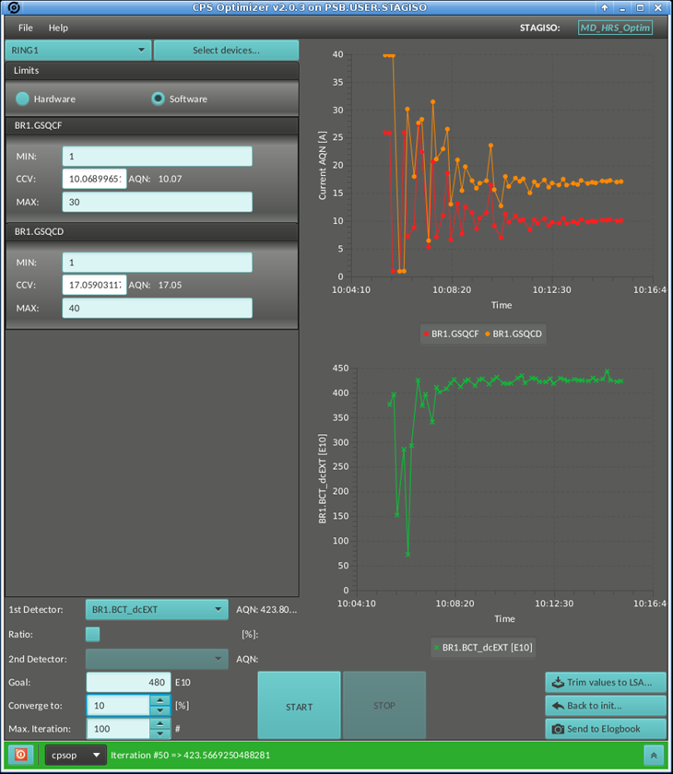
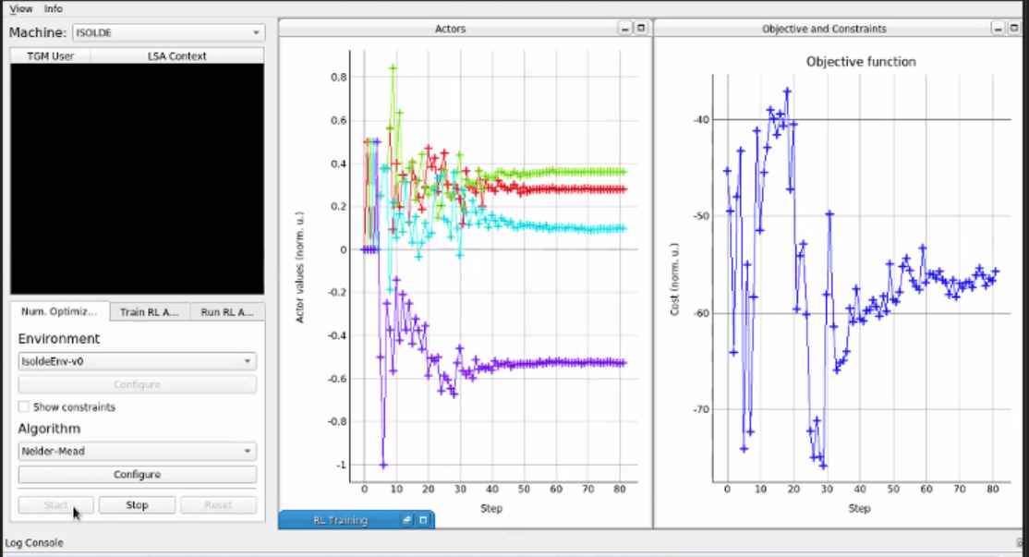
Machine Learning and AI for RIB facilities
S.Rothe, E.Piselli (CERN)
https://cds.cern.ch/record/2305963?ln=en
“RIB facilities are multi-parameter systems that require tuning and optimization to provide best experimental conditions for its USERS.”
a)
ML/AI Toolkits are in development at CERN
Proton beam tuning in accelerators, ion beam optimization at ISOLDE (a)
Agnostic toolkit allows swapping algorithms and system to be optimized (b)
Within EURO-LABS
Collaborate on unified ML optimizer toolkit which allows to share algorithms (gitlab..)
Extend toolkit to USERS and their experimental beamline e.g. link their observables
b)
E.Piselli et.al
Potential applications / synergies:
Target / plasma ion source / Laser ion source (RILIS)
Mass separation (MR-tof)
ion Beam delivery to experiments (overlap of laser/atom beam)
RF cavity phasing (https://cds.cern.ch/record/2693005?ln=en)
Links already established with GSI, potentially TRIUMF
N.Madysa et al.
Notes:
Emiliano Piselli <Emiliano.Piselli@cern.ch>

