Slide 1
Al and ML for accelerator control at FAIR/GSI
Automated machine optimization, S. Appel
Experience on beam based optimization
﻿Multi-objective ﻿genetic algorithms
Derivative free algorithms like ﻿BOBYQA and Bayesian
Usage: Beam lines and injection optimization
ML-assisted optimization has been applied successfully
Ongoing cooperation with CERN, Jülich (Cosy)
Planned: Reformed learning
Simulation
Courtesy: S. Appel
Predictive maintenance, O. + W. Geithner
Forecasting undesired machine state
A framework for assimilation and analysis of non-destructive sensor from FAIR accelerators, i.e. beam current and position monitors, machine settings like magnet values
Prototype for data acquisition and provisioning established at CRYRING@ESR.
Online
Courtesy: W. Geithner, S. Appel
S. Appel et al. International Journal of Modern Physics A Vol. 34, No. 36, 1942019 (2019)
S. Appel et al. Beam Line Optimization using Derivative-Free Algorithms, J. Phys.: Conf. Ser. 1350 012104

Slide 2
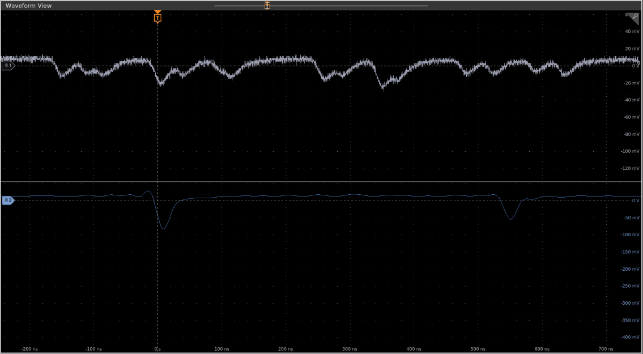
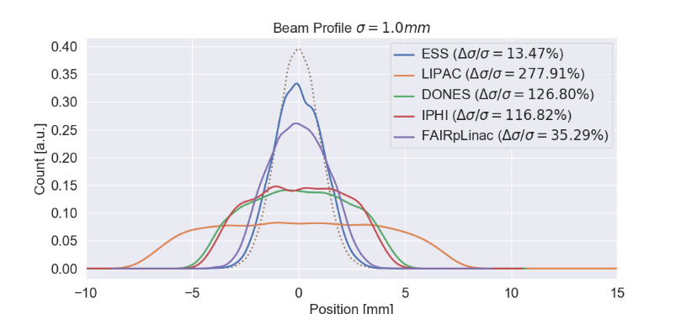
Al and ML for accelerator control at FAIR/GSI
Beam diagnostics, R. Singh, P. Boutachkov, D. Vilsmeier
Particle counters:
Limited by simple threshold based counting mechanisms. Counting rate could be significantly increased by supervised learning algorithms.
Vital for operating the scintillation counters under wide dynamic intensity ranges in FAIR for beam slow extraction and control. R. Singh, P. Forck, and S. Sorge, Phys. Rev. Applied 13, 044076
Profile reconstruction:
Under high intensities, profile monitors based on ionization and fluorescence are affected by the charged particle
Proposal of neural network based deconvolution. D. Vilsmeier, M. Sapinski, and R. Singh, Phys. Rev. Accel. Beams 22, 052801

