Slide 1
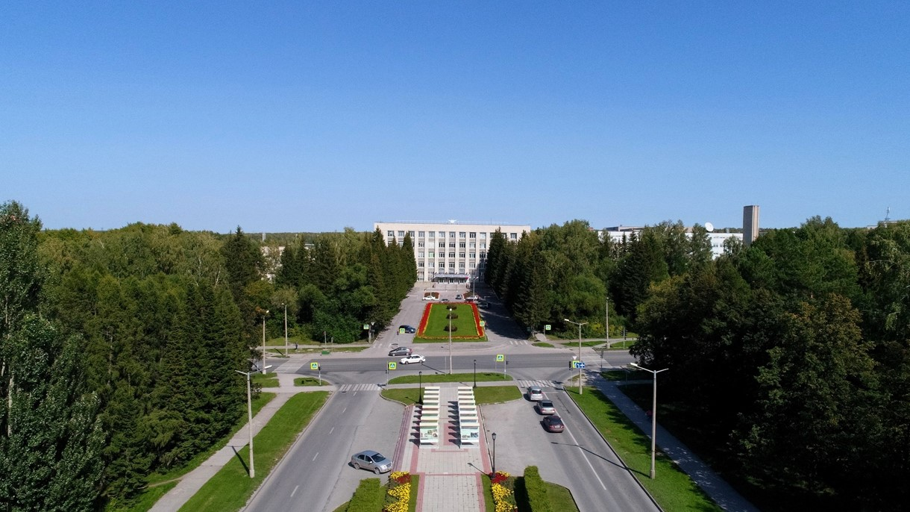
BINP
6th BINP-FAIR Collaboration Coordination Workshop

Slide 2
Branch Box (Conceptual design)

Slide 3
Superconducting FRagment Separator (Super-FRS) Branch Box.
Boxing position: the responsibility of BINP is marked in yellow.

Slide 4
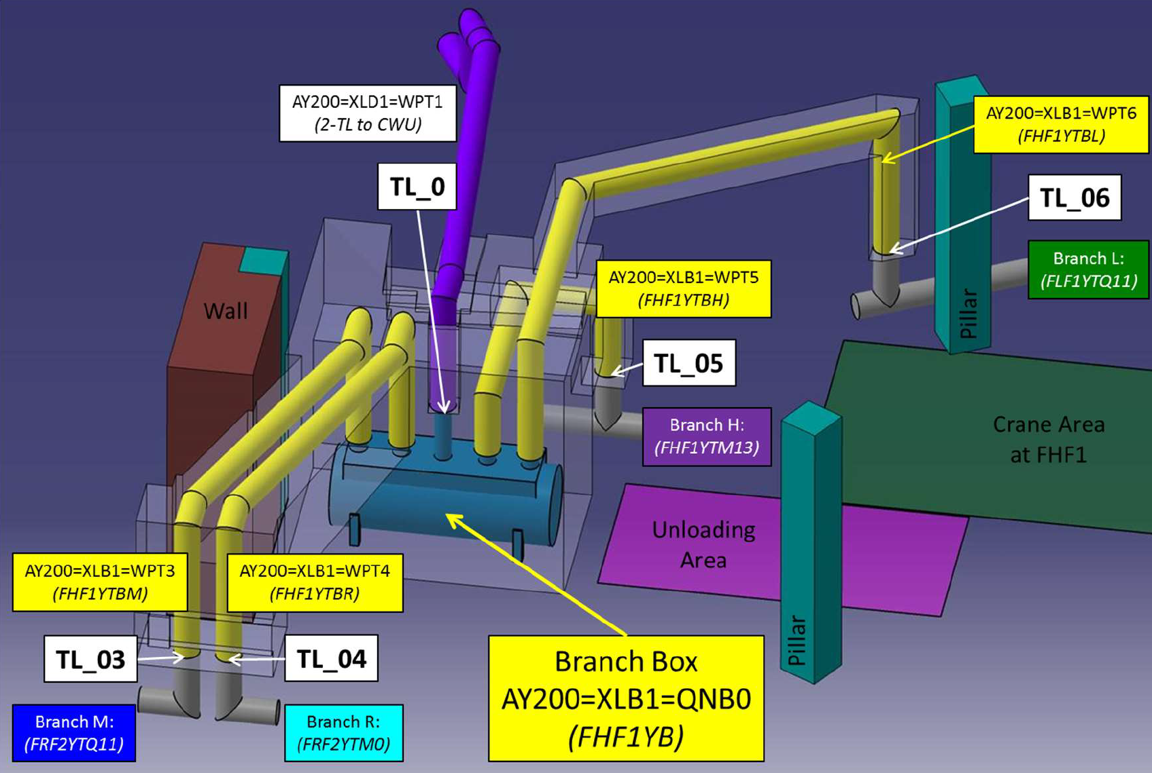
Conceptual 3D model of the Branch Box and its cryogenic Transfer Lines.
BINP responsibility
The scope of cooperation of this work includes the technological design of the branch box (BB), which distribute helium supply to four SFRS experimental branches, Sub-cooler of the BB and four Transfer Lines for M, R, H, and L branches.

Slide 5
Flowscheme of the Branch Box (January 2021).

Slide 6
Interface of the Branch Box.
The interface was agreed with the GSI in September 2020.

Slide 7
3D model of the Branch Box.
MPL
CWU supply
CWU return
4.5K supply
50K supply
5K return
80K return
Vent Line
Pumping & Purging
High Pressure Supply
3D model of the Branch Box with Warm piping and Pressure transmitters.

Slide 8
3D model of the Branch Box.
Safety Tube
Pressure transmitters (34 pcs.)
3D model of the Branch Box with Warm piping and Pressure transmitters.

Slide 9
Dimensions of the Branch Box.
CWU
Cooldown&Warmup Unit
MPL
Multi-Purpose (cold-warm He) Line
Branch L
Branch H
Branch R
Branch M
Outer diameter is 2060 mm (2220 mm flanges), length is 5500 mm. The weight is ~14t

Slide 10
3D model of the Branch Box.
Safety Tube
«Cold» Valves
Safety valves
Cryostat
Shield
Pressure transmitters
«Warm» Valves
Sub-cooler
Dimensions of the Branch Box wit Warm piping: 3 м width; 2,5 м height up to vacuum barriers branch M, R, H, L; 4 m height up to vacuum barrier CWU.

Slide 11
Cryostat of the Branch Box
Vacuum barrier-CWU
Cup
Flange
Cover
Safety Tube
Pumping
Shell
Leg
Outer diameter of the shell is 2060 mm, thickness is 12 mm, thickness of the cover is 45 mm, length of the Cryostat is 5500 mm. Material is St.St. The weight is ~7,3 t.

Slide 12
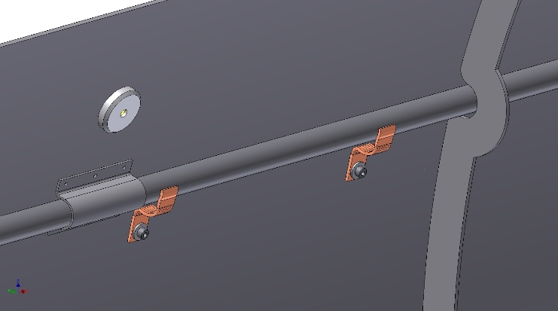
Shield of the Branch Box
Top Shield
Pipeline
Support
Thermal bridges
Bottom Shield
Cover
Flange
Outer diameter is 1956 mm, length is 5340 mm, thickness of the shell is 4 mm. Material is Aluminum alloy. The weight is ~0,54 t. The shield is cooled using thermal bridges.
The shield is positioned into the cryostat using ball bearings with G11 supports.

Slide 13
Sub-cooler of the Branch Box
Support
Sub-cooler
Pipes
Outer diameter is 711 mm, length is 3550 mm (3150 mm cylindrical part), thickness of the shell is 8 mm, Material is St.St. The weight is ~0,56 t. Sub-coolers pipes: d=12x1 (DN10), l=9 m, 8 pieces.

Slide 14
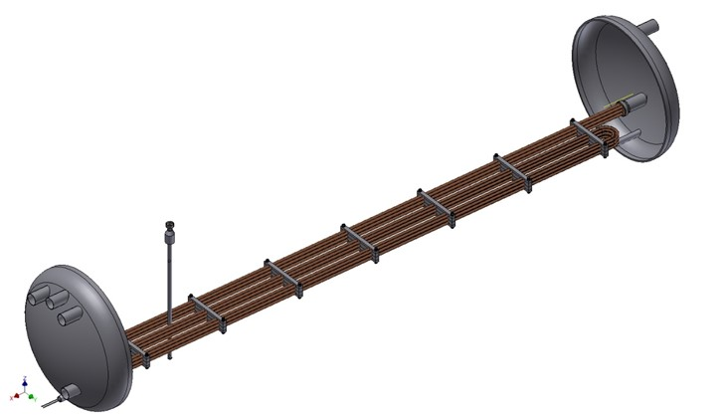
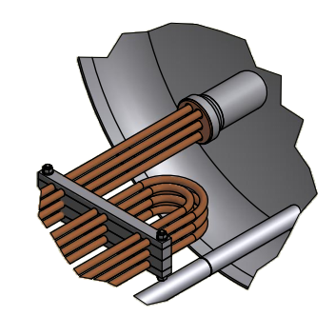
Sub-cooler of the Branch Box
Сharacteristic:
- The sub-cooler vessel volume – 1000 liters
The maximum design pressure is 20 bar against vacuum at all possible operating temperatures;
Temperature inlet - 6K;
Temperature outlet - 4,6K;
Pressure inlet - 4,0 bar;
Pressure outlet - 3,96 bar;
Flow rate - 174 g/s;
8 copper pipes OD12 x 1 mm (wall thickness) and length of the each pipe is 9 meters.

Slide 15
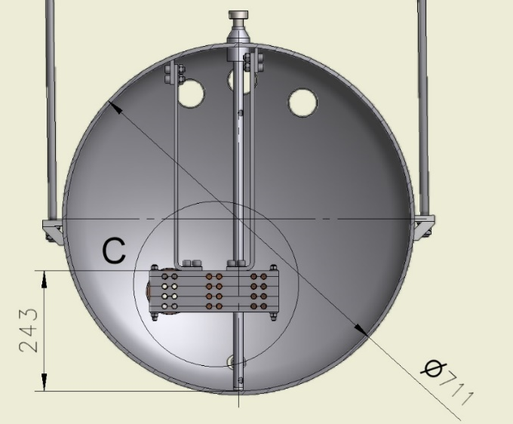
Sub-cooler of the Branch Box
The maximum LHe level
The minimum LHe level
The LHe volume is 1000 liters in the sub-cooler vessel. 254 liters shall be guaranteed.
The maximum LHe level in vessel shall be less than 530 mm from the bottom, the minimum LHe level in vessel shall be more than 380 mm from the bottom.
The installation height of the Sub-cooler has to below 300 mm from the bottom (really - 243 mm).

Slide 16
Cryostat, Shield and Sub-cooler of the Branch Box
Cryostat
Sub-cooler
Shield
Location of the Sub-cooler into the Cryostat

Slide 17
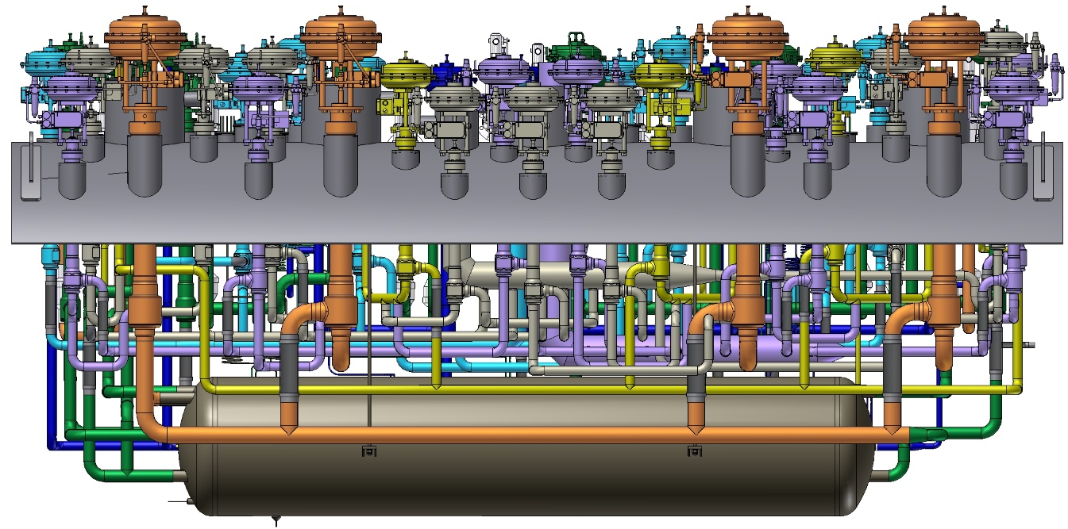
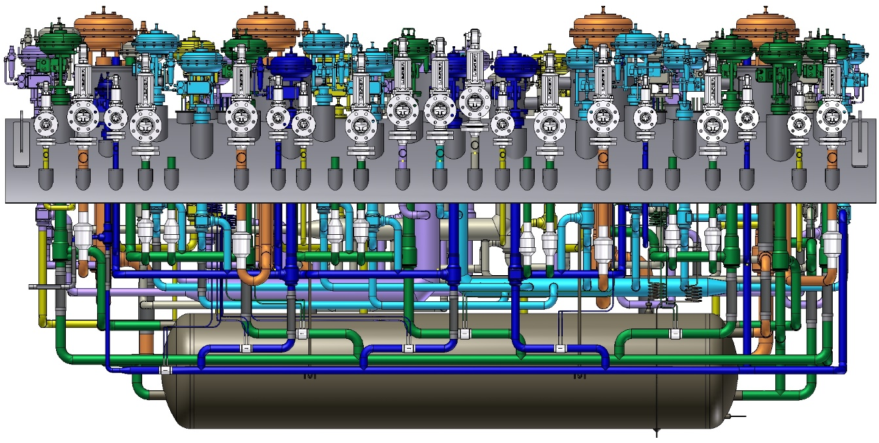
Pipelines of the Branch Box.
80K return
4.5K supply
5K return
50K supply
Sub-cooler

Slide 18
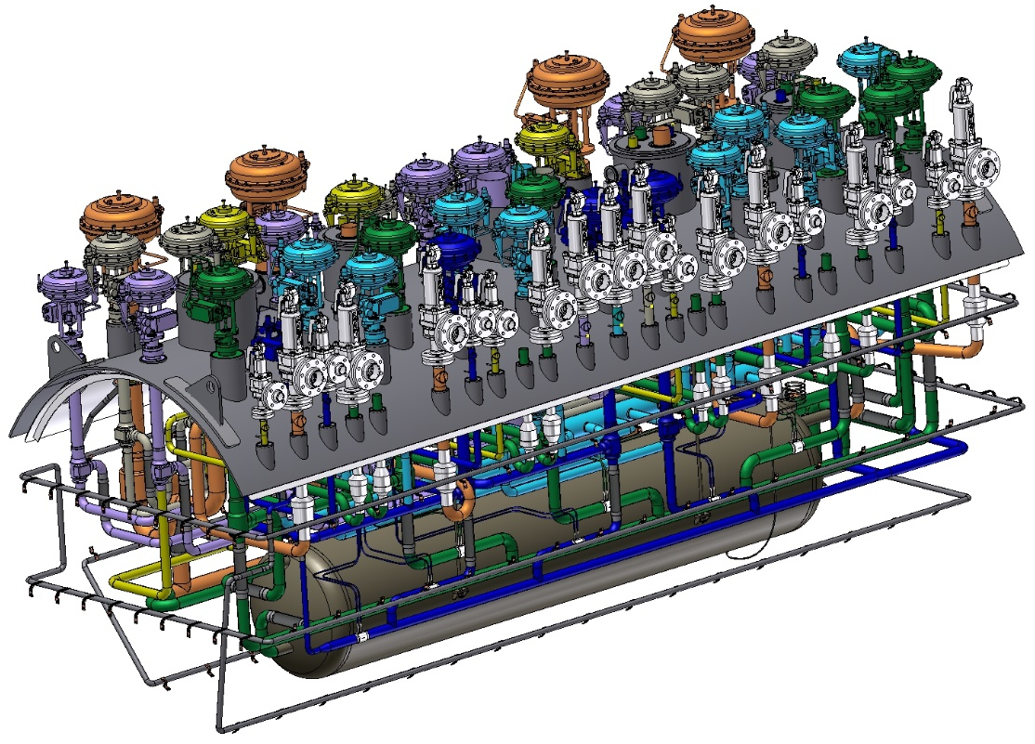
Pipelines of the Branch Box.
CWU supply
MPL
CWU return
5K return
4.5K supply
50K supply
80K return
Sub-cooler
Shield pipeline

Slide 19
3D model of the Branch Box.
Working Platform
Branch Box
3D model of the Branch Box with Working platform (6,4 m x 3,9 m; h=1,8 m).

Slide 20
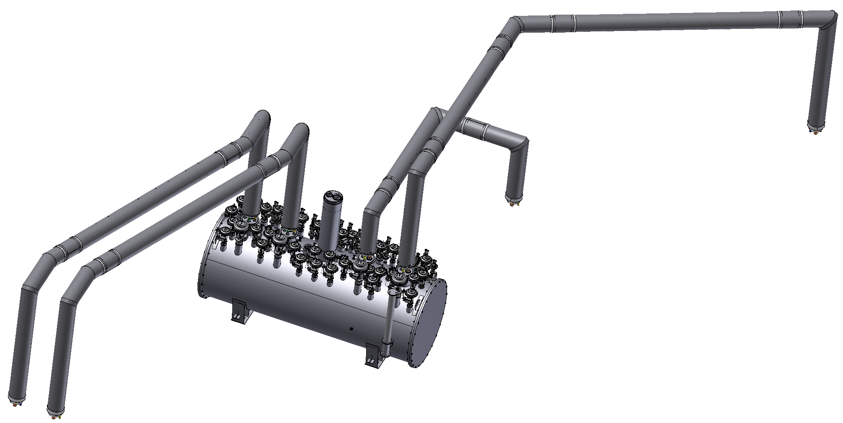
Conceptual design of the Transfer lines for M, R, H, and L branches.
TL05
TL06
TL03
TL04
G10 spacer
Metal hoses
Branch Box
He pipe
Ball joint
Al Thermal shield
Vacuum shell DN200

Slide 21
Installation of the Branch Box.

Slide 22
Plans:
After the final calculation of the flows, the diameters of the internal pipelines BB will be corrected.
The final calculation of the pipelines using the Caesar-II program
will be made.
The conceptual design of the Branch Box and four branch transfer lines will be prepared in September 2021.
The final design review will be prepared in January 2022.

Slide 23
Thank you for your attention!

