Slide 1
6rd BINP-FAIR Collaboration Coordination Workshop
Contract No. CC2.3.2-2 HEBT batch 2, 3 & 4
HEBT magnets status report

Slide 2
6rd BINP-FAIR Collaboration Coordination Workshop
Contract No. CC2.3.2-2 HEBT batch 2, 3 & 4
Dipole 4_0 | 2
Dipole 10_0 | 6
Dipole 13_0 | 2
Dipole 13_3 | 3
Dipole 19_0 | 4
Dipole 15_0 | 4
Dipole 15_1 | 1
Dipole 16_0 | 1
Dipole 17_0 | 1
Quadrupole 2 | 91
Quadrupole 2 long | 4
Quadrupole 10 | 4
Quadrupole 11 | 70
Quadrupole 12 | 12
Steering 13 | 5
Steering 18 | 48
Steering 100 | 45
Total magnets | 303
Delivered 74 magnets.
Prepared for shipment 17.
Was produced 25 magnets.
Was organized FAT
Online 18 magnets
TUV – 4 magnets

Slide 3
6rd BINP-FAIR Collaboration Coordination Workshop
Production plan HEBT Magnets Batch 2, 3 & 4 |  |  |  |  |  |  | 26.04.2021
Magnets | Quantity | At FAIR | Prepares for shipment | Was produced | 2021 months |  |  |  |  |  |  |  |  | 2022 months
 |  |  |  |  | 4 | 5 | 6 | 7 | 8 | 9 | 10 | 11 | 12 | 1 | 2 | 3 | 4 | 5 | 6 | 7 | 8 | 9 | 10 | 11 | 12
dip4_0 | 2 |  |  |  |  |  |  |  |  |  |  |  |  |  | 1 |  | 1
dip10_0 | 6 | 2 |  |  | 1 |  | 1 |  | 1 |  | 1
dip13_0 | 2 |  |  | 1 |  |  |  | 1
dip13_3 | 3 |  |  |  |  |  | 1 |  |  |  |  |  |  | 1 | 1
dip19_0 | 4 |  |  |  |  |  |  |  |  |  |  |  | 1 |  |  | 1 | 1 | 1
dip15_0 | 4 | 4
dip15_1 | 1 |  |  | 1
dip16_0 | 1 |  |  | 1
dip17_0 | 1 |  |  |  | 1
Quadrupole 2 | 91 | 32 | 5 | 13 |  |  | 5 |  | 5 |  | 5 |  | 5 |  | 5 |  | 5 |  | 5 |  | 5
Quadrupole 2 long | 4 |  |  |  |  |  |  |  |  |  |  |  |  |  | 1 |  | 1 |  | 2
Quadrupole 10 | 4 | 1 | 3
Quadrupole 11 | 70 | 5 | 1 | 11 |  |  |  |  |  | 5 |  | 5 |  | 5 |  | 5 |  | 5 |  | 5 | 3 | 5 | 5 | 5 | 5
Quadrupole 12 | 12 |  |  | 1 |  |  |  |  | 1 | 1 | 1 | 1 | 1 |  |  | 1 | 1 | 1 | 1 | 1 | 1
Steering 13 | 5 |  |  |  |  |  |  |  |  |  |  |  |  |  | 1 |  |  |  | 4
Steering 18 | 48 | 20 |  |  |  | 5 | 5 | 8 | 6 | 4
Steering 100 | 45 | 10 | 8 | 10 | 5 | 5 | 3 | 4
Total | 303 | 74 | 17 | 38 | 7 | 10 | 15 | 13 | 13 | 10 | 7 | 6 | 7 | 6 | 9 | 7 | 9 | 7 | 12 | 6 | 9 | 5 | 5 | 5 | 5

Slide 4
6rd BINP-FAIR Collaboration Coordination Workshop
11 magnets was prepared for next FAT.
Q2 – 6
Q11 -5

Slide 5
6rd BINP-FAIR Collaboration Coordination Workshop
Main problems:
Dipoles - magnetic measurements.
Quadrupoles – documentations
Quad 11 optimisation.
S13 steering magnet design.

Slide 6
6rd BINP-FAIR Collaboration Coordination Workshop
Needed CDR Test Protocol:
3-d models
Quadrupoles:
Q11 FHTQS323
Q2 FHTQS363
Q2 long FHTQS360
S18 steering magnet:
FHTKH011
FHTVA214
FHTKH002

Slide 7
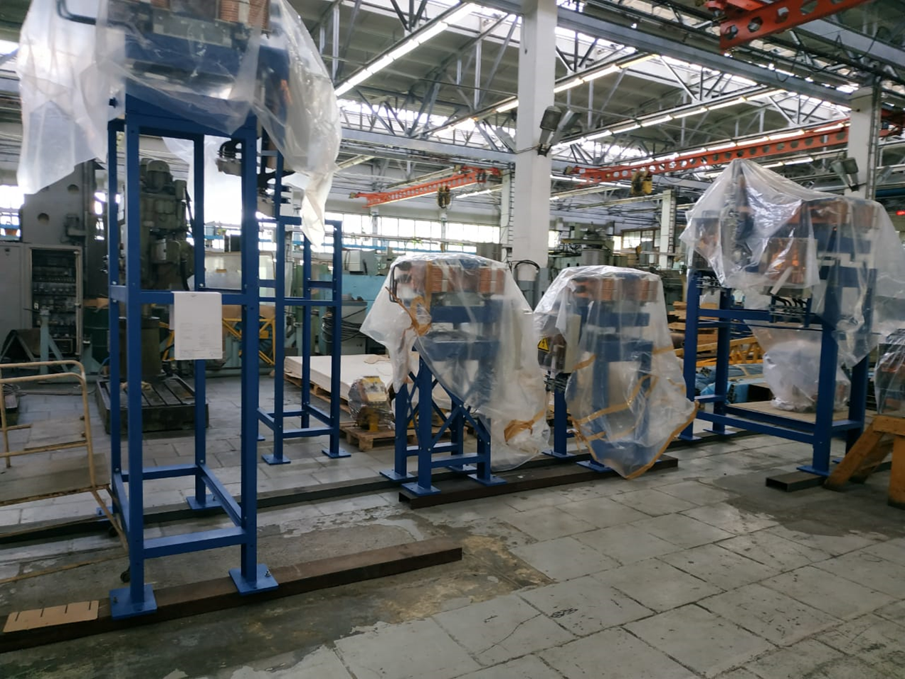
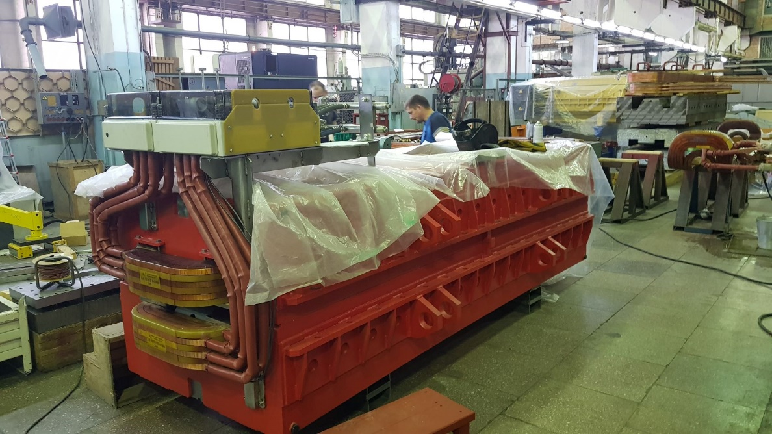
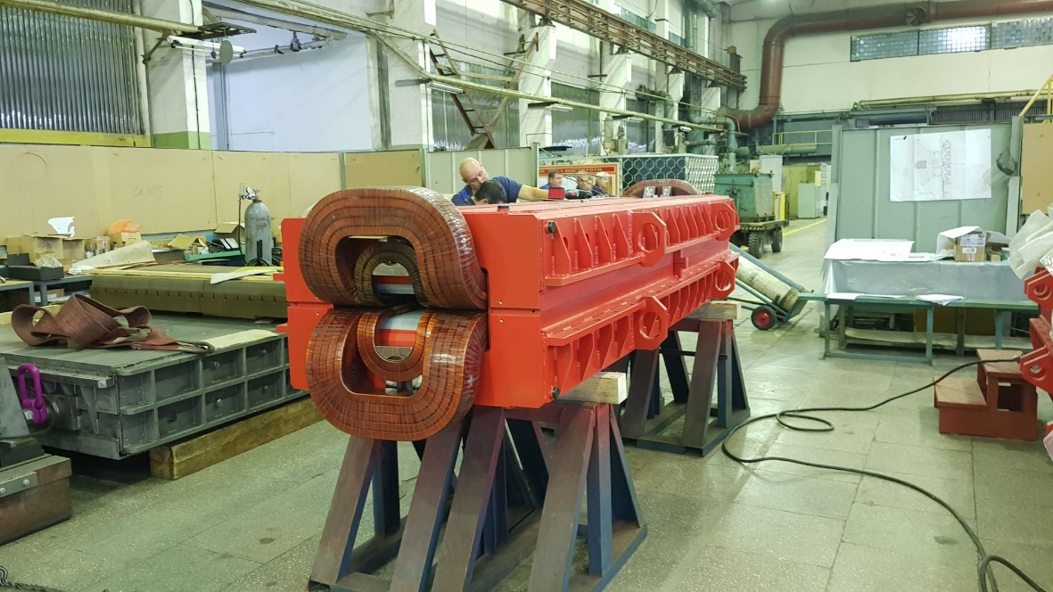
Steering 18
Steering 100
Dipole 10_0
Dipole 13_0

Slide 8
6rd BINP-FAIR Collaboration Coordination Workshop
Thank you for attention!

