Slide 1
6TH BINP-FAIR WORKSHOP
HESR-PANDA Chicane Dipole Magnet
STATUS AND PLANS
26-30 April 2021

Slide 2
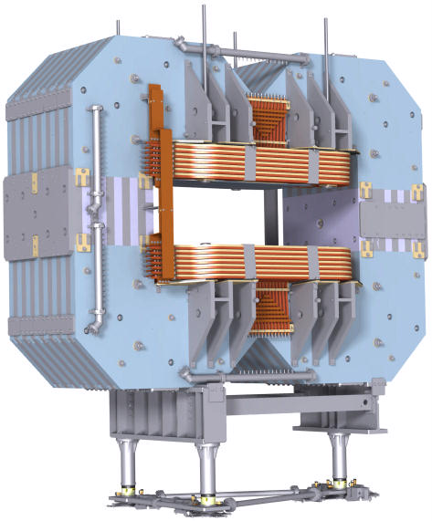
The HESR-PANDA Chicane Dipole Magnet
Normal conducting Spectrometer Dipole
Integral component of the HESR
Beam deflection angle 40 mrad (2.29°)
Dynamic range 0.2 T·m … 2.0 T·m
Ramping speed from 25% to 100% in 60 seconds
View of the dipole from upstream side, field clamp hidden.

Slide 3
Main Specifications for Dipole Magnet
Field integral along beam axis (z-direction) 2.0 T·m
Aperture angle horizontally ± 10°, vertically ± 5°
Yoke laminated to reduce eddy currents, lamination ~ 10 cm
Total weight 240 tons
Steel quality of yoke “21848” (carbon content < 0.02%)
Coil windings made of water cooled copper conductors
Total dissipated power ≤ 400 kW

Slide 4
Status
Stress analysis completed.
Magnetic field simulations completed.
Design of yoke (plates, blocks, halves, assembly) completed.
Design of support structure completed.
Design of coils completed.
Yoke machining technology developed.
3D model for entire magnet completed.
2D drawings derived and under checking/approval .
Intermediate report accepted.
Final report is ready (including Installation manual and other related documents) and under examination.
New fuses setup had been tested aiming at reliable and sharp dipole relief under seismic force distributed for each supporting leg.
Magnetic mapping system is under design.
Negotiations with steel maker and yoke machinery workshops are in process.

Slide 5
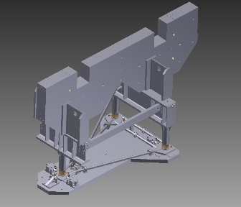
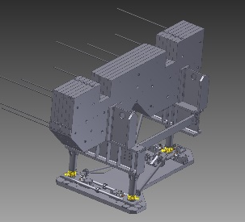
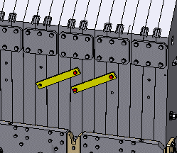
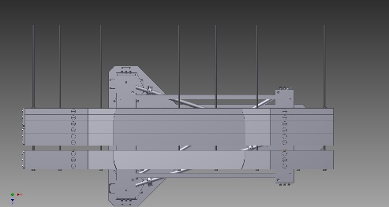
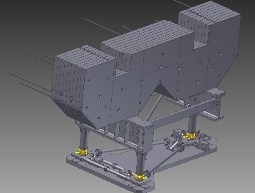
Final report - Installation manual-1
Sequence of dipole assembling had developed and approved by GSI and outside factory. Safety units have been adopted.
1
2
3
4
5
6

Slide 6
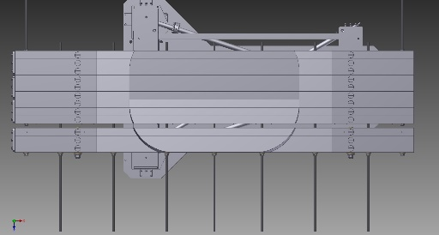
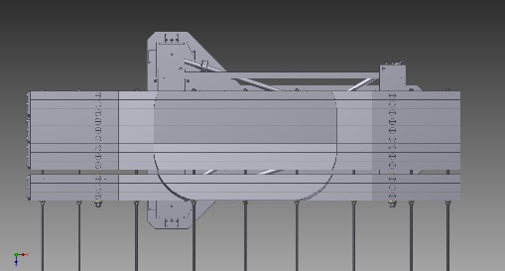
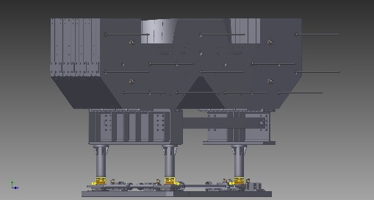
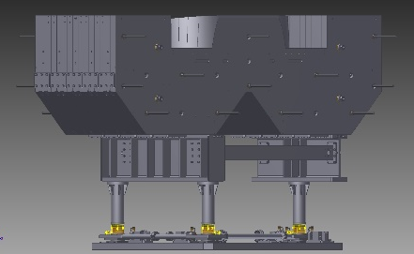
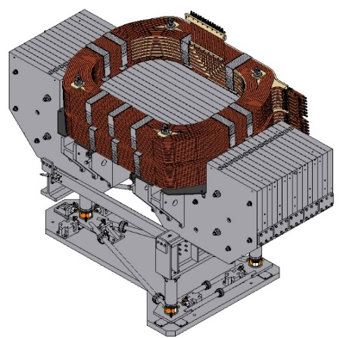
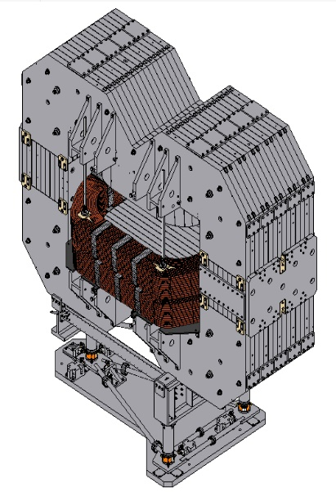
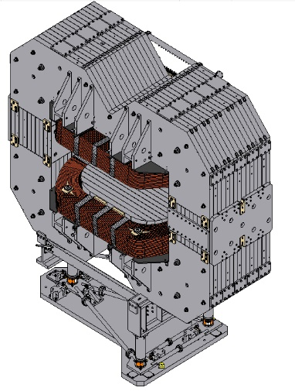
Final report - Installation manual-2
7
8
9
10
11
12
13

Slide 7
Final report – Operation manual
Operation manual had been developed including:
Technical parameters
Alignment procedure and requirements.
Operation conditions and operating data for dipole and power converter.
Conductor current, max | 2000 | A
Ramping rate of conductor current | 0.024 | kA/s
Resistance | 0.1003 | Ω
Low field inductance | 1.33 | H
Maximum DC voltage | 200,6 | V
Inductive ramping voltage | 32 | V
Duty cycle | up to 100 | %
Peak losses in PC at ramp end | 40 | kW
Total voltage, ramp end | 240 | V
Stored energy for PC/dipole | 39/2100 | kJ
Cooling water requirements for PC/dipole | 25/290 | L/min

Slide 8
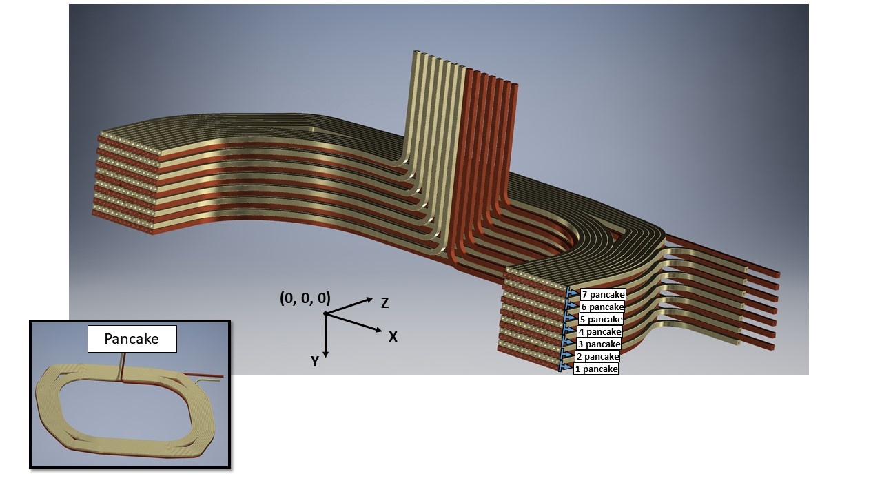
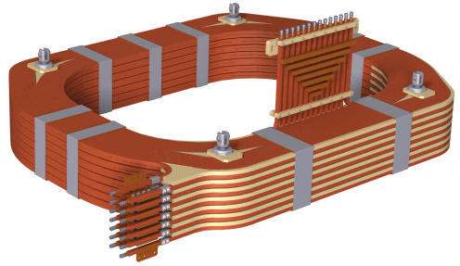
Final report – Coil manufacturing procedure-1
The basic data for the coil are as follows:
The coil consists of seven sections, the number of windings per section is two.
Each winding is wound separately.
Impregnation of each section is performed separately.

Slide 9
Final report – Coil manufacturing procedure-2
Coil manufacturing technology consists of following steps:
1. Preparing to wind a winding: | Copper conductor Preparation. Prepare the winding area to wind single winding.
2. Winding the single winding: | Single winding manufacturing. Preparation of the winding layer for wrapping the winding insulation. Wrapping inter-turn insulation. Testing.
3. Assembly and impregnation of the coil section: | Assembling the coil section. Wrapping up the housing insulation. Tests.
4. Impregnating the coil section: | Preparation of the impregnation device. Assembly of the mold with coil section. Impregnating the coil section. Preparation and carrying out tests.
5. Processing the coil section outputs.
6. Assembling the coil.

Slide 10
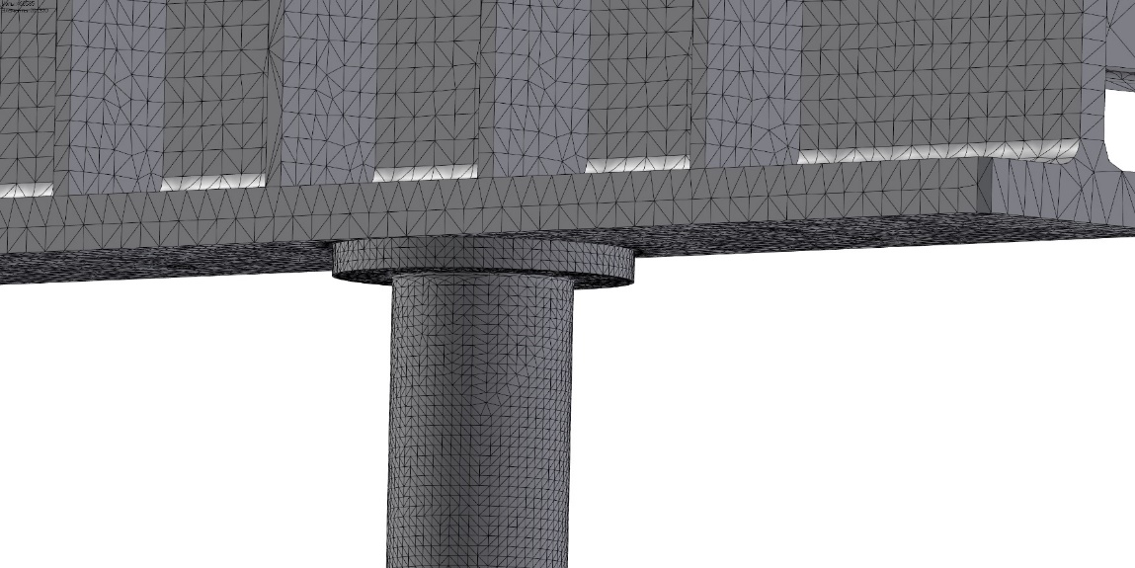
3D-FEM simulation of the dipole and its support structure-1
A 3D-FEM model of the whole set-up was used to identify regions of high stress concentrations and the reaction forces in the feet of the 3 support legs. A medium mesh size was chosen in order to get results in reasonable time.
Without horizontal (seismic) forces there are no regions with a stress level above 50% of the yield strength (which is 255 MPa for the chosen steel quality).
Conditions for simulations:
The steel is used as AISI 1020 107
Yield stress is 255 MPa.
Dipole weight is 240 t.
The mesh is used as curved element type.
Mesh 25 mm
Mesh 10 mm

Slide 11
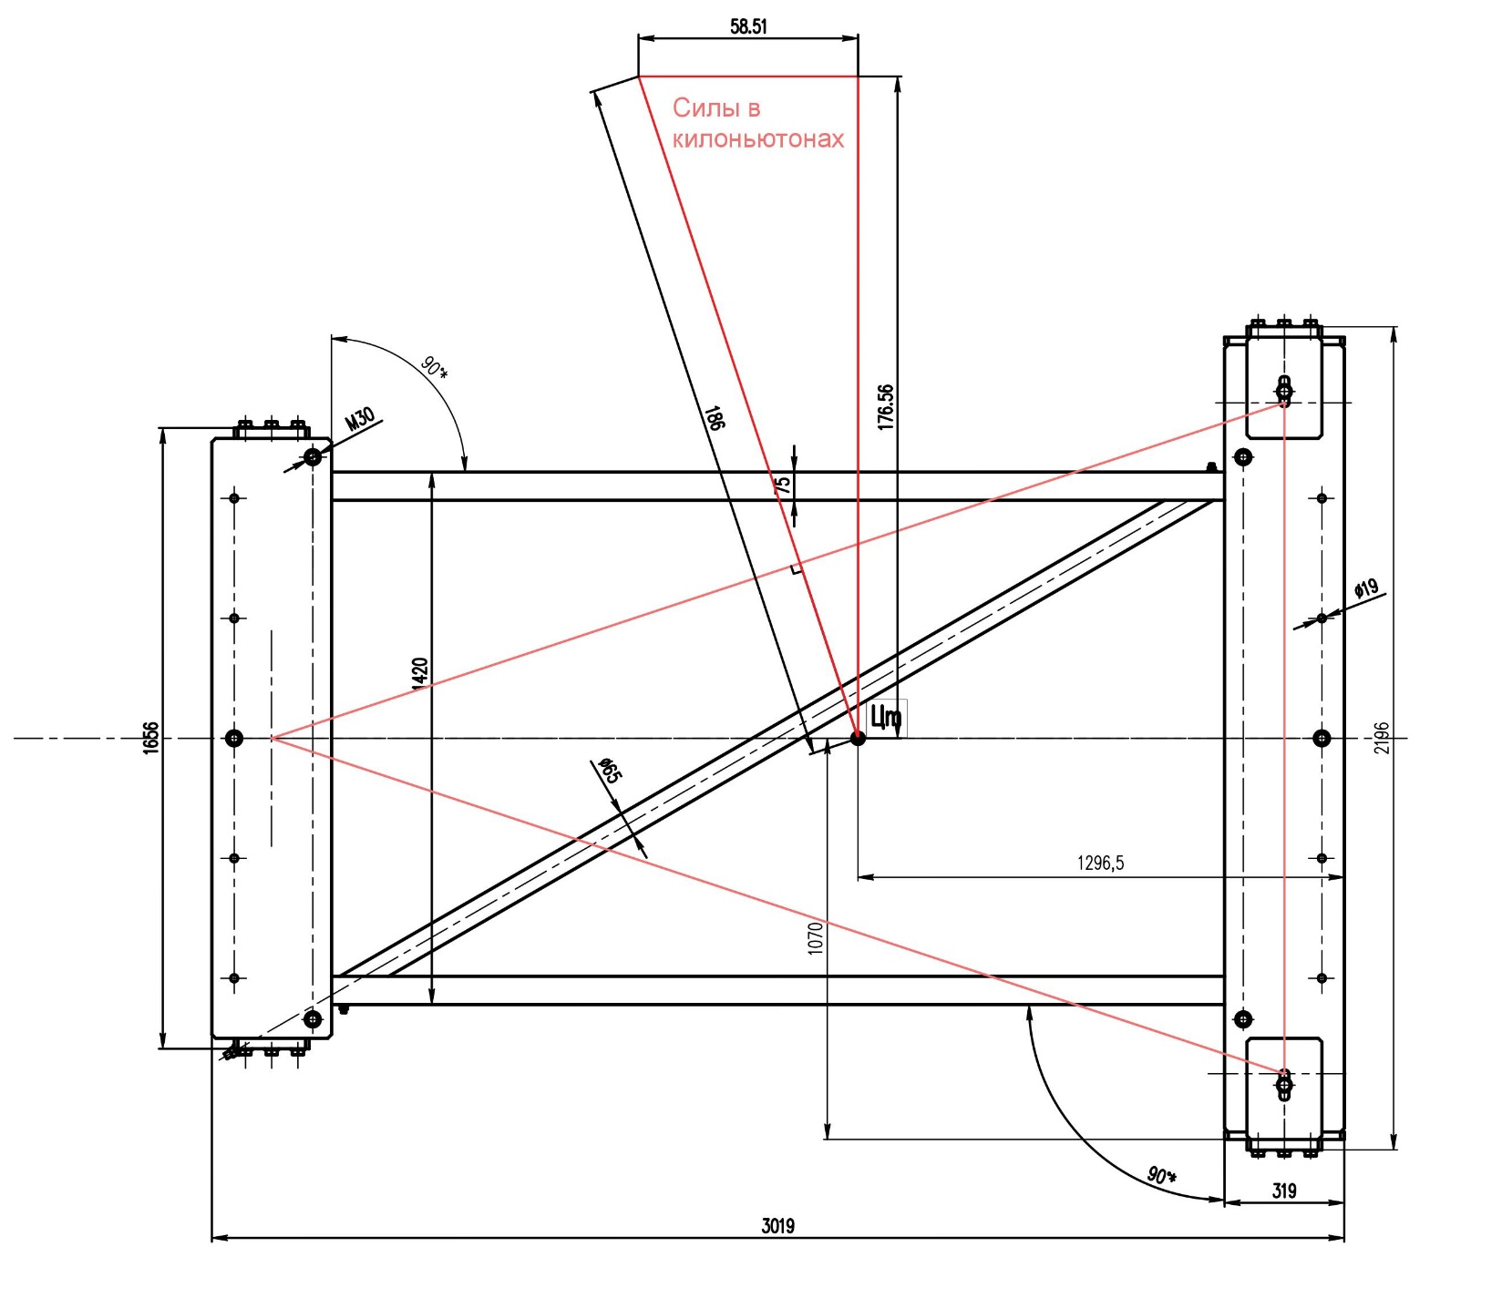
3D-FEM simulation of the dipole and its support structure-2
There are two crucial seismic directions which exert a maximum load on either the north-western
leg and/or on the eastern leg.
F_1
F_sum
F_2
Eastern leg
Force 8% acting towards
west-north feet.
Direction
west-north
Direction
eastern
West-north leg

Slide 12
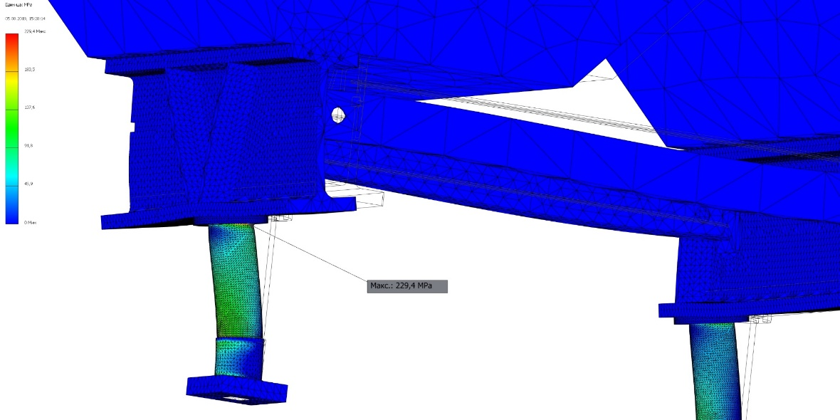
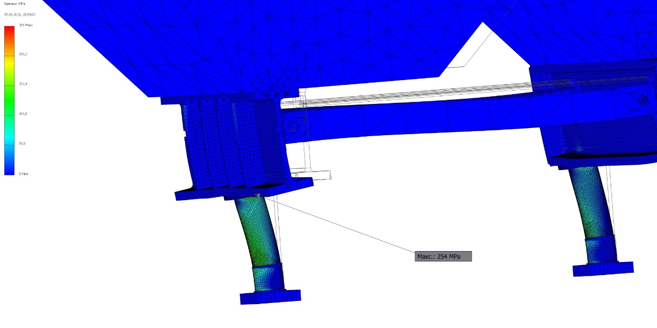
3D-FEM simulation of the dipole and its support structure-3
Options by using V-shape and II-shape additional reinforcement girders were studied
to reduce stress due to seismic force.
But still it was not enough to be below yield stress. The example is shown below.
Force of 8 % towards eastern leg.
Stress simulation. V-shape.
Force of 8 % towards eastern leg.
Stress simulation. II-shape.
Stress of Mises, MPa
Stress of Mises, MPa
F = 186kN = 19t = 8% 237t

Slide 13
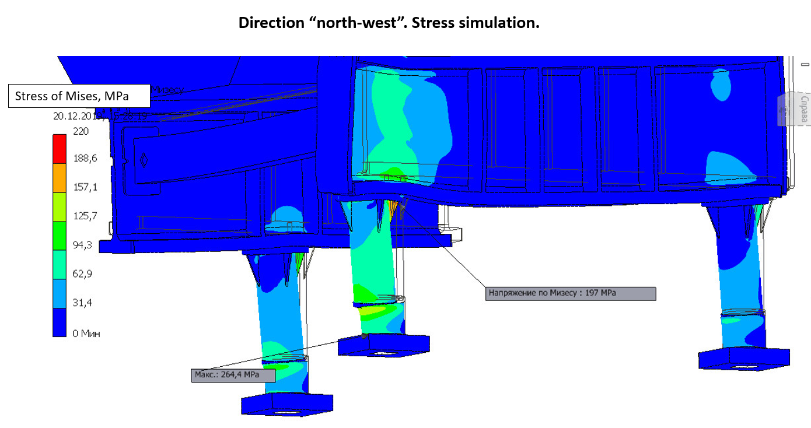
3D-FEM simulation of the dipole and its support structure-4
To further reduce the stress and displacement:
The leg wall thickness was increased from 20 to 30 mm.
Four and then six triangle girders have being installed under the flange of each of the 3 leg.
The design of the ground plate for a common alignment of the support legs was improved.

Slide 14
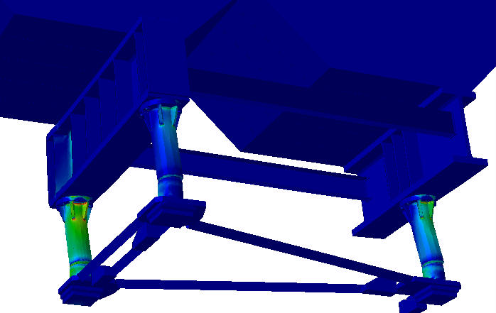
3D-FEM simulation of the dipole and its support structure-5
There are two crucial seismic directions which exert a maximum load on either the north-western leg and or on the eastern leg, respectively. In the figure below the stresses for one of the crucial directions (load case “north-west”) is shown.
Von-Mises stress / [MPa]
eastern leg
north-western leg

Slide 15
3D-FEM simulation of the dipole and its support structure-6
With 3 legs, the dipole is statically determined concerning vertical forces. The legs are arranged in such a way that each leg carries one third of the total weight, as long as there are no horizontal forces present.
Concerning horizontal (seismic) forces, the system is statically overdetermined. All feet of the support legs are fixed. A horizontal force will not be evenly shared among the 3 supports.
The 3D model of the whole dipole gave the following reaction forces for the 2 crucial load cases (in percent of the total vertical force 240 tons and of the total horizontal force 19.2 tons, respectively).
Load case | Leg north-west, vertical | Leg north-west, horizontal | Leg east, vertical | Leg east, horizontal
“north-west” | 48% | 46% | 30% | 36%
“east” | 28.5% | 25.5% | 43% | 49%
With these values, an independent FEM analysis considering only one leg and the adjacent big support beam was performed, with a much finer FEM mesh than before.

Slide 16
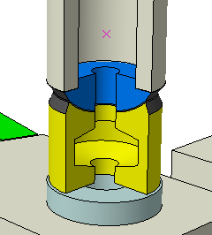
Stress analysis of a single support leg
For a separate analysis of a support leg, besides the vertical force a horizontal force has to be applied to the spherical center (the jack might be neglected then).
This force exerts a considerable bending moment on the leg.

Slide 17
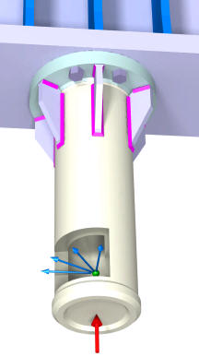
FEM-Model for Simulating the Top Region of a Single Dipole Leg
weld seams z = 7 mm (color magenta)
horizontal force 100kN, acting on virtual center of spherical bearing (green point).
4 load cases considered: horizontal force directions
0°, 30°, 60°, 90°.
vertical force 1152kN

Slide 18
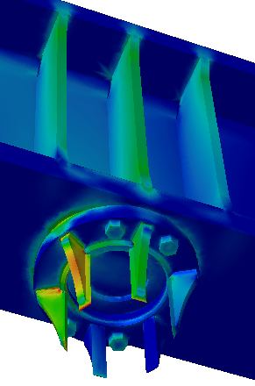
Load on any of the 6 braces for leg flange
The highest load on any brace will usually occur when the horizontal force is directed towards the brace in consideration (in the stress plot here the leg tube is hidden). In our case the brace pointed at will bear 9% (106_kN) of the total vertical leg load and 40% of the horizontal leg load (40_kN). The braces shown here will relieve the top of the tubular leg and the fillet weld between leg and flange on top of the leg sufficiently.
The critical limit in our case is mainly the shear stress in the weld seam between the leg and the braces.
The average stress will be 71 MPa according estimation as 106 kN/[250·7mm²].
Von-Mises stress / [MPa]

Slide 19
Fuses used to fixate the aligned magnet-1
The feet of the support legs are resting on special greased PTFE bearings which are needed for the alignment.
In case of a seismic event of medium magnitude (equivalent static acceleration 0.3 to 0.4 m/s², or 0.03 to 0.04 g, resp.), the friction in the PTFE bearings will be big enough to keep the magnet in place. A seismic event of bigger magnitude would cause the magnet to slide. To prevent this, at least up to an equivalent static acceleration of 0.8 m/s², specially tailored bolts (fuses) will be applied.
In the very unlikely case of an even bigger seismic event (> 0.08 g), these fuses have to yield reliably in order to avoid a horizontal overload of the support legs.
Three series of fuses have been tested to determine their yield behaviour. All were made of steel St10X with notch diameters of 5.6 mm to 9.8 mm (notch length 1.25 times notch diameter). In all 3 series it appeared that there was a clear cut yielding at about 800 MPa (± 2%).
notch

Slide 20
Fuses used to fixate the aligned magnet-2
Elongation vs. force for 8 mm notch fuse.
Elongation vs. force for
5.6 mm notch fuse.
Elongation vs. force for
9.8 mm notch fuse.

Slide 21
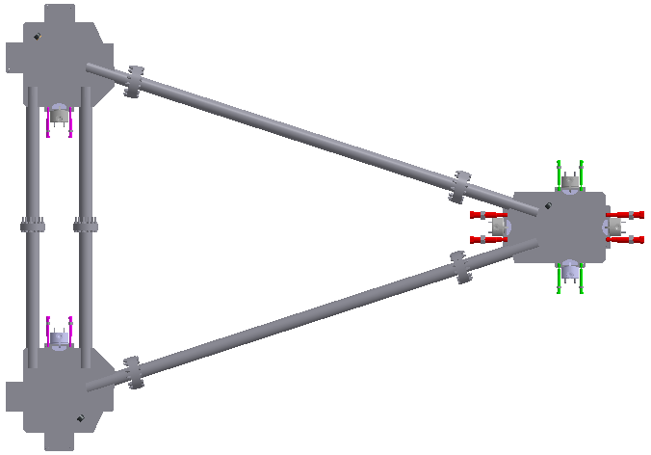
Distribution of fuses used at the support feet
North-west
Pairs of fuses fixating the top plates of the alignment bearings
East
Three types of fuses are applied. Their nominal yield forces are:
Red fuses (for east and west direction) 48 kN each
Magenta fuses (north and south direction) 32 kN each
Green fuses (north and south direction) 16 kN each
South-west
The notch diameters of the fuses are 8.8 mm, 7.2 mm, and 5.0 mm, respectively.
The size difference between the magenta and the green fuses is due to their different distance to the projected center-of-gravity of the magnet.

Slide 22
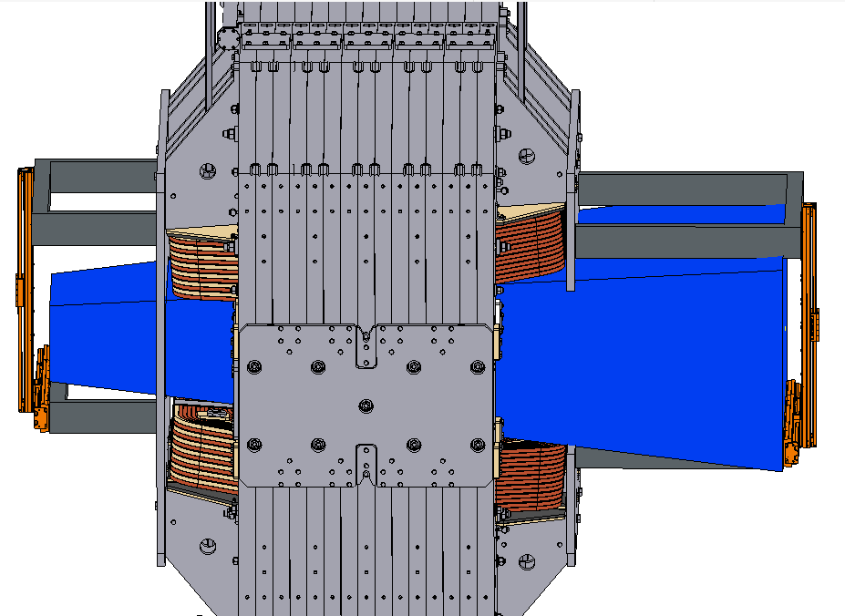
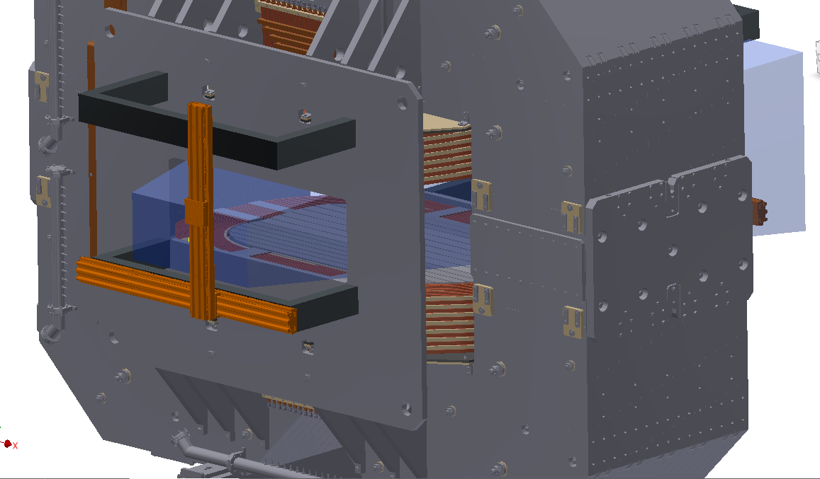
Magnetic measurement system for dipole-1
Boundary conditions:
using one 3D Hall sensor
covering all area inside magnet gap
accuracy 1 Gauss
measuring positions in X, Y, Z.
common control unit with Solenoid field mapping system

Slide 23
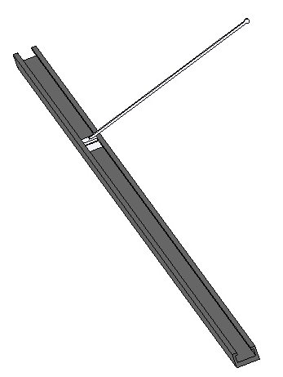
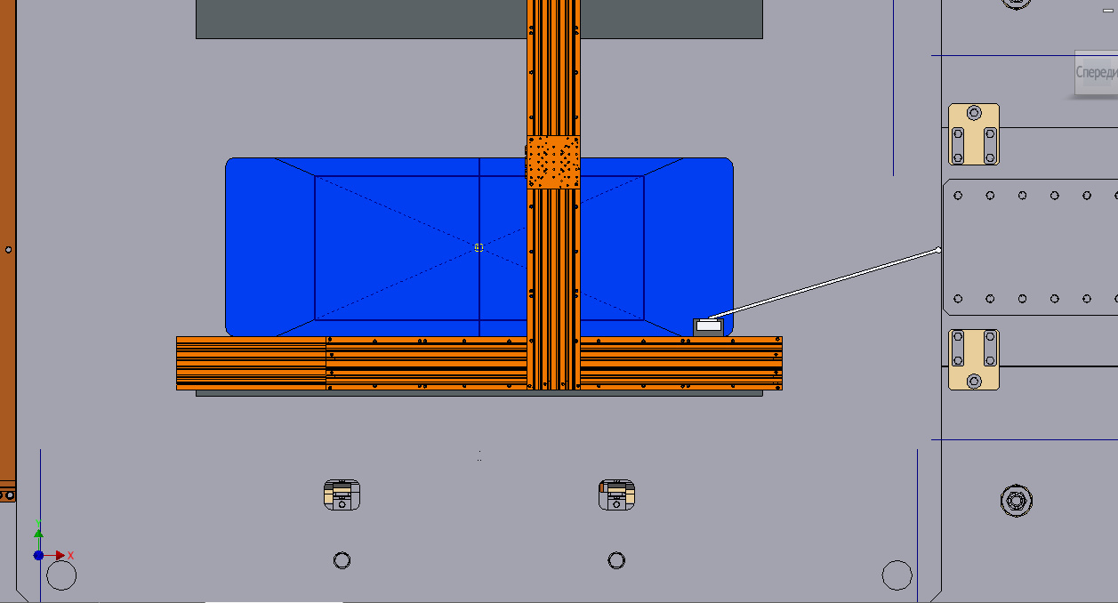
Magnetic measurement system for dipole-2
Location of 3D Hall Sensor and Laser Reflector
XY moving system can only move inside the area marked by blue (restriction imposed by a hole in the upstream field clamp)
Carbon fiber plastic
Guideline and carriage
Using this shape of the carriage, it is possible to measure the field near the pole surface inside the magnet gap while the guide is placed in the area of possible movement. The elongation height of the carriage was chosen so that measurements could be started below the median plane.

Slide 24
Magnetic measurement system for dipole-3
Guide line of carbon fiber plastic (weight 16 kg for 6 m)
Sag of guide line is 1.5 mm (inclination angle is 0.06 deg.) => at points with large Bz the error to By is about 4-5 G.
Carriage with 3 tracker mirrors and one 3D Hall sensor (weight 2 kg) for measuring field, coordinates and angle.
Selecting a reliable and inexpensive moving system

Slide 25
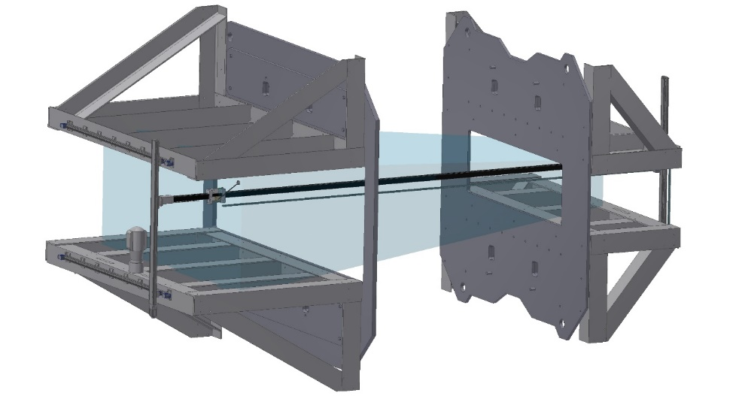
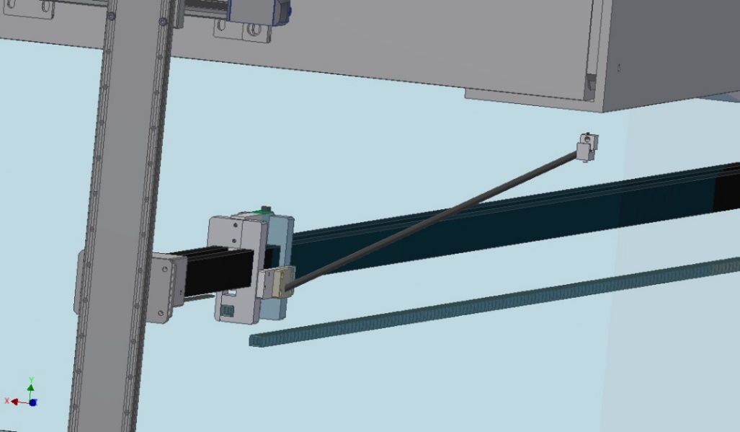
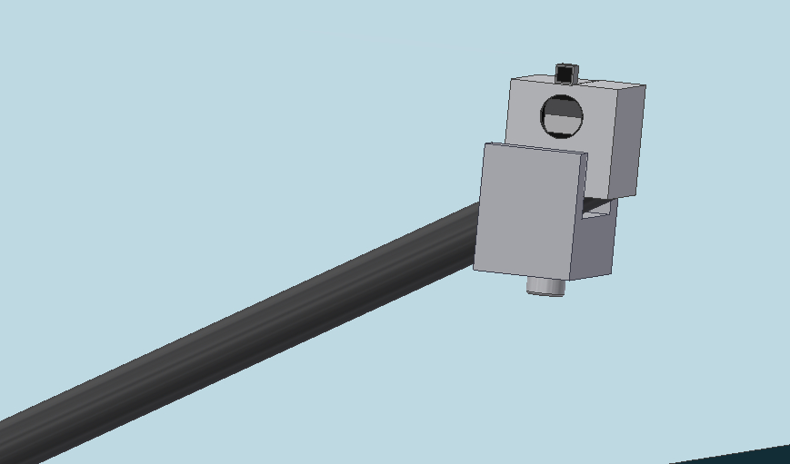
Magnetic measurement system for dipole-4
Magnetic mapping system.
(dipole is represented by field clamps only)
Carriage and rod with measuring module
3D Hall sensor
Reflector for laser tracker
Possible variations in the position of the rod with the 3D Hall sensor relative to the carriage,
Measuring module (Hall sensor and reflector)

Slide 26
Plans
2D drawings: correction by BINP and checking by GSI to be completed.
Magnetic mapping system design will be completed soon.
Developing 3D code, based on Maxwell tensor method, for precise simulations of repelling forces acting on yoke parts.
Tensile strength of electric steel “21848” (carbon content < 0.02%) produced by Magnitogorsk Metallurgical Combinat is under measurement according to contract with specialized testing Laboratory.
Tendering for the yoke is under preparation as well as for steel “21848”.

