Slide 1
FAIR Compressed Air System CR Distribution to consumers
R. Cannas 23/04/2021

Slide 2
Responsibilites
FSB Building Services
Engineering & Construction of the compressed air distribution system inside the buildings up to interconnection point ( location of interconnection point according to user requirements)
FAIR SMG (Site Management)
Engineering, procurement and construction of compressed air system between FSB interconnection point and accelerator air consumer .
User
Providing requirements to FSB building services (location of interconnection points)
Providing technical data to SMG for design and procurement of compressed air system between FSB interconnection point and air consumer connection
23.04.2021 SMG / R.Cannas

Slide 3
Responsibilites
FSB civil services
Engineering: BINP
Procurement of components: FSB Site Management
Construction: to be discussed
flexible hoses to consumer
BINP
connection point
compressed air consumer
Piping / Tubing
or flexible hose
pressure reducer as required
manifold/s as required
coupling or shut-off valve
23.04.2021 SMG / R.Cannas

Slide 4
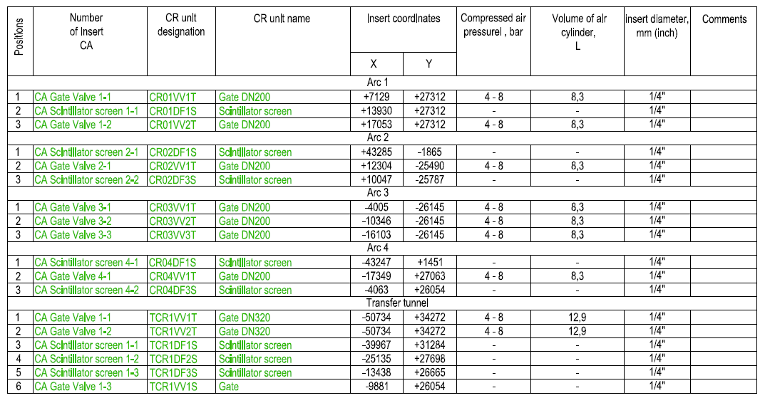
Air consumer data to component database (CDB)
Technical data necessary for CDB are already available on table of drawing ‚CR-16-6.2 Compressed air CR_building’
Is this the connection directly at the air consumer ?
If not, could BINP provide this information ?
Excel -Templates to fill technical data of air consumers to CDB were sent to BINP at 26/02/2021
If templates have not been filled in yet, BINP can provide Excel files according to the drawing table with the relevant current data and SMG will transfer the data into the CDB.
23.04.2021 SMG / R.Cannas

Slide 5
Components for air pressure pipe system
A standardized common construction kit for the entire FAIR plant shall be used to install the air pressure system to the consumers.
Currently several kit systems are under discussion.
Chosen kit system shall be used for all subprojects.
Procurement will be done centralized by FAIR Site Management
Bill of material for procurement for CR (number of manifolds, couplings, hoses etc.) should be prepared by BINP in coordination with FAIR Site Management
23.04.2021 SMG / R.Cannas

Slide 6
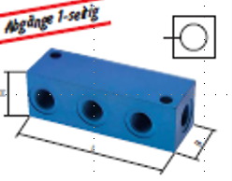
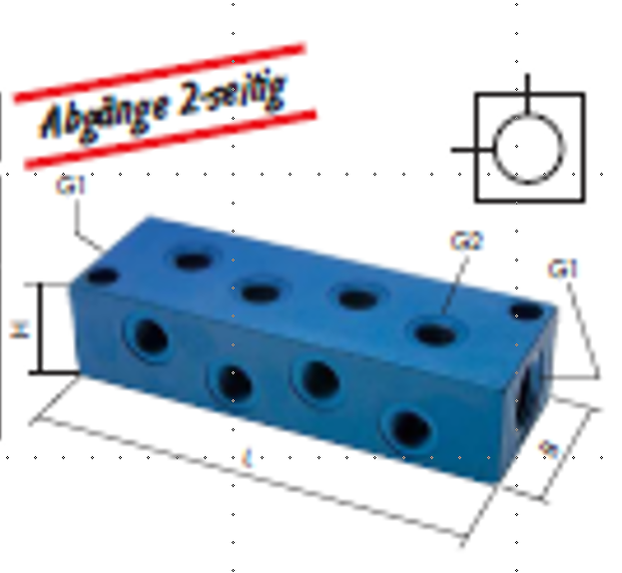
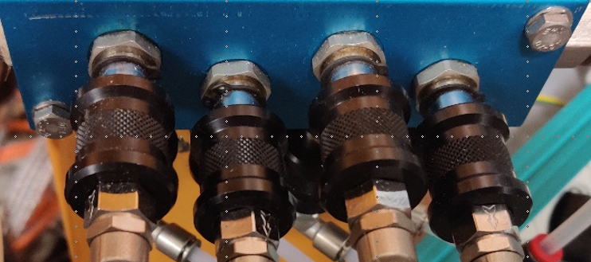
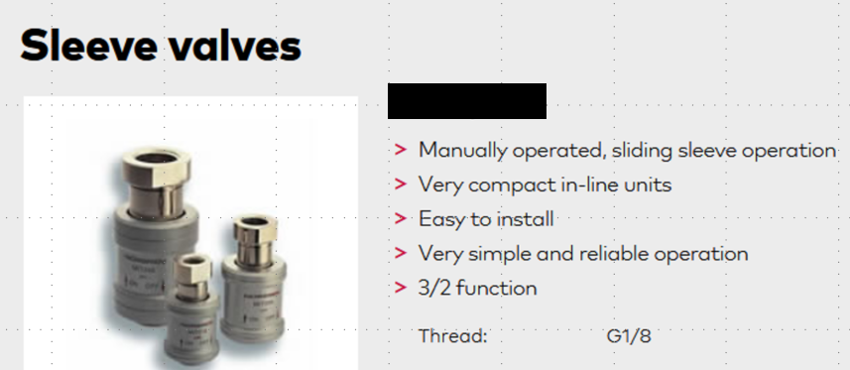
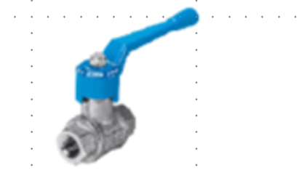
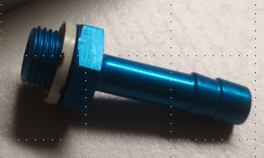
Components for air pressure pipe system
Examples for components to be used for the compressed air pipe system (still under discussion)
manifolds /subdistribution
(female screwed connections, different sizes)
valves / shut-off devices
(female screwed connection)
Ball valve
hose connections
21.04.2021 SMG / R.Cannas

Slide 7
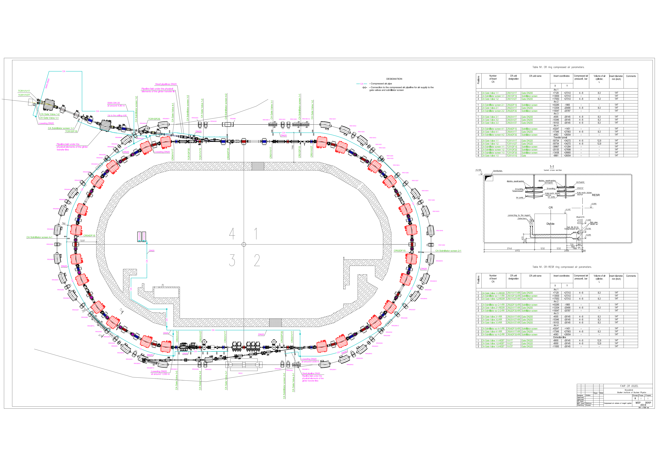
Pressured air in building H0209A

Slide 8
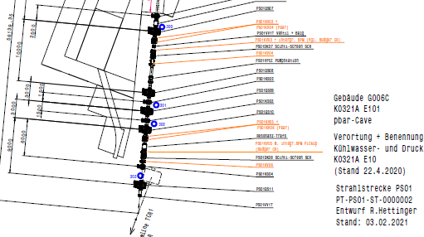
Pressured air in building H0209A

