Slide 1
CR-Building Status April 2021
Thorsten Ziglasch 23/04/2021

Slide 2
CR-building status April 2021
No budget
Therfore:
no planning
no correction of errors
still not a functioning building
no cable routing
no low voltage distribution

Slide 3
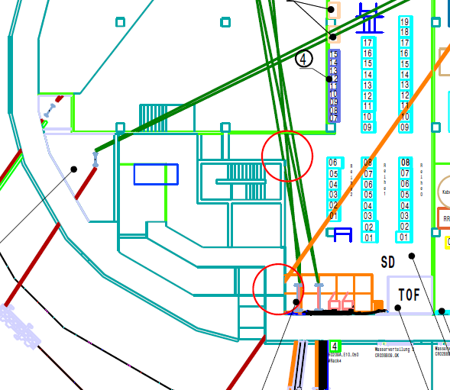
Critical errors in the layout

Slide 4
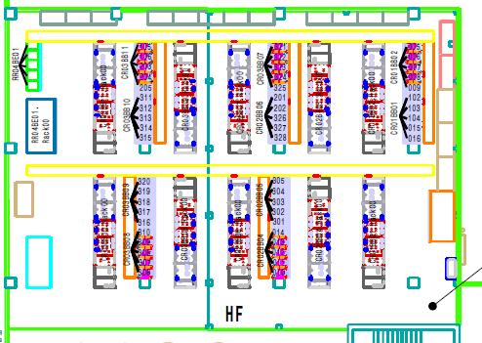
Critical errors in the layout
H0209A.E010.040 RRF
Unwanted pillars placed in the middle

Slide 5
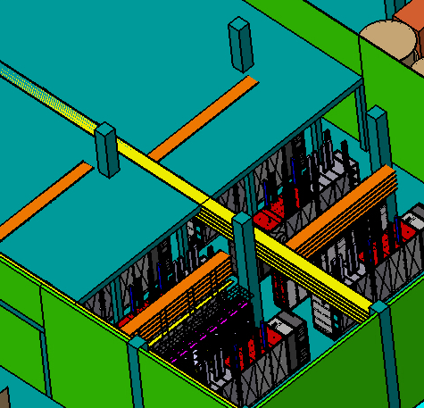
Critical errors in the layou
H0209A.E010.040 RRF

Slide 6
Tasks to complete
The owner report
-a lot of improvements but not yet finished
FSB sends a weekly report

Slide 7
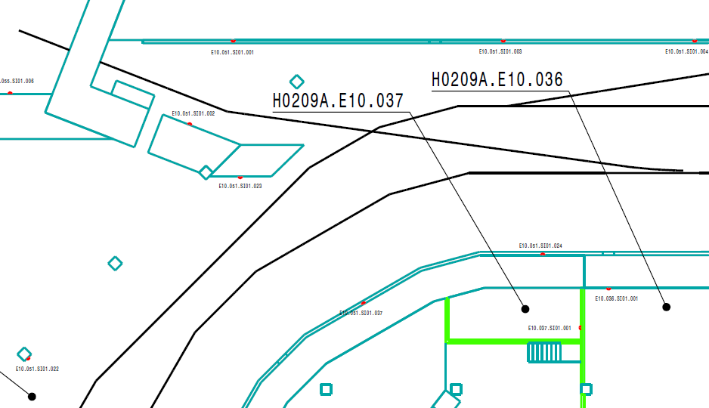
Tasks to complete
The emergency switches

Slide 8
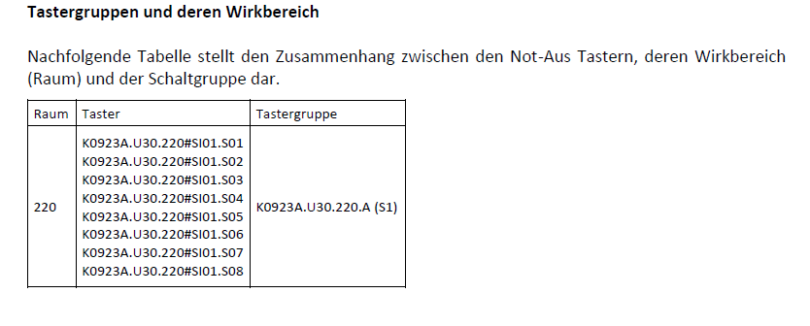
Tasks to complete
A matrix has to be created with the logic for the switches
Meaning: pushing a button xyz here cuts off power there
Problem:
there is no low distribution planned so we cannot name the rack of the low voltage distribution which is supposed to react to the emergency switches

Slide 9
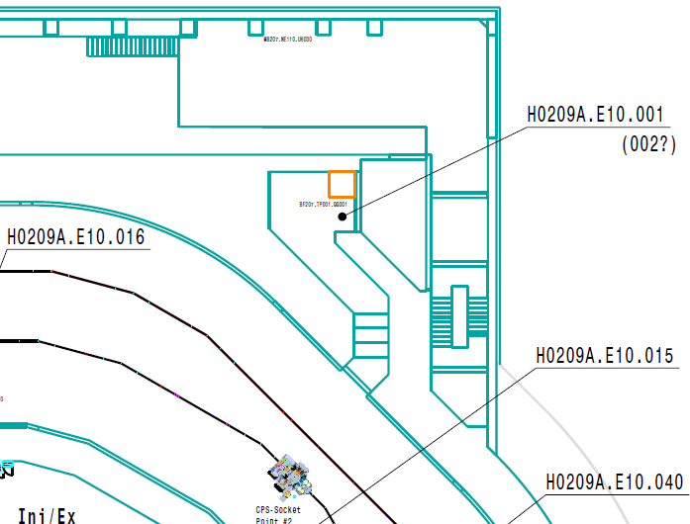
Tasks to complete
PAS

Slide 10
Tasks to complete
PAS
While placing the racks for PAS it was discovered that there are different versions of drawings distributed
Room numbers don‘t match
CDB needs to be checked again
As soon as this is sorted out additional signal cables need to be entered into the CDB

Slide 11
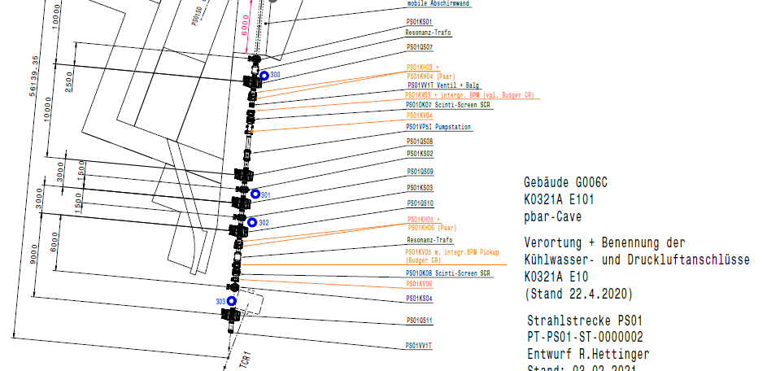
Tasks to complete
Cooling water distribution (as discussed with C. Will)
Pressured air distribution (as proposed by R.Cannas)

Slide 12
Tasks to complete
Brandlasten _ the fire load
All components in the CR-building are already included
Except: room H0209A.E010.015
The cable drums for the kicker cables (size and mass required)
The cooling/isolating oil for the kickers (volume required 580l)
The layout of the fire extinguishing system will depend on this data

