Slide 1
Status of SFRS vacuum components design and production at BINP
BINP
A.Krasnov, Alexander Dranitchnikov, Alexey Semenov, Alexander Zhukov, Aigerim Baynazarova, Tatiana Bedareva, Svetlana Glukhovchenko, Georgy Gusev, Vyacheslav Borodich
6th BINP-FAIR Collaboration Coordination Workshop

Slide 2
FAIR vacuum components producing at BINP
Name | Signed | End (expected) | Cost M€ | Status
AFAA1 SFRS Diagnostic chambers | 03.2019 | 12.2021 (12.2022) | 1.11 | FoS is produced and passed vacuum test. There are dimensions out of tolerance. Final machining is needed. First FAT: 06.2021. 2D drawings – 80%, CDR – 75%. All CF flanges are received.
AFAA3 SFRS Vacuum chambers inside SC dipoles | 10.2019 | 06.2022 (11.2022) | 0.87 | 3D model of combined chamber with pumping port is created. First CDR is planed in 05.2021. Material for pre-serial production: 10.2021. FEM analysis for NC dipole wide chamber is done without taking into account water flow parameters. 3D model and simplified 2D drawings are sent to subcontractor
AFAA5 SFRS vacuum components |  |  | 1.5 | Time schedule is agreed. Cost is fixed. Contract can be signed before detailed specification finalization.
SFRS branching chambers inside SC dipoles |  |  | 0.31 0.1 | The cost is too low for production the complex chambers. Simplified 2D drawings are sent to BINP workshop to learn production visibility and cost estimation

Slide 3
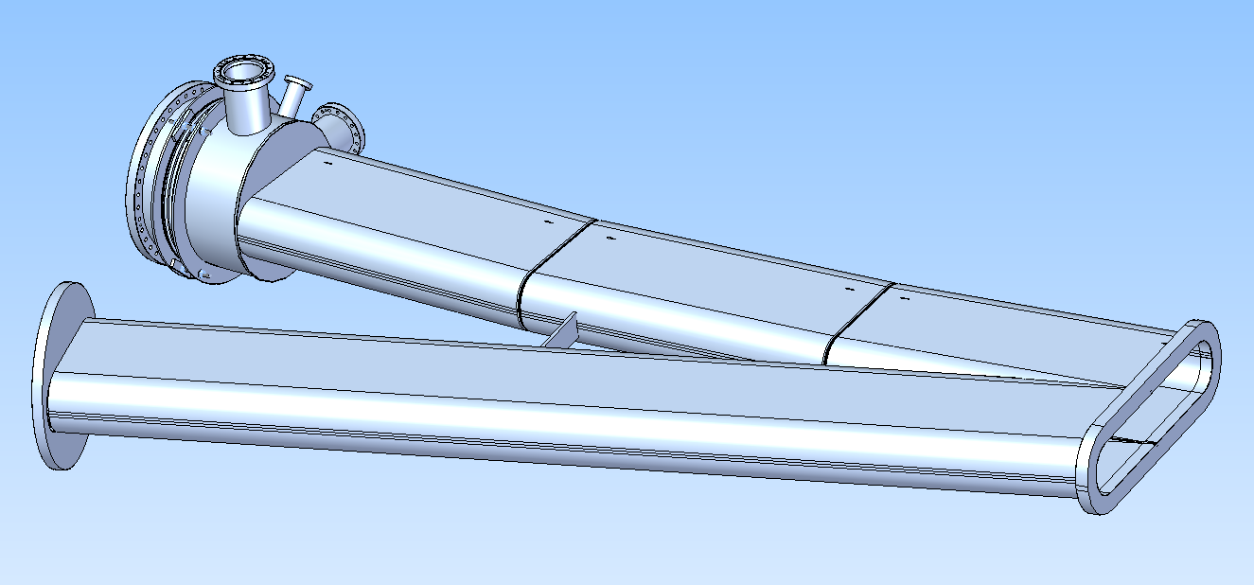
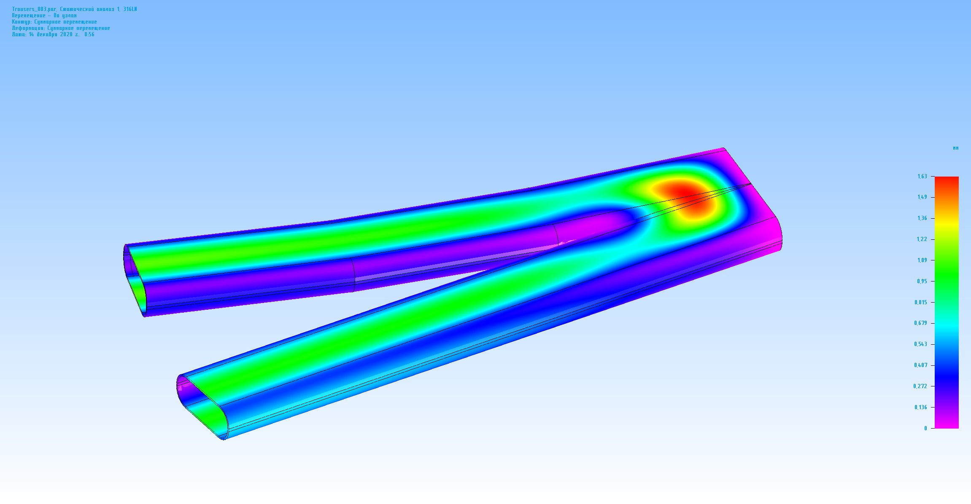
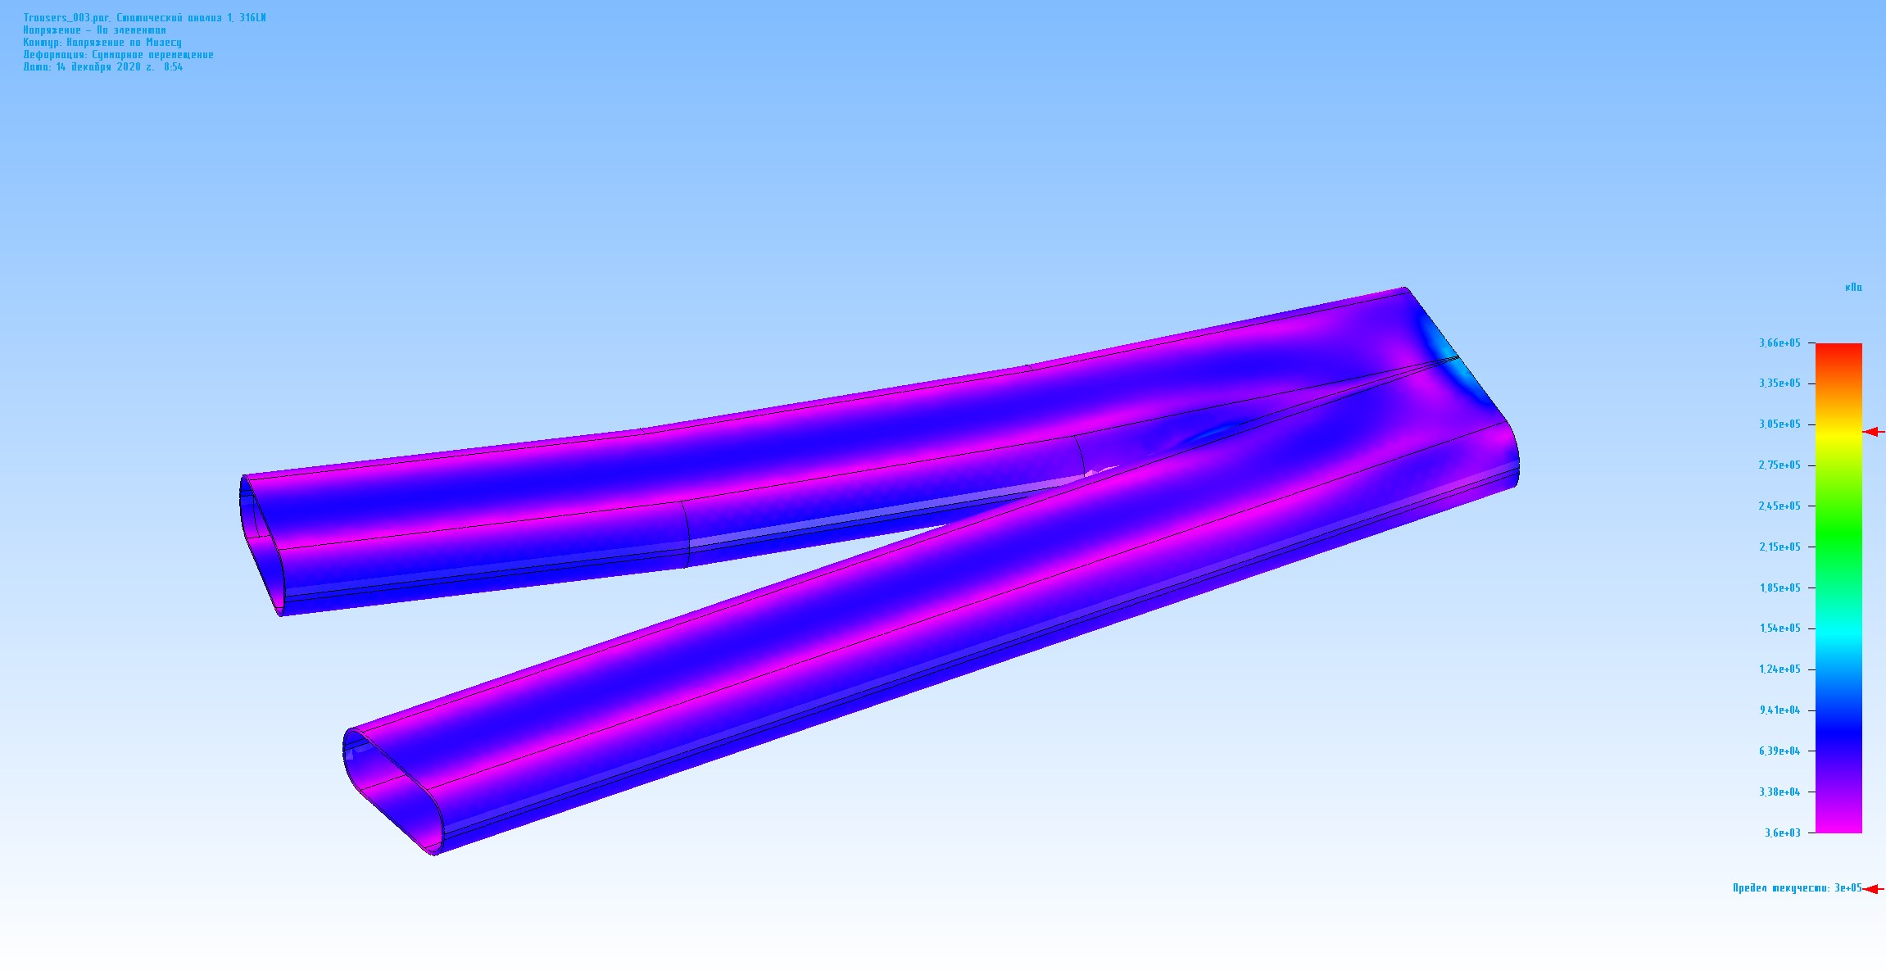
SFRS dipole branching chamber
Dipole branching chamber (9,75 deg) (conception)
Deflection - 1,63 mm (acceptable)
2D drawings are sent to BINP workshop to learn production possibility. Production duration and cost will be considered in next zoom meeting

Slide 4
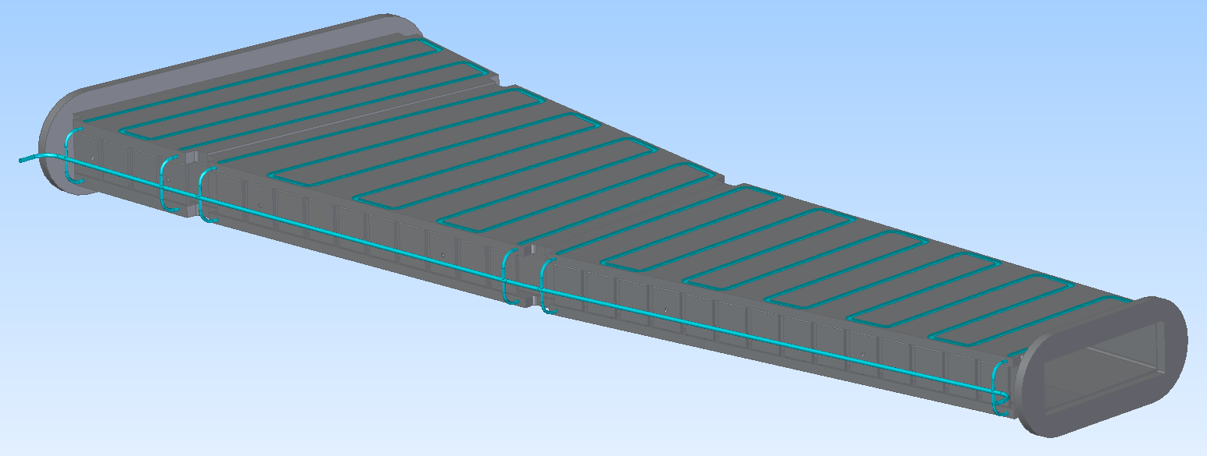
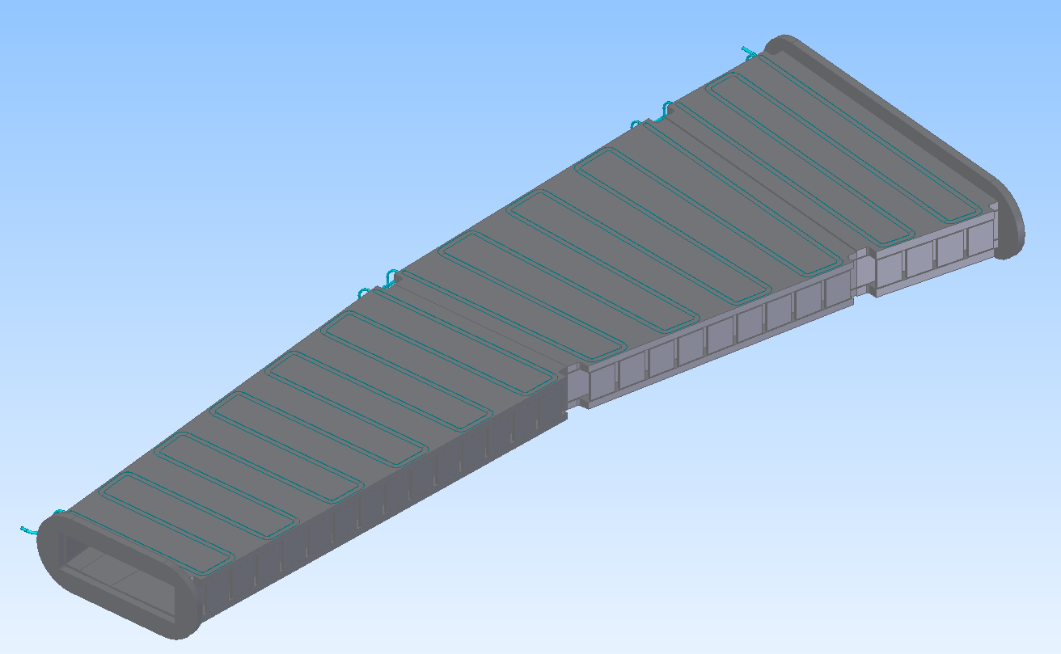
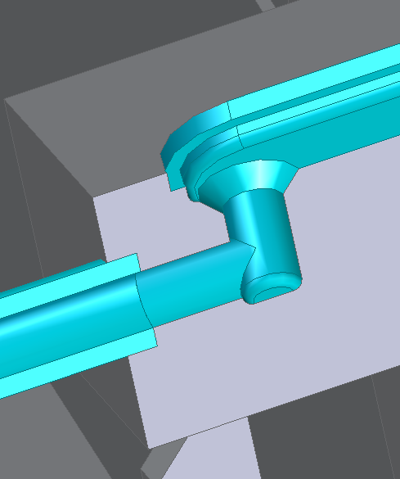
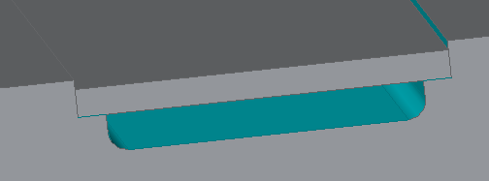
R&D for SFRS NC dipole chamber
Vertical size can be decreased at left side of the chamber
FEM analysis for wide chamber (inside SFRS NC RR dipoles) were made.
Results show that the chamber can be made of Ti or Ti alloy

Slide 5
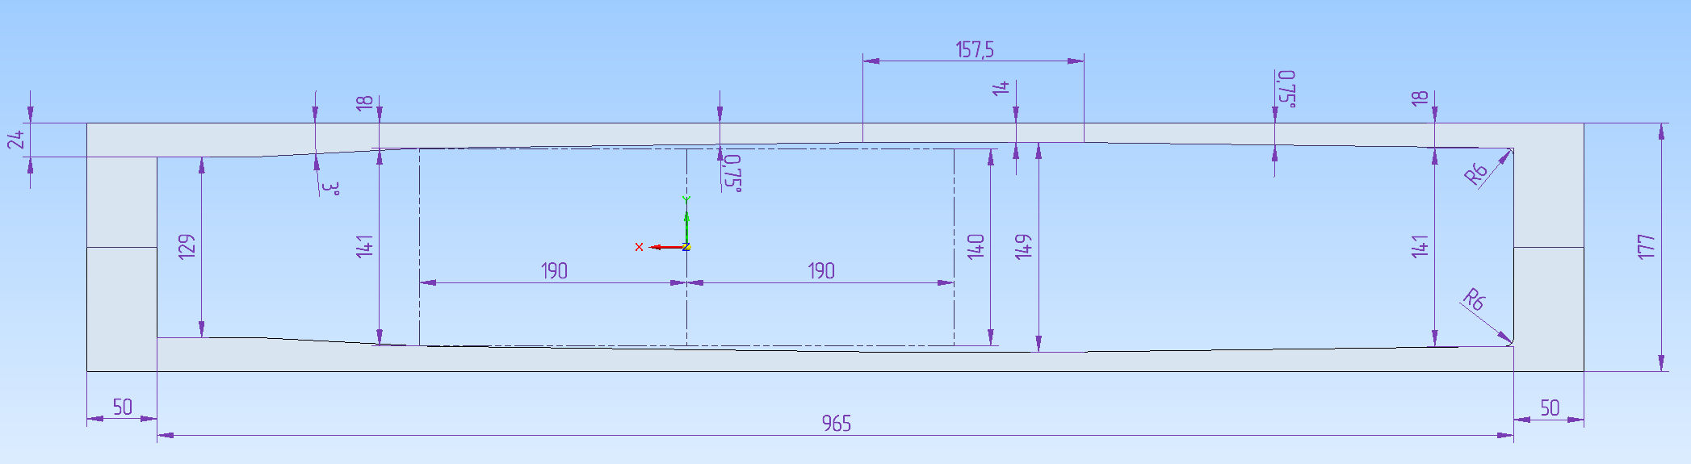
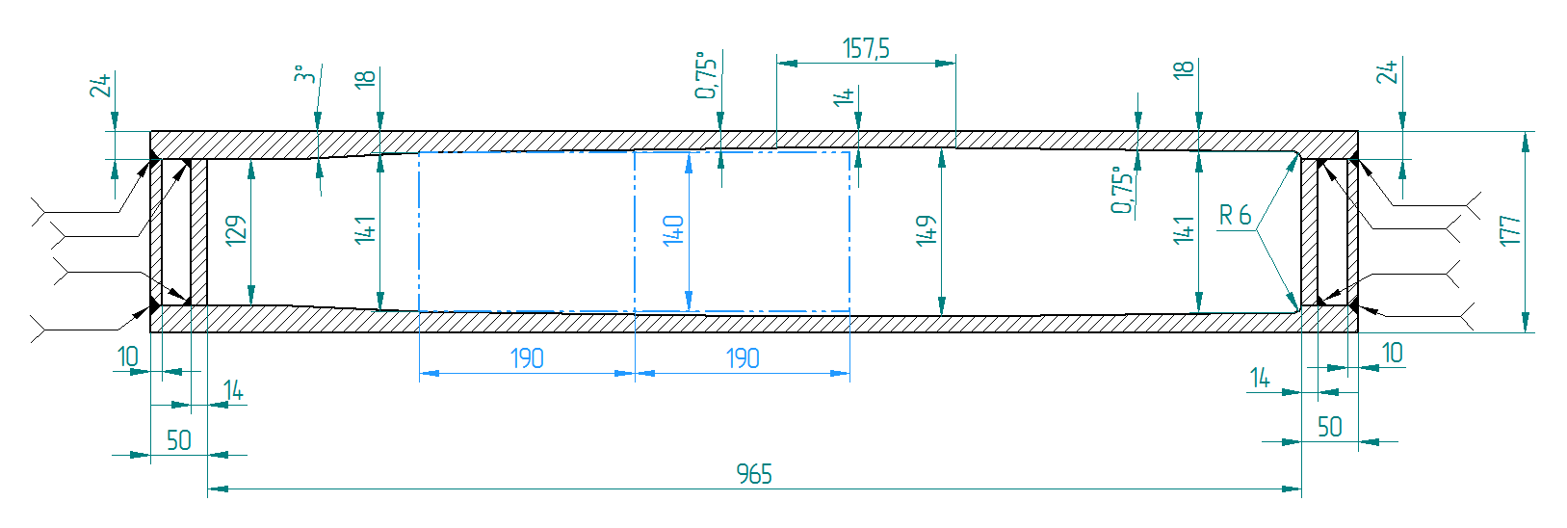
R&D for SFRS NC dipole chamber
Possible reliable solutions
Deflection: 2 x 3.7 mm – acceptable, made of Ti6Al4V (Grade5)

Slide 6
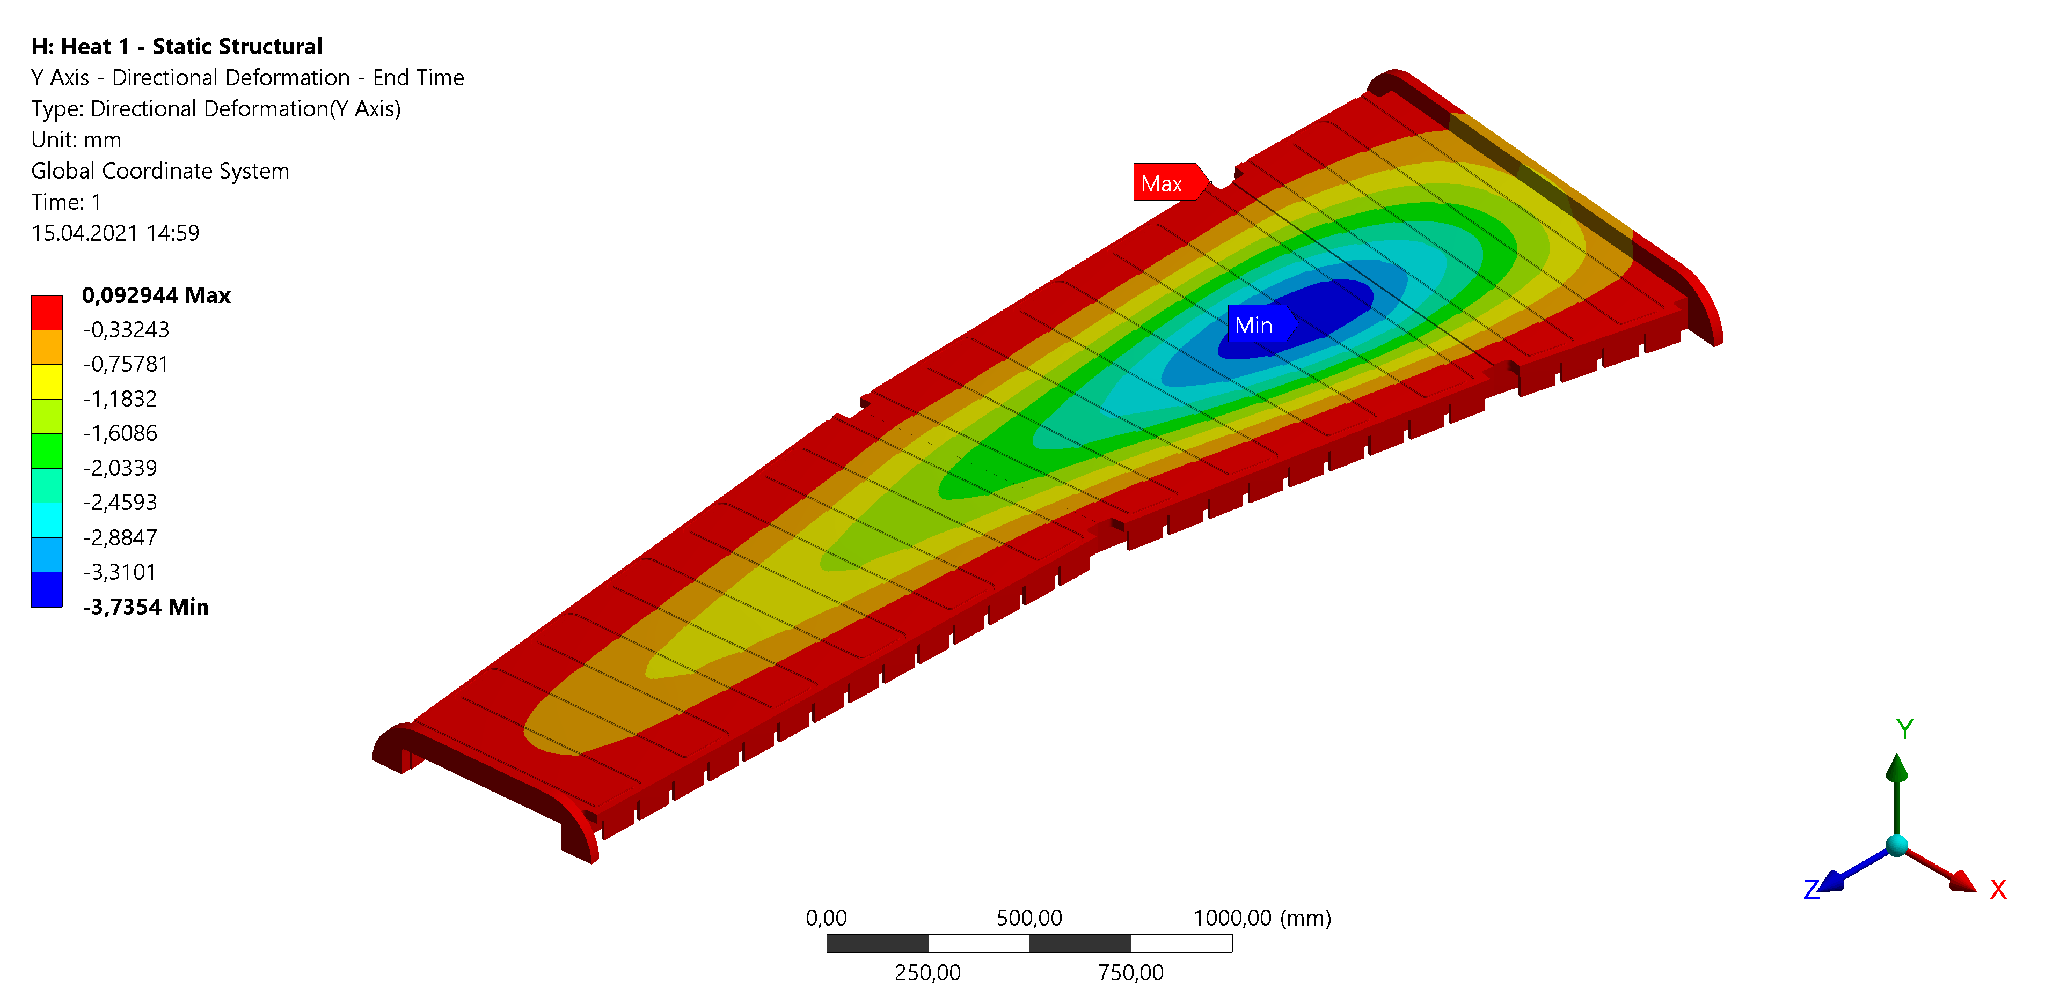


R&D for SFRS NC dipole chamber
Possible reliable solutions
Simulations were made according to different distances of beam loss positions from optical axis
10% Δp/p
20% Δp/p
Maximum deflection: 2 x 3.7 mm – acceptable
Material:
Ti6Al4V (Grade5)
30% Δp/p

Slide 7
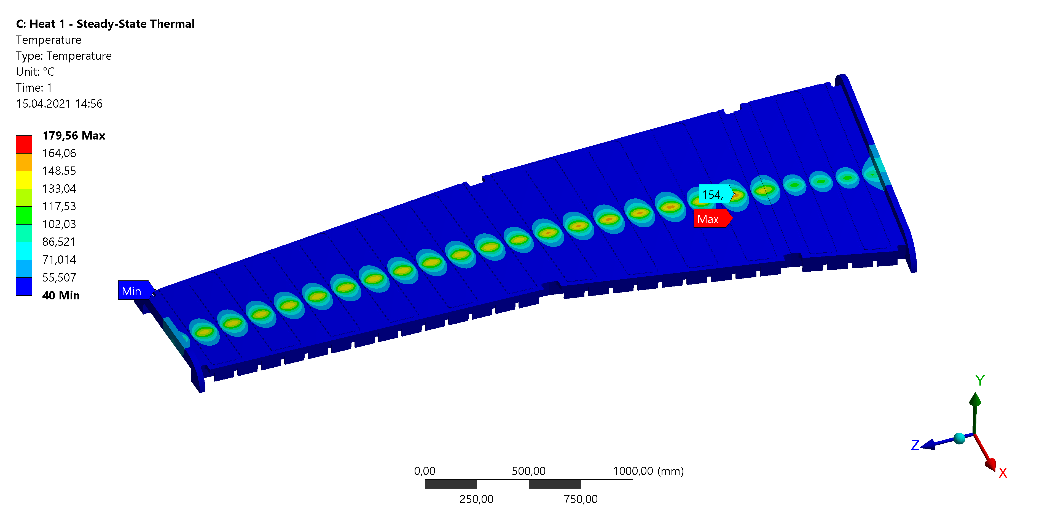
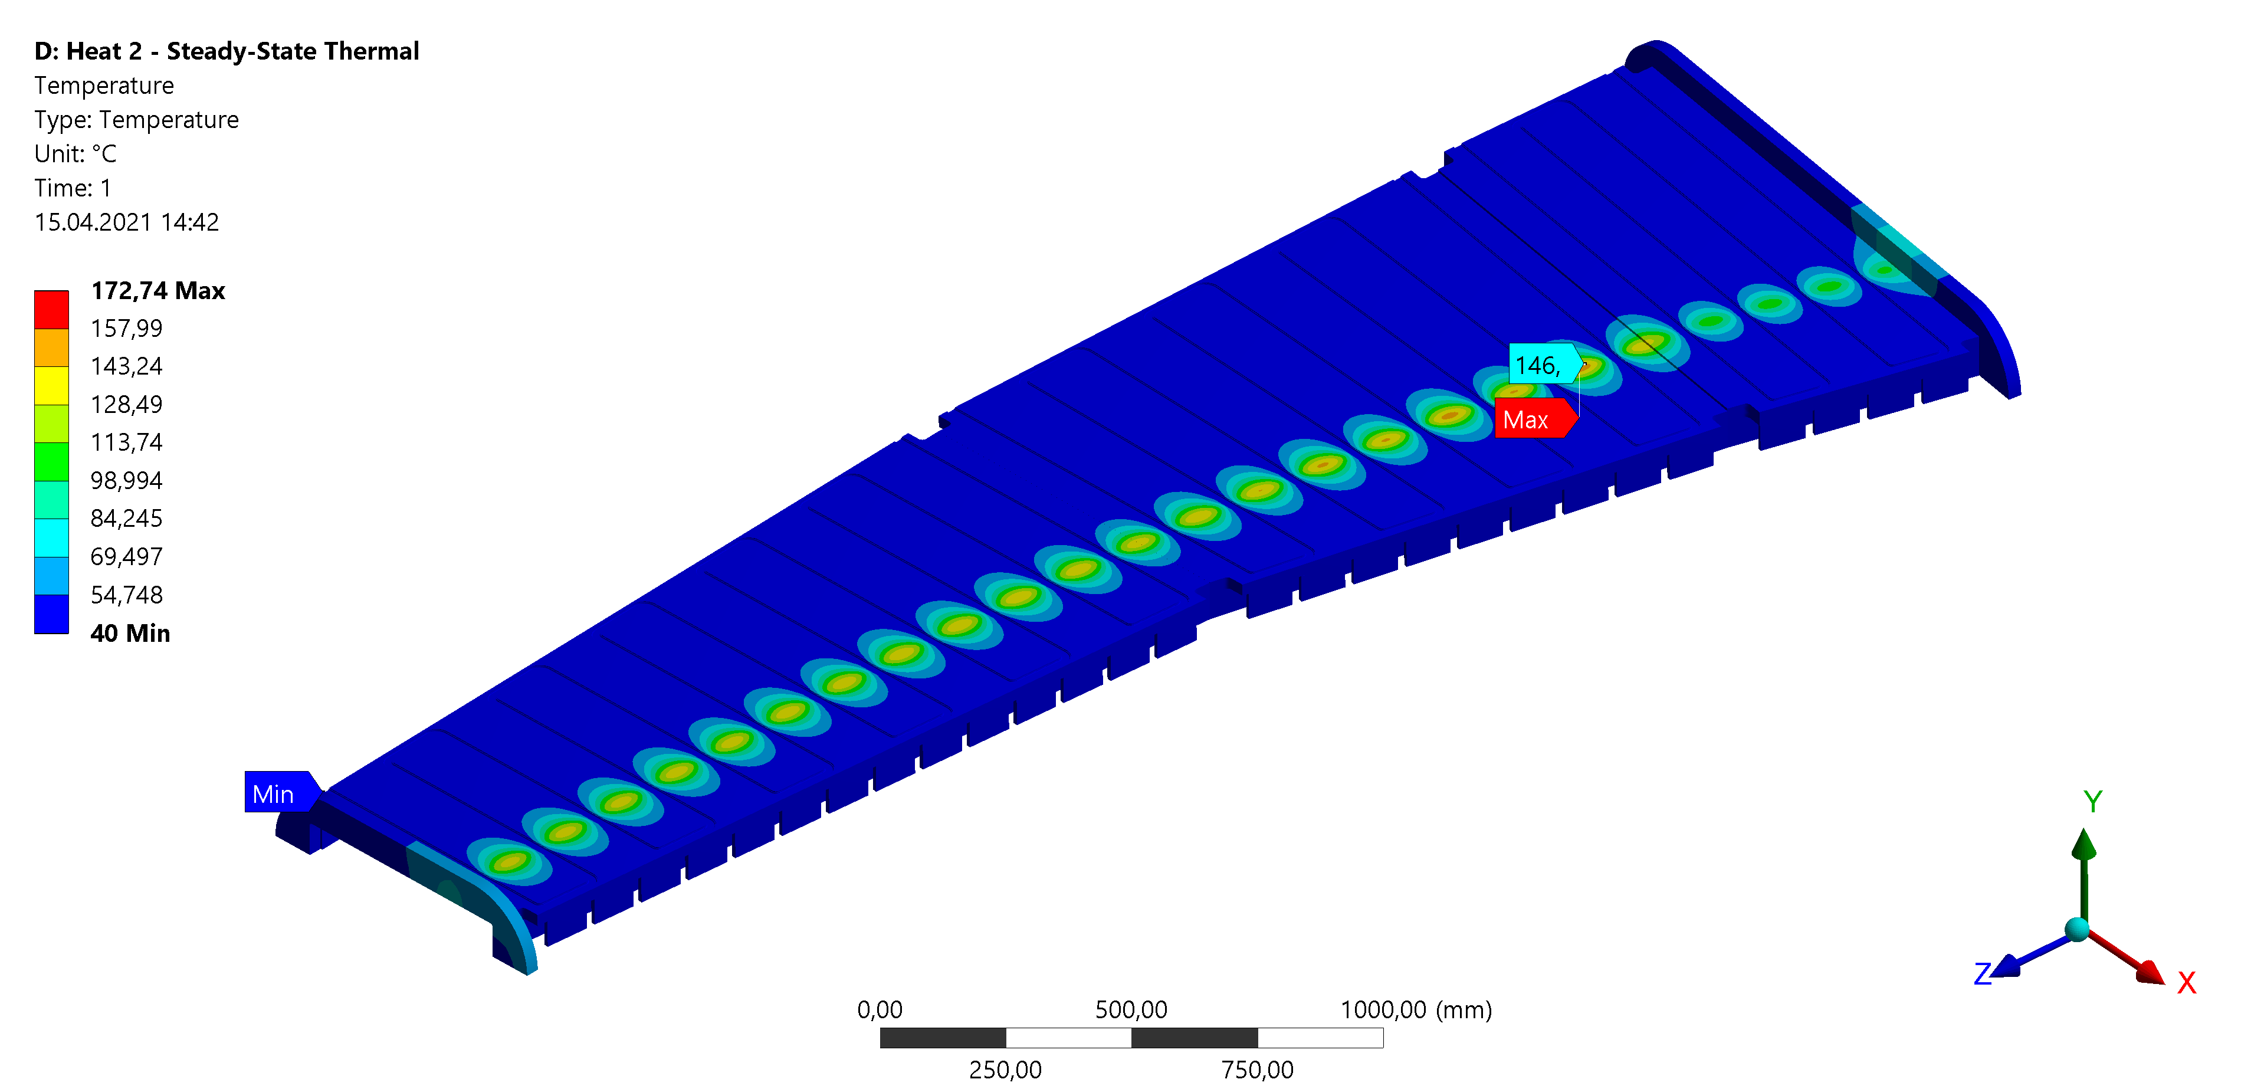
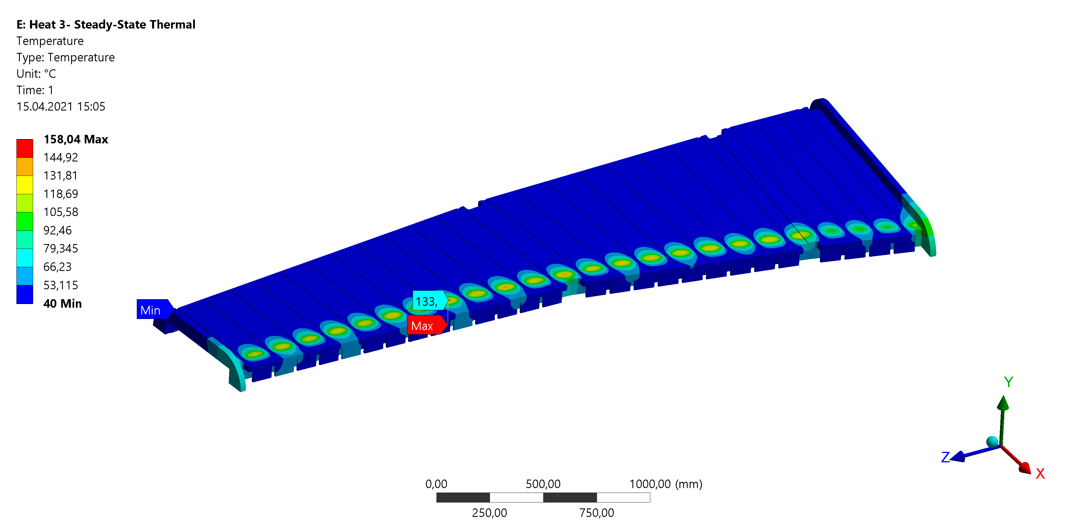
R&D for SFRS NC dipole chamber
10% Δp/p
20% Δp/p
Maximal service temperature is 179ºC
30% Δp/p

Slide 8
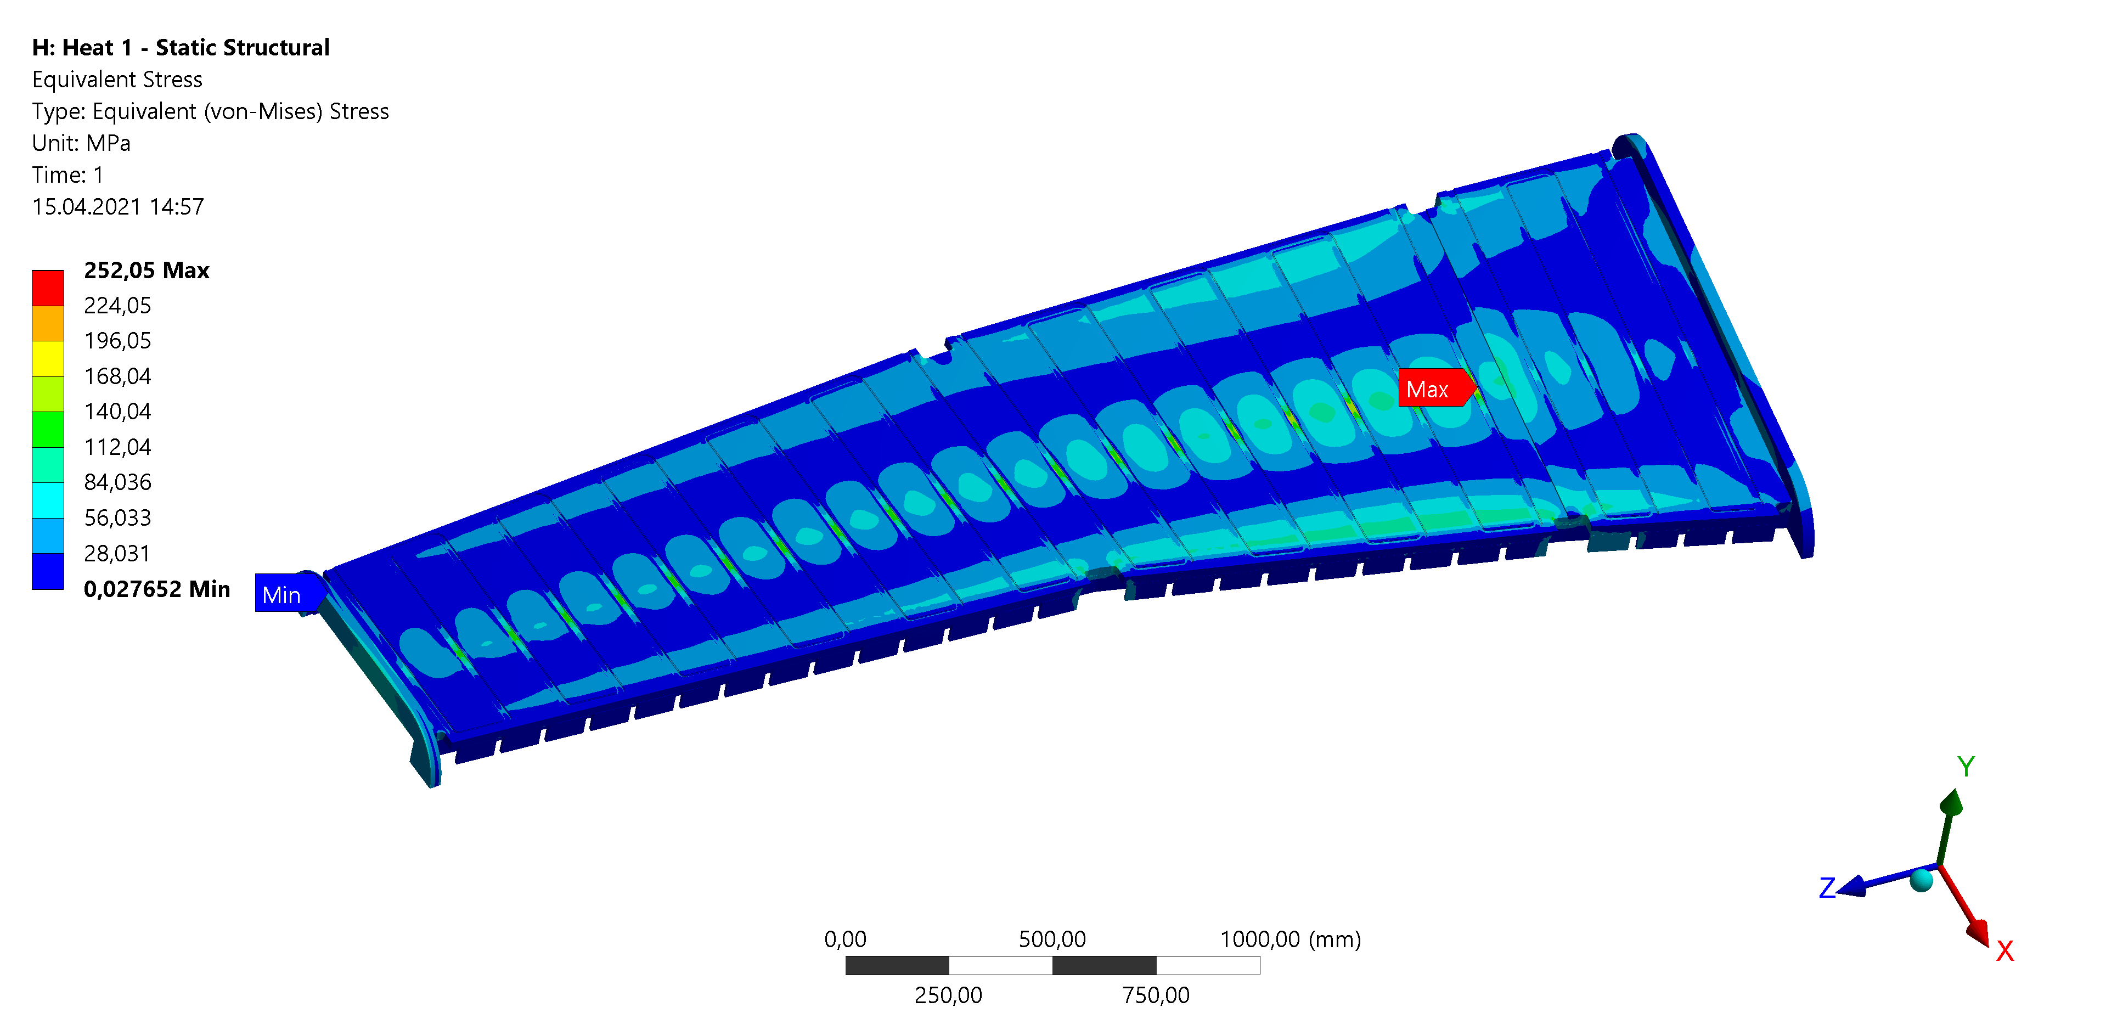
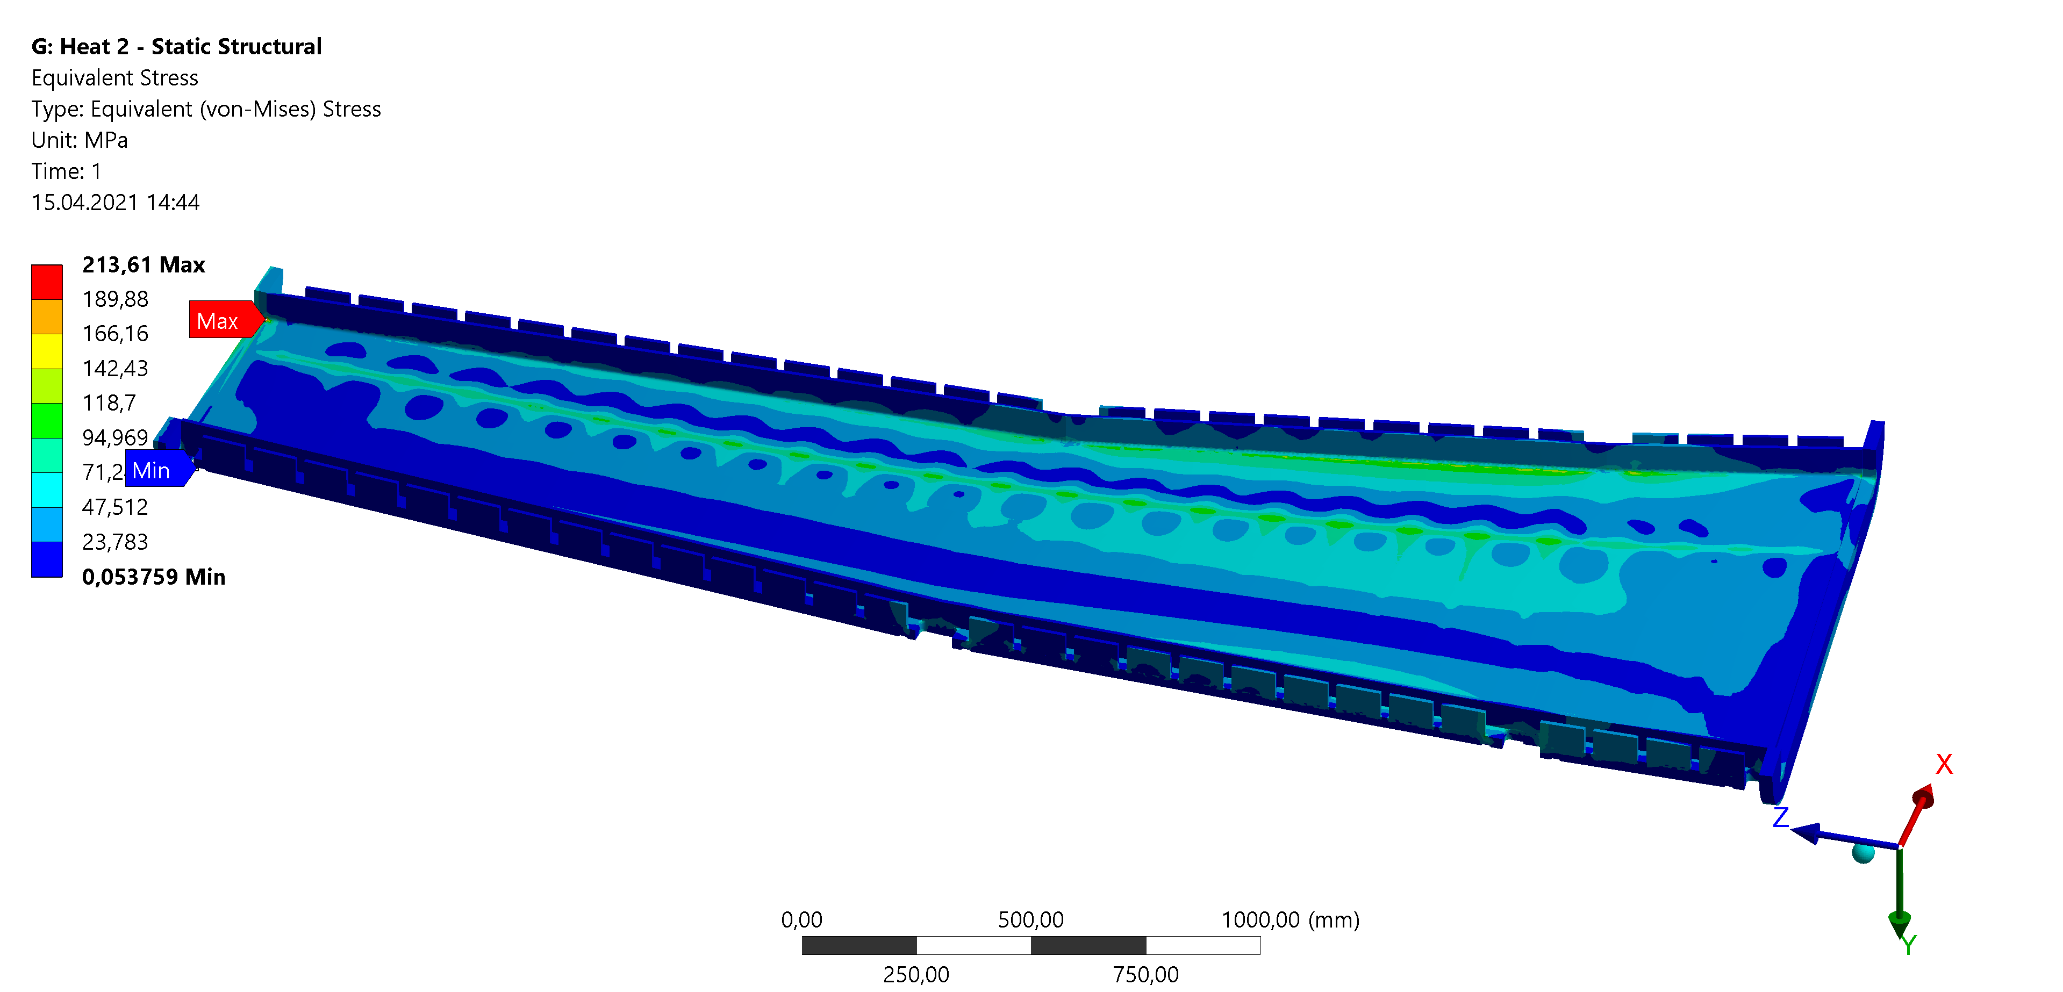
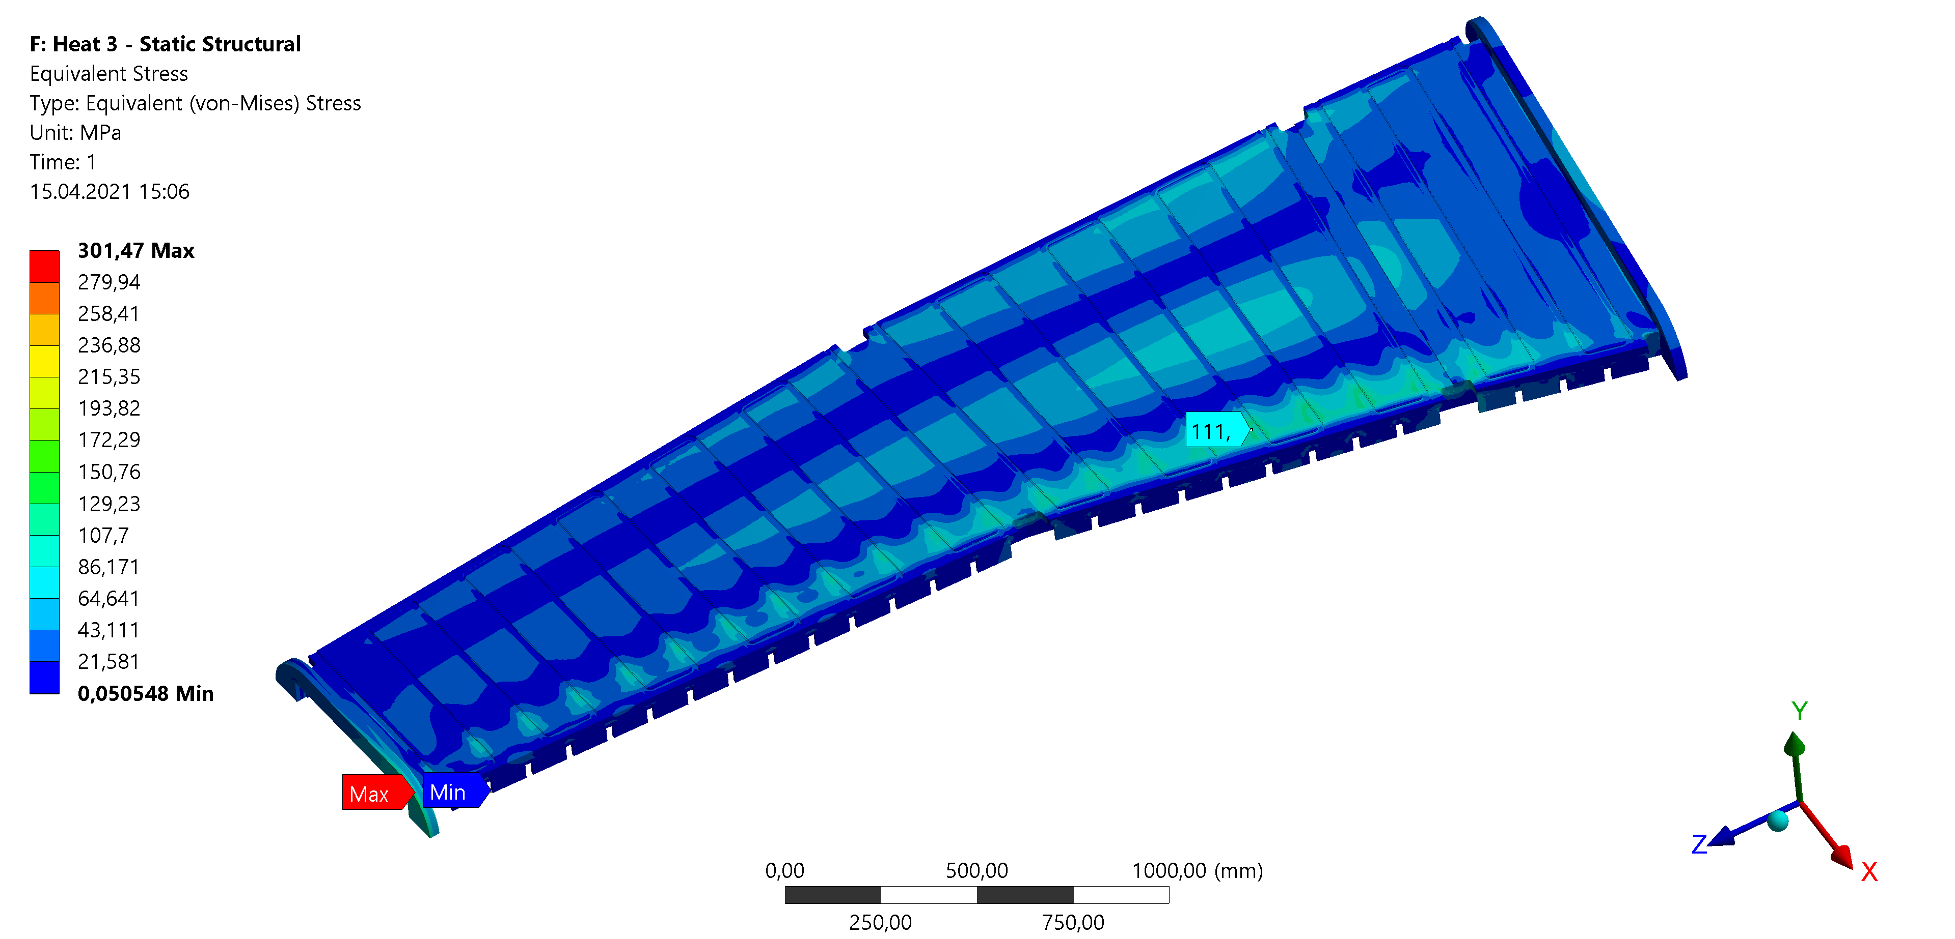
R&D for SFRS NC dipole chamber
Maximal equivalent stress is 301 MPa
10% Δp/p
20% Δp/p
3D model and simplified 2D drawings are sent to subcontractor. Expected info regarding production duration and cost is expected at the end of May 2021
30% Δp/p

Slide 9
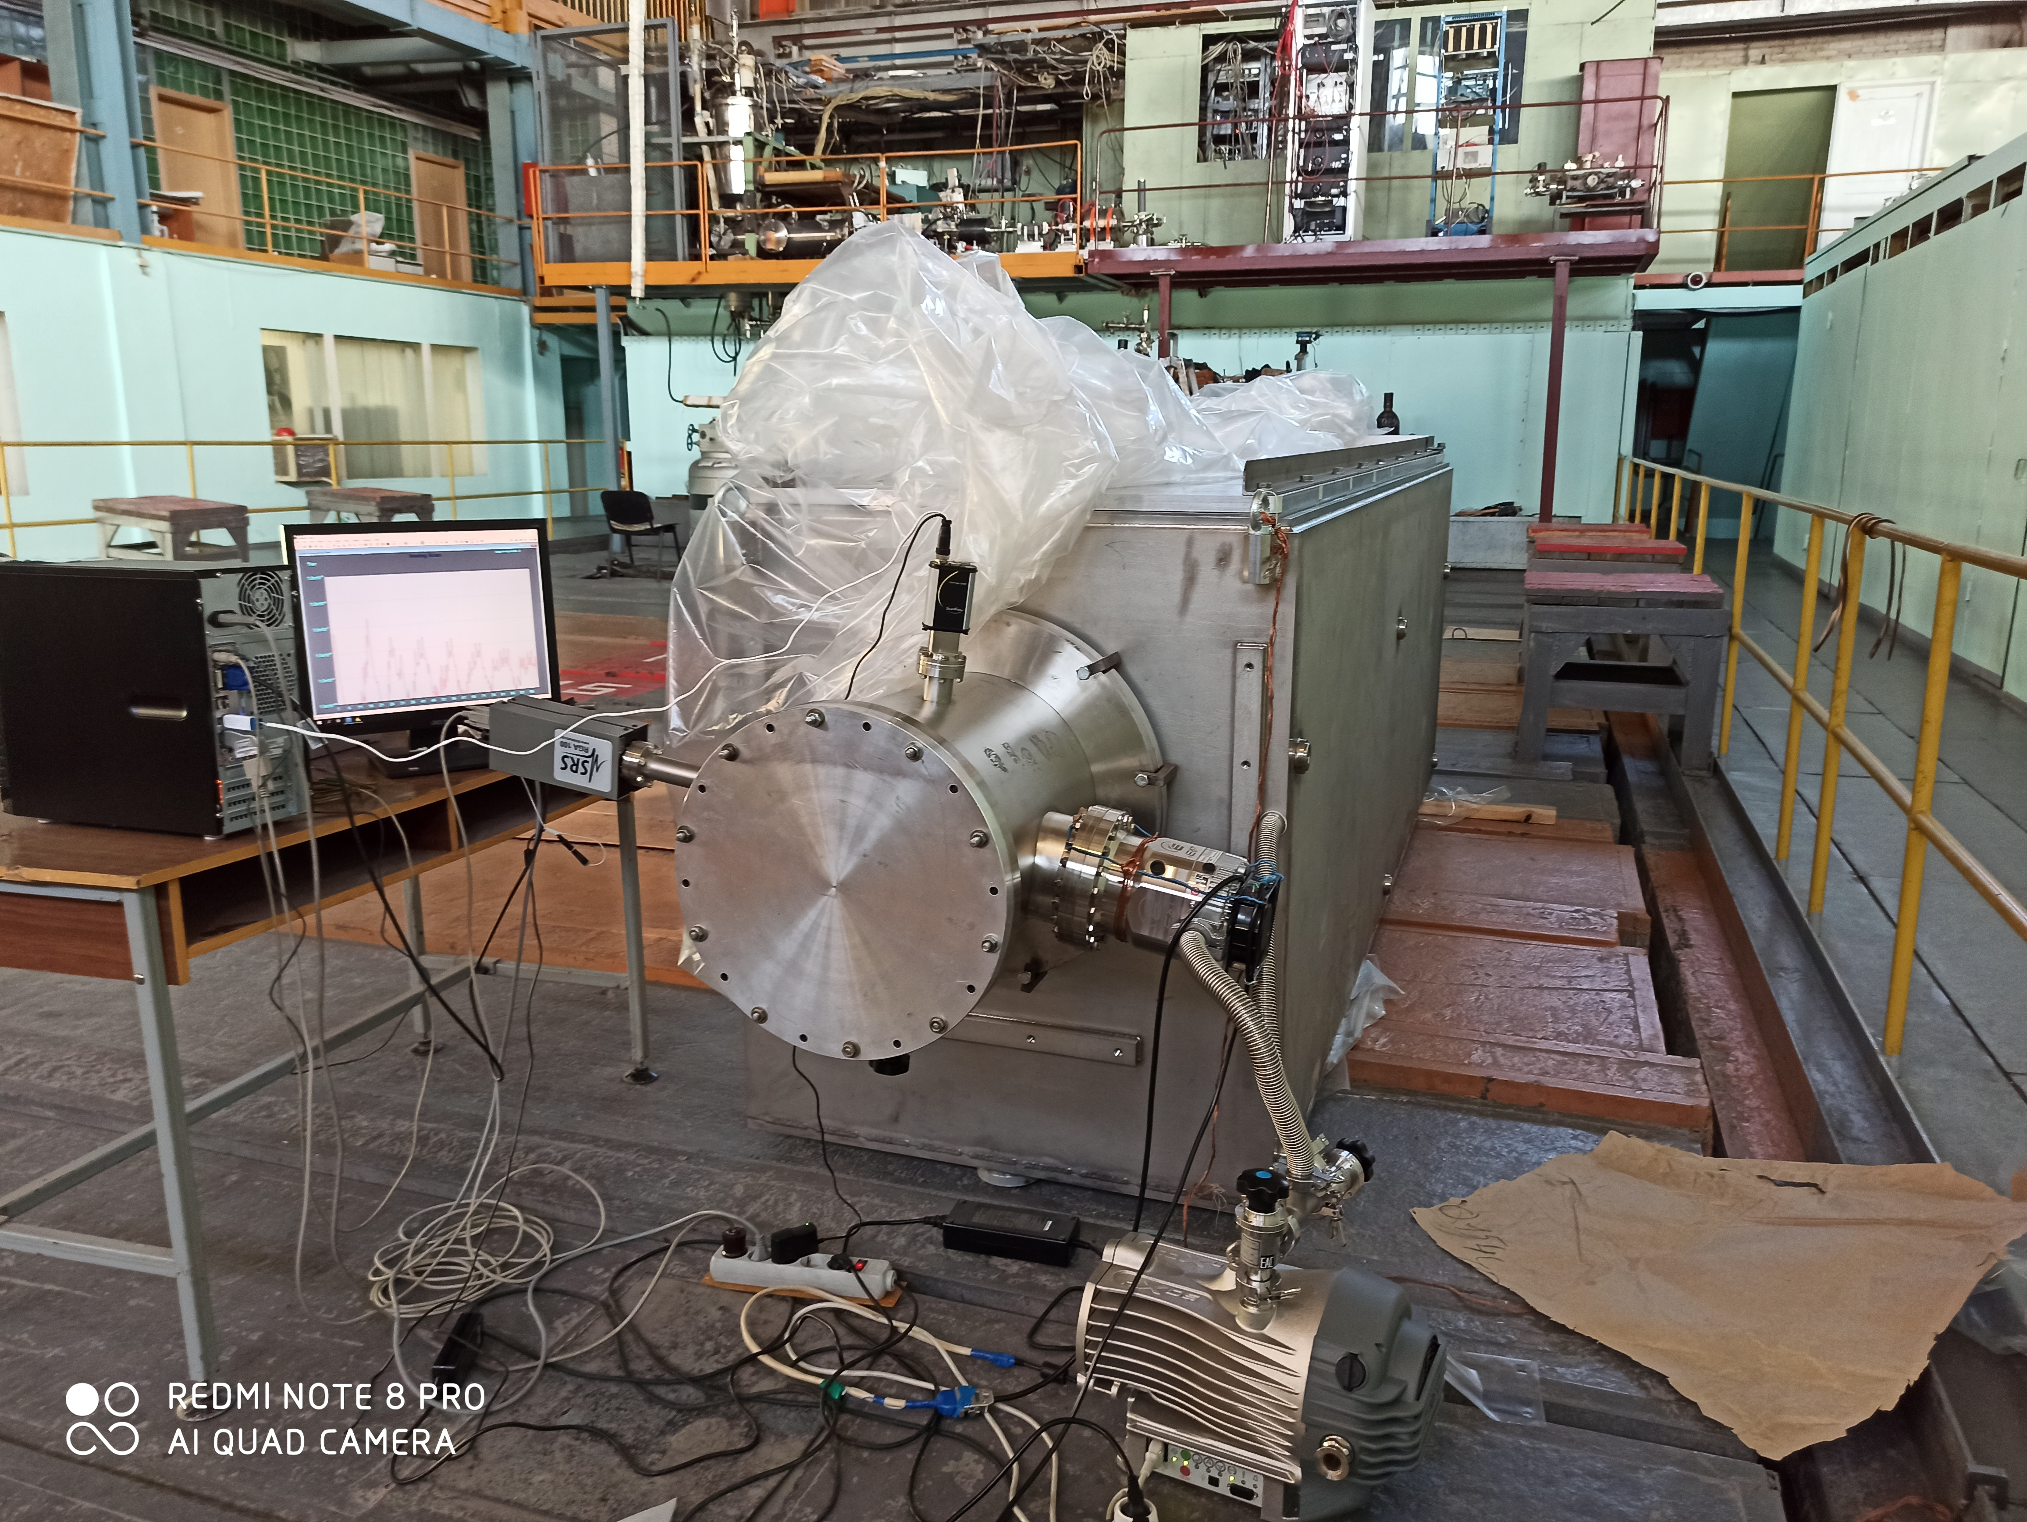
SFRS diagnostic chambers
FoS is produced and passed vacuum test
There are dimensions out of tolerance Final machining is needed
First FAT: 06.2021.
2D drawings – 80%
CDR – 75%
All CF flanges are received

Slide 10
SFRS diagnostic chambers
Sequence | Nomenclature | PSP | Designation (short name) | possible earliest FAT date (MVRicciardi) | Contracted FAT date [target date] | Contracted delivery date [target date] | Forecast FAT date [actual date] | Forecast delivery date [actual date] | 3D/ CDR | 2D/ FDR | alignment feets | flanges
1 | FPF2DK1_FoS | 2.4.7.1.12.1 and 2.4.7.2.2 | DC_02 FoS | Feb-20 | Feb-20 | Feb-20 | Jun-21 | Aug-21 | 3 | 2 | 2 | 3
 | FTF1DK1 | 2.4.7.1.12.1 and 2.4.7.2.2 | DC_01 | Jul-20 | latest Aug-2021 | latest Oct-2021 |  |  |  |  | 1 | 3
4 | FPF2DK1 | 2.4.7.1.12.1 and 2.4.7.2.2 | DC_02 | Aug-20 | latest Aug-2021 | latest Oct-2021 | Feb-22 | Apr-22 | 2 | 2 | 1 | 3
5 | FPF3DK1 | 2.4.7.1.12.1 and 2.4.7.2.2 | DC_03 | Sep-20 | latest Aug-2021 | latest Oct-2021 | Mar-22 | May-22 | 2 | 2 | 1 | 3
6 | FPF4DK1 | 2.4.7.1.12.1 and 2.4.7.2.2 | DC_04 | Sep-20 | latest Aug-2021 | latest Oct-2021 | Apr-22 | Jun-22 | 2 | 2 | 1 | 3
3 | FMF1DK1 | 2.4.7.1.12.1 and 2.4.7.2.2 | DC_05 | Oct-20 | latest Aug-2021 | latest Oct-2021 | Dec-21 | Feb-22 | 2 | 2 | 1 | 3
7 | FMF2DK1 | 2.4.7.1.12.1 and 2.4.7.2.2 | DC_06 | Nov-20 | latest Aug-2021 | latest Oct-2021 | May-22 | Jul-22 | 2 | 2 | 1 | 3
8 | FMF2DK2 | 2.4.7.1.12.1 and 2.4.7.2.2 | DC_07 | Nov-20 | latest Aug-2021 | latest Oct-2021 | Jun-22 | Aug-22 | 2 | 2 | 1 | 3
9 | FMF2DK3 | 2.4.7.1.12.1 and 2.4.7.2.2 | DC_08 | Dec-20 | latest Aug-2021 | latest Oct-2021 | Jun-22 | Aug-22 | 2 | 2 | 1 | 3
10 | FMF3DK1 | 2.4.7.1.12.1 and 2.4.7.2.2 | DC_09 | Jan-21 | latest Aug-2021 | latest Oct-2021 | Sep-22 | Nov-22 | 2 | 2 | 1 | 3
11 | FHF1DK1 | 2.4.7.1.12.1 and 2.4.7.2.2 | DC_10 | Jan-21 | latest Aug-2021 | latest Oct-2021 | Sep-22 | Nov-22 | 2 | 2 | 1 | 3
12 | FHF1DK2 | 2.4.7.1.12.1 and 2.4.7.2.2 | DC_11 | Feb-21 | latest Aug-2021 | latest Oct-2021 | Oct-22 | Dec-22 | 2 | 2 | 1 | 3
13 | FLF1DK1 | 2.4.7.1.12.1 and 2.4.7.2.2 | DC_12 | Mar-21 | latest Aug-2021 | latest Oct-2021 | Oct-22 | Dec-22 | 2 | 2 | 1 | 3
14 | FLF2DK1 | 2.4.7.1.12.1 and 2.4.7.2.2 | DC_13 | Apr-21 | latest Aug-2021 | latest Oct-2021 | Nov-22 | Jan-23 | 2 | 2 | 1 | 3
15 | FLF3DK1 | 2.4.7.1.12.1 and 2.4.7.2.2 | DC_14 | Apr-21 | latest Aug-2021 | latest Oct-2021 | Nov-22 | Jan-23 | 2 | 2 | 1 | 3
16 | FLF4DK1 | 2.4.7.1.12.1 and 2.4.7.2.2 | DC_15 | May-21 | latest Aug-2021 | latest Oct-2021 | Dec-22 | Feb-23 | 2 | 2 | 1 | 3
17 | FLF5DK1 | 2.4.7.1.12.1 and 2.4.7.2.2 | DC_16 | Jun-21 | latest Aug-2021 | latest Oct-2021 | Dec-22 | Feb-23 | 2 | 2 | 1 | 3
2 | FLF6DK1 | 2.4.7.1.12.1 and 2.4.7.2.2 | DC_17 | Jun-21 | latest Aug-2021 | latest Oct-2021 | Nov-21 | Jan-22 | 2 | 2 | 1 | 3
18 | FRF1DK1 | 2.4.7.1.12.1 and 2.4.7.2.2 | DC_18 | Jul-21 | latest Aug-2021 | latest Oct-2021 | Jan-23 | Mar-23 | 2 | 2 | 1 | 3
19 | FRF2DK1 | 2.4.7.1.12.1 and 2.4.7.2.2 | DC_19 | Aug-21 | latest Aug-2021 | latest Oct-2021 | Feb-23 | Apr-23 | 2 | 2 | 1 | 3
20 | FRF3DK1 | 2.4.7.1.12.1 and 2.4.7.2.2 | DC_20 | Aug-21 | latest Aug-2021 | latest Oct-2021 | Feb-23 | Apr-23 | 2 | 2 | 1 | 3
C

Slide 11
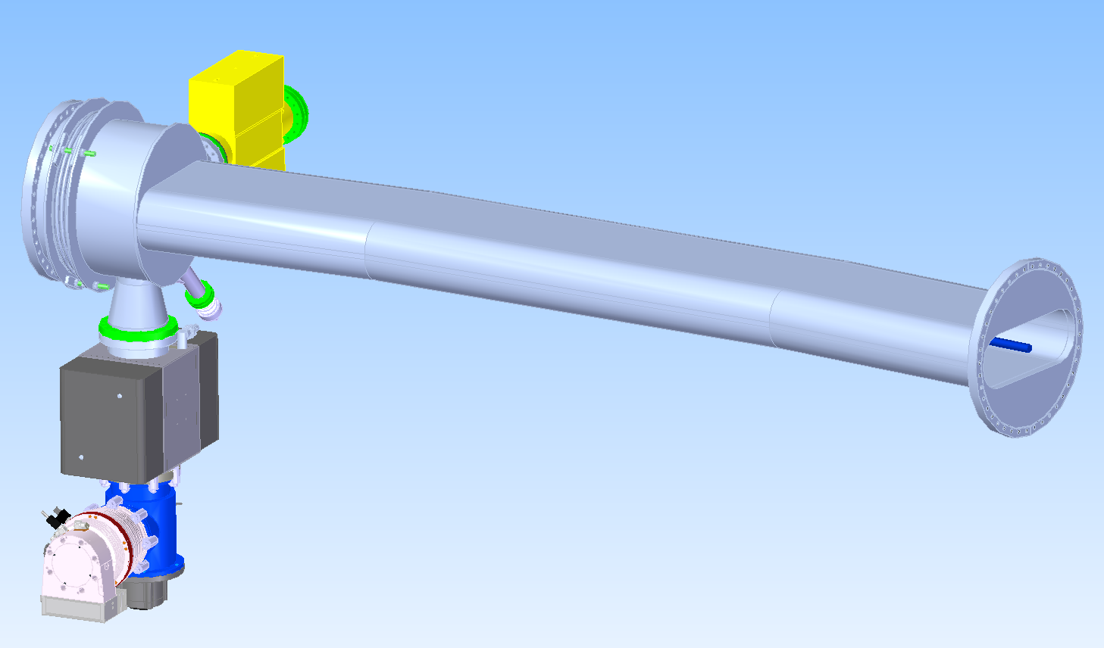
SFRS SC dipole chamber
New environment 3D model for FoS SC-Dipole chamber (9,75 deg) was received from GSI one week ago. BINP is making final 3D model and FEM calculation
There are no the input DMU 3D models for other chambers

Slide 12
SFRS SC dipole chamber
Nomenclature | PSP vacuum chamber | Designation | Contracted FAT date [target date] | Contracted delivery date [target date] | Forecast FAT date [actual date] | Forecast delivery date [actual date] | 3D/ CDR | 2D/ FDR | stainless steel plates | flanges | bellows
FPF4 xxx | 2.4.7.1.2.1.1 | 01 - St. dip. 2 chamber, curved exit | Jan-21 |  | Dec-21 | Jan-22 | 1 |  | 1 | 1 | 3
FPF4 xxx | 2.4.7.1.2.1.1 | 02 - St. dip. 2 chamber, curved exit | Feb-21 |  | Jun-22 | Jul-22 | 1 |  | 1 | 1 | 3
FPF4 xxx | 2.4.7.1.2.1.1 | 03 - St. dip. 2 chamber, curved exit | Feb-21 |  | Jun-22 | Jul-22 | 1 |  | 1 | 1 | 3
spare xxx | 2.4.7.1.2.1.1 | 26 - St. dip. 2 chamber, curved exit | Mar-22 |  | Jun-22 | Jul-22 | 1 |  | 1 | 1 | 3
FMF1 xxx | 2.4.7.1.2.2.1.1 | 04 - St. dip. 3 chamber, curved exit | Mar-21 |  | 01/12/2021 | Jan-22 | 2 | 1 | 1 | 1 | 3
FMF1 xxx | 2.4.7.1.2.2.1.1 | 05 - St. dip. 3 chamber, curved exit | Mar-21 |  | Dec-21 | Jan-22 | 2 | 1 | 1 | 1 | 3
FMF1 xxx | 2.4.7.1.2.2.1.1 | 06 - St. dip. 3 chamber, curved exit | Apr-21 |  | Jun-22 | Jul-22 | 2 | 1 | 1 | 1 | 3
FMF2 xxx | 2.4.7.1.2.2.1.1 | 07 - St. dip. 3 chamber, curved exit | May-21 |  | Jun-22 | Jul-22 | 2 | 1 | 1 | 1 | 3
FMF2 xxx | 2.4.7.1.2.2.1.1 | 08 - St. dip. 3 chamber, curved exit | May-21 |  | Jun-22 | Jul-22 | 2 | 1 | 1 | 1 | 3
FMF2 xxx | 2.4.7.1.2.2.1.1 | 09 - St. dip. 3 chamber, curved exit | Jun-21 |  | Jun-22 | Jul-22 | 2 | 1 | 1 | 1 | 3
FMF3 xxx | 2.4.7.1.2.2.1.1 | 12 - St. dip. 3 chamber, curved exit | Jul-21 |  | Nov-22 | Dec-22 | 2 | 1 | 1 | 1 | 2
FHF1 xxx | 2.4.7.1.2.2.1.1 | 15 - St. dip. 3 chamber, curved exit | Sep-21 |  | Nov-22 | Dec-22 | 2 | 1 | 1 | 1 | 2
FLF2 xxx | 2.4.7.1.2.2.1.1 | 16 - St. dip. 3 chamber, curved exit | Oct-21 |  | Nov-22 | Dec-22 | 2 | 1 | 1 | 1 | 2
FLF2 xxx | 2.4.7.1.2.2.1.1 | 17 - St. dip. 3 chamber, curved exit | Oct-21 |  | Nov-22 | Dec-22 | 2 | 1 | 1 | 1 | 2
FLF2 xxx | 2.4.7.1.2.2.1.1 | 18 - St. dip. 3 chamber, curved exit | Nov-21 |  | Nov-22 | Dec-22 | 2 | 1 | 1 | 1 | 2
FRF2 xxx | 2.4.7.1.2.2.1.1 | 19 - St. dip. 3 chamber, curved exit | Nov-21 |  | Nov-22 | Dec-22 | 2 | 1 | 1 | 1 | 2
FRF2 xxx | 2.4.7.1.2.2.1.1 | 20 - St. dip. 3 chamber, curved exit | Dec-21 |  | Nov-22 | Dec-22 | 2 | 1 | 1 | 1 | 2
FRF2 xxx | 2.4.7.1.2.2.1.1 | 21 - St. dip. 3 chamber, curved exit | Jan-22 |  | Nov-22 | Dec-22 | 2 | 1 | 1 | 1 | 2
FRF3 xxx | 2.4.7.1.2.2.1.1 | 22 - St. dip. 3 chamber, curved exit | Jan-22 |  | Nov-22 | Dec-22 | 2 | 1 | 1 | 1 | 2
spare xxx | 2.4.7.1.2.2.1.1 | 25 - St. dip. 3 chamber, curved exit | Mar-22 |  | Nov-22 | Dec-22 | 2 | 1 | 1 | 1 | 2
FMF3 xxx | 2.4.7.1.2.2.2 | 10 - St. dip. 3 chamber, curved exit, 9,75° | Jun-21 |  | Nov-22 | Dec-22 | 1 |  | 1 | 1 | 1
FHF1 xxx | 2.4.7.1.2.2.2 | 13 - St. dip. 3 chamber, curved exit, 9,75° | Aug-21 |  | Nov-22 | Dec-22 | 1 |  | 1 | 1 | 1
FRF3 xxx | 2.4.7.1.2.2.2 | 24 - St. dip. 3 chamber, curved exit, 9,75° | Feb-22 |  | Nov-22 | Dec-22 | 1 |  | 1 | 1 | 1
Bellows for Pre-serial production are received
Stainless steel 1.4429 for pre-serial production is expected in September-October 2021

Slide 13
Thank you for attention and stay healthy!

