Slide 1
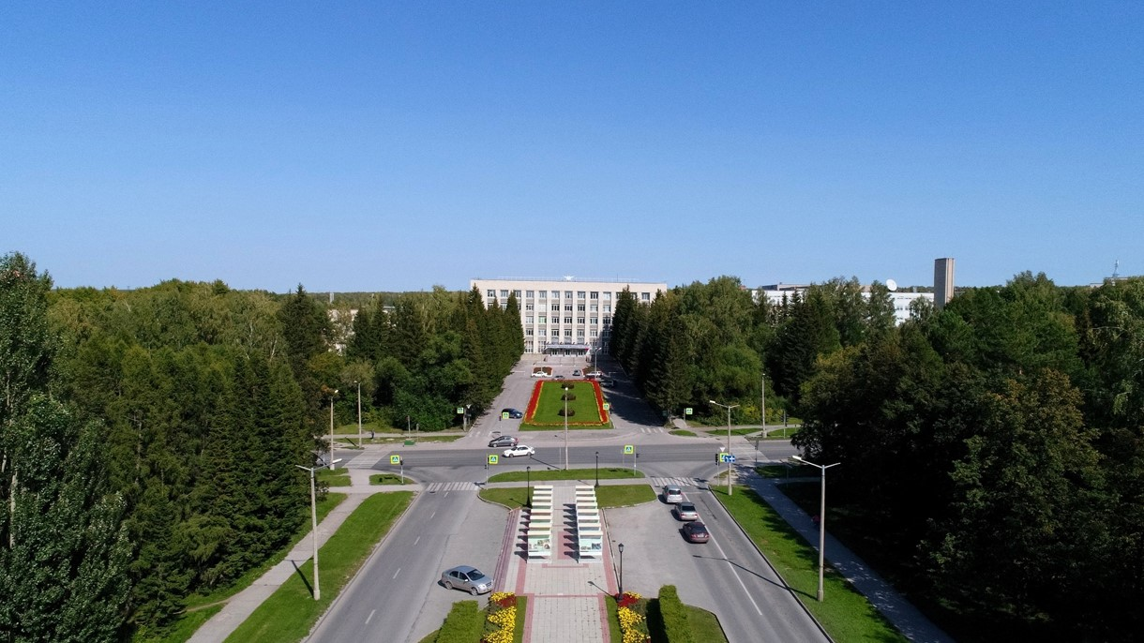
6th BINP-FAIR Collaboration Coordination Workshop SFRS local cryogenic

Slide 2
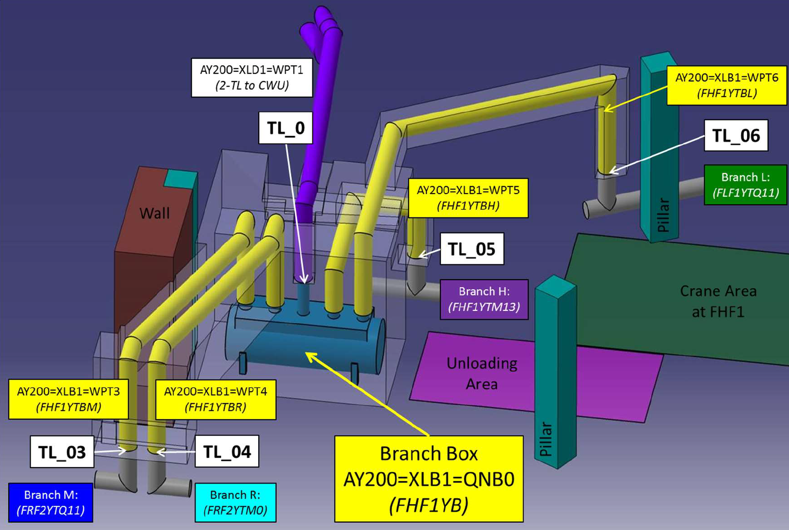
Conceptual 3D model of the Branch Box and its cryogenic Transfer Lines.

Slide 3
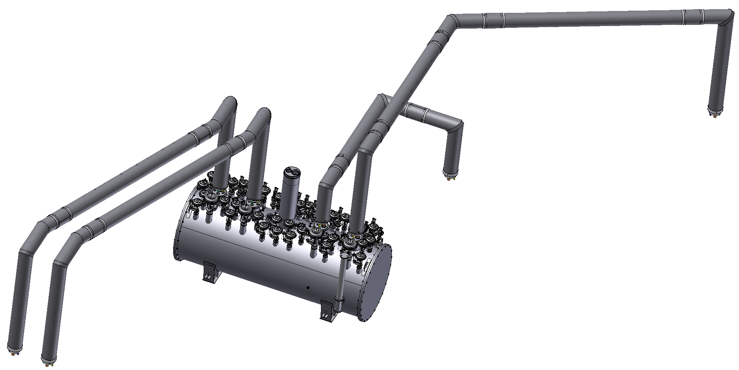
Up-to-date conceptual design of transfer lines for M, R, X, and L branches.
TL05
TL06
TL03
TL04
Branch Box
6th joint BINP-FAIR workshop SFRS local cryogenic E.Pyata; S.Pivovarov; M.Kholopov

Slide 4
3D Model of the Transfer lines
TL_05
TL-03,04
TL_06
Straight part
Angle part of TL
G10 spacer
Metal hoses
He pipe
Ball joint
Al Thermal shield
Vacuum shell DN200
6th joint BINP-FAIR workshop SFRS local cryogenic E.Pyata; S.Pivovarov; M.Kholopov

Slide 5
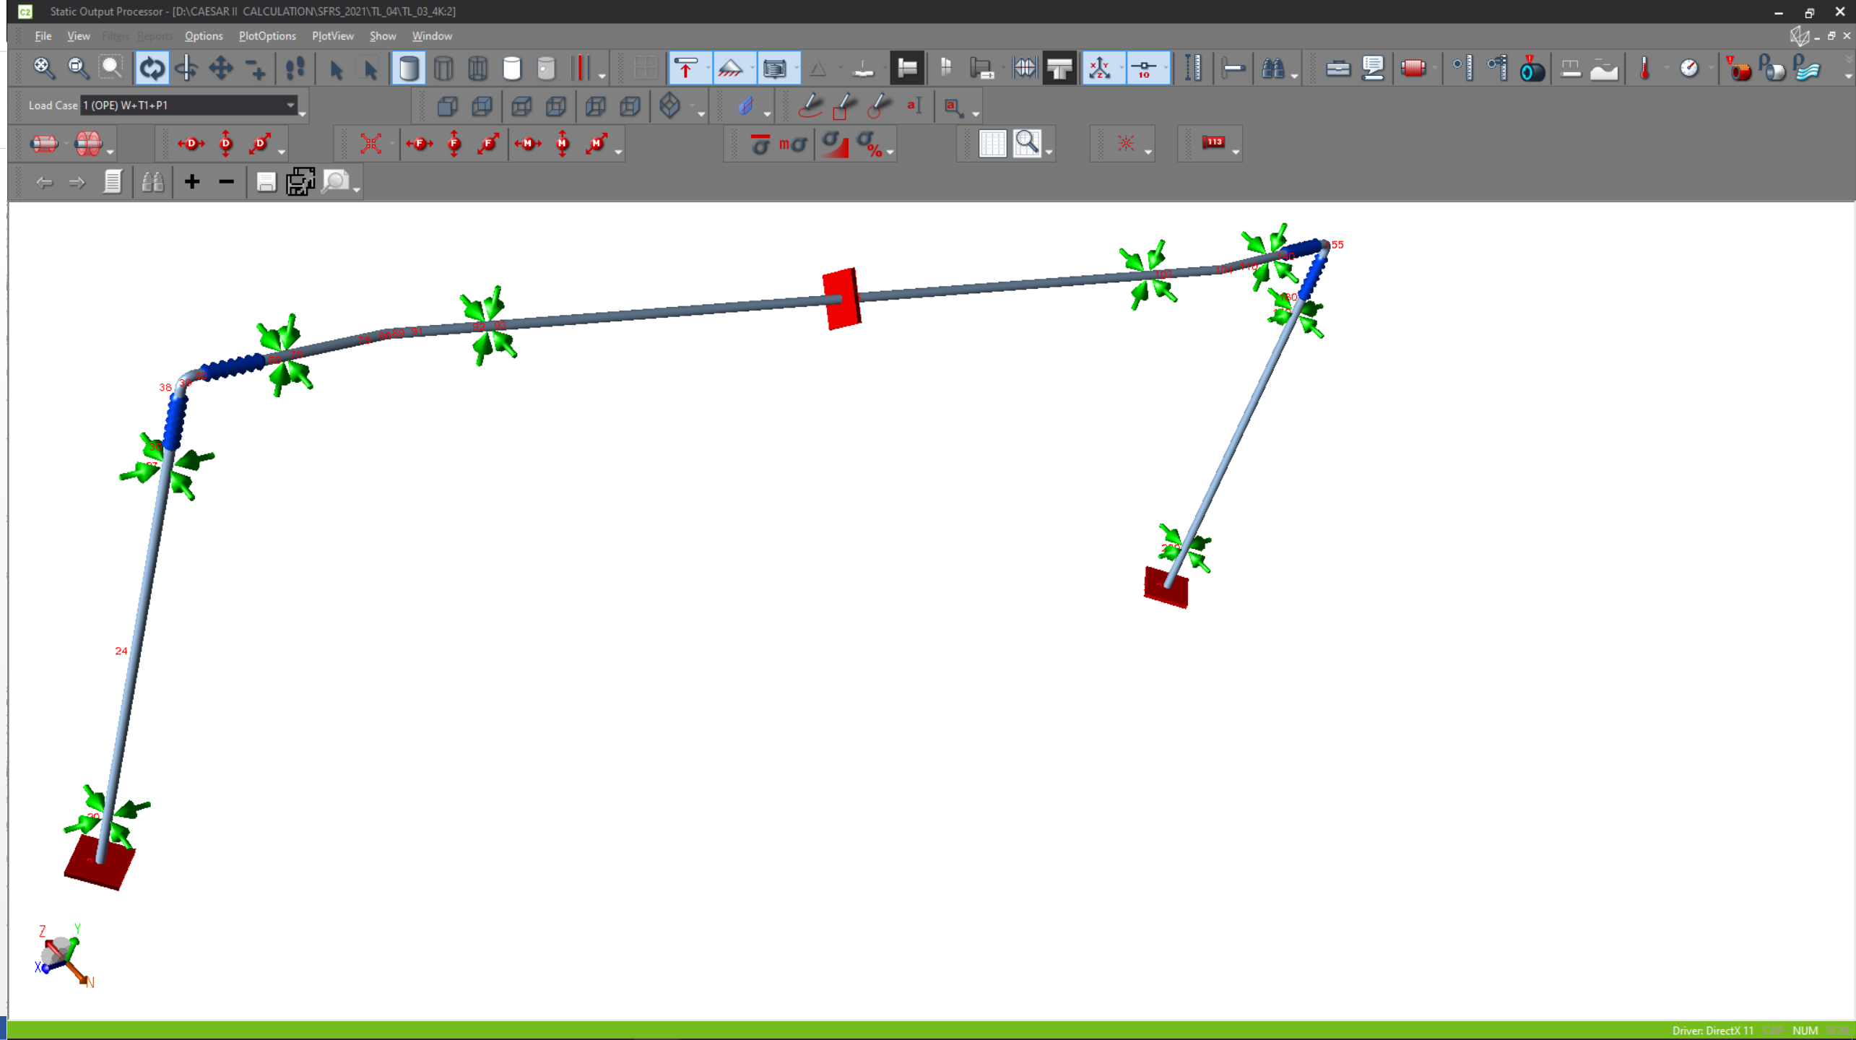
Calculation of the transfer lines
1.Calculation of the pipelines at a given temperature and pressure
- material- st.1.4541
- yield strength- 216MPa
- temperature- 4.5K, 5K, 50K, 80K
- pressure – 2026Kpa
1.1.Calculation of the pipelines TL_03,04
3 fix point, other spacers are sliding
6th joint BINP-FAIR workshop SFRS local cryogenic E.Pyata; S.Pivovarov; M.Kholopov

Slide 6
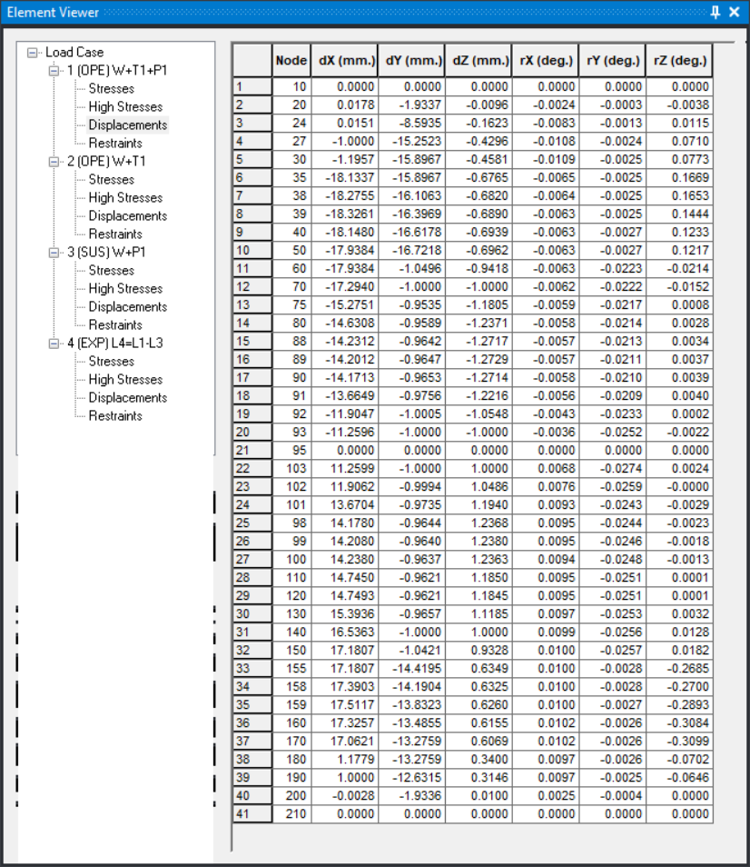
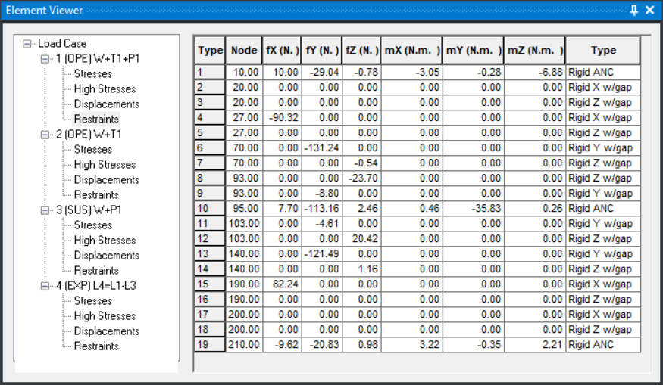
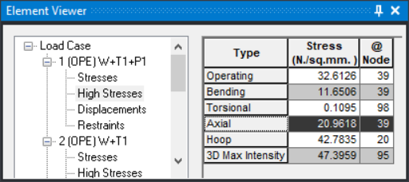
Calculation (example):
Diviation Loads
6th joint BINP-FAIR workshop SFRS local cryogenic E.Pyata; S.Pivovarov; M.Kholopov

Slide 7
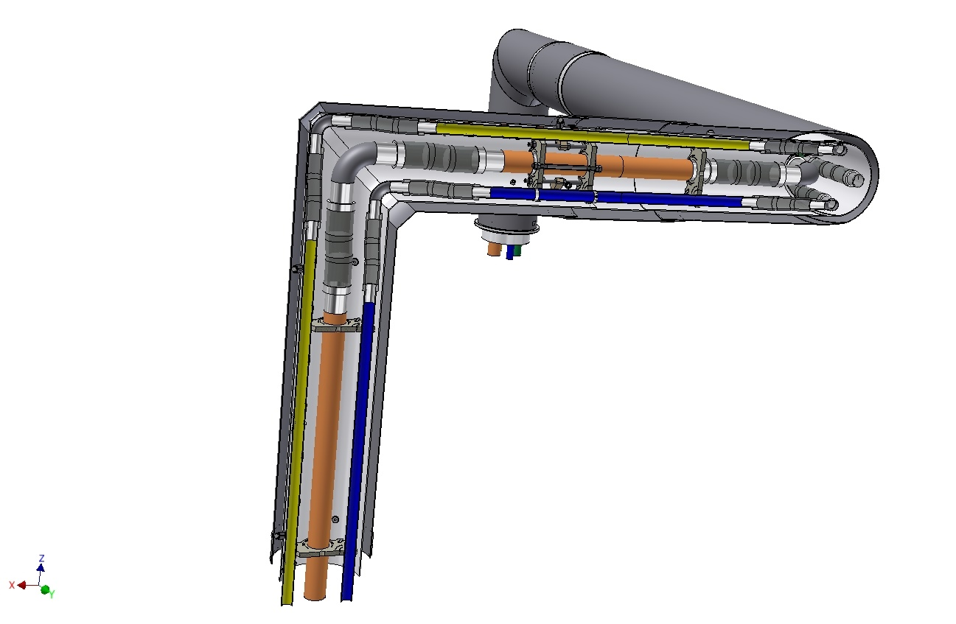
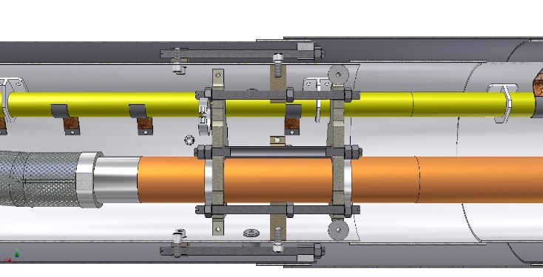
design of the BRANCH BOX (BB)/ transfer lines
Fix point
Branch B;
TL_05
to Tee connection

Slide 8
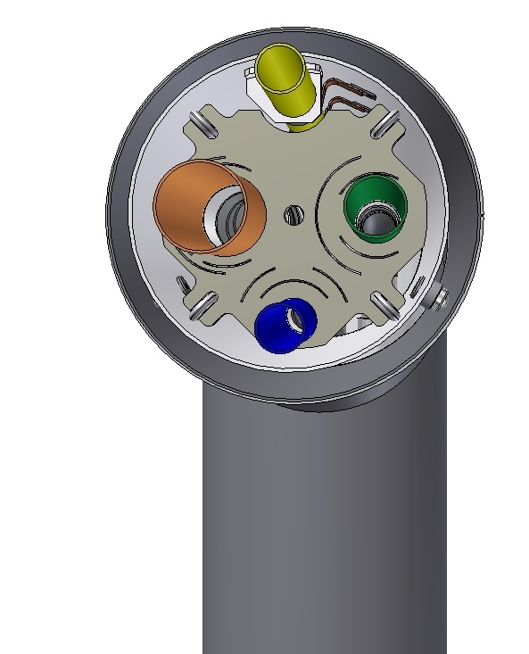
design of the BRANCH BOX (BB)/ transfer lines
Cross section:
Outer diameter – 406 mm;
Process pipes:
Yellow - DN40/ 80K return;
Brown - DN80/ 5,5K return;
Green - DN50/ 4,5K forward;
Blue - DN40/ 50K forward;
material - stainless steel 1.4541;

Slide 9
Plan
Continue design of BB and preparation documents for CDR in September 2021.
Design Transfer lines (warm line SFRS (WGS and CGR) – 1174 m and MLI -553 m)
Placement layout outside pipelines.
Calculation loads of the piping, shell of TLs, supports, vacuum barriers and etc. using the Caesar-II program.

Slide 10
design of the BRANCH BOX (BB) and local cryogenic
Accelerator Implementing Agreement No. 2 to the ACCELERATOR CO-OPERATION Agreement of dated by October 2, 2019. The scope of cooperation of this work includes, first of all, the technological design of the branch box (BB), which distribute helium supply to four SFRS experimental branches. Conceptual design and preparation for the introduction of devices will be performed by both organizations GSI and BINP SB RAS. BINP SB RAS will perform technological design. The GSI will provide scientific support. - OK
BINP developed sub-cooler of the BB. 1000 l LHe vessel, 174 g/sec flow; BINP defined a design of Branch Box with warm piping, instrument frames and worked platform. Conceptual 3D model is ready; BINP defined a conceptual design of MLI, installation supports on walls of tunnels and maybe FB at open areas;
According to our agreements 27 November 2019, GSI will prepare a contract FAIR-BINP for development and production of Transfer lines, part of Feed/End boxes and BB. Now we agreed milestones and items for contract for development and production of Transfer lines and BB.
BINP Workshop Steering, 26th April 2021
Out of all Contracts (8 signed and 7 in preparation) only one accelerator contract is actively in the serial production phase.
Although there is some progress in the design for SFRS Dipoles other areas are still lagging behind:
Design progress and agreed dates are repeatedly delayed for vacuum and local cryogenic components.
Proposals for consideration
to engage external design capacity for support of SFRS local cryogenics.
SPL | Category | Design CDR accepted | FDR | Prod FAT | Approx. production [open/total pcs/]
SFRS | R&D local cryo SFRS | No
SFRS | R&D local cryo SFRS | Wait signature |  |  | All open
Design Quality of SFRS beam diagnostic chamber and local cryogenic is insufficient:
The achieved out-put to date for the conceptual design of the Local Cryogenics is 5 months delayed with insufficient quality and no reliable solution for improvement recognisable.
Major Challenge - Material purchase
Situation:
Material purchase is now in a critical state for:
SFRS Local Cryogenic

Slide 11
Contract (wait signature) BRANCH BOX and Tls W9
Milestone plan and Task List for Provider WUST (white) and Provider BINP (grey) | Provider | Validation Criteria | Start | Finish
W8 CDR of Branchbox and Branch B Transferlines (BINP) | BINP | CDR of component accepted (M6) |  | 30.09.2021
FDR / Production preperation | BINP | FDR of component accepted (M7) | 30.09.2021 | 15.01.2022
Manufacturing of series | BINP | FoS FAT accepted (M8) | 15.01.2022 | 15.01.2023
Testing and FAT | BINP | FAT of component accepted (M8) | 15.01.2023 | 31.03.2023
W8.2 Installation Branch B (depending on Installationspace, maybe earlier) | BINP | SAT-Ab of component accepted (M11) | 31.03.2023 | 31.01.2024
W9 CDR of Warm Piping all nine Branches (BINP) | BINP |  |  | 31.03.2022
FDR / Production preperation | BINP | FDR of component accepted (M7) | 15.01.2022 | 30.06.2022
Manufacturing of series | BINP | FoS SAT-Ab accepted (M8) | 01.04.2022 | 30.09.2022
W9.2 Installation Warm piping and Multi-purpose Line (MPL) | BINP | SAT-Ab of component accepted (M11) | 30.09.2022 | 31.03.2023

Slide 12
Thank you for your attention

