Slide 1
Schedule for the pbar Installation
28.4.2021
K. Knie

Slide 2
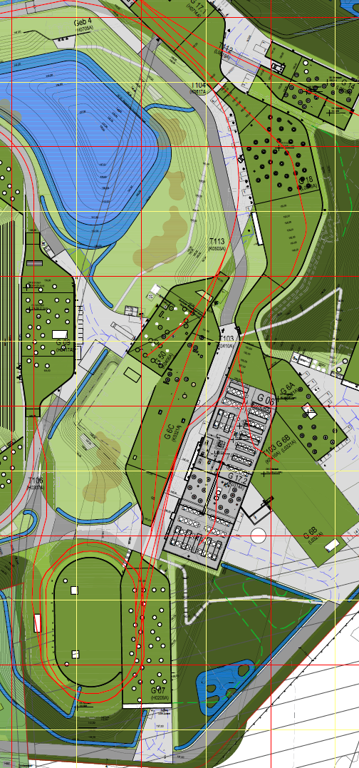
Access to Building 6c
From Building 4 along the beamline:
long way,
to narrow for dipole if HEBT is installed already
From Building 50 (APPA)
60 cm step,
2 beamlines to cross
From elevator in Building 6c
limited to 15 t
From Building 7 (CR)
beamlines to cross,
building 7 not constructed at start of installation

Slide 3
Access to Building 6c
From Building 4 along the beamline:
long way,
to narrow for dipole if HEBT is installed already
From Building 50 (APPA)
60 cm step,
2 beamlines to cross
From elevator in Building 6c
limited to 15 t
From Building 7 (CR)
beamlines to cross,
building 7 not constructed at start of installation

Slide 4
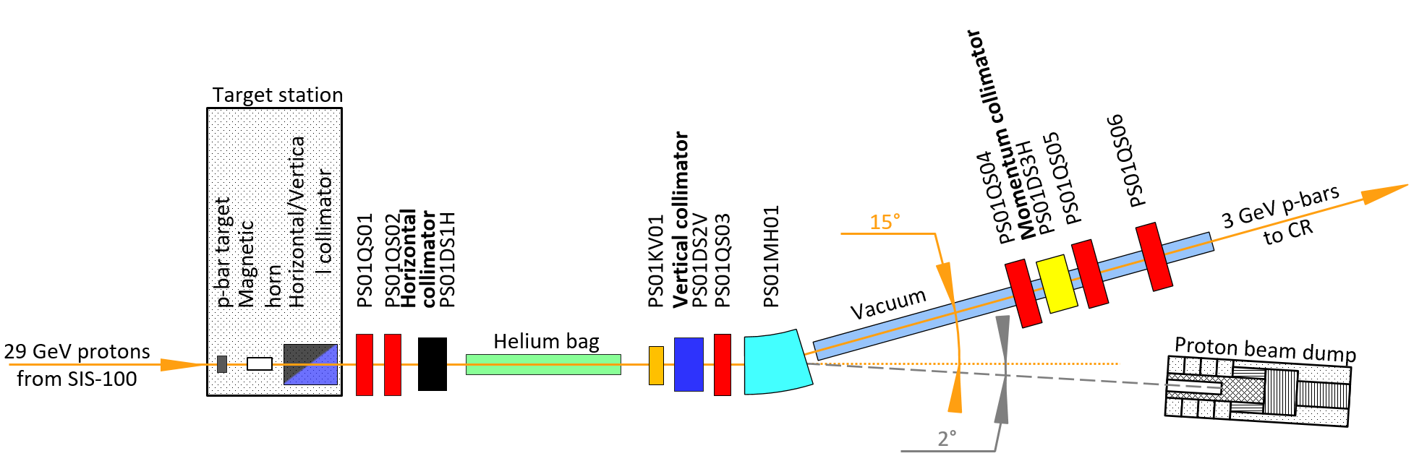
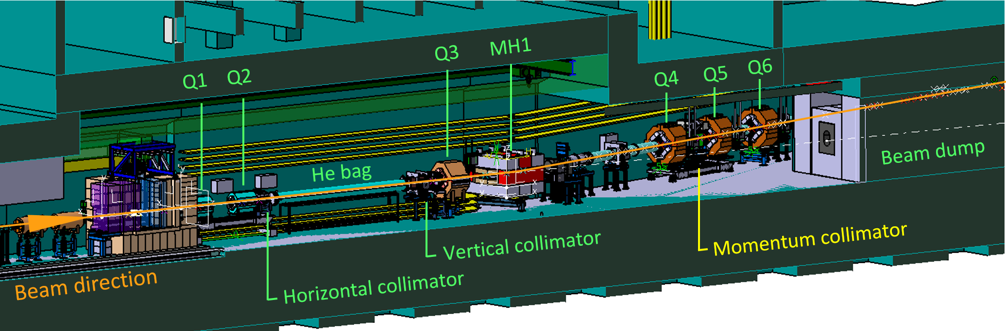
2-Step-Installation
Step 1
using elevator in 6c:
Targetstation, Horn, Dump
Step 2
from building 7
PS01 beamline
Commissioning w. beam:
Dipole needed, otherwise
dump will be missed!
Where to put neg. pions?

Slide 5
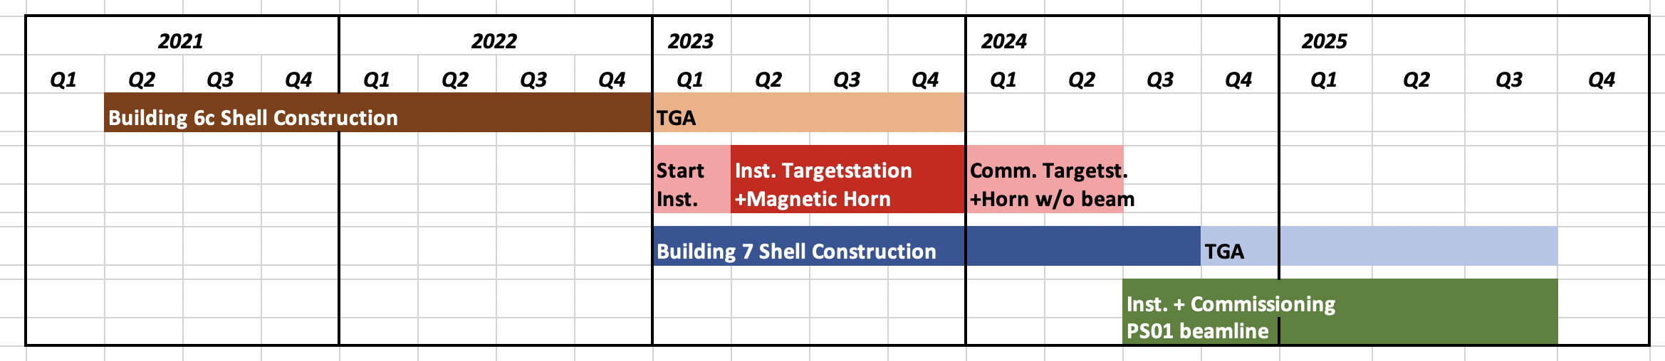
Schedule for installation
Horn needs to be tested with full current (400 kA) for 10⁵-10⁶ pulses to detect failures due to fatigue.
Rep. rate is 0.1 Hz, i.e. the testing phase will last weeks to months.
Operation with beam is strongly recommended only after these tests, because activation does not allow hands-on maintenance.
During these test the tunnel will be not accessible, i.e. no installation of the beamline will be possible.

Slide 6
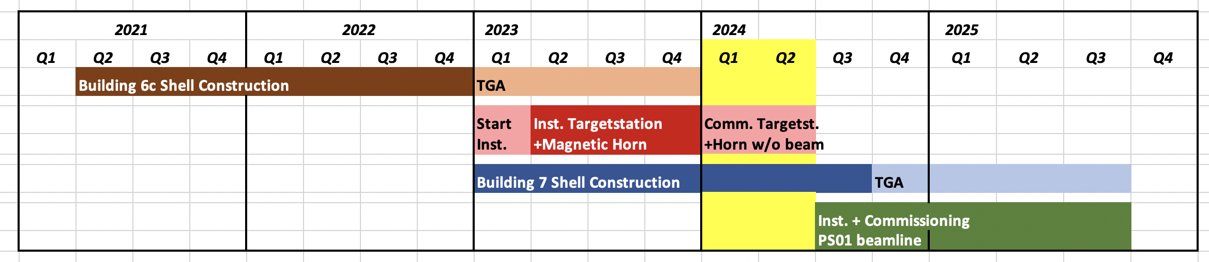
Schedule for installation
Horn needs to be tested with full current (400 kA) for 10⁵-10⁶ pulses to detect failures due to fatigue.
Rep. rate is 0.1 Hz, i.e. the testing phase will last weeks to months.
Operation with beam is strongly recommended only after these tests, because activation does not allow hands-on maintenance.
During these test the tunnel will be not accessible, i.e. no installation of the beamline will be possible.

Slide 7
Summary
Installation of target, horn and dump via elevator in 6c.
Commissioning of these components without beam after installation.
During commissioning period of horn (at least 6 months) access to tunnel is restricted.
As soon as access from building 7 is possible, installation of pbar separator
(PS01 + TCR1 beamlines) from target to CR.
Components should be made available according to the installation order.
Commissioning with beam after installation of whole pbar separator.
If commissioning of magnetic horn is delayed and building 7 is early,
this planning has to be reconsidered!

