Slide 1
Pre assembly and tunnel assembly
Preparations including Assembly drawings
Christina Will
27.04.2021

Slide 2
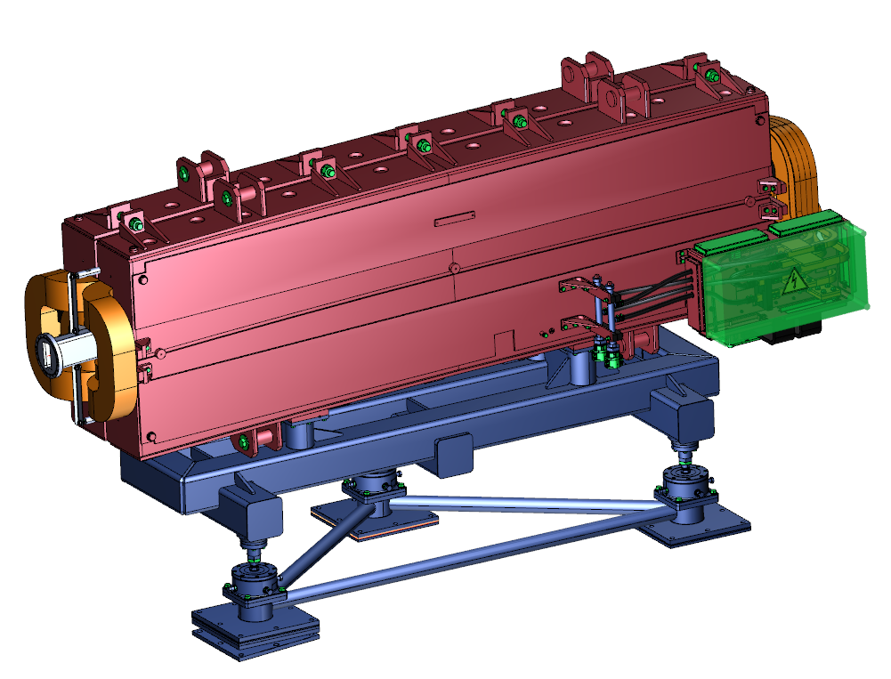
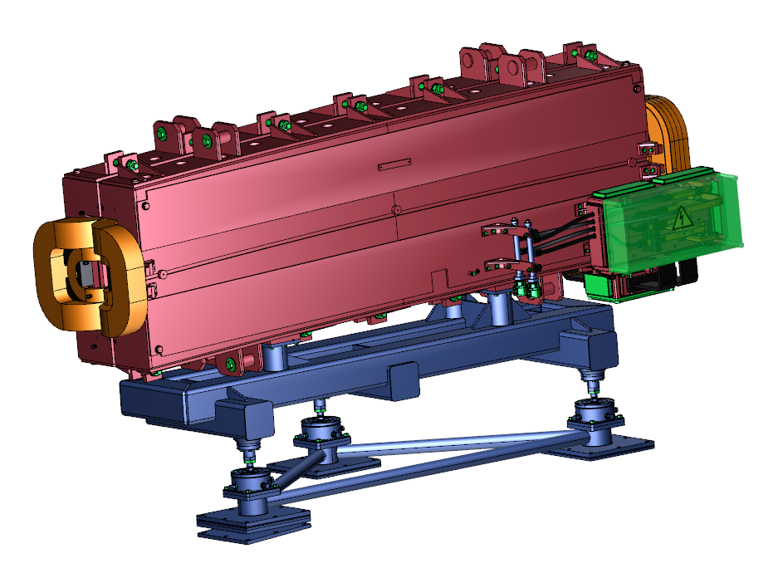
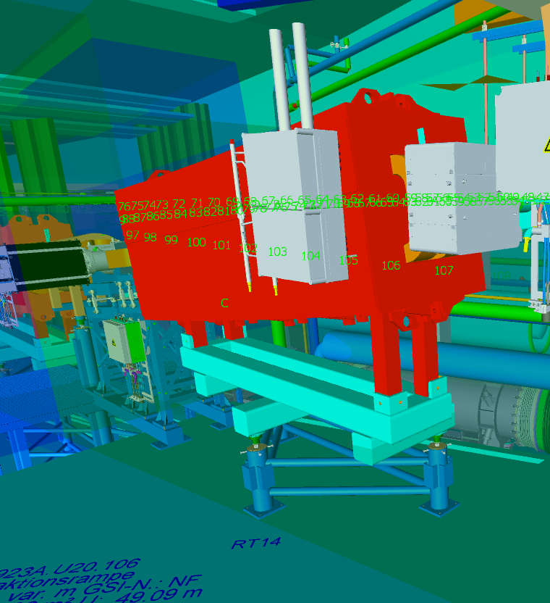
Process of preparation for assembly
Production Engineering
Pre Assembly
What
BOM
How
Drawing
AAW
Who
AV, BGV, SPL, ML
assembly ready for installation in the tunnel
When
ML, BGV
Production Engineering
Tunnel Assembly
What
BOM
How
Drawing
AAW
Who
AV, BGV, SPL, ML
AAW – Arbeitsanweisung (working advice)
AV – Team Arbeitsvorbereitung, Work preparation
SPL – Subporjectleader
ML – Head of Assembly tasks
BOM- Bill of Material (part list)
When
ML, BGV, SPL

Slide 3
Assembly drawings/ Definition
A technical drawing is a graphical document that is mainly used in mechanical engineering and plant construction and partly also contains in written form the information required for the production of an individual part or the assembly to a subassembly or the complete machine. It also serves as part of the technical product documentation. The technical drawing is the "language" of engineers.
DIN 199 defines it as follows: "A technical drawing is a drawing of the type and completeness required for technical purposes, e.g. by adherence to rules of representation and dimensional entries." This definition takes into account the complex process required to produce complete, standard-compliant technical drawings, which is called technical drawing.
1
Assembly drawing:
Identifies the components to be assembled and provides the information necessary for assembly
Is the basis for work planning, the planning of work equipment, the planning of logistics and the planning of quality assurance.
[1] https://www.google.com/url?sa=t&rct=j&q=&esrc=s&source=web&cd=&cad=rja&uact=8&ved=2ahUKEwitu8PdqI_wAhWwgf0HHVzfAoQQFjAAegQIBRAD&url=https%3A%2F%2Fde.wikipedia.org%2Fwiki%2FTechnische_Zeichnung&usg=AOvVaw0_QjkgqSxZ8QjOKFf8EkXc

Slide 4
Potential contents of assembly drawings
Dimensions | It must be possible to check all fitting dimensions and dimensions marked as test dimensions in the drawing against the drawing.
 | Dimensions or coordinates for the clear determination of the position of the components to the specified interfaces
 | Position in the building for tunnel assembly (dimensions also to reference points) (axes)
 | Dimensioning suitable for installation (the technician must not have to calculate)
 | Information on the required mounting size
Surfaces | Information on any surface finishes that may be necessary
Technology | Instructions for securing of screwed connections
 | Instructions on the necessary tightening torques
Marking in the drawing | if only one direction of rotation is possible for drive shafts and spindles, this direction shall be marked by a clearly visible halyard
 | any necessary lubrication points are to be marked
 | Necessary lengths of hoses or pipes must be marked.
 | Pneumatic cylinders or hydraulic cylinders are to be specified with piston size and stroke
 | all cable cross-sections are to be indicated in the plan
 | For valves, the switching functions are to be displayed; Direction of installation
 | Identification of facilities, sub-facilities and traffic routes, geographical north arrow, facility north

Slide 5
Possible contents of assembly drawings
Execution of drawings | Exploded views may be necessary
 | Representation of neighboring components (for tunnel assembly of the lines, also for line crossovers) Dashed
 | Several sheets per assembly drawing are allowed
 | the positions are marked with Arabic numerals with a circle around them
 | the numbering reference lines are not parallel to other lines
 | the arrangement of the position numbers according to the assembly sequence or clockwise
 | Precise marking of when the assembly step is completed. (belongs in assembly instruction AAW) Example: not everything is pre-assembled.
 | Beam direction
 | the bill of materials contains all necessary attachments and consumables
 | The references for necessary (e.g. static) calculations are to be indicated at the position numbers.
 | Information on assembly sequence
 | Information on joining methods (e.g. gluing)
 | The bill of materials is kept both on the drawing ( placed on top of the title block) and as a separate document. It is to be filled in from bottom to top (arguments about the risk of getting lost on the construction site and in the workshop are minimised, the risk of incorrect allocation is minimised).
 | Other applicable drawings are named on the assembly drawing.
 | Any necessary flow diagrams are to be shown on a separate sheet
 | for rotatable flanges, indications of the orientation of the pitch circle
 | Location and layout plans: Simplified outlines of the installations or parts of installations, traffic routes shown in simplified form; Main pipeline routes, main cable routes; dimensions and coordination for the clear positioning of the traffic routes and boundaries of the installation or sub-installation
 | Reference heights (level)
 | Required assembly stroke

Slide 6
Potential contents of assembly drawings
Execution of drawings | Connection details for the components including necessary tightening torques
 | Anchoring details (anchor holes, anchor bolts, anchor bars, etc.)
 | Details of necessary profiles and cross-sections,
 | Weld seams and other connection with references
 | Any required tolerances and machining symbols
 | Information on protection in case of interruption of assembly or completion of work (covers, aluminium foil, plastic foil, etc.)
 | Instructions for slinging for transport, transport instructions, orientation (so that component does not have to be turned in the tunnel)
 | Description of necessary special tools and their fitting into the installation spaces as well as information on their use
Freigabe/ Approval | Drawings must be approved

Slide 7
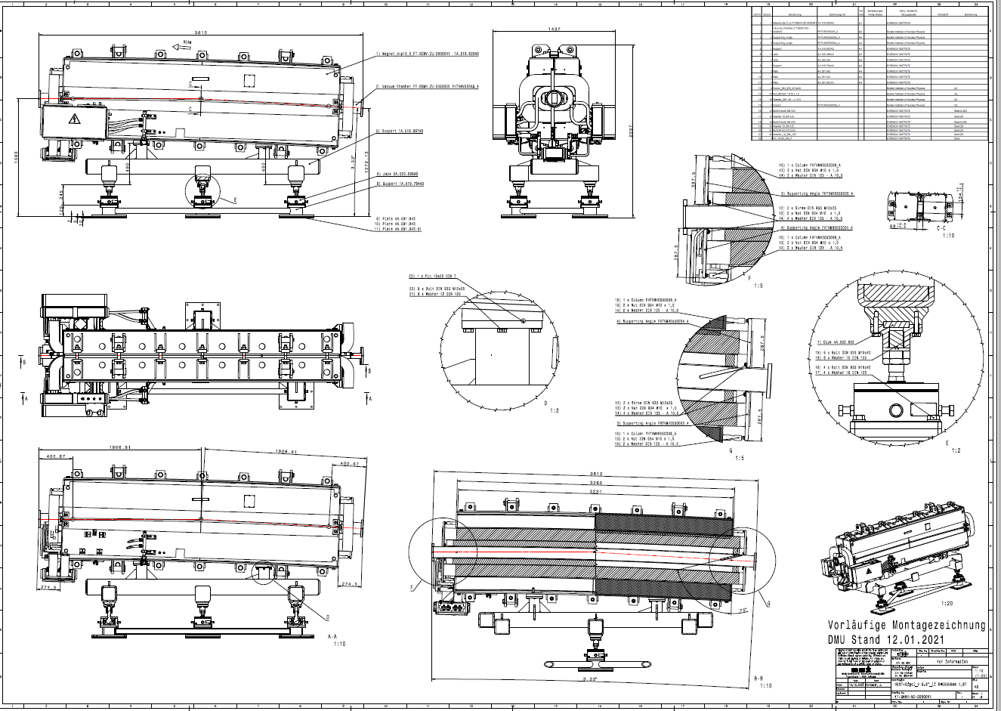
Example Drawing for Pre Assembly

Slide 8
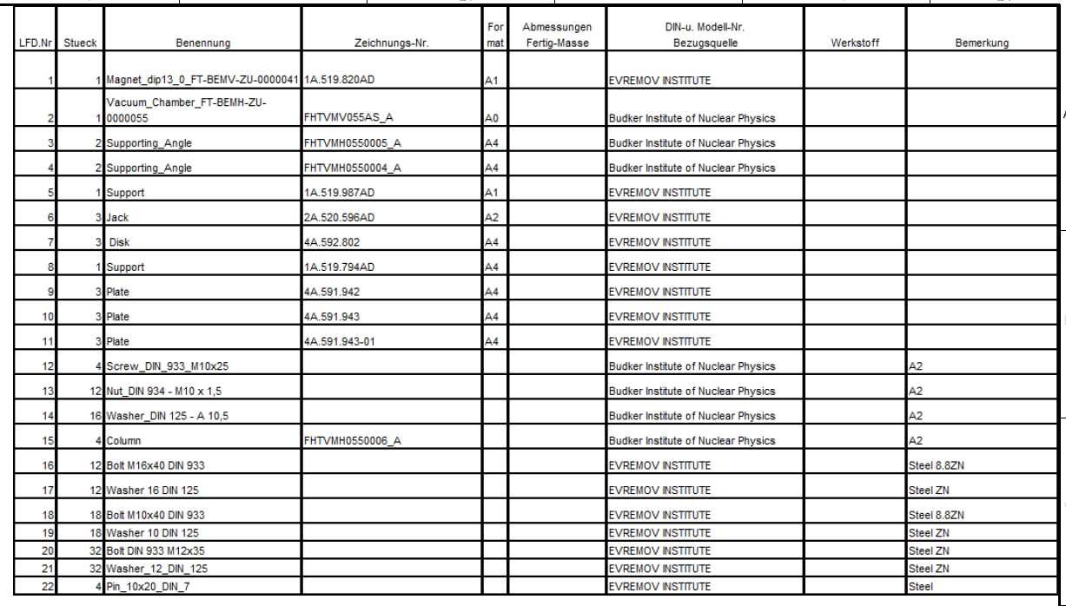
Example Drawing for Pre Assembly

Slide 9
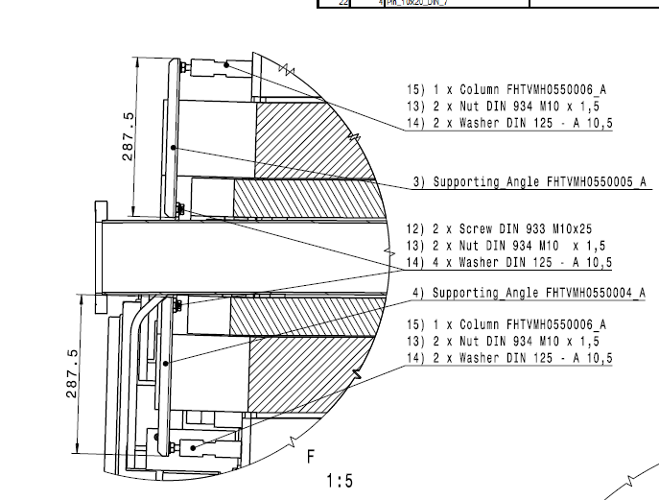
Example Drawing for Pre Assembly

Slide 10
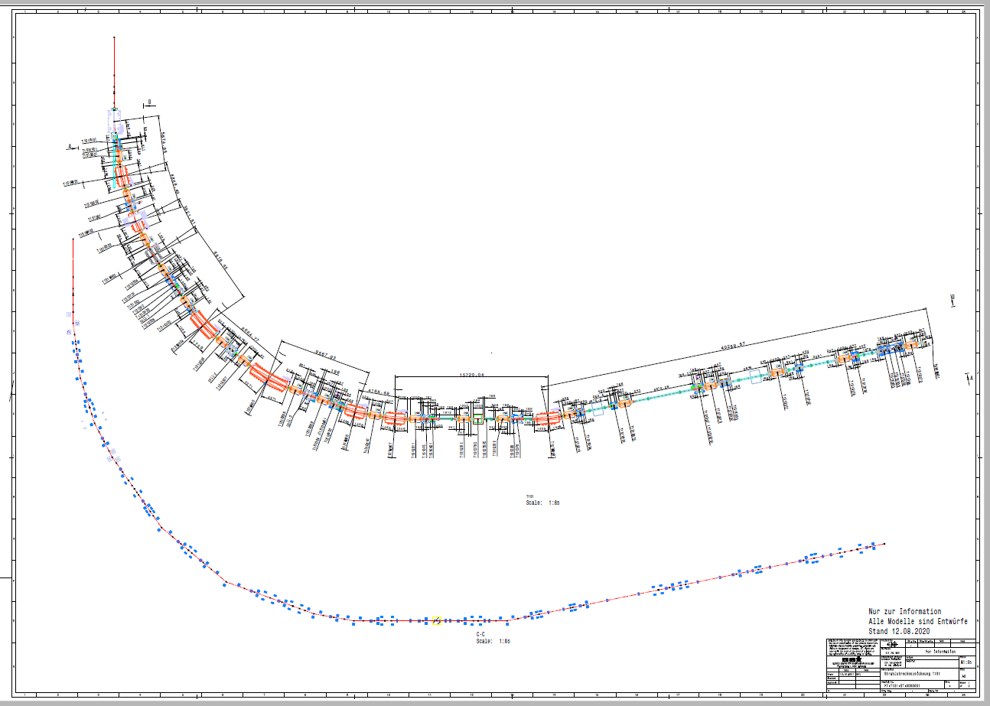
Installation in the tunnels

Slide 11
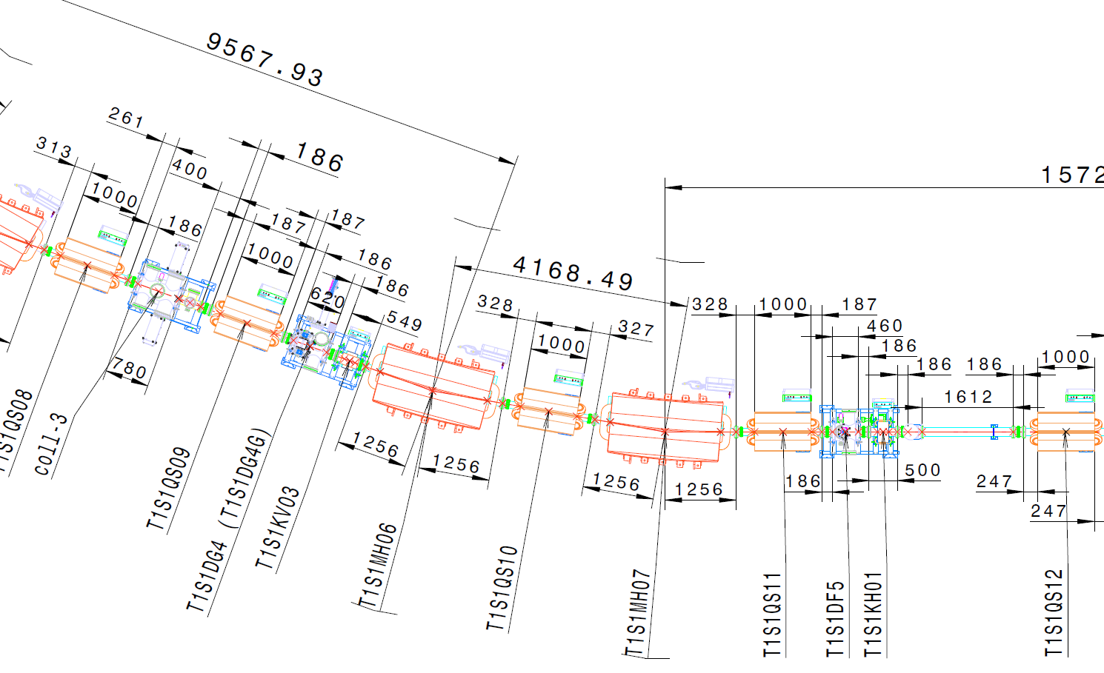
Installation in the tunnels/ details

Slide 12
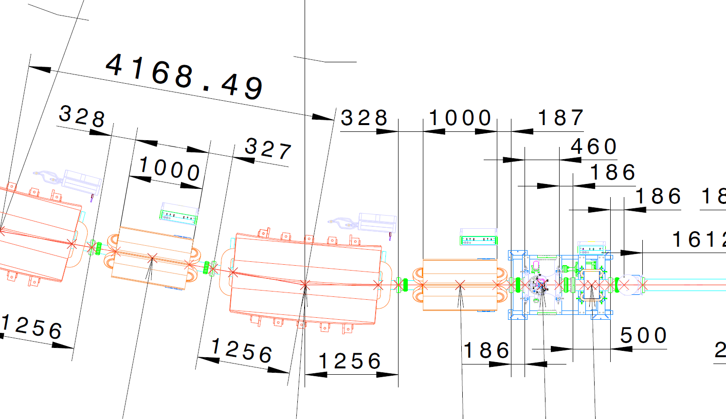
Installation in the tunnels/ details
As Information for positioning
Blueline
Blueline

Slide 13
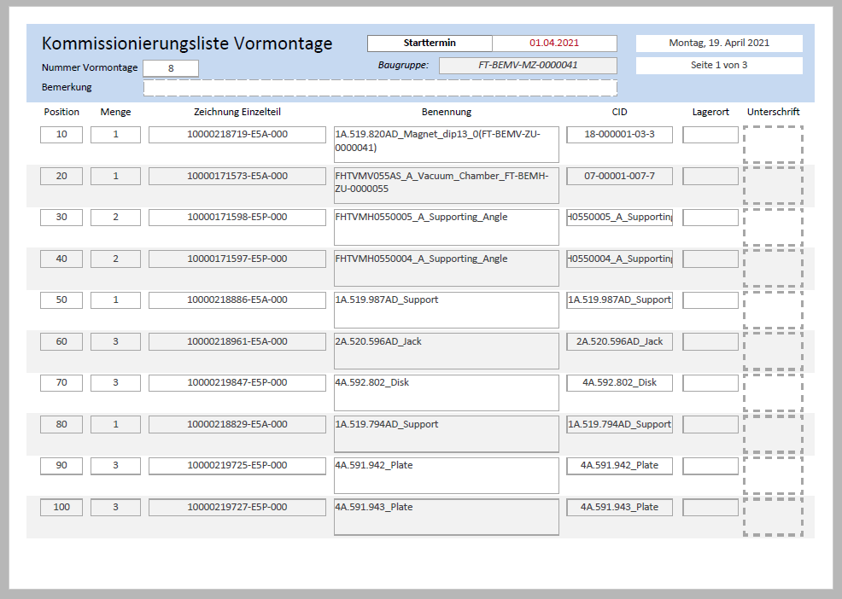
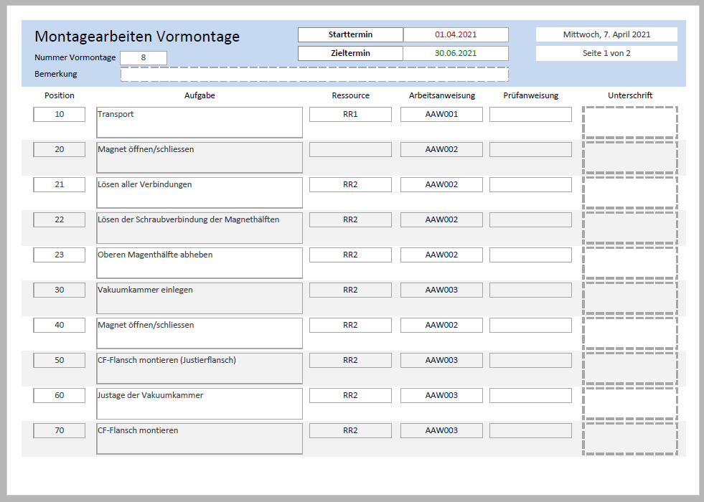
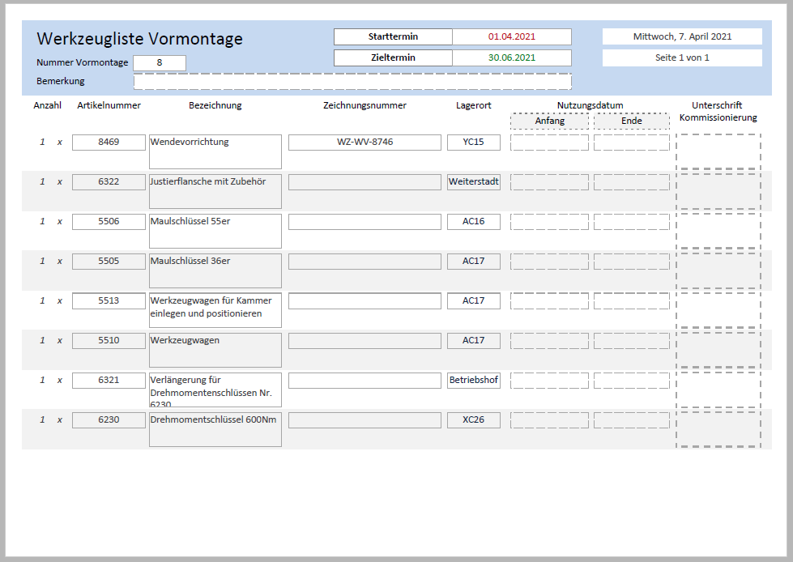
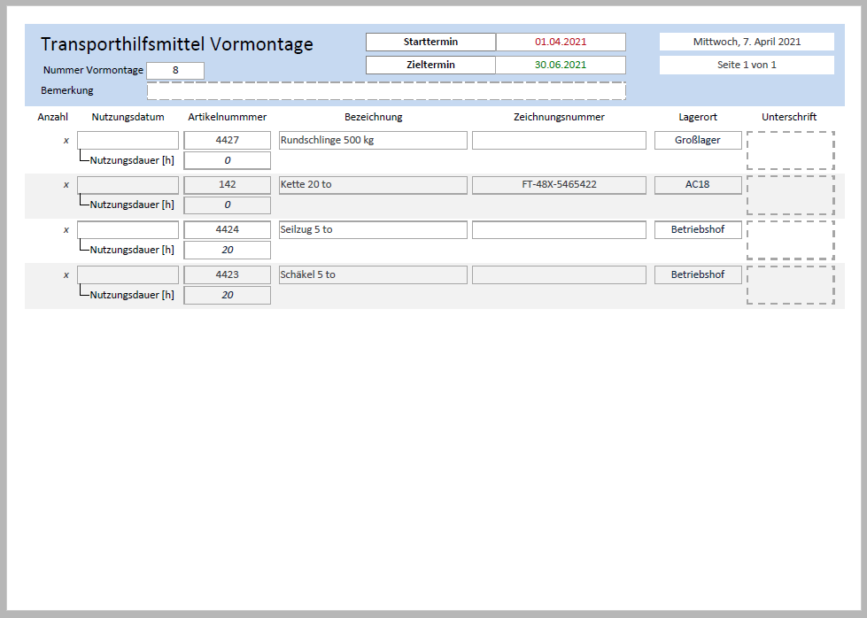
Production Engineering
Documentation
ADR + BOM
Database for Production Engineering
AAW
Preparation of commissioning list (Logistic
Preparation of the work steps list
Preparation of the tool list
Preparation of the list of transport aids
Manuals
FAT Protocols
Risk analysis
QA- Step!!!
ADR – Assembly drawing

Slide 14
Summary
Assembly drawings are the basis for:
the technical planning of the assembly processes
the technological planning of the assembly processes
the planning of the necessary resources (personnel, time, assembly stations)
the planning and development of assembly tools
the planning of means of transport
etc.
Planning for assembly work is a time-consuming process.
This is due to the limited space and personnel resources available for assembly. Due to technical peculiarities, careful pre-planning is of particular importance in order to enable both time- and cost-optimised processing of the tasks.

Slide 15
Questions?

