Slide 1
CBM Magnet design. Current status 04.2021.
2021 04, BINP, M.Kholopov, A.Bragin.

Slide 2
FAIR

Slide 3
3D Model of CBM Magnet and cryosyctem
1
2
Iron Yoke and Support m= 105T
Cryostat, Coils and Cryostats TL m=4750kg
Branch box m=3476kg
Transfer Line m=982kg
State of affairs:
1. Magnet yoke and Support-The 3D model is finished, the calculations are done, the drawings are ready.
2. Cryostat and coils-3D model is finished, calculations are at the final stage, drawings are being prepared.
3. Branch box-the 3D model is ready, the calculation of pipelines is performed.
4. Transfer line-the conceptual design is ready, there is a clarification of the lengths of the transfer line parts and the location of the supports.
3
4

Slide 4
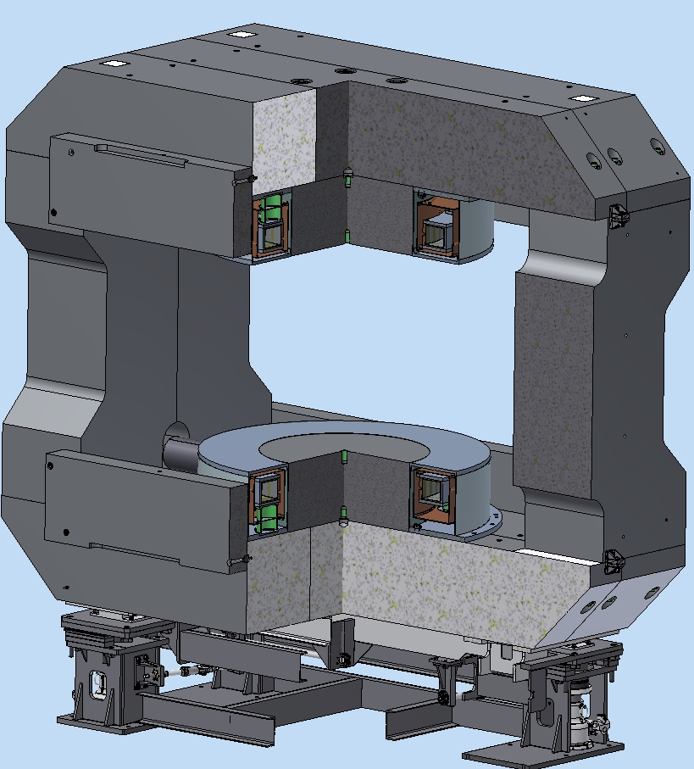
3D Model of CBM Magnet & support
Iron Yoke (m~146tons)
Coils (m~1.5tons)
Support (m~4.5tons Loading capacity 200tons)
total weight ~155 tons
Adjustment
positioning precision: ± 0.5 мм
The accuracy of the orientation (angular):± 0.5 mrad
Adjustment range: ±40 mm in x, y, z direction, ±4° around the Z axis.
2
3
1

Slide 5
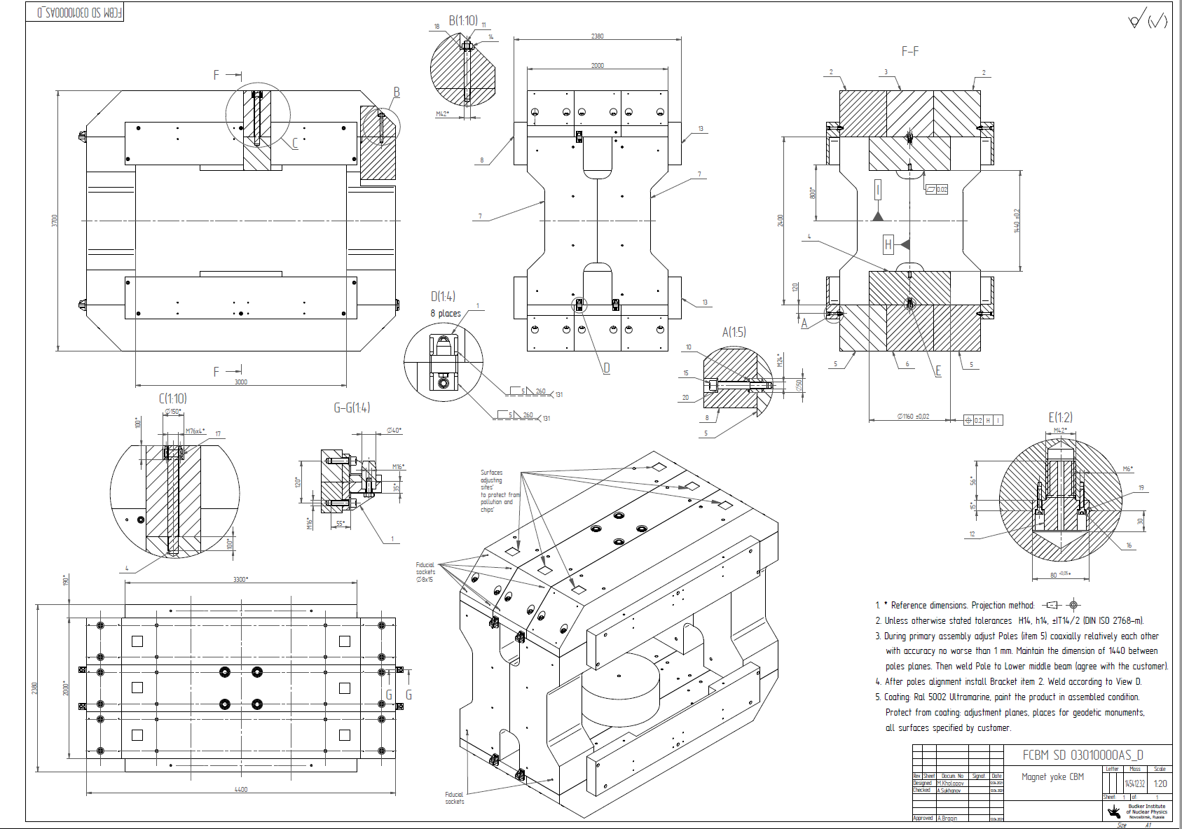
Iron Yoke drawing

Slide 6
Iron Yoke specification
The material of the main parts is steel 1.0322.
The material of the fasteners is steel of the 8 strength class.

Slide 7
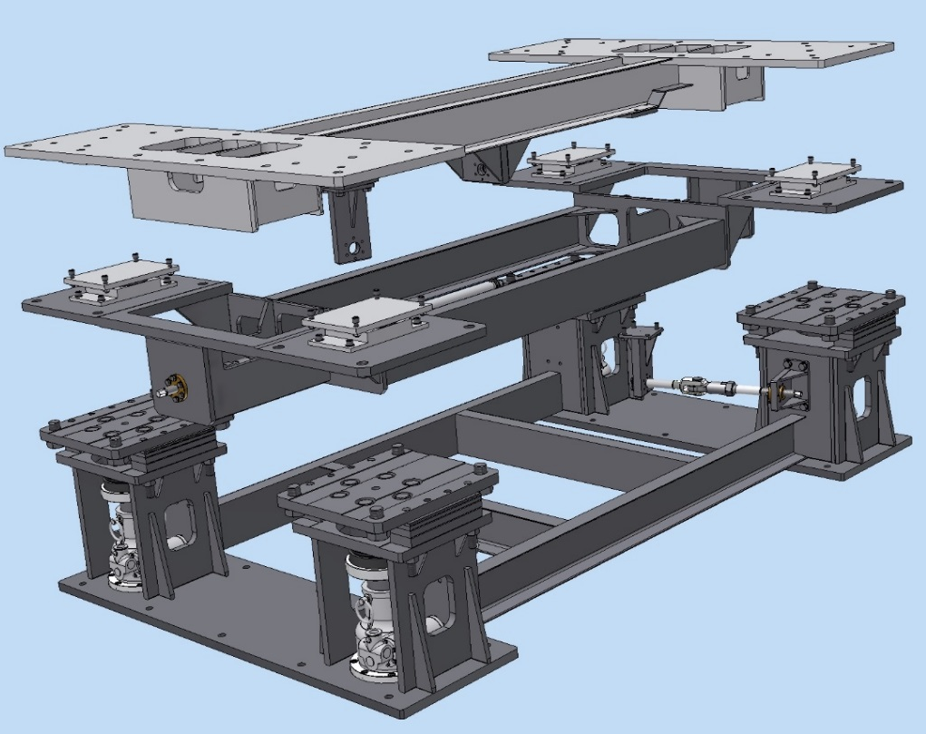
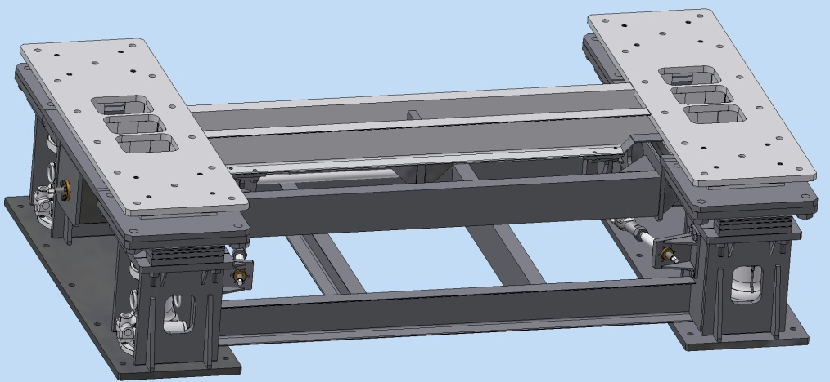
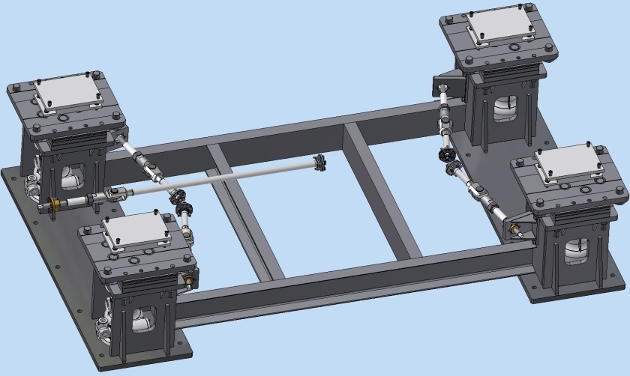
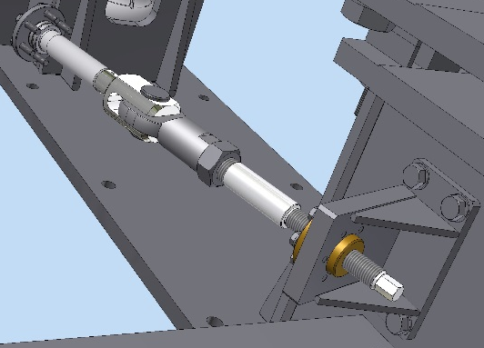
CBM Magnet support
Iron yoke
Fixation plate
Top frame
The accuracy of the alignment
- Position accuracy: ± 0.5 mm (meeting in December 2018)
- Orientation accuracy (roll): ± 0.5 mrad
-The gimbals has a fixation and alignment tool
Intermediate frame
Screw jack Rack
Sliding support
Weight and size
Gimbal longitudinal
m= 4500 kg
2022x3470x850mm
move in 3D ±40mm
Rotation top frame ±4⁰
Loading capacity 200000 kg
strength class of fasteners - 8.8
Swivel bearing
Cross gimbal

Slide 8
Magnet supports drawing

Slide 9
Magnet supports drawing

Slide 10
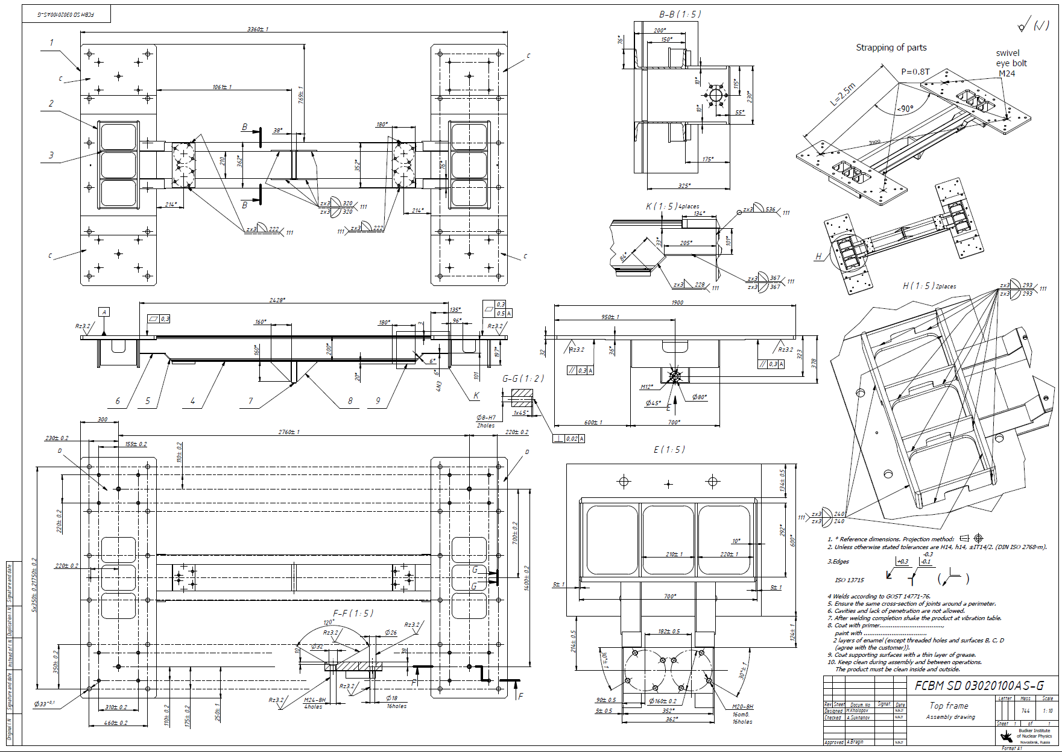
Top frame drawing

Slide 11
Bottom part of the support: design and calculation
The bottom part of the support is designed for a load of 240 tons and additionally added seismic hazar (20 tons)

Slide 12
Bottom part of the support: design and calculation

Slide 13
The CBM magnet support: calculation
The Magnet support was calculated under a double load from the magnet (the weight of the magnet+ 150 Tons) + 2 variants of the seismic load: frontal and longitudinal (20 Tons)

Slide 14
The CBM magnet support: calculation longitudinal variant
Parameter | Min | Max
Von Mises stress | 0 MPa | 479 Mpa*
Deformation | 0 mm | ~0.255 mm
Safety factor | 0.48 | >10

Slide 15
The CBM magnet support: calculation frontal variant
Parameter | Min | Max
Von Mises stress | 0 MPa | 256 Mpa*
Deformation | 0 mm | ~0.242 mm
Safety factor | 0.898 | >10

Slide 16
Cross gimbals : design and calculation
The old design
Swivel bearing Fmax=4T
swivel head Fmax=16T
The function of adjusting the position of the magnet in the horizontal plane and fixing its position in the working position is performed by Cross gimbals.
The Longitudinal gimbal is used to create a point of rotation on the axis of the magnet.
Swivel bearing Fmax=20T
Crosspiese Fmax=24T
The new design
The working load is the movement of the magnet.
The design load takes into account the seismic impact.
workload : 60kN
design load: 240kN

Slide 17
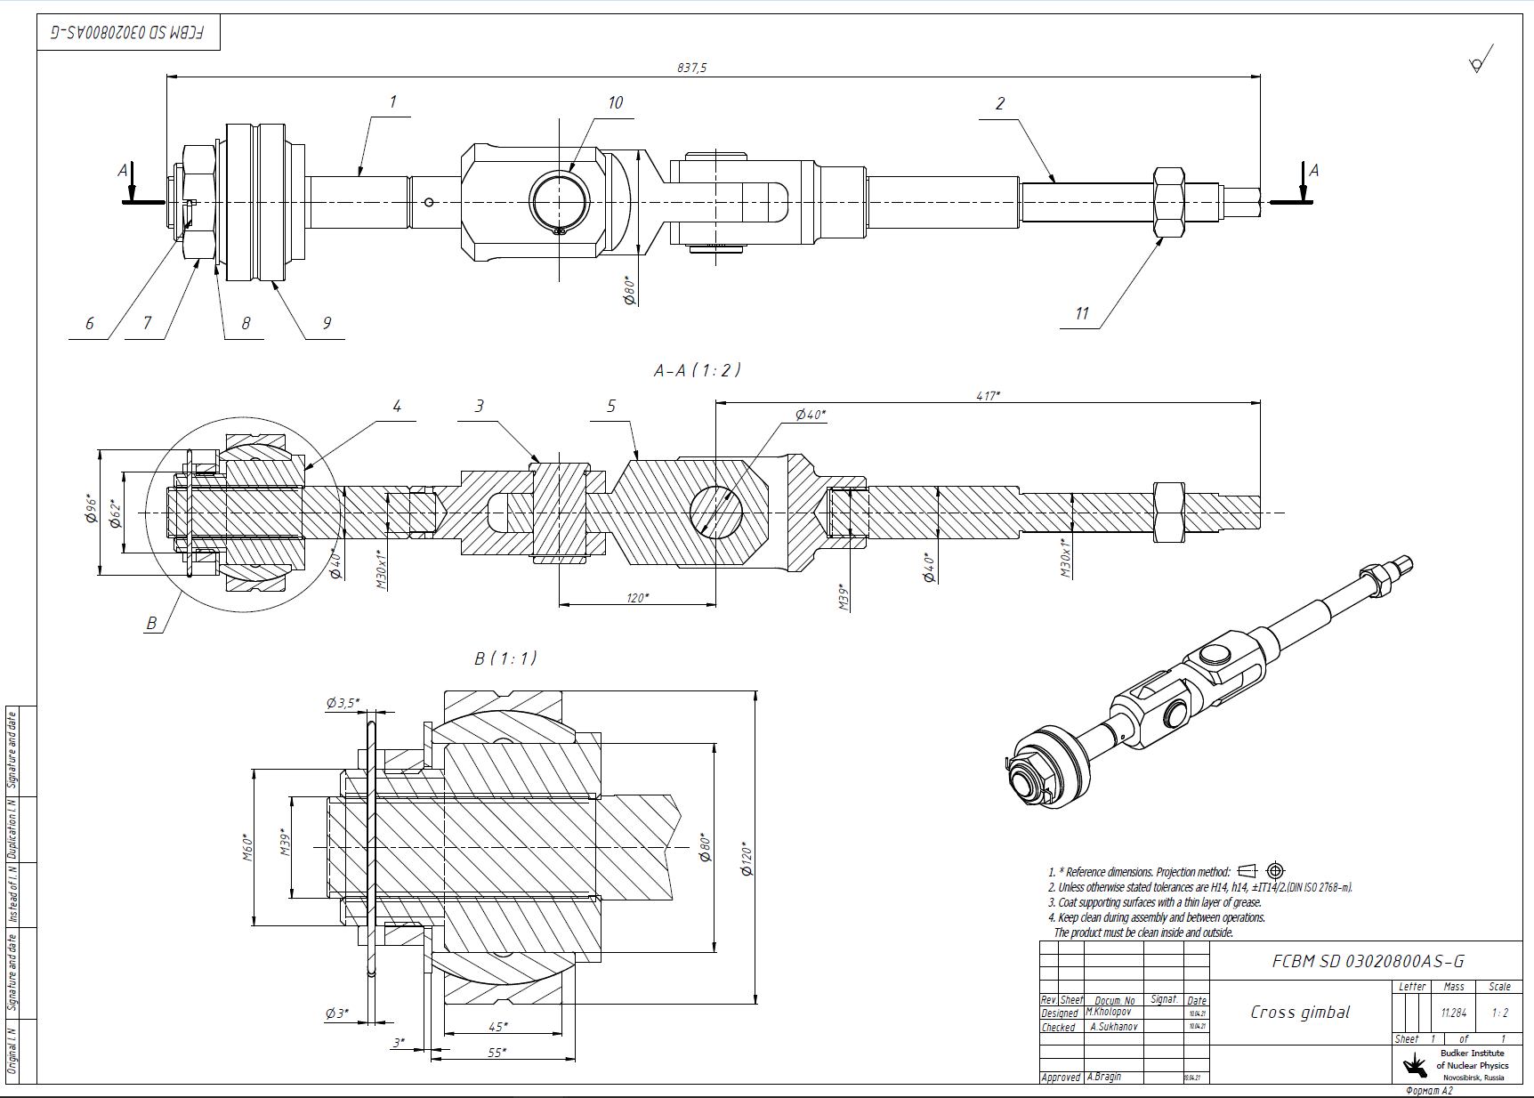
Gimbals : design and calculation
The new design

Slide 18
Gimbals : calculation
Parameter | Min | Max
Von Mises stress | 0 MPa | 433 MPa
Deformation | 0 mm | 0.408 mm
Safety factor | 2.21 | >10
Material: 1.6511 steel | Value
Density | 7850.000 kg/м^3
Modulus of elasticity | 215000.000 МPа
Poisson's ratio | 0.300
Yield strength | 1600.000 МPа
Ultimate strength | 1750.000 МPа
Elongation % | 12.000

Slide 19
3D Model of CBM Magnet and cryosyctem. Location in the CBM hall.
With the active participation of Peter Kuhl, work is being done on tracing the Transfer Line and ways to fix it in the space of the hall.

Slide 20
3D Model of CBM Branch box
DB2 detectors iterface
pressure sensors flange
Valves
HADES iterface
Gate valve DN160
Input interface
Cu Thermal shield
He Pipelines
Vacuum shell
Size: Tank shells diameter=1.5m, L=2.6m
Weight: 3476 kg
pressure sensors pipe

Slide 21
Designe of the CBM Transfer line
Straight section parts of TL:
croosection
Line part
G10 spacer
Angle part 2
He Pipes
Angle part 3
Cu Thermal shield
Vacuum shell DN200
Ball joint
Angle part 1
Total length of the transfer line: L=29m
Weight: 982 kg

Slide 22
3D Model of CBM Transfer line
Angle part of TL
Metal hose
Ball joint
Angle vacuum shell DN250
He Pipes
Cu Thermal shield
Vacuum shell DN200
G10 spacer

Slide 23
3D Model of CBM Transfer lines supports
Sliding support m=42kg
Sliding support
Spring-sliding support
Spring-sliding support m=58kg
Clamp DN200
We suggest using 2 types of supports to the Transfer Line.
-Sliding support for the upper part (axial movement only).
-Sliding support with compensating springs for the lower part (axial movement and vertical compensation+ - 20mm).
The Transfer Line fixing points are assumed to be on the Cryostat and Branch Box.
Sliding part
PTFE plate
Support plate
Spring block
Bracket

Slide 24
Thank you for your attention!

