Slide 1
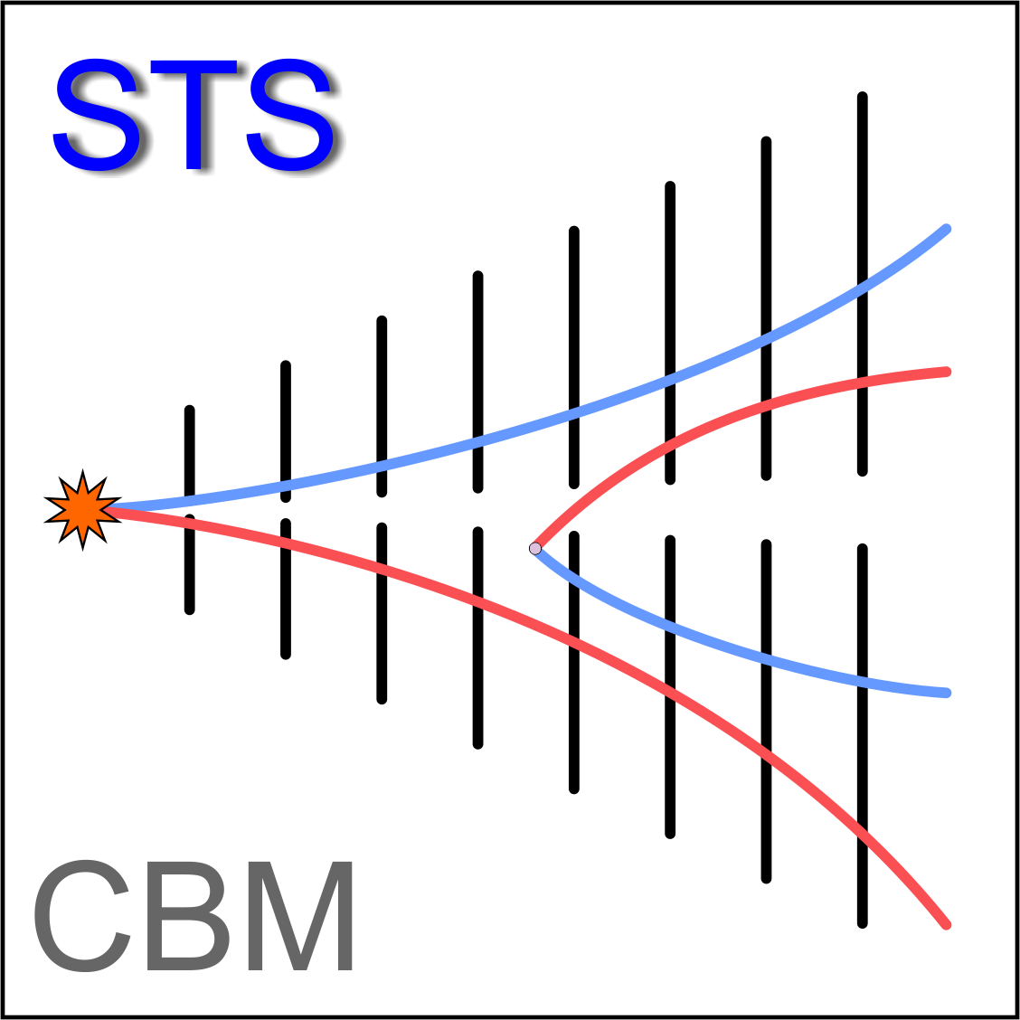
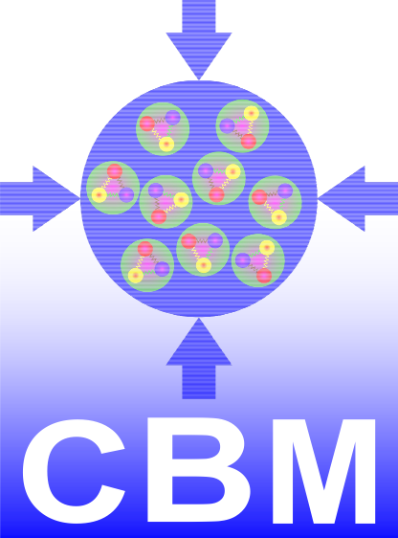
FSM for the mSTS
Marcel Bajdel

Slide 2
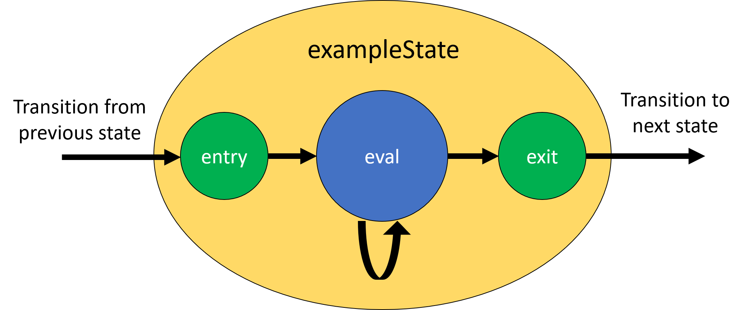
Finite state Machine for the mSTS
Should I use Sequencer?
Start-up, shut-down, fault recovery etc.
Little C code, many states, many transitions
Alternatives?
pyEpics based library Pysmlib
Integrated watchdog logic, multi-threading, integrated configurable logging systems
Compiled fast, can call any C(++) code, easy connection to CA

Slide 3
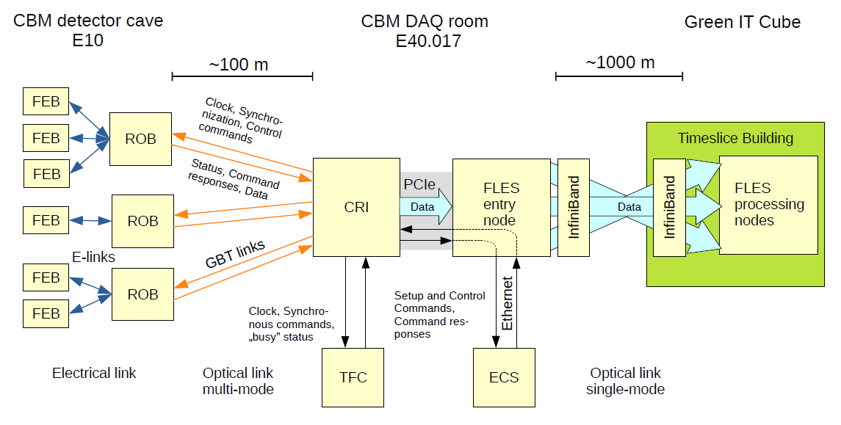
Finite state Machine for the mSTS – DAQ POV
1. Configuration of CRI by DCA (Device Control Agent)
2. power up FEE
3. configure ROB
4. power up FEBs
5. synchronize FEB links
6. configure FEBs
7. time synchronize FEB
8. reset and configure for run
No DCS – DAQ messaging
API between global DCS/partition DCS and DCA/PCA required
David Emschermann - Status of DAQ hardware - CBM CM 37

Slide 4
Finite state Machine for the mSTS – services POV
1. If services available, check HV, LV, Cooling
2. Low voltage on if temp is in range
4. ROB power-cycle
5. High voltage
6. Ready for the run
HV
FEE Cooling
Design of the upcoming mSTS

Slide 5
Finite state Machine for the mSTS – implementation
States of the FSM
Global states
Need for Detector Control Agent (DCS’s DCA)?
Init
Standby
Global states of the DCS/Sub-State/Error
Messaging with Device Control Agent/Partition Control Agent
- Status of FEE?
Standby
Preparing
LV
Shutting down
Error
ROB
HV
Run
Run

Slide 6
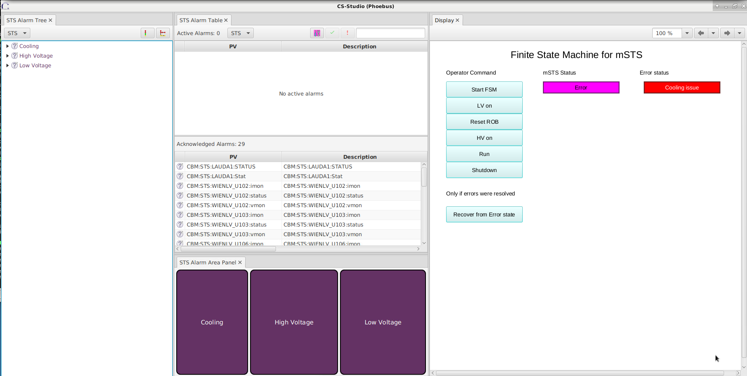
Finite state Machine for the mSTS – testing
Testing ongoing

