Slide 1
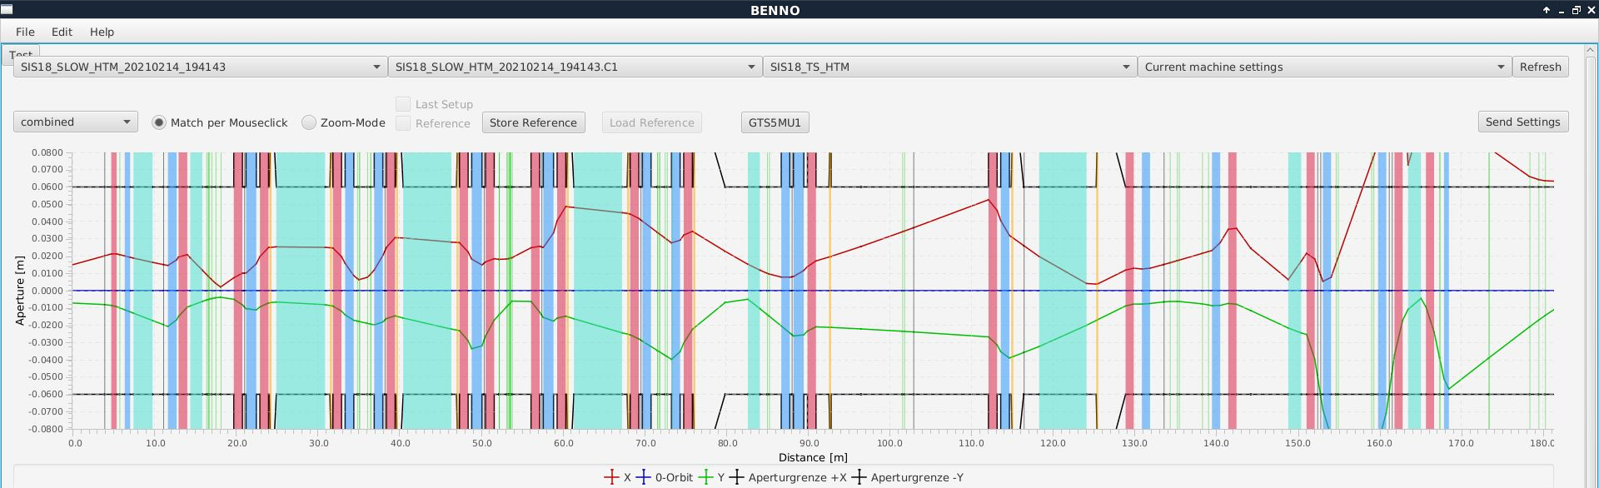
HEST – 02.03.2021
Work on understanding ESR-Cryring beam line optics on-going:
Correction angles required for GTT1MU1 and some other bending magnets were initially very large (up to 30 mrad). -> Maybe caused because GTT1MU0 was added later and theoretical angle of GTT1MU1 not corrected?
Measured position of 2 quadrupoles differs by approx. 80 cm from theoretical position.
New optics made by Petra, which includes settings found during beam line set-up and corrected theoretical dipole angles and magnet positions.
Optics to HTM via FRS:
Optics is in work by Benno and Emma.
No information on latest version.
Settings which probably have been used during recent tests:

Slide 2
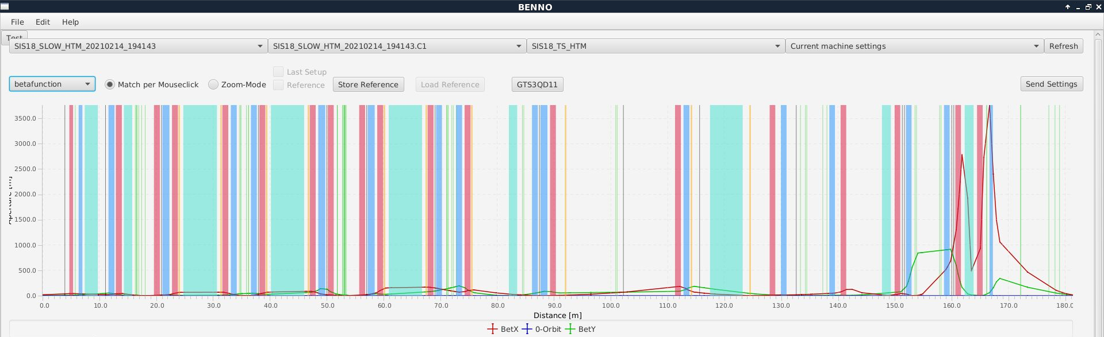
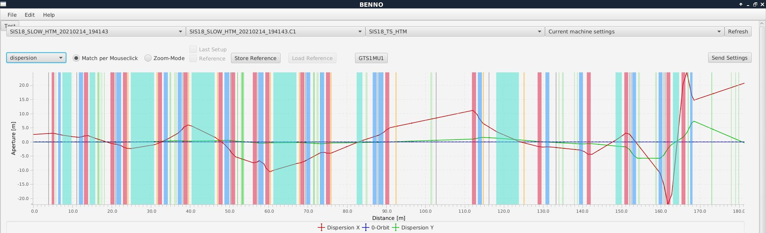
HEST – 02.03.2021

