Slide 1
PANDA COLLABORATION MEETING
Forward Spectrometer Dipole Magnet
STATUS AND PLANS
Evgeny Antokhin (Budker Institute for Nuclear Physics)
8-12 March 2021

Slide 2
Main Specifications for Dipole Magnet
Field integral along beam axis (z-direction) 2.0 T·m
Aperture angle horizontally ± 10°, vertically ± 5°
Yoke laminated to reduce eddy currents, lamination ~ 10 cm
Total weight 240 tons
Steel quality of yoke St-10
Coil windings made of water cooled copper conductors
Total dissipated power ≤ 400 kW

Slide 3
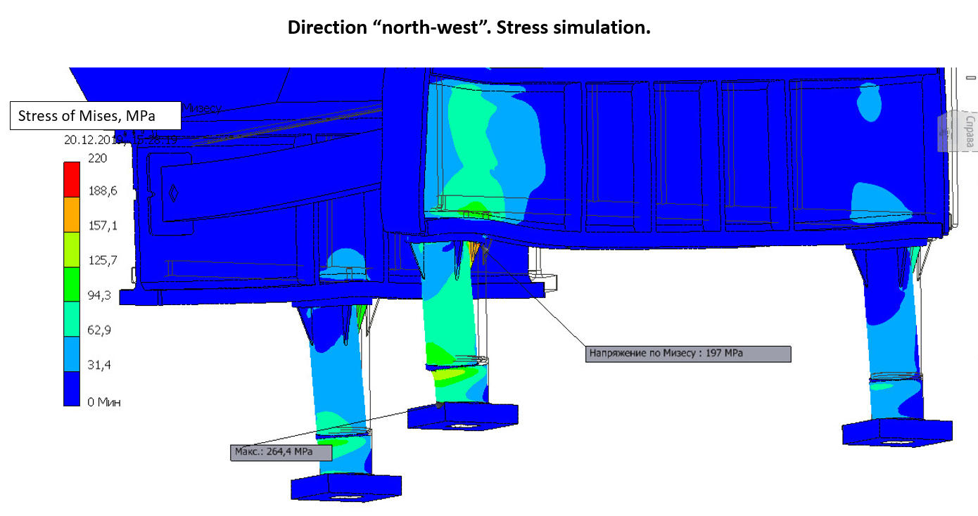
Stress analysis-2
To further reduce the stress and displacement:
The leg wall thickness was increased from 20 to 30 mm.
Six triangle girders are now installed under the flange of each of the 3 leg.
The design of the ground plate for a common alignment of the support legs was improved.
Finally there is no area anymore with stress above the yield strength of 255 MPa for St10.

Slide 4
Status
Stress analysis completed.
Magnetic field simulations completed.
Design of yoke (plates, blocks, halves, assembly) completed.
Design of support structure completed.
Design of coils completed.
Yoke machining technology developed.
3D model for entire magnet completed.
2D drawings derived and under checking/approval .
Intermediate report accepted.
Final report is in final stage of preparation, including Installation manual and
other related documents.
Magnetic mapping system is under design.
Negotiations with steel maker and yoke machinery workshops are in process.

Slide 5
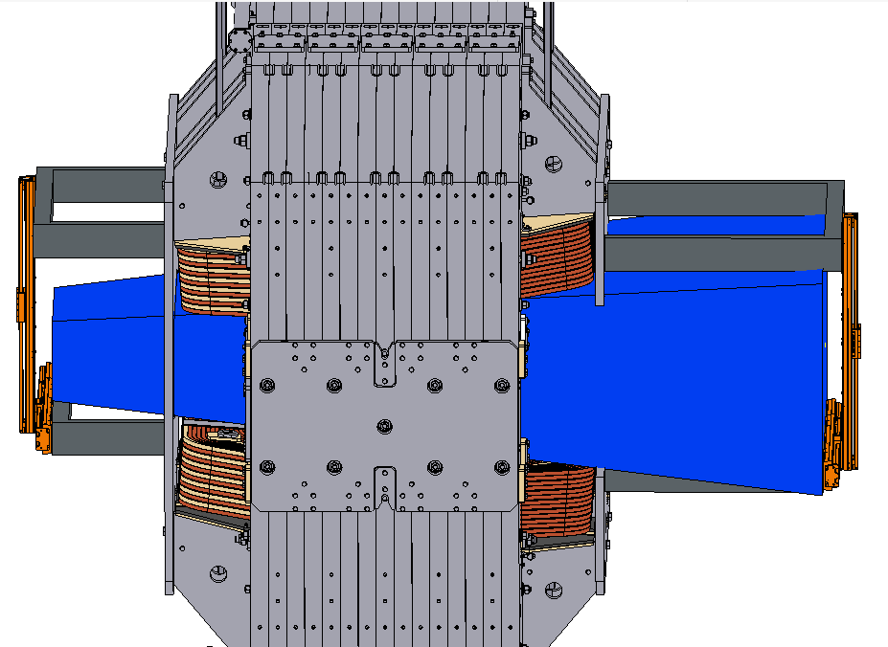
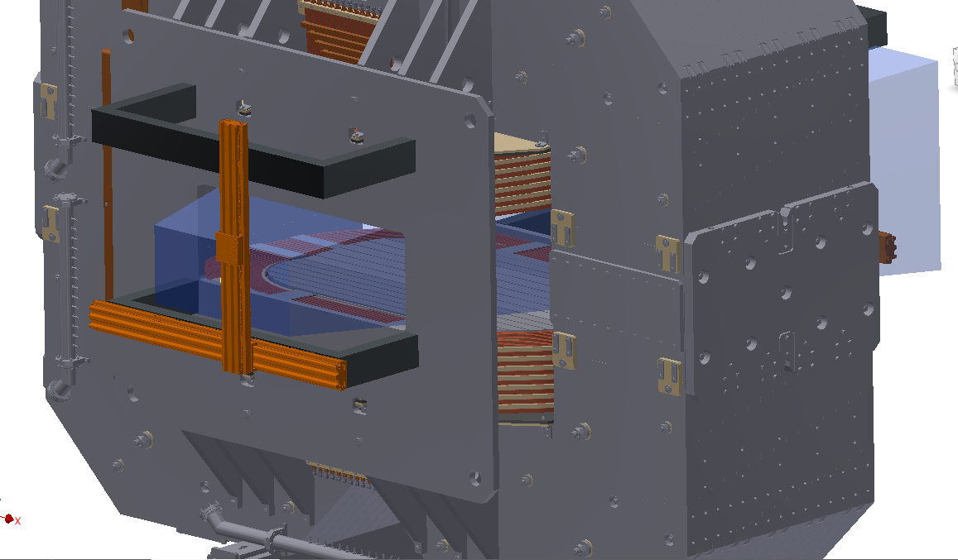
Magnetic measurement system for dipole.
Boundary conditions:
using one 3D Hall sensor
covering all area inside magnet gap
accuracy 1 Gauss
measuring positions in X, Y, Z.
common control unit with Solenoid field mapping system

Slide 6
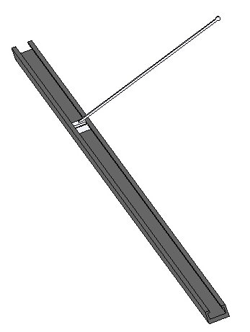
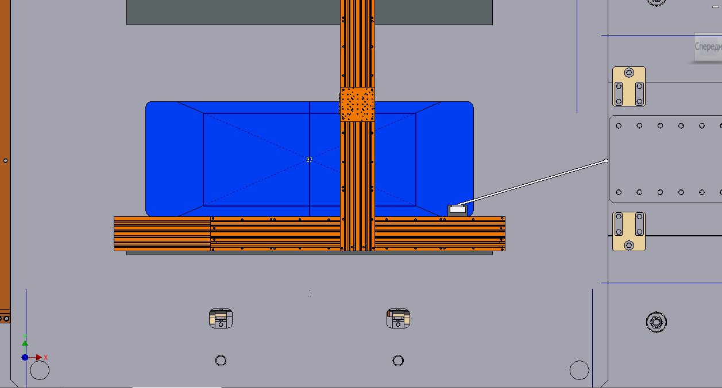
Magnetic measurement system for dipole-2.
Location of 3D Hall Sensor and Laser Reflector
XY moving system can only move inside the area marked by blue (restriction imposed by a hole in the upstream field clamp)
Carbon fiber plastic
Guideline and carriage
Using this shape of the carriage, it is possible to measure the field near the pole surface inside the magnet gap while the guide is placed in the area of possible movement. The elongation height of the carriage was chosen so that measurements could be started below the median plane.

Slide 7
Magnetic measurement system for dipole-3.
Guide line of carbon fiber plastic (weight 16 kg for 6 m)
Sag of guide line is 1.5 mm (inclination angle is 0.06 deg.) => at points with large Bz the error to By is about 4-5 G.
=> Carriage with 3 tracker mirrors and one 3D Hall sensor (weight 2 kg) for measuring field, coordinates and angle.
Selecting a reliable and inexpensive moving system (NEWPORT is good, but expensive).

Slide 8
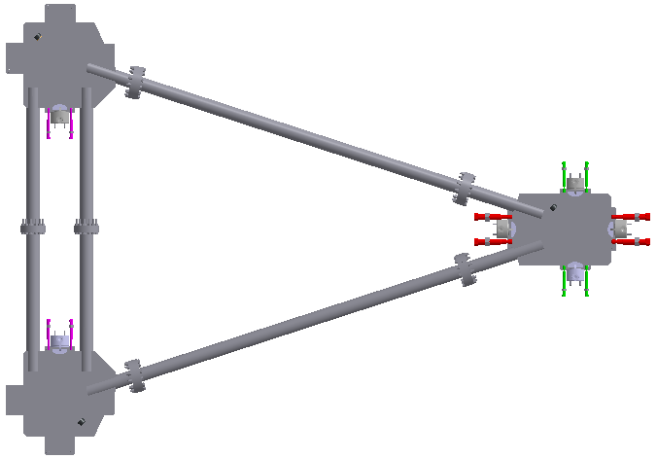
Fuses used to fixate the aligned magnet
The 3 support legs of the magnet are designed to carry a horizontal load of no more than 100 kN (10 tons). In order to protect the legs in case of a big seismic event, bolts (fuses) with defined cross sections and yield strength are employed. The fuses will keep the magnet in place if the seismic event is of medium magnitude (equivalent static acceleration ~0.7 m/s²), they will yield if the seismic acceleration will be more than 0.8 m/s².
North-west
Pairs of fuses fixating the top plates of the alignment bearings
East
Nominal yield force of fuses:
Red fuses (for east and west direction) 48 kN each
Magenta fuses (north and south direction) 32 kN each
Green fuses (north and south direction) 16 kN each
South-west

Slide 9
Plans
2D drawings: correction by BINP and checking by GSI to be completed.
Final report will be finished till March 31.
New fuses setup will be tested soon aiming at reliable and sharp dipole relief under seismic force distributed for each supporting leg.
Magnetic mapping system design will be completed soon.
Developing 3D code, based on Maxwell tensor method, for precise simulations of repelling forces acting on yoke parts.

